Slide 1

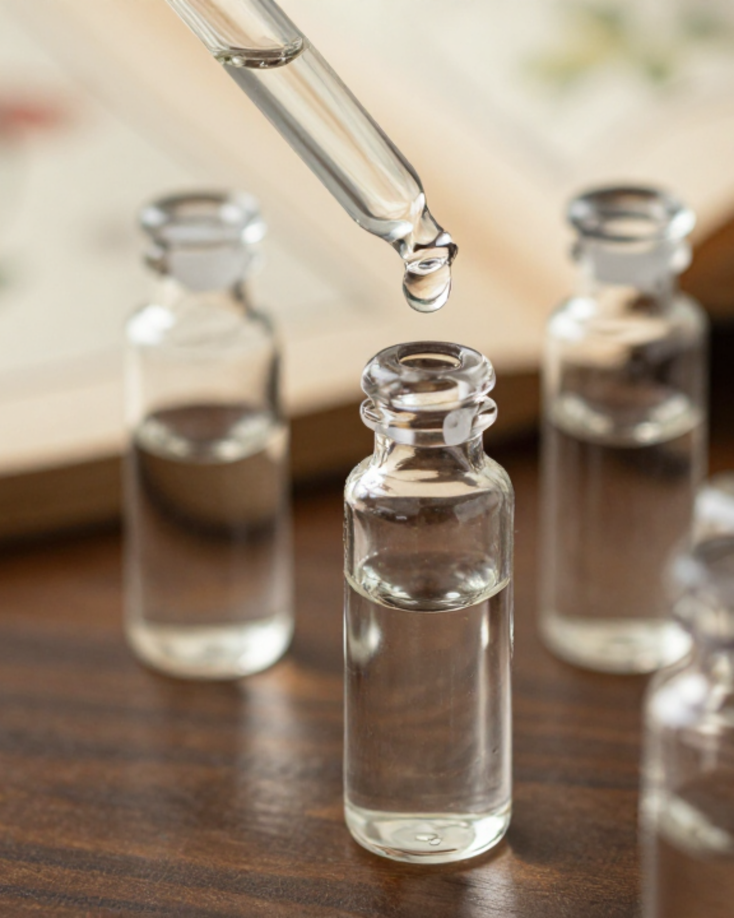


BRADFORD VTS TEACHING DECK
Homeopathy — What GPs Need to Know
Clinical Review & Evidence-Based Guidance
A comprehensive teaching deck covering the principles, history, and current regulatory landscape of homeopathy within the NHS.
AKT PREPARATION
SCA STRATEGY
GP Training Curriculum — May 2026 Edition

Slide 2















HOMEOPATHY: CLINICAL REVIEW
Evidence, Regulation & GP Consultation Strategy
Origins & Philosophy
The Five Core Principles
Law of Similars
Samuel Hahnemann (1755–1843)
Similia Similibus Curantur: "Like cures like" — a substance causing symptoms in healthy people can cure similar symptoms in the sick.
A German physician who founded homeopathy in its modern form. Disillusioned with the "heroic medicine" of his time (bloodletting/purging), he sought a more gentle approach based on systematic principles.
Minimum Dose
Ultra-dilute preparations; the theory suggests that "less is more powerful" through a process of serial dilution and succussion.
Concept of "Vital Force"
Homeopathy posits that illness is a disturbance in the body's innate healing energy or "Vital Force." Remedies aim to stimulate this force to restore health rather than just suppressing symptoms.
Holistic Single Remedy
• Single Remedy: One matched to the totality of symptoms.
• Whole Person: Considers constitution, personality, and emotions.

Slide 3









HOMEOPATHY: CLINICAL REVIEW
Brief History and NHS Integration
470 – 400 BC
1849
Hippocrates & Early Concepts
London Homoeopathic Hospital
Introduced the early concept of "like cures like" (Similia Similibus Curantur), suggesting that substances causing symptoms could also treat them.
Founded to provide specialized care. Became a central hub for homeopathic training and treatment in the UK for over 150 years.
1755 – 1843
Samuel Hahnemann: The Founder
1946
German physician who codified homeopathy in its modern form. Developed the principles of minimum dose and succussion after experimenting with Cinchona bark.
NHS Founding & Inclusion
When the NHS was founded, homeopathy was officially included from the start. Aneurin Bevan ensured existing homeopathic hospitals were incorporated into the new state system.
1832 – 1844
Arrival in London
AKT EXAM CONTEXT
Dr. Frederick Quin established the first homeopathic practice in London (1832). The British Homoeopathic Society followed in 1844 to formalize the practice.
Homeopathy was a funded part of the NHS for 72 years (1946–2018). Understanding this long-standing integration helps explain why many older patients still perceive it as a "standard" NHS option.

Slide 4

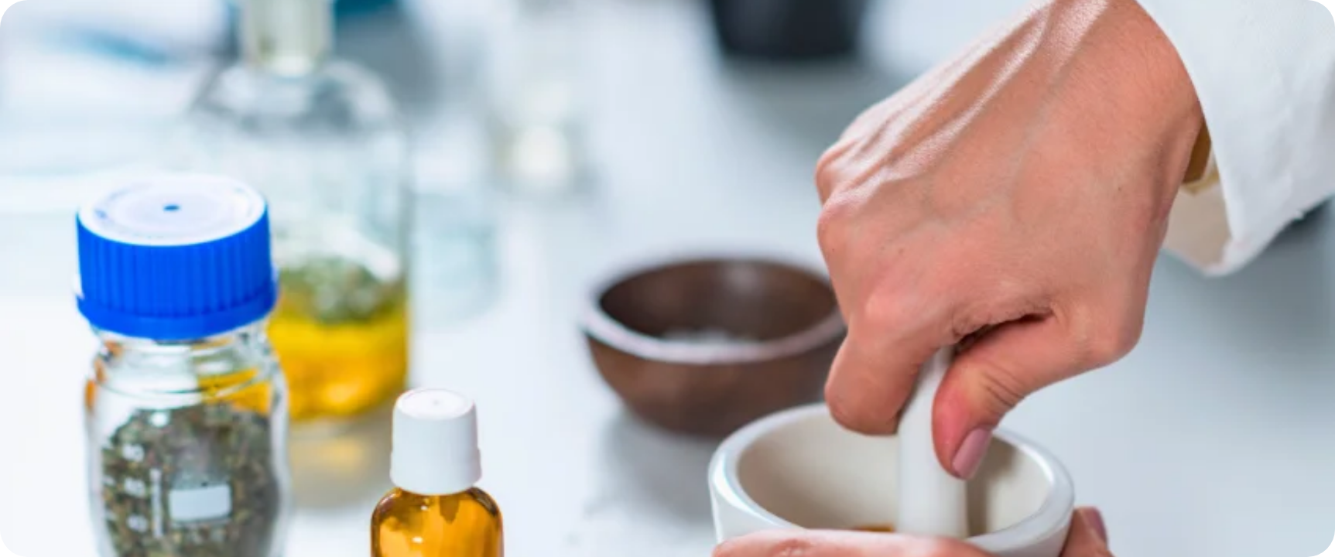














PREPARATION OF HOMEOPATHIC REMEDIES
Dilution, Succussion & The Scientific Threshold
The Potentisation Process
Serial Dilution: The substance is diluted stepwise in a solvent (usually water or alcohol).
Succussion: Vigorous shaking or striking against an elastic surface at each dilution stage.
The Theory: Homeopaths believe this "activates" the healing energy while removing toxicity.
AKT High-Yield: Scientific Limit
Dilution Scales & Potency
Avogadro’s Number (~6.022 × 10²³): The limit of molecular presence in a solution.
Decimal (x or D): 1 part substance to 9 parts solvent (1:10 dilution).
At dilutions above 12c or 24x, it is statistically certain that zero molecules of the original substance remain.
Centesimal (c or C): 1 part substance to 99 parts solvent (1:100 dilution).
Homeopathic claim of "Water Memory" is the proposed mechanism to explain efficacy at these levels, but it lacks scientific validation.
Common Potencies: 6c, 12c, 30c, 200c, 1M (higher numbers = more dilute).

Slide 5












HOMEOPATHY: CLINICAL REVIEW
Evidence, Regulation & GP Consultation Strategy
Current NHS and NICE Position
NHS England Decommissioning
NICE & Parliamentary Stance
2017–2018: NHS England guidance recommended CCGs cease funding for homeopathy.
NICE Position: Does not recommend homeopathy for any clinical condition.
By 2018, all CCGs in England stopped NHS funding; last NHS hospital (Bristol) ended treatment.
NICE concludes there is insufficient evidence of efficacy to support NHS use.
Rationale: "At best, homeopathy is a placebo. Providing ineffective treatments is not a good use of resources."
2010 Commons Report: Principles are scientifically implausible; evidence no better than placebo.
AKT High-Yield Fact: The NHS stopped funding homeopathy in England by 2018. NICE has zero recommendations for its use. Remember the £92k/year saving rationale for resource allocation questions.

Slide 6

















HOMEOPATHY: CLINICAL REVIEW
The Evidence Base: Systematic Reviews & The Placebo Effect
AKT HIGH YIELD
Evidence by Condition
The Meta-Analysis Landscape
Arnica: No convincing evidence beyond placebo for trauma or muscle soreness.
Over 200 RCTs conducted; four major systematic reviews (Kleijnen, Linde, Cucherat, Hill).
Asthma/Migraine: Insufficient evidence to draw any clinical conclusions.
Linde 1997 (Lancet): Initially found OR 2.45 in favor of homeopathy.
Influenza (Oscillococcinum): May reduce duration by 0.26 days (weak/low-quality evidence).
The Quality Paradox: When analysis is limited to high-quality trials, the benefit becomes non-statistically significant.
Otitis Media: No statistically significant benefit over standard care.
Consistency: Higher-quality RCTs show LESS benefit—classic sign of a placebo effect.
CONCLUSION: The principles of homeopathy are scientifically implausible. Evidence of efficacy is no better than placebo.
House of Commons (2010)
Science & Technology Committee concluded homeopathy is "scientifically implausible" and recommended an end to all NHS funding.
Rhetorical Framing: "If a remedy is 30C (diluted 1 in 10^60), how many molecules of the original substance remain?"
(Hint: Avogadro's constant is ~10^23. Statistically, zero molecules remain.)

Slide 7














HOMEOPATHY: CLINICAL REVIEW
Homeopathy in Primary Care: Patient Perspectives & Access
Why Patients Seek Homeopathy
Practical Realities & Access
Chronic & Medically Unexplained: Often used for conditions poorly managed by conventional medicine (ME/CFS, IBS, Fibromyalgia).
Common Requests: Allergies, teething, PMS, colic, anxiety, and grief responses are the most frequent presentations.
Private Market: Following NHS decommissioning, patients must access homeopathy privately. This is legal and their choice.
Holistic Philosophy: Patients value the "whole person" approach, feeling their emotions and personality are addressed.
Safety Concerns: Fear of conventional drug side effects, long-term toxicity, or "over-medicalization."
CLINICAL DUTY
The Consultation: Seeking the 60-120 minute "deep listening" experience that a 10-minute GP slot cannot provide.
GPs must ensure patients receiving private homeopathy also have an evidence-based conventional assessment. Do not assume the homeopath has screened for red flags.
GP Role: Be honest about the evidence, acknowledge the patient's choice, and document the use of private remedies in clinical notes.
SCA Key Point: Exploring the Expectations and Concerns behind the request is vital for the therapeutic alliance.

Slide 8












HOMEOPATHY: CLINICAL REVIEW
Evidence, Regulation & GP Consultation Strategy
The SCA Consultation Strategy
Acknowledge & Validate:
"I understand why you find homeopathy appealing — many patients value the individualised care and time practitioners give."
The Evidence Position:
"I want to be honest: current evidence doesn't show these remedies work better than a placebo, and the NHS no longer funds them."
Safety-First Approach:
"What worries me is using it instead of a treatment we know works — that could put your health at risk."
Exploring ICE (SCA Key Skill)
Private Choice:
"If you choose to use it privately alongside conventional care, please keep me informed so I can coordinate your health."
IDEAS
CONCERNS
EXPECTATIONS
"What made you interested in homeopathy for this?"
"Are there worries about drug side effects?"
"What are you hoping this will achieve today?"
Maintain the therapeutic alliance: Be honest, never dismissive. Address the unmet need behind the request.

Slide 9












SAFETY AND INDIRECT RISKS
Distinguishing between remedy safety and clinical management dangers
Direct Safety Profile
Indirect "Behavioral" Risks
Remedy Non-toxicity: At ultra-dilutions (e.g., >12c), remedies contain zero molecules of original substance.
Diagnostic Delay: Time spent on homeopathy may delay critical diagnosis of cancer or serious infection.
No Interactions: No chemical drug-drug interactions are possible. Safe in pregnancy and breastfeeding. AKT
Replacement Risk: Using homeopathy instead of proven interventions (e.g., malaria prophylaxis).
Placebo Profile: Adverse effects are psychologically driven (nocebo) or related to the vehicle (e.g., lactose intolerance).
Vaccine Opposition: Risk of some practitioners advising against routine immunizations.
Masked Worsening: "Healing crises" explanations may normalize deteriorating clinical signs.
SCA RED FLAG
The primary danger is not the chemistry, but the delay or refusal of evidence-based care for serious conditions. Always screen for "instead-of" behavior.

Slide 10










HOMEOPATHY: CLINICAL REVIEW
Evidence, Regulation & GP Consultation Strategy
Homeopathy vs. Herbal Medicine: Key Distinctions
Feature
Homeopathy
Herbal Medicine
Age & Origin
~200 years (Founded by Hahnemann)
~60,000 years (Traditional/Global)
Dose
Ultra-dilute: Statistically zero molecules of original substance remain
Material dose: Contains active plant constituents/chemicals
Mechanism
"Water memory" — not scientifically accepted
Pharmacological active phytochemicals
Drug Interactions
Essentially none (no material present)
Significant potential (e.g., St John's Wort)
Evidence Base
No convincing evidence beyond placebo
Variable — some herbs have robust RCT evidence
NHS Funding
Decommissioned in 2018 (All CCGs)
Not NHS funded (except Peppermint Oil)
UK Regulation
Voluntary (Society of Homeopaths)
Voluntary + MHRA THR (Traditional Herbal Registration)
AKT/SCA CLINICAL PEARL: THE INTERACTION GAP
GPs must distinguish these for safety. Herbal medicine poses material risks through CYP450 induction/inhibition (e.g., St John's Wort vs. Warfarin/COCP). Homeopathy is chemically safe (no molecules), but its danger is behavioral: the risk of delaying or replacing proven conventional treatments for serious pathology.

Slide 11






HOMEOPATHY: CLINICAL REVIEW
Regulation of Homeopathy in the UK
Faculty of Homeopathy
MHRA Product Registration
For medically qualified practitioners
Managed via the Homeopathic Registration Scheme
Includes doctors, pharmacists, nurses, and vets
Products must prove safety and quality standards
Sets standards for training and professional conduct
Registration does NOT require proof of efficacy
Society of Homeopaths
Legal Labeling Requirements
The largest body for non-medical practitioners
Must state "traditional use" without clinical claims
Operates a voluntary register for lay homeopaths
Labels cannot suggest the product treats specific illnesses
Registration is voluntary, not mandatory
Must clearly specify the dilution/potency level
AKT PEARL: Homeopathy is NOT statutory regulated. The title "Homeopath" is not protected by law—anyone can use it regardless of training.

Slide 12








HOMEOPATHY: CLINICAL REVIEW
Top Tips for GP Trainees: AKT & SCA Essentials
AKT High-Yield Facts
Consultation Strategy (SCA)
Decommissioning: NHS England ended funding between 2017–2018. No longer available via CCGs/ICBs.
Honesty without Dismissal: State the evidence clearly but validate the patient's desire for holistic care.
NICE Stance: No guideline recommends homeopathy for any medical condition.
Learning Point: The value of homeopathy often lies in the 60-minute holistic consultation. Emulate this through active listening.
The Evidence Paradox: Higher quality RCTs consistently show less benefit, pointing to a placebo effect.
Explore ICE: Why are they seeking it? Often reveals concerns about conventional side effects.
Homeopathy vs Herbal
Homeopathy: Ultra-dilute, essentially water/lactose. No active molecules. No drug interactions.
Herbal Medicine: Material doses of plant matter. Significant potential for drug-drug interactions (e.g., St John's Wort).
Safety Alert: The "Indirect" Risk
The remedy is safe (no molecules), but the behavior is not. The danger is a delay in conventional diagnosis or using homeopathy instead of proven treatments for serious illness (e.g., cancer, malaria).
Bradford VTS Teaching Deck • May 2026 • Verified against NHS England 2017/18 Decommissioning Guidance

Slide 13








HOMEOPATHY: CLINICAL REVIEW
Evidence, Regulation & GP Consultation Strategy
AKT HIGH-YIELD FACTS
SCA: ACUTE INFECTION
Funding: NHS England decommissioned homeopathy in 2017-2018; no CCG funding remains.
A parent requests Belladonna for a child with a spiking fever and suspected sepsis/meningitis.
GP Action: Be honest about evidence, prioritize antibiotics, and address safety concerns immediately.
NICE: Zero recommendations exist for any clinical condition.
Evidence Paradox: Higher quality RCTs consistently show LESS benefit (consistent with placebo).
Mechanism: Dilutions > 12c (Avogadro's number) contain no molecules of original substance.
SCA: PRIVATE REQUEST
Terminology: "Like cures like" = Law of Similars = Similia Similibus Curantur.
Patient with chronic fatigue wants to use private homeopathy alongside conventional care.
GP Action: Acknowledge choice, document use, and ensure no delay in evidence-based assessments.
SCA: SUBSTITUTION DANGER
Patient chooses homeopathy instead of chemotherapy for a malignant tumor.
GP Action: Patient safety emergency. Explore ICE, involve seniors, and assess capacity if refusing life-saving Tx.
AKT QUICK RECALL: True or False?
"Homeopathic remedies carry high risk of drug-drug interactions."
FALSE (No molecules present. Danger is behavioral delay, not chemistry.)

Slide 14





HOMEOPATHY: CLINICAL REVIEW
Red Flags & Common Pitfalls: Critical Safety and Exam Knowledge
Clinical Red Flags
Common GP Pitfalls
Refusal of Proven Treatment (e.g., Cancer)
Confusing Homeopathy with Herbal Medicine
Patient choosing homeopathy over chemo/surgery. This is a safety emergency; involve seniors and assess capacity.
Crucial distinction: Herbal medicine has material doses and significant drug interactions (e.g., St John’s Wort). Homeopathy does not.
Malaria Prevention
Incorrect Decommissioning Knowledge (AKT)
Homeopathy offers zero protection against malaria. Serious risk of morbidity and mortality if used as prophylaxis.
Forgetting that NHS England ceased funding in 2017–2018. All CCGs have now stopped homeopathy funding.
Child Safeguarding Concerns
Assuming Direct Remedy Toxicity
Parents refusing conventional antibiotics for a child with a serious infection (e.g., meningitis, sepsis) in favor of remedies.
The danger is behavioral (delay in Tx), not chemical. Remedies are safe per se as they contain no active molecules.
Uncontrolled Chronic Disease
Dismissive Communication in SCA
Replacement of essential medications (Insulin, Anti-epileptics, Anti-hypertensives) with ultra-dilute preparations.
Harshly rejecting a patient's interest in homeopathy damages the therapeutic relationship and may drive them away from conventional care.
Anti-Vaccination Advice
Ignoring the "Why" (ICE)
Homeopathic "nosodes" used as vaccine substitutes; poses risk to the individual and herd immunity.
Failing to explore why a patient seeks homeopathy often misses unmet needs, such as a desire for holistic care or fear of side effects.

Slide 15










HOMEOPATHY: CLINICAL REVIEW
Evidence, Regulation & GP Consultation Strategy
Foundations & Principles
The Evidence Base
Samuel Hahnemann: Founded ~200 years ago; "Like cures like" (Law of Similars).
Quality vs. Benefit: Higher quality RCTs consistently show LESS benefit.
Conclusion: Overall evidence is consistent with a placebo effect.
Ultra-Dilution: Diluted beyond 12c (Avogadro's number) = no molecules remain.
Mechanism: Claims "water memory"—not supported by mainstream science.
NHS & NICE Status
Safety & GP Role
Remedy Safety: Safe per se (no active molecules); no drug interactions.
Decommissioned: NHS England stopped funding in 2017–2018.
NICE Position: No recommendation for any condition due to insufficient evidence.
True Danger: Delay in conventional diagnosis or avoiding proven treatments.
Consultation: Explore ICE; be honest/non-dismissive; maintain therapeutic alliance.
TOP 3 EXAM TAKEAWAYS (AKT/SCA)
NHS Decommissioning Date: 2017–2018
Homeopathy ≠ Herbal Medicine (Dose/Interactions)
Safety Concern: Delay of conventional care

