Slide 1
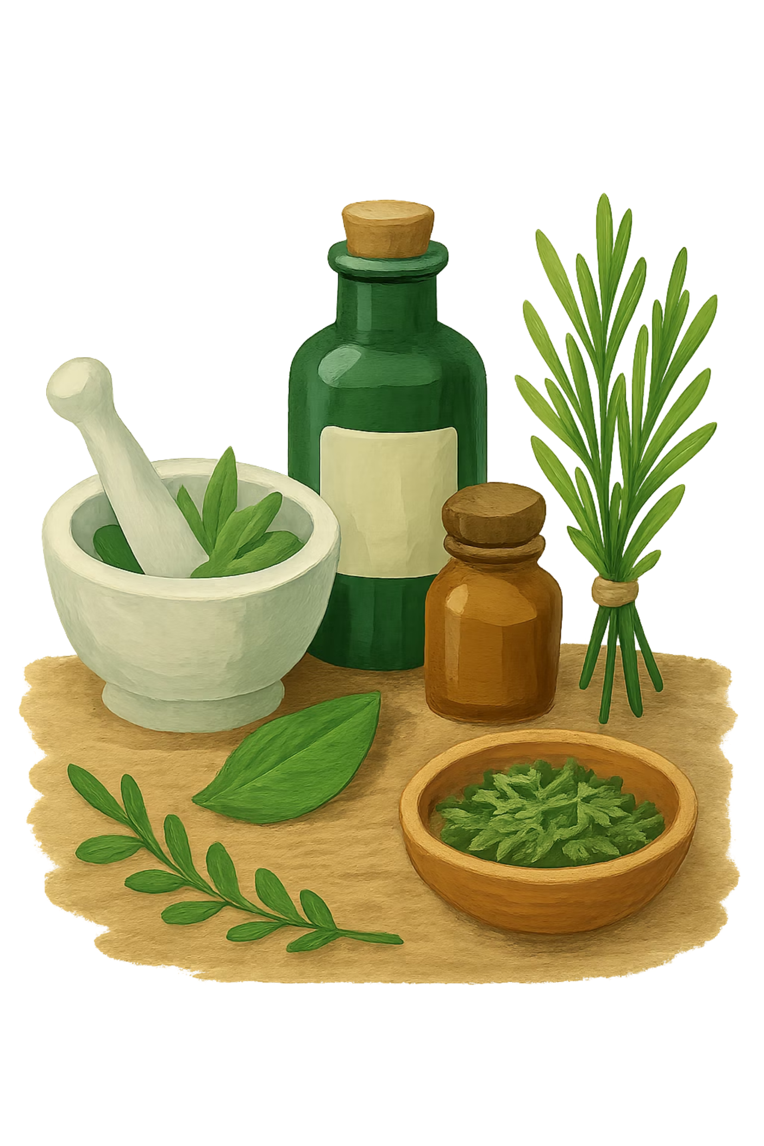
BRADFORD VTS TEACHING DECK
Types of Alternative Therapy
An Overview & Discussion
Adapted by Bradford VTS from original slides by Dr Layth Delaimy

Slide 2
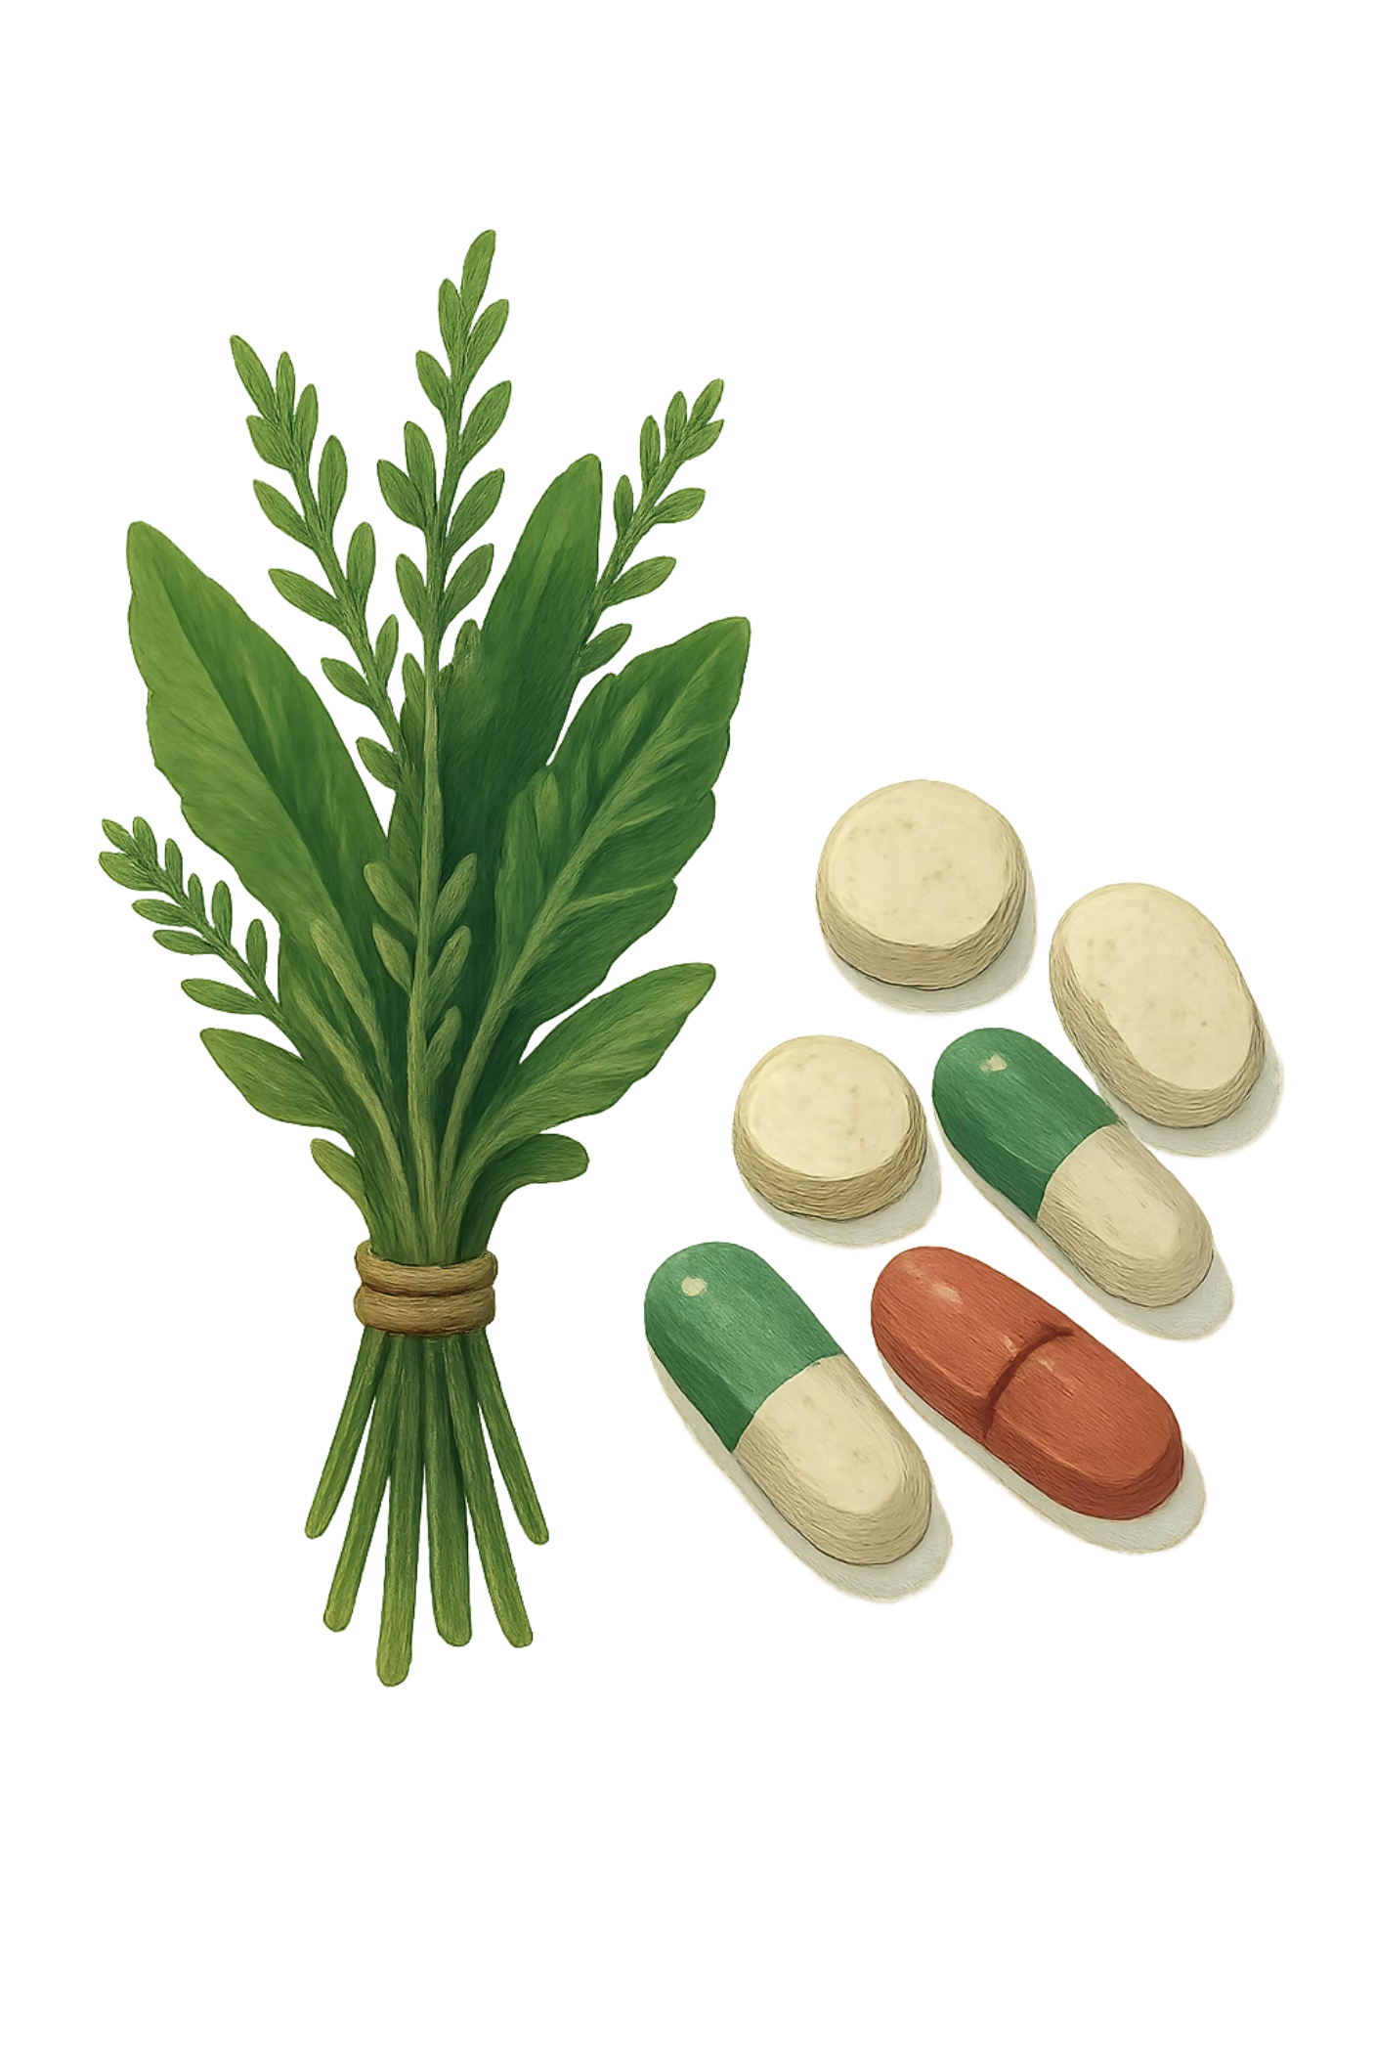
Definitions
Alternative Medicine
Complementary Medicine
Any form of practice that is outside the realm of conventional modern medicine. It covers a broad range of healing philosophies, approaches, and therapies — from ancient traditions to contemporary wellness practices.
When a treatment or therapy is done along with or in addition to conventional medicine, it is referred to as Complementary Medicine. The distinction is important: alternative medicine replaces conventional care, while complementary medicine works alongside it.

Slide 3
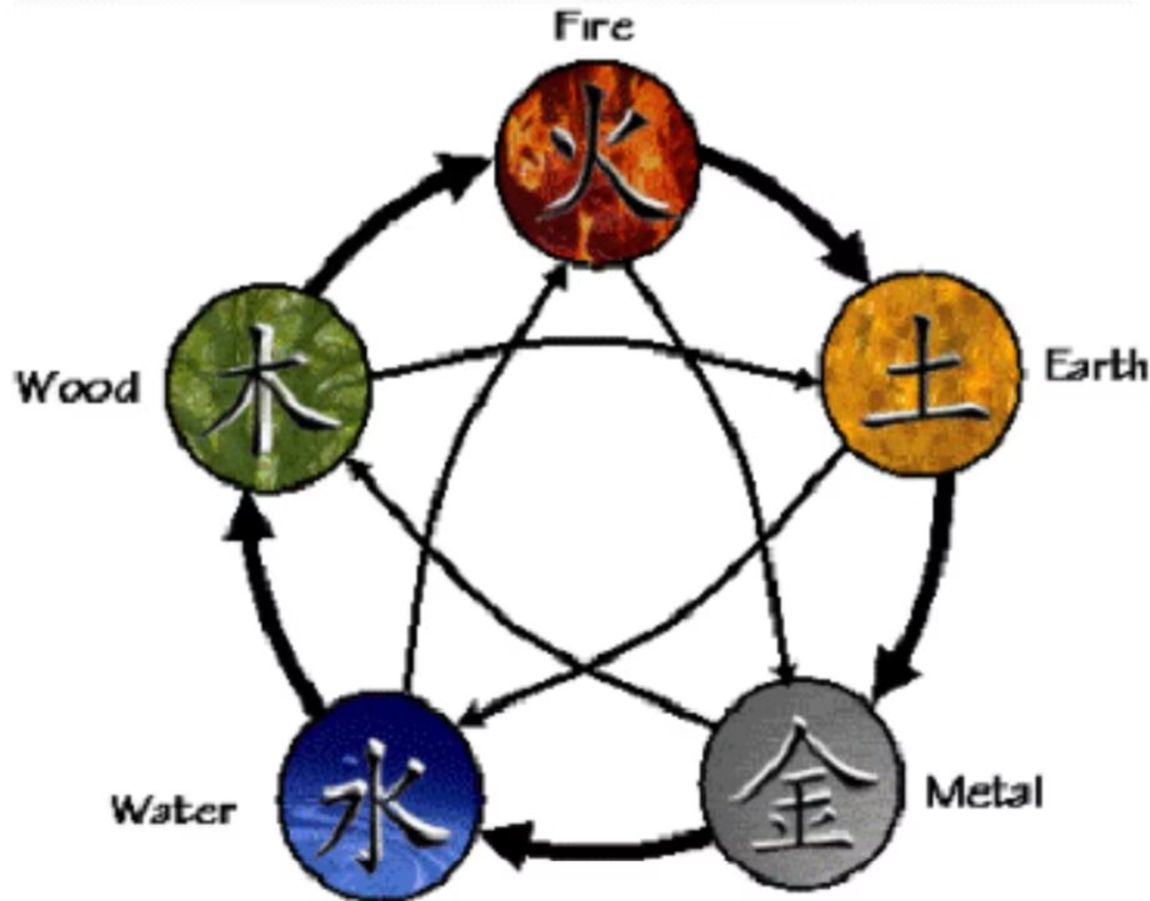
Acupuncture & Chinese Philosophy
Qi — The Life Force
Qi is both the life force (or vital substance) and the organising principle flowing through all things, establishing their interconnectedness. Chinese philosophy holds that every living thing — both human and non-human — possesses Qi.
Shen — The Treasure of Consciousness
Shen is the treasure that gives brightness to life and is responsible for consciousness and mental abilities. Sometimes compared to the soul, Shen is manifested within the individual through personality, thought, sensory perception, and the awareness of self.
Jing — Potential & Vitality
Jing is responsible for growth, development, and reproduction, representing a person's potential for development — comparable to the Western concept of genetic inheritance. Chinese philosophy held that everyone is born with a finite amount of Jing. Factors such as living a life of excess, drinking too much, excessive emotional reactions, overworking, and inappropriate sexual behaviour were all believed to deplete Jing. Balance in all things was considered the key to good health and long life.
The Shen Cycle (Five Elements Cycle) illustrates two sets of relationships: the outer Sheng Cycle (generation, clockwise: Wood → Fire → Earth → Metal → Water → Wood) and the inner Ke Cycle (control: Wood → Earth → Water → Fire → Metal → Wood).

Slide 4
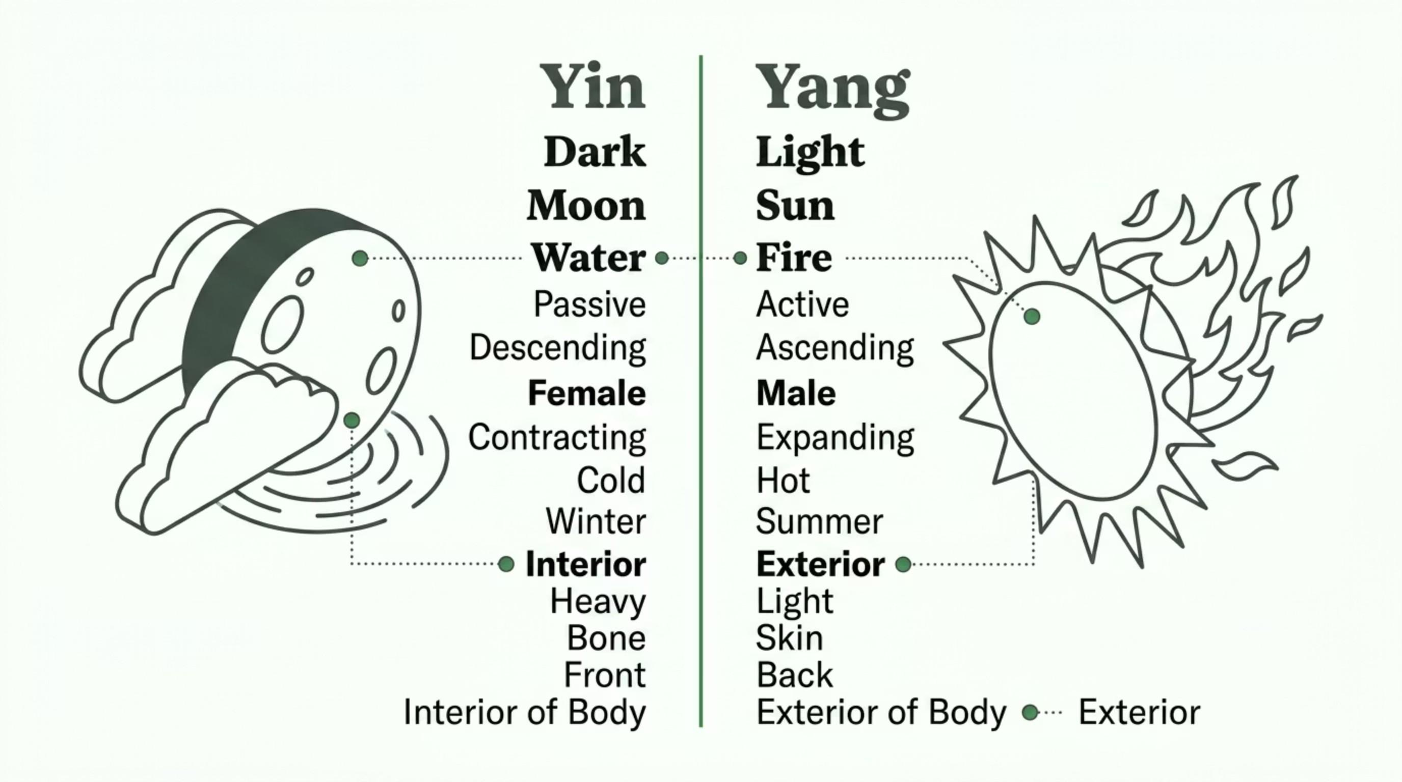
Yin & Yang
Central to Chinese medicine is the balance of opposing yet complementary forces. Illness arises when this balance is disrupted.

Slide 5
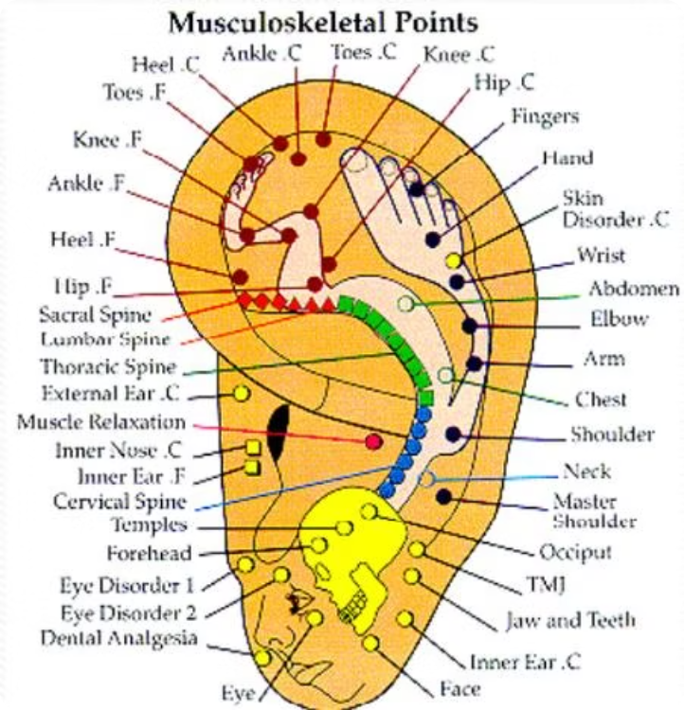
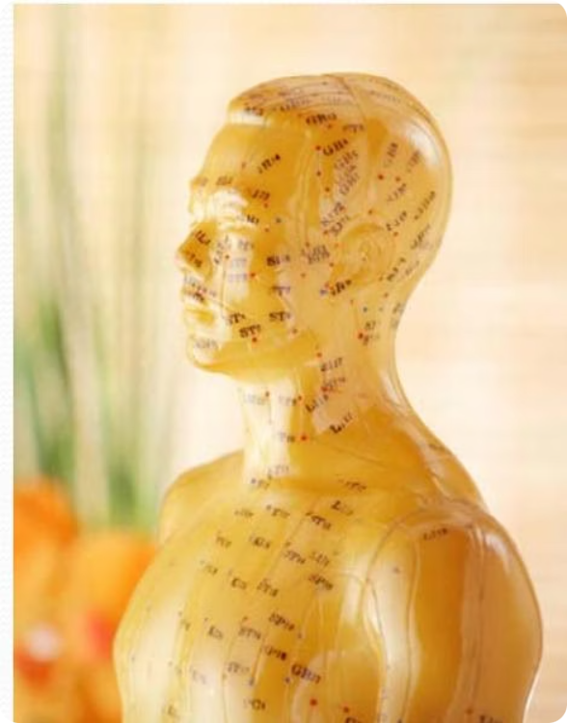
Acupuncture Points & Tai Chi
Auricular (Ear) Acupuncture — Musculoskeletal Points
Acupuncture maps specific points on the body to treat systemic conditions. The ear map below identifies colour-coded musculoskeletal points:
Red Points (Foot/Leg): Heel, Toes, Ankle, Knee, Hip
Green Points (Spine): Sacral, Lumbar, Thoracic, Cervical Spine
Blue Points (Neck/Shoulder): Muscle Relaxation, Inner Nose, Temples, Forehead
Other Points: Fingers, Hand, Wrist, Abdomen, Elbow, Shoulder, Neck, TMJ, Jaw and Teeth
Tai Chi — Sequence of Movements
Tai Chi is a key practice within Chinese medicine, combining slow, deliberate movements to cultivate Qi. The standard form includes: Starting → Parting The Wild Horse's Mane (×3) → White Crane Spreads Its Wings → Brush Knee, Push (×3) → Playing The Guitar/Lute/Pipa → Repulse Monkey (×4) → Hold The Ball, Ward Off → Grasp The Bird's Tail → Press, Sit Back → Open up and Push → Single Whip → Cloud Hands → High Pat on Horse → Right Heel Kick → Carry The Tiger Over The Mountain → Turn → Left Heel Kick → Snake Creeps Through The Grass → Stand on One Leg (both sides) → Shuttle Back And Forth → Needle At Bottom Of The Sea → Fan Through The Back → Right Back Fist → Parry and Punch → Apparent Closing → Cross Hands → Close.

Slide 6
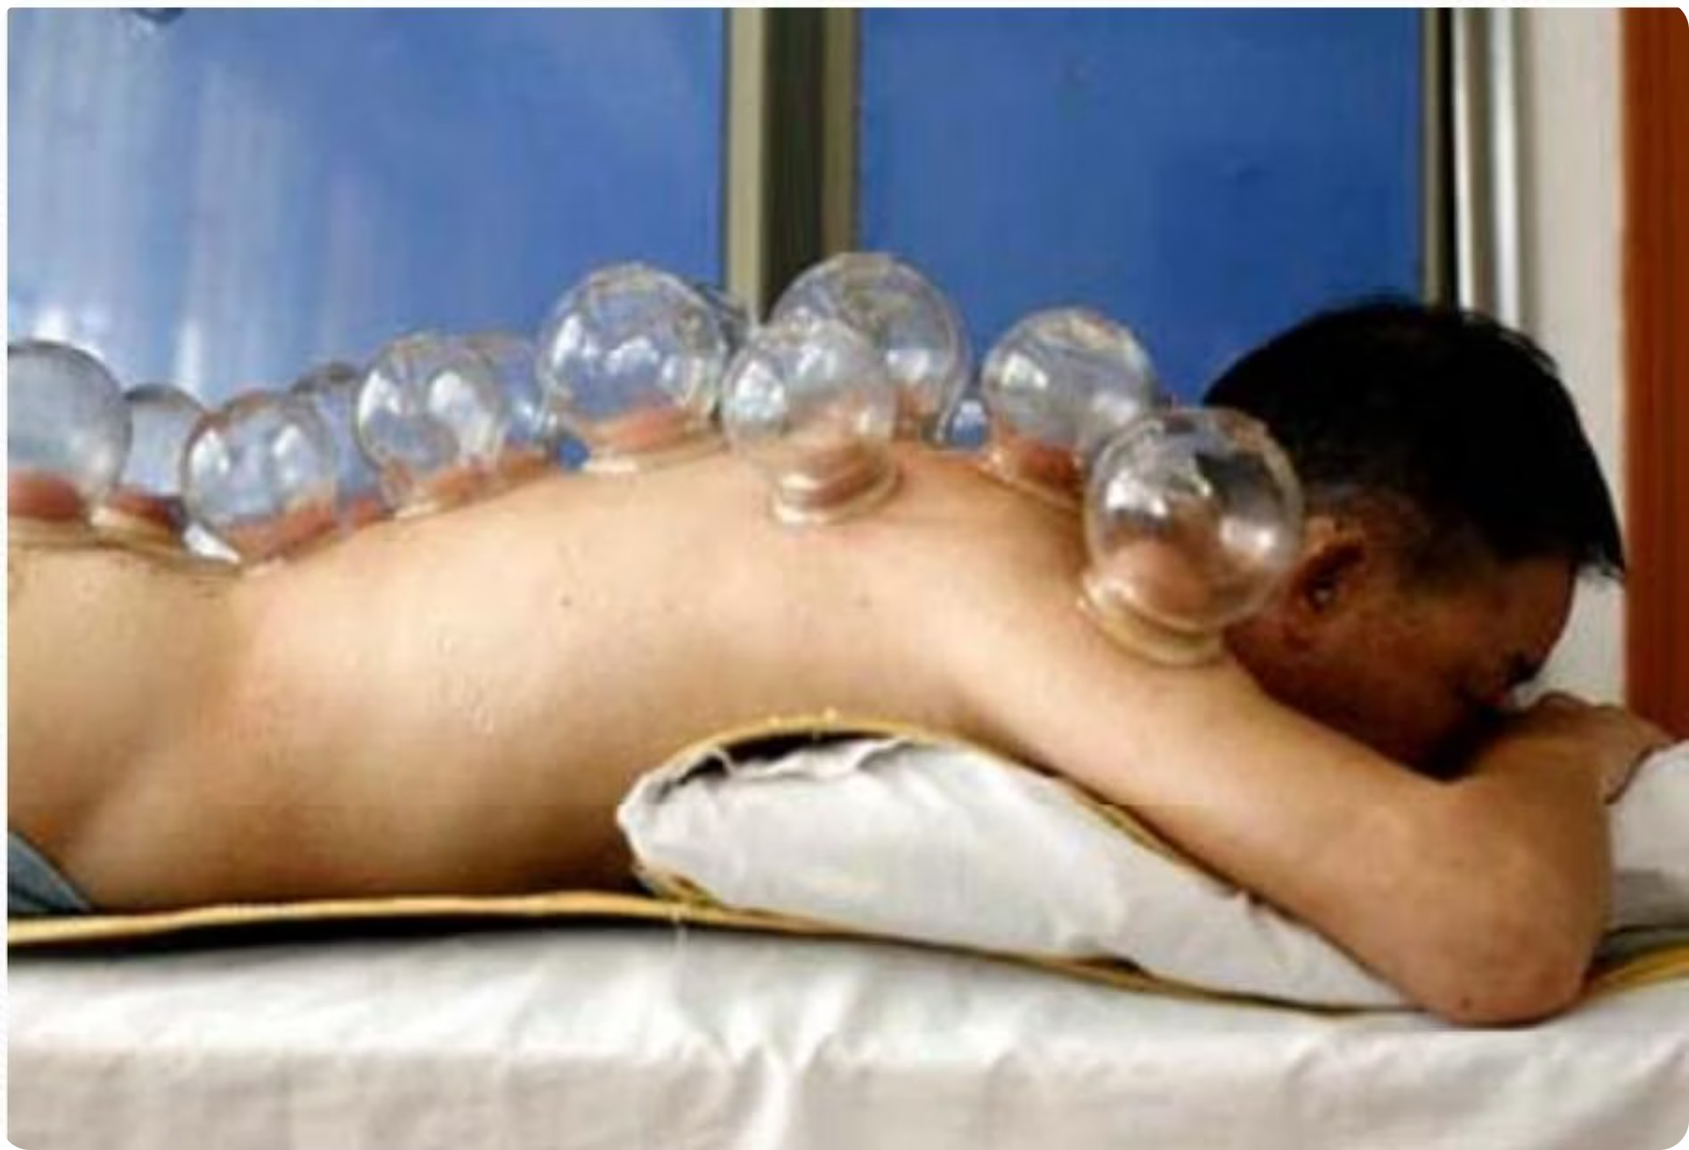
Cupping Therapy
Cupping is a traditional therapy in which glass or silicone cups are applied to the skin, creating suction. The negative pressure draws the skin and superficial muscle layer upward into the cup, promoting blood flow, relieving muscle tension, and stimulating the flow of Qi along the body's meridians. It is used to treat pain, inflammation, and respiratory conditions, and is often applied along the spine as shown. Cupping leaves characteristic circular marks on the skin that typically fade within a few days.

Slide 7
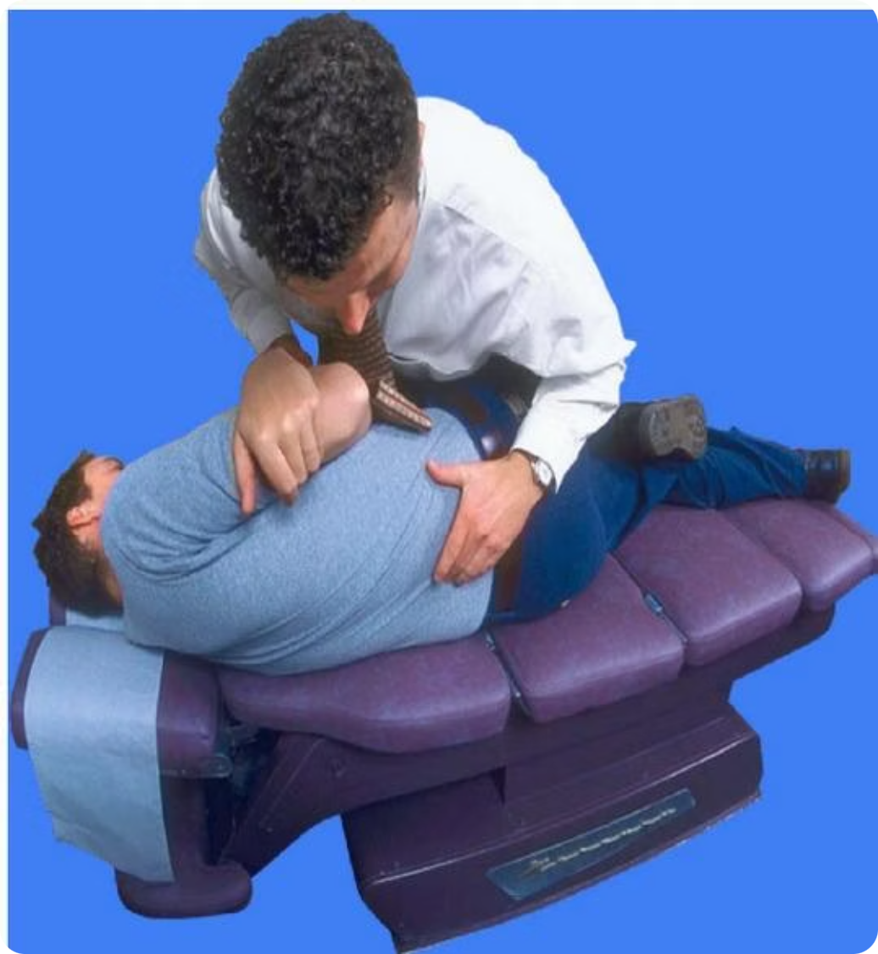
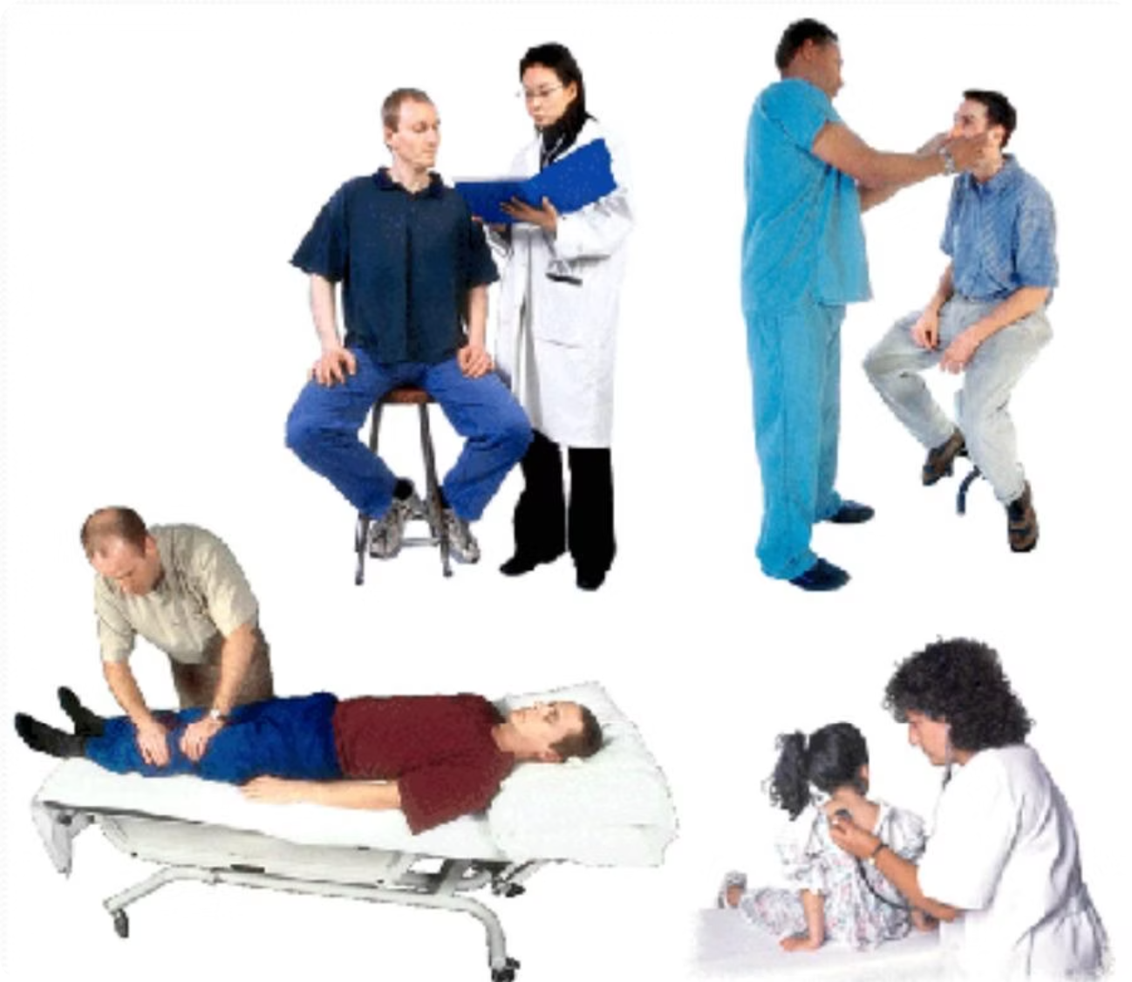
Chiropractic & Osteopathy
Chiropractic
Osteopathy
Chiropractors focus on dysfunctions that can result from irregularities of spinal structure or movement. Hands-on procedures are usually preferred to determine structural and functional problems. Spinal manipulation aims to restore mobility, alleviate pain, and improve function without surgery or medication.
Osteopathy is a manual medicine that focuses on total body health by treating and strengthening the musculoskeletal framework. Osteopaths can complement the advice given by GPs. For example, people who suffer from arthritis are often prescribed medication by their GP; in addition, Osteopaths can ease pain caused by joint and muscle stiffness by improving joint mobility and blood flow to the joints, and can show arthritis sufferers how to prevent causing injury to themselves.

Slide 8
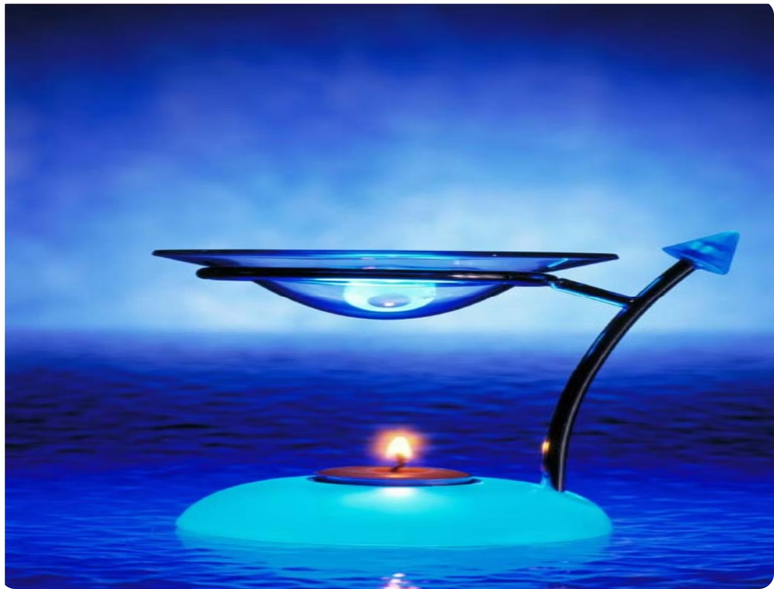
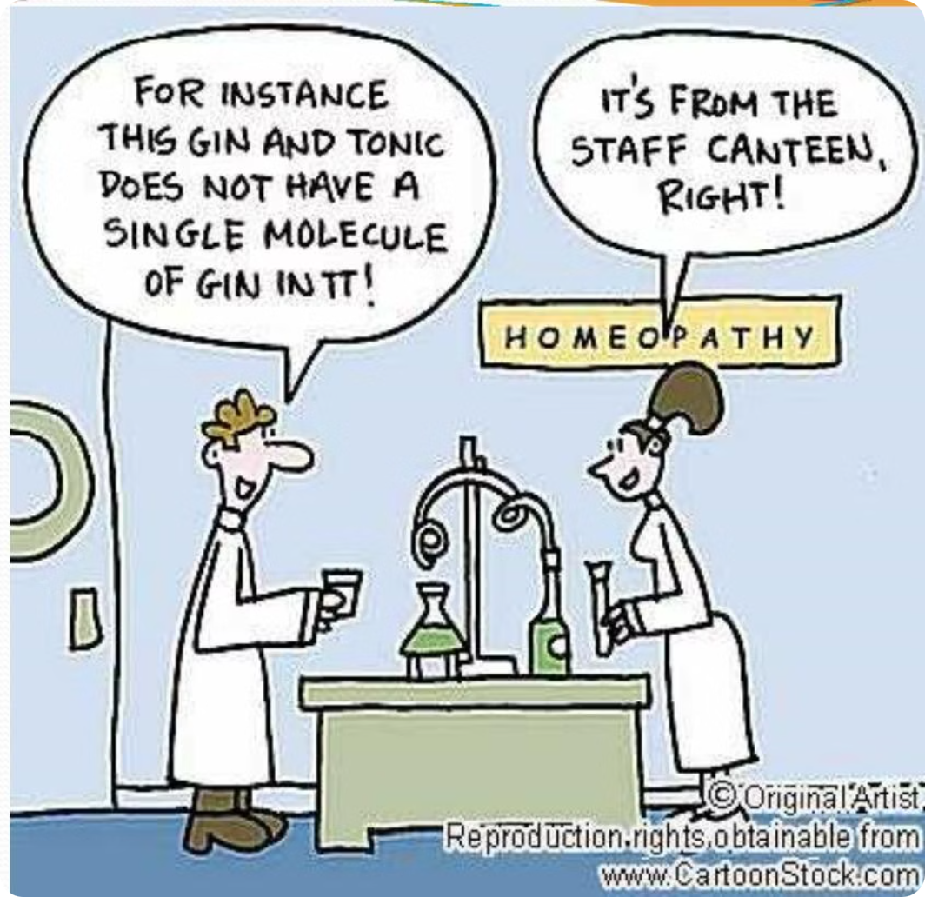
Homeopathy & Aromatherapy
Homeopathy
Aromatherapy
Homeopaths view symptoms as the body's attempt to heal itself — a positive sign that the body's defence mechanism is fighting the underlying cause. By this reasoning, symptoms should not be suppressed, as doing so works against the body's own curative effort.
Two core principles:
"Treatment using scents." Aromatherapy employs approximately 150 essential oils, most of which have antiseptic properties; some are antiviral, anti-inflammatory, pain-relieving, antidepressant, and expectorant.
As a complementary therapy, aromatherapy is used for relieving pain caused by the side effects of chemotherapy in cancer patients. Key examples:
"Similia similibus curantur" — like shall be cured by like
Dilution enhances the curative properties of a substance while eliminating side effects — the reverse of conventional drug philosophy, which requires a minimum dose for effect.
Eucalyptus & Lemon: Alertness
Lavender & Rosemary: Relaxation

Slide 9
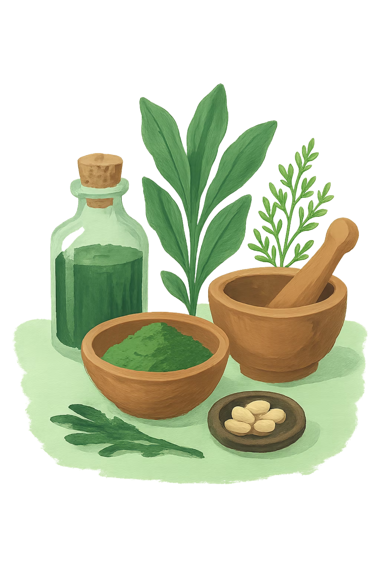
Natural Medicine
Any therapy that relies on the body's own healing powers may be considered natural medicine. These include herbal remedies, diet therapies, and water therapies. Natural medicine draws on the body's innate capacity for self-repair, using plant-based and environmental resources to support recovery and maintain health. For further resources, see: www.naturalherbsguide.com
Herbal Remedies
Plant-derived substances used to treat a wide range of conditions, drawing on centuries of traditional knowledge across cultures worldwide.
Diet Therapies
Therapeutic use of nutrition and dietary modification to prevent and treat illness, supporting the body's natural healing processes.
Water Therapies
Hydrotherapy and related practices that use water in various forms — hot, cold, steam — to stimulate circulation and promote healing.

Slide 10
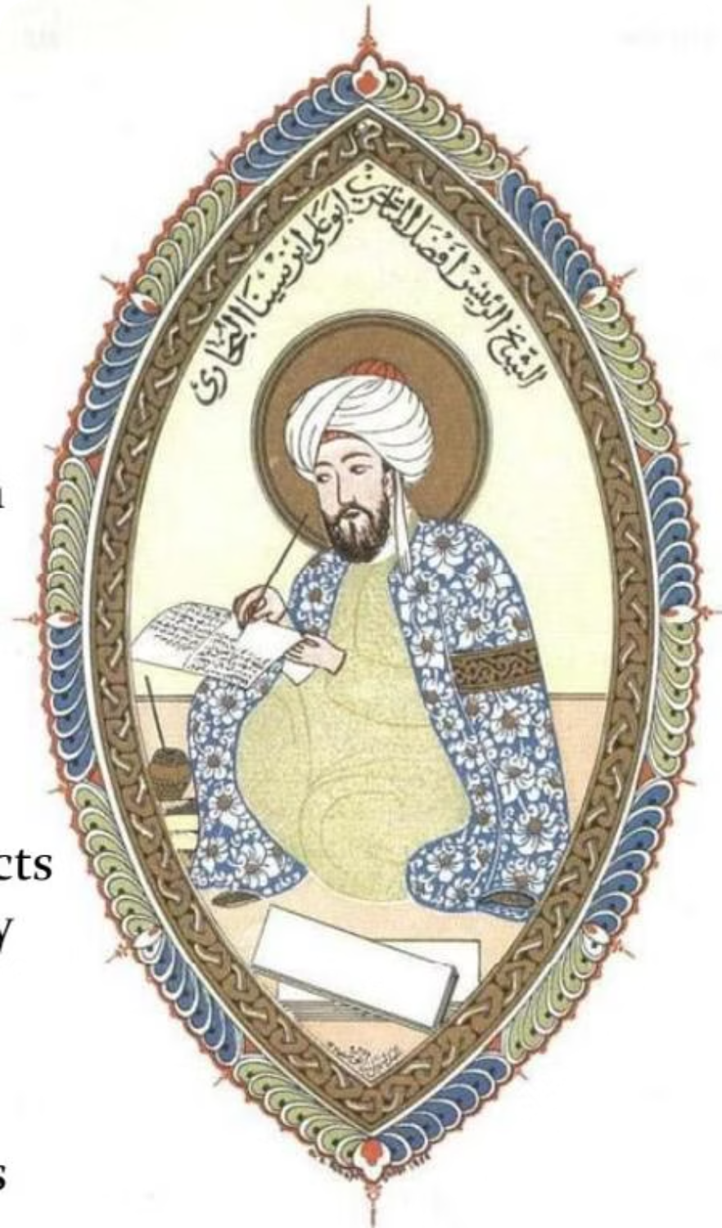
HISTORICAL FOUNDATION
The Canon of Medicine
Author: Avicenna (Ibn Sina) | Year: 1025 | Place: Baghdad
The Canon of Medicine was the first ever evidence-based and experiential medicine textbook, and the first Latin translation appeared in 1473. It served as the "Bible of Medicine" throughout Europe and the world until the 18th century.
800 tested drugs extracted from herbs
700 non-drug remedy therapies
First to describe Hirudotherapy (use of leeches in medicine)
A chapter on High Blood Pressure & Cholesterol effects
Chapter on Diabetes, describing both primary & secondary types (Types 1 & 2) — diagnosis was by tasting urine
Described Cancer and its diagnosis, with the need for early excision
Described how to clinically distinguish Mediastinitis & Pleurisy

