Slide 1




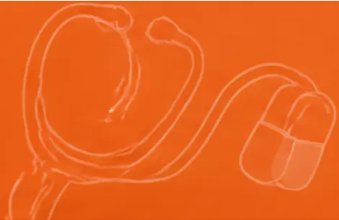

BRADFORD VTS TEACHING DECK
BRADFORD VTS TEACHING DECK
Alcohol misuse in primary care —
detoxification, medications and
relapse prevention
Bradford Vocational Training Scheme
www.bradfordvts.co.uk
Created May 2026 — aligned to current NICE 2023/2024 and BNF standards
www.bradfordvts.co.uk
Disclaimer: Always double-check this advice and drug doses
with the latest NICE/BNF guidance. This document is for
educational purposes only.
www.bradfordvts.co.uk
2 / 30

Slide 2









Overview
This teaching deck covers the pharmacological management of alcohol use disorders in
primary care — from safe detoxification to relapse prevention.
Medically assisted
withdrawal
Thiamine and vitamin
supplementation
Chlordiazepoxide and diazepam
regimes — community and
inpatient detox
Preventing Wernicke's encephalopathy —
oral and parenteral thiamine
Relapse prevention
medications
Dual diagnosis and
prescribing roles
Acamprosate, naltrexone,
nalmefene, disulfiram, baclofen
Co-occurring mental health conditions —
antidepressants, when and when not
to prescribe
All guidance aligned to NICE CG100, NICE CG115, BNF current edition, and UK Draft Guidelines November 2025
www.bradfordvts.co.uk
3 / 30

Slide 3

















Alcohol withdrawal syndrome (AWS)
Bradford VTS
MILD TO MODERATE
Why does withdrawal happen?
Sweating, tremor
Chronic alcohol use
Tachycardia, hypertension
Alcohol enhances GABA (inhibitory)
and suppresses glutamate (excitatory)
Anxiety, agitation, irritability
Nausea, vomiting
Insomnia, headache
Brain adapts
Upregulates glutamate receptors (NMDA)
— downregulates GABA receptors
SEVERE — MEDICAL EMERGENCIES
● Withdrawal seizures ('rum fits')
Alcohol removed
● Delirium tremens (DTs) — 5% mortality if untreated
Unopposed glutamate excitation →
CNS hyperexcitability
● Wernicke's encephalopathy
● Severe depression, suicidal ideation
AKT
The mechanism: chronic alcohol → GABA↓ + NMDA↑ → remove alcohol → unopposed excitation = AWS
www.bradfordvts.co.uk
4 / 30

Slide 4













Timeline of alcohol withdrawal
What happens — and when — after the last drink
Minor withdrawal
Alcoholic hallucinosis
Withdrawal seizures
Delirium tremens
Wernicke's risk
• Generalised tonic-clonic
• Visual, auditory or
tactile hallucinations
• Peak risk
• DTs may persist 3–5 days
• Tremor, sweating
• Confusion, agitation
• Anxiety, nausea
• Peak risk window
• Wernicke's encephalopathy
can occur at any point
• Tachycardia, headache
• Consciousness intact
• Hallucinations, hyperthermia
• ‘Rum fits’
• 5% mortality if untreated
• Ongoing vigilance required
6–12 hours
12–24 hours
24–48 hours
48–72 hours
72+ hours
Key teaching point: Seizures and DTs are medical emergencies.
Community detox must only be offered to those assessed as LOW risk for these complications.
www.bradfordvts.co.uk
Alcohol misuse in primary care
5 / 30

Slide 5











COMPLICATIONS OF AWS
When alcohol withdrawal becomes dangerous
Withdrawal seizures
Wernicke’s encephalopathy
Delirium tremens (DTs)
• Onset: typically 48–72 hours
after last drink
Classic triad:
• Generalised tonic-clonic
1. Ataxia
• Peak risk: 24–48 hours after last drink
• Features: confusion, agitation,
visual hallucinations, hyperthermia,
autonomic instability
2. Ophthalmoplegia
• Previous seizures = contraindication
to community detox
3. Confusion
• Can persist 3–5 days
Only ~10% present with all three –
any ONE in a drinker = treat immediately
Seizure during detox →
call 999 immediately
5% mortality if untreated –
medical emergency
Untreated → Korsakoff’s
psychosis (irreversible)
6–24h
Minor withdrawal
24–48h
Seizure risk peaks
48–72h
DTs peak risk
www.bradfordvts.co.uk
6 / 30

Slide 6





Who needs medically assisted withdrawal?
Use clinical criteria and SADQ score together – not in isolation
Medically assisted withdrawal IS needed
MAW is NOT required
• Physically dependent on alcohol – withdrawal
symptoms when stopping or cutting down
• Drinking <15 units/day (men) or <10 units/day
(women)
• Drinking >15 units/day (men) or >10 units/day
(women) regularly
• No withdrawal symptoms between drinking
episodes
• SADQ score ≥ 10
• No history of seizures or delirium tremens
• History of withdrawal symptoms on waking –
sweating, tremor, anxiety
• SADQ score < 10
• Drinks in the morning to prevent withdrawal
("eye opener")
• Occasional or binge pattern – not daily
dependent drinking
• Previous withdrawal seizures or delirium tremens
Key principle: MAW is about physical dependence – not simply how much someone drinks.
Always assess withdrawal history, morning drinking, and SADQ score alongside unit consumption.
www.bradfordvts.co.uk
7 / 30

Slide 7




















Assessing severity before detox
SADQ score and clinical indicators guide the detox pathway
Clinical indicators to assess alongside SADQ
Severity of Alcohol Dependence Questionnaire (SADQ)
■ Morning drinking to prevent withdrawal symptoms
A validated 20-item self-report questionnaire measuring
physical, affective and withdrawal symptoms over the past
month.
■ Sweating, tremor or anxiety on waking
■ History of previous withdrawal seizures or DTs
SADQ Score
Dependence Level
Detox Route
■ Drinking > 15 units/day (men) or > 10 units/day
(women) regularly
< 10
Mild / no dependence
No MAW needed
■ Drinks in the morning before eating
10 – 30
Moderate dependence
Community detox
■ Reporting they "need" alcohol to feel normal
> 30
Severe dependence
Inpatient detox
Pitfall: SADQ alone is not sufficient — always take a
full clinical history including seizure history, co-morbidities
Key rule: SADQ > 30 = inpatient detox. No exceptions. Do not attempt community detox in severe dependence.
Bradford VTS Teaching Deck — Alcohol Misuse in Primary Care
www.bradfordsvts.co.uk
8 / 30

Slide 8



COMMUNITY DETOX
Community detox — eligibility criteria and contraindications
✓ Suitable for community detox
✘ Requires inpatient detox
SADQ score 10–30 (moderate dependence)
SADQ score >30 or drinking >30 units/day
Drinking 15–30 units/day
History of withdrawal seizures or delirium tremens
Significant physical illness (decompensated liver disease,
cardiac problems)
No history of withdrawal seizures or delirium tremens
No significant physical comorbidities
Significant psychiatric illness or active suicide risk
Pregnancy
No significant psychiatric comorbidity or suicide risk
No social support, homeless, or chaotic circumstances
No concurrent benzodiazepine or CNS depressant misuse
Concurrent benzodiazepine or other CNS depressant misuse
Responsible adult available every day for the first week
Previous failed community detox
Patient motivated, able to consent, stable home environment
Clinician concern about safety
PITFALL — Never start community detox if SADQ >30 or drinking >30 units/day — refer directly
to inpatient detox. When in doubt, err on the side of inpatient admission.
www.bradfordvts.co.uk
9 / 30

Slide 9


















COMMUNITY DETOXIFICATION
Community chlordiazepoxide reducing regime
★ FIRST-LINE FOR COMMUNITY DETOX
Day
Total daily dose
Divided doses
Frequency
Day 1
120 mg
30 mg
Four times daily (QDS)
Day 2
100 mg
25 mg
Four times daily (QDS)
Day 3
80 mg
20 mg
Four times daily (QDS)
Day 4
60 mg
15 mg
Four times daily (QDS)
Day 5
40 mg
10 mg
Four times daily (QDS)
Day 6
20 mg
10 mg
Twice daily (BD)
Day 7
10 mg
10 mg
At night (nocte)
⚠ PITFALL
✓ SAFE PRACTICE
Do NOT stop abruptly. Taper is mandatory —
abrupt cessation risks rebound seizures.
Prescribe small quantities (daily or every other day)
if there is any concern about hoarding or misuse.
For milder dependence (SADQ 10–20): start at 80–100 mg day 1 and reduce proportionally.
For SADQ 20–30: consider starting at 120–160 mg with specialist input.
www.bradfordvts.co.uk
10 / 30

Slide 10




















DETOXIFICATION
Diazepam as alternative in detox
⚠ CAUTION — Long half-life
Diazepam's active metabolite (desmethyldiazepam) has a
half-life exceeding 100 hours. Accumulation is a significant
risk — especially with repeated dosing. Monitor closely for
excessive sedation.
Standard 7-day diazepam reducing regime
Day
Total daily dose
Day 1
40 mg
⊘ Avoid in hepatic impairment
Day 2
35 mg
Diazepam is extensively hepatically metabolised. In liver
disease, accumulation risk is high. Chlordiazepoxide is
preferred in community settings — particularly where
hepatic function is compromised.
Day 3
30 mg
Day 4
20 mg
Day 5
15 mg
Day 6
10 mg
🏥 When is diazepam used?
Day 7
5 mg
More commonly used in hospital/inpatient settings where
staff can monitor for accumulation. Symptom-triggered
dosing (CIWA-Ar scale) may be used in trained inpatient
teams — not appropriate for community detox.
Doses given in divided doses (e.g. TDS or QDS).
Adjust for individual clinical need.
✓ First choice for community detox remains chlordiazepoxide — diazepam is the acceptable alternative, not the default.
www.bradfordvts.co.uk
11 / 30

Slide 11








Monitoring during community detox
First 7 days — what must happen and when
When to escalate immediately
Contact schedule — first week
Breakthrough withdrawal symptoms not controlled
by current dose → increase dose or refer inpatient
Days 1–3
Daily contact — phone or in person
Seizure during detox → call 999; do not manage at home
Face-to-face review on days 1, 3, 5, and 7
Signs of DTs (confusion, hallucinations, fever)
→ 999 immediately
Every contact:
Wernicke’s signs (ataxia, eye signs, confusion)
→ 999; IV Pabrinex
Breathalyser reading — detox must pause if
patient still drinking significantly
Stopping or adjusting detox
Blood pressure, pulse, temperature check
If patient resumes significant alcohol use → discuss;
may need to restart or refer inpatient
Assess for signs of excessive sedation
or respiratory depression
CIWA-Ar or GMAWS scoring may be used if trained
staff available
Screen for early Wernicke’s signs
(ataxia, eye signs, confusion)
GP must remain contactable for urgent advice
throughout the full detox week
SCA tip: Always confirm the responsible adult is present and contactable before each contact —
social support is not optional, it is a clinical safety requirement
www.bradfordvts.co.uk
12 / 30

Slide 12
















CLINICAL DECISION
Inpatient detox — when and why
Any ONE of these criteria = refer for inpatient medically assisted withdrawal
NICE CG100
“For people in acute
withdrawal at high risk of
seizures or DTs — admit to
hospital for medically
assisted withdrawal.”
Severe dependence
Significant physical
co-morbidity
History of seizures or DTs
SADQ >30 or drinking
Previous withdrawal seizures
or delirium tremens = absolute
contraindication to community detox
Decompensated liver disease,
cardiac problems, or other
serious medical conditions
>30 units/day
Significant psychiatric
co-morbidity
Pregnancy
No social support
5% mortality if delirium
tremens left untreated
Active suicidal ideation, severe
mental illness, or high
self-harm risk
All pregnant patients require
inpatient setting regardless
of dependence severity
Homeless, chaotic home
environment, no responsible
adult available to supervise
Concurrent CNS depressant misuse
When in doubt — refer in.
Safety first.
Previous failed community detox
Benzodiazepine or other CNS depressant
co-dependence alongside alcohol
Or clinician concern about safety
for any reason
www.bradfordvts.co.uk
Inpatient detox — when and why
13 / 30

Slide 13
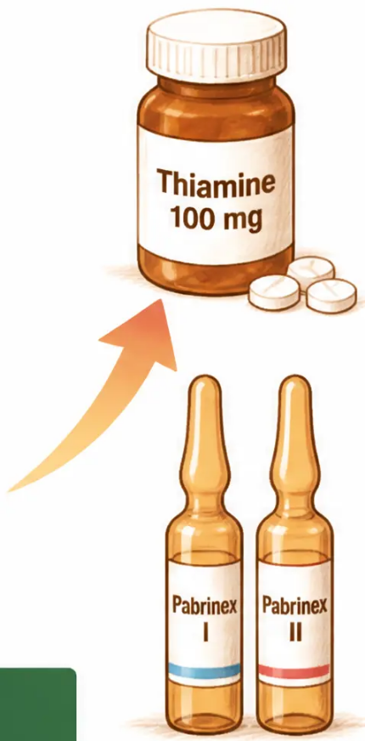








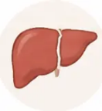


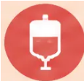




Vitamins — thiamine and B vitamins
Preventing Wernicke's encephalopathy — a prescribing priority in every alcohol-dependent patient
⚠Thiamine deficiency in alcohol dependence is common, dangerous and preventable — always co-prescribe with detox
Why alcohol-dependent patients are deficient
Thiamine prescribing regimes
Poor dietary intake
Oral thiamine (prophylactic — community detox)
Alcohol replaces food; nutritional neglect
is common
Thiamine 100 mg three times daily (TDS)
• Prescribe to ALL patients undergoing planned withdrawal
• Vitamin B compound strong tablets: 1–2 tablets TDS
(supportive — not a substitute)
Impaired gut absorption
Alcohol damages the intestinal mucosa;
thiamine cannot be absorbed properly
Pabrinex IM (Wernicke's risk — community)
1 pair of ampoules (Pabrinex I + II) IM — once daily
Reduced hepatic storage
• Give for 3–5 days before or during community detox
The liver stores and activates thiamine —
alcohol damages this capacity
• Use when patient has signs or risk factors for Wernicke's
Pabrinex IV (confirmed/suspected Wernicke's)
Increased demand during illness
2–3 pairs of ampoules IV — three times daily for 2–3 days
Acute withdrawal and illness dramatically
raise thiamine requirements
• Then 1 pair once daily for 5 days
• ⚠ Have resuscitation facilities available —
anaphylaxis risk with parenteral thiamine
SAFE PRACTICE — Every patient starting community detox should receive oral thiamine 100 mg TDS
from day one. Do not wait for symptoms of deficiency to appear. Wernicke's encephalopathy is preventable.
AKT PEARL — Oral thiamine dose: 100 mg TDS (not once daily). Pabrinex before glucose in suspected Wernicke's —
glucose depletes remaining thiamine stores.
www.bradfordvts.co.uk
Vitamins — thiamine and B vitamins
14 / 30

Slide 14













BRADFORD VTS TEACHING DECK
SLIDE 15 - EMERGENCY MANAGEMENT
Wernicke's encephalopathy —
recognition and emergency management
MEDICAL EMERGENCY
RECOGNITION — THE CLASSIC TRIAD
EMERGENCY MANAGEMENT — ACT NOW
1 Ataxia
1 Step 1 — Call 999
Hospital admission required — this cannot be managed in the community
Cerebellar type — unsteady gait, difficulty walking
2 Ophthalmoplegia
2 Step 2 — IV Pabrinex IMMEDIATELY
Lateral rectus palsy (CN VI) — diplopia,
nystagmus, abnormal eye movements
2 pairs of ampoules (500mg thiamine) three times daily for 2–3 days, then reassess
Then 1 pair once daily for a further 5 days
3 Confusion
Step 3 — Do NOT give glucose first
Global confusional state — disorientation,
altered consciousness
X Do NOT administer glucose before thiamine
Glucose administration depletes remaining thiamine stores and
can precipitate or worsen Wernicke's encephalopathy
Only ~10% of patients present with all three features.
Any ONE feature in an alcohol-dependent patient =
Wernicke's immediately. Do not wait for the full triad.
4 Step 4 — Do NOT rely on oral thiamine
Gut absorption is unreliable in acute illness — only parenteral
thiamine is effective in the emergency setting
Untreated Wernicke's → Korsakoff's psychosis — irreversible anterograde amnesia,
confabulation, personality change. There is no coming back from this. Thiamine prevention matters.
www.bradfordvts.co.uk
15 / 30

Slide 15







Relapse prevention — overview and NICE guidance
Medication alone is not enough — all relapse prevention drugs
must be combined with psychosocial support to be effective
NICE CG115 | UK Draft Guidelines November 2025
FIRST-LINE
FIRST-LINE
REDUCTION
SECOND-LINE
Acamprosate
Naltrexone
Nalmefene
Disulfiram / Baclofen
Reduces craving
Opioid antagonist
PRN before drinking
Aversive / GABA-B
Start after detox
Reduces reward
Not for abstinence
Specialist-led
Goal: abstinence
Goal: abstinence
Goal: cut down
Goal: abstinence
Pitfall: Explore relapse prevention options BEFORE detox completion — do not leave discussion to the final day
www.bradfordvts.co.uk
16 / 30

Slide 16


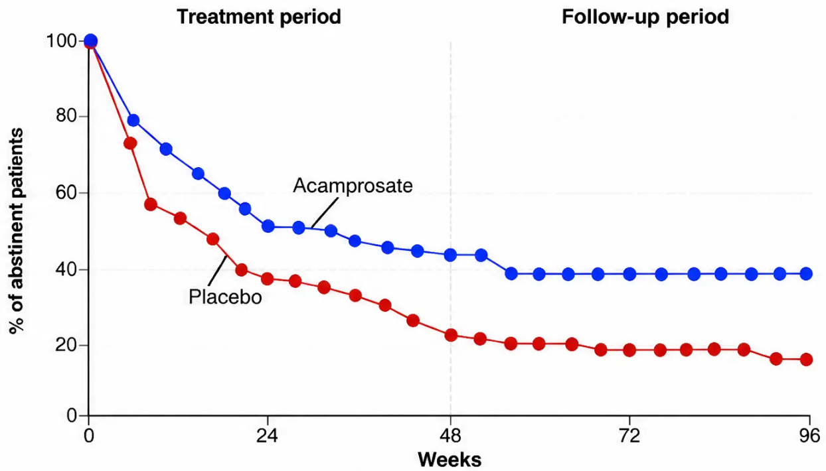



Acamprosate — mechanism, dosing, evidence, contraindications
17 / 30
Mechanism
GABA analogue — normalises NMDA glutamate receptor
activity post-withdrawal. Reduces the neurological "noise"
driving craving. Does not produce reward or euphoria.
Dosing (BNF-verified)
Weight
Dose
≥ 60 kg
666 mg three times daily (6 tablets/day)
< 60 kg
666 mg morning · 333 mg midday ·
333 mg evening (4 tablets/day)
Start after successful detox — as soon as possible post-withdrawal
Duration: up to 1 year recommended; continue through brief lapses
Acamprosate vs placebo — % abstinent patients over 96 weeks (treatment + follow-up).
Acamprosate more than doubles long-term abstinence rates vs placebo in meta-analyses.
Contraindications
Why GPs like acamprosate
• Severe renal impairment (eGFR < 30)
• No hepatotoxicity — safer than naltrexone in liver disease
• Minimal drug interactions
• Severe hepatic failure (Child-Pugh C cirrhosis)
• Can be co-prescribed with disulfiram
• Pregnancy and breastfeeding
• Does not impair driving
• GP can initiate if specialist unavailable (NICE CG115)
AKT: Acamprosate dose = 666 mg TDS (≥60 kg) · Start AFTER detox · Contraindicated if eGFR < 30 · No hepatotoxicity
www.bradfordvts.co.uk
Bradford VTS Teaching Deck — Alcohol Misuse in Primary Care

Slide 17

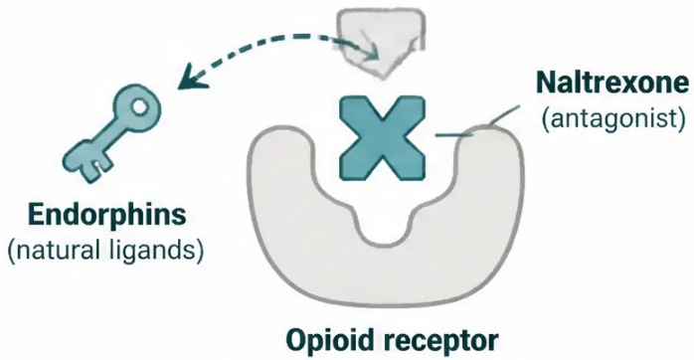

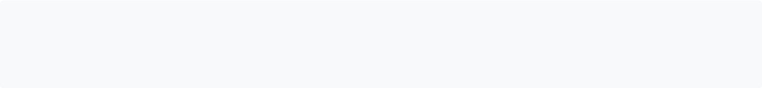













RELAPSE PREVENTION
Naltrexone — mechanism, dosing, evidence, cautions
Mechanism of action
Opioid receptor antagonist — blocks the endorphin release triggered by alcohol,
removing the rewarding “buzz.” Reduces craving and motivation to drink.
Also blunts the severity of any lapse — helping prevent a single drink becoming a full relapse.
Dosing (BNF-verified)
50 mg once daily — start after at least 7–10 days of abstinence from opioids and alcohol
Review monthly for first 6 months, then at reduced frequency
Stop if drinking continues for 4–6 weeks after starting
Licensed in UK for alcohol dependence — NICE CG115 first-line alongside acamprosate
Evidence
Reduces relapse rates and heavy drinking days. Particularly effective at reducing the
transition from a lapse to a full relapse. Most effective when combined with
psychosocial support — not a standalone treatment.
CAUTION — Read before prescribing
• Absolute contraindication: Any concurrent opioid use — will precipitate acute opioid withdrawal immediately.
Always ask about opioid use (codeine, tramadol, morphine, methadone, buprenorphine) before prescribing.
• Hepatotoxicity risk: Check LFTs before starting; avoid in acute hepatitis or severe hepatic failure;
monitor LFTs during treatment.
• Opioid analgesics: Patients cannot use opioid-based painkillers whilst on naltrexone —
plan ahead for surgery or acute pain management.
Naltrexone 50 mg OD. Cannot combine with ANY opioid —
will precipitate withdrawal. Check LFTs before and during.
First-line with acamprosate per NICE CG115.
“Before I prescribe this, I need to ask — do you take
any painkillers like codeine, tramadol or morphine?”
This medication would cause a very unpleasant
reaction with those.”
AKT pearl
SCA tip
www.bradfordvts.co.uk
18 / 30

Slide 18

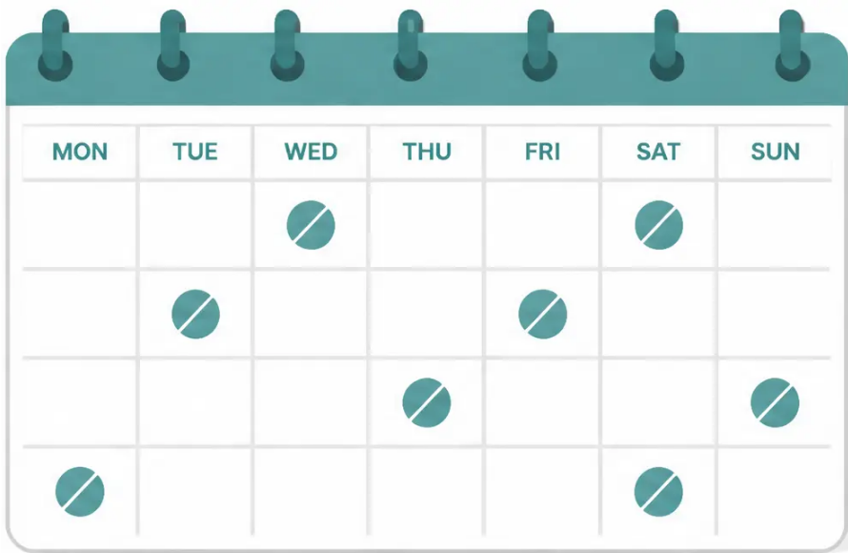















19 / 30
Nalmefene — for reducing alcohol consumption
Take it on days you plan to drink — not every day
WHAT IS IT?
• Opioid receptor partial agonist/antagonist — modulates the brain's
reward response to alcohol
• Licensed in the UK to reduce alcohol consumption — not for abstinence
• Indicated when the patient has a high drinking risk level and does not
require immediate detoxification
WHO IS IT FOR?
Indicated when ALL of the following apply:
• High drinking risk level (men >60g alcohol/day; women >40g/day)
• No physical withdrawal symptoms requiring detox
• No immediate need for medically assisted withdrawal
Do not prescribe if the patient needs detoxification first
DOSING
Dose
18mg tablet, taken as required (PRN)
Taken only on planned drinking days
Timing
1–2 hours before anticipated drinking
Frequency
Maximum one tablet per day; not needed on alcohol-free days
Review
4–6 weeks; reassess at 3 months
SCA PEARL
Continue if
Meaningful reduction in drinking days or units achieved
"This tablet isn't something you take every day — you take it
about an hour or two before you think you'll be drinking. On
days you don't drink, you don't need it. The idea is to gradually
help you drink less, not necessarily to stop altogether."
Nalmefene
Naltrexone
→ PRN, taken BEFORE drinking
→ daily, taken AFTER detox
→ goal is REDUCTION
→ goal is ABSTINENCE
AKT PEARL
Use shared decision-making — explore patient's goal before prescribing
Nalmefene: 18mg PRN, up to once daily, taken 1–2 hours before drinking
Naltrexone: 50mg daily — these are NOT interchangeable
www.bradfordvts.co.uk
19 / 30

Slide 19






















RELAPSE PREVENTION — MEDICATION 4 OF 5
Disulfiram (Antabuse) — mechanism, monitoring, cautions
HOW IT WORKS
Prescribing essentials
■ Start at least 24 hours after last alcoholic drink
Alcohol
■ Standard dose: 200mg daily — increase to max 500mg if reaction insufficient
■ Specialist initiation recommended; GP may continue with monitoring plan
Acetaldehyde
Monitoring schedule
(accumulates — TOXIC)
Weeks 1–8
Months 3–6
Month 6+
Fortnightly
Monthly
Every 6 months
Aversive reaction
(LFTs, U&E,
(LFTs, clinical
(ongoing review,
clinical review)
review)
LFTs)
Blocks aldehyde dehydrogenase →
LFTs before starting and throughout — hepatotoxicity risk
acetaldehyde builds up → deeply
Hidden alcohol — warn patients about ALL of these
unpleasant reaction within minutes of drinking
Food (trifle, sauces)
Perfume /
AVERSIVE REACTION
Mouthwash
aftershave
Flushing · nausea · vomiting
Some IV
Herbal remedies
Aerosol sprays
Palpitations · hypotension
medications
Headache · collapse (severe)
Advise patients to check every product label — reactions can occur even from topical exposure
Even tiny amounts of alcohol trigger this reaction
KEY INTERACTIONS
PITFALL: Disulfiram has no better evidence than placebo if
unsupervised. Supervised administration by a carer or
pharmacist is essential for effectiveness.
• Warfarin (↑ INR)
• Tricyclic antidepressants
• Metronidazole (psychosis)
• Phenytoin
• Isoniazid (neurological)
www.bradfordvts.co.uk
20 / 30

Slide 20









Baclofen — second-line, off-label use
SECOND-LINE / OFF-LABEL
MECHANISM
LICENSED USE IN UK
GABA-B receptor agonist — reduces craving
and alcohol consumption by dampening
CNS excitability
Licensed for muscle spasticity —
NOT licensed for alcohol dependence
GUIDELINE POSITION
UK Draft Clinical Guidelines (November 2025): listed as second-line relapse prevention
alongside disulfiram, after acamprosate and naltrexone have been considered or tried
Growing evidence for use in patients with high anxiety, heavy dependence, or advanced liver
disease — where acamprosate (renal impairment) or naltrexone (liver disease) may be contraindicated
IF PRESCRIBING OFF-LABEL — ALL THREE REQUIRED:
Informed consent
documented
Prescriber records clear
rationale in notes
Specialist initiation — not to be
started in primary care without
specialist guidance
Pitfall: Do NOT initiate baclofen for alcohol relapse prevention in primary care without specialist
input. This remains a specialist-led treatment. GPs may continue under a shared care agreement —
but should not start it independently.
www.bradfordvts.co.uk
Bradford VTS Teaching Deck — Alcohol Misuse in Primary Care
21 / 30

Slide 21








Antidepressants in alcohol misuse
NICE CG115 — what to do, and what NOT to do
The right approach
Do NOT prescribe routinely
• Antidepressants (including SSRIs) should not
be used routinely for alcohol misuse alone
1. Treat the alcohol problem first
2. Reassess mood after 3-4 weeks of abstinence
• Up to 80% of harmful drinkers have
depressive symptoms — but most are
secondary to alcohol
3. If depression or anxiety persists → assess formally
4. Consider referral and treat with appropriate
antidepressant
• Prescribing while the patient is still drinking
provides little benefit and adds
polypharmacy risk
Antidepressants ARE appropriate when:
— Primary depressive disorder pre-dating alcohol use,
persisting through abstinence
Depression in active drinkers usually
resolves with abstinence
— Independent anxiety disorder (GAD, PTSD, social phobia)
not resolving with abstinence
— Bipolar disorder (with mood stabilisers)
“I understand you’re feeling very low. Let’s tackle the drinking first —
often the mood lifts significantly once alcohol is out of the system.”
We’ll review how you’re feeling in four weeks.”
SCA pearl
www.bradfordvts.co.uk
22 / 30

Slide 22
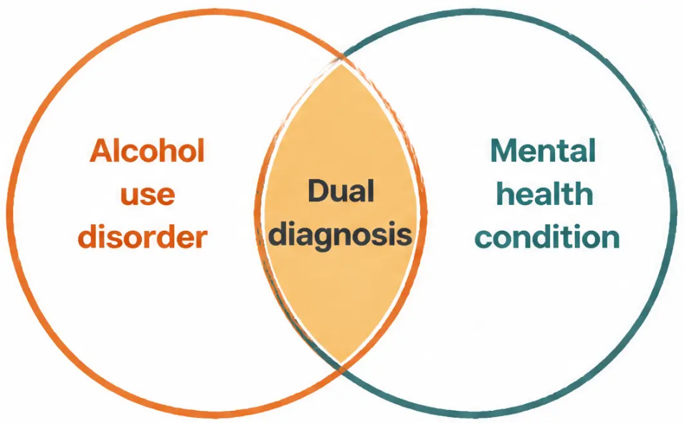




DUAL DIAGNOSIS
Dual diagnosis — managing co-occurring mental health conditions
Up to 50% of alcohol-dependent patients have a co-occurring mental health condition
Common co-occurring conditions
• Depression — most common; often secondary to alcohol; assess after abstinence
• Anxiety disorders — GAD, panic disorder, PTSD, social phobia
• Bipolar affective disorder
• Schizophrenia and psychotic disorders
• Borderline personality disorder
• ADHD
Key principles (NICE)
• Treat both conditions — do not ignore either
• Do not treat only the addiction while ignoring psychiatric co-morbidity
• Do not treat only the psychiatric condition while ignoring alcohol
• Depression/anxiety that resolves with abstinence = secondary to alcohol
Treat both — neither can be safely ignored
• Depression/anxiety persisting after 3–4 weeks abstinence = assess and
treat independently
Pitfall: Finding the 'cause' of addiction and fixing it
does not automatically cure the addiction — addiction
behaves as a second primary diagnosis once established.
SCA tip: “I can see you're struggling with both your
mood and your drinking. These two things are very
connected — we need to address both together,
step by step.”
www.bradfordvts.co.uk
23 / 30

Slide 23

















BRADFORD VTS — PRESCRIBING ROLES
Prescribing roles — who initiates, who continues, when to refer
Responsibilities between GP and specialist in alcohol pharmacotherapy
TREATMENT
GP CAN INITIATE?
SPECIALIST INVOLVEMENT
Community detox (chlordiazepoxide)
Refer if SADQ >30, previous seizures, complex comorbidities
✓ YES
— with training, SADQ <30, no contraindications
Thiamine prescribing
✓ ALWAYS
Hospital if suspected Wernicke's — 999 and IV Pabrinex
— oral thiamine; arrange IM if Wernicke's risk
Acamprosate
— ideally after specialist assessment; GP can initiate if unavailable
SIGN: "If specialist unavailable, GP should offer acamprosate and monitor"
⚡ YES
Naltrexone
⚡ IDEALLY SPECIALIST
Check LFTs before initiating; avoid in opioid users
— GP may continue once established
Nalmefene
Review at 4-6 weeks; continue only if meaningful reduction achieved
⚡ USUALLY SPECIALIST
— some trained GPs may initiate
Disulfiram
— GP may continue with monitoring plan
Fortnightly review × 2 months, then monthly × 4 months, then 6-monthly
⚡ SPECIALIST INITIATION
Baclofen (off-label)
Off-label; requires documented consent and specialist oversight
✕ SPECIALIST ONLY
— do not initiate in primary care
Antidepressants
✓ YES
Do NOT prescribe for alcohol misuse alone; treat alcohol first
— after 3-4 weeks abstinence with clear indication
Amber = Shared care /
ideally specialist
SCA tip: In a consultation, if asked about starting acamprosate — you can
do this in primary care. If asked about baclofen — always say “I’d want to
discuss this with our specialist alcohol service first.”
Green = GP can initiate
Red = Specialist only
www.bradfordvts.co.uk
24 / 30

Slide 24













TOP TIPS
Clinical pearls for the exam and the consultation room
1 Never start community detox above 30 units/day
5 Disulfiram only works if supervised
SADQ >30 = inpatient referral. No exceptions.
Unsupervised disulfiram has no better evidence
than placebo. Supervision is the intervention.
6 Don't prescribe antidepressants for alcohol misuse alone
2 Always co-prescribe oral thiamine
Prescribe 100mg TDS alongside chlordiazepoxide —
never wait for signs of deficiency.
Treat alcohol first. Reassess mood at 4 weeks of
abstinence — most low mood lifts.
7 Naltrexone + opioids = acute withdrawal
3 Wernicke's triad is complete in only 10%
Ataxia alone in a drinker = treat with IV Pabrinex
immediately. Call 999.
Always ask about opioid use before prescribing.
This is a dangerous interaction.
8 Chlordiazepoxide must be tapered — never stopped abruptly
4 Acamprosate = abstinence; nalmefene = reduction
Know the difference — they are prescribed at
different stages and for different goals.
The 7-day reducing regime is the treatment.
Abrupt cessation defeats the purpose.
www.bradfordvts.co.uk
25 / 30

Slide 25






BRADFORD VTS
TRANSFORMING VOCATIONAL TRAINING
Exam pearls — AKT and SCA focus
High-yield facts for your MRCGP examinations
AKT — Knowledge recall
SCA — Consultation skills
1. First-line community detox medication: chlordiazepoxide
Before detox starts:
2. Start dose: 120 mg/day (30 mg four times daily) —
taper over 7 days
"Do you have someone at home with you every day for the first week?"
Explaining thiamine:
3. Why not chlormethiazole outpatient? Higher addiction
risk — no longer recommended
"Alcohol can cause a serious vitamin deficiency that damages the
brain — these tablets will protect you."
4. Acamprosate dose: 666 mg three times daily (≥60 kg);
4 tablets/day if <60 kg — start after detox
Explaining acamprosate:
"It turns down the noise in your head that tells you to drink — it
doesn't make you sick if you slip."
5. Naltrexone: 50 mg once daily — check LFTs; never with opioids
Explaining disulfiram:
"Even mouthwash or perfume can trigger a reaction — you must be
completely committed to not drinking."
6. Nalmefene: PRN before drinking — for reduction, not abstinence
7. Disulfiram: 200 mg daily — start 24 h after last drink;
supervised only
Safety-netting:
"If you feel shaky, confused, or see things that aren't there —
call 999 immediately, don't wait."
8. Thiamine oral: 100 mg three times daily — co-prescribe with
chlordiazepoxide always
On antidepressants:
9. Wernicke's triad: ataxia + ophthalmoplegia + confusion →
IV Pabrinex immediately
"Let's tackle the drinking first. Mood often lifts significantly once
alcohol leaves the system. We'll review in 4 weeks."
10. Give thiamine before glucose in Wernicke's — glucose
depletes remaining stores
Don't prescribe antidepressants for alcohol-related low
mood — treat alcohol first, reassess at 4 weeks
⚠ SADQ >30 = inpatient detox required — never attempt community detox above this threshold
www.bradfordvts.co.uk
26 / 30

Slide 26
















RED FLAGS
Dangerous clinical situations in detox
Withdrawal seizure during
community detox
Delirium tremens
Agitation, hallucinations, fever, autonomic instability → 999 now
Call 999 immediately — do not attempt to manage at home
Wernicke's encephalopathy signs
Severe hepatic decompensation
Ataxia, eye movement abnormality, or confusion
in a drinker → 999 + IV Pabrinex
Jaundice, ascites, or encephalopathy →
same-day hospital referral
Suicidal ideation with medication access
Patient drinking heavily during planned detox
Urgent psychiatric assessment — prescribe
small quantities only
Stop detox — reassess — consider
inpatient admission
SADQ score rises above 30 during assessment
Switch immediately to inpatient referral pathway — community detox is no longer safe
www.bradfordvts.co.uk
Bradford VTS Teaching Deck — Alcohol Misuse in Primary Care
27 / 30

Slide 27

COMMON PITFALLS
Medication errors and clinical mistakes
Avoid these in practice — and in your SCA
Prescribing chlormethiazole for community detox
Prescribing antidepressants for alcohol-related low mood too early
No longer recommended — use chlordiazepoxide;
chlormethiazole has higher addictive potential
Per NICE CG115 — treat alcohol first; reassess mood
after 3-4 weeks of abstinence
Not co-prescribing thiamine with chlordiazepoxide
Not monitoring LFTs during naltrexone
Always prescribe oral thiamine 100mg TDS alongside
detox medication — Wernicke's is preventable
Hepatotoxicity risk — check LFTs before starting and
at regular intervals during treatment
Starting acamprosate before detox is complete
Treating nalmefene as equivalent to naltrexone
Acamprosate begins after successful withdrawal,
not during — timing matters
Nalmefene = PRN before drinking (reduction goal);
naltrexone = daily for abstinence maintenance —
different drugs, different indications
Prescribing naltrexone in opioid users
No social support arranged before community detox
Will precipitate acute opioid withdrawal —
always screen for opioid use first
A responsible adult at home every day for the first week
is mandatory — do not skip this check
Two more
to remember:
Disulfiram without a monitoring plan — fortnightly review for 2 months, then monthly for 4 months;
do not initiate without this structure
Under-prescribing thiamine — 100mg TDS, not once daily; frequency matters as much as the drug itself
www.bradfordvts.co.uk
Bradford VTS Teaching Deck — Alcohol Misuse in Primary Care
28 / 30

Slide 28






























BRADFORD VTS — QUICK RECALL
Quick recall
Core facts — know these cold
Chlordiazepoxide
PRN — 1–2 hours BEFORE
anticipated drinking
Community detox — first line
Nalmefene — how to take
Starting dose
120 mg/day (30 mg QDS) — day 1
Supervised use only —
unsupervised = no better than placebo
Disulfiram — supervision
Taper duration
7 days — never stop abruptly
Wernicke's triad
Ataxia + ophthalmoplegia + confusion
Always co-prescribe
Oral thiamine 100 mg TDS
Acamprosate — when to start
Wernicke's — give FIRST
AFTER successful detox — not during
IV Pabrinex — BEFORE glucose
Acamprosate dose (≥60 kg)
666 mg TDS (6 tablets/day)
Inpatient detox required
SADQ >30 means
Never use with opioids —
precipitates withdrawal
Treat alcohol first — reassess mood
at 4 weeks abstinence
Naltrexone — key caution
Antidepressants — rule
💡 If you know all 13 of these, you are AKT-ready on alcohol pharmacology.
www.bradfordvts.co.uk
29 / 30

Slide 29



BRADFORD VTS TEACHING DECK
Alcohol misuse in primary care — detoxification, medications and relapse prevention
Important disclaimer
Always verify all drug doses, clinical thresholds, and guideline recommendations
against the latest BNF and current NICE guidance before applying to patient care.
This teaching deck was created for educational purposes only. It is intended for
GP trainees (ST1–ST3) and IMGs preparing for AKT and SCA assessments
within the Bradford VTS programme.
Clinical guidelines and drug doses change. What is correct today may be superseded.
The authors accept no responsibility for clinical decisions made on the basis of this
material alone.
References used in this deck:
• NICE CG100 — Alcohol-use disorders: diagnosis and clinical management of alcohol-related physical complications
(2010, updated 2017)
• NICE CG115 — Alcohol-use disorders: diagnosis, assessment and management of harmful drinking and
alcohol dependence (2011, updated 2014)
• BNF — Current edition (verify at bnf.nice.org.uk)
• UK Draft Clinical Guidelines for Alcohol Treatment, November 2025
Created May 2026 · Updated to current NICE and BNF standards
www.bradfordvts.co.uk
www.bradfordvts.co.uk
30 / 30

