Slide 1



BRADFORD VTS TEACHING DECK
Drug misuse and dependence
- A comprehensive guide for primary care
Created May 2026 · Updated to NICE 2024/2025 standards
For GP Trainees (ST1–ST3) and IMGs · Bradford VTS
www.bradfordvts.co.uk

Slide 2




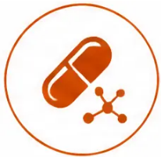







Bradford VTS Teaching Deck
Learning objectives
By the end of this session, you will be able to:
Describe the scale and epidemiology
of drug misuse in the UK
Explain the pharmacological
classification of commonly
misused substances
Recall the UK legal classification of
controlled drugs under the Misuse
of Drugs Act
Conduct a structured GP assessment
using the five-domain framework
Apply evidence-based substitute
prescribing principles for
opioid dependence
Identify red flags, harm reduction
strategies, and AKT/SCA
exam priorities
www.bradfordvts.co.uk

Slide 3



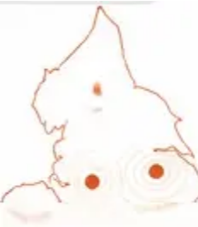







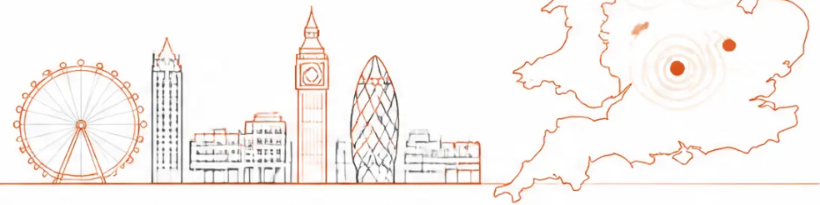
Section 1 · Current UK figures 2023/2024
Epidemiology and scale
280,000
5,000+
1–2%
adults per year
drug-related deaths per year
annual mortality rate
in contact with specialist
in England and Wales —
in untreated heroin users —
higher than many cancers
the majority are preventable
drug treatment services in England
OHID 2022/23
ONS 2023
OHID
Opiates and opioids
Cocaine (powder)
18–34 year old males
most common primary
substance in treatment
second most common
referral reason; rising trend
highest-risk demographic
group
⚠ Common mistake
These deaths are largely preventable — most involve opioids
combined with alcohol and/or benzodiazepines.
Polydrug use is the key risk factor.
www.bradfordvts.co.uk

Slide 4
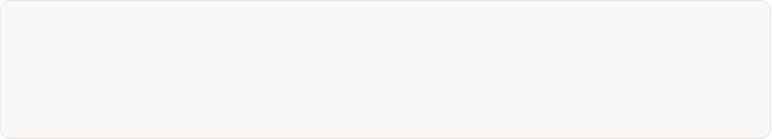


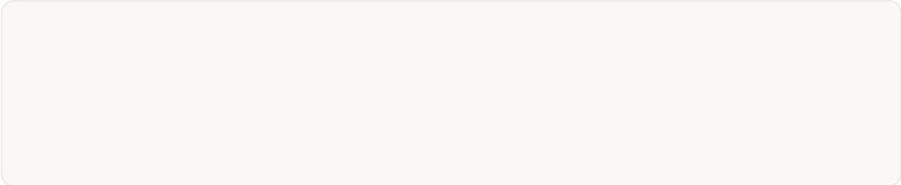
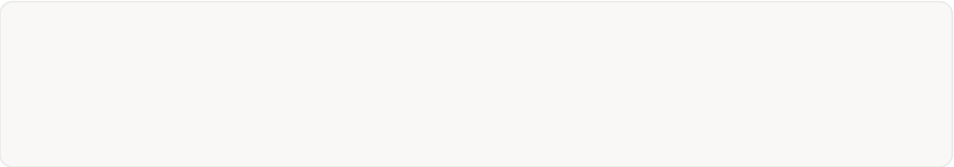
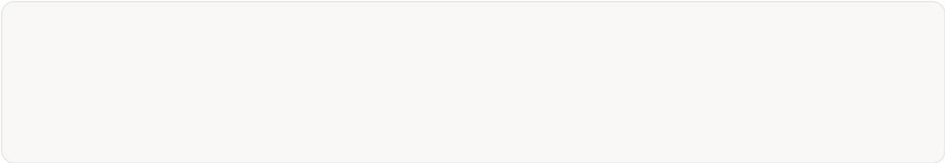
Key definitions
Understanding the language before the clinical encounter
Drug
Physical dependence
Any substance taken into the body for its
psychoactive effect
The body undergoes measurable withdrawal
when the substance is removed — sweats,
shakes, seizures
Tolerance
Psychological dependence
Needing more of a substance to achieve the
same effect over time
Mental compulsion to use — the most
important factor in understanding and
treating drug use
Withdrawal
Dependence
Physical and psychological effects that
occur when a substance is stopped
A continuum, not a binary — more clinically
useful than the term "addiction"
☑ Harm reduction
Reducing harm to the user, their family, and society — does not require abstinence.
Always something you can offer.
⚠ Pitfall: "Addiction" is less clinically useful than "dependence."
Avoid using it as a diagnostic label in consultations.
www.bradfordvts.co.uk

Slide 5









Classification by pharmacological effect
How drugs act on the central nervous system
Stimulants
Depressants
Hallucinogens
CNS arousal ↑ · Energy ↑ · Mood ↑
CNS arousal ↓ · Sedation · Pain relief
Perception distorted · Reality altered
Cocaine · Crack cocaine
Heroin · Opioids · Methadone
Benzodiazepines · Alcohol
GHB · Ketamine (low dose)
LSD · Psilocybin (magic mushrooms)
DMT · Mescaline
Ketamine (high dose)
Amphetamine · MDMA
Methamphetamine · Nicotine
Key risks
Key risks
Key risks
Paranoia · Psychosis · Cardiac
events · Crash and craving cycle
Respiratory depression · Overdose ·
Dependence · Fatal combinations
Bad trips · Prolonged psychosis ·
Unpredictable effects
Cannabis is pharmacologically complex — mild stimulant + depressant + mild hallucinogen properties.
Ketamine is dissociative. Neither fits neatly into one category.
www.bradfordvts.co.uk

Slide 6















UK legal classification
Misuse of Drugs Act 1971 — Classes and Schedules
Schedules 1–5 (govern prescribing, storage, and record-keeping)
Most severe penalties — possession up to 7 years,
supply up to life
Schedule 1 — No recognised medicinal use.
Research licence required.
LSD, cannabis plant
Heroin · Cocaine / crack · Methadone · Morphine ·
MDMA · LSD · Psilocybin · PCP
Schedule 2 — High misuse potential.
Also: any Class B drug if injected
Full CD requirements apply.
Heroin, cocaine, methadone, morphine, fentanyl, amphetmnine
Possession up to 5 years, supply up to 14 years
Schedule 3 — CD requirements, less strict.
Amphetamine · Dihydrocodeine · Cannabis ·
Buprenorphine, temazepam
Codeine · Methylphenidate · Barbiturates · Ketamine
Schedule 4 — Includes benzodiazepines
and anabolic steroids.
Diazepam (Schedule 4)
Possession up to 2 years, supply up to 14 years
Benzodiazepines (illicit) · GHB · Anabolic steroids
Schedule 5 — Minimal control.
Low-strength preparations.
Codeine linctus, small-dose preparations
PITFALL — Cannabis is Class B, NOT Class C
Cannabis was reclassified from Class C back to Class B in 2009. Older textbooks and revision
notes still say Class C — this is wrong. In the AKT, always select Class B for cannabis.
www.bradfordvts.co.uk

Slide 7




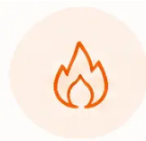
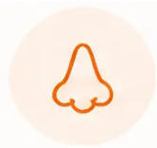






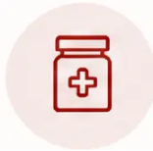

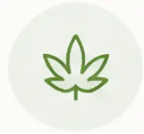













Commonly misused drugs and street names
Routes · street names · primary clinical risks
Heroin
Crack cocaine
Cocaine powder
“Gear, brown, smack, horse”
“Rock, stone, white”
“Charlie, coke, snow”
IV injection · smoked (chasing) · snorted
Snorted · IV
Smoked
Respiratory depression · overdose · BBV
Intense short high → crash → craving cycle
Cardiac arrhythmia · mental health
Methadone
Diazepam / benzos
Cannabis
“Meth, linctus, green”
“Blues, jellies, valium”
“Weed, skunk, draw, dope”
Oral mixture
Oral
Smoked · edibles
Fatal in overdose if diverted
Withdrawal seizures
Psychosis risk · Class B
Amphetamine
MDMA / ecstasy
Ketamine
“Whizz, speed”
“Pills, mandy, ecstasy”
“Ket, special K”
Oral · snorted · IV
Oral
Snorted · IV
Psychosis · cardiovascular
Hyperthermia · hyponatraemia
Dissociation · bladder damage
Opioids
Stimulants
Sedatives
Mixed/dissociative
Pitfall: Polydrug use is the norm, not the exception — always ask about
ALL substances, not just the presenting drug.
www.bradfordvts.co.uk

Slide 8
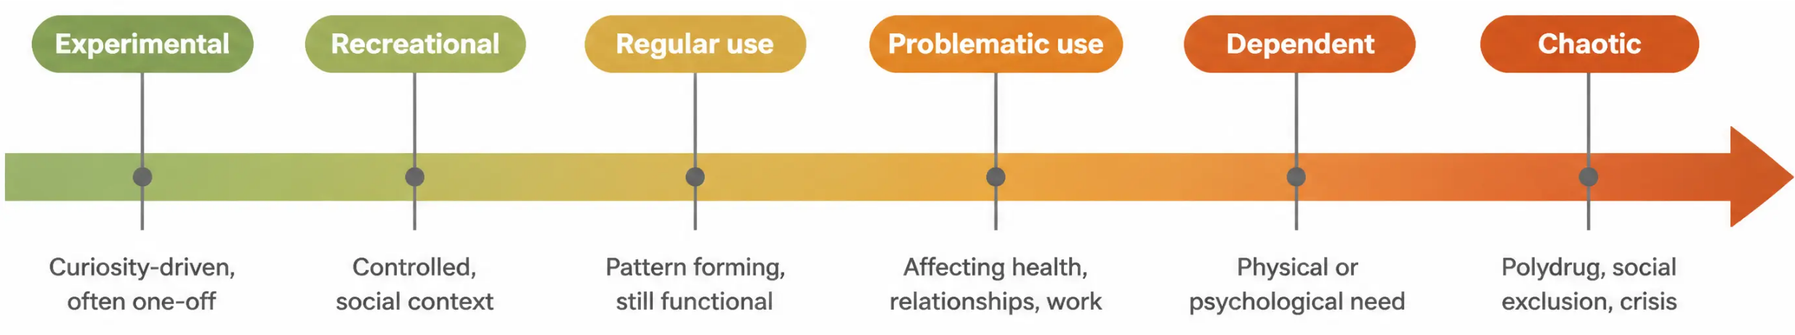




Spectrum of use
Most people who use drugs never reach dependence — but understanding
the full spectrum helps us intervene at the right moment
Most people sit in recreational or regular use —
GP contact is an opportunity to prevent
progression, not just treat dependence.
Chaotic use typically involves polydrug
combinations, homelesssess, criminal justice
involvement, and multiple health needs —
refer to specialist Tier 3/4 services.
www.bradfordvts.co.uk

Slide 9







Why people use drugs
Social · Psychological · Biological — understanding the person, not just the substance
"People rarely use drugs for no reason. Understanding why is the foundation of effective treatment."
Social drivers
Psychological drivers
Biological drivers
• Self-medication of anxiety,
depression, PTSD
• Genetic predisposition to dependence
• Peer pressure and social norms
• Poverty, deprivation, and housing
instability
• Brain reward pathway sensitisation
(dopamine)
• Seeking pleasure, escape, or
relief from pain
• Trauma, adverse childhood
experiences (ACEs)
• Physical pain management leading
to dependence
• Impulsivity and risk-taking
personality traits
• Availability and local drug culture
• Tolerance developing rapidly in
vulnerable individuals
• Boredom, hopelessness, lack of purpose
SCA focus: In the consultation, always explore why the patient uses — not just what they use.
"What does the drug do for you?" is more powerful than "How much do you take?"
Understanding function drives shared decision-making.
www.bradfordvts.co.uk

Slide 10
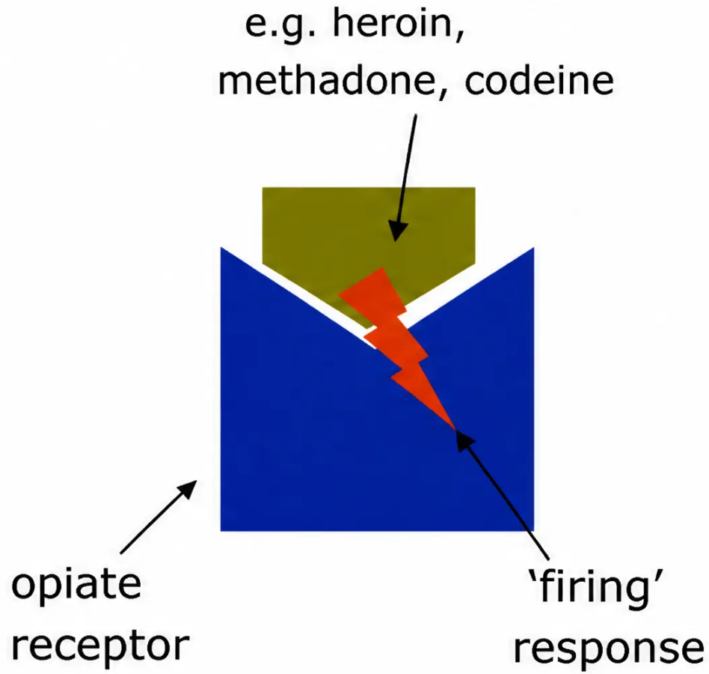






Basic pharmacology
OPIATE AGONIST
How drugs interact with receptors — and why it matters clinically
Agonist
Binds to a receptor and activates it.
Produces the expected physiological response.
Example: heroin and methadone bind to mu-opioid
receptors → sedation, analgesia, euphoria.
Full agonist = maximum response · Partial agonist =
submaximal response (e.g. buprenorphine)
Antagonist
Binds to a receptor but does NOT activate it.
Blocks the receptor — prevents agonists from binding.
Example: naloxone and naltrexone block mu-opioid
receptors → reverses or prevents opioid effect.
Clinical use: naloxone reverses overdose · naltrexone
prevents relapse
AKT focus
Buprenorphine = partial mu agonist. High receptor
affinity — can displace full agonists and precipitate
withdrawal if given too soon. Always wait for
COWS ≥ 8 before first dose.
Opiate agonist binding: the drug fits the receptor like
a key in a lock, triggering the physiological response.
www.bradfordvts.co.uk

Slide 11








Drug-related deaths
Causes, risk combinations, and prevention in primary care
5,000+
Drug-related deaths per year in England and Wales (ONS 2023)
Opioids and opiates
Opioid + alcohol + benzodiazepine
Post-abstinence relapse
Most frequent drug in drug-related
deaths; heroin and illicitly
manufactured fentanyl are leading
contributors
The majority of drug-related deaths
involve this combination — all three
suppress respiratory drive
simultaneously
Tolerance lost after prison, hospital,
or detox — users return to previous
doses; overdose risk is extremely high
Common pitfall: Prescribing benzodiazepines or sedating antihistamines to opioid-dependent patients
significantly increases overdose mortality risk — avoid unless closely monitored.
Red flag — Safety-critical
Reassuring — Preventable
Pinpoint pupils + unconscious + slow breathing =
opiate overdose until proven otherwise.
Call 999 immediately. Give naloxone 400 micrograms IM.
Repeat every 2-3 minutes if no response.
Naloxone half-life is shorter than most opioids —
patient may re-narcotise. Stay with them.
Most drug-related deaths are preventable.
Take-home naloxone, supervised consumption, harm
reduction advice, and avoiding polydrug combinations
all save lives. GP involvement makes a measurable
difference.
www.bradfordvts.co.uk

Slide 12









Overdose management
Recognising signs · Risk factors · Immediate management
EMERGENCY: Respiratory rate <8, pinpoint pupils, unconscious → Opioid overdose until proven otherwise.
Call 999. Give naloxone immediately.
Recognise it
Manage it
● Unconscious or unresponsive
1. Call 999 — do not delay
● Pinpoint (miotic) pupils
2. Airway — recovery position if breathing; airway opening manoeuvres
3. Naloxone — 400 micrograms IM or SC; repeat every 2–3 minutes
if no response
● Slow, shallow, or stopped breathing (RR <8)
● Blue lips or fingertips (cyanosis)
4. Monitor — naloxone half-life is 30–90 min; patient may re-narcotise
● Gurgling or snoring sounds
5. Stay — do not leave the patient alone until ambulance arrives
● Pale, clammy skin
6. Reassess — if no response after 2–3 doses, consider other causes
Pitfall: Polydrug overdose (opioids + benzos + alcohol)
is the most common pattern. Signs may be mixed –
do not wait for "classic" picture.
AKT focus: Naloxone dose = 400 micrograms IM
(NOT 400 mg – a dangerous error in older sources).
Nyxoid nasal spray = 1.8 mg. Half-life shorter than most
opioids — always call 999 even if patient wakes up.
Who is at highest risk?
Recent prison /
hospital discharge
Tolerance lost
after abstinence
Polydrug use
(opioids + benzos + alcohol)
Using alone
High-dose or
unknown-strength supply
www.bradfordvts.co.uk

Slide 13
















Blood-borne viruses
HIV · Hepatitis B · Hepatitis C — prevention and screening in people who inject drugs
HIV
Hepatitis B
Hepatitis C
• Transmitted via shared needles, syringes, and
injecting equipment
• Transmitted via shared injecting equipment
and sexual contact
• Most common BBV in people who inject
drugs in UK
• Sexual transmission also significant
• Transmitted primarily via shared needles and
equipment — even once is enough
• More infectious than HIV per exposure
• Prevalence lower in UK PWID than HCV —
but rising
• Vaccination available and effective —
offer full course
• Often asymptomatic for years → silent
liver damage
• Offer HIV test at first contact
• Check vaccination status at first assessment
• Acute infection can become chronic →
cirrhosis, liver cancer
• Highly treatable now: direct-acting antivirals
(DAAs) — 8–12 week cure rates >95%
• Refer to specialist if positive
• Pre-exposure prophylaxis (PrEP) available
• Test at first contact; refer to hepatology or
specialist nurse
• Refer to hepatology if chronic infection
confirmed
• Reinfection possible after treatment —
reinforce harm reduction
Needle and syringe programme (NSP)
Never share equipment
Vaccination
free sterile equipment, reduces
BBV transmission significantly
needles, syringes, spoons, filters,
water — all carry risk
Hepatitis B course offered to all PWID;
Hepatitis A and tetanus also recommended
SCA — screening conversation
Red flag
"Have you ever had a blood test for hepatitis or HIV? It's something
we offer routinely — it's a simple blood test and it means we can
catch anything early and treat it effectively."
Fever + injecting drug use = suspect endocarditis, septicaemia,
or DVT — assess urgently. Do not wait.
www.bradfordvts.co.uk

Slide 14




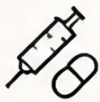

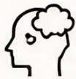






GP assessment: the 5-domain framework
A structured approach to every drug-misusing patient in primary care
1
2
3
4
5
Physical health
Drug use
Psychological
health
Social
circumstances
Criminal justice
• Which drugs, quantity,
frequency
• Injection sites, DVT signs
• DIP (Drug Intervention
Programme)
• Dual diagnosis very
common
• Housing, employment status
• Infections: abscesses,
endocarditis
• Route of administration
• Depression, anxiety,
PTSD, psychosis
• Relationships and family
support
• Court orders, probation, bail
• Withdrawal and overdose
history
• BBV status (Hep B, C, HIV)
• Drug Rehabilitation
Requirement
• Children in household →
safeguarding
• Safeguarding awareness
• Nutrition, dental health, BMI
• Previous treatment
episodes
• Risk of self-harm or suicide
• Treat as any other patient
• Social isolation or exclusion
Pitfall
SCA
Don't focus only on the drug history. Physical
complications and safeguarding are frequently
missed in real consultations.
In the SCA, always explore all five domains — even briefly.
Missing social circumstances or safeguarding signals a
failure to think holistically.
Confirm with: history + examination (injection sites, pupils, withdrawal signs) + urine drug screen + LFTs, FBC, hepatitis/HIV serology
www.bradfordvts.co.uk

Slide 15
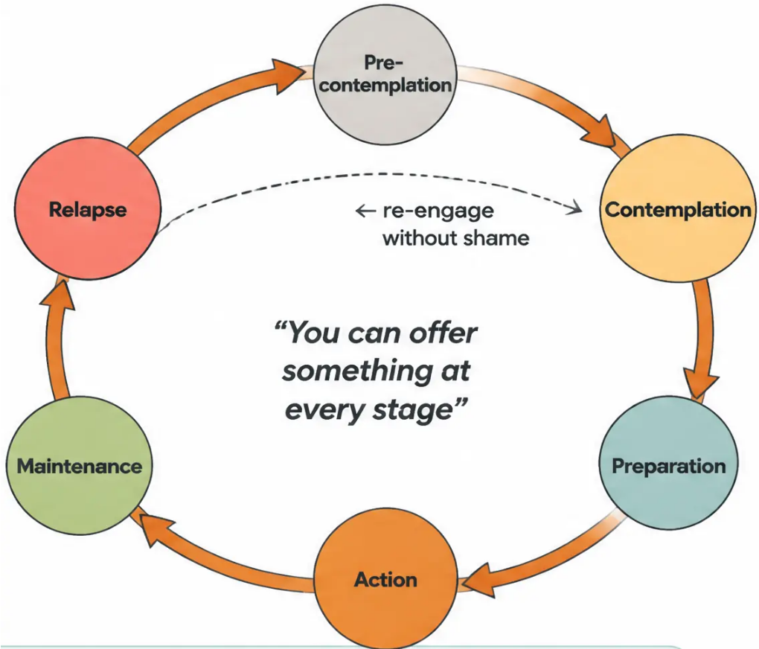


Motivational interviewing and the cycle of change
Prochaska & DiClemente — offer something at every stage
Pre-contemplation – Build rapport ·
harm reduction · no pressure
Contemplation – Explore ambivalence ·
motivational interviewing
Preparation – Agree a plan ·
referral · set a quit date
Action – Substitute prescribing ·
structured support
Maintenance – Monitor · prevent
relapse · celebrate progress
SCA tip
Relapse – Normalise · re-engage ·
no shame
“Part of you wants to change, and part of you isn’t sure yet —
that’s really common.”
Use open questions. Meet the patient where they are.
www.bradfordvts.co.uk

Slide 16











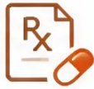


Aims of treatment in primary care
What are we actually trying to achieve?
Reduce harm
Improve quality of life
Reduce drug-related deaths
Physical, psychological, and social —
for the patient, their family, and the
wider community.
Better health, relationships, housing,
and daily functioning — not just
abstinence.
The UK loses over 5,000 lives per
year to drug-related causes — most
are preventable.
Reduce crime and disorder
Support social reintegration
Provide appropriate treatment
Stable prescribing and treatment
reduce acquisitive crime driven
by dependence.
Housing, employment, family
reconnection — recovery is social,
not just medical.
Substitute prescribing, detox, or
referral — matched to the individual's
readiness and risk.
Green — safe to manage in primary care
Most patients with drug dependence can be assessed, counselled, and harm-reduced in general practice.
You do not need to do everything — doing something is always better than nothing.
www.bradfordvts.co.uk

Slide 17



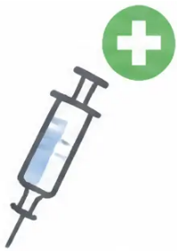
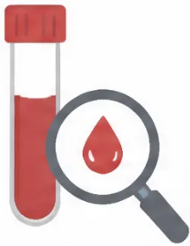
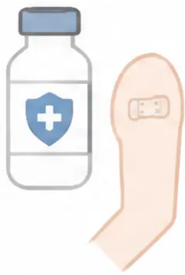



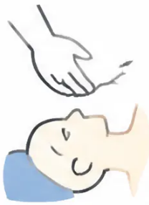


Harm reduction interventions
Practical measures that save lives — abstinence is not required
Needle & syringe
programme.
Vaccination.
Hep C screening.
Offer hepatitis B course
to all injecting drug users.
Also offer hepatitis A and
tetanus. Check and
complete immunisation
history.
Test all current and past
injecting drug users.
Direct-acting antivirals
(DAAs) now cure Hep C.
Refer to hepatology or
specialist service.
Free sterile equipment.
Reduces hepatitis B, C and
HIV transmission. Available
at pharmacies and drop-in
services.
Safer use advice.
Overdose prevention.
✅ Green — safe to start
in primary care
Don't use alone. Smoke rather
than inject where possible.
Don't share needles, spoons,
or filters. Use a smaller
amount after any break.
Basic resuscitation training for
patients and carers. Recovery
position. When to call 999.
Naloxone kit supply and
training.
All of these interventions can be
initiated by the GP without specialist
referral. Harm reduction does not
require the patient to be ready to
stop using drugs.
www.bradfordvts.co.uk

Slide 18








Take-home naloxone update
2024 legislation change · Critical AKT and clinical knowledge
NEW — December 2024: Community pharmacies can now supply take-home naloxone WITHOUT a prescription
Available to people at risk of opioid overdose and their family members or carers · No GP prescription required
How to use it
What GPs must know
• Route: Intramuscular (IM) or subcutaneous (SC) injection
• Any GP can prescribe naloxone on a standard FP10
• Community pharmacies supply via Patient Group Directions
(PGDs) — no prescription needed since December 2024
• Dose: 400 micrograms — always micrograms, never milligrams
• Repeat: Every 2–3 minutes if no response
• Half-life is very short: 30–90 minutes
• Nasal spray options: Nyxoid 1.8 mg · Prenoxad 1 mg/ml
• Most opioids last longer than naloxone — patient may re-narcotise
• Always call 999 — do not rely on naloxone alone
• Always send to hospital even if patient wakes up
• Offer naloxone kit to patient and their family/carers
PITFALL — Common error in older sources:
“400 mg” is written in some old materials. This is
dangerously wrong.
The correct dose is 400 micrograms (mcg) —
one thousand times smaller.
AKT FOCUS:
Take-home naloxone is available from community pharmacy
without prescription since December 2024. Dose = 400 micrograms IM.
Half-life = 30–90 min. Always call 999.
If a patient is unresponsive with pinpoint pupils and slow breathing — this is opioid overdose until
proven otherwise. Give naloxone. Call 999. Do not leave them alone.
www.bradfordvts.co.uk

Slide 19










Principles of substitute prescribing
Opioid substitution therapy (OST) — when, why, and how to start
Who qualifies for OST?
Confirmed opioid dependence (ICD-10 / DSM-5 criteria)
At least 6 months of regular problematic use (usually)
High-risk behaviour — injecting, sharing, overdose history
Patient has requested treatment and is willing to engage
Refer to specialist if: psychotic features, serious psychiatric comorbidity, under 18, or pregnancy
What are we trying to achieve?
Stabilisation
Maintenance
Detoxification
● AKT focus
Reduce illicit use · reduce
harm · reduce crime
Long-term stability ·
address social factors
Structured dose reduction → abstinence
(when patient is ready)
First-line OST: methadone OR
buprenorphine equally recommended
(NICE TA114 · Orange Book Dec 2024)
Before starting — confirm all of these:
☐ Identify most suitable programme: maintenance vs detox
Supervised consumption: minimum
3 months after initiation
☐ Agree psychosocial therapy alongside prescribing
☐ Document care plan and conditions for stopping
Prescribe on FP10MDA
(blue instalment form)
☐ Nominate a pharmacy — discuss supervised consumption
www.bradfordvts.co.uk

Slide 20

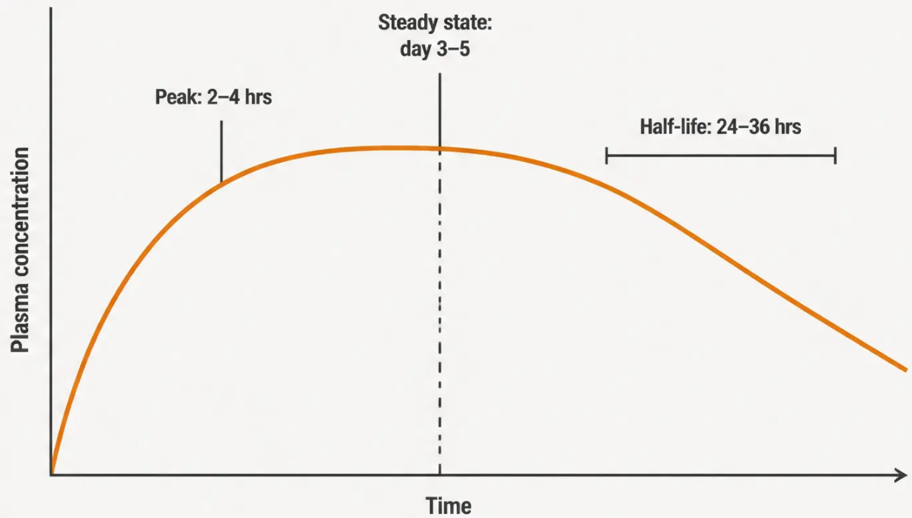




Section 6 • Substitute Prescribing
Methadone: clinical facts
What is it?
• Synthetic opioid – full mu-receptor agonist
• Oral mixture: 1 mg per 1 ml (green, blue, or clear liquid)
• Class A, Schedule 2 controlled drug
Pharmacokinetics
• Long half-life: 24–36 hours (range 15–55 hours)
• Absorbed within 30 minutes; peak at 2–4 hours
• Takes 3–5 days to reach steady state – do not rush dose increases
Advantages
• Once-daily dosing – supports routine and stability
• Reduces cravings effectively at optimal doses
• Strong evidence base: reduces illicit heroin use and crime
• Retains patients in treatment – reduces mortality
Disadvantages
• Narrow therapeutic window – overdose risk at initiation
Methadone accumulates slowly – this is why dose increases must be spaced apart
• QTc prolongation – ECG required at baseline; avoid with other
QTc-prolonging drugs
• Sedating – especially early in treatment
Common Pitfall
• Difficult withdrawal compared to buprenorphine
• Diversion risk if not supervised
Methadone accumulates over days. Increasing the dose too
quickly before steady state is reached is a leading cause of
fatal overdose. Wait at least 5–7 days between significant
dose increases.
AKT Focus
Initiation dose: 10–30 mg daily. Titrate in steps of
5–10 mg. Do not exceed 30–40 mg on day 1.
Optimal maintenance: 60–120 mg/day.
Prescribe on FP10MDA.
www.bradfordvts.co.uk

Slide 21
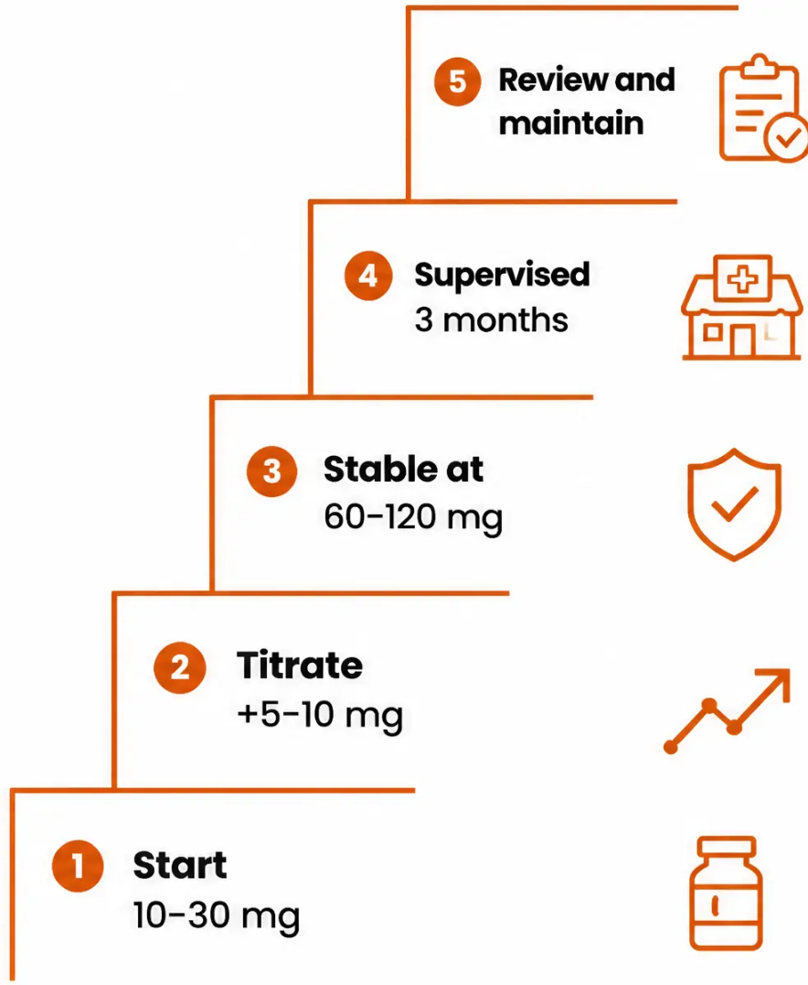








Methadone prescribing and dosing
BNF 2024/2025 • Orange Book December 2024
AKT
Starting dose
• Begin at 10-30 mg daily — based on history and observed withdrawal signs
• Never exceed 30-40 mg on day one without supervised titration
• Do not exceed 80 mg without specialist review at initiation
• Review after 3-7 days — steady state takes 5-7 days to reach
Titration
• Increase in steps of 5-10 mg at a time
• Allow adequate time between increases — do not rush
• Optimal maintenance dose: 60-120 mg/day (higher doses most
effectively suppress illicit heroin use)
• Reassess at each review: withdrawal signs, illicit drug use, patient wellbeing
Pitfall
Supervised consumption — do not skip this step
• Minimum 3 months of daily supervised consumption at a nominated pharmacy
• Supervision can be reduced gradually when patient is stable — not before
• Prescribe "to be consumed under pharmacist's supervision"
• Nominate one pharmacy only
AKT
FP10MDA — instalment prescribing form (blue form)
• Handwritten in indelible ink — name, address, date, drug, form, strength
• Dose written can words AND figures
• Total quantity in words AND figures
• Specify dispensing frequency: e.g. "daily, Saturday's supply for Sunday"
• Period: up to 14 days per prescription
www.bradfordvts.co.uk

Slide 22
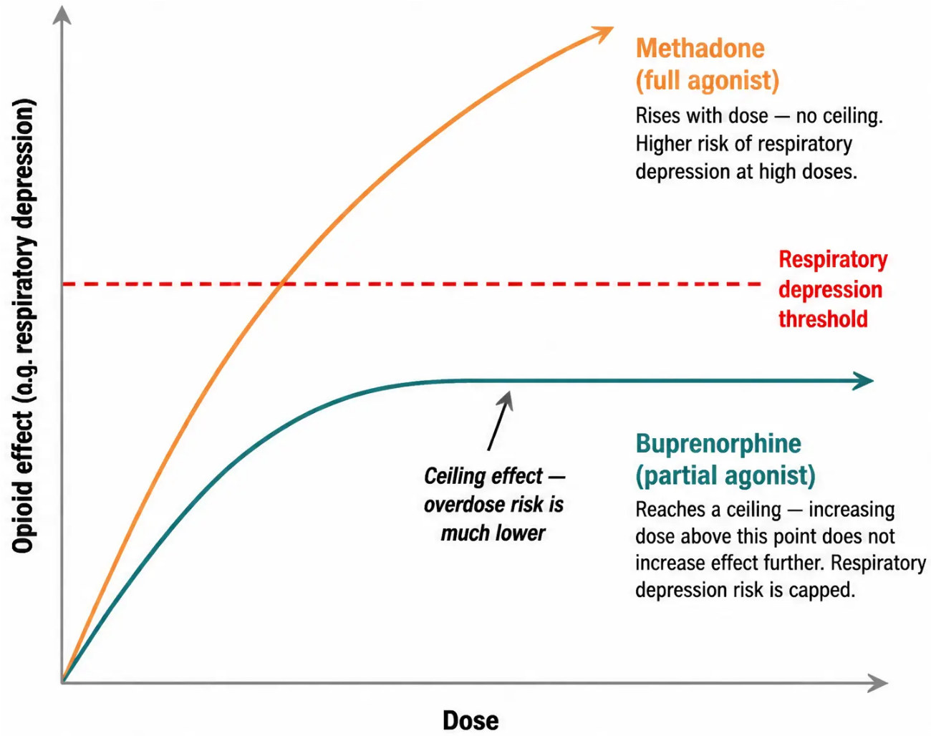




Buprenorphine: clinical facts
Partial agonist · Safer in overdose · Sublingual and long-acting options
The ceiling effect — why buprenorphine is safer
Receptor action
Partial mu-receptor agonist and kappa antagonist. High receptor
affinity — it binds tightly and can displace methadone, potentially
precipitating withdrawal if given too soon.
Forms available
• Subutex — sublingual tablets (buprenorphine only)
• Suboxone — sublingual film (buprenorphine + naloxone;
reduces IV misuse risk)
• Buvidal — long-acting subcutaneous/IM injection; weekly or
monthly; available in UK since 2019
Dosing (BNF 2024/2025)
Initial dose: 0.8–4 mg sublingually on day 1 — only after withdrawal
signs appear (COWS ≥ 8).
Titrate over days 1–7.
Usual maintenance: 8–24 mg/day sublingually.
Supervised consumption required for at least first 3 months.
When to start
Wait at least 12–24 hours after last heroin use, or 24–48 hours after
last methadone dose. Do not give until the patient is in moderate
withdrawal — starting too early causes precipitated withdrawal,
which is severe and distressing.
AKT focus
Buprenorphine must NOT be given until COWS ≥ 8 or moderate withdrawal is
present. Starting too early precipitates severe withdrawal. Initial dose: 0.8–4 mg
SL. Maintenance: 8–24 mg/day. Buvidal (long-acting injection) is weekly or
monthly IM — confirmed first-line option in December 2024 Orange Book update.
SCA focus
A patient asks: "Will buprenorphine make me high?" You can explain: "It works
differently to heroin — it partially activates the same receptors, which means it
reduces cravings and withdrawal without giving the same high. And because of
how it works, it's much safer if you accidentally take too much."
www.bradfordvts.co.uk

Slide 23









Methadone vs buprenorphine
Both are first-line options
Per NICE TA114 and the December 2024 Orange Book
update — choice is based on patient preference,
clinical history, and risk profile.
Comparison of receptor action, safety, and side effects
Methadone
Buprenorphine
Full mu-receptor agonist · Class A · Schedule 2
Partial mu-agonist · Class C · Schedule 3 (Subutex/Suboxone/Buvidal)
Overdose safety
Lower — narrow therapeutic window
Overdose safety
Higher — ceiling effect limits respiratory depression
Sedation
More sedating
Sedation
Less sedating
Drug interactions
More (CYP3A4 pathway)
Drug interactions
Fewer
QTc prolongation
Yes — ECG required at initiation
QTc prolongation
No
Withdrawal difficulty
More difficult
Withdrawal difficulty
Easier to taper
IV misuse risk
Higher (oral liquid — divertible)
Lower (Suboxone film reduces this further)
IV misuse risk
Not available
Long-acting injection
Yes — Buvidal (weekly or monthly IM)
Long-acting injection
Ideal when
Patient prefers once-daily liquid;
high illicit heroin use; needs strong
cravings suppression
Ideal when
Overdose risk is high; patient requests it;
safer option needed; Buvidal for adherence
Wait for COWS ≥ 8 before first dose — precipitated
withdawal if given too early
Never exceed 30–40 mg on day 1 without supervised titration
AKT key fact
Both prescribed on FP10MDA · Supervised consumption required for minimum 3 months ·
Buvidal (long-acting buprenorphine injection) confirmed as standard option — December 2024 Orange Book
www.bradfordvts.co.uk

Slide 24

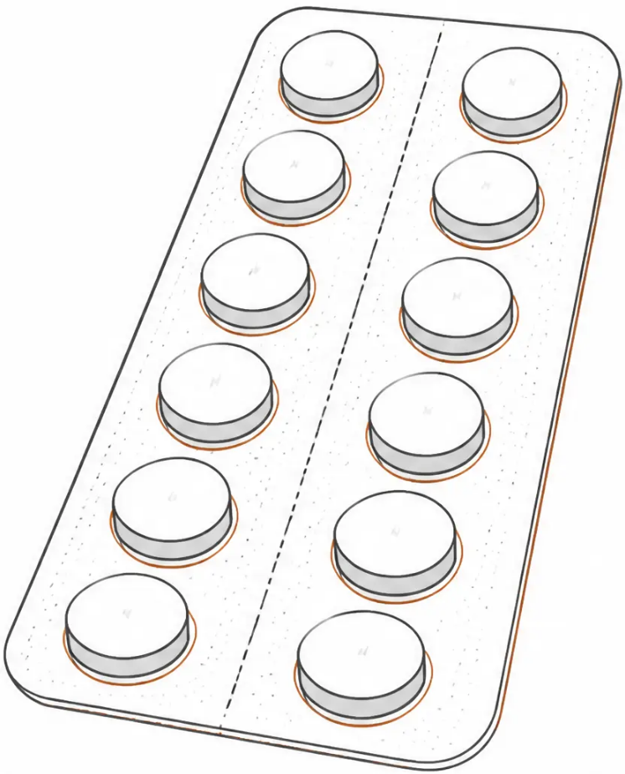











Substitute prescribing — second-line options
Dihydrocodeine
What is it for?
Low-level opioid dependence — not suitable for high-dependency patients
Short, rapid detox — useful as a bridge while awaiting methadone initiation
Clinical facts
• Class B controlled drug, Schedule 2 (requires FP10MDA)
• Less potent than methadone — not first-line (NICE TA114 recommends
methadone or buprenorphine first)
• Equivalent dose: approximately 1 mg methadone ≈ 2.5–3 × 30 mg DHC tablets
• Maximum dose: 120 mg three times daily (360 mg/day)
⚠ Common mistake
Old protocols incorrectly used a 1:1 ratio for DHC-to-methadone conversion.
This is wrong and potentially dangerous. Use the correct equivalence:
1 mg methadone ≈ 2.5–3 × 30 mg DHC tablets.
🚨 Diversion risk
DHC tablets are easily diverted. Use with caution. Supervised consumption is
strongly recommended. Not appropriate for patients with complex or chaotic polydrug use.
✓ When it works well
Short detox in genuinely low-level dependence. Bridge prescribing while specialist
referral is arranged. Motivated patient with good social support and no complex comorbidities.
🎓 AKT focus
*Second-line only — use methadone
or buprenorphine first
DHC is NOT first-line. NICE TA114 recommends methadone or buprenorphine first. DHC max dose =
360 mg/day. Prescribe on FP10MDA. Correct conversion: 1 mg methadone ≈ 2.5–3 × 30 mg DHC tablets
(not 1:1).
www.bradfordvts.co.uk

Slide 25
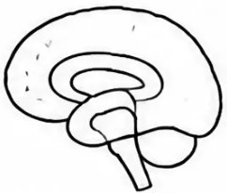
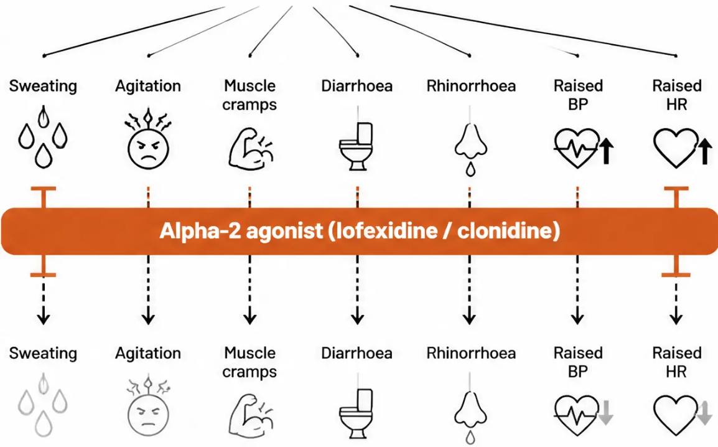
















Lofexidine and clonidine
Opioid withdrawal —
noradrenergic overactivity
Alpha-2 adrenergic agonists for opioid withdrawal symptom relief
Alpha-2 agonists reduce the noradrenergic "storm" that drives
opioid withdrawal symptoms — sweating, agitation, muscle cramps,
diarrhoea, and runny nose.
Sympathetic overdrive
Lofexidine (BritLofex)
Clonidine
Status: NICE-approved for
opioid withdrawal symptom
management
Status: Used off-label for
opioid withdrawal
Route: Oral tablets
Route: Oral tablets
Duration of use: Typically
7–10 days during
withdrawal/detox phase
Duration of use: Typically
7–10 days
Key side effect: Significant
hypotension risk — monitor
BP closely; more pronounced
than lofexidine
Key side effect: Hypotension —
monitor blood pressure; less
severe than clonidine
Key point: Does NOT prevent
opioid craving — purely
symptomatic relief
Key point: Not licensed for this
indication in UK — off-label
use only
Pitfall: These drugs treat the symptoms of withdrawal — not the
addiction. They are adjuncts, not substitutes. Do not use instead of
methadone or buprenorphine in opioid-dependent patients who need
maintenance therapy.
AKT focus: Lofexidine is NICE-approved for opioid withdrawal
symptoms. Clonidine is off-label. Neither is a substitute therapy —
they do not address craving or dependence. Monitor BP with both.
Duration: 7–10 days.
www.bradfordvts.co.uk

Slide 26

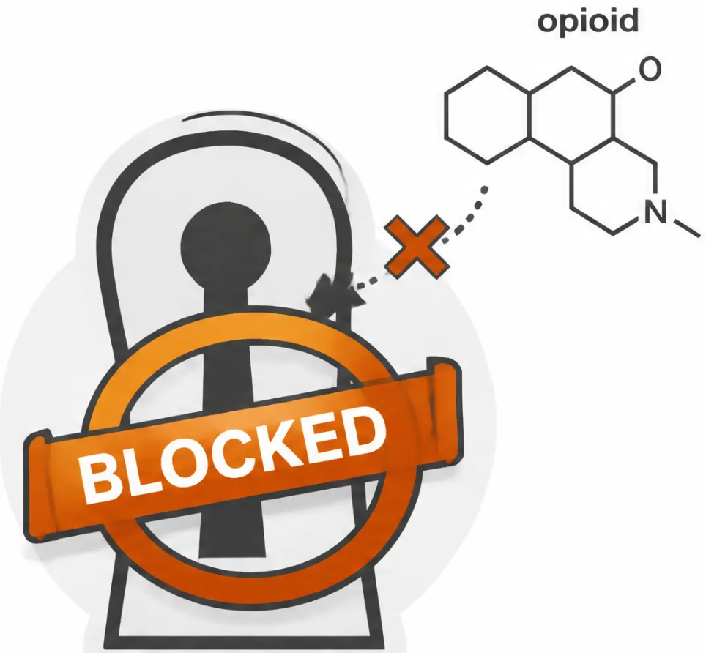















Relapse prevention · Section 18
Naltrexone for relapse prevention
Naltrexone is a full opioid antagonist — it blocks opioid receptors completely.
It does not produce euphoria or relieve cravings. It works by making
opioids ineffective if the patient relapses.
MECHANISM
Full mu-receptor blockade. If opioids are taken,
no effect is felt. Removes the reward of relapse.
FORMULATIONS
• Oral tablet: 50 mg daily
• Subcutaneous implant: ~3-month duration
(available privately)
PATIENT SELECTION
Highly motivated patients. Those completing
structured abstinence programmes. Less evidence
for retention than substitute prescribing.
AKT EXAM FOCUS
Patient must be opioid-free for 7–10 days before starting naltrexone.
Confirm with urine drug screen ± naloxone challenge test.
Starting too early causes precipitated withdrawal — severe and distressing.
Also licensed for alcohol dependence (NICE TA115).
opioid receptor
COMMON PITFALL
Naltrexone occupies receptors —
opioids cannot bind
Do not confuse naltrexone (antagonist — relapse prevention) with naloxone
(antagonist — overdose reversal). Different drugs, different roles, different
routes and doses.
www.bradfordvts.co.uk

Slide 27




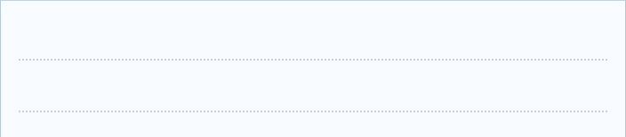





















Writing controlled drug
prescriptions
FP10MDA
Example only –
not for clinical use
Instalment Prescription for
Controlled Drugs
1. Patient name and full address
Patient's name
and address
Mr J. Smith
— mandatory
FP10MDA – the instalment prescribing
form for controlled drugs
12 Example Street, Bradford
2. Date of prescribing
Date
— indelible ink only
22 May 2026
AKT exam focus
Drug (name, form
and strength)
3. Drug name, form, and strength
— full specification
Methadone mixture DTF 1mg/1ml
FP10MDA is the blue instalment form
used for Schedule 2 and 3 CDs –
including methadone and
buprenorphine. Every requirement
below is legally mandated and
examinable.
Dose (in words
and figures)
4. Dose in words AND figures
Forty milligrams (40mg) daily
— both required by law
Total quantity
to be supplied
(in words and figures)
Two hundred and eighty
milligrams (280mg)
5. Total quantity in words AND figures
— both required
Dispensing
frequency
To be dispensed daily
6. Dispensing frequency
Common mistake
Saturday's supply
for Sunday
— daily / alternate days specified
Saturday's supply for Sunday
Forgetting to write the dose in both
words and figures is the most common
FP10MDA error. The prescription is
legally invalid without both.
7. Saturday’s supply for Sunday
Supervised
consumption
instruction
To be consumed under
pharmacist's supervision
— must be stated explicitly
8. Supervised consumption instruction
Photocopies and carbon copies are
not permitted – every prescription
must be individually handwritten
and signed.
Signature of prescriber
(Indelible ink)
— for first 3 months minimum
Dr A. Ahmed
9. Prescriber signature
— handwritten, indelible ink;
no carbon copies
www.bradfordvts.co.uk

Slide 28










Section 10 · Substitute Prescribing
Monitoring substitute prescribing
Urine drug screens
Regular clinical review
Supervised consumption
• Random, not predictable – prevents
gaming the system
• Weekly initially → reducing to
monthly when stable
• Minimum 3 months daily supervised
consumption after initiation
• Test for both prescribed drug AND
illicit substances
• Review withdrawal signs, mental
health, social circumstances
• Reduces diversion risk significantly
• Reduce supervision frequency only
when patient is stable
• At least one result per review
consultation
• Assess housing, employment,
relationships at each visit
• Pharmacist is a key clinical partner –
communicate regularly
• Confirms compliance and detects
concurrent use
• One nominated pharmacy for
all dispensing
• Document any missed doses or
pharmacy concerns
• Review care plan and default
conditions at every appointment
• Document result clearly in notes
AKT focus
Common pitfall
Supervised consumption must continue for a minimum of 3 months
after initiation of substitute prescribing. Prescribe on FP10MDA
(blue instalment form). At least one random urine drug screen
result is required per review consultation. Random screening is
essential — predictable testing is clinically meaningless.
Reducing supervision too early is a frequent error. A patient
appearing stable is not the same as being stable. Diversion risk
remains high in early months. Always confirm stability over time,
not over one or two visits.
www.bradfordvts.co.uk

Slide 29











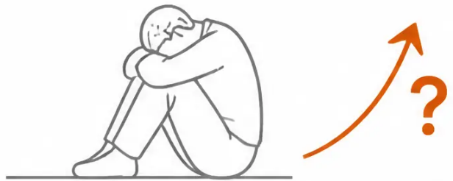




Section 10 · Stimulant drugs
Cocaine and stimulants
No substitute prescribing exists for stimulants — management is psychosocial.
Cocaine (powder)
Snorted, IV, or smoked as crack; intense euphoria, short duration;
cardiac arrhythmia risk; mental health deterioration with chronic use
Crack cocaine
Smoked; extremely short intense high followed by crash and
intense craving; highly addictive; common in polydrug users
Amphetamine / MDMA
Oral, snorted, or IV; psychosis risk with heavy use; MDMA —
hyperthermia and hyponatraemia are the key dangers
⚠ Pitfall — don't reach for a prescription
There is no licensed substitute therapy for cocaine or amphetamine dependence.
Prescribing benzodiazepines or other sedatives under pressure is dangerous and
inappropriate. Psychosocial intervention is the evidence-based approach.
💬 SCA focus — what to offer in the consultation
• Explore the pattern of use and what the patient wants from today
• Offer brief intervention, motivational interviewing, and referral to structured
psychosocial therapy (CBT, community reinforcement approach)
• Address mental health, safeguarding, and harm reduction — even if the
patient is not ready to stop
✅ Safe to manage in primary care
Most cocaine and stimulant use can be managed in primary care with brief
interventions and referral. You do not need specialist prescribing authority to
help these patients.
The stimulant cycle: intense high → rapid crash →
craving → repeat
MDMA harm reduction: Advise temperature regulation, rest breaks, sip fluids
(approximately 500 ml/hour — do not over-hydrate; hyponatraemia is the danger,
not dehydration alone).
www.bradfordvts.co.uk
29 / 38

Slide 30







Section 9 · Specific substances
Cannabis and mental health
Amber — Common mistake
Cannabis is Class B — NOT Class C.
Reclassified in 2009. Many older sources still state Class C — this is wrong.
What is street cannabis today?
Modern street cannabis ("skunk") is high-THC, low-CBD — far more
potent than traditional resin. High THC with little CBD removes the
natural buffering effect on psychosis risk.
Red flag — mental health
• Increases risk of psychosis and schizophrenia — especially with
early onset use, high-potency products, and frequent use
• Linked to anxiety, depression, and paranoia
• Can trigger or worsen existing psychotic illness
• Psychosis risk is dose-dependent and cumulative
Other effects:
Memory and learning impairment · Coordination problems ·
Motivational syndrome with heavy use · Detectable in urine up to
28 days (heavy users)
Green — Primary care management
Purple — AKT focus
• Brief intervention and motivational interviewing
• Cannabis = Class B, Schedule 1 (no medicinal use in standard practice)
• CBT referral for cannabis use disorder
• Urine detection: up to 28 days in heavy users
• Monitor mental health at every review
• Withdrawal is not medically dangerous (unlike alcohol or benzodiazepines)
• Withdrawal: not life-threatening — irritability, sleep disturbance, appetite change
• Medicinal cannabis: specialist-prescribed only (Schedule 2, unlicensed in UK)
• No licensed substitute prescribing exists for cannabis dependence
www.bradfordvts.co.uk

Slide 31












Section 31 of 38 · Special Populations
Drug misuse in special groups
Pregnancy
Dual diagnosis
⚠ RED FLAG — Urgent referral
AKT FOCUS
• Majority of opioid-dependent patients have comorbid
mental illness
• Opioid dependence in pregnancy = obstetric emergency
• Refer urgently to shared care / One Stop Maternity Service
• Methadone or buprenorphine maintenance is safer than
continued heroin use
• Most common: depression, anxiety, PTSD, psychosis
• Treat both conditions simultaneously — do not defer
mental health
• Neonatal abstinence syndrome (NAS) — plan neonatal
care in advance
• Avoid over-prescribing sedatives — high misuse risk
• Breastfeeding permitted if no HIV and no heavy additional
drug use
• Involve specialist psychiatry when psychotic features present
• Integrated care pathways are more effective than
sequential treatment
• Social services safeguarding referral is mandatory
Young people (under 18)
Criminal justice system
⚠ PITFALL — Do not prescribe alone
SCA FOCUS — Non-judgmental care
• Drug Intervention Programme (DIP): targeted support for
drug-misusing offenders
• Refer ALL under-18s to specialist young people's drug services
• Do NOT commence substitute prescribing in general practice
without specialist involvement
• Drug Rehabilitation Requirement (DRR): court-ordered
treatment — GP may receive referrals
• Child safeguarding considerations are paramount — always
consider
• Treat as any other patient — same clinical standards apply
• Parental awareness and consent issues require careful
navigation
• High-risk period: post-prison or post-hospital discharge
(tolerance lost → overdose risk extreme)
• Offer take-home naloxone at every opportunity in this group
• Lower threshold for safeguarding referral in this group
• Coordinate with probation, housing, and addiction services
Post-custody overdose risk: Tolerance drops rapidly during custody. Patients are at highest risk of fatal overdose in the days
immediately after release. Always offer naloxone and safety-netting before discharge from any institution.
www.bradfordvts.co.uk

Slide 32












Referral pathways:
models of care
Tier 4
• Inpatient detox
• Residential rehabilitation
Intensive
specialist
• Specialist inpatient
psychiatric care
Understanding the Tier 1–4 framework –
knowing when to refer
Tier 3
• Community drug treatment teams
• Community detox
Structured
community
treatment
• Structured day programmes
Safe to manage in primary care (Tier 1–2):
• Community prescribing
✓ Harm reduction advice
• Care-planned psychosocial interventions
✓ Naloxone provision
✓ Brief intervention
Tier 2
• Needle and syringe programmes
✓ Signposting and referral
• Drop-in services
Open access
harm
reduction
✓ Monitoring stable substitute prescribing
• Brief interventions
• Advice and information
Refer to Tier 3/4 when:
• Outreach
⚠ Polysubstance dependence
⚠ Serious mental health comorbidity
• GPs
⚠ Under 18 years old
Tier 1
Non-specific
universal
• A&E
⚠ Pregnancy + opioid dependence
• Housing services
⚠ Failed community treatment
• Probation
⚠ Requesting inpatient detox/rehab
• Social services
www.bradfordvts.co.uk

Slide 33







AKT quick recall: prescribing and law
Purple box: key facts for the AKT exam — doses, classifications, legal requirements
● First-line opioid substitutes
● Methadone: initiation dose
Methadone OR buprenorphine — both equally recommended
(NICE TA114 · Orange Book Dec 2024)
Start 10–30 mg daily
Titrate in steps of 5–10 mg
Maintenance: 60–120 mg/day
Do not exceed 30–40 mg on day 1
● Buprenorphine: key rules
● Supervised consumption
Wait for COWS ≥ 8 before first dose
Start 0.8–4 mg sublingually
Maintenance: 8–24 mg/day
Buvidal: weekly or monthly IM injection
Minimum 3 months after initiation
Daily dispensing at nominated pharmacy
Prescribe on FP10MDA (blue instalment form)
● Naloxone: critical dose
● Legal classification — must know
400 micrograms IM — NOT milligrams ⚠️
Repeat every 2–3 minutes if no response
Half-life 30–90 min — shorter than most opioids
Community pharmacy supply without prescription since Dec 2024
Cannabis → Class B (not C – reclassified 2009)
Methadone → Class A, Schedule 2
Ketamine → Class B (reclassified 2014)
Naltrexone: opioid-free for 7–10 days first
LAAM → WITHDRAWN — do not prescribe
www.bradfordvts.co.uk

Slide 34








SCA scenarios and consultation skills
Applying ICE, non-judgmental language, and safety-netting in real consultations
SCA EXAM FOCUS — Consultation skills in drug misuse
ICE framework — suggested phrases
Non-judgmental language
“I’m not here to judge you — I’m here to help keep you as safe as possible.”
Ideas
“It sounds like part of you wants to change, and part of you
isn’t sure yet — that’s really common.”
“What do you think is going on with your drug use?
What do you already know about what you’ve been taking?”
“You’ve clearly thought about this a lot. What would need
to be different for you to feel ready?”
Concerns
“What worries you most about this? Is there anything
specific you’re frightened of?”
Safety-netting
“Please don’t use alone — if something goes wrong, no one
will be there to help.”
Expectations
“If you use again after a gap, your tolerance will be much lower.
Please use a much smaller amount first.”
“What were you hoping we could do together today?
What would a good outcome look like for you?”
“I’d like to give you a naloxone kit today — let me show you
how it works.”
• Appearing judgmental or dismissive of drug use
Common SCA
pitfalls to avoid
• Not asking what the patient actually wants today
• Offering harm reduction only after abstinence is refused —
offer it earlier
• Failing to address safeguarding when children are at home
www.bradfordvts.co.uk

Slide 35












Common pitfalls and mistakes
What catches GP trainees out — and how to avoid it
Prescribing under pressure
Starting methadone too high
Patients in withdrawal can be distressed and
persuasive. Never prescribe temazepam, diazepam,
or additional opioids just to end a difficult
consultation. Document your reasoning clearly.
Initial dose must not exceed 30–40 mg on day one.
Methadone has a long half-life — toxicity builds
over days, not hours. Fatalities have occurred
from overly generous starting doses.
Giving buprenorphine too early
Assuming all drug users want to stop
Starting buprenorphine before the patient is in
moderate withdrawal (COWS ≥ 8) precipitates
severe withdrawal. Always wait — even if the
patient is impatient. This is one of the most
common errors.
Many patients attend for harm reduction, not
abstinence. Pushing abstinence on someone not
ready damages rapport and disengages them
from care. Meet them where they are.
Missing safeguarding
Forgetting tolerance loss after abstinence
Always ask: are there children at home? Drug
dependence is a safeguarding trigger. Failing to
document and act on child protection concerns
is a serious clinical and legal error.
After a period of abstinence — prison, hospital,
detox — tolerance drops sharply. Returning to the
same dose can be fatal. Always warn patients and
offer naloxone at these high-risk moments.
www.bradfordvts.co.uk

Slide 36










Red flags and safety-critical issues
Recognise these presentations — act immediately
Any of the following requires urgent action. Do not defer. Do not manage alone if unsure.
Pregnancy + opioid dependence
Respiratory depression / opioid overdose
RR below 8, pinpoint pupils, unresponsive — opioid
overdose until proven otherwise. Call 999 immediately.
Give naloxone 400 micrograms IM without delay.
Repeat every 2–3 minutes if no response.
Treat as obstetric emergency. Urgent same-day
shared care referral. Continued heroin use is more
dangerous than methadone or buprenorphine
maintenance. Plan for neonatal abstinence syndrome.
Child safeguarding concerns
Acute drug-induced psychosis
Children in the household of a chaotic drug user are at
significant risk. Mandatory referral to children's social
care. Document clearly. Do not delay for parental
consent if child is at immediate risk.
New psychotic symptoms in a drug user — may be drug-
induced (stimulants, cannabis) or unmasked primary
psychosis. Assess urgently. Do not dismiss as "just drugs."
Refer to psychiatric services if symptoms persist or patient is unsafe.
Fever + injection drug use
High-risk period after custody or hospital
Tolerance is lost rapidly. Patients who resume previous
doses after even a short break are at extreme overdose
risk. Always provide take-home naloxone and explicit
safety-netting at these contacts.
Think: endocarditis, septicaemia, DVT, necrotising fasciitis,
epidural abscess. Examine injection sites. Do not normalise
fever in an IVDU. Same-day urgent assessment or emergency
referral if systemically unwell.
● Also urgent: Suicidal ideation during stimulant crash or opioid withdrawal — assess immediately, do not leave
the patient without a safety plan.
www.bradfordvts.co.uk

Slide 37





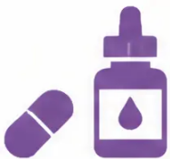







Summary and key takeaways
Recapping assessment · harm reduction · evidence-based prescribing
Assess all 5 domains
Use motivational interviewing
First-line: methadone or
buprenorphine
Drug use, physical health, mental health,
social circumstances, and criminal
justice — every time.
Meet the patient where they are.
Ambivalence is normal. You can offer
something at every stage of change.
Both equally recommended (NICE TA114,
Orange Book 2024). Choice based on
patient preference and risk profile.
Naloxone saves lives
Know the common errors
Primary care can do a lot
400 micrograms IM. Short half-life —
always call 999. Available from community
pharmacy without prescription since
December 2024.
Cannabis is Class B. Naloxone is
micrograms not milligrams. LAAM is
withdrawn. Buprenorphine needs
withdrawal signs before starting.
Harm reduction, prescribing, monitoring,
safeguarding, and referral — GPs are
central to drug treatment in the UK.
www.bradfordvts.co.uk

Slide 38


Disclaimer and guidance
Always double-check this advice and
drug doses with the latest NICE and BNF guidance.
This document is for educational purposes only and does not constitute
clinical advice. Individual patient management should always be guided
by current guidelines, local formulary, and clinical judgement.
Prepared for Bradford VTS • Created May 2026 • Updated to NICE 2024/2025 standards • www.bradfordvts.co.uk
Bradford VTS Teaching Deck
Supporting GP trainees and IMGs across Bradford and beyond.
www.bradfordvts.co.uk

