Slide 1


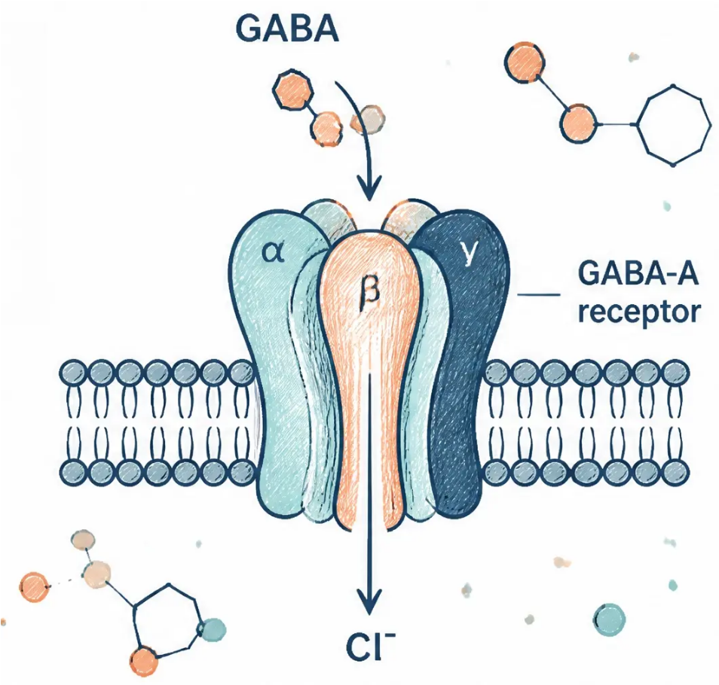
BRADFORD VTS TEACHING DECK
Benzodiazepines & Z-Drugs
prescribing, dependence and withdrawal
Created May 2026 · Updated to current NICE NG215 2022/2025 standards
www.bradfordvts.co.uk
www.bradfordvts.co.uk

Slide 2







Scope of the problem
Benzodiazepine prescribing in the UK
~1.5 million
people in the UK estimated to be long-term benzodiazepine users
Licensed for 2–4
weeks only
Dependence within
2–4 weeks
Older adults:
highest risk
Long-term use beyond
4 weeks is inappropriate
for most patients
Physical and psychological
dependence can develop
rapidly with daily use
Falls, fractures, cognitive
impairment, and increased
mortality in elderly patients
• Many patients were prescribed benzodiazepines decades ago, when long-term prescribing was routine –
these individuals may have been taking them for years or even decades
NICE NG215 (2022): One of 5 medicines identified by NHSE as associated with dependence and withdrawal
www.bradfordvts.co.uk

Slide 3
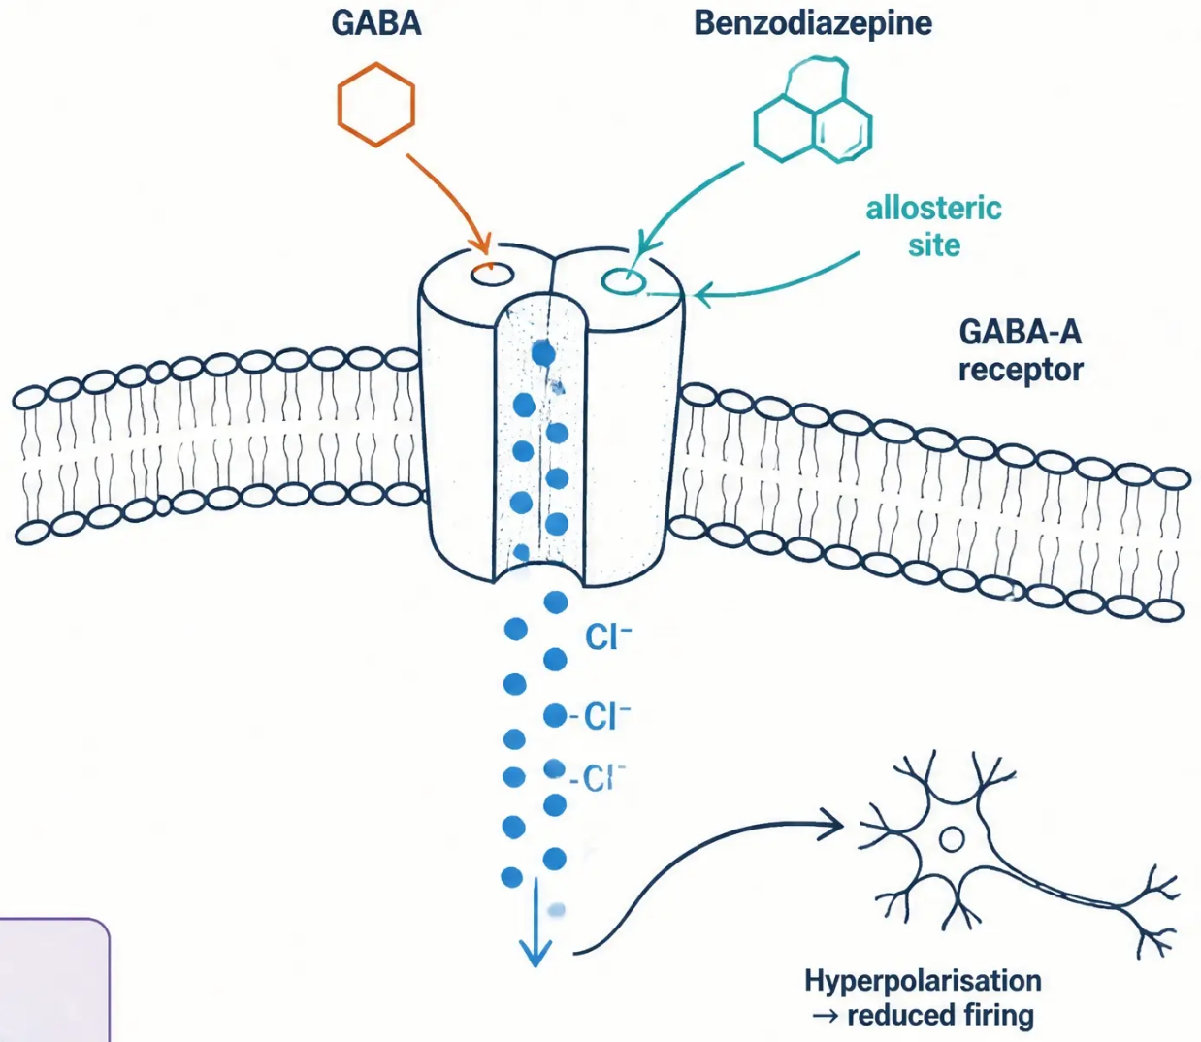















Pharmacology: Mechanism of action
How benzodiazepines work at the GABA-A receptor
Benzodiazepine binds
Benzodiazepine binds to the GABA-A
receptor at a site distinct from GABA
itself (allosteric site).
GABA effect enhanced
The drug enhances — not mimics —
the effect of GABA, increasing the
frequency of chloride ion channel opening.
CNS
depression
Chloride ions flood in
Anxiolytic
Increased chloride influx causes
neuronal hyperpolarisation — the
neuron becomes less likely to fire.
Hypnotic
Anticonvulsant
CNS depression
The net result is CNS depression:
anxiolytic, hypnotic, anticonvulsant,
muscle relaxant, and amnesic effects.
Muscle relaxant
Amnesic
AKT
Benzodiazepines enhance GABA — they do not mimic it.
GABA-A receptor → ↑ Cl⁻ influx → hyperpolarisation →
CNS depression.
www.bradfordvts.co.uk

Slide 4









Classification of benzodiazepines and Z-drugs
Same core pharmacology — different clinical roles
Anxiolytics
Hypnotics
Anticonvulsants
Reduce anxiety and tension
Promote sleep onset and maintenance
Seizure suppression and
epilepsy management
Diazepam
Temazepam
Lorazepam
Nitrazepam
Clonazepam
Alprazolam
Flurazepam
Clobazam
Oxazepam
Loprazolam
Chlordiazepoxide
Lormetazepam
(a)
(h)
(e)
Z-drugs — same mechanism, same risk
Zopiclone · Zolpidem · Zaleplon
Not chemically benzodiazepines — but act on the same GABA-A receptor.
Share the same dependence potential and withdrawal profile.
Treat as benzodiazepines for all clinical purposes.
www.bradfordvts.co.uk

Slide 5





































Benzodiazepine equivalence table
All doses shown are equivalent to 10 mg diazepam
Drug (brand name)
Equivalent dose
Half-life (hrs)
Clinical note
Diazepam (Valium)
10 mg
20–100 h (metabolite 36–200 h)
Long-acting; preferred for withdrawal
Chlordiazepoxide (Librium)
25 mg
Long-acting; used in alcohol withdrawal
5–30 h (metabolite 36–200 h)
Lorazepam (Ativan)
1 mg
10–20 h
Short-acting; high dependence potential
Temazepam (Normison)
20 mg
8–22 h
Short-acting hypnotic; high street value
Nitrazepam (Mogadon)
10 mg
15–38 h
Medium-acting hypnotic
Oxazepam (Serax)
20 mg
4–15 h
Short-acting; lower dependence risk
Alprazolam (Xanax)
0.5 mg
6–12 h
Very potent; high dependence risk
Clonazepam (Rivotril)
0.5 mg
18–50 h
Very potent; UK licensed for epilepsy only
Zopiclone (Zimovane)
15 mg
5–6 h
Z-drug; same dependence profile as benzodiazepines
Zolpidem (Stilnoct)
20 mg
2 h
Z-drug; very short-acting
SCA tip
Pale cream =
Reference
standard
Pale amber =
Caution — high
dependence /
street value
Pale red =
High alert —
very potent
Pale green =
Relatively lower
dependence risk
Pale lavender =
Z-drug
Z-drugs carry the same dependence and
withdrawal risk as benzodiazepines —
counsel patients accordingly
www.bradfordvts.co.uk

Slide 6
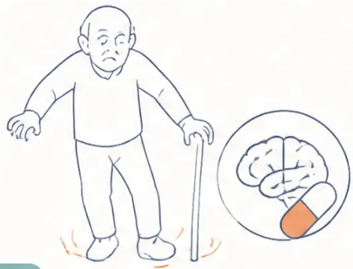


Adverse effects of long-term benzodiazepine use
Psychological and physical harms at a glance
Psychological
Physical
• Drug dependence (physical and psychological)
• Vertigo and dizziness
• Daytime sedation and cognitive impairment
• Dysarthria — slurred speech
• Ataxia → falls → fractures (especially in older adults)
• Memory disruption — anterograde amnesia
• Paradoxical disinhibition — increased anxiety,
hostility, aggression
• Psychomotor impairment — driving risk
• Respiratory depression (especially with
alcohol or opioids)
• REM rebound — vivid nightmares on stopping
• Drug dependence
⚠ Prescribing pitfall
Long-acting benzodiazepines accumulate in older patients — effective half-life may extend to several
days, dramatically increasing fall and fracture risk. Always proactively review elderly patients on
long-term benzodiazepines.
www.bradfordvts.co.uk

Slide 7











Who not to offer withdrawal: Contraindications
Not every patient is ready — and enforced withdrawal will not work
Drug is currently clinically necessary
Current acute crisis or deterioration
Active mental health crisis — not the
right moment to add withdrawal stress
E.g. active epilepsy — do not withdraw
the anticonvulsant cover
Diagnosis of psychosis or dementia
Concurrent alcohol misuse
Cognitive fragility makes safe withdrawal
unreliable and potentially harmful
Combined CNS depressant withdrawal
carries serious seizure risk
Patient does not wish to reduce
Documented refusal must be respected —
enforced withdrawal is not appropriate
PITFALL
Enforcetd withdrawal is not appropriate and will not work. Always explore the patient's
readiness and document their арбоrate before initiating any reduction plan.
www.bradfordvts.co.uk

Slide 8

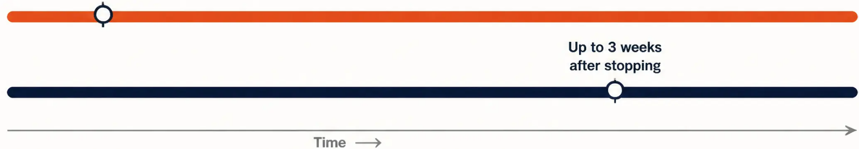



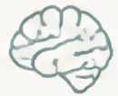






Benzodiazepine withdrawal syndrome: Onset and symptoms
Timing depends on the half-life of the drug
Within a few hours
Short-acting
of stopping
(e.g. lorazepam,
temazepam)
Long-acting
(e.g. diazepam)
COMMON WITHDRAWAL SYMPTOMS
Psychological
PITFALL
• Anxiety and panic attacks
• Insomnia and nightmares
Symptoms wax and wane — patients experience
'windows' of normality that gradually widen.
• Perceptual distortions
Sensory
This is not a sign of relapse.
Warn patients in advance so they are not alarmed.
• Excess sensitivity to light and sound (hyperaesthesia)
• Tinnitus
• Muscle twitching
REASSURING FACT
Physical
Some symptoms can persist for weeks to months
after stopping — but they do resolve.
• Tremor and sweating
• Palpitations
• Nausea, weight loss, abdominal cramps
Gradual tapering significantly reduces severity.
www.bradfordvts.co.uk

Slide 9

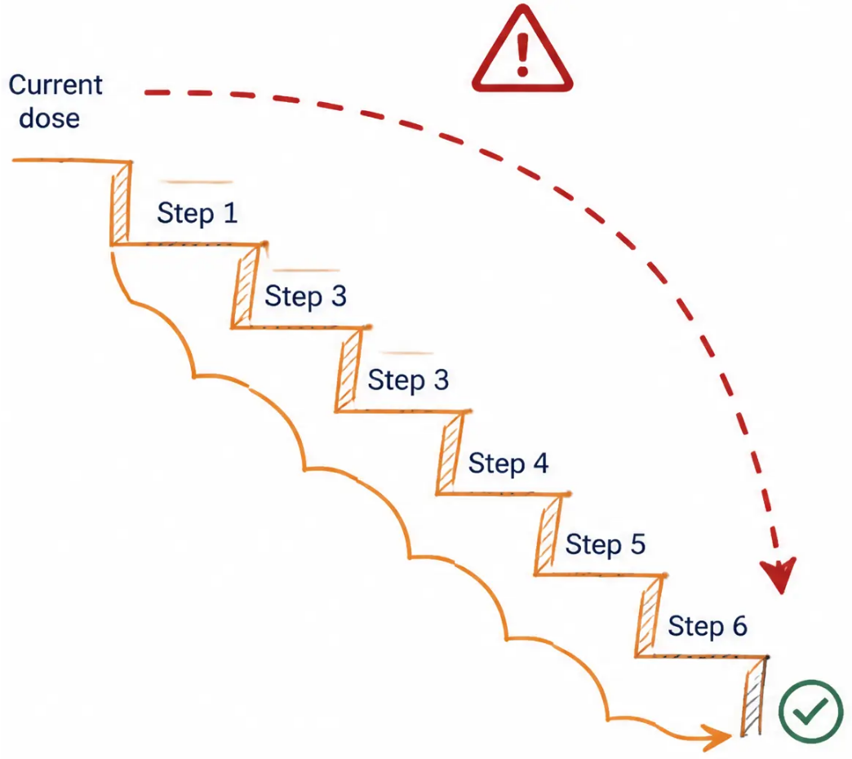




Severe withdrawal risks and key principles
Abrupt cessation can be life-threatening — always taper gradually
Never stop benzodiazepines
abruptly in a long-term user
SEVERE / LIFE-THREATENING WITHDRAWAL FEATURES
• Seizures (convulsions) — potentially fatal; risk is highest with
abrupt cessation of high-dose benzodiazepines
• Toxic psychosis — acute confusion, paranoia, hallucinations
• Delirium — resembles delirium tremens (alcohol withdrawal)
Abrupt withdrawal of a high-dose benzodiazepine can be fatal.
RED FLAG
Abrupt benzodiazepine withdrawal in a long-term user → seizures.
This is a medical emergency. Do not stop suddenly. If a patient
presents having stopped abruptly, treat as urgent.
REASSURING PRINCIPLE
Symptoms wax and wane — patients experience 'windows' of
normality that gradually widen over time. This is a good sign,
not a relapse. Some symptoms may persist for weeks to months —
this is expected and manageable.
Gradual tapering — the only safe route
www.bradfordvts.co.uk

Slide 10





WITHDRAWAL · METHOD 1 OF 3
Self-management
16–60%
Simple advice or a letter — often more effective than expected
of patients stop or substantially reduce
Who it works for:
by self-management alone, when simply asked
• Best suited to low-dose, long-term users
• Not appropriate if the patient is in crisis or on high doses
Reassuring message
What to advise:
“Around 40% stop with no difficulty at all.”
Many patients are simply waiting to be asked.”
• Cut down very gradually — reduce number of tablets slowly
• Halve the last tablet before stopping completely
• No sudden stopping
What to warn about:
• Withdrawal symptoms are temporary — not a sign of relapse or new illness
• Symptoms wax and wane; "windows" of normality gradually widen
• Encourage the patient: most people feel better without the tablets in time
Pitfall
Don't assume patients want to stay on benzodiazepines.
Many haven't been offered a way out. Failing to ask
is a missed opportunity.
www.bradfordvts.co.uk

Slide 11









Withdrawal method 2: Conversion to diazepam
Why diazepam? How to convert?
Convert to equivalent diazepam dose
Use the equivalence table to calculate total daily dose
of diazepam. Prescribe preferably at night.
RATIONALE
Why use diazepam?
Begin gradual dose reduction
• Long half-life (20–100 hrs) –
smoother, more stable blood levels
Reduce slowly — by small increments every 1–2 weeks.
Slower is always better than faster.
• Active metabolite extends effect
further (up to 200 hrs)
Hold or step back if symptoms appear
• No "kick" effect – unlike
short-acting temazepam
If withdrawal symptoms emerge, pause reduction.
Step back up if needed — this is expected, not failure.
• Calming effect lasts up to 24 hours –
once-daily dosing possible
Stop completely when ready
Final stop after very low dose achieved.
Withdrawal may take 6–8 weeks to over a year.
Preferred agent for all
benzodiazepine withdrawal
⚠ Pitfall
Never rush the taper. Reducing too quickly causes
rebound symptoms and loss of patient confidence.
www.bradfordvts.co.uk

Slide 12











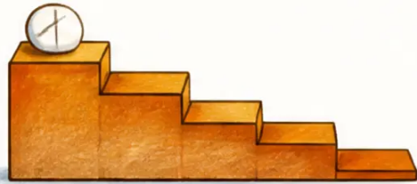
Tapering diazepam and available formulations
Method 2, step 2 — adjusting the rate to the patient
Available formulations
STARTING DOSE ≤ 20 MG
Reduce by 1 mg every 1–2 weeks
Diazepam 2 mg tablets
— standard reduction steps
STARTING DOSE ~40 MG
Diazepam 5 mg tablets
Reduce by 2 mg every 1–2 weeks
— for higher starting doses
Diazepam liquid 2 mg/5 ml
FINAL STAGES — DOSE ≤ 4–5 MG
— 1 ml = 0.4 mg; ideal for very fine
reductions in the final stages
Reduce by 0.5 mg every 1–2 weeks
Slower is always better than faster
If withdrawal symptoms appear —
hold at current dose. Step back up if needed.
Never rush the taper. A reduction that feels
'too slow' is far safer than one that triggers
withdrawal and loses the patient's trust.
www.bradfordvts.co.uk

Slide 13







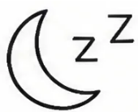
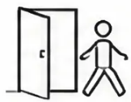
METHOD 3
Anxiety management and support
Psychological and behavioural support during and after withdrawal
Most patients need more than dose reduction alone — address the underlying anxiety, not just the drug.
Sleep hygiene
Panic attacks
Agoraphobia and
social phobia
Depression
• Avoid caffeine and alcohol
near bedtime
• Explain the panic mechanism —
it peaks and passes
• May emerge or worsen during
withdrawal
• Antidepressants only if clinical
depression confirmed
• Controlled breathing exercises
• Regular sleep and wake times
• Usually resolves with sustained
abstinence
• Do not prescribe routinely
during withdrawal
• Panic diary to track triggers
and patterns
• Relaxation techniques before bed
• Reassure: insomnia improves
with abstinence
• Reassure the patient — this
is temporary
• Distinguish withdrawal-related
low mood from MDD
• Anxiety management
programme if needed
• CBT referral if persistent
after stopping
• Psychological support first
SCA
Simple reassurance and sleep hygiene are first-line → escalate to formal CBT-I for
persistent insomnia or CBT for anxiety. Only offer antidepressants if clinical depression is confirmed.
www.bradfordvts.co.uk

Slide 14














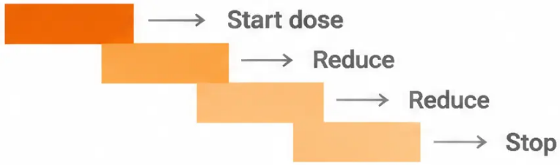

BNF withdrawal protocol
Structured dose reduction for safe benzodiazepine cessation
Reduce by approximately ⅛ of the daily dose every fortnight
Acceptable range: 1/10 to 1/4 per fortnight — individualise to the patient
1
2
3
4
Reduce in fortnightly steps
Switch to smaller steps
Transfer to diazepam
Stop completely
Convert current
benzodiazepine to
equivalent daily dose of
diazepam, preferably
taken at night.
Reduce diazepam by
2–2.5mg every two weeks.
Hold the dose if withdrawal
symptoms appear.
Reduce further in smaller
fortnightly increments for
difficult cases. Slower is
always better than faster.
Full cessation may take
4 weeks to a year or more.
Duration is not a failure —
it is safety.
CBT may help
alongside withdrawal
Beta-blockers only if
other measures fail
Antidepressants: only for
clinical depression or
panic disorder
Avoid antipsychotics —
may worsen withdrawal
symptoms
AKT
BNF: reduce by 1/8 every 2 weeks.
Range: 1/10–1/4. Convert to
diazepam first.
www.bradfordvts.co.uk

Slide 15










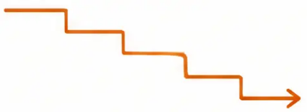






Ashton Manual: Key withdrawal schedules
Individualised, patient-led dose reduction — diazepam substitution is central to all schedules
Schedule 2 — Diazepam taper
Schedule 3 — Lorazepam → diazepam
Schedule 4 — Nitrazepam → diazepam
• Starting dose: Diazepam 40mg
(20mg morning + 20mg night)
• Starting point: Lorazepam 6mg
(≈ diazepam 60mg equivalent)
• Starting point: Nitrazepam 10mg
(≈ diazepam 10mg equivalent)
• Reduction: 2mg every 1–2 weeks
• Process: Gradually substitute
diazepam for lorazepam across the
first 11 stages, then taper diazepam
alone
• Process: Replace with diazepam
10mg at night, then reduce by
1mg every 1–2 weeks
• Duration: ~6–12 months
• Stages: 26
• Stages: 12
• Stages: 36
Key principles of all Ashton schedules
Transfer to diazepam first — long-acting profile
gives smoother, gentler withdrawal
Reduce morning doses before night doses —
preserves sleep as long as possible
Patient sets the pace — schedules are guides,
not rigid rules; never rush
Final stages: consolidate to once-daily bedtime dose;
use liquid diazepam (2mg/5ml) for very fine reductions
www.bradfordvts.co.uk
Page 15 of 22

Slide 16


















Practical prescribing points
What GPs need to know in day-to-day practice
Short-term prescribing only
Prescribe in smaller quantities
Benzodiazepines are licensed for 2–4 weeks maximum. If a
new prescription is needed, document the clinical reason and
planned duration clearly in the notes.
For patients undergoing withdrawal, consider weekly
dispensing to support compliance monitoring and
reduce diversion risk.
Temazepam: prescribe with caution
Avoid long-term lorazepam
High street value. Avoid in patients with drug-seeking
behaviour or history of diversion. Consider safer alternatives.
Short-acting, high dependence potential. Not suitable
for maintenance prescribing — plan a structured review
from the outset.
Never prescribe long-term for insomnia alone
Review all long-term users
Refer to CBT for insomnia (CBT-I) as first-line.
Benzodiazepines mask the problem and create dependence.
Proactively identify patients on repeat benzodiazepines.
Offer structured withdrawal where appropriate under
NICE NG215 (2022).
⚠ Pitfall
✔ Safe practice
Agreeing to repeat prescriptions beyond 4 weeks
without a documented plan is a common SCA failure
point — and a real-world prescribing error.
Document: indication, planned duration, and the
patient's awareness of dependence risk —
every time.
www.bradfordvts.co.uk

Slide 17











NICE NG215 framework for dependence
Medicines associated with dependence or withdrawal symptoms — primary care guidance (2022/2025)
NICE NG215 (2022) is the governing guideline for identifying and supporting patients on long-term benzodiazepines in primary care.
Identify
Review
Support
• Review all patients on long-term
benzodiazepines (>4 weeks)
• Structured medication review for
all long-term users
• Offer structured withdrawal where
appropriate
• ICBs and practices should have
systems to find these patients
• Explore original indication —
is it still valid?
• Provide anxiety management and
psychological support (CBT-I, CBT)
• Flag older adults — highest risk of
falls and cognitive harm
• Never withdraw without patient
agreement
• Assess current benefit vs risk
• Approximately 1.5 million long-term
users in the UK
• Document the review and any
planned changes
• Follow up regularly — withdrawal
takes months, not days
SCA relevance
Pitfall
In the consultation, always explore whether the patient has
been on benzodiazepines long-term. NICE NG215 expects
GPs to proactively raise this — waiting for the patient to
ask is not enough.
Repeating a benzodiazepine prescription beyond 4 weeks
without a documented plan or review is not in line with
NG215 — and is a common SCA fail.
www.bradfordvts.co.uk

Slide 18


AKT quick recall: Key facts
High-yield facts for the Applied Knowledge Test
AKT
Pharmacology
Equivalence anchors
Withdrawal essentials
• GABA-A receptor enhancement → ↑ chloride
influx → neuronal hyperpolarisation → CNS
depression
• Anchor: diazepam 10mg = the reference dose
• NEVER stop abruptly in a long-term user →
seizures, psychosis, delirium — potentially fatal
• Lorazepam 1mg ≡ 10mg diazepam — short-
acting, high dependence risk
• Short-acting (lorazepam, temazepam):
withdrawal onset within hours of stopping
• All benzodiazepines share the same core
effects: anxiolytic, hypnotic, anticonvulsant,
muscle relaxant, amnesic
• Temazepam 20mg ≡ 10mg diazepam — high
street value
• Long-acting (diazepam): withdrawal onset
up to 3 weeks after stopping
• Z-drugs (zopiclone, zolpidem, zaleplon) —
same mechanism and withdrawal profile as
benzodiazepines
• Nitrazepam 10mg ≡ 10mg diazepam
• BNF taper: reduce by 1/8 of dose every 2 weeks
• Chlordiazepoxide 25mg ≡ 10mg diazepam
• Convert to diazepam first — long half-life =
smoother withdrawal
• Alprazolam 0.5mg ≡ 10mg diazepam —
very potent
• Licensed for short-term use only: 2–4 weeks
maximum
• Avoid antipsychotics during withdrawal —
worsens symptoms
• Clonazepam 0.5mg ≡ 10mg diazepam —
UK: epilepsy only
• Dependence can develop within 2–4 weeks
of daily use
• Beta-blockers: only if other measures fail
• Zopiclone 15mg ≡ 10mg diazepam (Z-drug)
• Governing guidance: NICE NG215 (2022)
www.bradfordvts.co.uk

Slide 19


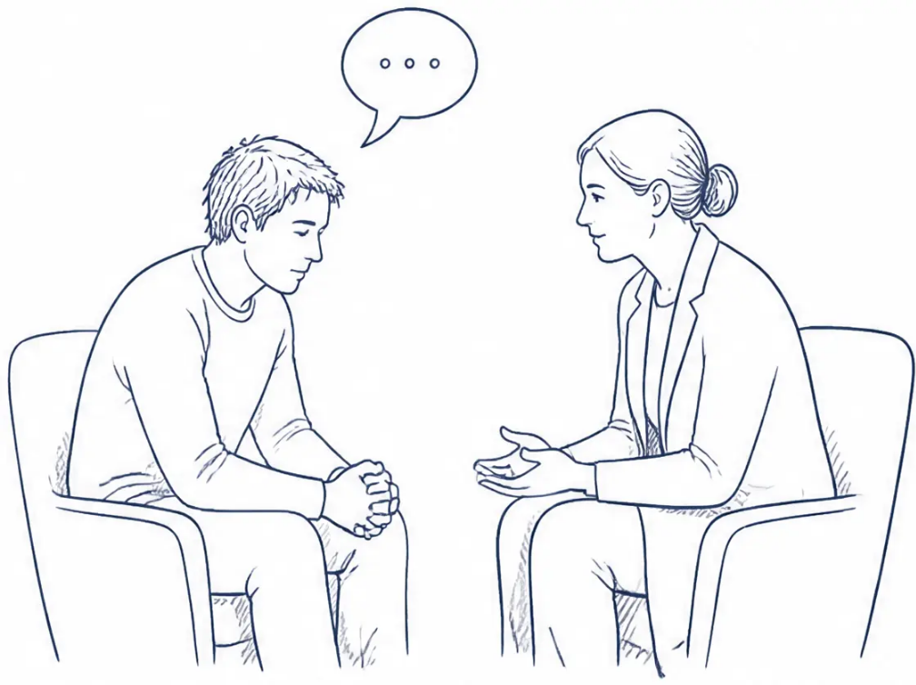

SCA consultation skills: Exploring concerns
Communication strategies for long-term benzodiazepine use
SCA
These phrases support patient-centred exploration of long-term benzodiazepine use and readiness to change.
Opening
“You’ve been taking this for a long time –
how do you feel about it?”
Framing
“I’d like to talk with you about these tablets, if that’s OK.
Some people find they’re harder to stop than they expected.”
History
“Have you ever tried reducing or stopping?
What happened?”
www.bradfordvts.co.uk

Slide 20










SCA consultation skills: Motivation and safety-netting
What to say — and how to say it
SCA Skills
Motivating change
Safety-netting
“A lot of people are surprised to find they actually
feel better without them — particularly their
sleep and memory.”
“Please don't stop suddenly — it can be
dangerous. Always come and talk to us first.”
“We can take this at whatever pace suits you.
There's no rush.”
“If you feel very anxious, can't sleep, or feel like
you're shaking, come and see us. That's
completely manageable — we'll slow things down.”
“Many people who've been on these for years
have told me stopping was one of the best
things they did.”
“We'll keep a close eye on you throughout.
This is a team effort.”
Pitfall
Agreeing to repeat benzodiazepine prescriptions beyond four weeks without
a clear reduction plan is a common SCA fail — always address it proactively.
www.bradfordvts.co.uk

Slide 21










Red flags and prescribing pitfalls
Situations requiring urgent action or careful clinical judgement
RED FLAGS
PRESCRIBING PITFALLS
Abrupt withdrawal → seizures
Repeat prescribing without a plan
Stopping long-term benzodiazepines suddenly can cause
life-threatening seizures or delirium — always taper.
Agreeing to repeat benzodiazepine prescriptions beyond
4 weeks without a documented tapering plan is a common
SCA pitfall.
Elderly patient + benzodiazepine → falls
Not exploring the original reason
Increased fall and hip fracture risk in older adults —
proactively review all long-term users.
Always ask why the benzodiazepine was first prescribed —
the underlying condition may still need addressing.
Benzodiazepine + alcohol
Ignoring temazepam diversion risk
Dangerous CNS and respiratory depression —
this combination can be fatal.
Temazepam has high street value — prescribe with caution
and consider safer alternatives in patients with drug-seeking
behaviour.
Benzodiazepine + opioid
High-dose benzo without clear indication
Potentially fatal respiratory depression — document
MHRA warning discussed with patient; prescribe with
extreme caution.
Urgent medication review needed — high-dose long-term
prescribing without documented rationale is a patient
safety concern.
www.bradfordvts.co.uk

Slide 22



Disclaimer and guidance notice
Bradford VTS Teaching Deck — Benzodiazepines
Always double-check this advice and drug doses
with the latest NICE and BNF guidance before applying
to clinical practice.
This document is for educational purposes only.
Prepared for GP trainees (ST1–ST3) and IMGs by Bradford VTS.
Updated to NICE NG215 2022/2025 standards · Created May 2026
www.bradfordvts.co.uk
www.bradfordvts.co.uk

