Slide 1

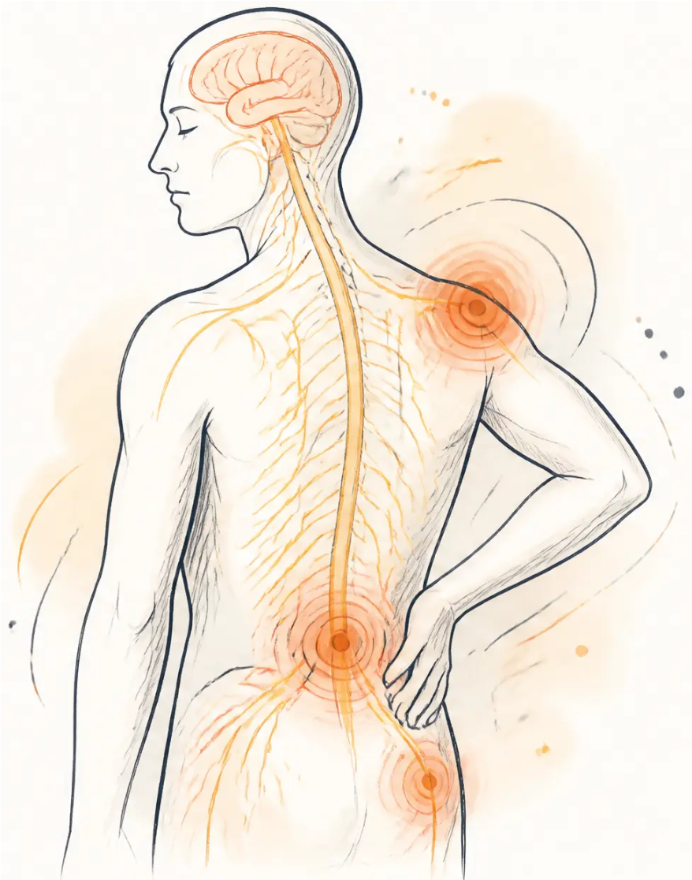

BRADFORD VTS TEACHING DECK
GP Training Resource · Bradford VTS
Opioids in primary care
From heroin to pain management
Created May 2026
Updated to current NICE 2024/2025 standards
www.bradfordvts.co.uk
www.bradfordvts.co.uk
For GP Trainees (ST1–ST3) and IMGs

Slide 2

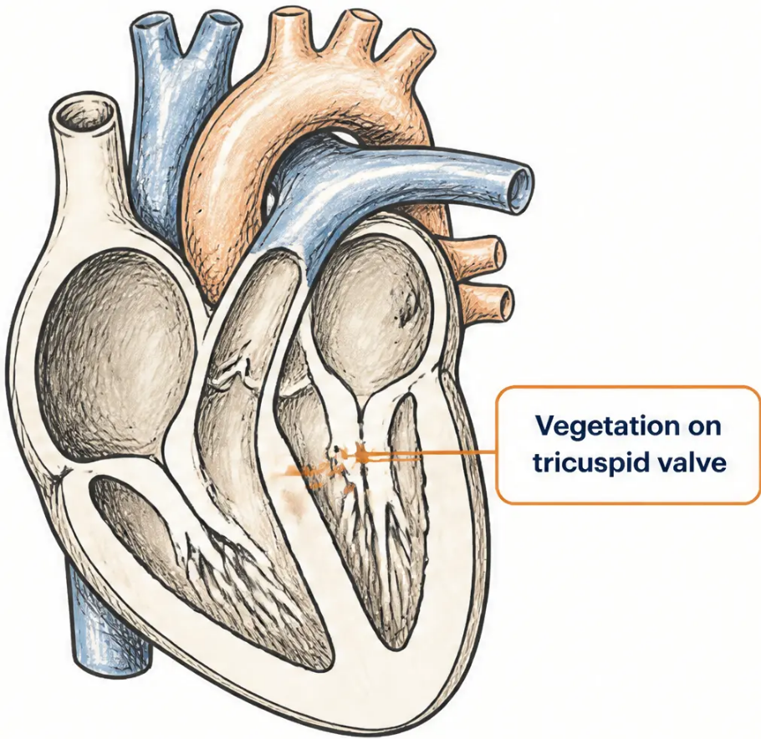



Case study · Section 1
Case study: Jennifer
The clinical impact of missed addiction
Jennifer, 17 years old
Admitted to A&E with one week of fevers and three days of haemoptysis.
Temperature 40°C on examination.
Blood cultures: Staphylococcus aureus — both bottles positive.
Echo: vegetation on the tricuspid valve.
Diagnosis: Infective endocarditis with septic emboli
What was missed
Jennifer kept leaving the ward and returning. Her IV heroin use
was not identified. Withdrawal was not managed. She was unable
to stay for treatment.
🚩 RED FLAG
✦ KEY LESSON
“We failed to address her addiction and withdrawal —
so we failed to treat her acute medical problem.”
Fever + IV drug use → suspect endocarditis,
septicaemia, DVT, or pneumonia.
Admit urgently. Blood cultures and echo.
Right-sided endocarditis + fever in any patient →
always ask about IV drug use.
www.bradfordvts.co.uk
Slide 2 of 24

Slide 3



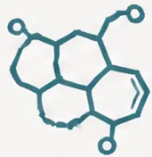















Pharmacology fundamentals
Definitions: Opiates, opioids, and receptors
OPIATE
OPIOID
Derived directly from the opium poppy
Any compound whose effects are
stereospecifically antagonised by naloxone —
natural opiates AND synthetic drugs
(Papaver somniferum)
e.g. morphine, codeine, heroin
(diacetylmorphine)
e.g. methadone, fentanyl, tramadol,
buprenorphine, pethidine
Endogenous opioids: endorphins, enkephalins, dynorphins —
the body’s own pain modulators
Mu (μ)
Kappa (κ)
Delta (δ)
• Analgesia
• Analgesia
• Analgesia
• Euphoria
• Sedation
• Mood modulation
• Respiratory depression
• Constipation
• Dysphoria
• Physical dependence
Primary target
Full agonist — full receptor activation
(heroin, morphine, methadone, fentanyl)
Partial agonist — ceiling effect
(buprenorphine)
Antagonist — blocks and reverses
opioid effects (naloxone, naltrexone)
www.bradfordvts.co.uk
Opioids in primary care • Bradford VTS

Slide 4
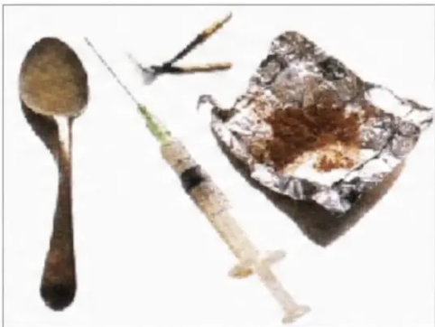






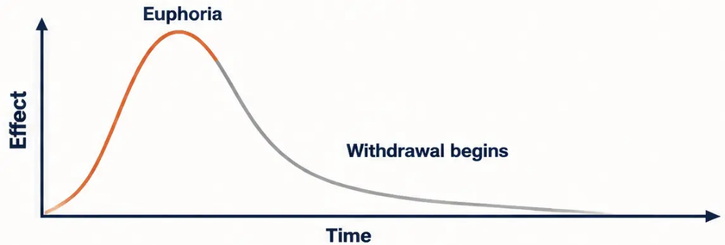


Pharmacology · Section 3
Heroin pharmacology: Routes of use and clinical effects
The drug
■ Chemical name: Diacetylmorphine — synthetic
derivative of morphine (acetylated)
■ Legal status: Class A, Schedule 2 — pharmaceutical
diamorphine has legitimate UK medicinal use
Common paraphernalia associated with IV heroin use
Clinical effects
■ Street purity: Typically 30–50% — remainder is
cutting agents
Euphoria
Sedation
Analgesia
Respiratory
depression
The euphoria is intense and rapid — this is the core of its addictive pull
Routes of administration
Why dependence develops so quickly
Smoked — “chasing the dragon” (heated on
foil, vapour inhaled)
Half-life: approximately 30 minutes — extremely short
Multiple doses needed per day to avoid withdrawal
Snorted — intranasal powder
Rapid cycling between euphoria and withdrawal drives compulsive use
Injected — intravenous, intramuscular, or
subcutaneous
Rectal — rarer; associated with “black tar” heroin
Pitfall
Street heroin purity varies widely — a user returning after a period of
abstinence (prison, hospital) may misjudge their dose fatally. Never
assume tolerance has been maintained.
www.bradfordvts.co.uk
Slide 4 of 24

Slide 5




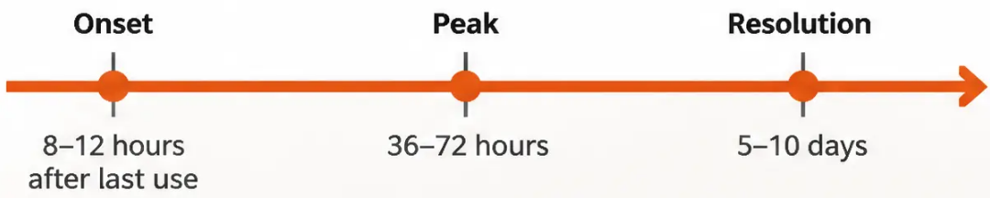
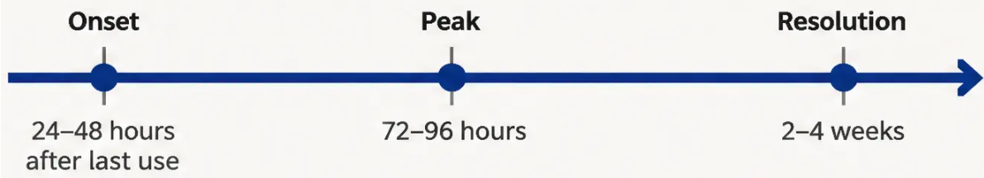










Opioid dependence • Clinical management
Opioid withdrawal: Timeline and clinical grading
Heroin (short-acting)
Methadone (long-acting)
Longer half-life = slower onset, more prolonged course
Grade 1
Grade 2
Grade 3
Grade 4
First 24 hours
• Restlessness
• Dilated pupils
• Tachycardia
• Vomiting
• Watery eyes (lacrimation)
• Muscle twitching and
spasms
• Hypertension
• Diarrhoea
• Runny nose (rhinorrhoea)
• Tachypnoea, pyrexia
• Dehydration
• Yawning
• Severe aches — back,
abdomen, legs
• Anorexia, nausea
• Hypotension
• Sweating
• Extreme restlessness
• Gooseflesh ("cold turkey")
Not always separately classified
Reassuring
Clinical tool: COWS
Opioid withdrawal is extremely unpleasant but not life-threatening
in otherwise healthy adults.
Clinical Opiate Withdrawal Scale
Score ≥ 8 = moderate withdrawal
(Unlike alcohol or benzodiazepine withdrawal — which can be fatal)
→ Appropriate to initiate buprenorphine
www.bradfordvts.co.uk
Slide 5 of 24

Slide 6







Emergency management • Opioid toxicology
Opioid overdose: Recognition and emergency management
Recognise it first
Act immediately
1 Call 999 immediately
● Classic triad of opioid overdose
1. Coma / unresponsive
2 Airway, breathing, circulation — basic resuscitation
2. Respiratory depression (RR < 8/min, shallow)
3. Pinpoint (miotic) pupils
3 Naloxone — see dose below
Other signs to look for:
4 Repeat every 2–3 minutes if no response —
up to 10mg may be needed
• Cyanosis — blue lips or fingertips
• Cold, clammy skin
• Deep snoring or no breathing
5 Monitor continuously — naloxone wears off in
30–90 minutes; re-sedation is a real risk
• Slow heart rate
Pitfall: Polydrug use multiplies risk dramatically.
Opioids + alcohol + benzodiazepines can increase
overdose risk approximately 14-fold.
Always ask about co-ingestion.
6 Patient may become aggressive on reversal —
be prepared
Pitfall — Dose correction: Naloxone 400 MICROGRAMS IM or SC — NOT 400mg.
This is a dangerous transcription error found in older materials. Always verify with current BNF.
IV route allows careful titration and near-immediate reversal in hospital settings.
www.bradfordvts.co.uk
Slide 6 of 24

Slide 7


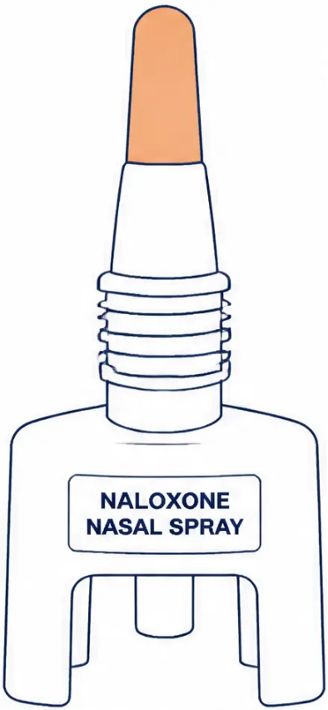








Harm reduction • 2024 update
Take-home naloxone: December 2024 legislative update
SAFE / REASSURING — LEGISLATIVE CHANGE
Since December 2024, community pharmacies in the UK can supply take-home naloxone
without a prescription to:
People at risk of opioid overdose
Their family members and carers
Drug and alcohol services
GPs can also prescribe naloxone on FP10 — and trained non-prescribers can supply
via Patient Group Directions (PGDs).
Available products
SCA — PATIENT KEY MESSAGES
Naloxone injection
Don’t use alone — the safest rule of all
400 micrograms / 1 ml — given IM or SC
Call 999 even after giving naloxone —
it wears off
Nyxoid nasal spray
1.8 mg per spray — single nostril
Carry it; give a kit to family members too
Prenoxad nasal spray
Show your carer or family how to use it
before they need to
1 mg / ml — intranasal
www.bradfordvts.co.uk
Slide 7 of 24

Slide 8
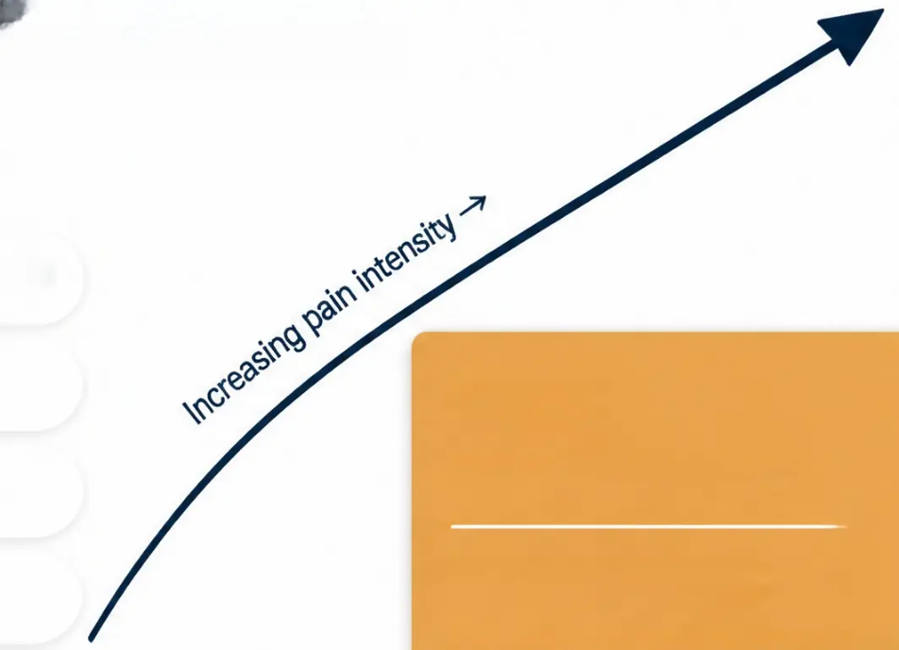




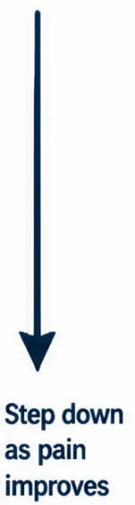








Cancer pain · WHO framework
The WHO analgesic ladder
Step 3
Four core principles
Moderate to severe pain
By the clock – fixed intervals, not as-needed
Switch to a strong opioid
By the mouth – oral route preferred
Morphine · Oxycodone · Fentanyl
Hydromorphone · Buprenorphine patch
± non-opioid ± adjuvant
Step 2
Mild to moderate pain
By the ladder – step by step, don't skip
Add a weak opioid
Titrate to effect – no fixed ceiling dose
Codeine · Dihydrocodeine · Tramadol
± non-opioid ± adjuvant
Pitfall to avoid
Step 1
Always prescribe breakthrough
analgesia alongside regular doses –
1/6 of the 24-hour total oral
morphine dose, available up to hourly
Mild pain
Paracetamol and/or NSAID
± adjuvant therapy
www.bradfordvts.co.uk
8 / 24

Slide 9





Cancer Pain · Primary Care Prescribing
Managing opioids for cancer pain in primary care
Starting and titrating morphine
Managing inevitable side effects
• First-line choice: Oral morphine for moderate-to-severe
cancer pain — start with normal-release tablets or solution
Constipation
Start a stimulant laxative on day one — co-danthramer or
docusate with senna. Opioids slow gut motility reliably;
waiting for constipation to develop is poor practice.
• Starting dose: 5–10 mg every 4 hours — reduce to
2.5–5 mg if elderly, frail, or renal impairment
Safe practice: Prescribe a laxative simultaneously
with the first opioid prescription — every time,
without exception.
• Titrate to effect: Increase by 30–50% every 24–48 hours
until pain controlled — no fixed ceiling dose
• Once stable: Switch to modified-release morphine
(MST Continus 12-hourly or MXL 24-hourly) — continue
prescribing normal-release for breakthrough
Nausea
Offer an antiemetic for the first 5–7 days — cyclizine,
metoclopramide, or haloperidol. Usually settles after
the first week as tolerance develops.
Pitfall: Bioavailability of oral morphine is variable
(15–64%) — always titrate to the individual patient.
Do not rely on population averages.
Drowsiness
Common on initiation and after dose increases. Usually
resolves within 48–72 hours. Warn patients; reassess
before increasing dose further.
Breakthrough dose = 1/6 of the total 24-hour oral morphine dose — prescribed as immediate-release morphine, available up to hourly
www.bradfordvts.co.uk
Slide 9 of 24

Slide 10






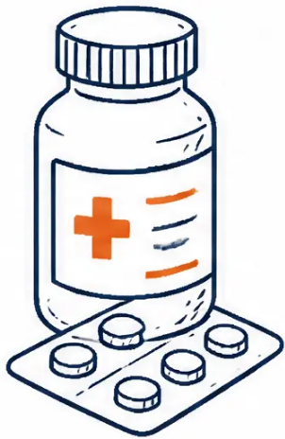


Cancer pain · Opioid prescribing
Morphine prescribing
Initiation, maintenance, and breakthrough doses
Phase 1 · Initiation
Phase 2 · Maintenance
Phase 3 · Breakthrough
Starting dose
When to switch
Breakthrough dose formula
Once stable on 4-hourly regime
5–10 mg oral morphine every 4 hours
(lower if elderly, frail, or renal impairment)
1/6 of total 24-hour
oral morphine dose
Modified-release options
Route
Preparation
MST Continus — 12-hourly
MXL capsule — 24-hourly
Normal-release oral morphine (Oramorph)
Oral preferred — normal-release preparation
Frequency
Frequency
Principle
Up to every hour as needed
Total 24-hour dose unchanged — just
repackaged into fewer, longer-acting doses
Six doses per day (by the clock — not PRN)
Example
24-hour total = 60 mg → breakthrough = 10 mg
⚠ Pitfall
✓ Reassuring
Constipation is universal — start a laxative (co-danthramer
or docusate + senna) from day one. Never wait for the
patient to complain.
Most patients are well managed on 200–300 mg oral
morphine daily. Drowsiness usually settles within a few
days. Tolerance to sedation develops faster than
tolerance to analgesia.
Nausea is common in the first week — prescribe an antiemetic
(cyclizine, metoclopramide, or haloperidol) prophylactically.
www.bradfordvts.co.uk
Slide 10 of 24

Slide 11






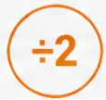










Cancer pain · Opioid prescribing
Opioid conversion: Key principles and equianalgesic ratios
Pitfall — never apply
conversions mechanically
Conversion ratios are guides only — always titrate to the individual patient.
Start the new opioid at 25–50% of the
calculated equianalgesic dose, then
titrate upward.
Most common conversion
Syringe driver
Potency ratio
Oral morphine ÷ 3
Oral oxycodone
× 1.5
Oral morphine ÷ 2
Considerable inter-patient variation
exists — age, renal function, opioid
tolerance, and genetics all affect
response.
= 24-hour SC diamorphine dose
= 24-hour SC morphine dose
= oral morphine equivalent
Conversion charts are a starting point,
not a prescription.
High potency opioid
Transdermal
Quick rule
Breakthrough dose rule
1/6 of the 24-hour total oral
morphine dose
Oral
hydromorphone
× 7.5
Patch strength
(mcg/hr) ÷ 5
25 mcg/hr patch
given as immediate-release morphine
≈ oral morphine
60–90 mg/day
Oramorph breakthrough =
≈ SC diamorphine
breakthrough dose (mg)
1/3 of the 12-hourly MST dose
= oral morphine equivalent
SC diamorphine breakthrough =
1/6 of 24-hour SC dose
www.bradfordvts.co.uk
Slide 11 of 24

Slide 12






Opioid Dependence · Detoxification
Choosing an opiate detoxification regimen
Four key questions guide agent selection: opioid type, likely compliance,
home versus day-care setting, and patient preference.
Buprenorphine
Dihydrocodeine (DHC)
Methadone (10-day detox)
Lofexidine
Partial agonist · ceiling effect
Familiar opioid · community use
Alpha-2 agonist · non-opioid
Long-acting · specialist familiarity
Best for
Best for
Best for
Best for
✓ Motivated patients
✓ Community detox setting
✓ Seeking full abstinence
✓ Stable patients
✓ Compliance uncertain
✓ Patient familiar with opioid effects
✓ Non-opioid detox preferred
✓ Motivated, positive alternatives in place
✓ Heroin up to ~£30/day equivalent
✓ Self-titration appropriate
✓ Short-acting opioid withdrawal
✓ Drug-free state as clear goal
✓ Methadone up to 30mg/day
✓ Can extend to 14 days if needed
✓ Momentum for rapid change
Avoid if
Avoid if
Avoid if
Avoid if
✘ Used heroin in last 4 hours
✘ Co-prescribing benzodiazepines
✘ Pulse below 60 bpm
✘ Chaotic lifestyle
✘ Used methadone in last 24 hours
✘ Very high-dose heroin use
✘ BP below 90/60 mmHg
✘ High illicit drug use expected
✘ COWS score below 8 — wait
✘ High diversion risk
✘ Significant hypotension risk
✘ Supplements likely below 20mg
Pitfall — Buprenorphine precipitation
If buprenorphine is given before the patient is in sufficient withdrawal, it will precipitate severe acute withdrawal.
Always confirm COWS ≥ 8 before the first dose. Wait at least 4 hours after last heroin use or 24 hours after last methadone dose.
www.bradfordvts.co.uk
Slide 12 of 24

Slide 13

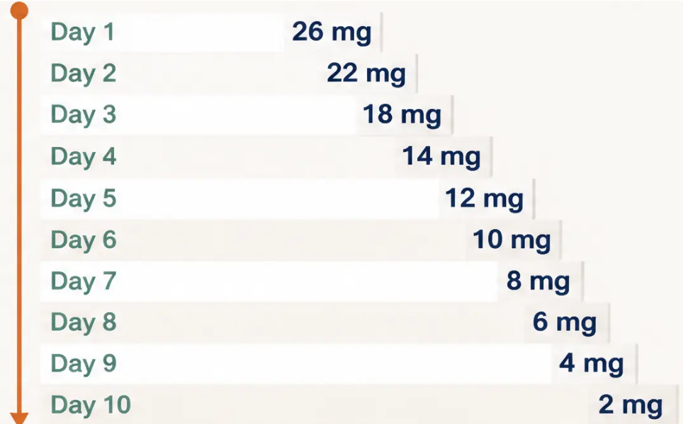
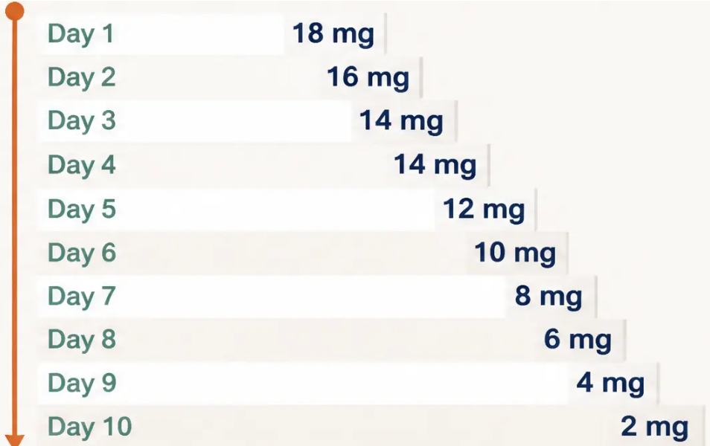

Opiate Detoxification · Section 11
Methadone detoxification: The 10-day rapid regime
For stable, motivated patients with a clear goal of achieving a drug-free state within two to three weeks.
Starting dose: 30 mg
Starting dose: 20 mg
Reduces by approximately 4 mg every 1–2 days
Day 4 held at 14 mg — built-in stabilisation step
➔ 7 days after last methadone dose → naltrexone can be initiated
Many patients begin supplementing with illicit opioids when their dose falls below 20 mg.
This regime works best for genuinely stable patients with positive alternatives already
in place — not those in chaotic circumstances.
Pitfall
www.bradfordvts.co.uk
Slide 13 of 24

Slide 14









Opioid Detoxification · Phase Protocol
Dihydrocodeine (DHC) crossover and withdrawal protocol
✓ Patient familiar with opioid effects
✓ Community detox
✓ Can extend to 14 days if needed
CROSSOVER PHASE – Days 1–7
WITHDRAWAL PHASE – Taper to zero
⚠ Pitfall
Structured dose reduction over 7 steps
DHC blocks severe withdrawal symptoms
while methadone clears from the body
Step
DHC dose
Do NOT co-prescribe
benzodiazepines
during DHC detox –
combined CNS
depression increases
overdose risk
significantly.
Then taper ↓
Day 8
600mg
Methadone 30mg → 600mg DHC daily (20 × 30mg tabs)
Day 9
480mg
Day 10
360mg
Methadone 20mg → 480mg DHC daily (16 × 30mg tabs)
Day 11
240mg
Day 12
180mg
Day 13
120mg
Day 14
60mg
Monitor for diversion
of DHC tablets.
From 20mg starting point: begin taper at 480mg,
same step-down pattern
Three days after the last DHC dose → naltrexone can begin
Goal: naltrexone initiated within 2 weeks of starting detox
www.bradfordvts.co.uk
14 / 24

Slide 15


Opioid detoxification · Protocol
Buprenorphine crossover and withdrawal management
⚠ Pitfall — precipitated withdrawal
Patient MUST be in active withdrawal (COWS score ≥ 8) before the first buprenorphine dose.
Giving buprenorphine too early displaces other opioids from receptors and precipitates severe, sudden withdrawal.
Wait ≥ 4 hours after last heroin dose · Wait ≥ 24 hours after last methadone dose
From methadone 30 mg
From heroin — direct withdrawal
Crossover phase first
No crossover phase needed
Day
Dose
Day
Dose
Day 1
4 mg
Day 2
8 mg
Day 1
4 mg
Day 3
8 mg
Day 2
8 mg
Day 4
8 mg
Withdrawal phase:
Day 3
6 mg
Step
Dose
Day 4
4 mg
1
6 mg
Day 5
2 mg
2
4 mg
3
2 mg
Day 6
0.8 mg
4
2 mg
Day 7
0.4 mg
5
1.6 mg
6
1.2 mg
7
0.8 mg
Shorter course — heroin clears faster than methadone
8
0.8 mg
9
0.4 mg
10
0.4 mg
✓ Start naltrexone 2 days after last dose
✓ Start naltrexone 2 days after last dose
Why buprenorphine? High receptor affinity displaces methadone · Blocks withdrawal · Mild residual effect eases the final taper
www.bradfordvts.co.uk
Slide 15 of 24

Slide 16

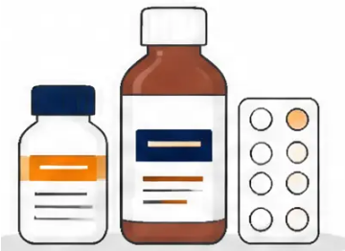






Opioid detoxification · Supportive prescribing
Adjuvant medications for managing withdrawal symptoms
Symptomatic support
Licensed for opioid withdrawal
Lofexidine (BritLofex)
For when the body needs a helping hand
Mechanism: Alpha-2 adrenergic agonist — dampens
sympathetic noradrenaline surge
● Ibuprofen (NSAID)
What it helps:
Muscle aches, back pain, headaches
● Paracetamol
● Sweating · Diarrhoea · Runny nose
● Muscle cramps · Gooseflesh
Fever, general pain
Dosing:
● Metoclopramide
Nausea and vomiting
● Start: 0.2 mg four times daily
● Loperamide
● Increase to: 0.2–0.4 mg four times daily
● Maximum: 2.4 mg per day
Diarrhoea — safe and effective
● Duration: 7–10 days
● Gaviscon (antacid)
Stomach upset and reflux
Before each dose: Check blood pressure — hold if
systolic below 90 mmHg
● Short-course hypnotic
Sleep disturbance — see caution below
Pitfall — hypotension risk
Pitfall — temazepam diversion risk
Lofexidine causes blood pressure to drop. Do not prescribe
if resting pulse is below 60 or systolic BP is below 90/60.
Check BP before every dose during the 7–10 day course.
Temazepam has significant street value. Prefer zopiclone
for short-course sleep support during withdrawal. Never
co-prescribe benzodiazepines with DHC.
www.bradfordvts.co.uk
Slide 16 of 24

Slide 17





Addiction Medicine · Protocol
Naltrexone protocol: Initiation and maintenance
BEFORE YOU START
Confirm adequate opioid-free period
Methadone: 10 days opioid-free · Heroin: 4 days opioid-free · DHC: 4 days opioid-free
INITIATION SETTING
Ideally initiated in an addiction unit or specialist clinic
Patient sees doctor · Treatment fully discussed · Written consent obtained
BEFORE FIRST DOSE
Check baseline LFTs
Naltrexone is hepatotoxic at high doses — LFTs required before starting and monitored periodically
CRITICAL GATEWAY
Naloxone challenge: 1.2 mg IM — observe for minimum 1–1.5 hours
If withdrawal symptoms are mild (SSA score <5): proceed to naltrexone
If withdrawal symptoms are severe: do NOT give naltrexone — repeat challenge the following day
DAY 1
Naltrexone 25 mg on day 1, then 50 mg daily from day 2
Maintenance: 50 mg daily oral · Alternative: 350 mg weekly in two divided doses
AKT
Naltrexone blocks ALL opioid analgesia
Key recall facts
Warn the patient clearly. They must carry an alert card and inform
any treating clinician — including A&E, anaesthetists, and dentists —
that they are on naltrexone. Emergency pain management will
require non-opioid strategies or specialist anaesthetic input.
• Naloxone challenge dose: 1.2 mg IM
• Naltrexone day 1: 25 mg → then 50 mg daily
• Opioid-free before starting: methadone 10 days, heroin/DHC 4 days
• Monitor LFTs — hepatotoxic at high doses
• LAAM: withdrawn from EU since 2001 — do not use
www.bradfordvts.co.uk
Slide 17 of 24

Slide 18





Chronic pain · NICE 2021
Opioid prescribing for chronic non-cancer pain
What should GPs do instead?
What does the evidence actually say?
■ Long-term opioids for chronic non-cancer pain
(CNCP) offer limited evidence of benefit beyond
three months of use
Offer first: Active rehabilitation, physiotherapy,
psychological therapies (CBT, ACT), pain management
programmes
■ Harms accumulate with duration: dependence,
hyperalgesia, hormonal disruption, cognitive effects,
and overdose risk
Review existing patients: All patients on long-term
opioids should have a structured medication review —
assess benefit, harm, and patient goals
■ NICE guideline (2021) states: do not offer opioids
routinely for chronic primary pain — non-pharmacological
approaches should come first
Support tapering: Where opioids are not helping,
support a slow, collaborative dose reduction —
do not abruptly stop
Address the whole person: Sleep, mood, activity,
social support — these matter as much as the prescription
Common pitfall
Continuing to increase opioid doses in patients with
CNCP when pain is not improving is not safe practice.
Escalation without structured review is a patient
safety concern. Always ask: is this opioid still helping?
AKT recall
NICE 2021 chronic pain guideline: do NOT offer opioids
routinely for chronic primary pain. Non-opioid and
non-pharmacological approaches are first-line.
Long-term opioids = limited evidence + significant harm risk.
www.bradfordvts.co.uk
18 / 24

Slide 19











NHS England · Prescribing Safety
Monitoring, safety, and the 5 medicines framework
NHS England priority medicines associated with dependence and withdrawal (2022/2024)
01
02
03
04
05
Opioids
Benzodiazepines
Z-drugs
Gabapentinoids
Antidepressants
Chronic pain — limited
evidence beyond 3 months
Anxiety, insomnia —
dependence risk
Sleep aids — tolerance
develops rapidly
Neuropathic pain —
misuse potential
Discontinuation syndrome
on stopping
NICE 2021: Do not offer opioids routinely for chronic non-cancer pain —
prioritise non-pharmacological and non-opioid alternatives first.
⚠ Pitfall
✓ Good practice
Long-term opioid prescribing for CNCP often continues
by default. Every patient on opioids for >3 months
needs a structured medication review — don't just
repeat the prescription.
Support patients to taper gradually — sudden withdrawal
is harmful. Frame it as reducing side effects and
improving function, not “taking away their medication.”
www.bradfordvts.co.uk
Slide 19 of 24

Slide 20







AKT Quick Recall • High-yield opioid facts
Rapid-fire facts for the AKT exam — learn these cold
⚠ Pitfall
Definitions
Withdrawal timelines
Naloxone — get the dose right
Heroin: onset 8–12 hrs • peaks 36–72 hrs •
lasts 5–10 days
Dose: 400 micrograms IM (NOT 400mg —
dangerous error)
Opiate = natural (derived from the opium poppy)
Opioid = any compound antagonised by naloxone
Repeat every 2–3 minutes; up to 10mg
may be needed
Methadone: onset 24–48 hrs • lasts 2–4 weeks
Endogenous opioids = endorphins,
enkephalins, dynorphins
COWS score ≥8 = moderate withdrawal →
safe to start buprenorphine
Half-life: 30–90 minutes — re-sedation
risk after it wears off
Mu receptor = primary target: analgesia,
euphoria, respiratory depression
Withdrawal is unpleasant but NOT
life-threatening (unlike alcohol/BZD)
THN: community pharmacy can supply
WITHOUT prescription since Dec 2024
Morphine prescribing
Opioid conversions
Naltrexone & detox timings
ⓧ Withdrawn
Starting dose: 5–10mg oral morphine every 4 hours
Opioid-free before starting naltrexone:
— Methadone: 10 days • Heroin: 4 days • DHC: 4 days
Oral oxycodone × 1.5 = oral morphine equivalent
Breakthrough: 1/6 of 24-hour total
oral morphine dose
Oral hydromorphone × 7.5 = oral morphine equivalent
Fentanyl patch 25 mcg/hr ≈ oral morphine
60–90 mg/day
Naloxone challenge first: 1.2 mg IM →
observe 1–1.5 hrs
Oral → SC diamorphine: divide 24-hr
oral dose by 3
Fentanyl patch (mcg/hr) ÷ 5 = SC diamorphine
breakthrough (mg)
Day 1: naltrexone 25 mg • Day 2 onwards:
50 mg daily
Oral → SC morphine: divide 24-hr
oral dose by 2
Always start new opioid at 25–50% of
calculated dose — then titrate
LAAM: WITHDRAWN from EU 2001 —
cardiac arrhythmias — do not use
Always start laxatives from day one
www.bradfordvts.co.uk
Slide 20 of 24 • Bradford VTS Teaching Deck

Slide 21







SCA Skills · Communication
SCA consultation skills: ICE and
motivational interviewing
SCA tip · These phrases are not scripts — they are tools. Adapt them to the patient in front of you.
Motivational interviewing —
exploring ambivalence
Safety-netting —
keeping patients safe
ICE — Ideas, concerns, expectations
“What's made you decide you
want to try detox now?”
It sounds like part of you is ready
for change and part of you is
worried about it — that makes
complete sense.”
“Your tolerance is much lower now.
Please use a much smaller amount
if you do use again — people die
this way.”
“What worries you most about
the withdrawal?”
Please don't use alone. If someone
is with you, they can call 999 and
give you the naloxone kit.”
“What support do you have
at home?”
“What would your life look like in
a year if things stayed the same?”
“What have you tried before,
and what happened?”
“What would it look like if you
made this change?”
Come straight to the surgery or
A&E if you feel very unwell or
you're struggling.”
www.bradfordvts.co.uk
Slide 21 of 24

Slide 22










Clinical Safety · Section 19
Red flags in opioid management and addiction
⚠ Fever + IV drug use
⚠ Right-sided heart murmur + fever in a drug user
Suspect endocarditis or septicaemia — urgent
blood cultures, echo, and hospital admission
Tricuspid valve endocarditis until proven otherwise —
do not discharge without investigation
⚠ Respiratory rate below 8/min +
pinpoint pupils + unresponsive
⚠ Child safeguarding concern
Follow local safeguarding pathway immediately —
do not delay referral awaiting clinical resolution
Opioid overdose — call 999 immediately and give
naloxone 400 micrograms IM without delay
⚠ High-dose opioid escalation
in chronic non-cancer pain
⚠ Pregnancy + opioid dependence
Urgent referral to obstetrics and specialist
addiction services — do not delay
Structured medication review required — do not simply
increase the dose; seek specialist input
www.bradfordvts.co.uk
Opioids in primary care · Bradford VTS Teaching Deck

Slide 23



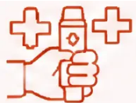
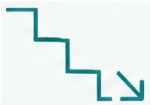


Bradford VTS · Opioids in Primary Care
Summary of key clinical lessons
Carry these principles into every consultation involving opioids
Overdose &
emergency response
Dependence &
detoxification
Cancer pain &
safe prescribing
• Naloxone 400 micrograms IM – never 400mg
• Start buprenorphine only when
COWS ≥ 8 – never before
• Start oral morphine at 5–10 mg every
4 hours; titrate to effect
• Repeat every 2–3 minutes; monitor
for re-sedation
• Methadone withdrawal lasts 2–4 weeks;
heroin 5–10 days
• Breakthrough dose = 1/6 of total
24-hour morphine dose
• Naloxone half-life is short – always
call 999
• Naltrexone needs full opioid clearance –
10 days post-methadone
• Oral morphine ÷ 3 = SC diamorphine
equivalent
• Community pharmacy can now supply
take-home naloxone without prescription
(Dec 2024)
• Withdrawal is uncomfortable but not
life-threatening in healthy adults
• Always start laxatives on day one –
constipation is universal
Pitfall to avoid: Long-term opioids for chronic non-cancer pain have limited evidence beyond 3 months.
NICE 2021 says: do not offer routinely. Review all patients on long-term opioids and support tapering where appropriate.
www.bradfordvts.co.uk
Slide 23 of 24

Slide 24



Bradford VTS Teaching Deck · Opioids in Primary Care
Always verify before you prescribe
Always double-check this advice and all drug doses
against the latest NICE guidelines and BNF before
clinical use.
This document is for educational purposes only and
does not constitute clinical advice.
Drug guidance changes. Always use the most current version.
Pitfall to avoid: Never use conversion doses or detox
regimes from memory alone. Confirm with the BNF, your
local addiction service, or a specialist colleague before
prescribing.
Thank you for learning with Bradford VTS.
We hope this session supports your practice and your patients.
www.bradfordvts.co.uk
Slide 24 of 24

