Slide 1


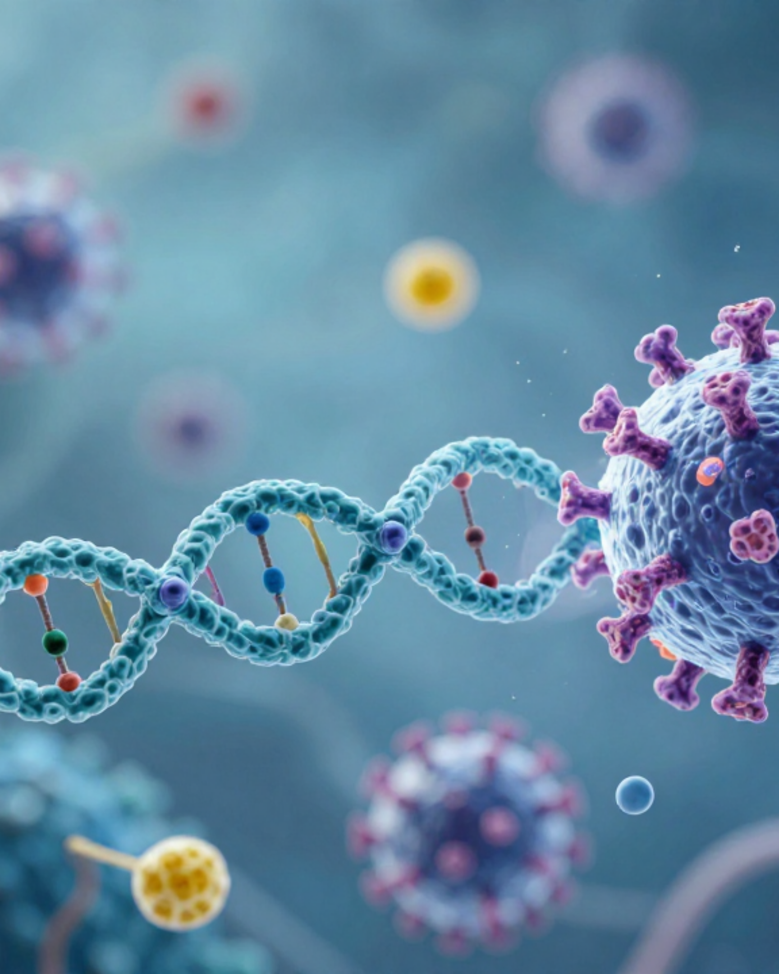


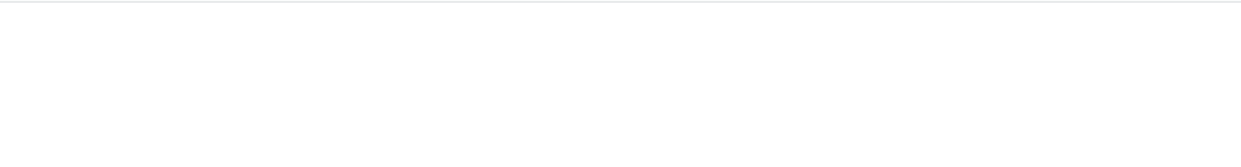
BRADFORD VTS TEACHING DECK
How Vaccines Work:
Comprehensive GP Training
An essential academic briefing on immunology, vaccine platforms, and primary care implementation for modern general practice.
GP Trainee Curriculum
AKT & SCA High-Yield
Prepared May 2026 | MRCGP Training Series
UPDATED TO 2025/2026 JCVI / GREEN BOOK STANDARDS

Slide 2













WHY VACCINES MATTER IN GENERAL PRACTICE
Public Health Impact & GP Clinical Responsibilities • 2025/26 Standards
Vaccines remain the most effective public health intervention in history. For GP trainees, mastering vaccinology is critical for clinical safety, AKT performance, and evidence-based patient advocacy in primary care.
Immunological Basis
New Platforms
Understanding how vaccines generate memory without causing disease.
Mainstreaming of mRNA and adenoviral vector technologies.
Distinguishing between innate and adaptive immune responses.
Rapid development cycles and safety profiling of LNPs.
Key concepts for AKT: B-cells, T-cells, and IgG/IgM kinetics.
Understanding the removal of older platforms (e.g., AstraZeneca).
UK Clinical Standards
Patient Counselling
Adherence to the latest JCVI and Green Book guidelines.
Addressing vaccine hesitancy and dismantling common myths.
Managing the 2025/26 COVID-19 vaccination campaigns.
Clear communication of rare risks (e.g., myocarditis, VITT).
Identifying eligibility for high-risk and immunosuppressed groups.
Enhancing uptake through motivational interviewing (SCA focus).
SCA / AKT PEARL
GPs are the primary source of vaccine trust. Success in exams and practice requires bridging complex science with simple, reassuring patient communication.

Slide 3













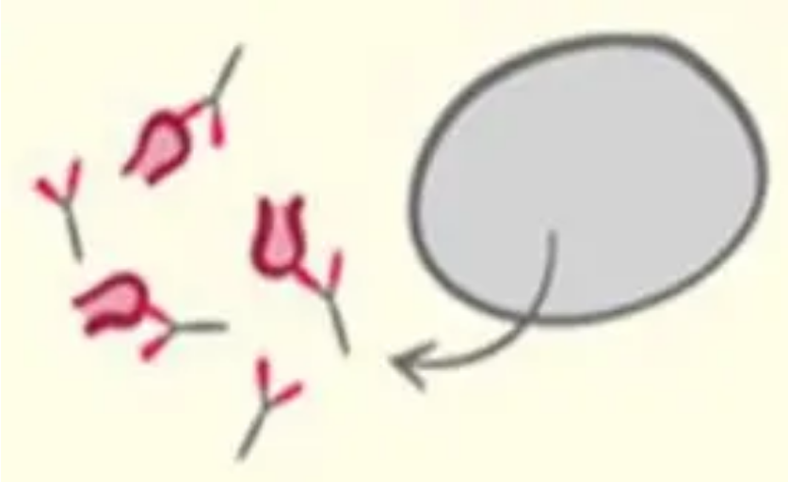

BASIC IMMUNOLOGY: INNATE AND ADAPTIVE RESPONSES
Immunology & Clinical Application • 2025/26 Standards
Innate Immunity
Adaptive Immunity
Immediate Response: Activated within minutes to hours of pathogen exposure.
Delayed & Specific: Takes days to develop; highly antigen-specific.
B Cells (Humoral): Produce antibodies (IgM then IgG). Memory B cells persist for rapid re-exposure.
Non-Specific: Recognizes broad patterns (PAMPs) rather than specific antigens.
T Cells (Cellular):
Key Cellular Components:
CD4+ Helper: Coordinate response
Neutrophils & Macrophages
CD8+ Cytotoxic: Kill infected cells
Natural Killer (NK) cells
Immunological Memory: The ability to respond faster and more effectively upon re-exposure.
Complement System
Effector Functions: Inflammation, phagocytosis, and cytokine production.
AKT EXAM PEARL: Memory B and T cells are the primary targets of vaccination, ensuring a rapid "Secondary Response" (high-titre IgG) upon future natural infection.

Slide 4


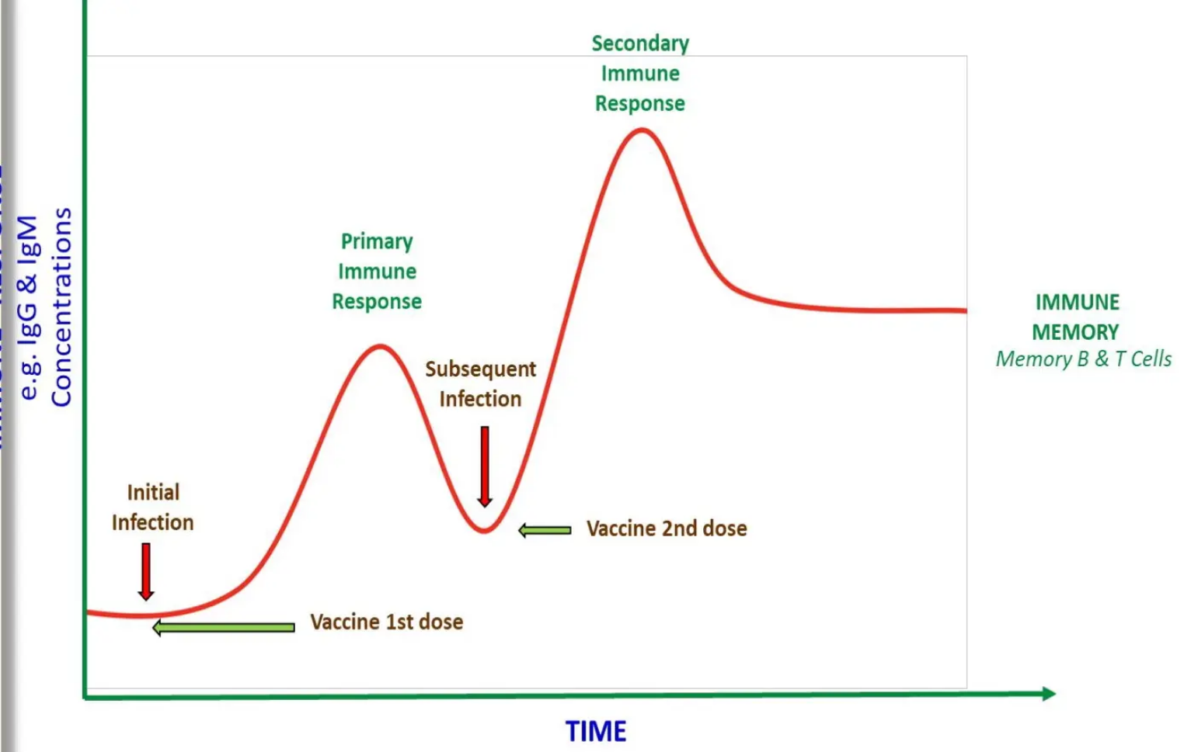











GENERATING LONG-TERM IMMUNITY AND MEMORY
Immunology & Clinical Application • 2025/26 Standards
Primary vs. Secondary Response
Primary: First exposure to antigen; slow development, low antibody titre (mostly IgM).
Secondary: Booster dose or re-exposure; rapid, high-titre IgG response via memory cells.
Goal: Establishment of Memory B and T cells that can persist for decades for rapid protection.
The Role of Adjuvants
Enhance immune response by stimulating innate receptors (e.g., Toll-like receptors).
Figure 1: Comparison of IgG and IgM kinetics following 1st and 2nd vaccine doses.
Improve antigen presentation to the adaptive system, leading to stronger memory.
AKT EXAM PEARL
The Secondary Response is the immunological basis for booster doses. It produces a higher affinity, more durable IgG response compared to the initial IgM-heavy primary response. Memory B/T cells are the clinical target for long-term protection.
Examples: Aluminium hydroxide/phosphate, AS01B (Shingrix), Matrix-M (Novavax).

Slide 5










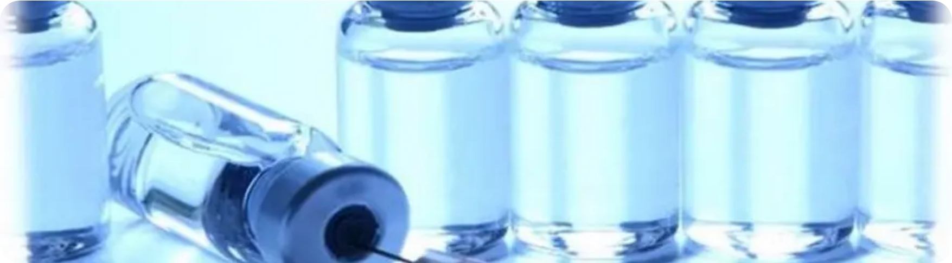



TRADITIONAL PLATFORMS: LIVE ATTENUATED & INACTIVATED
Mechanisms and clinical considerations for live attenuated vaccines like MMR and inactivated vaccines, including their safety profiles in immunocompromised patients.
Live Attenuated Vaccines
Inactivated (Killed) Vaccines
Mechanism: Weakened form of pathogen replicates to stimulate strong cellular and humoral immunity.
Mechanism: Pathogen killed by heat or chemicals (formaldehyde); cannot replicate or cause disease.
Examples: MMR (Measles, Mumps, Rubella), BCG, Varicella, Yellow Fever, Rotavirus.
Examples: Inactivated Polio (IPV), Hepatitis A, Rabies, Injectable Influenza.
Advantages: Safe in immunocompromised; stable at 2–8°C; no risk of vaccine-derived infection.
Advantages: Broad immune response; often provides lifelong immunity with a single dose.
Disadvantages: Weaker immune response; usually requires multiple doses and booster shots.
Disadvantages: Requires strict cold chain; rare risk of reversion to virulent form.
GP PRACTICE MANAGEMENT
AKT PEARL: Live vaccines are ABSOLUTELY CONTRAINDICATED in severely immunocompromised patients and during pregnancy.
Always check the Green Book for current UK schedules. Ensure 15-minute observation post-injection for all new vaccines.

Slide 6










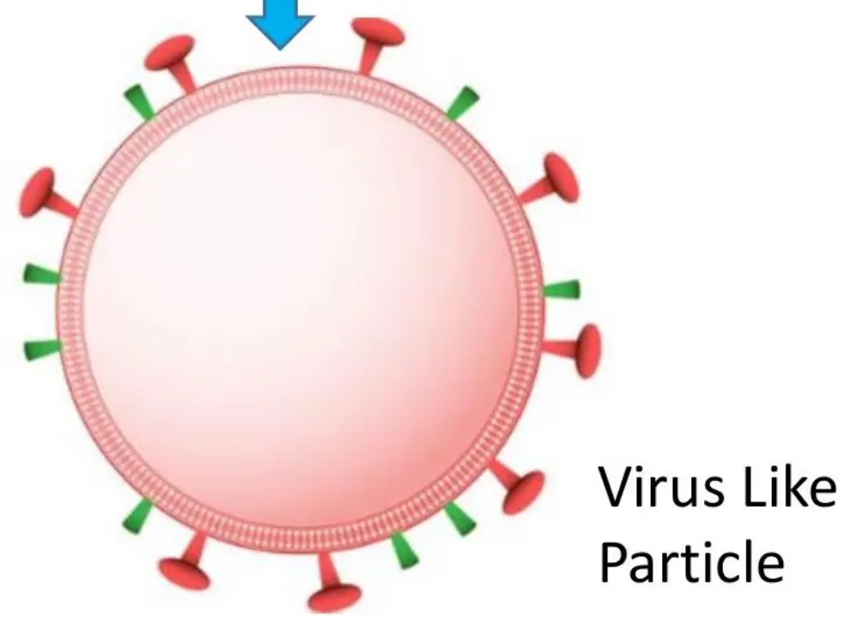



PROTEIN SUBUNIT AND VIRAL VECTOR VACCINES
Immunology & Clinical Application • 2025/26 Standards
Protein Subunit Platform
Viral Vector Platform
Mechanism: Contains purified pathogen proteins (antigens) + adjuvants to stimulate immunity without whole virus.
Mechanism: Uses a harmless, non-replicating adenovirus to deliver genetic code for the antigen into human cells.
Novavax (Nuvaxovid): Uses recombinant spike protein + Matrix-M adjuvant. Preferred for varied platform resilience.
AstraZeneca (Vaxzevria): Officially withdrawn from UK/EU markets in May 2024 due to commercial reasons.
Safety Profile: Highly stable, no infection risk, and safe in immunocompromised patients (e.g., Hep B, HPV, Shingrix).
Current UK Status: No viral vector COVID-19 vaccines remain in active use for the 2025/26 campaigns.
AKT Exam Pearl: VITT
VITT Pathophysiology: Vaccine-induced immune thrombocytopenia and thrombosis (anti-PF4 antibodies).
Presentation: Thrombosis at unusual sites (CVST, portal vein) + low platelets within 4–28 days post-vector dose.
Management: Urgent admission; avoid heparin (worsens VITT). Historical relevance for AKT diagnosis questions.
Figure 1: Illustration of a Virus-Like Particle (VLP) used in subunit technology.

Slide 7


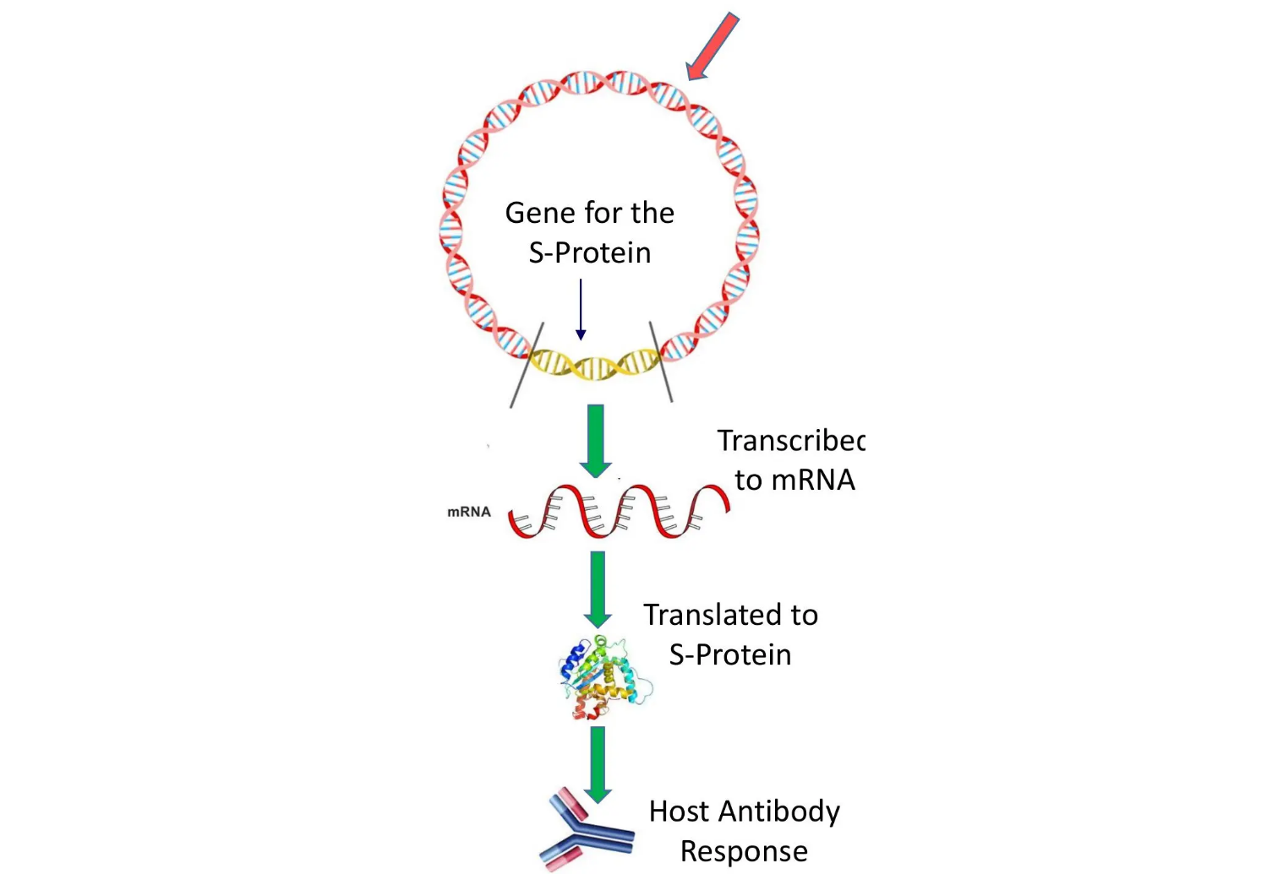








MRNA VACCINE TECHNOLOGY: MECHANISM AND MYTHS
Immunology & Clinical Application • 2025/26 Standards
Biological Mechanism of Action
LNP Delivery: Lipid Nanoparticles protect and carry mRNA instructions into human cells.
Translation: Cellular ribosomes read mRNA to synthesize the SARS-CoV-2 spike (S) protein.
Immune Recognition: Spike proteins displayed on cell surfaces trigger both B and T cell responses.
Rapid Degradation: mRNA is naturally broken down by cellular ribonucleases within days.
Addressing Patient Concerns (The "DNA Myth")
NO Nuclear Entry: mRNA performs its function in the cytoplasm and never enters the cell nucleus.
CRITICAL AKT EXAM PEARL
mRNA vaccines DO NOT alter DNA. This is the most common vaccine myth that GPs must address. When counselling, clarify that the mRNA is a temporary set of instructions that is rapidly cleared by the body after the immune response is triggered.
NO DNA Alteration: Humans lack the reverse-transcriptase enzymes required to turn mRNA back into DNA.
NO Genomic Integration: It is a biological impossibility for mRNA to alter or integrate into the human genome.

Slide 8

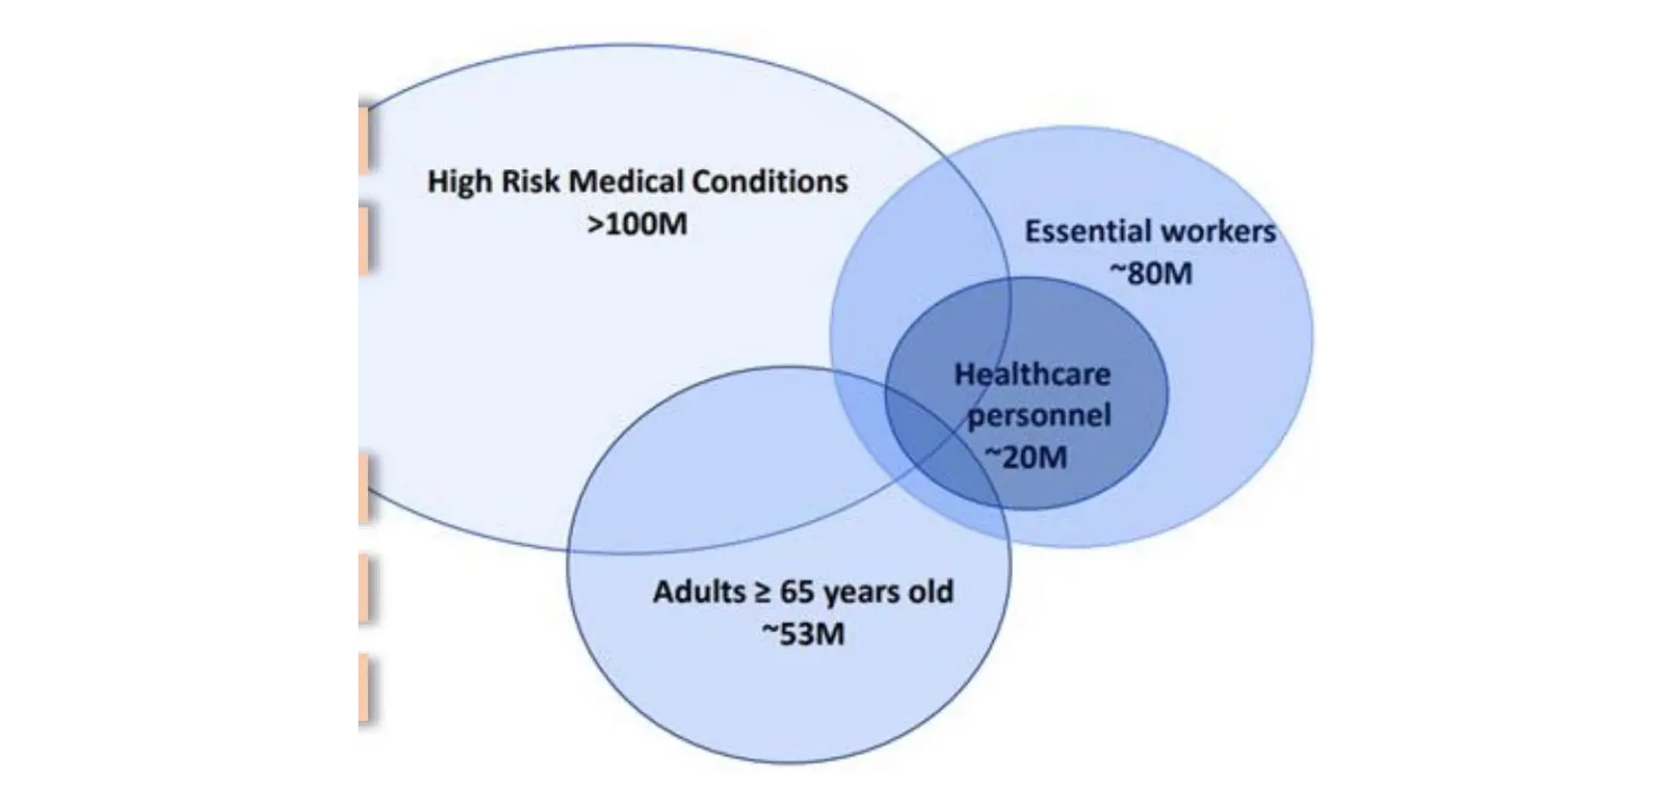












UK COVID-19 VACCINATION PROGRAMME 2025-2026
JCVI Standards • Spring 2026 Eligibility • Clinical Implementation
Programme Logistics
Campaign: 7 April – 30 June 2026
Dose Interval: Usually ≥6 months after last dose (min. 3 months acceptable)
Available Platforms: mRNA (Pfizer/Moderna) & Protein subunit (Novavax)
Effectiveness: ~55% reduction in hospital admissions (Spring 2025 data)
Spring 2026 Eligibility
AKT / Green Book Pearl
Adults aged 75 years and over (by 30 June 2026)
Residents in care homes for older adults
JCVI Resilience Principle: The programme uses multiple platforms (mRNA + Protein-based) to ensure supply resilience.
Individuals aged 6 months+ who are immunosuppressed
Autumn 2025 Change: Adults aged 65–74 were NOT eligible, focusing resources on the most vulnerable.

Slide 9








VACCINE SAFETY AND ADVERSE EVENT MANAGEMENT
Immunology & Clinical Application • 2025/26 Standards
Anaphylaxis Management
VITT (Historical Focus)
AKT HIGH YIELD
Incidence: Rare (2–5 per million doses); usually due to PEG in lipid nanoparticles.
Mechanism: Anti-platelet factor 4 (PF4) antibodies post-adenoviral vector vaccines.
Observation: 15 mins standard; 30 mins if history of previous systemic allergy.
Features: Thrombosis at unusual sites (CVST, portal vein) + Thrombocytopenia.
Immediate Action: IM Adrenaline 0.5mg (1:1000) for adults; call 999 immediately.
Management: Urgent admission; DO NOT GIVE HEPARIN (worsens the condition).
Myocarditis & Pericarditis
MHRA Yellow Card Scheme
Risk Group: Young males (16–30), typically following the second dose of mRNA vaccines.
Role: Post-marketing surveillance (Phase 4) for all suspected serious reactions.
Presentation: New-onset chest pain, palpitations, or dyspnoea within days of vaccination.
GP Duty: Report even if the causal link is uncertain; essential for new vaccine platforms.
Management: Urgent ECG and Troponin. Cardiology referral; typically mild and self-limiting.
Patient Access: Encourage patients to report via the mobile app or online portal.
AKT PEARL: Vaxzevria (AstraZeneca) was withdrawn in 2024. While VITT is no longer a current clinical risk in UK primary care, the pathophysiology remains a common AKT exam topic. Remember: Thrombosis + Low Platelets + Anti-PF4.

Slide 10















REGULATORY FRAMEWORK: MHRA AND JCVI ROLES
Vaccine Approval Pipeline • Clinical Implementation Standards 2025/26
MHRA Role
JCVI Role
Safety & Efficacy: Primary regulator for all medicines in the UK. Assesses safety, quality, and effectiveness.
Clinical Policy: Independent advisory body that decides who should receive which vaccine and when.
Marketing Authorisation: Grants conditional or full licenses based on rigorous Phase 3 trial data analysis.
Strategic Advice: Considers cost-effectiveness, disease burden, and population-level risk-benefit ratios.
Pharmacovigilance: Leads "Phase 4" monitoring via the Yellow Card scheme to identify rare adverse events.
Green Book: Provides the definitive clinical guidance for the national immunisation schedule.
THE VACCINE DEVELOPMENT & APPROVAL PIPELINE
Pre-clinical
Clinical Trials
MHRA Review
JCVI Advice
Implementation
In vitro / Animals
Phases 1, 2, & 3
Safety Approval
Eligibility & Policy
UKHSA Delivery
AKT PEARL: MHRA focuses on "Is it safe/effective?" whereas JCVI focuses on "Who gets it and when?" based on public health strategy.

Slide 11









AKT EXAM PEARLS: HIGH-YIELD CLINICAL FACTS
Immunology & Clinical Application • 2025/26 Standards
Pathophysiology Must-Knows
Spring 2026 Eligibility
VITT: Anti-Platelet Factor 4 (PF4) antibodies. Thrombosis at unusual sites + thrombocytopenia. Avoid Heparin.
Age Group: Adults aged 75 years and over (by 30 June 2026).
Vulnerable: Residents in care homes for older adults.
Myocarditis: mRNA vaccines only. Typically 2nd dose, young males (16–30). Usually mild/self-limiting.
Immunosuppressed: Individuals aged 6 months and over (meeting Green Book criteria).
mRNA Safety: Degraded by ribonucleases. Does NOT enter nucleus or alter DNA (biological impossibility).
Note: Healthy 65–74s are not eligible in this specific campaign.
Vaccine Platforms & Timing
Regulatory Roles
Booster Interval: Ideally 6 months (minimum 3 months for operational delivery).
MHRA: Approves safety, quality, and efficacy (licensing).
JCVI: Advises UK health departments on implementation and eligibility schedules.
Live Vaccines: MMR, BCG, Varicella. Contraindicated in significant immunosuppression.
Yellow Card: GP's primary route for reporting suspected adverse reactions.
Observation: 15 mins standard for all; 30 mins if history of prior allergic reaction/anaphylaxis.
AKT QUICK FIRE
"Which of the following is a specific contraindication to receiving a mRNA COVID-19 booster?"
Answer: Anaphylaxis to a previous dose or component (e.g. PEG).

Slide 12














SCA CONSULTATION PEARLS: NAVIGATING HESITANCY
Immunology & Clinical Application • 2025/26 Standards
Motivational Interviewing
Reassurance Messaging
Explore: Use open questions to identify specific barriers (safety, speed, or religious concerns).
mRNA Safety: "The mRNA breaks down in days; it never enters the nucleus or changes your DNA."
Acknowledge: Validate the patient's perspective to build trust before offering new information.
AstraZeneca Update: "That vaccine is no longer used in the UK; we now use different, highly effective platforms."
Offer Reassurance: Provide concise, evidence-based facts tailored to their specific fear.
Efficacy: "The primary goal is preventing severe illness and hospitalisation, which data confirms it does."
Effective Opening Phrases
SCA Consult Breakout
"What is your current understanding of how the Flu vaccine works?"
Avoid Confrontation: Don't dismiss concerns. Acknowledge the speed of development but explain the rigorous MHRA approval.
"What are the main things concerning you about having the vaccine today?"
Shared Decision Making: Provide information, check understanding, and offer to revisit the discussion if they aren't ready.
"I can hear this feels uncertain — let me share what the medical evidence shows..."
Safety Netting: Mention common side effects (arm soreness, mild fever) so they know what to expect post-vaccination.

