Slide 1





BRADFORD VTS TEACHING DECK
Learning Disabilities in General Practice
Comprehensive GP Training Module
STANDARDS & GUIDELINES
NICE NG54, NG96, QS187 & LeDeR 2023
RESOURCE LINK
www.bradfordvts.co.uk
PUBLICATION DATE
Created May 2026
DISCLAIMER
Always double check this advice and drug doses with the latest NICE/BNF guidance. This document is for educational purposes only.

Slide 2

















Definition and Classification of Learning Disability
NICE NG96: CORE CRITERIA AND IQ CLASSIFICATION
Classification
IQ Range
Typical Functioning
Three Core Criteria (NICE NG96)
Most common; majority live semi-independently
Mild LD
50–70
Impaired Intelligence
Significantly reduced ability to understand new or complex information and learn new skills.
Often require some support with daily tasks
Moderate LD
35–50
Require significant support with personal care
Impaired Social Functioning
Severe LD
20–35
Significantly reduced ability to cope independently in everyday social situations.
High dependency and 24-hour care needs
Profound LD
Early Onset
<20
Both criteria started before adulthood (18 years) and have a lasting effect on development.
Clinical Distinction
Learning disabilities are distinct from Specific Learning Difficulties (e.g., Dyslexia, Dyspraxia). Specific difficulties affect specific processing skills but do not impact general intellectual ability or overall social functioning.

Slide 3











Prevalence and Common Causes
AKT FOCUS: EPIDEMIOLOGY & ETIOLOGY (NICE NG96)
2–3%
Approximate prevalence of Learning Disabilities in the UK population.
Common Causes (Incidence per 2,000)
The Typical GP Practice
Down's Syndrome
Other Chromosomal
~2 patients per list
~1 patient (e.g., Fragile X)
For a standard list of 2,000 patients:
• Approximately 8 adults will have a formal LD diagnosis.
Autistic Spectrum
Cerebral Palsy
~1 patient (with co-occurring LD)
• Many more (often with mild LD) remain undiagnosed or unrecorded on registers.
~1 patient per list
Other / Unknown
~3 patients (Infection, Hypoxia, Postnatal injury)

Slide 4



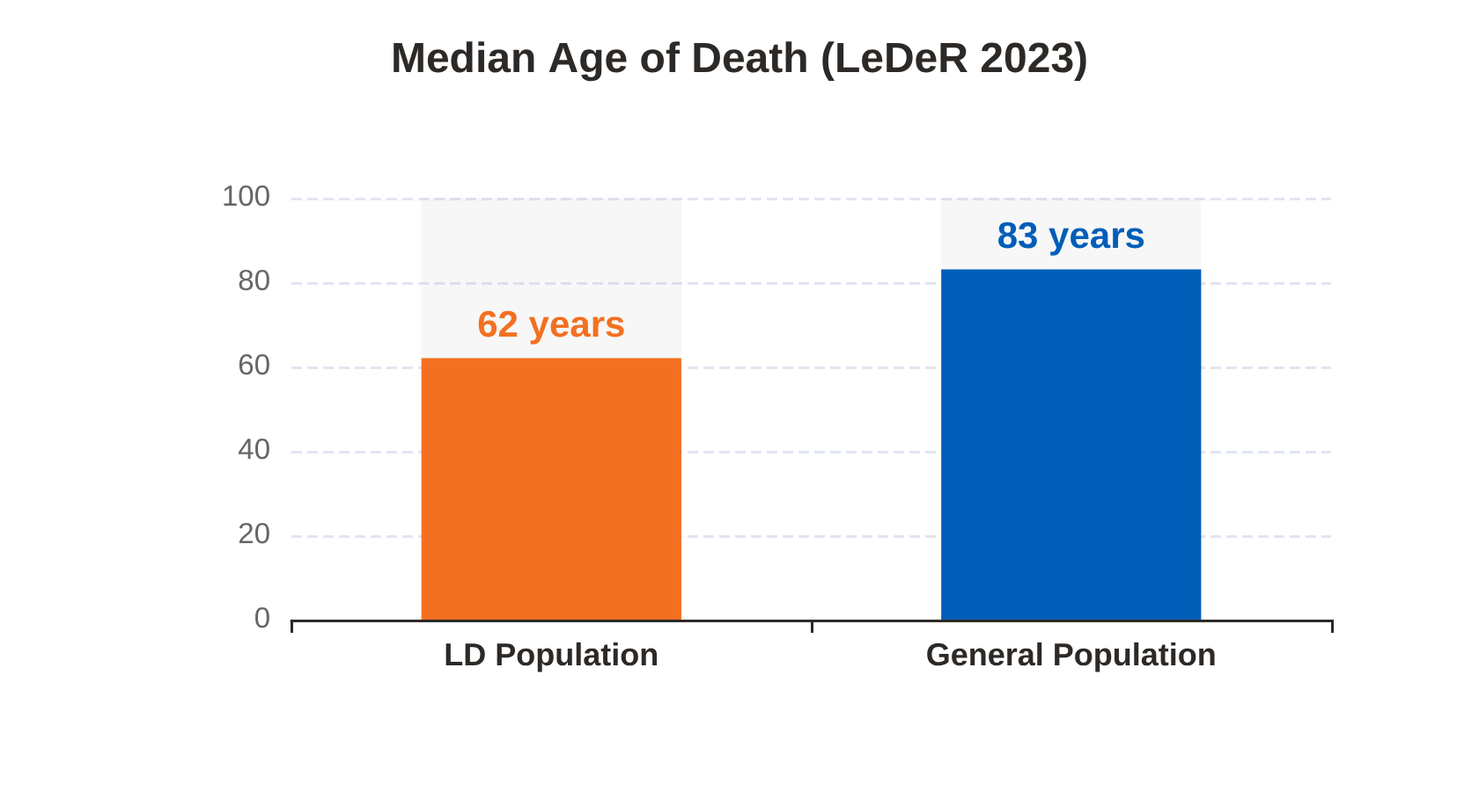





Health Inequalities and Mortality Data
LEDER ANNUAL REPORT 2023 (PUBLISHED DEC 2025) / NICE NG96
Avoidable Mortality Gap
39–40%
of LD deaths are avoidable (vs 22% general population)
Cardiovascular Conditions
26.4%
Respiratory Disease
23.8%
Sepsis
Top 3
"Why is the median age of death 21 years younger for our LD patients?"
People with LD have 2.5× as many comorbidities as the general population. Respiratory disease remains the #1 overall killer.

Slide 5















Barriers to Effective Healthcare
WHY DO PEOPLE WITH LD RECEIVE INFERIOR HEALTHCARE?
Diagnostic Overshadowing
Communication Barriers
Attributing all symptoms to the person's LD or pre-existing condition.
Acquiescence Bias: Saying "yes" to please the clinician rather than answering accurately.
Example: Attributing challenging behavior to LD when it is actually abdominal pain/constipation.
Literal interpretation of clinical questions and instructions.
Leads to missed diagnoses and avoidable mortality.
Limited understanding of abstract concepts (e.g., pain duration/severity).
Access & Systemic Problems
Mental Capacity & Consent
Complex appointment systems and inaccessible written communications.
Assuming lack of capacity due to LD diagnosis (contravenes MCA 2005).
Distressing Environments: Waiting rooms can be noisy and overwhelming.
Decision-Specific: Capacity must be assessed for each specific decision.
Failure to make Reasonable Adjustments under Equality Act 2010.
Failure to involve advocates or family in Best Interest decisions.
BRADFORD VTS TEACHING DECK
www.bradfordvts.co.uk
May 2026

Slide 6
















Associated Physical Health Conditions
COMORBIDITY BURDEN: 2.5X GENERAL POPULATION | NICE NG96 & LEDER 2023
Neurological & Sensory Health
Gastrointestinal & Swallowing
Epilepsy (30%): 10x higher prevalence. Risk of SUDEP; requires annual medication and safety review.
Dysphagia: High risk for aspiration pneumonia. Refer to SALT urgently for coughing/choking during meals.
Vision Loss (30%): High rate of undiagnosed refractive errors and cataracts; annual optometry vital.
Constipation: Extremely common (meds, diet, mobility). Nationally linked to preventable deaths.
Hearing Loss (30%): Often missed; ear wax is a common reversible cause of behavior change.
Obesity: Common; requires proactive dietary support, exercise plans, and social prescribing.
Respiratory Health
Physical & Mobility
Primary Killer: Respiratory disease remains the leading cause of death in people with LD.
High prevalence of continence problems and mobility issues requiring pressure sore monitoring.
Annual flu and pneumococcal vaccinations are mandatory components of the Health Action Plan.
Diagnostic Overshadowing: Atypical pain presentation (e.g., self-harm or withdrawal) is frequent.
AKT Key: LD patients have 2.5x the comorbidities of the general population.

Slide 7






Syndrome-Specific Care and STOMP
DOWN'S SYNDROME MONITORING & MEDICATION GOVERNANCE (NICE NG54 / QS187)
Down's Syndrome Monitoring
STOMP & STAMP Programme
Annual Thyroid Function: Lifelong monitoring for hypothyroidism is mandatory due to significantly elevated prevalence.
STOMP / STAMPStopping Over-Medication of People with LD / Paediatrics with Psychotropic medicines.
Dementia Screening: Baseline cognitive assessment at age 40; high risk of early-onset Alzheimer's.
Sensory Health: Annual review of vision and hearing; ear wax management is a frequent barrier to communication.
Core Aim: Reduce inappropriate use of antipsychotics/anxiolytics for "challenging behavior" without diagnosis.
*Atlantoaxial instability: Screen before surgical procedures.
GP Role: Annual structured medication review as part of the Health Check; liaise with community LD teams.
NICE NG54: Mental health symptoms must be assessed thoroughly before prescribing; avoid diagnostic overshadowing.

Slide 8

















Mental Capacity Act 2005 Principles
KEY PRINCIPLES FOR GPS: ASSUME CAPACITY, SUPPORT DECISION-MAKING, AND ENSURE BEST INTERESTS
Statutory Principles 1-3
Nature of Assessment
1. Assume Capacity:
Presume capacity unless proven otherwise; do not assume based on diagnosis.
Decision-Specific:
Capacity depends on the complexity of the choice (e.g., blood test vs. major surgery).
2. Support Decision-Making:
Provide information in accessible formats and allow extra time before concluding incapacity.
Time-Specific:
Capacity can fluctuate due to health (e.g., infection) or environment.
3. Unwise Decisions:
A person is not "incapable" just because they make a choice that seems unwise to others.
NICE NG96: Always document the specific decision and rationale for the assessment outcome.
Statutory Principles 4-5
Legal Safeguards & Tools
4. Best Interests:
Decisions for those lacking capacity must reflect their known values and wishes.
Lasting Power of Attorney (LPA):
Health & Welfare vs. Property & Finance; must be registered to be valid.
5. Least Restrictive:
Choose the option that achieves the goal while minimizing interference with rights.
DoLS:
Deprivation of Liberty Safeguards apply when care involves continuous supervision.

Slide 9





















Consultation Skills: Top 10 Tips
PRACTICAL ADJUSTMENTS & NICE NG96 STANDARDS
SCA Roleplay Framing
6. Communication Aids
"A 24-year-old with Down’s Syndrome presents with weight gain. How do you adjust your communication to ensure autonomy and accurate history taking?"
Use easy-read materials, pictures, or Makaton signing tools.
7. Triangulate Information
Seek carer input after the patient to verify specific details.
1. First Appointment Slot
8. Repeat-Back Method
Reduces waiting room stress and distress for the patient.
Ask the patient to summarize the plan in their own words.
2. Double Appointment Time
9. Event-Based Schedules
A mandatory reasonable adjustment under the Equality Act.
Link meds to "breakfast" or "bedtime" rather than clock times.
3. Speak to Patient First
10. Explicit Connections
Always address the patient before the carer to respect autonomy.
Do not assume patients link symptoms to causes; explain clearly.
4. Use Open Questions
Avoid yes/no questions to minimize "acquiescence bias."
5. Explain the Process
Clinical Bottom Line: Reasonable adjustments are not just "nice to have"—they are legal requirements that improve safety and reduce diagnostic overshadowing.
Briefly outline listening, examination, and planning phases.

Slide 10











The LD Register and Annual Health Check
QOF REQUIREMENTS & NICE QS187 / NG96 STANDARDS
The Foundation: LD Register
AHC Core Components
LD001 Maintain an up-to-date register of all patients with a learning disability.
Physical & Mental Health: Collaborative review with specific syndrome checks (e.g., TFTs for Down's syndrome).
LD004 Offer AHC to all patients aged 14 and over on the register.
Medication & STOMP: Review accuracy and necessity of all psychotropics; reduce inappropriate use.
QOF Target: Practices expected to achieve annual checks for 75% of register.
Immunisations: Flu (mandatory), Pneumococcal, HPV (to age 25), and Hep B where appropriate.
Transition Focus: Proactively add young people transitioning from pediatrics/school EHCP teams.
Cancer Screening: Review uptake for Cervical, Bowel, and Breast screening; flag for reasonable adjustments.
Audit Tip: Ensure "mild LD" patients are not missed; they often lack formal codes.
Reasonable Adjustments: Phone-call invites, quiet/first-slot clinics, and double appointments.
MANDATORY OUTCOME: Health Action Plan (HAP). A personalized written summary of findings and goals. Must be provided in an accessible format (Easy-Read) as per the Accessible Information Standard.

Slide 11









Frameworks: THiNK LD and Hospital Passports
IMPROVING COMMUNICATION & SAFETY IN ACUTE CARE
THiNK ACCESS
Hospital Passport Purpose
Identify and remove physical or sensory barriers preventing service use.
• Documents communication needs and sensory preferences.
• Highlights pain indicators and specific distress triggers.
• Reduces clinical errors during acute hospital admissions.
THiNK FLEXIBLE
Provide reasonable adjustments like double appointments and quiet waiting areas.
GP Implementation
• Use the Bradford VIP Hospital Passport as the local tool.
THiNK EQUALITY
• Ensure all patients on the LD register have an up-to-date copy.
Ensure patients with LD achieve the same clinical outcomes as others.
• Link passport availability to the Annual Health Check (AHC).

Slide 12












Top Tips and Clinical Pearls
CLINICAL BEST PRACTICE & PATIENT ADVOCACY
Patient Autonomy
Avoid Overshadowing
Constipation Control
Down's Syndrome
Always speak to the patient first before their carer. Respect their independence and maintain a direct therapeutic relationship.
Never attribute new symptoms solely to LD. Always exclude physical causes (pain, infection, constipation) for behavioral changes.
Monitor and treat constipation early. It is a major cause of preventable hospital admissions and significant morbidity in patients with LD.
Conduct annual thyroid function tests (TFTs) and initiate active dementia monitoring from age 40 due to significantly elevated risks.
Reasonable Adjustments
Dysphagia Risks
Health Check Targets
STOMP Principles
Proactively screen for swallowing issues. Aspiration pneumonia remains the leading cause of avoidable death in the LD population.
Ensure every patient aged 14+ on the LD register receives a comprehensive Annual Health Check. Aim for the 75% QOF target.
Review all psychotropic medications annually. Challenge prescribing for "challenging behavior" without a clear psychiatric diagnosis.
Book double appointments and offer the first slot of the session to reduce waiting room stress and sensory overload.

Slide 13












Exam Pearls for AKT and SCA
RCGP AKT & SCA PREPARATION • NICE NG96/QS187
AKT: DATA & EPIDEMIOLOGY
SCA: COMMUNICATION
LeDeR 2023 & Prevalence
Consultation Etiquette
Avoidable Deaths: 39–40% of LD deaths are preventable (vs 22% in gen. pop).
Autonomy: Always speak to the patient first before addressing the carer.
Mortality Gap: Median age of death is 62 years (vs 83 years general).
Adjustments: Offer double appointments and the first slot of the session.
Epilepsy: 30% prevalence (10x higher than general population).
Communication: Use simple language and ask them to repeat back instructions.
AKT: QOF & MANAGEMENT
SCA: LEGAL FRAMEWORK
QOF & Annual Checks
Capacity & Consent
MCA 2005: Always assume capacity; it is decision-specific and time-specific.
QOF LD004: Annual Health Checks (AHC) for all aged 14+ on LD register.
Best Interests: If capacity lacks, consult family/carers for a best-interest decision.
Target: Practices expected to achieve 75% completion for AHCs.
Documentation: Clearly record the capacity assessment for the specific clinical decision.
Cancer Screening: Flag LD patients to screening hubs for reasonable adjustments.
SCA: CLINICAL SAFETY
AKT: SYNDROME MONITORING
Diagnostic Overshadowing
Down's Syndrome Care
Definition: Don't attribute physical symptoms (e.g. pain) to the LD itself.
Thyroid: Annual TFTs are mandatory for life.
Red Flags: Treat sudden behavior change as a physical illness until proven otherwise.
Dementia: Monitor cognitive changes from age 40 (high Alzheimer's risk).
Sensory: Annual vision and hearing reviews are recommended.
Safety Net: Provide carers with clear, easy-read red flag symptoms and escalation plans.

Slide 14












Red Flags and Common Pitfalls
CLINICAL SAFETY AND AVOIDING DIAGNOSTIC BIAS (NICE NG96 / LEDER)
Clinical Red Flags
Common Pitfalls
Sudden Behaviour Change: Consider physical causes first—infection, constipation, toothache, or acute pain.
Diagnostic Overshadowing: Attributing physical/emotional symptoms to the LD rather than a new condition.
Dysphagia/Aspiration: Recurrent chest infections are a major warning sign; refer SALT urgently.
Assuming No Capacity: Violates MCA 2005. Capacity must be assessed per decision and time.
Weight Loss (Down's): Screen for hypothyroidism, early dementia, or swallowing difficulties.
Excluding the Patient: Speaking only to the carer violates autonomy and misses the primary history.
Safeguarding: Unexplained bruising, unusual behaviour around specific carers, or financial "cuckooing."
Missing Monitoring: Neglecting annual TFTs in Down’s syndrome or failing to check psychotropics (STOMP).
Abdominal Distension: Risk of volvulus or faecal impaction; do not delay treatment for severe constipation.
Passport Neglect: Failing to ensure an up-to-date hospital passport is ready before an acute admission.
Always safety-net clearly with carers for red flag symptoms.
Reasonable adjustments are a legal duty, not an optional extra.

Slide 15















Quick Recall and Final Disclaimer
SUMMARY: CLINICAL PRIORITIES & AKT/SCA RAPID REVIEW
LD: impaired intelligence + social functioning
Annual health check: age 14+, QOF
IQ 50–70 = mild; <20 = profound
Down's: TFTs annually; dementia from 40
39–40% LD deaths avoidable (LeDeR)
STOMP: reduce psychotropics without indication
Median LD death age: 62 years
Speak to patient first; always
30% have epilepsy; 30% sensory issues
Dysphagia → aspiration → leading killer
Diagnostic overshadowing: don't blame LD
Capacity is decision-specific; assume it
⚠ Disclaimer: Always double check this advice and drug doses with the latest NICE/BNF guidance. Clinical guidelines and mortality data are subject to change.
This document was created for educational purposes for the Bradford VTS GP Training Scheme (May 2026).

