Slide 1
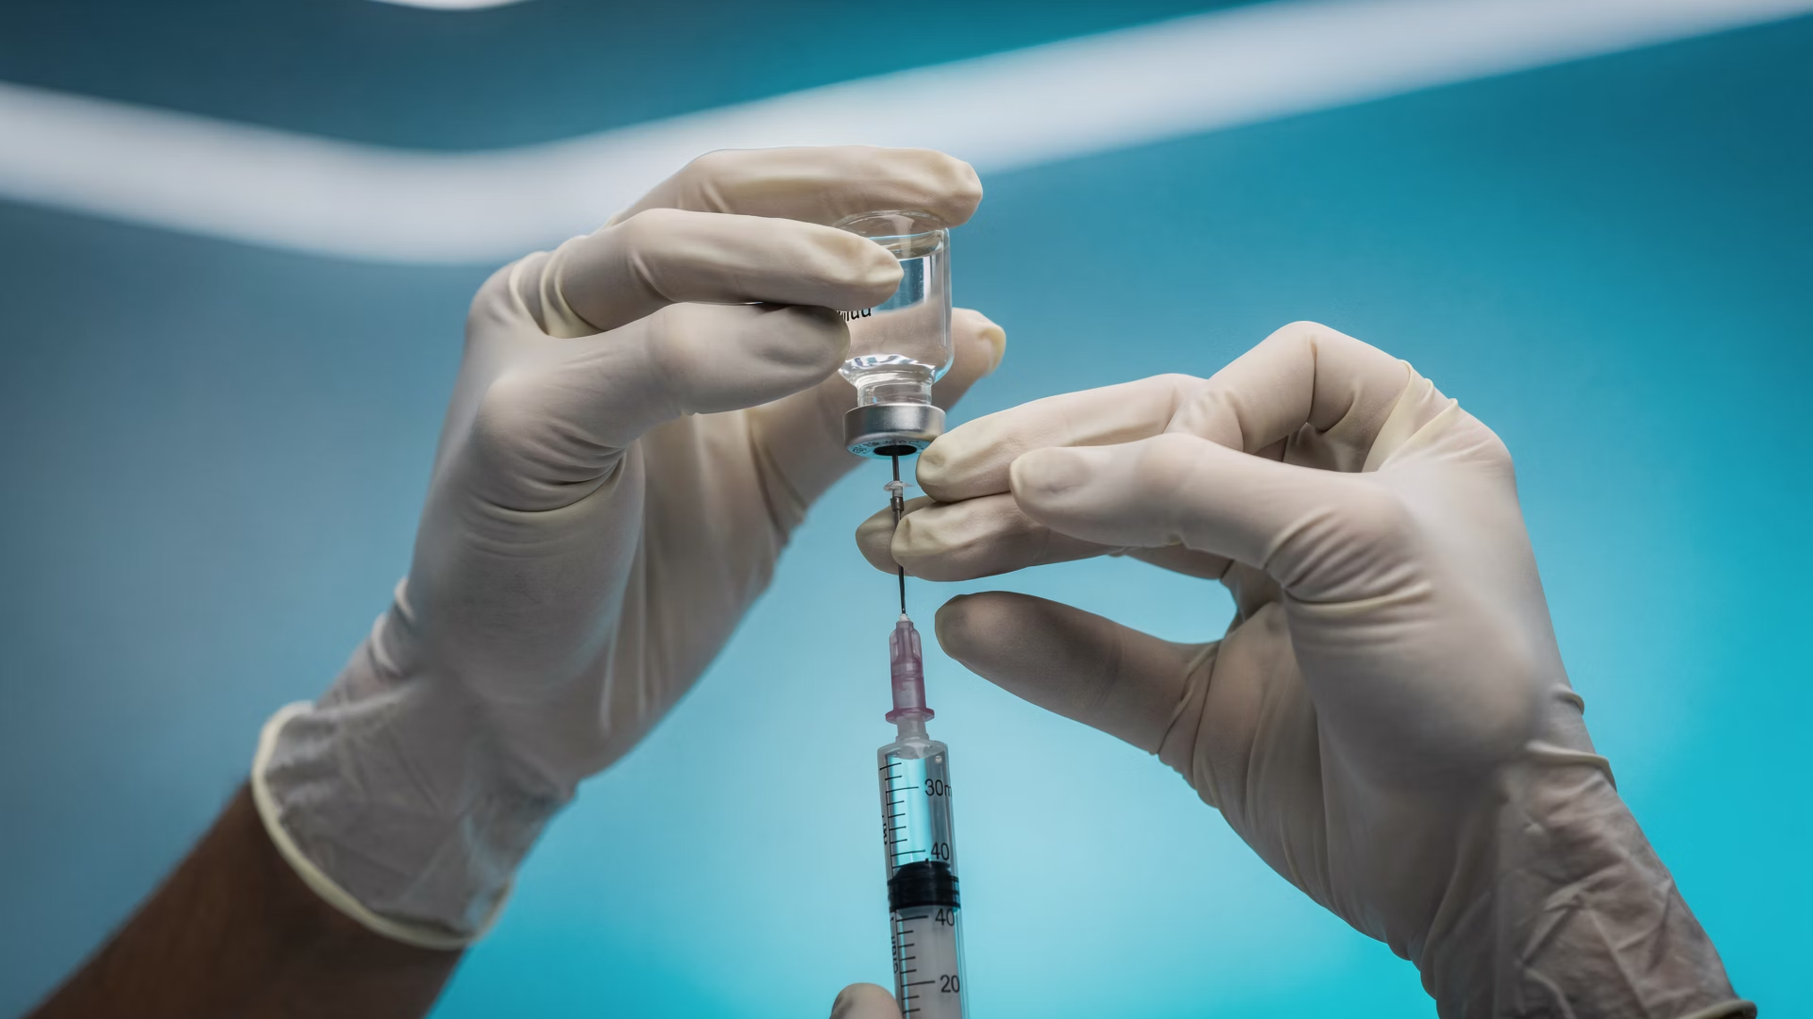
Joint Injections in Pictures
Adapted from an original presentation by Dr. Kathy Rainsbury (2008)
May 2026
BRADFORD VTS TEACHING DECK

Slide 2
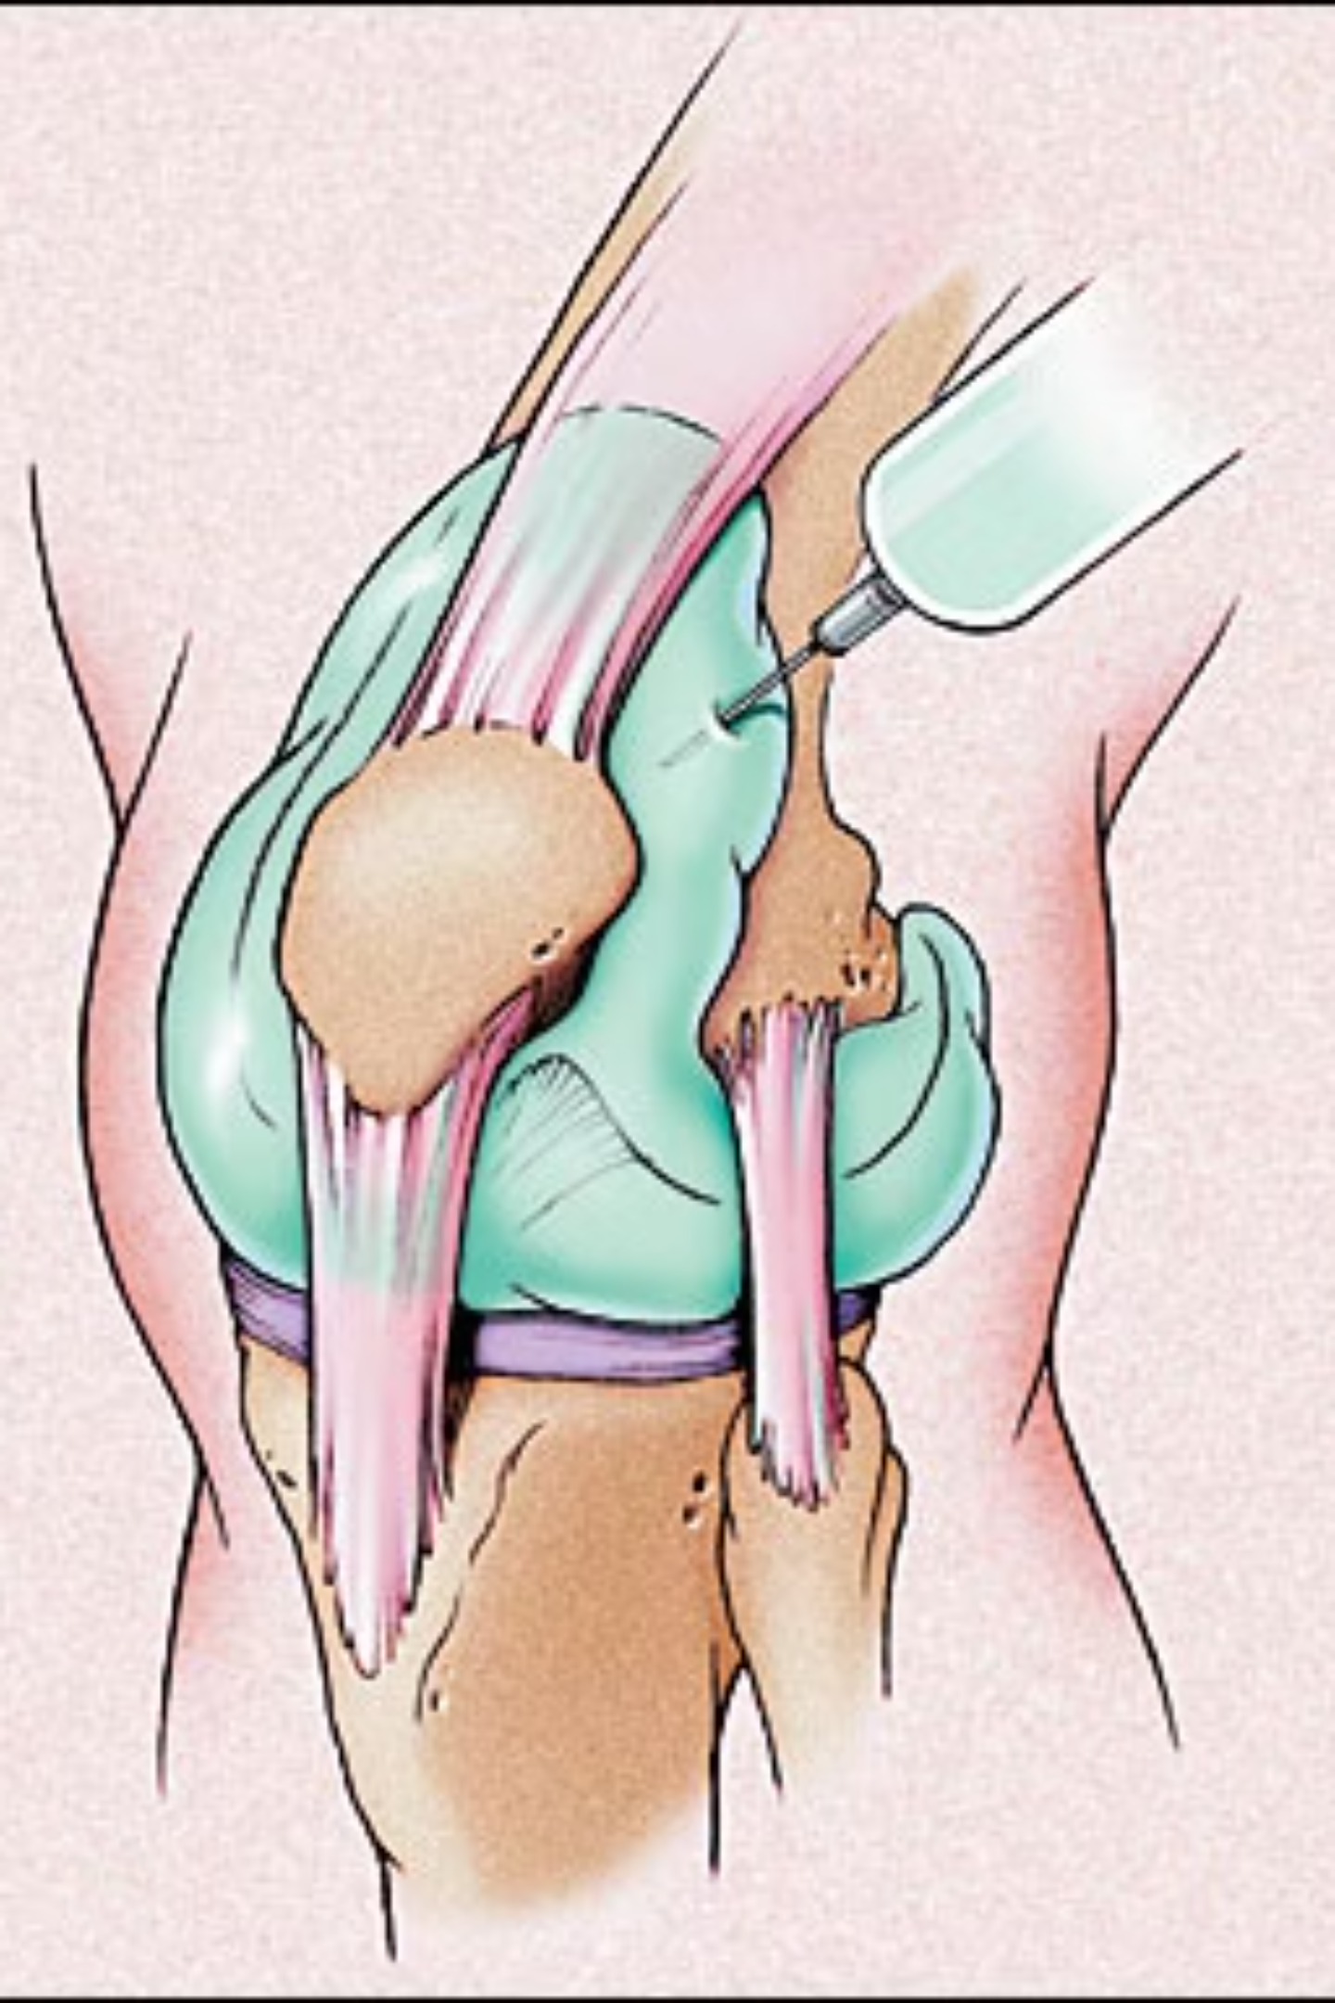
Knee injections
Patient on the couch, knee slightly bent
Palpate superior-lateral aspect of patella
Mark 1 fingerbreadth above + lateral to this site
Clean
LA, corticosteroid
Clean + bandage

Slide 3
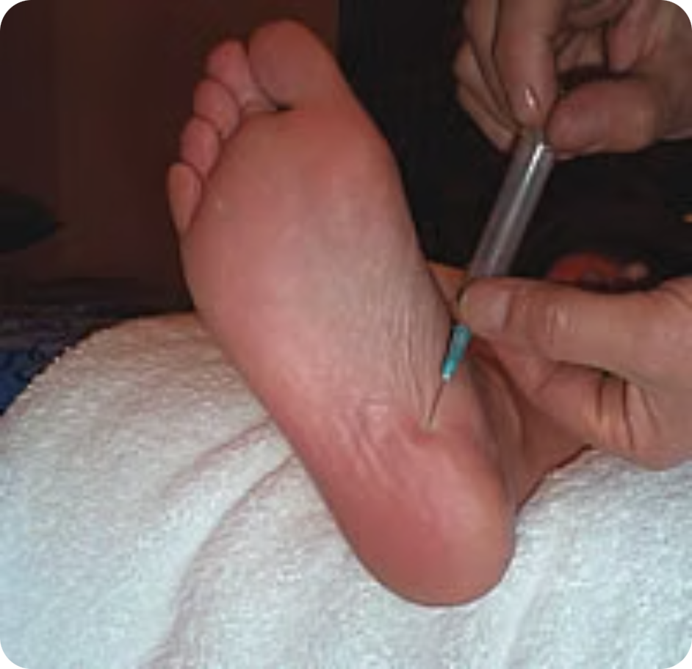
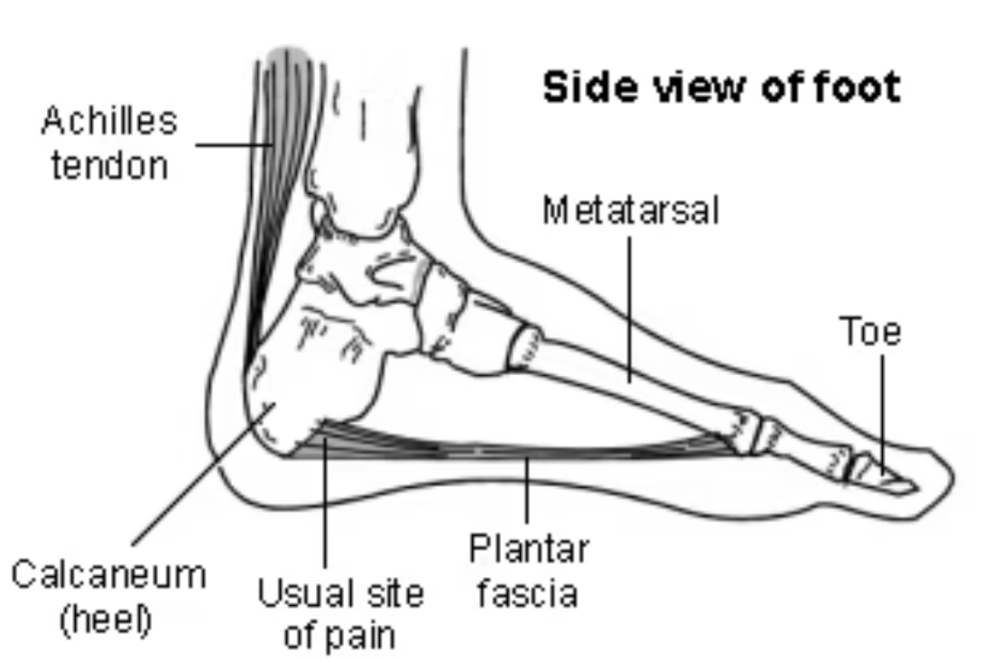
Plantar fasciitis
Procedure can be painful. Benefits are often short-term; consider stretching, orthotics, physiotherapy and shockwave therapy first.
Pt indicate tender spot
Approach from thinner skin + direct posterior-laterally
Small blebs as near to bony insertion as possible
Do not inject fascia itself

Slide 4
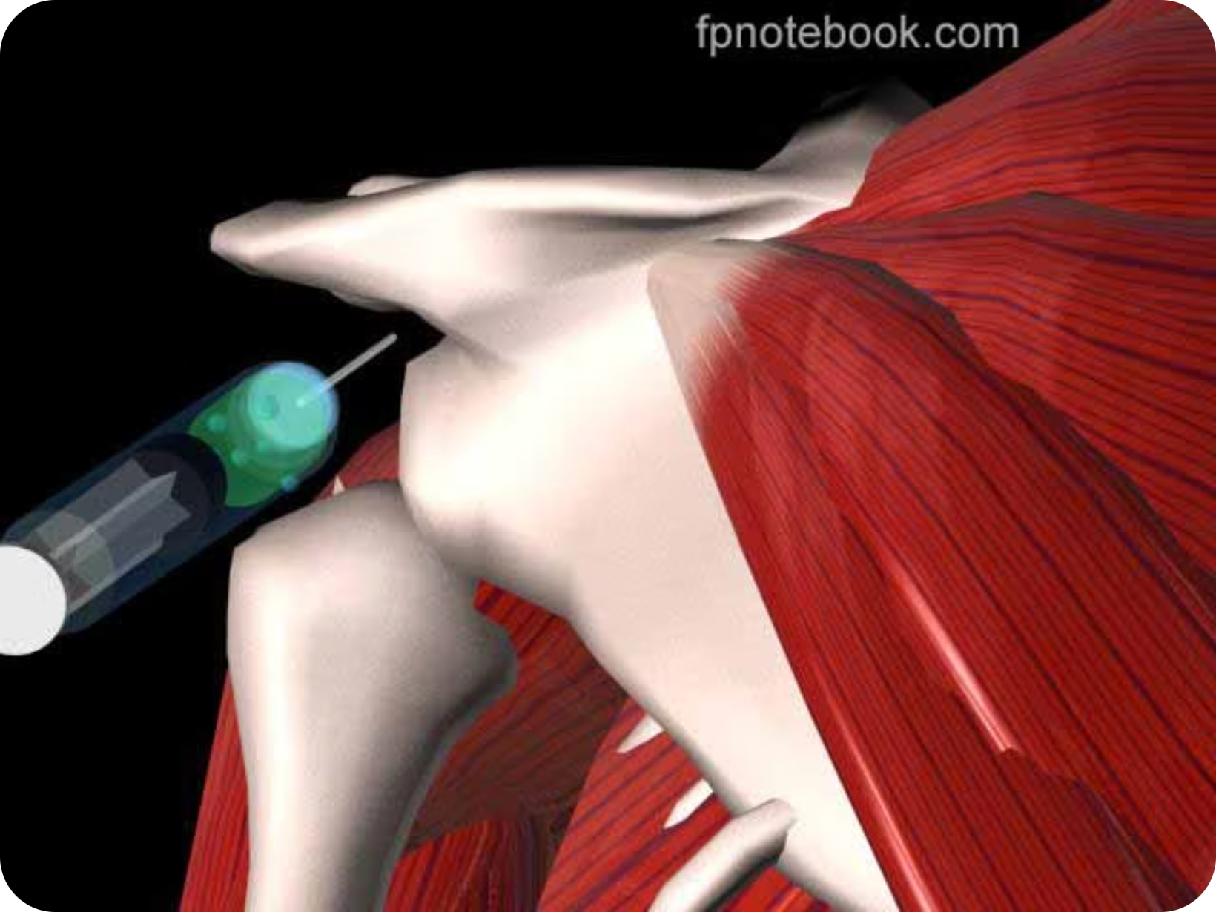
Glenohumeral joint injection
Pt sits, arm by side, externally rotated
Find sulcus between head of humerus and acromion
Posterolateral corner of acromion (2-3 cm inferior)
Direct needle anteriorly toward coracoid process
Insert needle to full length
Fluid should flow easily

Slide 5
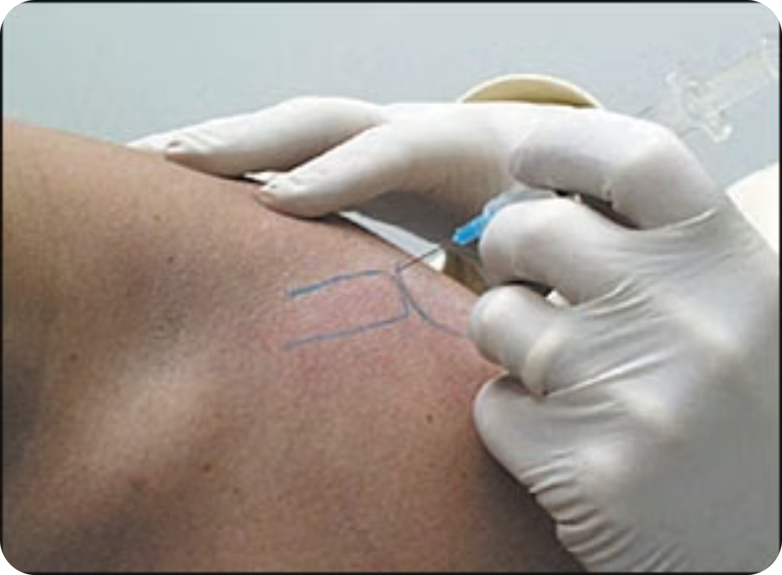
AC joint injection
Palpate clavicle to distal aspect
Slight depression where clavicle meets acromion
Insert needle from anterior and superior approach
Direct needle inferiorly

Slide 6
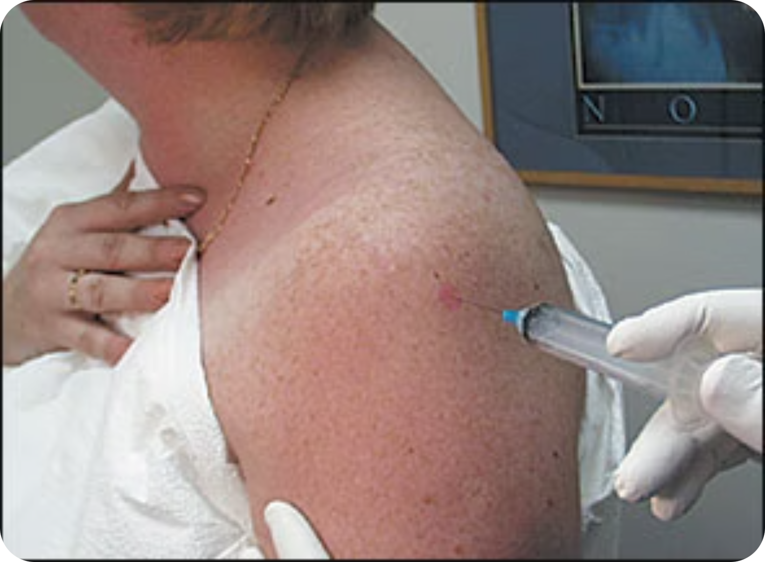
Subacromial bursa injection
Posterior and lateral aspect of shoulder
Inferior to lower edge of posterolateral acromion
Insert inferior to acromion at lateral shoulder
Direct needle toward opposite nipple
Insert needle to full length
Fluid should flow easily

Slide 7
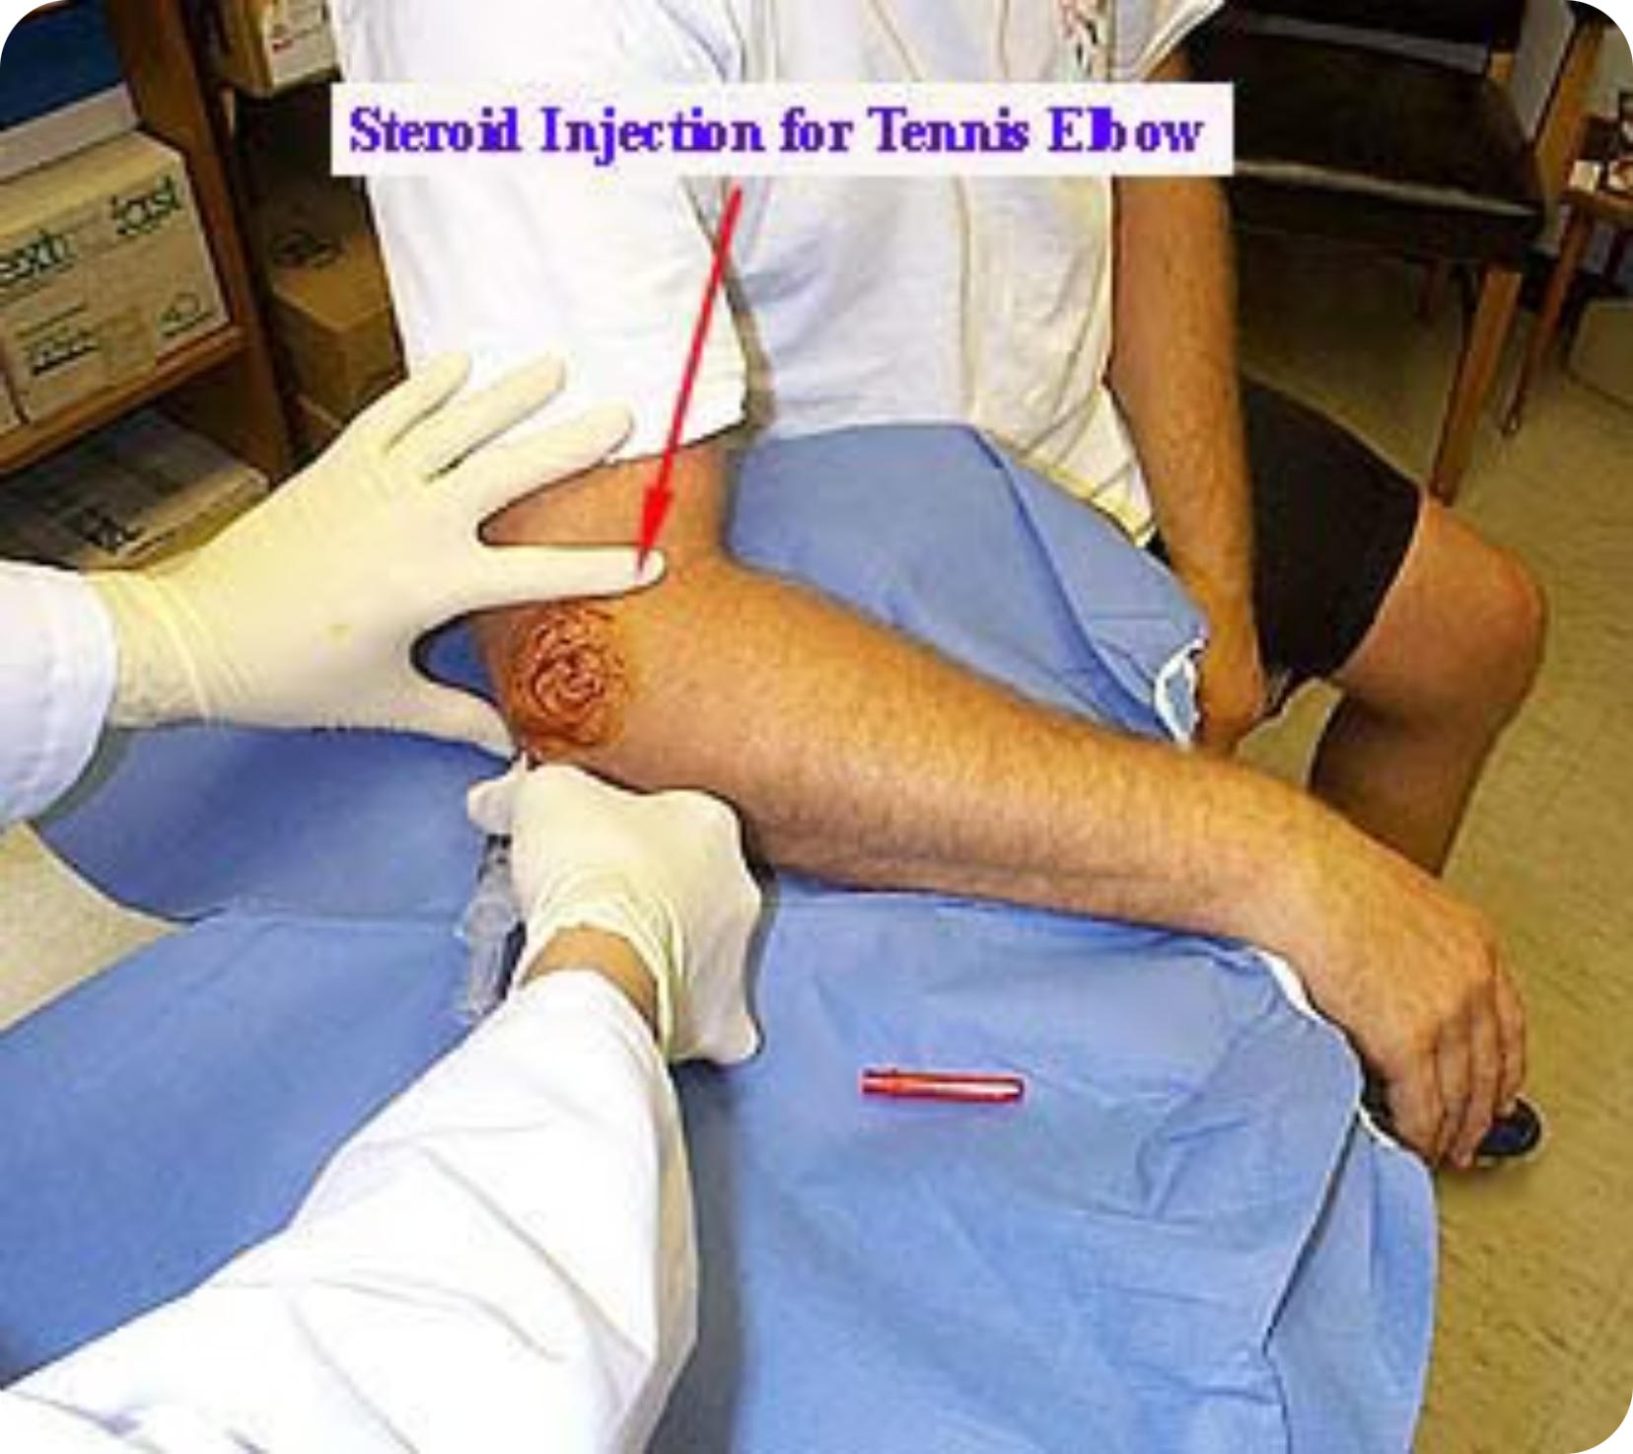
Tennis elbow (lateral)
Arm adducted at side
Elbow flexed to 45 degrees
Wrist pronated
Insert needle perpendicular to skin at point of maximal tenderness
Insert to bone, then withdraw 1-2 mm
Inject corticosteroid solution slowly

Slide 8
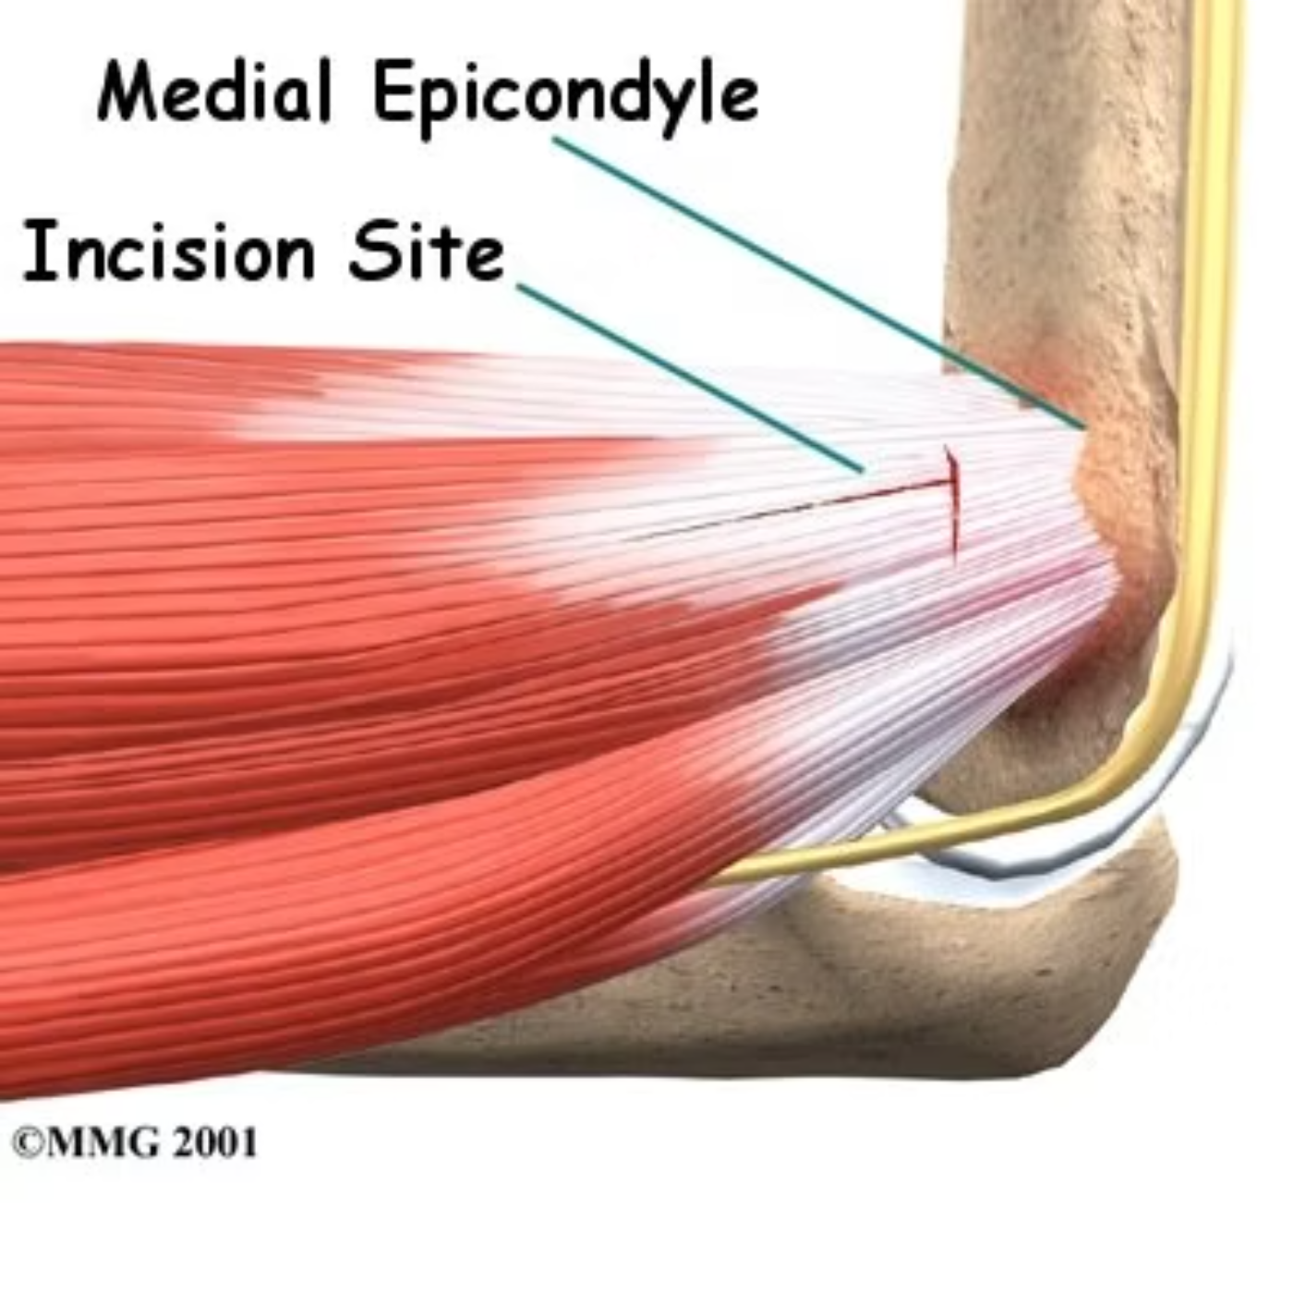
Golfer's elbow (medial)
Beware ulnar nerve!
Rest arm in comfortable abducted position
Elbow flexed to 45 degrees
Wrist supinated
Point of maximal tenderness - insert to bone, then withdraw 1-2 mm
Inject corticosteroid solution slowly

Slide 9
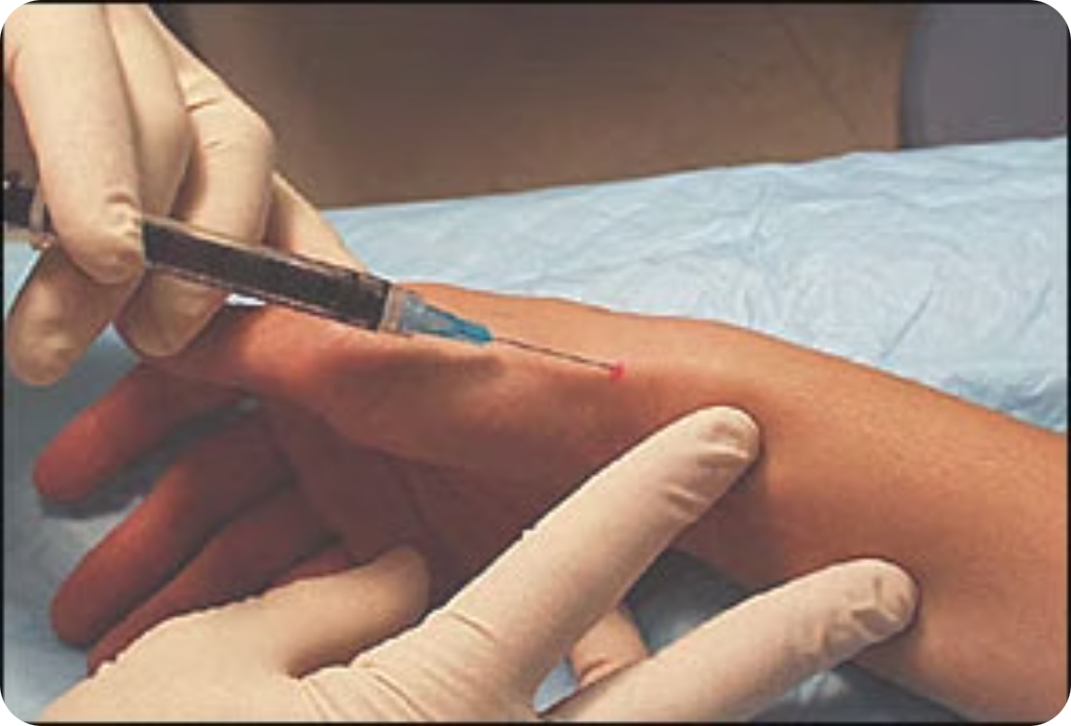
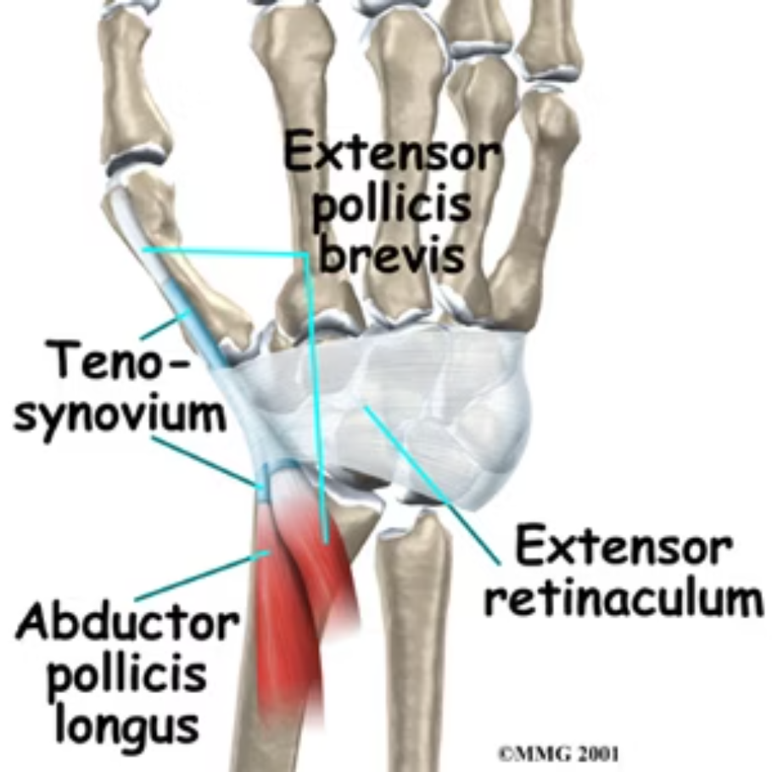
De Quervain's tenosynovitis
Maximally abduct thumb (accentuates abductor tendon) — Injection site
Snuffbox at base of thumb
Aim 30-45 degrees proximally toward radial styloid
Insert needle between the 2 tendons (not in tendon)
Do not inject if paraesthesias (sensory branch radial nerve)

Slide 10
SOME LIGHT THEORY

Slide 11
Why inject joints?
Can be joint or soft tissue
Corticosteroid injection (+ needle + LA)
Inflammation — e.g. degenerative joint disease, bursitis, tendinitis
Helps decrease inflammatory rxn (includes limiting capillary dilatation + vascular permeability)

Slide 12
Basic principles before you start
History and examination
Shared decision-making
Consider exercise therapy, physiotherapy, weight loss and analgesia before injection.
Careful patient selection
Consent
Know your anatomy!
Use repeat injections cautiously
Usually avoid more than 3 injections per year in a single joint and space by at least 3 months.

Slide 13
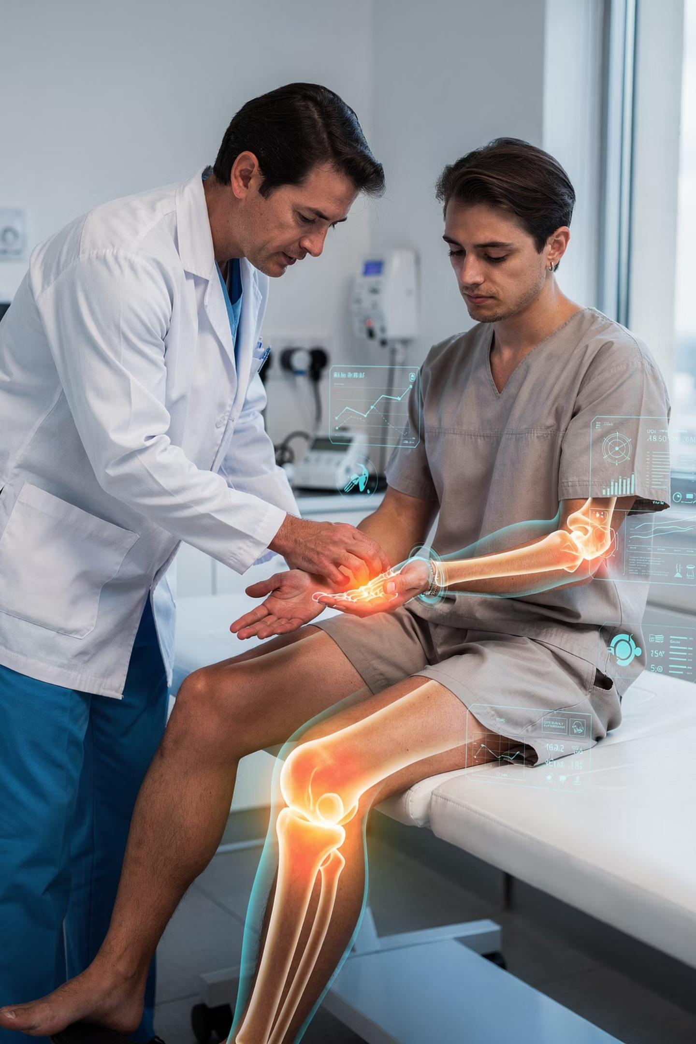
Indications for injection
Osteoarthritis
Rheumatoid arthritis
Gouty arthritis
Synovitis
Bursitis
Tendonitis
Muscle trigger points
Carpal tunnel syndrome

Slide 14


Inject with caution
Charcot joint (neuropathic sensory loss)
Tumour
Neurogenic disease
Active infections (eg, tuberculosis)
Immune-suppressed hosts
Hypothyroidism
Bleeding dyscrasias

Slide 15
Contraindication to injection
Adjacent osteomyelitis
Bacteraemia
Hemarthrosis
Impending (scheduled within days) joint replacement surgery
Infectious arthritis
Joint prosthesis
Osteochondral fracture
Periarticular cellulitis / severe dermatitis / soft tissue infection
Uncontrolled diabetes or inability to monitor steroid-related hyperglycaemia
Uncontrolled bleeding disorder or coagulopathy

Slide 16

Technique 1
Object is to inject the corticosteroid with as little pain and as few complications as possible.
Do not attempt any injections in the vicinity of known nerve or arterial landmarks
eg lateral epicondyle of elbow ok, medial – beware ulnar nerve
Never inject into substance of a tendon
Sterile technique

Slide 17
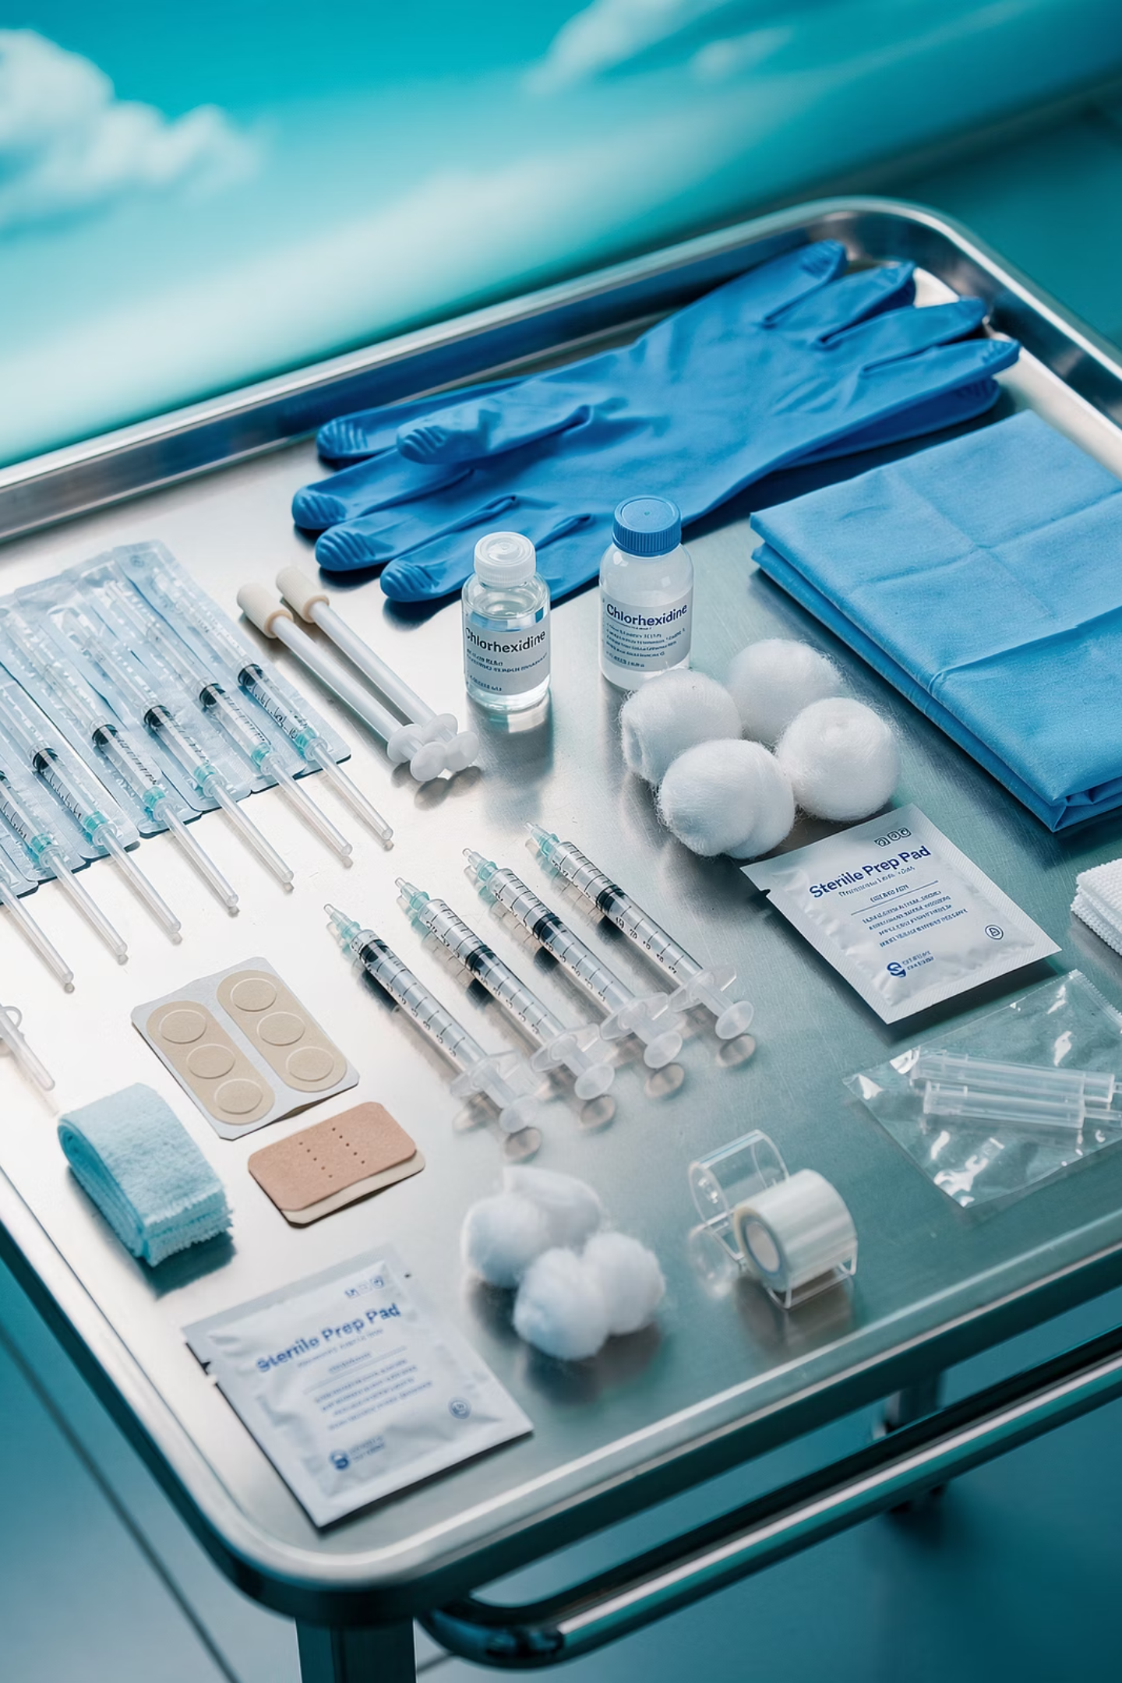
Technique 2
ANTICIPATION! Get your kit ready:
Needles
Syringes
Sterile container
LA
Steroid
Gloves
Drapes
Chlorhexidine
Cotton wool
Plaster
1 or 2 needle technique
Clean area – ensure solution is DRY (esp iodine)

Slide 18
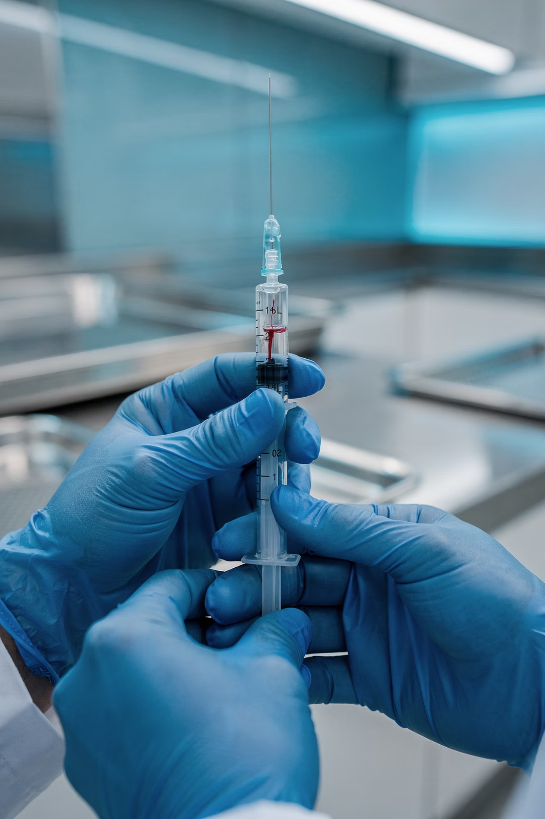
Technique 3
01
Withdraw syringe first
Always withdraw syringe back first to ensure not injecting into a blood vessel.
02
Inject local anaesthetic (LA) first
eg lidocaine 1% or marcaine.
03
Wait 3–5 minutes
Then use a larger bore needle to inject corticosteroid.
04
Corticosteroid options
Eg hydrocortisone acetate, methylprednisolone acetate, triamcinolone hexacetonide.

Slide 19

What to warn the patient
Pain returns after 2 hours, when the local anaesthetic wears off – may be worse than before.
If pain is severe or increasing after 48hrs, seek advice
Warn of local side effects
Advise to seek help if systemic s/es develop

Slide 20
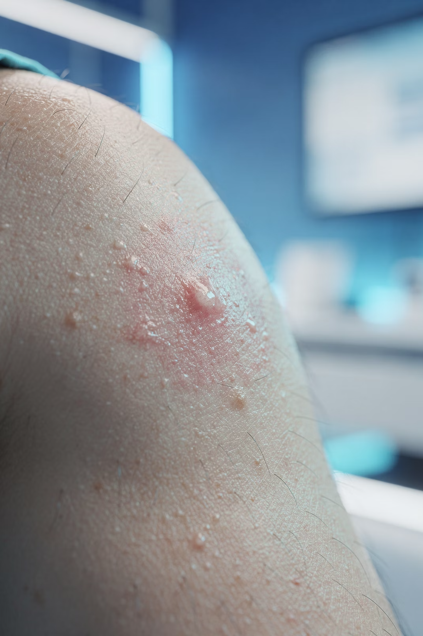
Local side effects
Infection, subcutaneous atrophy, skin depigmentation, and tendon rupture (<1%)
Post-injection 'flare' in 2-5%
Often are the result of poor technique, too large a dose, too frequent a dose, or failure to mix and dissolve the medications properly
Steroid benefit is often temporary and should accompany rehabilitation/exercise advice.

