Slide 1

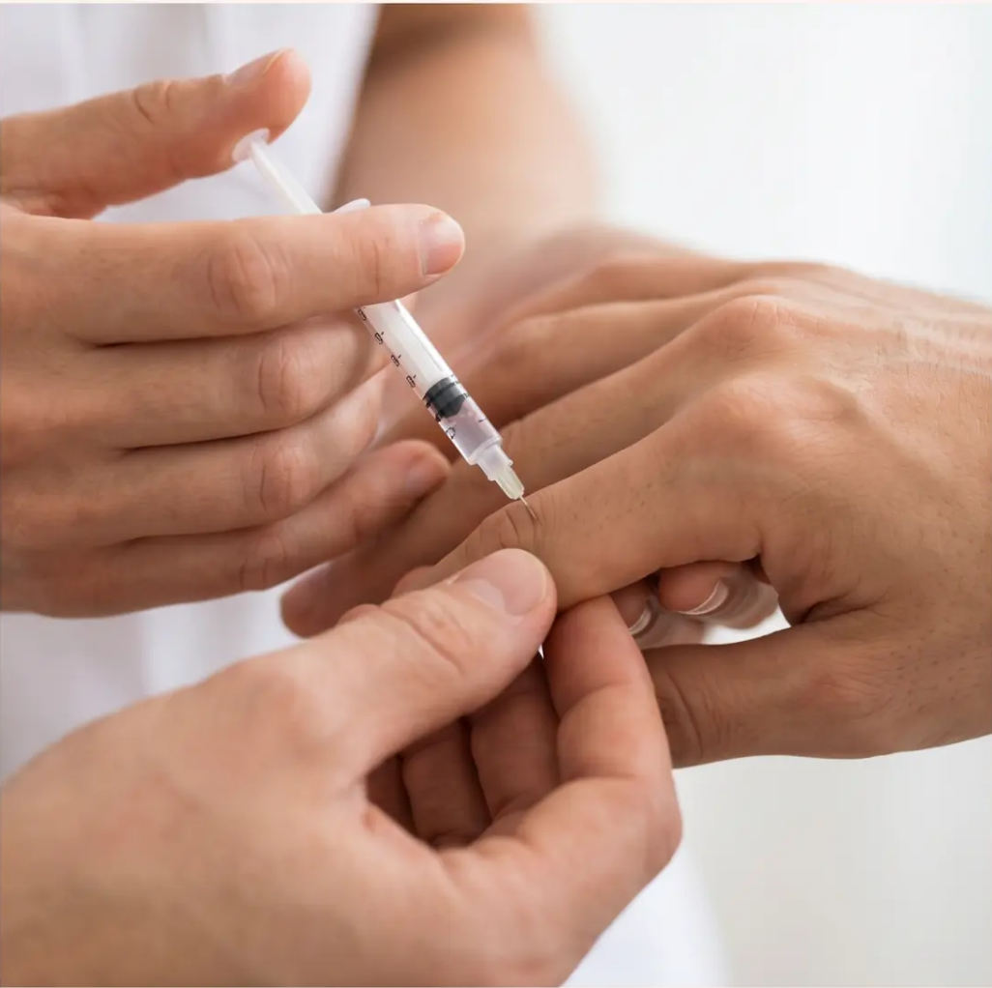
BRADFORD VTS TEACHING DECK
Joint and Periarticular
Injections in
General Practice
This Bradford VTS teaching deck provides a comprehensive
guide for GP trainees on joint injections, updated to NICE
2022/2026, BNF 2026, and MHRA 2026 standards.
www.bradfordvts.co.uk
Updated: NICE NG226 2022/2026 • BNF 2026 • MHRA 2026
© Bradford VTS 2026

Slide 2
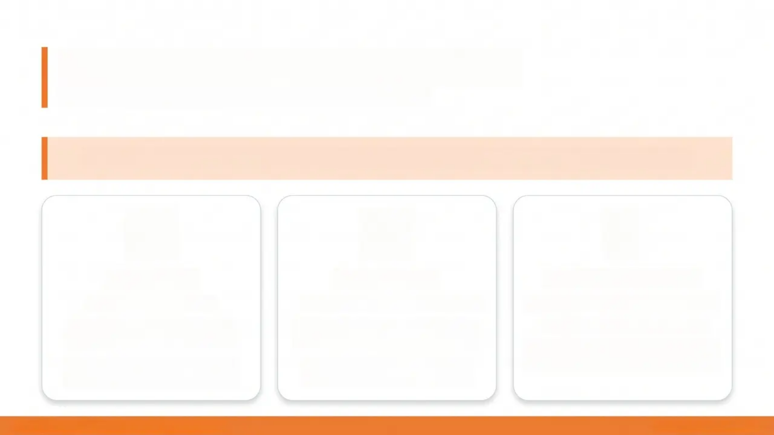
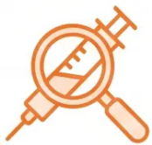
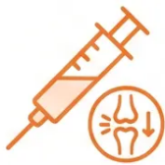
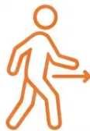
Introduction to Joint Injections
Why inject? When to inject? And what to try first.
“Injection is always second-line. Conservative treatment must be tried first.”
Diagnostic
Therapeutic
Conservative First
Synovial fluid analysis
Identify infection, crystals, or
inflammation
Aspiration mandatory if septic
arthritis suspected
Corticosteroid + local anaesthetic
Reduces capillary dilatation and
vascular permeability
Targets joints, bursae, tendon
sheaths, and entheses
NSAIDs, physiotherapy, analgesia
Activity modification, ice/heat
Injection is second-line — always
try this first
Bradford VTS — Joint Injections Teaching Deck
www.bradfordvts.co.uk

Slide 3

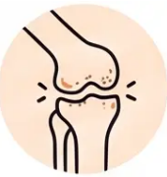
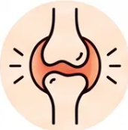

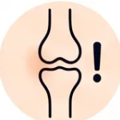
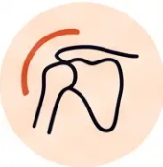
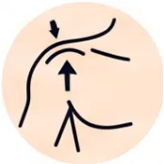

Indications for Intra-articular Injections
When is intra-articular injection appropriate?
Rheumatoid
Arthritis
Osteoarthritis
Crystal Arthritis
Second-line adjunctive per NICE NG226
— after exercise, analgesia, and NSAIDs
Acute flares with joint effusion; as
adjunct to disease-modifying therapy
Gout and pseudogout — aspiration for
diagnosis; injection for relief
Acute
Monoarthritis
Frozen
Shoulder
Subacromial
Impingement
Aspiration is MANDATORY — must
exclude septic arthritis first
Early painful phase (Stage 1) only —
less benefit in the stiff phase
Rotator cuff tendinopathy — after
failed conservative management
Conservative treatment must be attempted first — injections are second-line in most indications.
Bradford VTS • Joint Injections
Slide
35

Slide 4
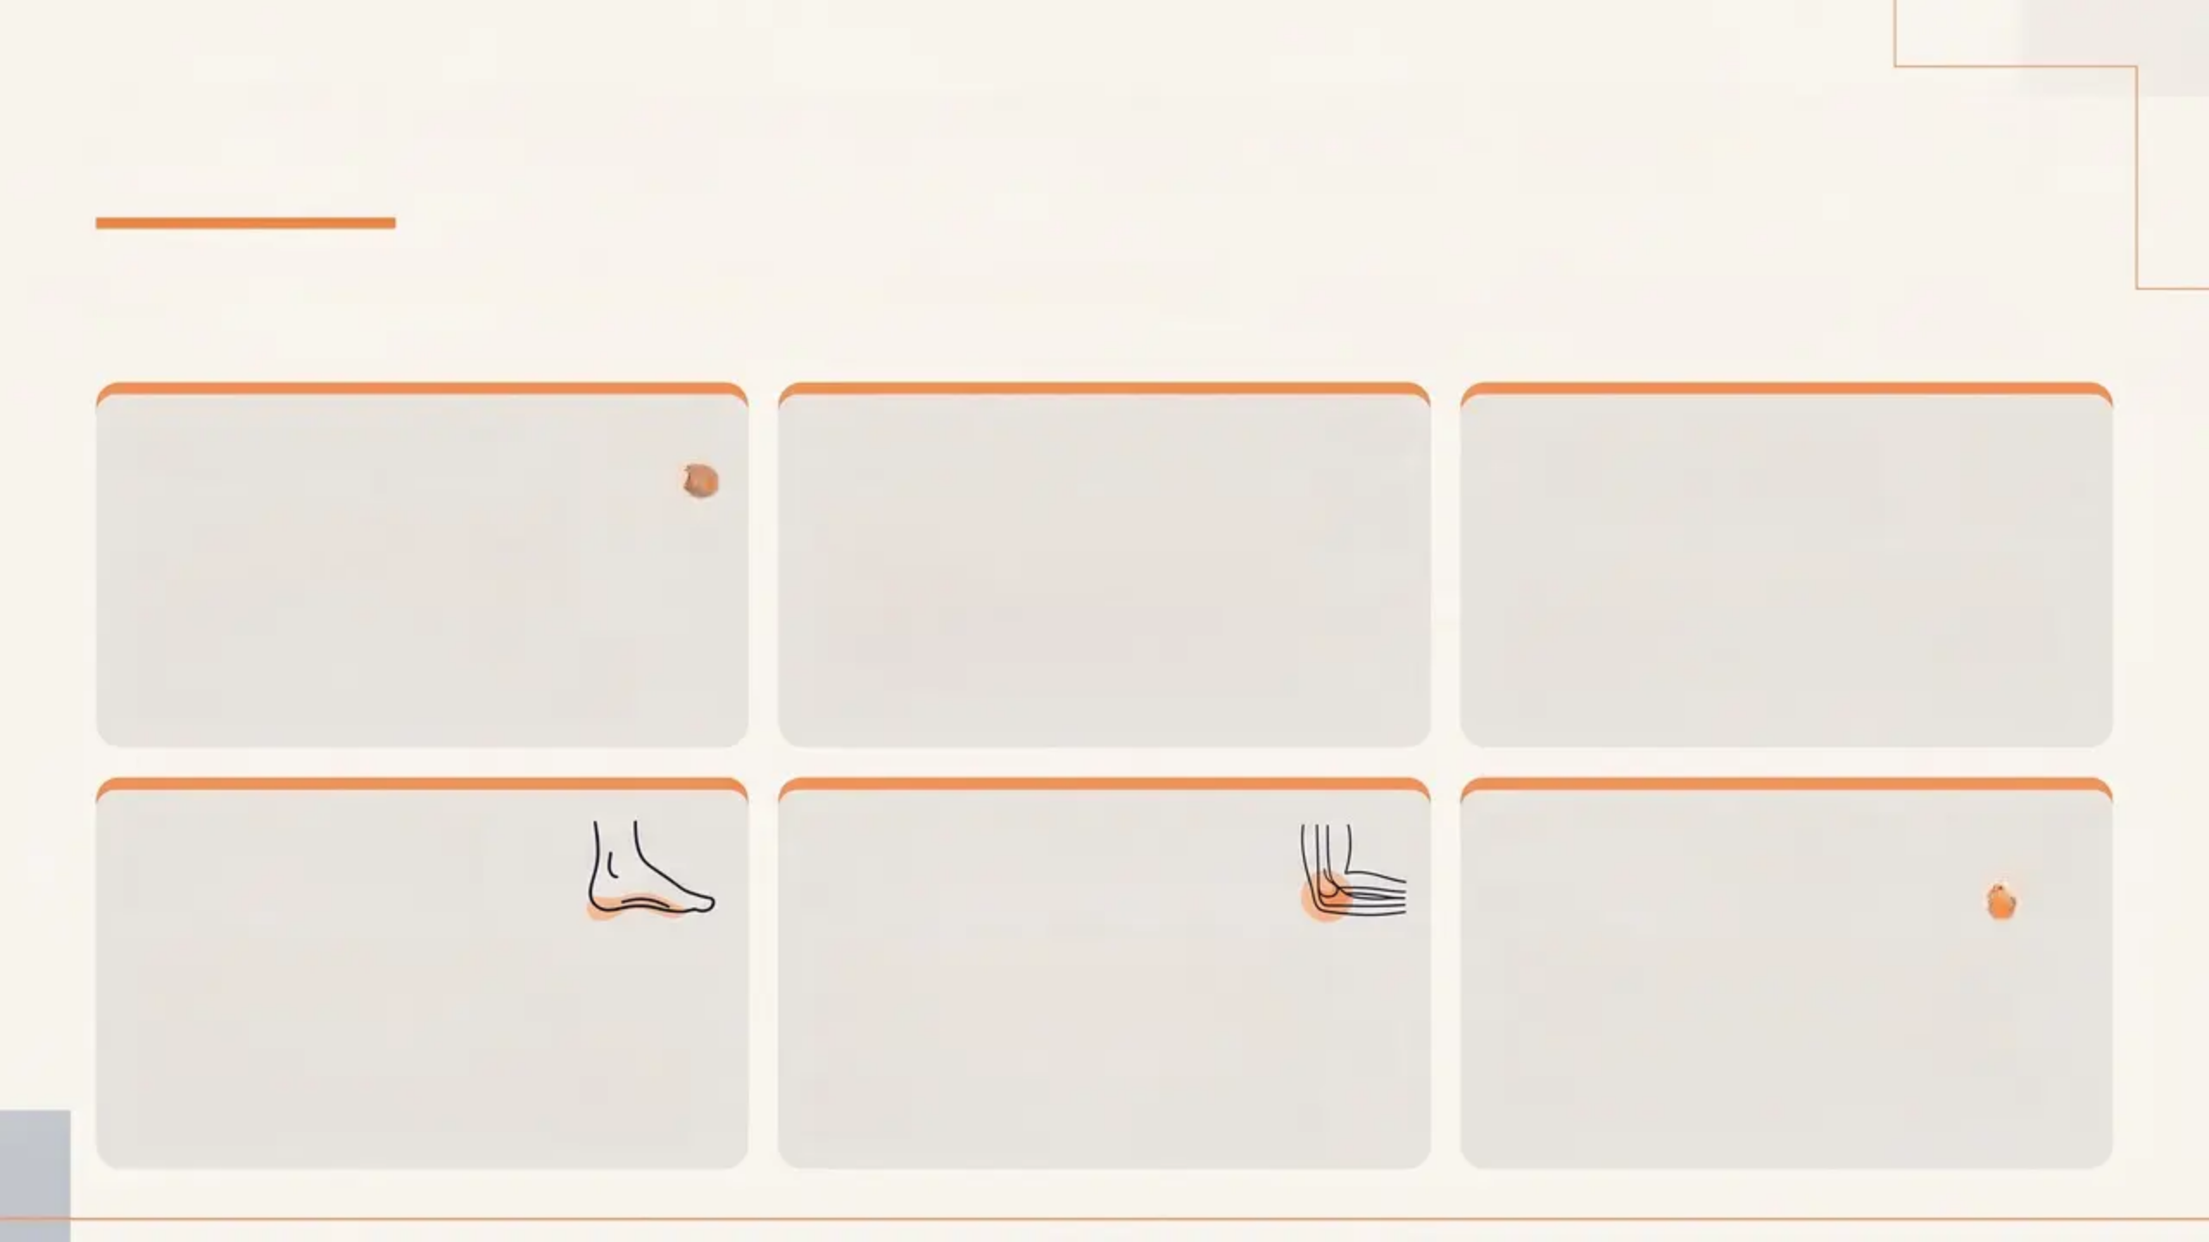
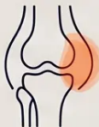
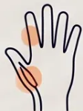
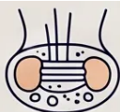
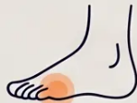
Indications for Soft Tissue & Periarticular Injections
*Periarticular conditions commonly managed in UK primary care*
Card 1 — Bursitis
Card 2 — Tenosynovitis
Card 3 — Carpal
Tunnel Syndrome
• Subacromial bursa
(shoulder impingement)
• Olecranon bursa (elbow)
• Trochanteric bursa (greater
trochanteric pain syndrome)
• De Quervain's tenosynovitis
(thumb/wrist)
• Trigger finger (flexor tendon sheath)
• Prefer methylprednisolone at
superficial sites
• Moderate CTS in primary care
• Exclude: acute, traumatic, late-
pregnancy CTS
• Injection before surgical referral
Card 4 — Plantar
Fasciitis
Card 5 — Tennis Elbow
(Lateral Epicondylitis)
Card 6 — Morton's
Neuroma
• Refractory cases only
• Evidence for long-term benefit is
limited
• Avoid repeated injections — fat
atrophy risk
• Only after 6–8 weeks of failed
conservative treatment
• NOT first-line per NICE CKS 2026
• Short-term relief only; worse
outcomes at 12 months
• Interdigital neuroma injection
• Specialist or experienced GP
only
• Consider podiatry referral first

Slide 5

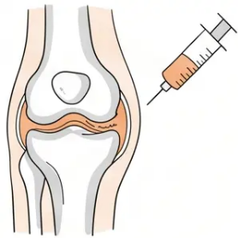



NICE NG226 Guidance on Osteoarthritis
Updated 2022, Reviewed 2026 — Hip & Knee OA
Corticosteroid injection is a second-line, adjunctive treatment — only after
exercise, weight management, and analgesia have been tried.
When to Consider
Realistic Expectations
Counselling the Patient
Other treatments have failed:
exercise therapy, weight loss,
NSAIDs, analgesia
Short-term benefit only
Set realistic expectations upfront
Typical relief: 2–10 weeks
Explain short-term nature of relief
Second-line adjunctive use only
Benefit does NOT persist long-term
Discuss likelihood of repeat
injections
Applicable to hip and knee OA
Repeated injections likely needed
Agree shared decision with patient
NICE NG226 · Updated 2022/2026
Bradford VTS · www.bradfordvts.co.uk

Slide 6

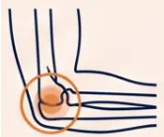
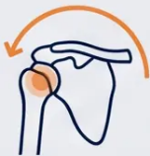
NICE CKS Guidance: Tennis Elbow and Frozen Shoulder
Updated NICE CKS 2026 — Key Guidance for GP Trainees
Tennis Elbow
Frozen Shoulder
Lateral Epicondylitis
Adhesive Capsulitis
First-line: Activity modification,
physiotherapy, “wait and see”
CSI recommended in the early painful
phase (Stage 1)
Clinical utility drops significantly in the stiff
phase (Stage 2)
CSI is NOT first-line — do not inject early
Consider injection only after 6–8 weeks of
failed conservative treatment
NOT recommended for acute traumatic
rotator cuff tears — urgent surgical referral
CSI gives better short-term relief (<6 weeks)
BUT worse outcomes at 12 months vs
physiotherapy
Younger patients with shoulder pain not
improving → consider surgical referral
(rotator cuff rupture risk)
Avoid repeated injections — increases chronic
pain risk
Injection site: glenohumeral joint (posterior
approach preferred)
AKT Pearl: CSI = better short-term, worse at 12
months — a classic AKT question
Clinical Tip: Timing matters — inject in the
painful phase, not the frozen/stiff phase
Bradford VTS Teaching Deck — Joint Injections
www.bradfordvts.co.uk

Slide 7
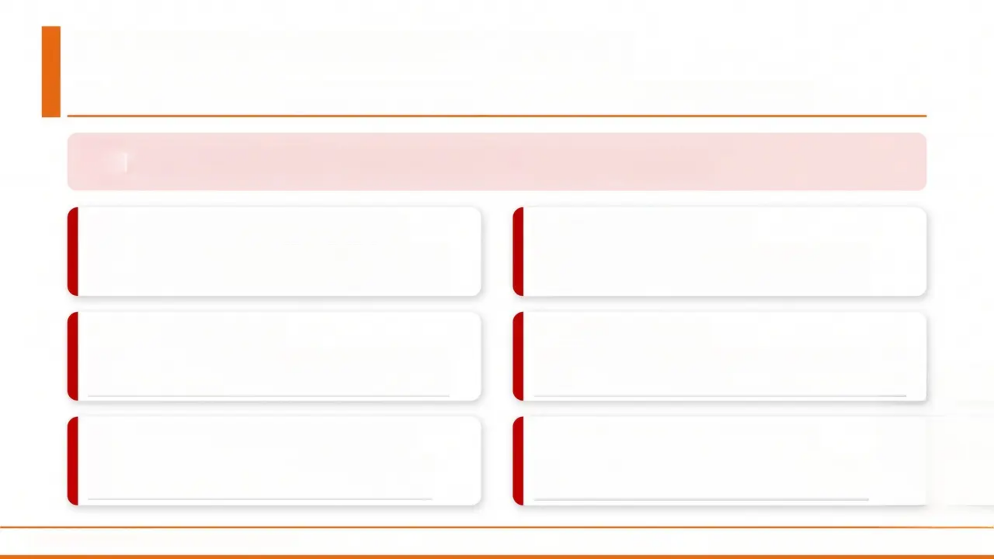

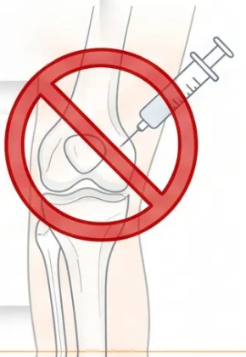
Absolute Contraindications
Situations where injection is strictly prohibited — no exceptions
Never inject if any of the following are present
Septic / Infectious Arthritis
Adjacent Infection
Active infection within the joint — injection
risks seeding and worsening sepsis
Osteomyelitis, periarticular cellulitis, or
bacteraemia near the target site
Joint Prosthesis
Haemarthrosis
Prosthetic joint at the injection site — high
infection risk; refer to surgeons
Blood in the joint — investigate and identify
the underlying cause first
Pending Joint Replacement
Osteochondral Fracture
Surgery planned within days — injection
increases perioperative infection risk
Fracture at or near the joint — injection
inappropriate until fracture is managed
Bradford VTS — Joint Injections Teaching Deck
Slide 7 of 35

Slide 8
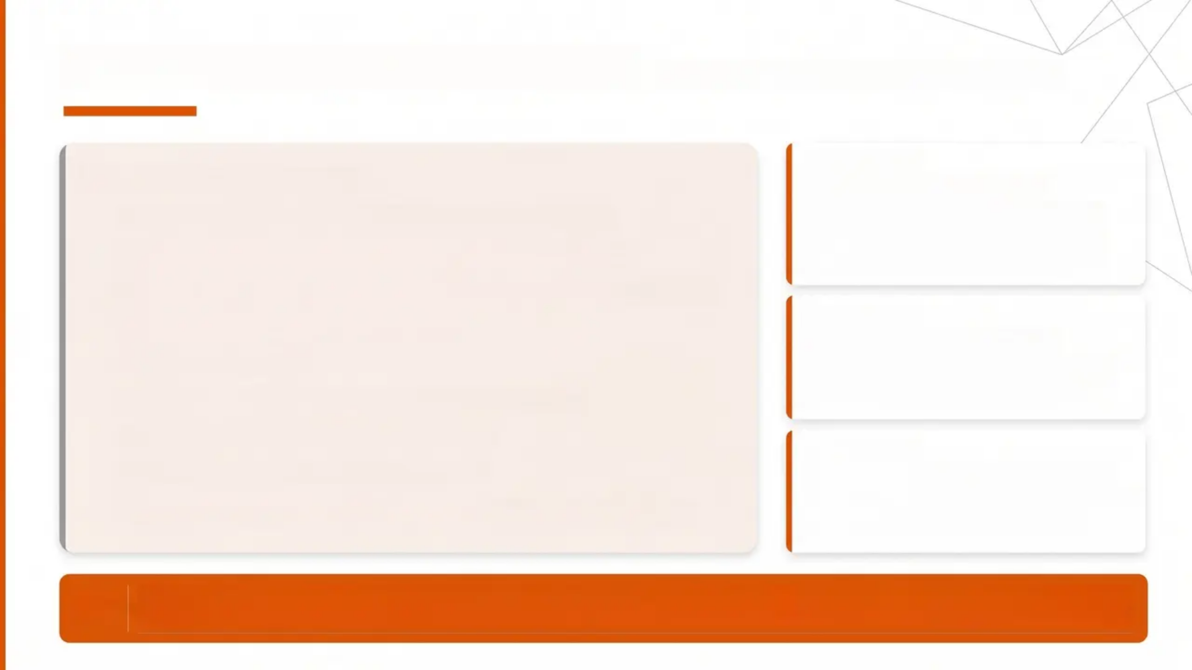


Relative Contraindications
Inject with caution — not absolute “no”
Why it Matters
INJECT WITH CAUTION
Poorly Controlled Diabetes
• Suspected (unconfirmed) infection — exclude first
• Immunosuppressed patients — higher infection risk
• Bleeding disorders / coagulopathy / severe thrombocytopenia
• Poorly controlled diabetes mellitus
• Active tuberculosis
• Charcot joint (neuropathic joint — sensory loss)
• Known tumour at or near injection site
• Hypothyroidism / neurogenic disease
• No response to previous injections → reconsider repeating
Corticosteroid injection can elevate blood
glucose significantly for up to 2-4 weeks
post-injection. Always counsel diabetic
patients before proceeding.
Why it Matters
Immunosuppressed Patients
Higher risk of introducing infection into the
joint. Weigh benefit vs. risk carefully.
Consider specialist input.
Why it Matters
Coagulopathy / Thrombocytopenia
Increased risk of haemarthrosis post-injection.
Ensure clotting status is known before
proceeding.
TIP “Poorly controlled diabetes is a RELATIVE contraindication — NOT absolute. Injection may
proceed with careful blood sugar monitoring and patient counselling.”

Slide 9
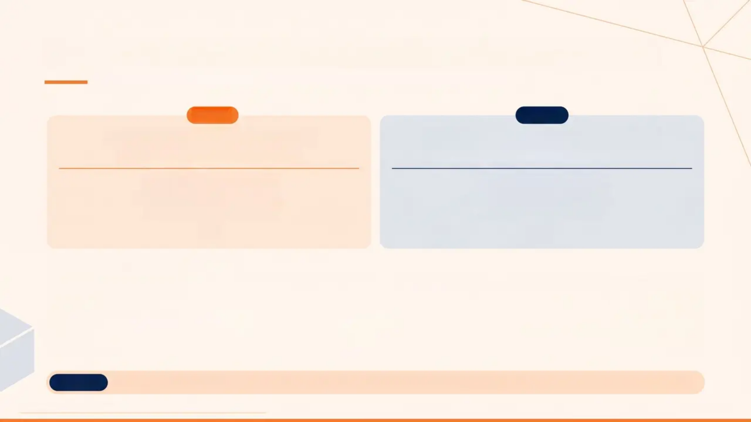


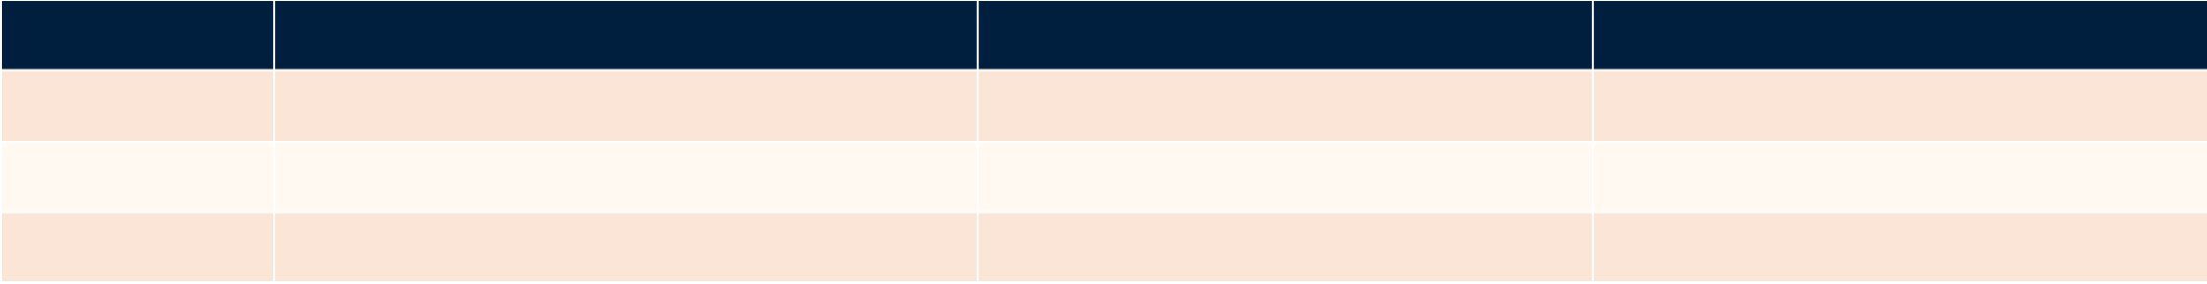
















Corticosteroid Preparations and BNF 2026 Dosing
BNF 2026 — Adult Dosing Reference for Intra-articular Use
DRUG 1
DRUG 2
Triamcinolone Acetonide
Methylprednisolone Acetate
Kenalog 40 mg/ml — Suspension
Depo-Medrone 40 mg/ml — Suspension
Large joints: 20–80 mg
Medium joints: 10–40 mg
Small joints: 2.5–10 mg
Large joints: 40–80 mg
Medium joints: 10–40 mg
Small joints: 4–10 mg
At-a-Glance Dosing Comparison
Joint Size
Example Joints
Triamcinolone Acetonide
Methylprednisolone Acetate
Large
Knee, Shoulder, Hip
20–80 mg
40–80 mg
Medium
Elbow, Wrist, Ankle
10–40 mg
10–40 mg
Small
Finger joints, AC joint
2.5–10 mg
4–10 mg
BNF 2026
*Always confirm current doses in the BNF before administering. Doses above are for adults; adjust for elderly and low body weight patients.
Bradford VTS Teaching Deck • Joint and Periarticular Injections
Slide 9 of 35

Slide 10
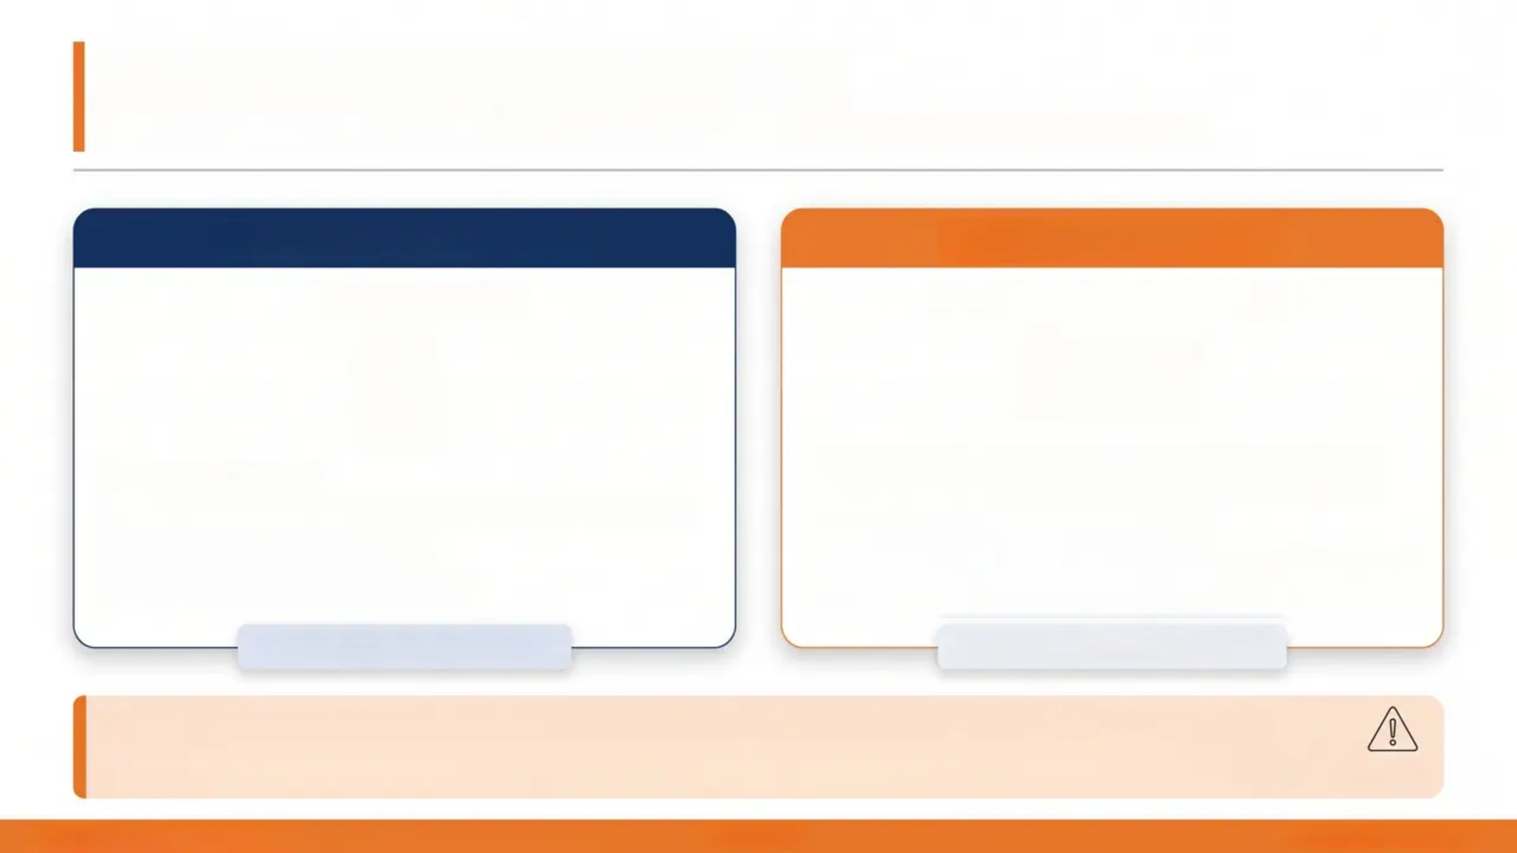
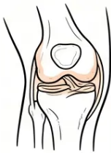
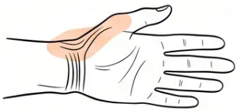
Selecting the Right Preparation
Matching the corticosteroid to the injection site reduces risk and improves outcomes.
Intra-Articular Injections
Periarticular Injections
Large & Deep Joints
Superficial & Soft Tissue Sites
✦ Knee, shoulder, hip
✦ Triamcinolone acetonide or methylprednisolone acetate
✦ Both preparations appropriate
✦ Larger volumes, deeper placement
✦ De Quervain's, trigger finger, carpal tunnel, olecranon
bursa, elbow epicondyles
✦ Prefer methylprednisolone acetate
✦ Triamcinolone — higher potency = higher skin atrophy risk
✦ Especially important in elderly and dark-skinned patients
Either preparation suitable
Methylprednisolone preferred
Key Rule: Use methylprednisolone acetate for all superficial and periarticular injections.
Triamcinolone's higher potency increases risk of subcutaneous fat atrophy and skin hypopigmentation — particularly visible in patients with darker skin tones.
Bradford VTS · Joint Injections
Slide 10 of 35
www.bradfordvts.co.uk

Slide 11
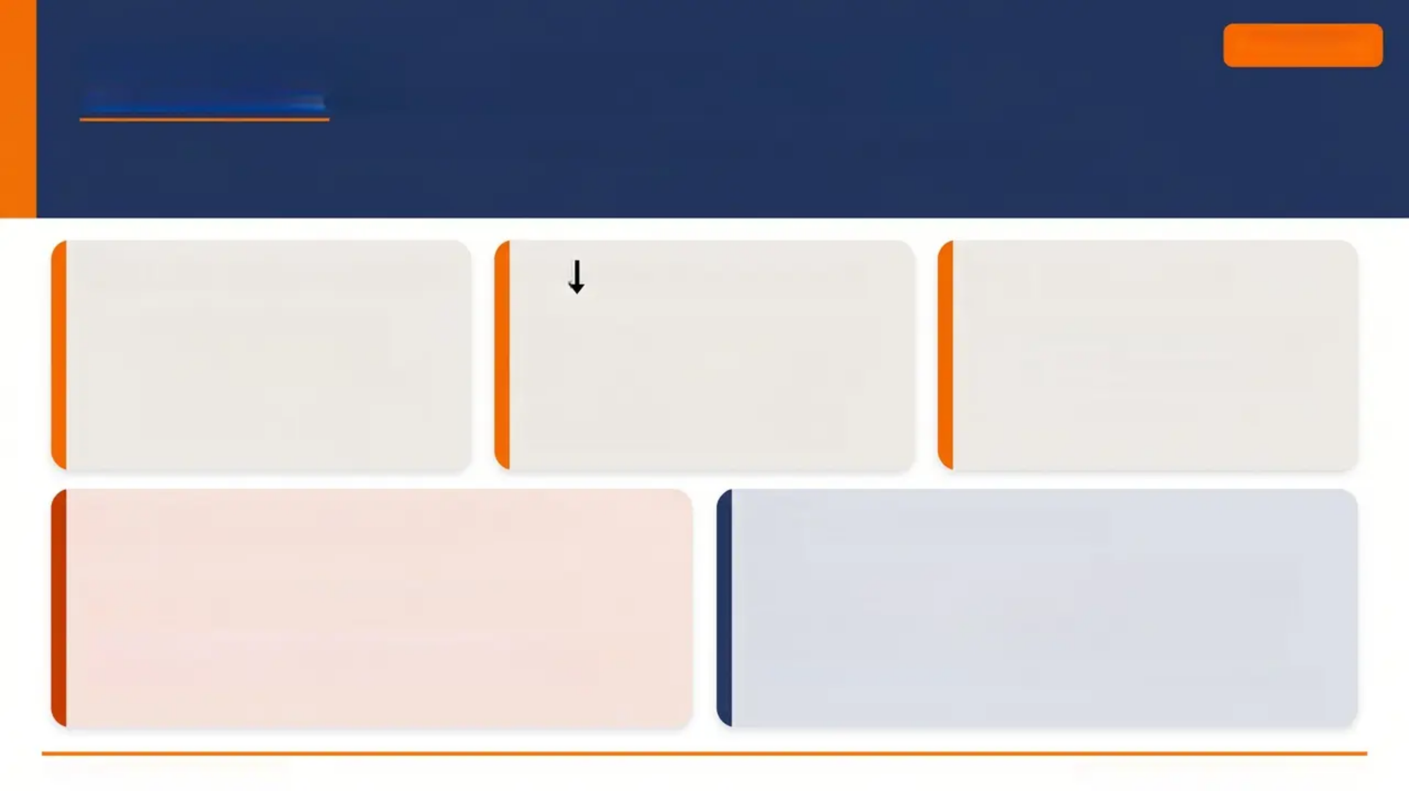





MHRA 2026 Safety Warnings
MHRA 2026
Mandatory updates for clinical practice — know before you inject
Minimum 3-Month Interval
Cartilage Damage Risk
Tendon Rupture
• Minimum 3 months between
injections at the same site
• Maximum 3-4 injections per joint
per year
• Exceeding limits increases
complication risk
• Frequent intra-articular injections
accelerate cartilage loss
• Knee joint especially vulnerable
• Warn patients; limit frequency
strictly
• Never inject into tendon substance
• Never inject against unexpected
resistance
• Risk is rare but irreversible
Central Serous Chorioretinopathy
Post-Injection Reactions
Rare — MHRA 2026 New Warning
• Facial flushing: ~40% of patients — transient, benign;
warn beforehand
• Post-injection flare: ~5% — pain peaks within hours,
resolves within 24h
• Pain persisting beyond 48h → re-aspirate; exclude septic
arthritis
• Risk of blurred vision or visual disturbance after
corticosteroid injection
• Advise all patients to seek urgent ophthalmology review
if any visual symptoms develop post-injection
• Applies to all routes of corticosteroid administration
Source: MHRA 2026 · BNF 2026
Bradford VTS · www.bradfordvts.co.uk

Slide 12
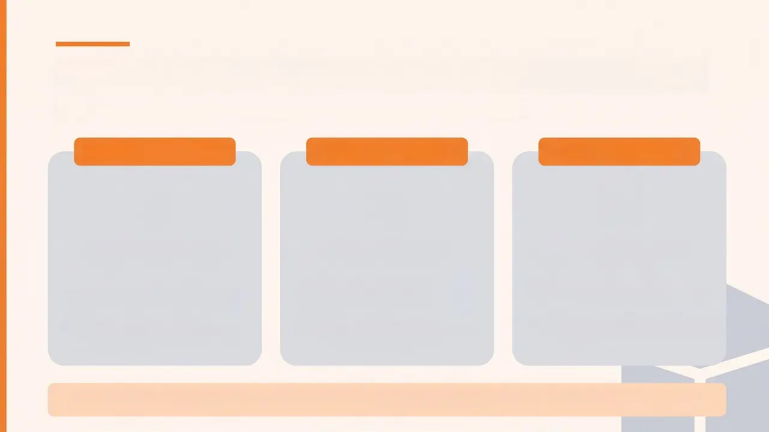

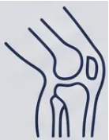

General Principles of Injection Technique
Pre-procedure essentials for safe and effective practice
BEFORE YOU START
ANATOMY FIRST
VALID CONSENT
• Confirm diagnosis with full
history and examination
• Conservative treatment
must have been tried first
• Aim for as few injections as
possible
• Identify target structure
precisely
• Know neurovascular
landmarks to avoid
• Max 3-4 injections per joint
(lifetime)
• Discuss expected benefits
(duration, realistic relief)
• Explain risks: flare, infection,
skin changes, tendon rupture
• Discuss alternatives (physio,
NSAIDs, activity modification)
“Undertake as few injections as needed to settle the problem.”
— BNF / MHRA Guidance 2026

Slide 13
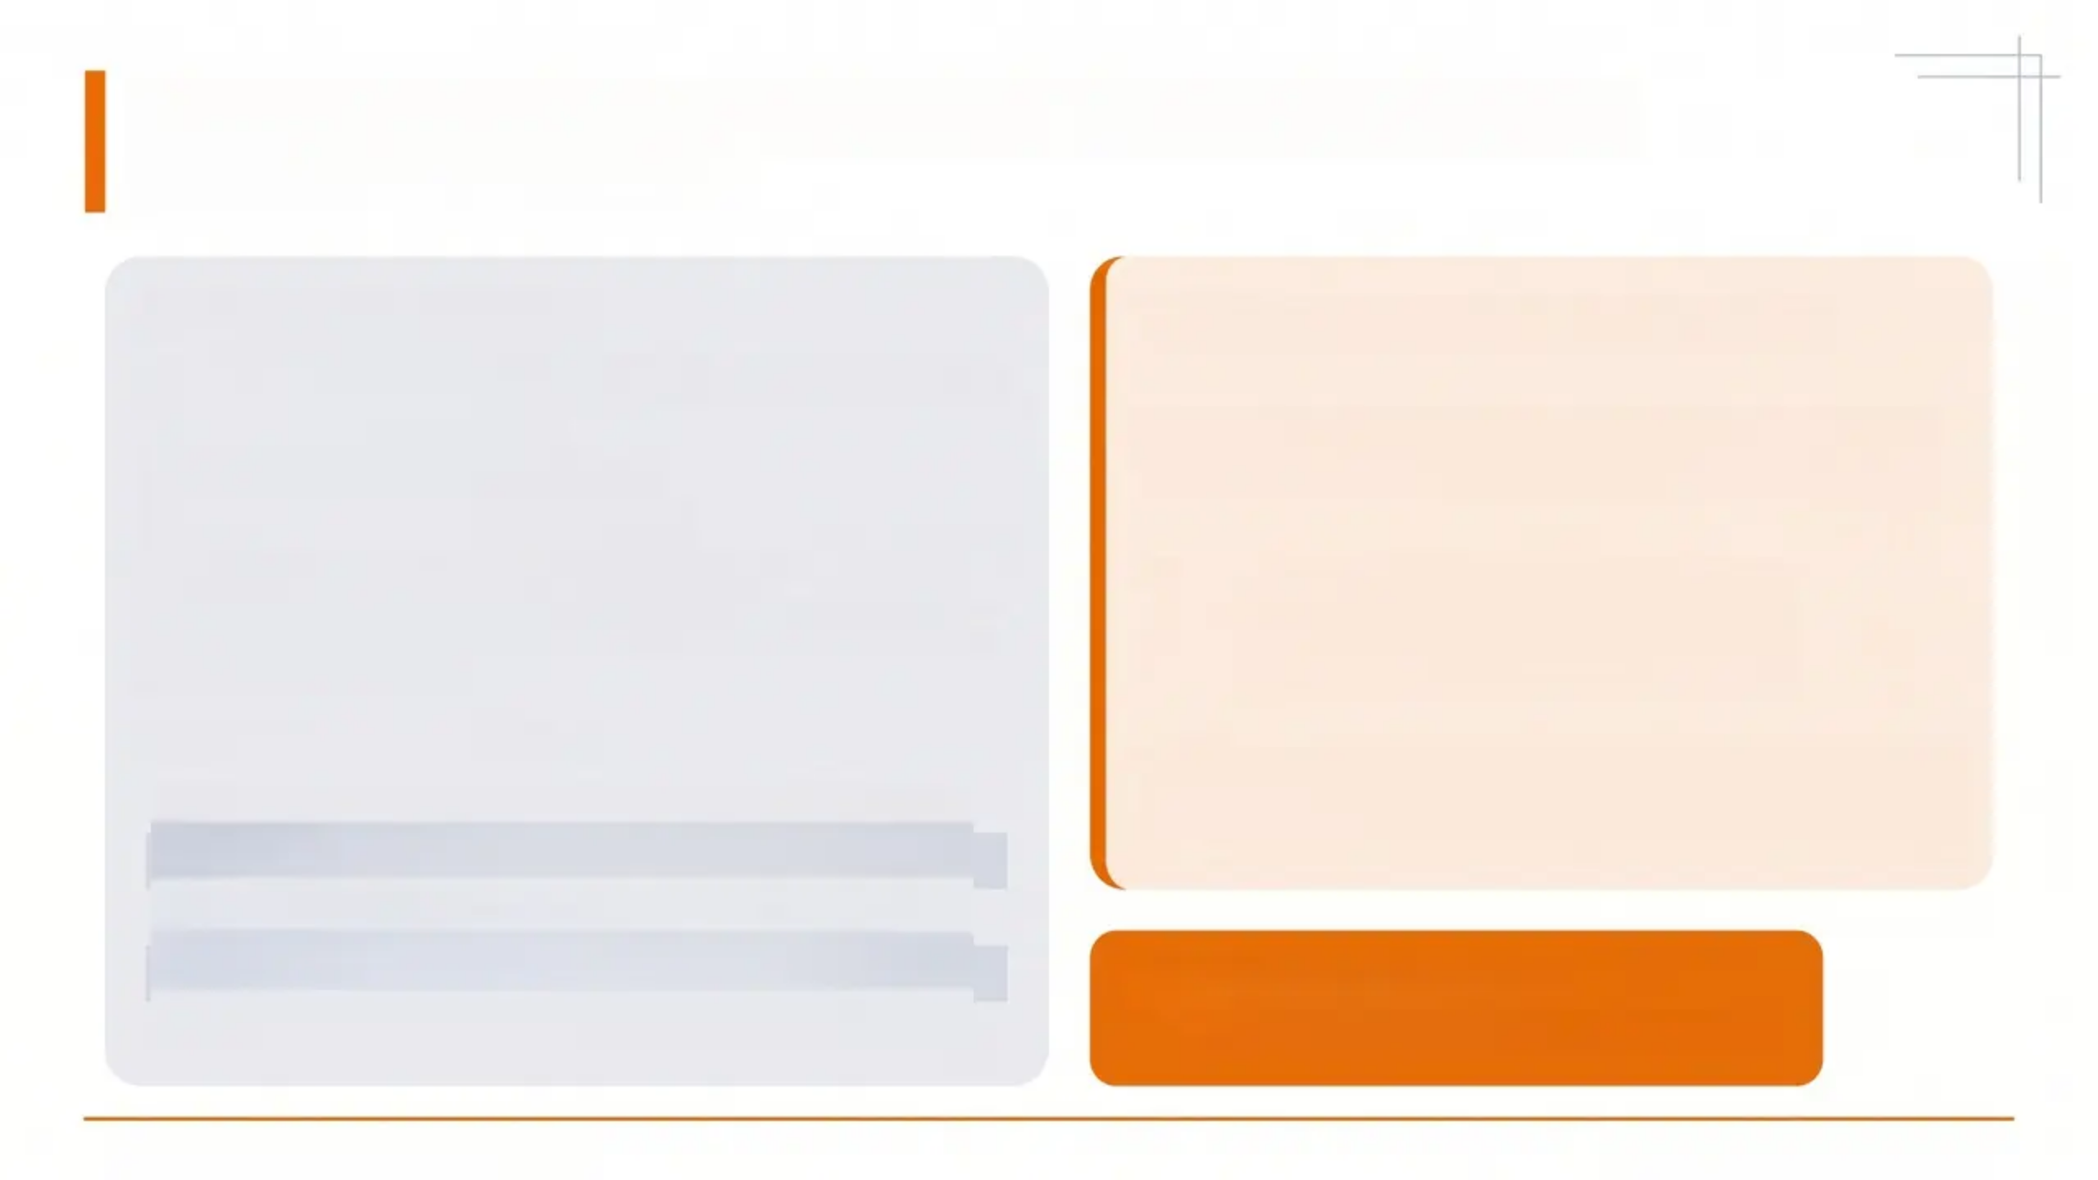

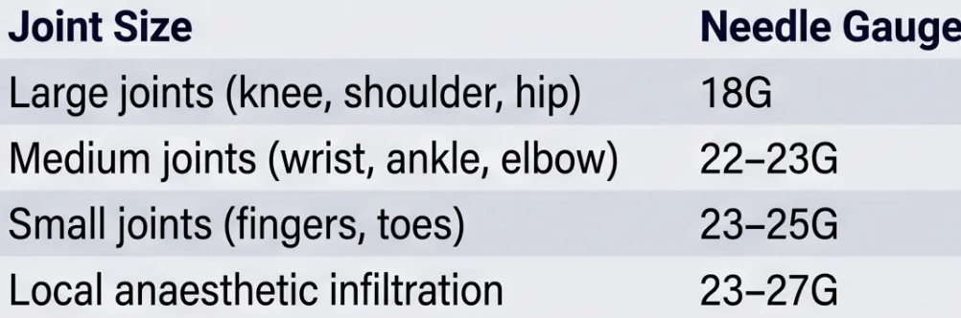
Equipment and Local Anaesthetic Requirements
What you need before you start
Your Injection Kit
Local Anaesthetic: Key Rules
■ Antiseptic solution — povidone-iodine or chlorhexidine
■ Sterile gloves and drapes
■ Gauze, cotton wool, and plaster
■ 1% lidocaine plain (no adrenaline)
■ Corticosteroid preparation (as selected)
■ Syringes: 3–5 ml for injection · 10–50 ml for aspiration
■ Drawing-up needle
1. Use 1% Lidocaine — Plain Only
No adrenaline required for intra-articular injections
2. Inject LA First
Wait 3–5 minutes before proceeding with
corticosteroid
Needle Gauge by Joint Size
3. Ensure Antiseptic is DRY Before Injecting
Iodine solution is a fire risk if wet near electrocautery
> ⚠️ Plain lidocaine only.
Adrenaline is NOT used in joint injections.
Bradford VTS — Joint & Periarticular Injections
Slide 13 of 35 • www.bradfordvts.co.uk

Slide 14

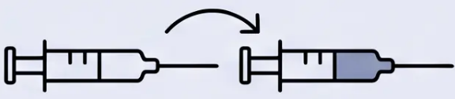
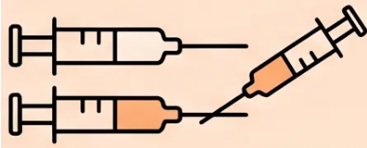
Procedural Methods: One-Needle vs. Two-Needle
Ensuring accurate delivery — local anaesthetic first, corticosteroid second
One-Needle Technique
Two-Needle Technique
1. Draw up local anaesthetic and corticosteroid in
separate syringes
2. Insert needle and inject local anaesthetic first
3. Detach syringe — keep needle in place, do not move
4. Attach corticosteroid syringe to the same needle
5. Inject corticosteroid
1. Draw up local anaesthetic and corticosteroid in
separate syringes
2. Insert first needle — inject local anaesthetic
3. Withdraw first needle completely
4. Insert second, fresh needle for corticosteroid injection
5. Inject corticosteroid at confirmed depth
VS
✔ Fewer skin punctures
✔ Reduces risk of superficial steroid deposition
Key principle: Always aspirate before injecting — confirm needle is not in a blood vessel. Do not inject against unexpected resistance.

Slide 15
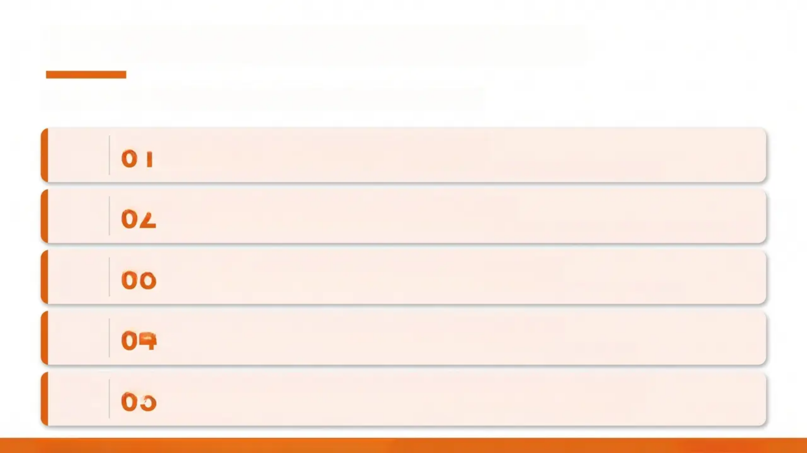
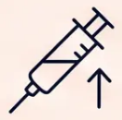


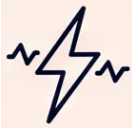

Critical Safety Rules during Injection
Non-negotiable practices — every injection, every time
01
Always Aspirate Before Injecting
Pull back the plunger first — confirm you are not in a blood vessel before delivering any drug.
02
Never Inject Into Tendon Substance
Intra-tendinous injection causes tendon rupture — target the sheath or peristeal junction, not the tendon itself.
03
Stop if You Meet Unexpected Resistance
Resistance means the needle tip is incorrectly placed — reposition before applying any pressure.
04
Stop Immediately if Paraesthesias Occur
Tingling or shooting sensation = needle near a nerve — withdraw and reposition at once.
05
Maintain Sterile No-Touch Technique Throughout
Every step — from skin prep to needle withdrawal — must follow strict aseptic protocol.
Septic arthritis risk: 1 in 15,000 procedures — strict technique is your patient's protection.
www.bradfordvts.co.uk

Slide 16

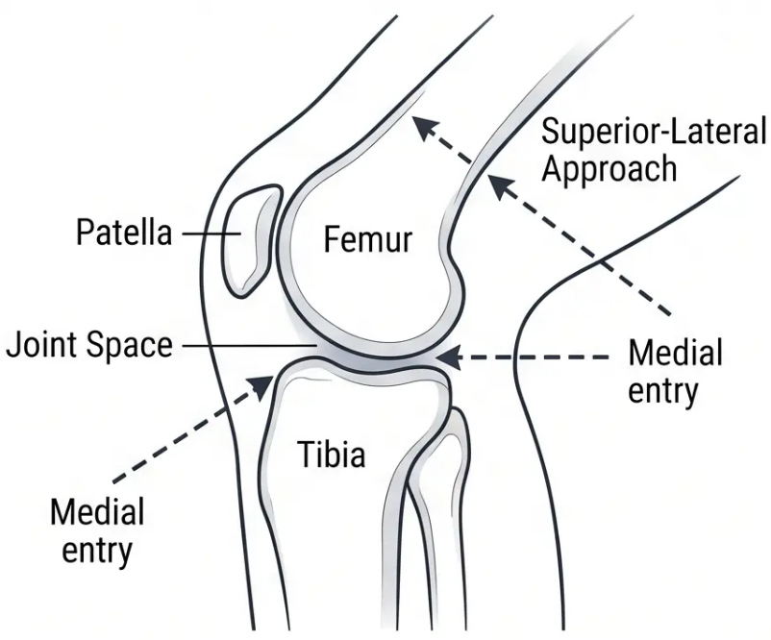
Bradford VTS
Joint Specific: Knee Injection Techniques
*Section 7 · Joint-Specific Approaches
APPROACH OPTIONS
Medial Approach
Patient supine or sitting, knee slightly bent or extended
Needle inserted at mid-point between upper and lower poles of patella
Aimed at undersurface of patella
Use 22G needle
Superior-Lateral Approach
Palpate superior-lateral aspect of patella
Mark one fingerbreadth above and lateral to patella
Needle directed medially and slightly inferiorly
Use 22G needle
Dose: 40–60mg Methylprednisolone
Medial and superior-lateral needle entry paths – knee joint
⚠️ BAKER'S CYST – MANAGEMENT NOTE
Do NOT inject the Baker's cyst directly. Treat the underlying knee disorder (OA, synovitis). The cyst resolves when the primary condition is managed.

Slide 17

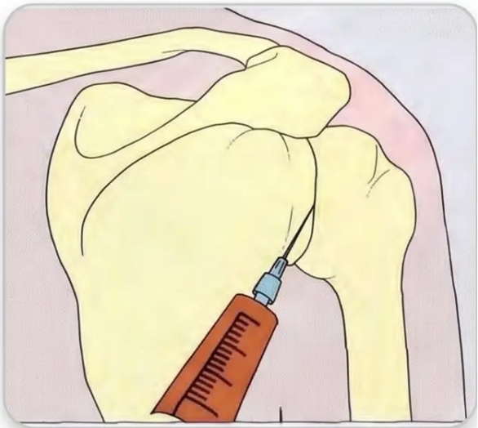
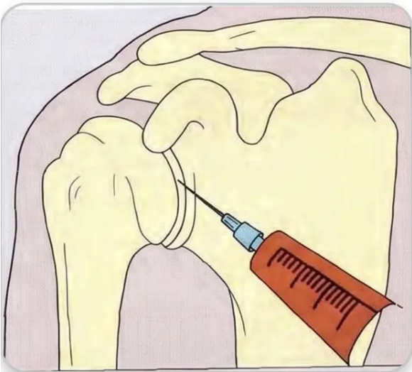
Joint Specific: Glenohumeral Shoulder Injection
Dose: 40–60 mg methylprednisolone · 22G needle
POSTERIOR APPROACH ★ Preferred
➢ Patient seated, arm resting comfortably by side
➢ Needle inserted 1 cm below and 1 cm medial to
posterolateral acromion corner
➢ Direct needle anteriorly toward coracoid process
ANTERIOR APPROACH
• Needle entry 1 cm distal and lateral to coracoid
process
• Direct posteriorly; guide forearm gently into
internal rotation as needle enters joint
• Useful when posterior access is difficult
Posterior Approach
Anterior Approach
⚠️ Use chair with armrests · Have assistant
present · Watch for vasovagal response
Bradford VTS · Joint Injections Teaching Deck
Slide 17 of 35

Slide 18

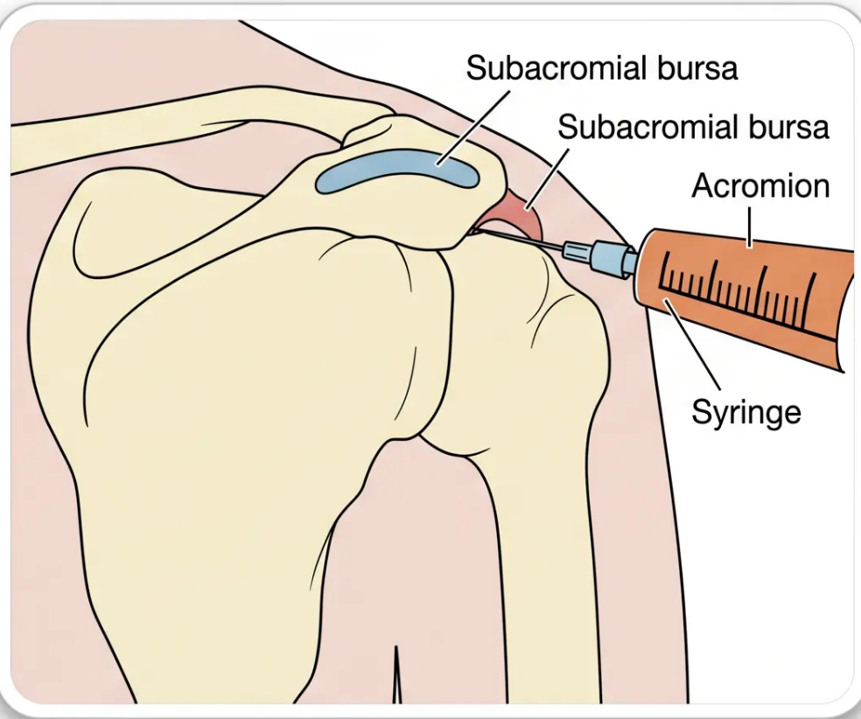
Subacromial Bursa and
Acromioclavicular Joint
Joint-Specific Techniques · Slide 18 of 35
Subacromial Bursa
Indication: Subacromial Impingement · Calcific Tendinitis
• 🩹 Dose: 30–40 mg methylprednisolone (22G or 25G needle)
• 📍 Posterolateral approach (standard): Inferior to posterolateral acromion;
needle aimed anteromedially, directed toward the opposite nipple
• 📍 Anterior approach: Flush with inferior surface of acromion, 1 cm lateral
to AC joint
Only ~50% of subacromial injections are accurately placed without
imaging — yet clinical results can still be good even with imperfect
placement.
Acromioclavicular (AC) Joint
• 🩹 Dose: 10–20 mg methylprednisolone (23G butterfly or 22G needle)
• 📍 Approach: Needle perpendicular to articular cleft; advance
approximately 0.5 cm
• ⚠️ Technically difficult — AC joint is narrow with a partial meniscus; do not
force the needle
• 🚫 Caution: Suspect septic AC arthritis in IV drug users or patients with
subclavian catheter history
Posterolateral approach to the subacromial bursa —
standard technique in primary care.
Illustration: Posterolateral Approach
Bradford VTS · Joint and Periarticular Injections
www.bradfordvts.co.uk

Slide 19
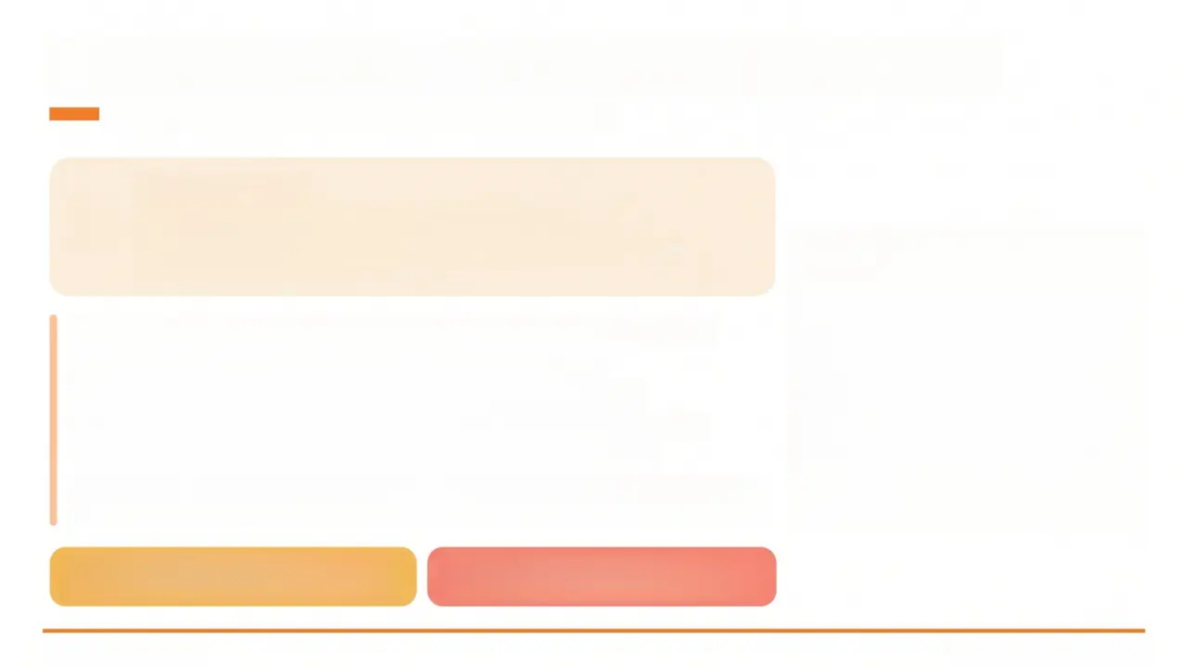
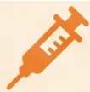
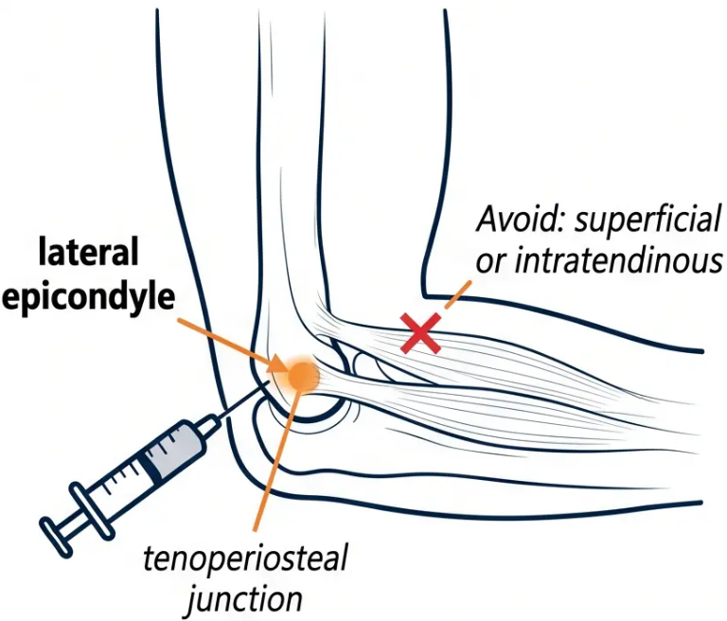
Elbow: Tennis Elbow (Lateral Epicondylitis)
Joint-Specific Injection Technique — Slide 19 of 35
Dose & Equipment
Drug: Methylprednisolone 10–20 mg Needle: 22G
Infiltrate 2–3 ml lidocaine 1% first, then inject corticosteroid
Site: tenoperiosteal junction — not superficially, not into tendon
1. Identify the point of maximal tenderness over the lateral epicondyle
2. Clean the skin with antiseptic — allow to dry completely
3. Infiltrate 2–3 ml of 1% plain lidocaine first; wait 3–5 minutes
4. Advance needle to periosteal contact at the tenoperiosteal junction
5. Inject corticosteroid slowly — do not inject against resistance
6. Verify placement: ask patient to perform resisted wrist dorsiflexion — If
pain is NOT eradicated → wrong site → reposition needle before injecting
Transient pain increase post-injection in
~40% of patients — warn beforehand
Repeated injections → risk of chronic
pain — avoid serial injections
www.bradfordvts.co.uk
Slide 19 • Bradford VTS 2026

Slide 20

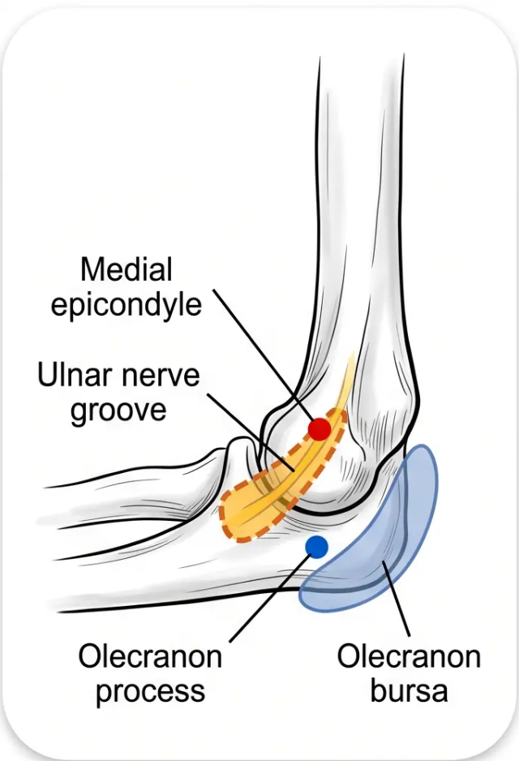
Elbow: Medial Epicondylitis & Olecranon Bursa
*Joint-Specific Technique — Elbow
Golfer's Elbow — Medial Epicondylitis
Position: Arm comfortably abducted, elbow flexed at 45°, wrist supinated
Approach: Identify point of maximal tenderness at medial epicondyle; advance
needle to bone, then withdraw 1–2mm before injecting slowly
Dose: 10–20mg methylprednisolone + lidocaine (22G needle)
BEWARE: Ulnar Nerve
The ulnar nerve passes directly posterior to the medial epicondyle. A medial approach carries
real risk of nerve injury. Identify and avoid the nerve groove before inserting the needle.
Olecranon Bursa
Approach: Lateral entry through normal skin, aiming at the centre of the bursa —
never enter at the tip
Dose: 20mg methylprednisolone (22G needle)
Do NOT use triamcinolone — higher risk of skin atrophy and septic bursitis at this
superficial site
Conservative first: Advise patient to avoid leaning on elbow for at least 3 months
before considering injection
Taps at the very tip of the bursa risk creating a chronic fluid leak. Medial entries risk ulnar
nerve damage. Always approach laterally.
Elbow — medial and posterior landmarks
Bradford VTS — Joint Injections Teaching Deck
Slide 20 of 35

Slide 21
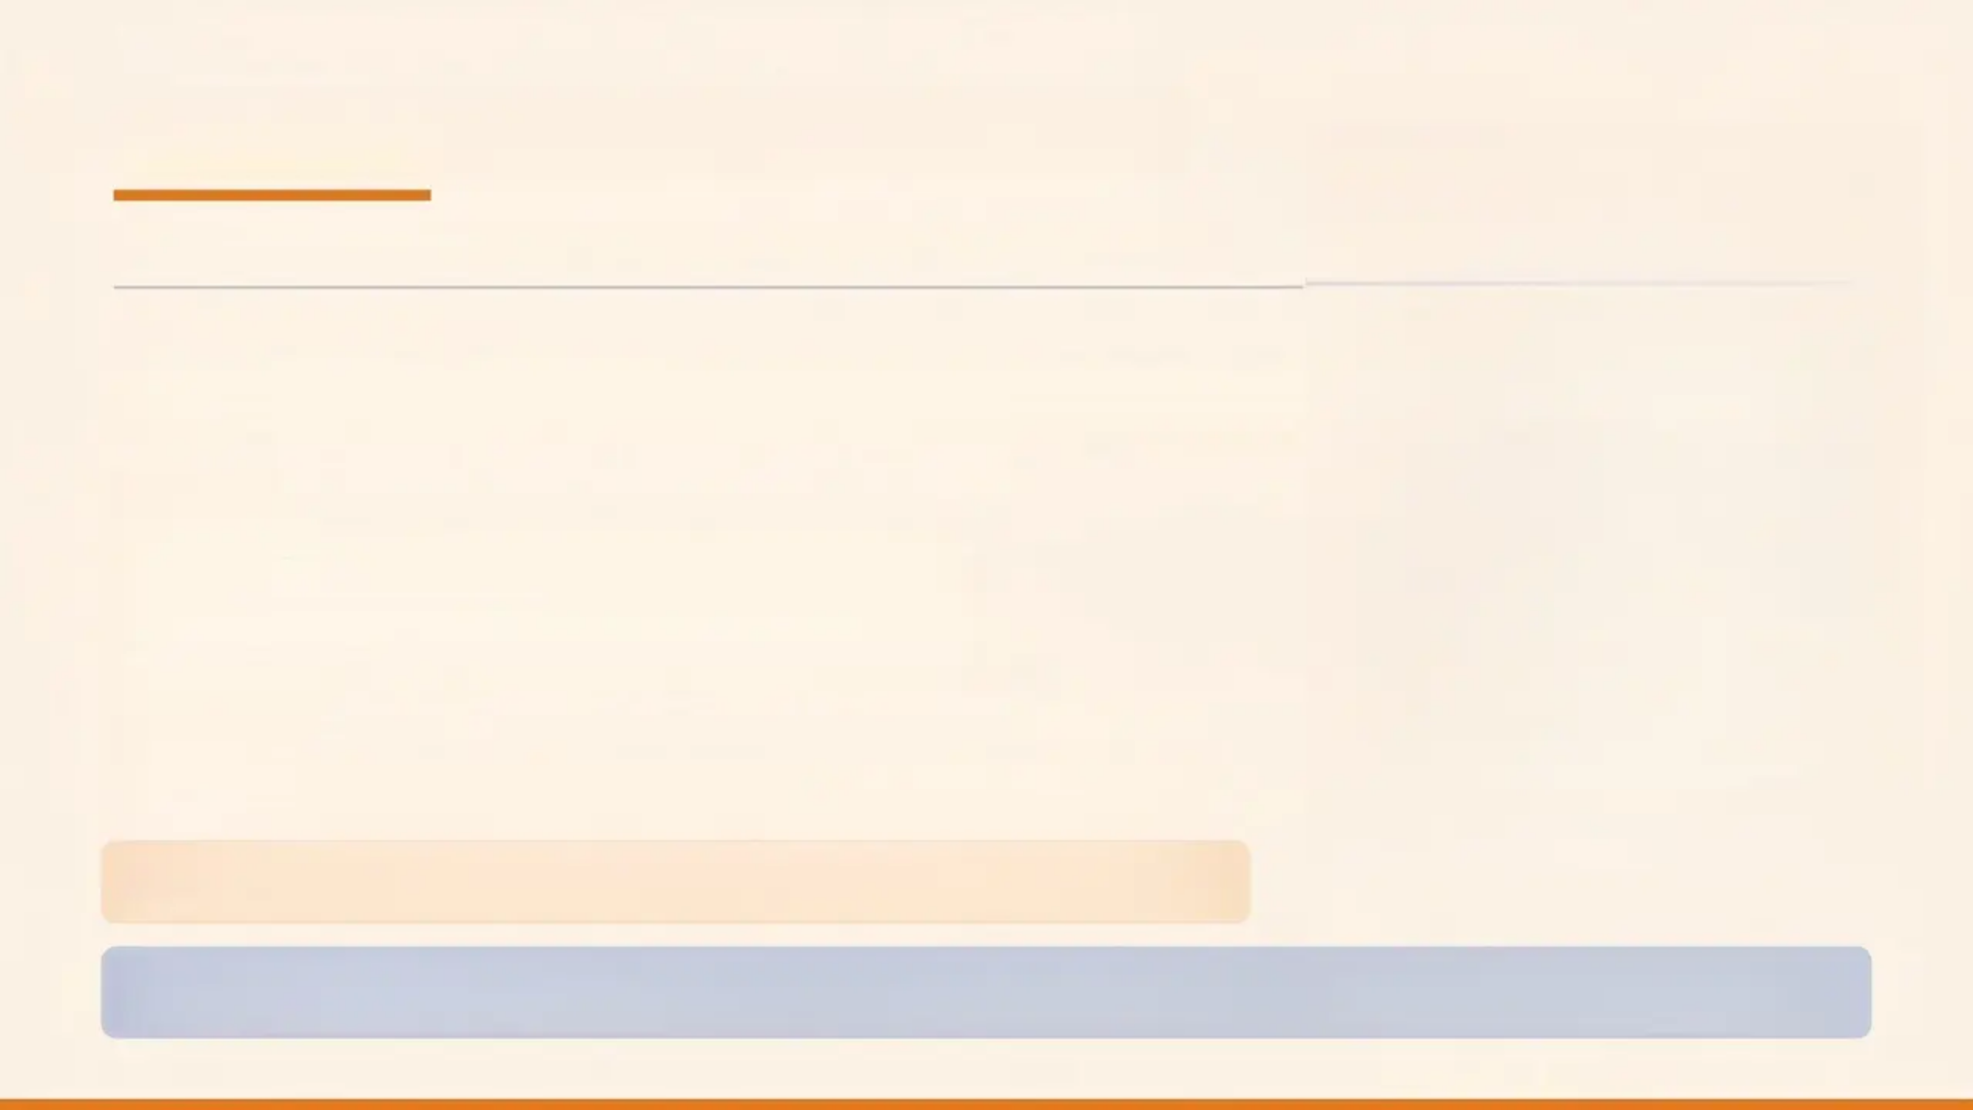
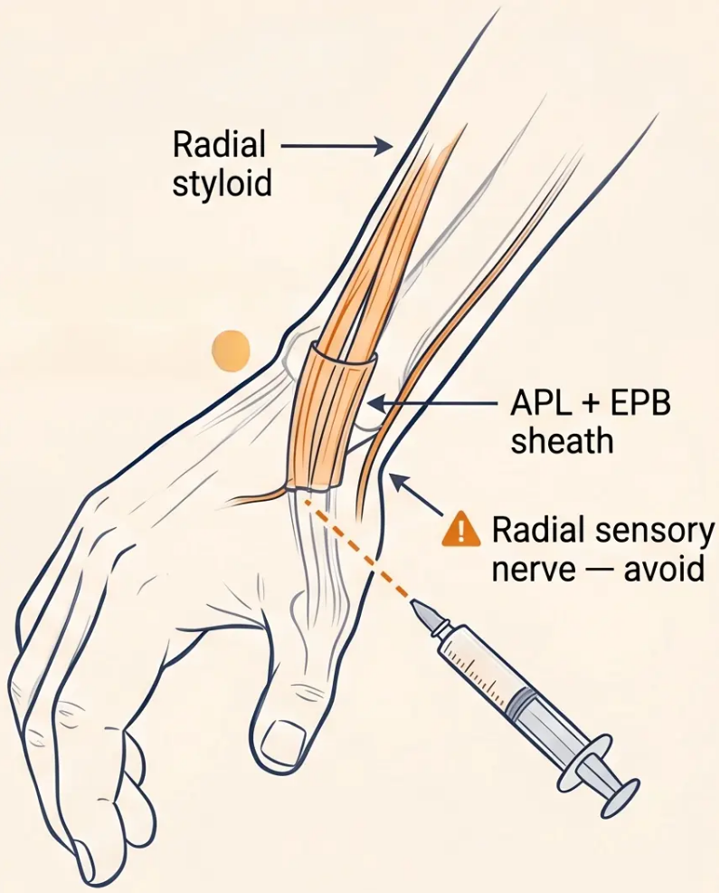
De Quervain's Tenosynovitis
Targeted injection for the common tendon sheath of APL and EPB
INDICATION & PREPARATION
■ Inflammation of the common sheath of abductor pollicis longus (APL) and extensor pollicis brevis (EPB)
■ Preferred steroid: Methylprednisolone acetate 20–30 mg (25G needle)
Avoid triamcinolone — skin atrophy risk
TECHNIQUE
1 Maximally abduct the thumb to accentuate the APL tendon
2 Aim needle toward the radial styloid along the tendon sheath
3 Advance until tip sits within the sheath; pull back by 1–2 mm
4 Inject slowly — sheath should distend distally to metacarpal base
WARNINGS
⚠️ Stop immediately if paraesthesias felt — sensory branch of radial nerve at risk
⚠️ Do NOT inject grossly thickened sheaths — consider mycobacterial infection
⚠️ Warn patients with dark skin: skin hypopigmentation is common and visible —
may take months to years to resolve
⭐ Quick Pearl: “I need to warn you — if you have darker skin, there’s a small but real chance of some lightening of the skin at the
injection site. This usually improves over time, but I want you to be aware before we proceed.”
Bradford VTS • Joint Injections Teaching Deck
Slide 21 of 35
www.bradfordvts.co.uk

Slide 22

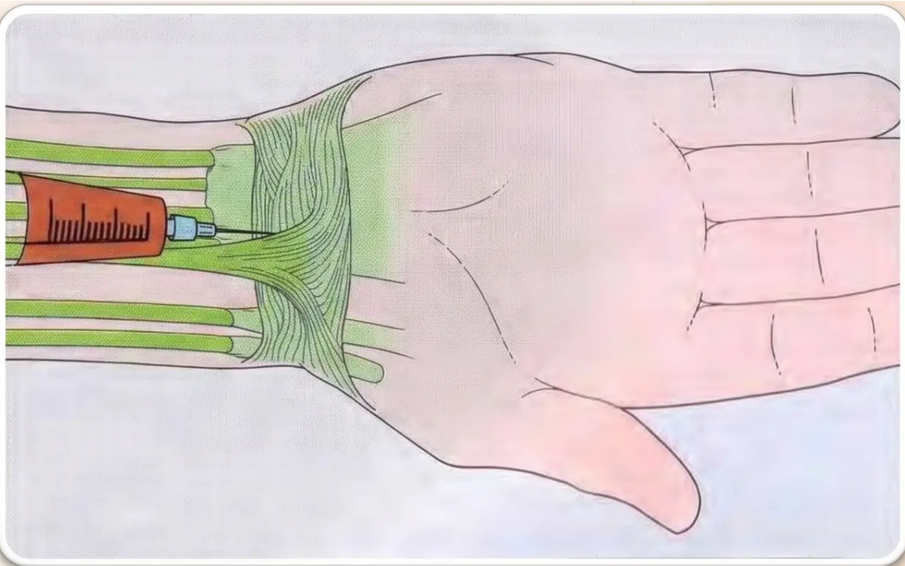
Carpal Tunnel Syndrome
Injection Technique, Landmarks & Post-Procedure Care
INDICATION
All CTS except acute causes — fracture, haemorrhage, infection, or
late-pregnancy CTS.
DRUG & DOSE (BNF 2026)
• 30–40 mg methylprednisolone acetate
• + 2–3 ml plain 1% lidocaine (no adrenaline)
• Needle: 22G or 25G
APPROACH
• Entry point: just distal to the distal wrist crease
• Just medial to the palmaris longus tendon
• Needle angled: 45° distal inclination + 45° lateral inclination
• Advance to approximately 1 cm depth
• Aspirate before injecting — confirm not in vessel
STOP & REPOSITION IF...
⚠️ Paraesthesia felt → median nerve engaged — withdraw and reposition
⚠️ Needle moves with finger flexion → tendon engaged — withdraw and
reposition
Carpal tunnel injection approach — medial to palmaris longus tendon
AFTERCARE
• Resting night splint in neutral wrist position — maintains lowest
intracarpal tunnel pressure during healing
Bradford VTS • Joint Injections
Slide 22 of 35 • www.bradfordvts.co.uk

Slide 23

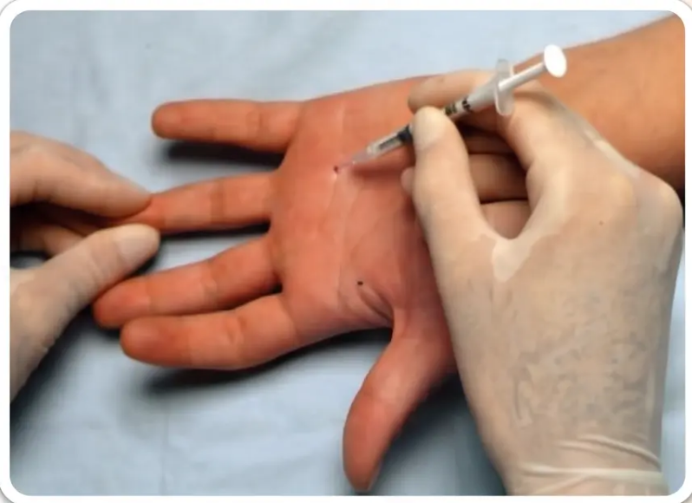
Trigger Finger (Flexor Tendon Sheath)
Flexor tenosynovitis — injection technique and safety
Dose: 15–20 mg methylprednisolone + 1–2 ml lidocaine
Needle: 25–27G fine needle
1
Entry point
Palmar crease of the affected digit — identify the A1 pulley at the base of the finger.
2
Needle angle
Insert at 45° distal inclination toward the tendon sheath, not perpendicular to skin.
3
Gently inject — fluid should flow with minimal resistance into the sheath.
Confirm sheath placement
Ask patient to flex and extend the finger passively. If the needle moves with finger
motion → needle is in the tendon → withdraw slightly before injecting.
4
Avoid intratendinous injection
5
Repeat injections
Palmar injection technique — flexor tendon sheath
Up to 3 injections permitted, spaced at least 3 weeks apart.
CRITICAL SAFETY CHECK
“Reciprocal needle movement with passive finger flexion = tendon engagement.
Back off 1–2 mm before injecting. Never inject against resistance.”
Bradford VTS · Joint Injections · Slide 23 of 35
www.bradfordvts.co.uk

Slide 24

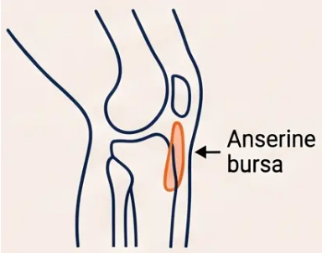
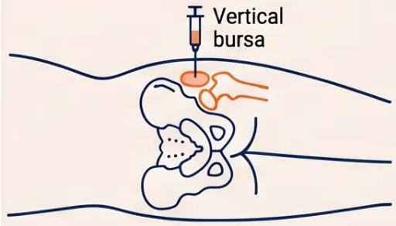

Anserine and Trochanteric Bursitis
Technique, Dosing, and Biomechanical Considerations
ANSERINE BURSITIS
TROCHANTERIC BURSITIS (GTPS)
Drug & Dose: Methylprednisolone 20–30 mg +
lidocaine 2–3 ml (22G needle)
Approach: Medial tibia at tendinous insertion, knee in
semiflexion; infiltrate 3 cm diameter area adjacent to
periosteum
Key Point: Almost always secondary — address the
primary cause (genu valgum, OA); physiotherapy for
quadriceps strengthening
Drug & Dose: Methylprednisolone 30–40 mg + lidocaine 3
ml (22G, 1.5-inch needle; spinal needle for obese patients)
Position: Patient lateral decubitus; palpate greater trochanter
Approach: Insert needle vertically to bone — Step 1:
infiltrate lidocaine radially in cone pattern; Step 2 (if pain
relieved): inject corticosteroid + LA
Key Point: Represents enthesopathy at gluteus medius/
minimus insertion — address causative biomechanical factors
“Both bursitides are often secondary conditions — treat the cause, not just the bursa.”

Slide 25


Plantar Fasciitis
Soft Tissue Injection
Medial approach • Calcaneal entheses • Proceed with caution
Technique & Approach
• Approach: medial, needle parallel to plantar skin surface
• Advance approximately 2 cm deep, aiming at medial plantar tubercle of calcaneus
• Inject both deep and superficial to the plantar fascia for full coverage
Dose & Equipment
• 20–30 mg methylprednisolone + 2 ml 1% plain lidocaine
• 22G needle — firm technique required given depth
Important Cautions
⚠️ Procedure is painful — counsel patient thoroughly beforehand
⚠️ No proven long-term benefit — consider this before injecting
⚠️ Limit to one re-injection maximum — repeated injections cause
plantar fat pad atrophy → chronic heel pain
AKT Reminder
Fat pad atrophy from repeated injections is a recognised cause of
chronic plantar heel pain — do not inject more than twice.
Bradford VTS • Joint & Periarticular Injections
www.bradfordvts.co.uk
Slide 25 of 35

Slide 26





Wrist and Ankle Joints
Dorsal and Vertical Approaches — Landmarks, Doses, and Technique
WRIST JOINT
ANKLE JOINT
Approach
Approach
• Dorsal approach — just distal to Lister's tubercle
• Needle enters ulnar to extensor pollicis longus tendon
• Wrist slightly palmar-flexed to open joint space
• Aspirate before injecting
• Patient supine, foot relaxed
• Vertical entry medial to anterior tibialis tendon
• Avoid the dorsalis pedis artery (lateral to entry point)
• Aspirate before injecting
Dose & Equipment
Dose & Equipment
• Methylprednisolone 30–40 mg
• 23G needle for injection
• 18–20G needle for aspiration
💡 Always aspirate before injecting the wrist — important for
crystal arthritis diagnosis
• Methylprednisolone 40–60 mg
• 22G needle
⚠️ Avoid dorsalis pedis artery — always palpate the pulse
and enter medially
Both joints: aspirate before injecting • Strict aseptic technique • Document drug, dose, batch number, and site

Slide 27






Hip Joint: Specialist Considerations
Not a primary care procedure — imaging guidance required
Imaging Guidance is Mandatory
Hip joint injection requires fluoroscopy, ultrasound, or CT guidance to
ensure accurate needle placement. Blind injection is not appropriate
due to depth and anatomical complexity.
Refer to Orthopaedics or Radiology
Hip injections in primary care are not recommended. Refer to
orthopaedic or radiology services for: Suspected septic arthritis of
the hip, Prosthetic joint loosening, Diagnostic aspiration,
OA pain management when conservative treatment has failed.
When is Aspiration Indicated?
Aspiration of the hip is performed for DIAGNOSTIC purposes only in
primary care — never for routine corticosteroid injection. Always
arrange specialist referral with imaging.
Hip injection — imaging-guided
specialist procedure
Bradford VTS — Joint Injections Teaching Deck
Slide 27 of 35

Slide 28



































Synovial Fluid Analysis and Interpretation
Gross appearance • Cell counts • Viscosity • Clinical interpretation
Feature
Normal
Osteoarthritis
Inflammatory (RA)
Septic Arthritis
Gross Appearance
Clear
Clear
Opaque
Opaque
Volume
0–1 ml
1–10 ml
5–50 ml
5–50 ml
Viscosity
High ↑
High ↑
Low ↓
Low ↓
WBC Count /mm³
< 200
200–10,000
5,000–75,000
> 50,000
% Polymorphs
< 25%
< 50%
> 50%
> 75%
🔬 Cell Count
Gram Stain & Culture
💡 Polarised Light Microscopy
Urate crystals = Gout •
Pyrophosphate = Pseudogout
Total and differential white cell count
Including anaerobes
Note: Crystal synovitis and infection can coexist — never rely on crystal identification alone.
Bradford VTS — Joint Injections Teaching Deck
Slide 28 of 35 • www.bradfordvts.co.uk

Slide 29





Complications: Common Side Effects
Know them, warn patients, and distinguish flare from infection
Facial Flushing
Post-Injection Flare
Skin Atrophy
Skin Hypopigmentation
~40% of patients
~5% of intra-articular injections
Common with superficial injections
Common – de Quervain's, elbow
• Transient, self-limiting
• Warn patient
beforehand
• Pain peaks hours after
injection, lasts ~24h
• If pain persists beyond
48h → re-aspirate
• More likely in elderly
patients
• Avoid injecting
subcutaneously
• Especially visible in
dark-skinned patients
• Resolves over months
to 2 years
No treatment needed
Rule out septic arthritis at 48h
Inject at correct depth
Warn patients with darker skin tones
Post-injection pain increasing beyond 48 hours = re-aspirate and exclude septic arthritis
⚠️
Bradford VTS · Joint Injections Teaching Deck
29 / 35

Slide 30




Complications: Serious Adverse Events
Rare but potentially life-altering — recognise and act fast
Septic Arthritis
Tendon Rupture
Systemic Effects
*1 in 15,000 procedures*
*Rare but serious and irreversible*
*Clinically significant in vulnerable patients*
• Strict no-touch sterile technique is
essential
• Never inject if infection is suspected
• Post-injection: pain increasing
beyond 48 hours → re-aspirate
urgently
• Never inject directly INTO tendon
substance
• Never inject against unexpected
resistance
• Highest risk: Achilles, rotator cuff,
patellar tendon
• Hyperglycaemia: significant glucose
rise 2–4 weeks in diabetics
• Adrenal suppression: risk with
serial/multiple site injections
• Central serous chorioretinopathy: visual
disturbance — MHRA 2026 warning
• Facial flushing: ~40%, transient but
must be pre-warned
“If in doubt — aspirate, don't inject”
“Resistance = stop and reposition”
“Always warn diabetic patients before injecting”
QUICK PEARL
*Post-injection flare: self-limiting within 24 hours. Pain increasing beyond 48 hours = suspect septic arthritis — re-aspirate and
send fluid for urgent MC&S.

Slide 31




Essential Post-Injection Aftercare
Guidance for patients following corticosteroid joint injection
Rest the
Joint
Rest the Injected Joint for 24-48 Hours
Resting the joint after injection minimises steroid leakage and allows the anti-inflammatory effect to
establish. Avoid strenuous activity or heavy loading of the injected area for at least 24-48 hours.
Expect
Temporary
Pain Increase
Pain May Worsen Before It Improves
When the local anaesthetic wears off — usually within 2 hours — pain may return and feel temporarily
worse than before. This is normal and expected. A post-injection flare occurs in approximately 5% of
cases, peaking within hours and usually resolving within 24 hours. Reassure the patient beforehand.
When to Seek Urgent Review
Red-Flag
Monitoring
• Pain that is severe or increasing beyond 48 hours → re-aspirate to exclude septic arthritis
• Any visual disturbance after injection → urgent ophthalmology review (MHRA 2026: chorioretinopathy)
• Signs of systemic infection: fever, rigors, or spreading redness → urgent review or admission
• Diabetic patients: monitor blood glucose — significant elevation may persist for 2-4 weeks
Bradford VTS · Joint Injections Teaching Deck
www.bradfordvts.co.uk

Slide 32




Minimising Litigation and Documentation
Protect your patient — and yourself
SAFE PRACTICE
WHAT TO DOCUMENT
Full aseptic precautions at all times — no-touch
sterile technique throughout
Diagnosis — confirmed clinical indication
Consent discussion — benefits, risks, and
alternatives discussed
Never inject if infection is suspected — refer
urgently to specialist; seeding a joint is catastrophic
Injection site — precise anatomical location
Know your neurovascular anatomy — particular
care at the medial epicondyle (ulnar nerve) and
wrist (median nerve, radial artery)
Drug name and dose — e.g., methylprednisolone
acetate 40mg
Batch number — for traceability
Keep phenol separate from lidocaine and
cleansing agents; store in a locked cupboard after
use
Technique used and clinical outcome —
response at time of procedure
Urgent Referral Rule: If joint infection is suspected at any point — before or after injection — refer
urgently to specialist. Do not delay.
Bradford VTS — Joint Injections Teaching Deck
www.bradfordvts.co.uk

Slide 33



Top Tips & Exam Pearls
EXAM FOCUS
Key Takeaways for Minor Surgery Exams
TOP TIPS
EXAM PEARLS
Conservative first — Injection is always second-line. Try NSAIDs,
physio, and activity modification first.
Exam classic: Tennis elbow injection gives better SHORT-TERM
relief (<6 weeks) but WORSE outcomes at 12 months compared to
physiotherapy. Expect this as an AKT option question.
Exclude infection before you inject — Aspiration is mandatory
if septic arthritis is possible. Never inject into a possibly infected
joint.
Exam classic: Poorly controlled diabetes = RELATIVE
contraindication (not absolute). Injection may be given with
careful glucose monitoring and patient counselling.
Never inject INTO a tendon — Inject the sheath, not the tendon
substance. Tendon rupture risk is serious.
Exam classic: Baker's cyst does NOT need direct injection — treat
the underlying knee disorder (OA, synovitis).
Minimum 3 months between same-site injections — MHRA
2026 rule. Max 3-4 per joint per year.
Exam classic: Septic arthritis risk from joint injection = 1 in 15,000
procedures.
Exam classic: Post-injection flare occurs in ~5% of intra-articular
injections. Distinguish from septic arthritis using the 48-hour rule.
Warn diabetic patients — Corticosteroid injections can
significantly elevate blood glucose for 2-4 weeks. Always counsel
and arrange monitoring.
Script: “The pain may feel worse when the local anaesthetic
wears off — usually around 2 hours. If pain is increasing after 48
hours, please call us straight away.”
Warn about visual disturbance — MHRA 2026: any post-
injection visual symptoms = urgent ophthalmology referral
(chorioretinopathy).
Script: For dark-skinned patients considering de Quervain’s
injection — specifically warn about risk of skin
depigmentation/lightening at the injection site.
Injection into the tendon is a serious complication.
Always assess for infection and diabetes.
Bradford VTS · Joint Injections Teaching Deck · 2026
www.bradfordvts.co.uk

Slide 34








Red Flags and Common Pitfalls
Warning signs and clinical errors to know before you inject
RED FLAGS — Act Urgently
Pain worsening
after 48h
Visual disturbance
post-injection
Fever, rigors
after injection
Decreased grip
+ wrist pain
Facial flushing
persisting >2 days
Re-aspirate — exclude
septic arthritis
Urgent ophthalmology —
central serous
chorioretinopathy (MHRA 2026)
Systemic infection —
urgent admission
Possible tendon rupture
— urgent review
Plus other symptoms —
seek review
COMMON PITFALLS — Don't Fall Here
1. Injecting when infection not yet excluded
→ risk of seeding septic arthritis
4. Not warning patient about post-injection pain flare
5. Forgetting to warn diabetic patients about blood
glucose elevation
2. Injecting INTO the tendon substance
→ tendon rupture risk
6. Using triamcinolone for superficial periarticular
sites → skin atrophy; prefer methylprednisolone
3. Repeating injections too soon (< 3 months)
→ MHRA minimum interval
7. Medial epicondyle approach without caution for
the ulnar nerve
Bradford VTS · Joint Injections Teaching Deck · 2026
www.bradfordvts.co.uk

Slide 35

Quick Recall
Core principles at a glance – commit these to memory
1
Conservative treatment first; injection second-line
6
Tennis elbow: CSI = worse outcomes at 12 months
2
Methylprednisolone for periarticular/superficial
injections
Aspiration mandatory if sepsis suspected
7
3
Never inject INTO tendon substance
8
Warn diabetics: blood sugar rises post-injection
4
Warn: visual disturbance = urgent ophthalmology
Min 3 months between same-site injections
9
5
Facial flushing in 40%: transient, benign
Post-flare: normal if <24h; >48h → re-aspirate
10
Disclaimer
“This teaching resource has been prepared by Bradford VTS for educational purposes only. It is intended for GP trainees preparing for RCGP AKT
and SCA examinations. Clinical decisions must always be based on individual patient assessment, current local guidelines, and up-to-date national
guidance including NICE NG226 (2022/2026), BNF 2026, and MHRA 2026 recommendations. This material does not constitute medical advice and
should not replace clinical judgement or formal supervision.”
www.bradfordvts.co.uk
© Bradford VTS 2026 · Updated to NICE NG226 2022/2026, BNF 2026, MHRA 2026
Bradford VTS – GP Training Resource
Slide 35 of 35

