Slide 1

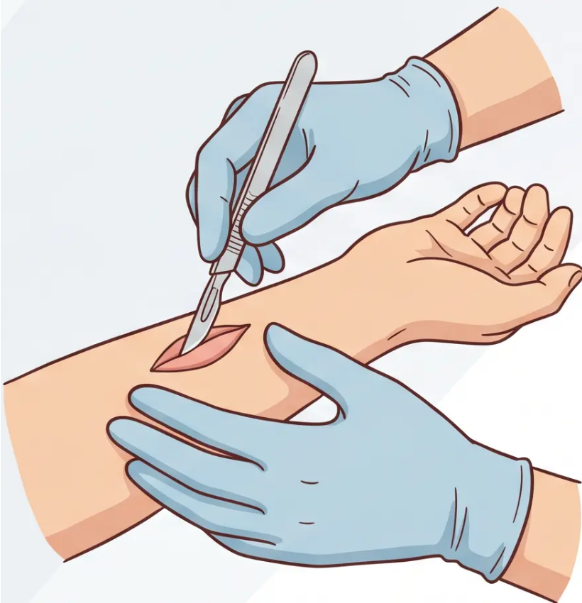
Bradford VTS
www.bradfordvts.co.uk
Minor Surgery in
General Practice
Bradford VTS Teaching Deck
Comprehensive GP training guide for Minor Surgery
Updated to NICE NG12 2026 · BNF 2026 standards
Quick Tips
Pearls of Wisdom
Bradford VTS · GP Training · Minor Surgery
www.bradfordvts.co.uk

Slide 2

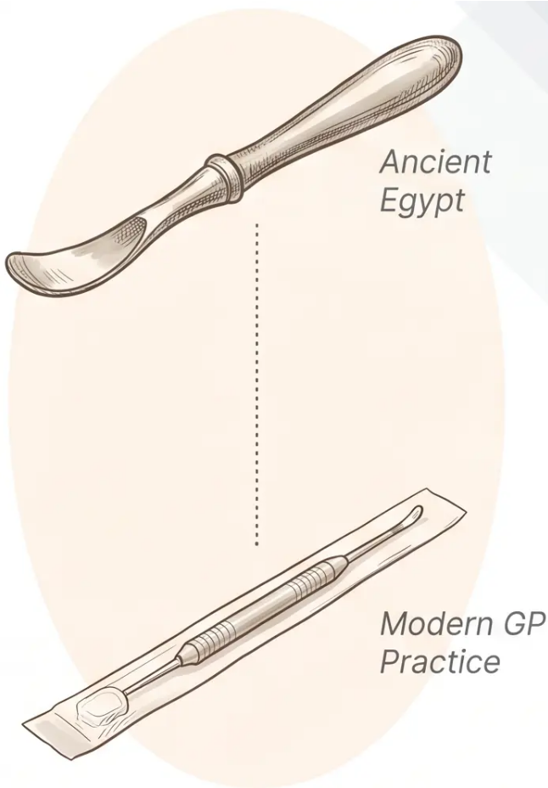
Introduction and Historical Context
Minor surgery has been part of clinical practice for
centuries — and remains a core GP skill today.
ETYMOLOGY
ETYMOLOGY
Curettage
Cautery
From Latin curare — “to cure.”
Bronze curettes have been
found in Egyptian tombs, used
used for thousands of years.
From Latin cauterium — “a
branding iron.” One of the
earliest surgical techniques, still
highly relevant in modern GP
practice.
CORE PRINCIPLE
Never use any destructive technique if there is
diagnostic doubt.
Always biopsy first — or refer. This applies to cautery, cryotherapy,
and all destructive methods.
Bradford VTS - Minor Surgery
www.bradfordvts.co.uk

Slide 3




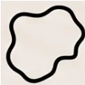



NICE NG12 (2026) — Suspected Melanoma Referral
2-WEEK WAIT
Weighted 7-Point Checklist — refer urgently if total score ≥ 3
Major Features
Minor Features
2 points each
1 point each
Change in Size
Diameter ≥ 7 mm
Growth or expansion of lesion
Minor feature — not major
Inflammation
Irregular Shape
Redness around lesion
Asymmetry or uneven border
Oozing
Bleeding or crusting
Irregular Colour
Change in Sensation
Variation within the lesion
Itch or altered feeling
AKT PEARL: Threshold = ≥3, NOT ≥4
Any pigmented lesion where melanoma
cannot be excluded → urgent referral
Refer urgently (2WW) if score ≥ 3

Slide 4
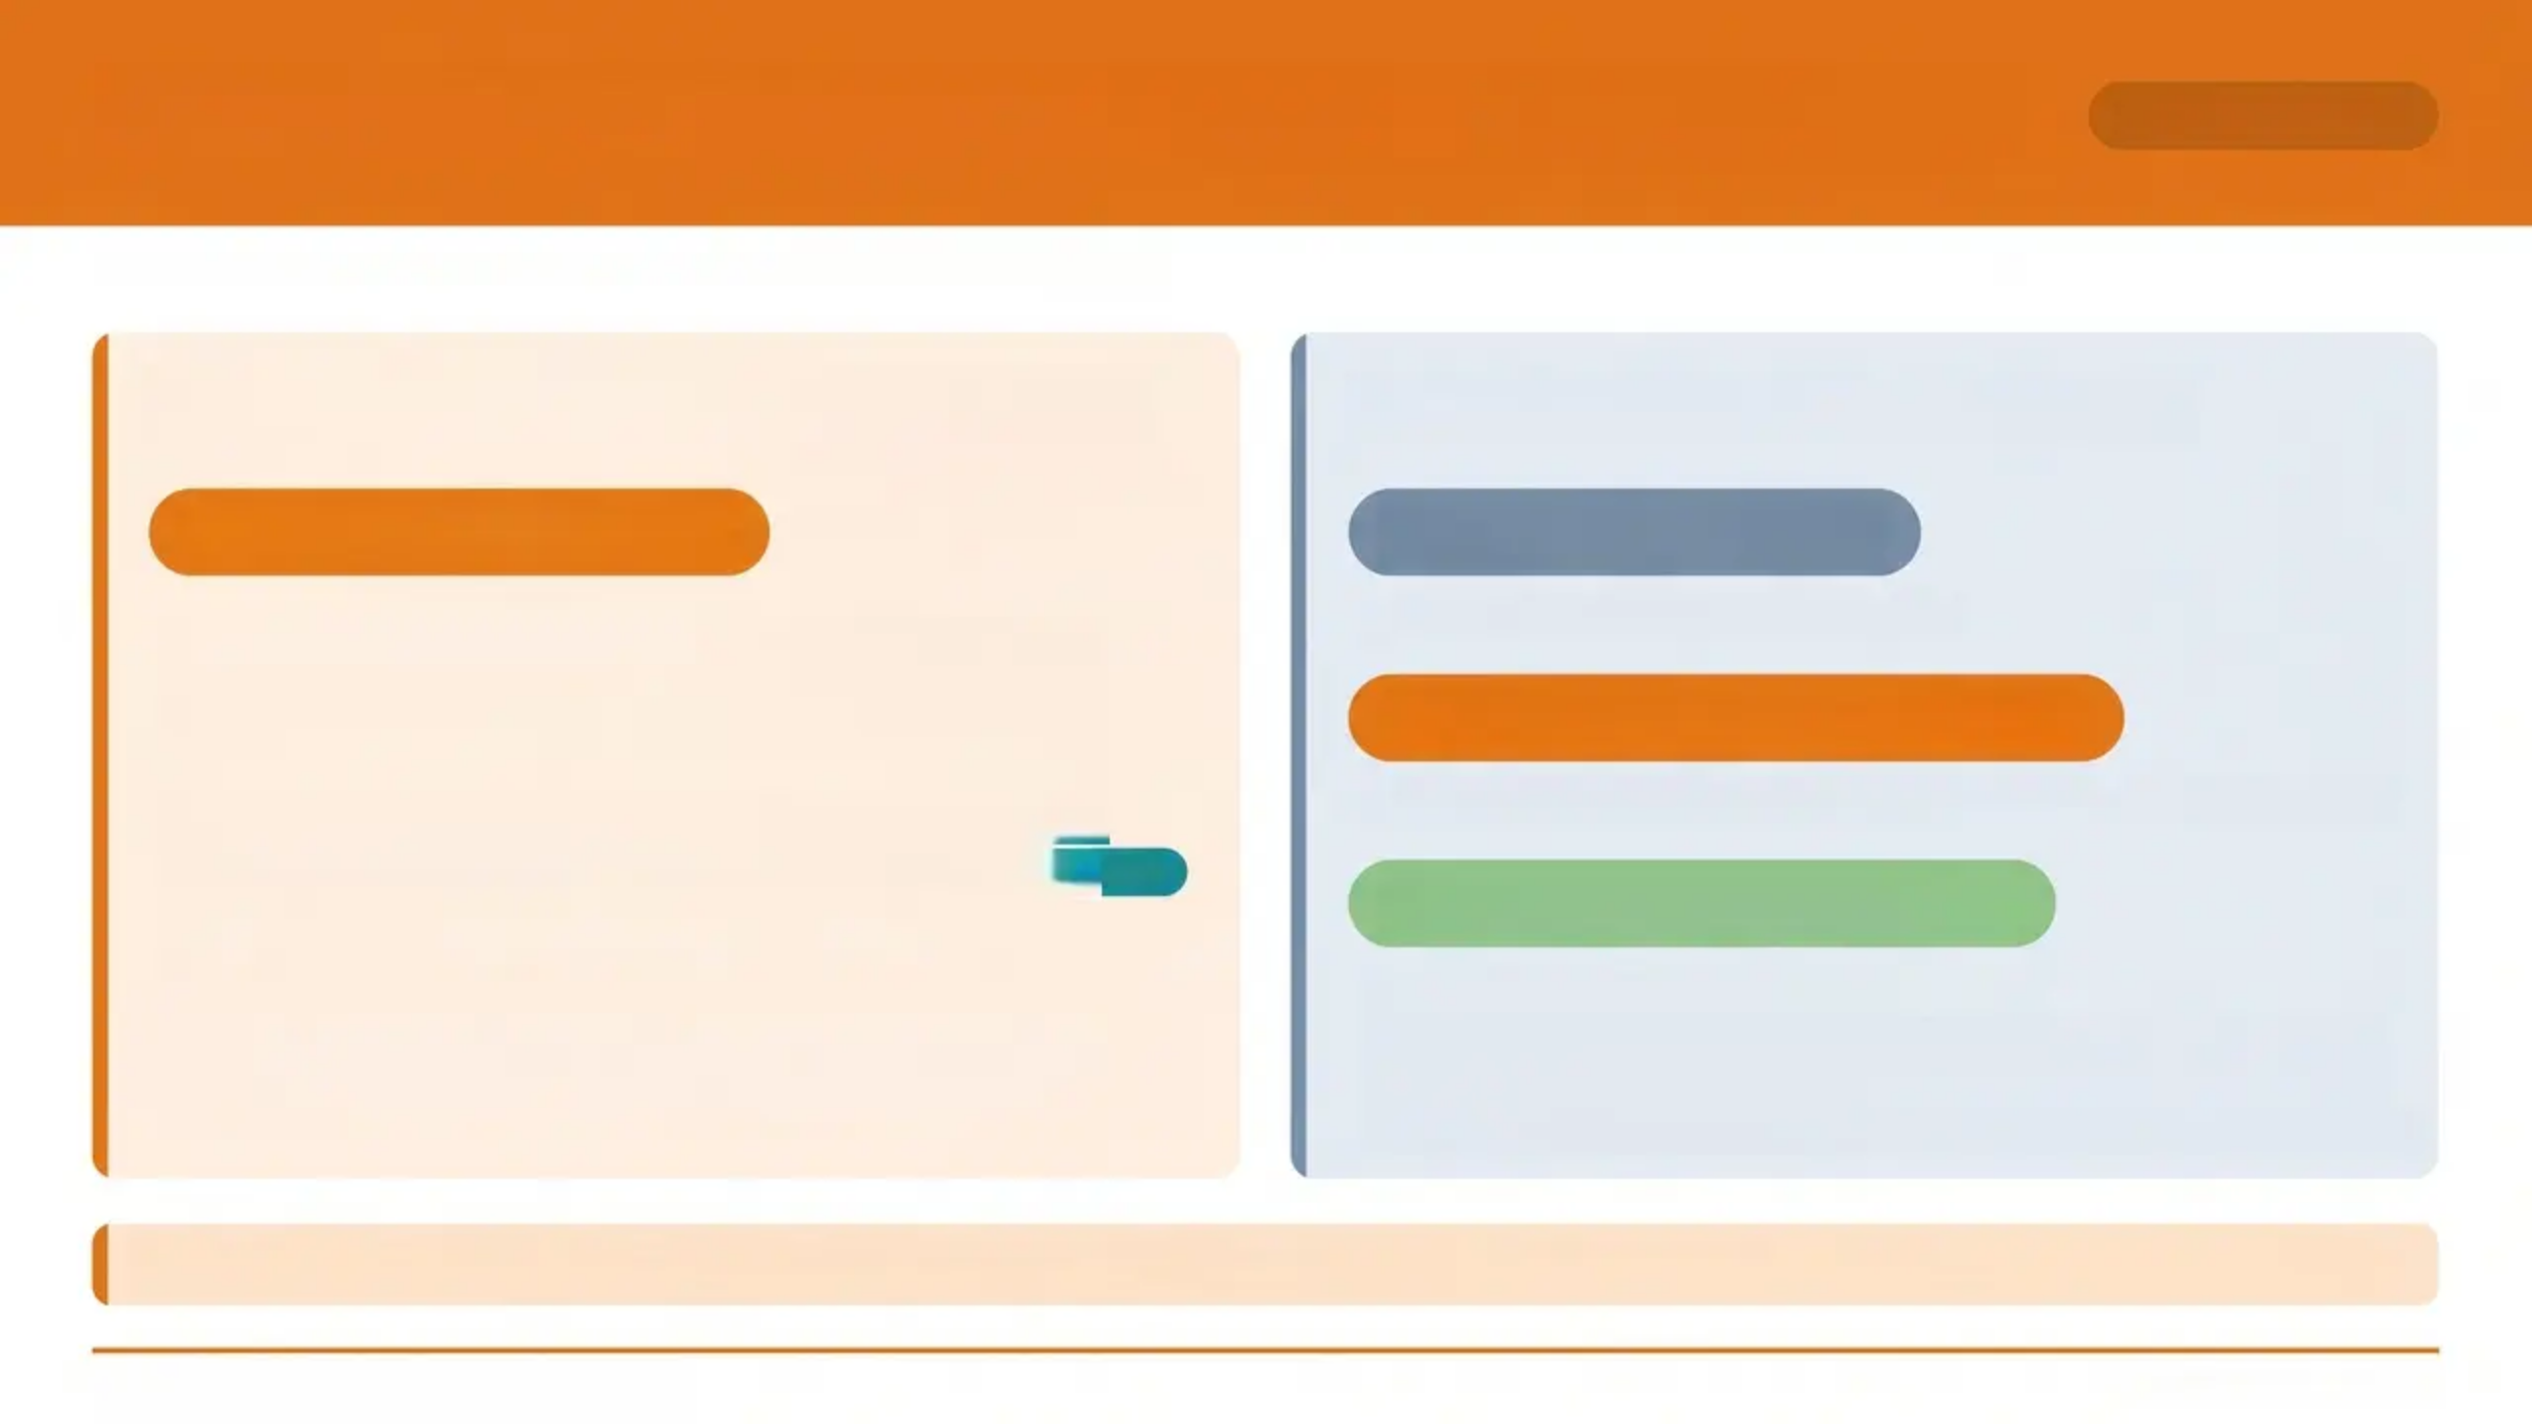

NICE NG12 (2026) — SCC & BCC Referral Criteria
REFERRAL GUIDE
NICE NG12 April 2026 · Suspected Cancer: Recognition and Referral
Squamous Cell Carcinoma (SCC)
Basal Cell Carcinoma (BCC)
URGENT 2-Week Wait
Routine (Non-Urgent)
Standard referral for most BCC cases
— Consider urgent 2WW referral for any
lesion suspicious of SCC
Urgent 2WW — Selected Only
'Consider' = recommendation to think about referral — NOT
mandatory urgent referral. Clinical judgement required.
AKT TIP
Site or size suggests significant impact from delay (e.g., near orbit)
Community — If Trained GP
• Patient age over 24; not immunosuppressed
• Lesion under 2 cm on body OR under 1 cm on face (not ears, nose,
lips, eyelids)
• GP must hold appropriate training and accreditation (PCDS/NICE CSG8)
⚠️ Key Principle: 'Consider' in NG12 is a recommendation — not a mandatory action. Only melanoma and high-risk SCC trigger mandatory 2WW.
Bradford VTS - Minor Surgery Teaching Deck
www.bradfordvts.co.uk

Slide 5


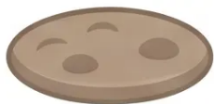

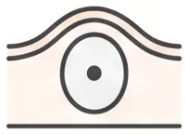
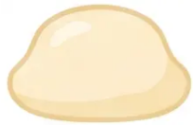


Slide 5 — Benign Lesions Safe for Primary Care Treatment
Primary Care
Treat with confidence — but only when diagnosis is certain.
Skin Tags
Seborrheoic Keratoses
Viral Warts
Acrochordons · Common
Stuck-on appearance
Common & plantar types
Epidermoid Cysts
Lipomata
Pyogenic Granuloma
Central punctum · Mobile
Soft · Subcutaneous
Also: Molluscum contagiosum
Never use cautery or cryotherapy if there is ANY
diagnostic doubt — biopsy first or refer.
Confident Diagnosis is Essential
Bradford VTS · Minor Surgery
www.bradfordvts.co.uk
5

Slide 6


Cryotherapy Principles and Mechanisms
Section 3 — Cautery
How Cryotherapy Works
Cryotherapy Agents Compared
Liquid Nitrogen (LN₂)
-196°C
• Most effective — deepest tissue destruction
• Applied via cryogen spray or cotton bud
• Stored in Dewar flask (max 2 days)
• Usually ONE application sufficient
Freeze applied
to tissue
Ice crystals
form inside
cells
Cell membranes
rupture →
Cellular lysis
Nitrous Oxide (N₂O)
-89°C
• Via cryogen from cylinder
• May need 2-3 treatments, 10-14 days apart
• Prescribable on FP10 — always available
One freeze-thaw cycle (FTC) destroys tissue.
Repeat cycles increase destruction depth.
Commercial Sprays (e.g. Histofreeze)
Less cold
• Least effective of the three
• Suitable only for small, superficial lesions
• NOT suitable for plantar warts, Bowen's disease,
or superficial BCC
Key Principle: Never use cryotherapy if there
is diagnostic doubt — biopsy or refer first.
Bradford VTS - Minor Surgery Teaching Deck
www.bradfordvts.co.uk

Slide 7

























NICE CKS Cryotherapy Freeze Times (2026)
CLINICAL REFERENCE
Freeze times measured from ice-ball formation — not from spray start
Lesion Type
Freeze Time
Cycles (FTC)
Treatment Interval
• Viral Warts (Common)
10–30 seconds
1 FTC
(single freeze-thaw)
Every 2–3 weeks
· max 6 treatments
• Plantar Warts (Mosaic / Stubborn)
Up to 30 seconds
Consider double FTC
Every 2–3 weeks
•
10–20 seconds
1 FTC
Reassess at 4–6 weeks
Seborrhoeic Keratoses
•
5–10 seconds
1 FTC
Reassess after treatment
Molluscum Contagiosum
10–20 seconds
(reduce on thin or facial skin)
1 FTC
Reassess at 4–6 weeks
•
Actinic Keratosis (AK)
•
Bowen's Disease
20–30 seconds
1 FTC
Reassess after treatment
⚠️ Always include a 2mm margin of normal surrounding skin in the freeze zone
⚠️ Histofreeze / commercial sprays are NOT suitable for plantar warts or Bowen's disease
Bradford VTS · Minor Surgery · www.bradfordvts.co.uk
Slide 7 of 35

Slide 8

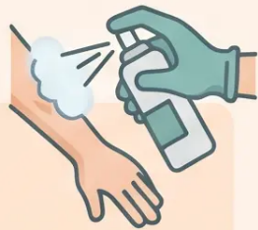
Cryotherapy Risks and Patient Aftercare
PATIENT SAFETY
Known Risks
Aftercare & Anatomical Cautions
Blistering — Warn patient in advance. Do NOT
pop the blister — allow to dry naturally.
Aftercare box
- Always give the patient a written aftercare
leaflet.
- Daily gentle washing; keep area clean and dry.
- Paracetamol for post-procedure discomfort.
Hypopigmentation — Especially on darker skin
tones. Counsel specifically before treatment.
Anatomical Danger Zone
Pain / Throbbing — Can persist up to 12 hours
post-procedure. Paracetamol is appropriate.
“⚠️ Extensor Tendon Risk”
Dorsal MCP and DIP joints of fingers — cryotherapy here
carries a rare but serious risk of damage to extensor
tendons. Avoid or use with extreme caution.
Nail Dystrophy — Risk if cryotherapy applied near
nail margin.
“Dark Skin — Hypopigmentation”
Counsel all patients with darker skin tones specifically
about permanent or prolonged hypopigmentation before
proceeding. Document consent.
Leg Ulceration — Avoid cryotherapy on gaiter area
of lower legs where circulation is compromised.
Bradford VTS · Minor Surgery
www.bradfordvts.co.uk · Slide 8 of 35

Slide 9

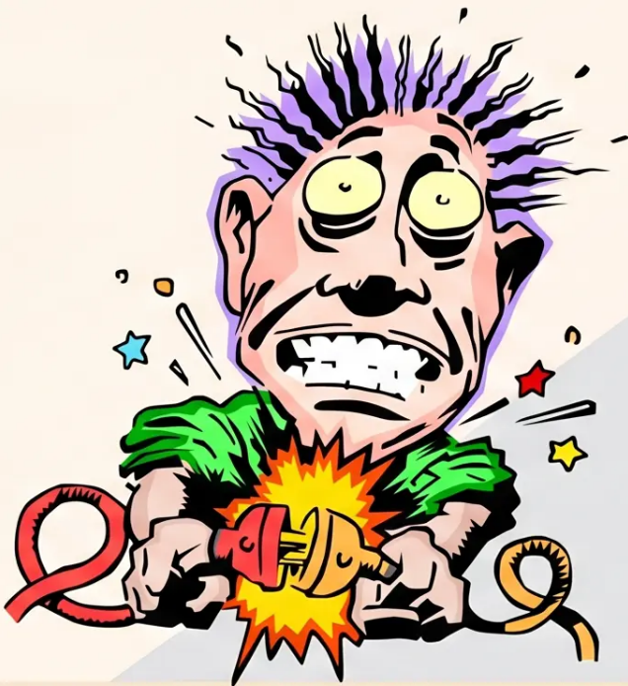
Electrocautery Principles and Safety
SAFETY
How It Works
- Burns tissue using direct current (DC)
- Requires local anaesthesia before use
- Excellent haemostasis — useful adjuvant to scalpel surgery
Clinical Uses
- Haemostasis during excision procedures
- Needle-point tips for spider naevi and capillary flares
- Adjuvant to curettage for wound contraction
⚠️ Fire & Safety Rules
- Never use spirit-based skin cleaners with
electrocautery — fire risk
- Do not contact dressings or swabs during use
- Avoid near flammable prep solutions
Unsuitable For
- Viral warts — highest recurrence rate of any wart
therapy (PCDS)
Bradford VTS · Minor Surgery · www.bradfordvts.co.uk

Slide 10

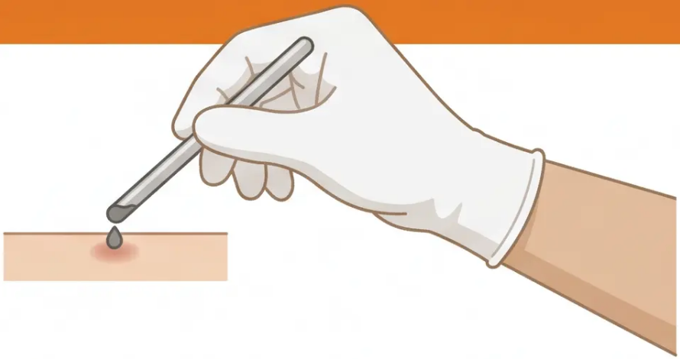





Bradford VTS
TECHNIQUE
Chemical Cautery with Silver Nitrate
WHEN TO USE IT
Over-Granulation Tissue
Excess granulation in healing wounds
ESSENTIAL SAFETY STEPS
Pyogenic Granuloma
Always wear gloves — stains skin, clothing, and surfaces permanently
Chemical destruction of surface lesion
Apply Vaseline to surrounding skin before use — protects healthy tissue
Nasal Cautery — Little's Area
Moisten first — dip stick in water; lesion or stick must be moist before contact
Recurrent epistaxis from visible vessel
Never use in open wounds — incorporated silver nitrate causes deep tissue damage
Wound Granulomas
Store correctly — dry, dark place away from light and moisture
Post-surgical or post-injury granulation
Warn patients — black stain fades as top skin layer naturally sheds
NEVER use silver nitrate deeper than the skin surface — incorporated silver nitrate causes significant and irreversible tissue damage
Bradford VTS - Minor Surgery
10 / 35
www.bradfordvts.co.uk

Slide 11

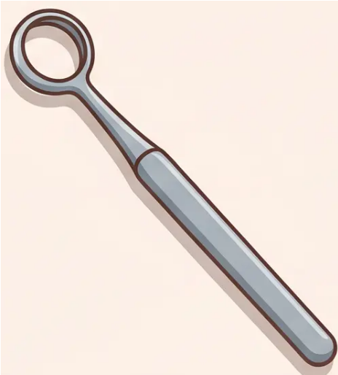

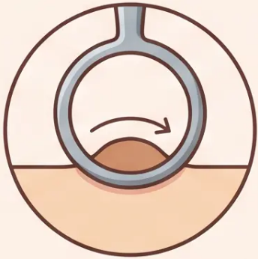






Curettage — Principles and Indications
NHS SCHEME
“From Latin curare — to care, to cure”
Bronze curettes found in Egyptian tombs — one of medicine's oldest instruments.
Tissue Yield
Key Requirements
- Produces material for CYTOLOGY ⚠️
- NOT suitable for formal histology
- Contrast: excision/punch biopsy
→ histology
- Requires local anaesthesia
- Claimable under NHS minor surgery scheme
- Disposable curettes: 4mm and 7mm ring sizes
- Cost approximately £2-3 per curette
Best Indications for Curettage
Seborrhoic
keratoses
Skin tags
Keratoacanthomas
Facial
warts
Pyogenic
granuloma
Chalazions
(eyelid)
Ring curette — 4mm and 7mm
sizes available
Bradford VTS - Minor Surgery
www.bradfordvts.co.uk

Slide 12
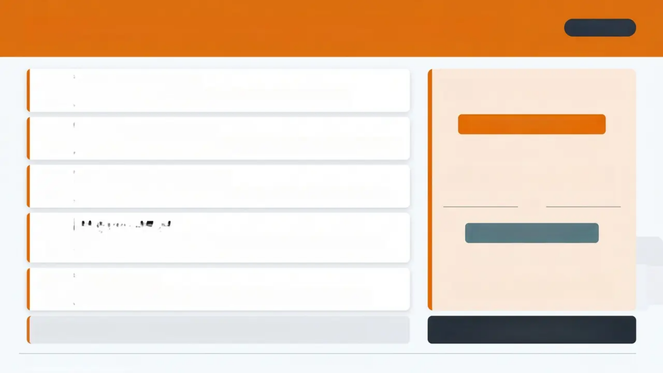


Curetteage Technique and Histology Warning
TECHNIQUE
Step
1
Position the Curette
Critical Distinction
Identify the correct (sharper) side of the curette before beginning.
Step
2
Enter Below the Lesion
CURETTAGE PRODUCES
CYTOLOGY
Advance the curette deep to the base of the lesion to ensure clean separation.
Tissue is scraped and crushed — only
cellular material, not intact architecture.
Step
3
Scrape in Two Directions
Work first in one direction, then perpendicular — cross-hatching technique.
Step
4
Listen and Feel
EXCISION PRODUCES
A scraping sound and firm resistance = normal skin reached. Mushy feel =
diseased tissue remaining.
HISTOLOGY
Step
5
Hemostasis
Intact tissue architecture preserved —
formal histological diagnosis possible.
Apply gentle cautery if needed — this also contracts the wound edges.
🎓 AKT EXAM TRAP — This distinction is a classic
exam question. Do not confuse the two.
For benign lesions: avoid going into fat — slows healing and worsens cosmesis.
Bradford VTS · Minor Surgery
www.bradfordvts.co.uk
Slide 12 of 35

Slide 13



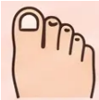


Local Anaesthesia — Choice of Agent
CLINICAL DECISION
Lidocaine + Adrenaline
Plain Lidocaine ONLY
First choice for most procedures
Mandatory for these situations
Fingers, Toes, Penis
Vasoconstriction reduces bleeding
avoid 1 — End-artery sites
End-arteries — adrenaline causes ischaemia
VS
Prolongs anaesthetic duration
Raynaud's Phenomenon
Cleaner operative field
avoid 2 — Raynaud's Phenomenon
Vasospasm risk
Use for trunk, face, scalp, limbs
(proximal)
Within 6 months of MI or CABG
avoid 3 — Recent Cardiac History
Or troublesome ongoing cardiac dysrhythmia
Never inject adrenaline-containing LA into fingers, toes, or the penis
End-arteries have no collateral circulation — vasoconstriction risks digital ischaemia

Slide 14

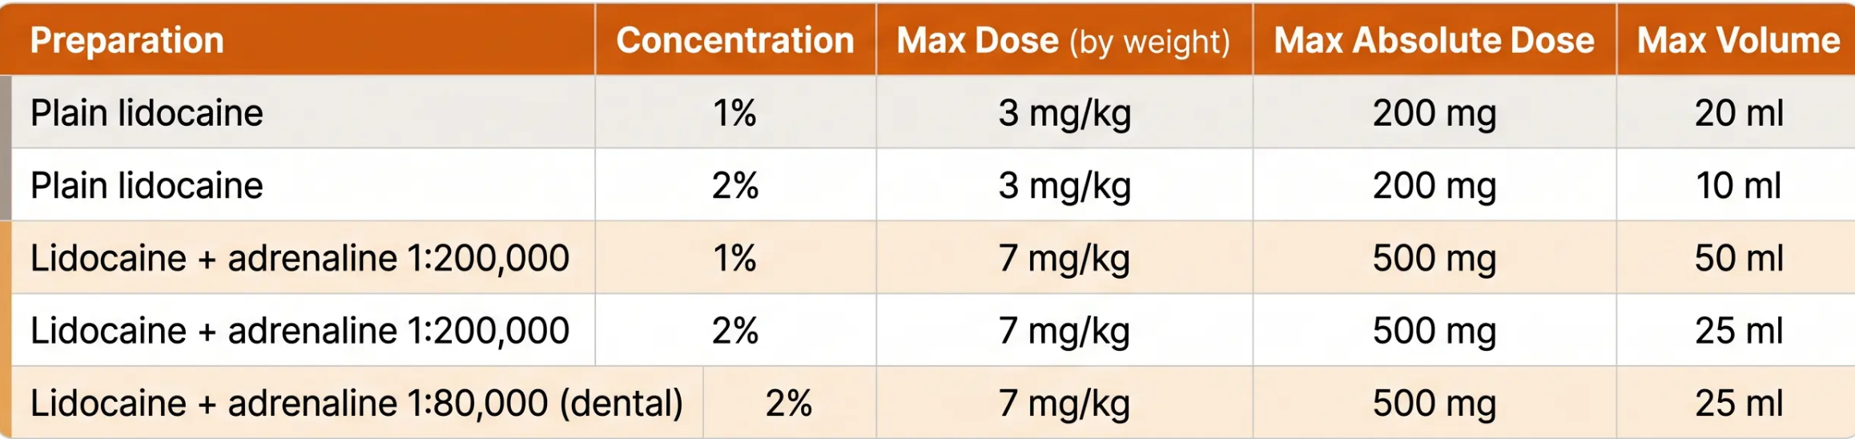
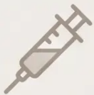
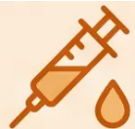
BNF 2026 Maximum Safe Doses for Lidocaine
LOCAL ANAESTHESIA
Doses are weight-based — always calculate before injecting.
3 mg/kg
7 mg/kg
Plain lidocaine maximum
Lidocaine + adrenaline maximum
Absolute ceiling: 200 mg
Absolute ceiling: 500 mg
Source: BNF 2026 · Doses apply to healthy adults — reduce in elderly, low body weight, hepatic impairment
Bradford VTS · Minor Surgery
www.bradfordvts.co.uk

Slide 15

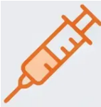
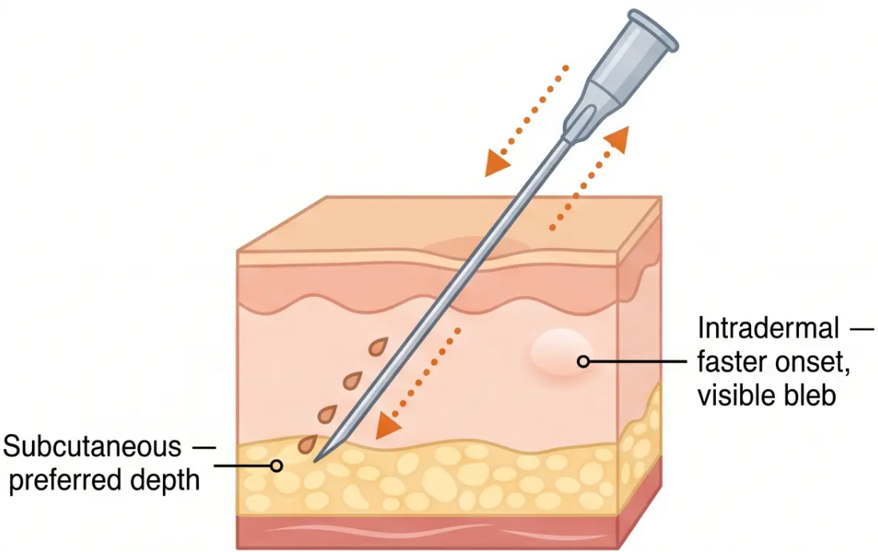

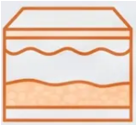

Local Anaesthesia Injection Techniques
TECHNIQUE
Use a 27G Needle
Fine gauge reduces patient discomfort and improves
control during slow infiltration
Inject on Withdrawal
Advance needle to furthest point first — then inject slowly
as you withdraw. Reduces risk of intravascular injection.
Subcutaneous = Less Painful
Preferred over intradermal. Intradermal gives faster onset
and a visible white bleb — useful to confirm anaesthetised zone.
Wait 15 Minutes
Adrenaline vasoconstriction takes up to 15 minutes to
reach full effect — do not start the procedure before this.
**Intradermal injection shows as a white raised
area — this confirms the zone is anaesthetised.**
Bradford VTS • Minor Surgery
www.bradfordvts.co.uk • Slide 15 of 35

Slide 16
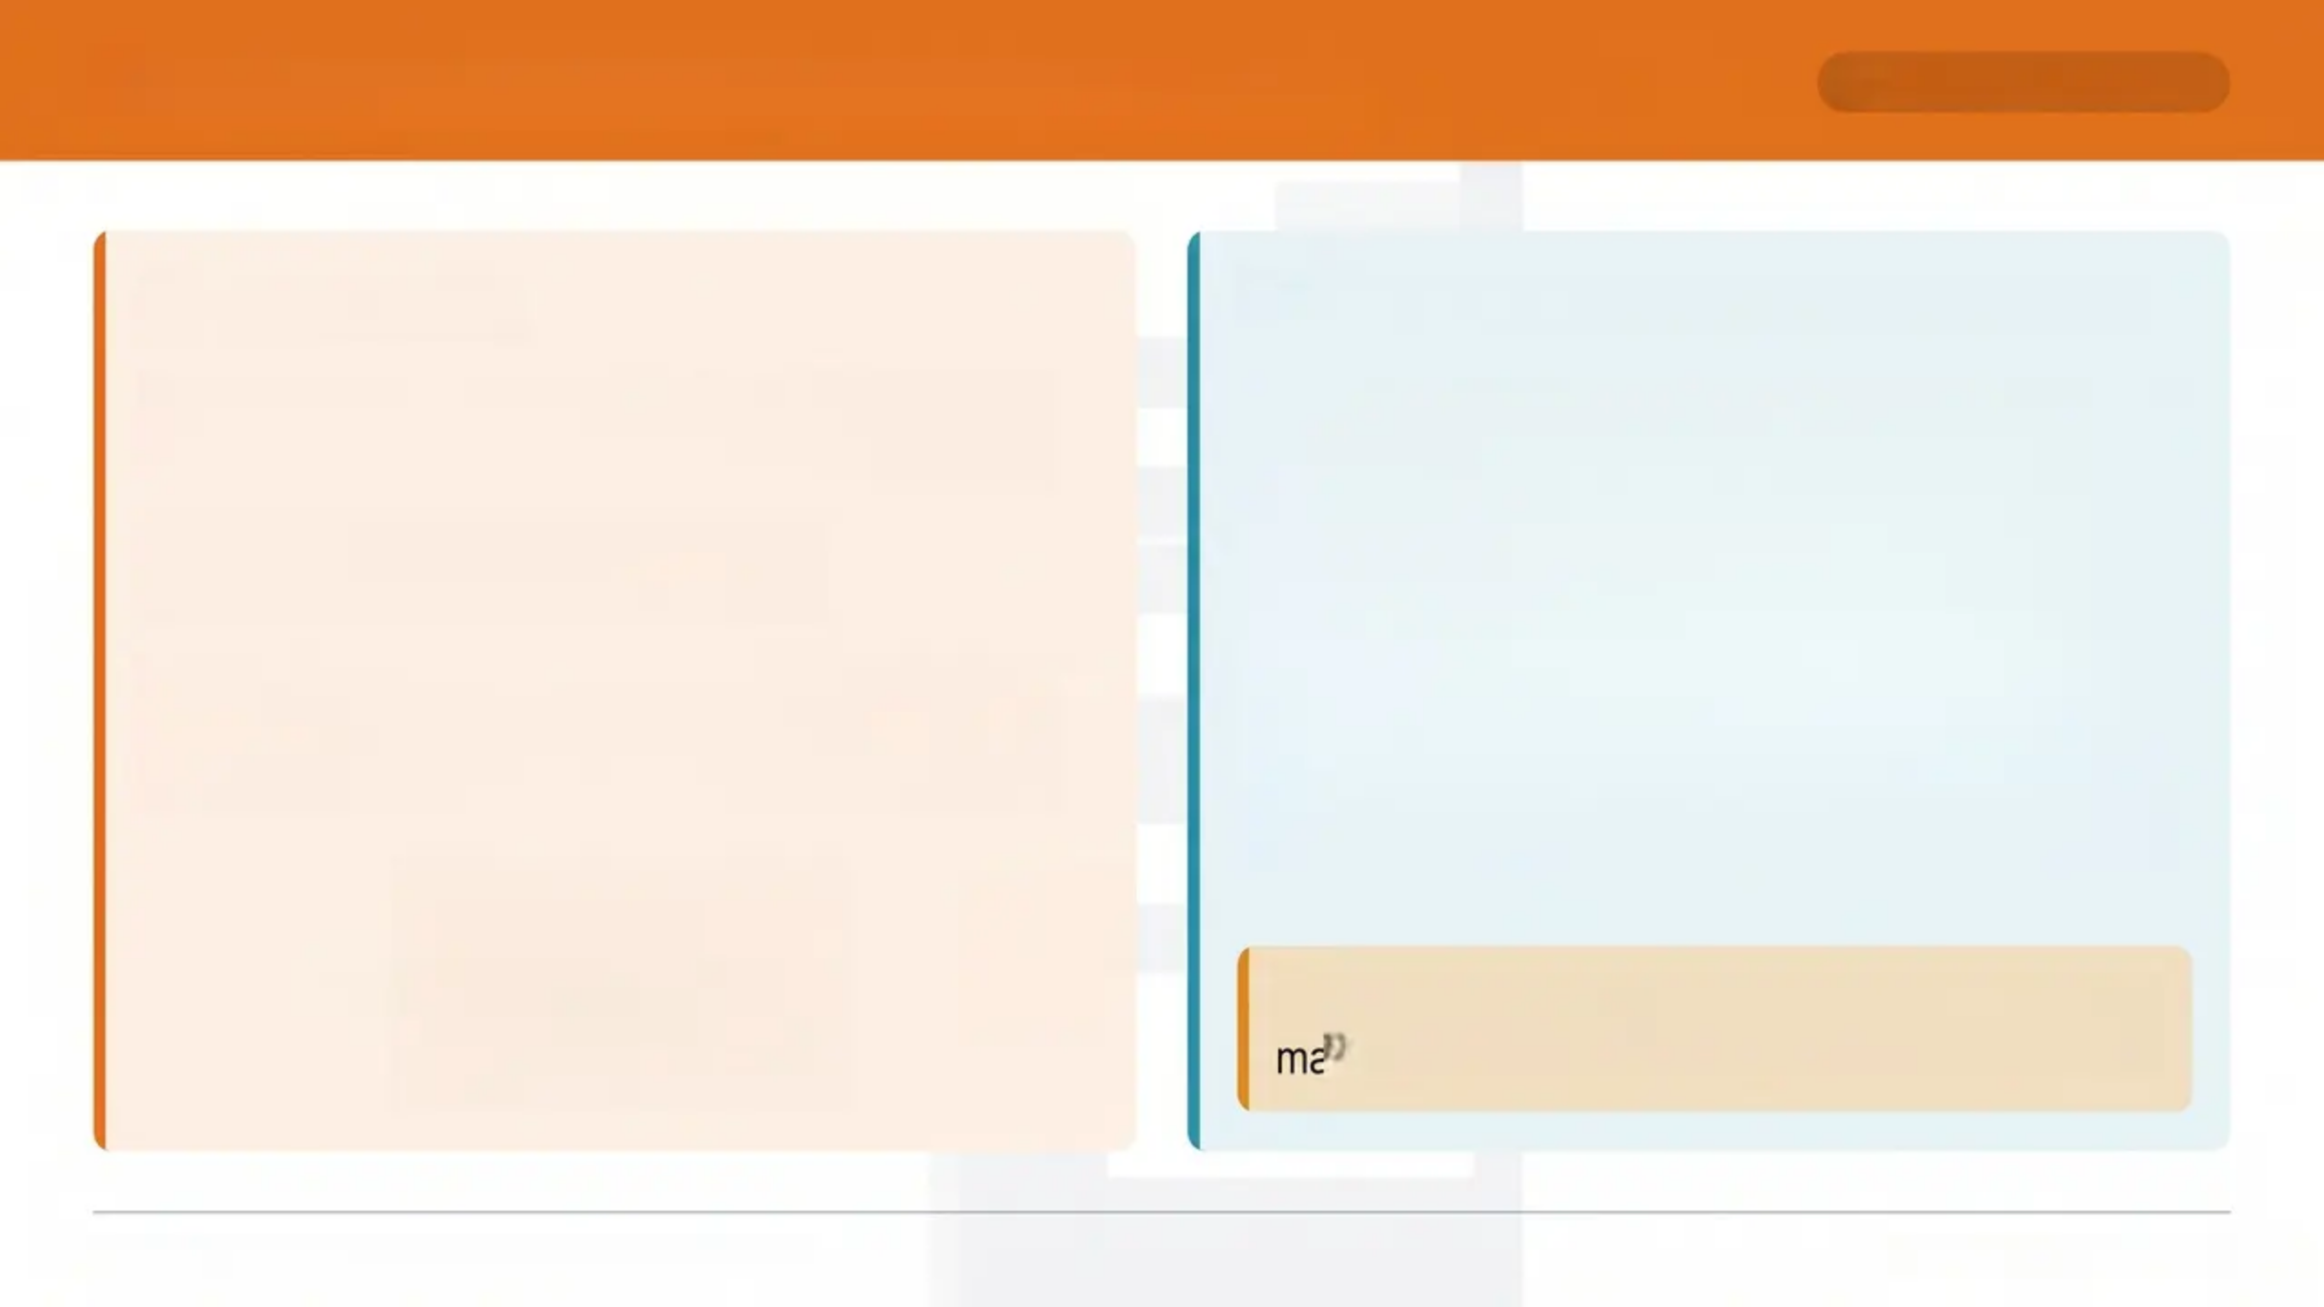
















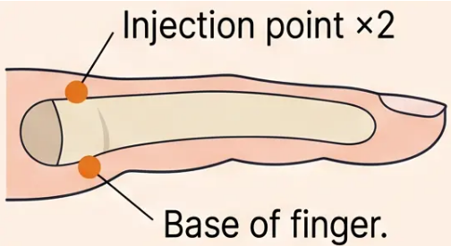

Ring Blocks and Topical Anaesthesia
LOCAL ANAESTHESIA
Ring Blocks
Topical Anaesthesia in Children
• Agent: 2% plain lidocaine — NO adrenaline
End-artery anatomy — adrenaline risks digit ischaemia
EMLA Cream
Ametop
(Tetracaine 4%)
• Maximum volume: 4 ml per finger
Avoid vascular compression
Onset time
90+ minutes
30–45 minutes
Vasoconstriction?
Yes — skin
goes white
No
vasoconstriction
• Technique note: Inject at base of finger — two
injection points, one each side
Time the occlusion period
Preferred for
children?
Second choice
✅ Preferred
🏆 Ametop preferred in children when speed
matters — onset 30-45 min vs 90+ min for EMLA
Bradford VTS • Minor Surgery in General Practice
www.bradfordvts.co.uk

Slide 17

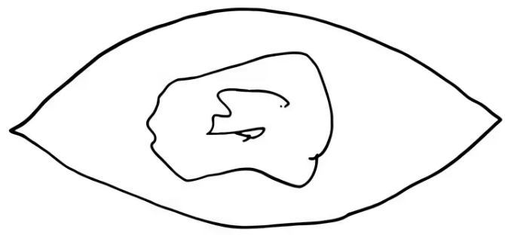
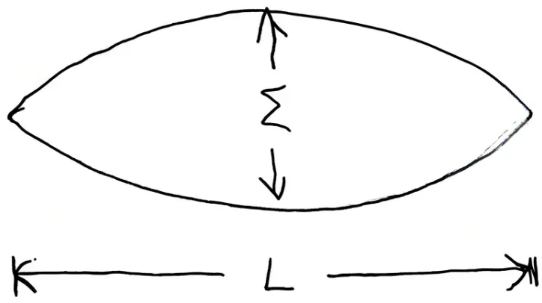
Excision Technique — Planning the Ellipse
TECHNIQUE
3 : 1 Ratio
The ellipse must be three times as long as it is wide. A shorter
ellipse creates dog-ear deformities at the wound apexes.
Equal Limb Lengths
Both sides of the ellipse must be equal in length. Unequal limbs
are the most common cause of dog-ear formation.
Lesion centred within the planned ellipse outline.
Follow Langer's Lines
Align the long axis of the ellipse with lines of minimal skin tension.
This minimises wound tension and produces the finest scar.
Orientation by Site
• Transverse — limbs, abdomen, forehead
• Vertical — glabellar area
• Avoid horizontal sutures on central cheeks
L : W = 3 : 1 — the fundamental excision ratio.
Bradford VTS • Minor Surgery Teaching Deck • www.bradfordvts.co.uk
slide 17 of 35

Slide 18
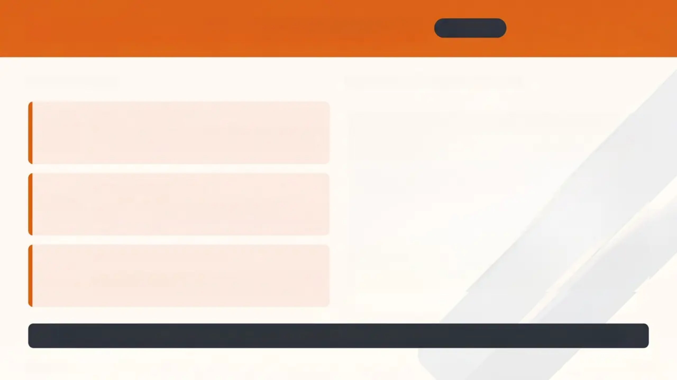
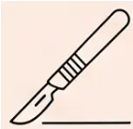
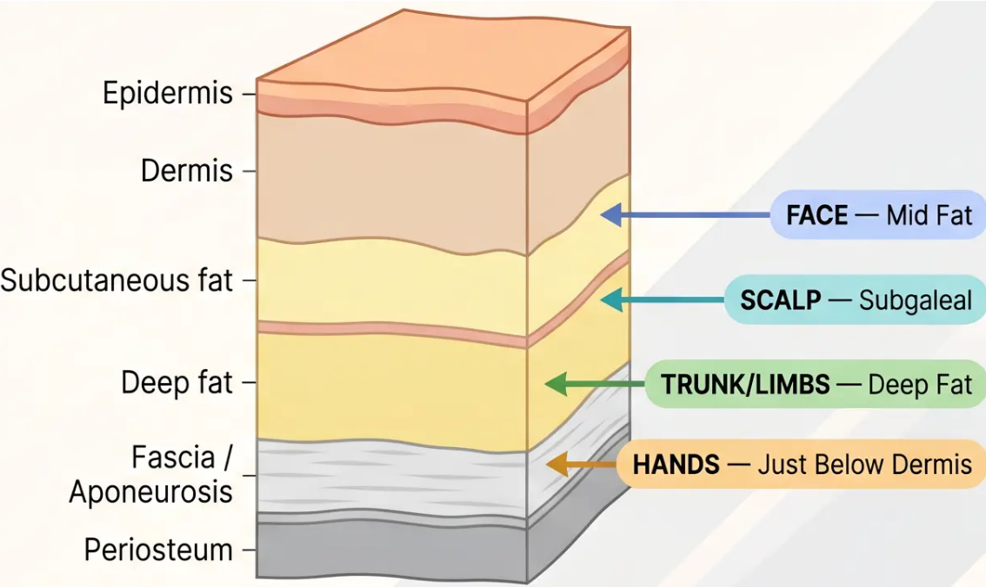


Surgical Incision and Tissue Dissection
TECHNIQUE
THE INCISION
DISSECTION DEPTH GUIDE
90° Blade Angle
Hold scalpel perpendicular to skin surface — ensures
clean, vertical wound edges for accurate apposition
One Bold Movement
Single, confident pass — never saw back and forth.
Hesitant strokes cause ragged edges and poor healing
Reverse Blade at Apexes
Flip blade direction at each apex of the ellipse —
prevents fish-tail deformity and maintains clean tip closure
⚠️ Scalp dissection must stay subgaleal — below fat, above periosteum — to protect the galea and minimise bleeding
Bradford VTS · Minor Surgery
18 / 35

Slide 19
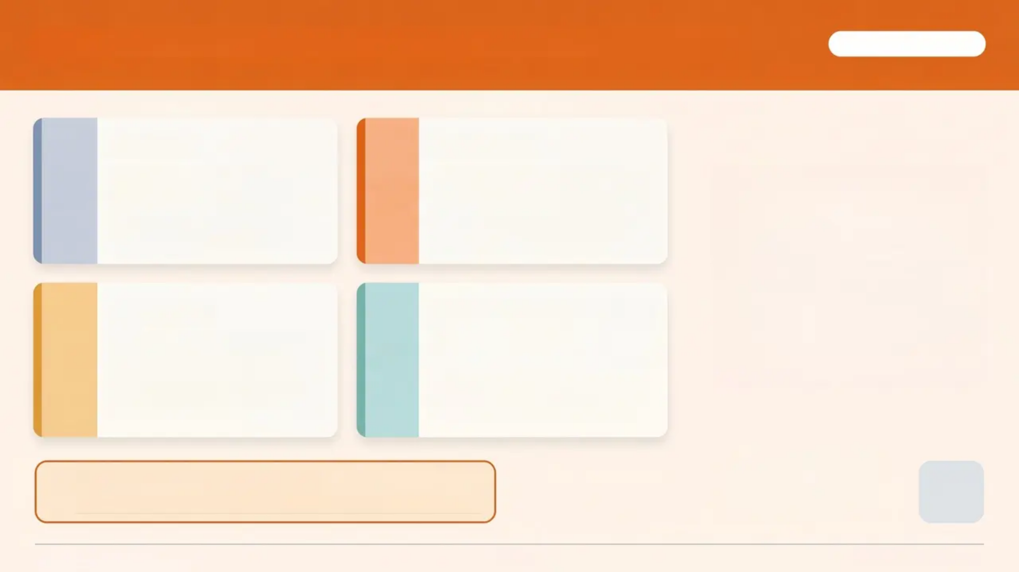


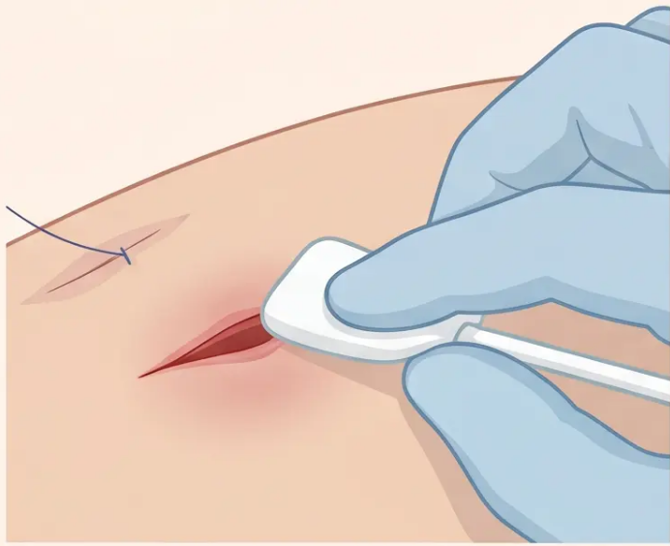



Haemostasis Management in Minor Surgery
SURGICAL TECHNIQUE
Pressure
Adrenaline
Always the first step. Simple
sustained pressure is
effective and should never be
skipped.
Takes up to 15 minutes for full
vasoconstriction — always wait
before proceeding with the
procedure.
Diathermy
Large Vessels (>1mm)
Bipolar or unipolar hyfriecator.
Keep away from wound
edges to avoid necrosis.
Use sterile covers.
Pressure dressings for high-bleed-
risk sites — forehead lipoma,
deep cysts, patients on warfarin.
Pressure dressings essential for:
forehead lipomata • deep cysts • anticoagulated patients
Bradford VTS • Minor Surgery
19 / 35
www.bradfordvts.co.uk

Slide 20

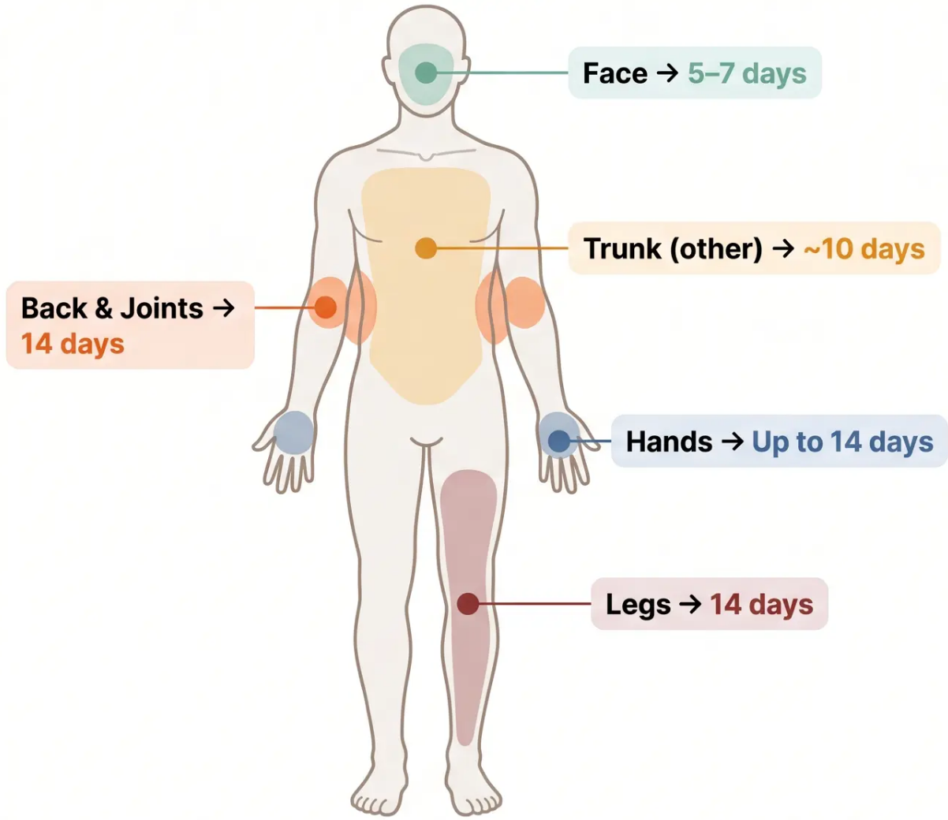
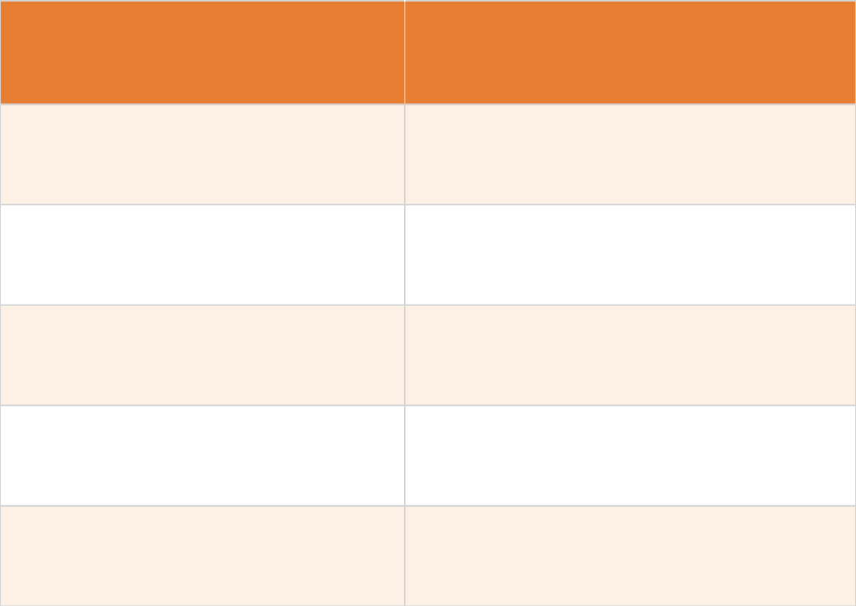

















Suturing — Site-Specific Removal Guide
CLINICAL REFERENCE
Body Site
Days to Removal
Face
5–7 days
Trunk (other)
~10 days
Back and Joints
14 days
Hands
Up to 14 days
Legs
14 days
🔑 Earlier removal on the face minimises scarring. Longer
times on joints and legs allow adequate tensile strength.
Bradford VTS • Minor Surgery Teaching Deck • www.bradfordvts.co.uk

Slide 21


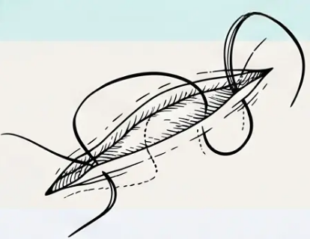
Suture Materials and Sizes
Suture Materials and Sizes
TECHNIQUE
SURFACE SUTURES
DEEP / SUBCUTANEOUS SUTURES
Non-Absorbable
Monocryl ● Subcutaneous layers, smooth absorption
Prolene
Ethilon
Vicryl ● Deep layers — avoid on face (tissue reaction)
Preferred for skin closure — smooth, strong, easy
to remove.
PDS ● Deep tension-bearing areas
Vicryl Rapid — dissolves in 10-14 days • Ideal for
scalp and behind-ear wounds.
⚠️ Silk — avoid: higher infection risk and poor
scarring outcomes.
Face
5/0 or 6/0
Body
3/0 • 4/0 • 5/0
Scalp
3/0 or 4/0
SIZE GUIDE
Bradford VTS • Minor Surgery
21 / 35

Slide 22

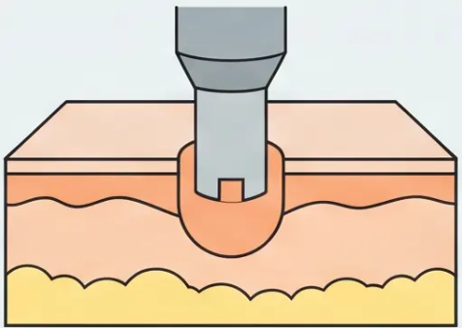
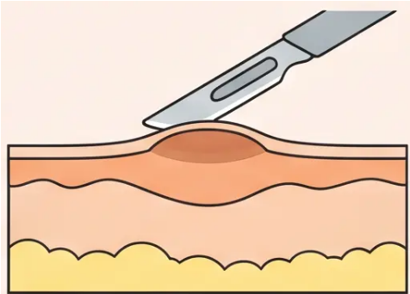

PUNCH BIOPSY AND SHAVE EXCISION
TECHNIQUE
Slide 22 of 35
PUNCH BIOPSY
SHAVE EXCISION
• Size range: 3–8 mm diameter
• Stretch skin perpendicular to tension lines — creates elliptical
wound, easier to close
• Handle specimen with skin hook or needle — never forceps
(crushes tissue, compromises histology)
• Small punches (3–4 mm) may not need suturing
• Benign proud lesions only — operator must be confident of
benign diagnosis
• Scarring outcomes: minimal in 45% head/neck, 30% trunk cases
• Recurrence rate: up to 25% — counsel patients beforehand
• Post-op care: Bactroban or chloramphenicol ointment, then
Vaseline twice daily for several days
⚠️ Do NOT use on pigmented lesions unless entire lesion fits within
punch with 2 mm clear margin — use elliptical excision instead
ℹ️ All shave specimens MUST be sent for histology — even
when lesion appears obviously benign
ALL specimens from minor surgery — punch, shave, or excision — must be sent for histology. No exceptions.
Bradford VTS - Minor Surgery Teaching Deck
www.bradfordvts.co.uk
Slide 22 of 35

Slide 23
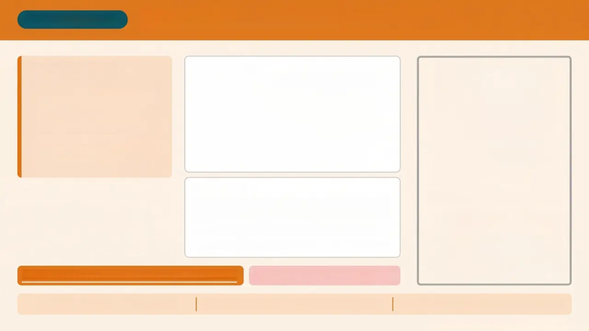

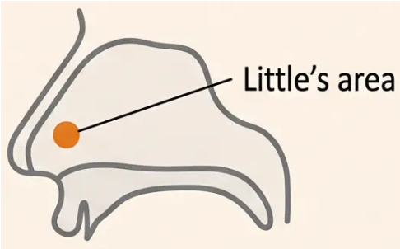
CLINICAL PROCEDURE
Nasal Cautery for Recurrent Epistaxis
BEFORE YOU START
PREPARATION
• Good lighting essential —
visualise Little's area clearly
• Wash area with adrenaline 1:10,000 from
syringe (no needle attached)
• Only cauterise if an obvious
bleeding vessel is seen
• Apply Vaseline generously to the upper lip
— prevents chemical burns
• Not suitable during active
bleeding — defer until
bleeding has stopped
• Advise patient to leave Vaseline on overnight
• Wear gloves throughout — silver nitrate
stains permanently
TECHNIQUE
• Touch silver nitrate stick to the specific vessel
only — do NOT cauterise the whole septum
Little's area — anterior nasal septum
• Use a gentle rolling movement on contact
• Procedure may need repeating at a later date
Vaseline on upper lip — medico-legally important
Never cauterise whole septum
Warn: staining fades as skin sheds
Paracetamol for post-procedure discomfort
Review if bleeding recurs — may repeat
Bradford VTS • www.bradfordvts.co.uk • Slide 23 of 35

Slide 24


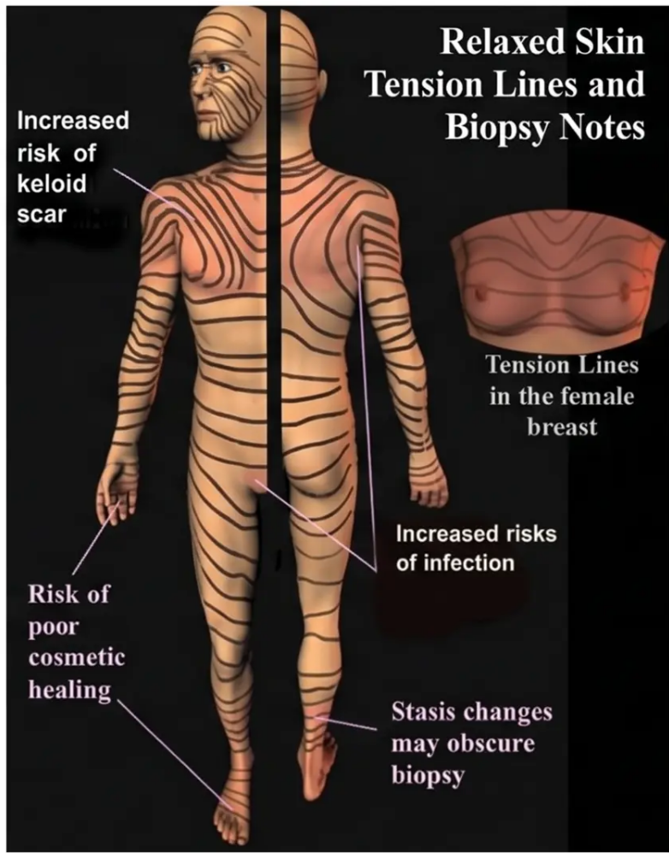
Anatomy and Surgical Problem Areas
REFER IF IN DOUBT
FACE
• SMAS envelops facial muscles — deep dissection risk
• Superficial temporal artery — visible in temple region
• Temporal branch of facial nerve → difficulty elevating eyebrow if damaged
• Marginal mandibular branch → lip weakness if damaged
• Facial nerve exits just below the inferior earlobe
• Subfrontalis lipomata go very deep — refer
NECK
• External jugular vein — minimal platysma cover in elderly
• Accessory nerve at Erb's point — deep to superficial fascia
SHOULDER & CHEST
• Warn all patients — document in notes
• Consider referral for lesions in these areas
HIGH-RISK ZONES
Axilla → brachial plexus branches
Popliteal fossa → common peroneal nerve
Lateral thigh → lateral cutaneous nerve; Shin → sural nerve
LOWER LIMBS
• Avoid excessive undermining — compromises blood supply
• Consider Dopplers before surgery on lower legs
• Secondary intention healing: check perfusion first
Relaxed Skin Tension Lines and Surgical Risk Zones
Bradford VTS - Minor Surgery in General Practice
Slide 24 of 35 - www.bradfordvts.co.uk

Slide 25

CONSENT
Consent and the Mental Capacity Act 2005
25 / 35
The Five Statutory Principles (MCA 2005)
Best Interests Assessment Includes:
■ patient's past and present wishes, values and beliefs
01
— Presumption of Capacity
■ views of family and carers (advisory — cannot veto)
Assume the patient has capacity unless proven
otherwise
■ general well-being, not just medical interests
02
■ spiritual and religious welfare
— Support to Decide
Take all practicable steps to help the patient make
their own decision
Form 4 — When Patient Lacks Capacity
03
— Right to Make Unwise Decisions
■ use when patient lacks capacity AND procedure is in
their best interests
An unwise decision does not equal lacking capacity
— Best Interests
■ family/carers cannot require treatment the clinician
deems inappropriate
04
Any act or decision made must be in the patient's
best interests
■ High Court approval required for:
▪ donation of regenerative tissue
▪ sterilisation for contraception
▪ withdrawal of artificial nutrition in PVS
— Least Restrictive Option
05
Choose the option that least restricts the patient's
rights and freedom
Capacity is decision-specific — a patient may lack capacity for complex
decisions but retain it for simple ones.
📝 Written consent is best practice — scan signed form into patient notes.
Bradford VTS · Minor Surgery in General Practice · www.bradfordvts.co.uk
Updated to MCA 2005 · NICE NG12 2026

Slide 26



Infection Control & MRSA Management
INFECTION SAFETY
26 / 35
Surgical Environment Standards
MRSA Patient Protocol
HIGH PRIORITY
Dedicated clean surgical area — reserved and
prepared before each case
Operate last — always schedule MRSA
patients at the end of the surgical list
Elbow-operated taps — avoid hand
contamination at the sink
Clear the room — remove all unnecessary
items before the procedure begins
Short nails + Hibiscrub — scrub before every
case without exception
Thorough clean — full room
decontamination immediately after the case
Avoid shaving hair-bearing areas — increases
infection risk
Spirit-based cleaners — must be avoided
with electrocautery (fire risk)
Sterile covers when hyfrieator is in use
Past MRSA — Still Treat as Active
Occasional masks for larger or deeper procedures
Even patients with previously positive but now
negative MRSA swabs must be managed as
though they still carry MRSA.
~5% infection rate across all skin surgery cases
False negatives are not uncommon.
*Document all complications in the Minor Surgery Record Book
*Bradford VTS · Minor Surgery Teaching Deck · www.bradfordvts.co.uk

Slide 27


Histology Requirements and Limitations
CLINICAL GOVERNANCE
THE ABSOLUTE RULE
HISTOLOGY LIMITATIONS
ALL specimens from minor
surgery MUST be sent for
histology — no exceptions.
Punch biopsy and lentigo maligna
Punch biopsy may miss early lentigo maligna — sampling
error is a real risk.
Dysplastic naevi
What to include on the request form:
• Duration of lesion
• Site and size of lesion
• Provisional diagnosis — your clinical impression
• Relevant history — e.g. immunosuppression,
previous skin cancer
Difficult to differentiate moderate/severe dysplastic
naevus from melanoma histologically — ALL incompletely
excised dysplastic naevi must be re-excised.
Difficult rashes
Some inflammatory or complex rashes may not benefit
from biopsy — refer to dermatology instead.
*Inadequate clinical history on the request form is a common audit failure point.
EXAM TRAP
Curettage produces CYTOLOGY — NOT histology.
*Only formal excision or punch biopsy provides tissue suitable for histological analysis.

Slide 28





Minimising Litigation and Risk Management
RISK & SAFETY
Document everything. Warn clearly. Refer when in doubt.
Document Thoroughly
Warn the Right Patients
Refer When in Doubt
• Maintain a Minor Surgery Record Book
• Record: operation performed, LA
used, sutures used, histology results,
complications
• Written post-op instructions given to
patient
• Document suture removal and wound
state at follow-up
• Scan written consent into patient
notes
• Keloid/hypertrophic scar risk groups:
chest above nipple line, upper back,
shoulders
• Higher risk: young patients, female
sex, Afro-Caribbean patients
• Shoulder, chest, deltoid — warn and
consider referral
• Hypopigmentation risk from
cryotherapy — especially on dark skin
• Scarring risk must be discussed and
documented at consent
• Any facial surgery — refer to
specialist if uncertain
• Any diagnostic doubt — biopsy first,
do NOT destroy
• Spirit-based skin cleaners must be
avoided with electrocautery
• Agreed post-op protocol for wound
care and suture removal
• Patient must know who to contact if
concerns arise post-op
The Minor Surgery Record Book
Every procedure must be logged: operation • LA used • sutures • histology result • complications.
This is your medico-legal record.
Bradford VTS • Minor Surgery in General Practice • www.bradfordvts.co.uk
28 / 35

Slide 29



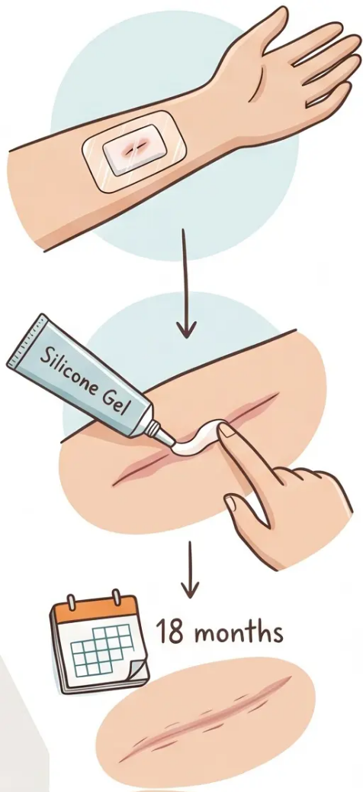



POST-OP CARE
Post-Operative Care and Dressings
29 / 35
Dressing Selection
• Dressings are not always necessary after minor surgery
• When needed, use non-adhesive options: Tegaderm or Mepore
• Haematoma-risk sites (e.g. forehead, deep cysts, warfarin patients): use Jelonet +
non-adhesive dressing + bandage — not too tight on lower legs
• Keep wound moist with Vaseline; daily gentle washing is sufficient
Wound Healing and Daily Care
• All curettage and cauterery wounds heal by secondary intention — this is normal
• Secondary intention healing works well under the ear and in the temporal area
• Check Dopplers on lower limbs before leaving wounds to heal by secondary intention
• Prevent post-operative oedema: leg elevation and compression if Dopplers are satisfactory
Scar Maturation
• Scar maturation takes up to 18 months — reassure patients
• Most small dog-ears resolve spontaneously within 18 months
• For keloid-prone patients: apply silicone gel (e.g. Dermatix) once wound is healed (10-14 days post-op)
• Apply thinly, twice daily for a minimum of 2 months
• Shave excision: apply Bactroban or chloramphenicol ointment, then Vaseline BD for several days post-procedure
Keloid risk sites: chest above nipple line, upper back, shoulders — warn patients and document in notes

Slide 30

Top Tips Clinical Pearls for Minor Surgery
CLINICAL PEARLS
1
2
3
4
Biopsy First,
Always
7-Point Checklist:
Score ≥3
No Adrenaline
in Digits
Curettage =
Cytology Only
Never use cautery or
cryotherapy if there is any
diagnostic doubt — biopsy
first or refer.
Use the Weighted 7-Point
Checklist for pigmented
lesions — score ≥3 triggers
urgent 2-week wait referral.
Plain lidocaine only for
fingers, toes, and penis —
adrenaline causes end-
artery ischaemia.
Curettage scrapes and
crushes tissue — it produces
cytology, NOT histology.
Always send excisions for
formal histology.
5
6
7
8
Ice-Ball = Start
the Clock
Past MRSA =
Active MRSA
Wait 15 Minutes
for Adrenaline
All Specimens
→ Histology
Liquid nitrogen freeze time
is measured from when the
ice-ball forms — not from
when the spray begins.
All patients with a past
history of MRSA (even now
negative swabs) must be
managed as if still MRSA
positive.
Full vasoconstriction from
adrenaline-containing LA
takes up to 15 minutes — do
start operating before this.
Every specimen removed in
minor surgery must be sent
for histology — no exceptions,
even if clearly benign.
Bradford VTS - Minor Surgery Teaching Deck
www.bradfordvts.co.uk - Updated NICE NG12 2026 / BNF 2026

Slide 31





Exam Pearls 💡
AKT • SCA
*Know these — they come up every time
AKT FOCUS 📋
SCA FOCUS 🩺
Curettage = CYTOLOGY, not histology
Classic AKT trap — excision provides histology
Always discuss histology when consenting
'We will send the sample to the lab to check it' —
say this explicitly
7-point checklist threshold = score ≥ 3
Not ≥ 4 — refer urgently at 3 or above
Warn about scarring before every procedure
Document the discussion — especially chest,
shoulder, upper back
Diameter ≥ 7mm = MINOR feature (1 point)
Not a major feature — a common misconception
Dark skin = specific hypopigmentation warning
Cryotherapy on darker skin tones — counsel
proactively, document
Lidocaine plain max = 3 mg/kg (up to 200 mg)
With adrenaline = 7 mg/kg (up to 500 mg)
Ametop onset 30 min • EMLA onset ≥ 90 min
Ametop preferred in children when speed matters
'Can you just burn off this mole?'
Examine carefully first. If any doubt — do not
destroy. Refer.
🎯 The golden rule: when in doubt — biopsy first or refer. Never destroy without a diagnosis.
Bradford VTS • Minor Surgery
31 / 35 • www.bradfordvts.co.uk

Slide 32

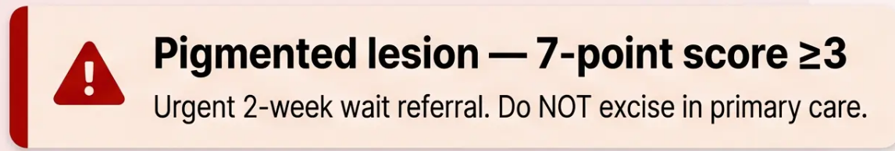
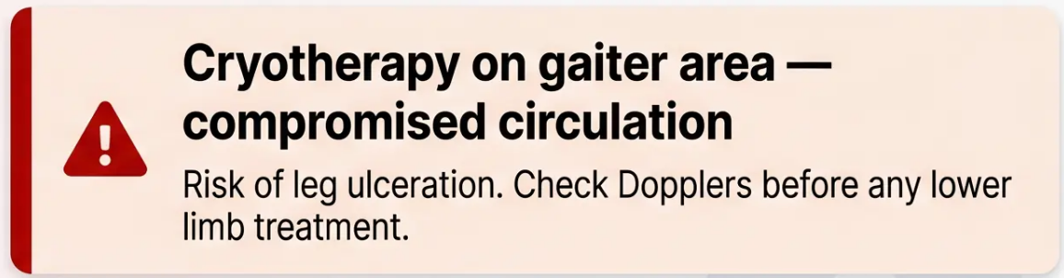
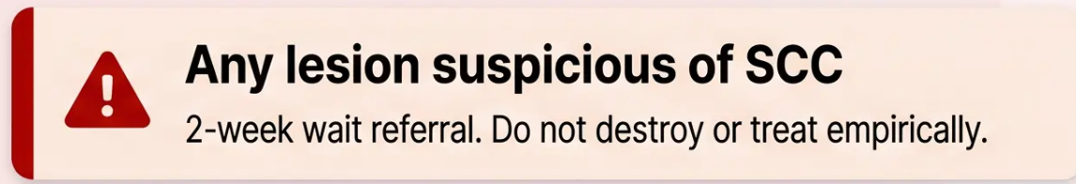
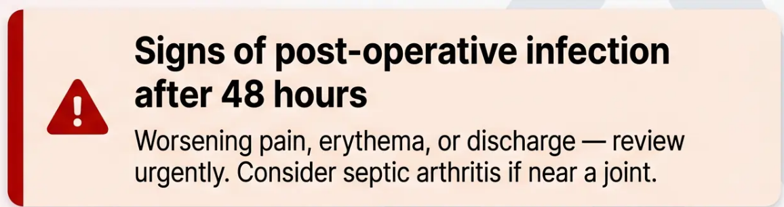
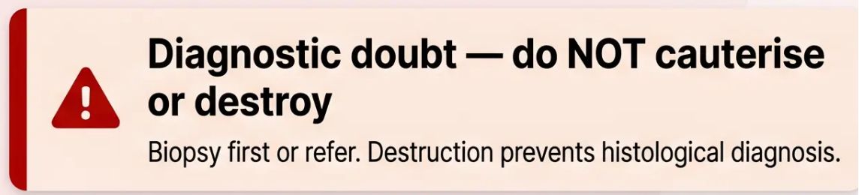
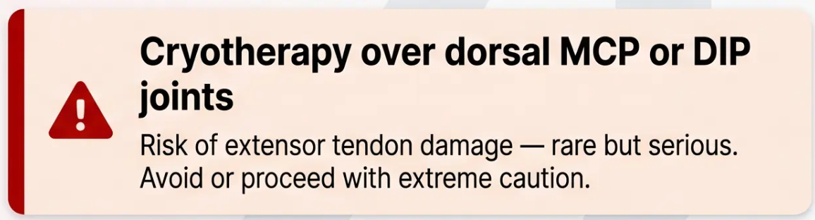
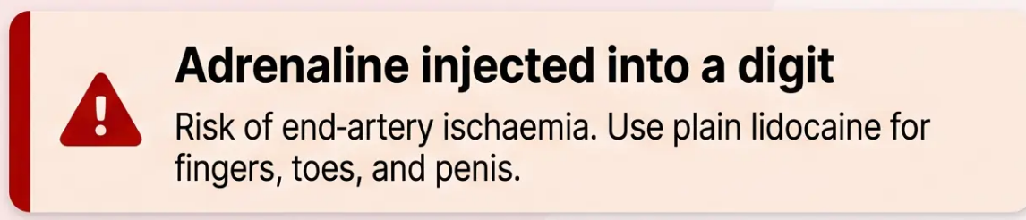
Red Flags — Safety-Critical Warnings
PATIENT SAFETY
Do not ignore these — act immediately or do not proceed.
Bradford VTS · Minor Surgery · Red Flags
32 / 35
www.bradfordvts.co.uk

Slide 33
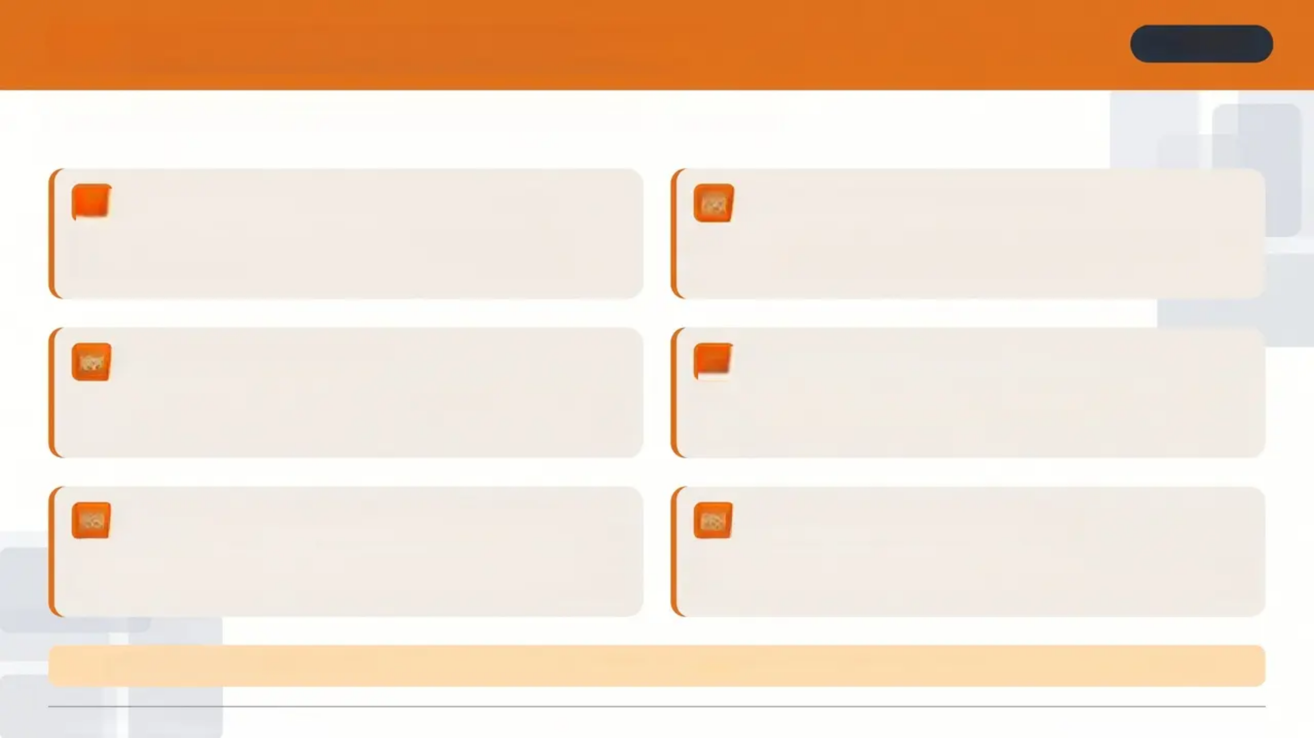
Common Pitfalls in Minor Surgery
AVOID THESE
Frequent errors that lead to patient harm, poor outcomes, or medico-legal risk
01
Not sending specimens for histology
02
Electrocautery for viral warts
Assuming a lesion is 'clearly benign' is never sufficient — all
excised tissue must go to histology without exception.
Electrocautery has the highest recurrence rate of any wart therapy.
It is not recommended — use cryotherapy or salicylic acid instead.
03
Adrenaline LA in digits
04
Cryotherapy on ischaemic lower legs
Using lidocaine with adrenaline in fingers, toes, or penis risks
ischaemia due to end-artery anatomy. Always use plain lidocaine here.
Applying cryotherapy to the gaiter area in a patient with peripheral
vascular disease risks non-healing ulceration. Check Dopplers first.
Confusing Histofreeze with liquid nitrogen
05
06
Not waiting after LA injection
Commercial sprays are far less cold than LN₂. Not suitable for plantar
warts, Bowen's disease, or superficial BCC — do not substitute.
Adrenaline vasoconstriction takes up to 15 minutes to reach full effect.
Starting too soon means more bleeding and poorer field visibility.
⚠️ Pitfall 07 — Underestimating the 3:1 ellipse ratio: a length-to-width ratio below 3:1 results in dog-ear deformity at wound ends.
Bradford VTS • Minor Surgery Teaching Deck
www.bradfordvts.co.uk • Slide 33 of 35

Slide 34

QUICK RECALL SUMMARY
KNOW THESE
Rapid-fire key facts – know these cold before your AKT
7-POINT CHECKLIST
CURETTAGE
ADRENALINE — AVOID IN
Fingers • Toes • Penis
Score ≥ 3 → Urgent
2WW referral
Produces CYTOLOGY
— NOT histology
LIQUID NITROGEN FREEZE
ELECTROCAUTERY & WARTS
LIDOCAINE — PLAIN MAX
3 mg/kg → up to 200 mg
(20 ml of 1%)
Timed from ice-ball —
not from spray start
Highest recurrence rate
— avoid for warts
LIDOCAINE + ADRENALINE MAX
PAST MRSA PATIENTS
Manage as active MRSA
— false negatives occur
ALL SPECIMENS
7 mg/kg → up to 500 mg
(50 ml of 1%)
Must be sent for
histology — no exceptions
Bradford VTS · www.bradfordvts.co.uk

Slide 35


Disclaimer & Resources
BRADFORD VTS
Medical Disclaimer
- This teaching material is intended for educational
purposes for GP trainees registered with Bradford VTS.
- Clinical guidance is updated to NICE NG12 (April 2026)
and BNF 2026 at time of publication.
- Guidelines change — always verify current
recommendations before clinical practice.
Bradford VTS Resource
- This deck does not replace individual clinical judgement
or formal clinical supervision.
www.bradfordvts.co.uk
GP Training · West Yorkshire · Minor
Surgery Resources
- For patient-specific decisions, consult current NICE, BNF,
and local trust guidelines.
GP Training
Produced by Bradford VTS — updated to NICE NG12 2026 and BNF 2026 standards.
Bradford VTS · Minor Surgery in General Practice · Teaching Deck 2026
www.bradfordvts.co.uk

