Slide 1


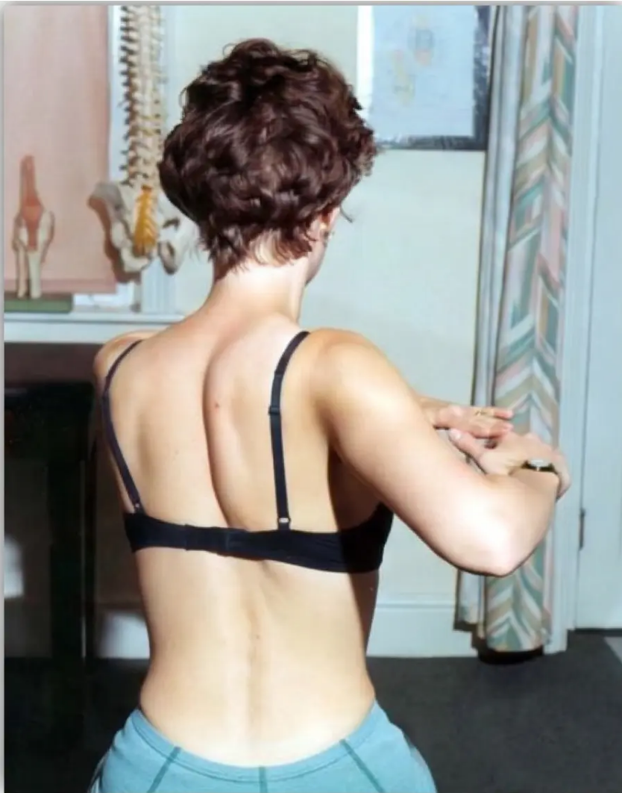

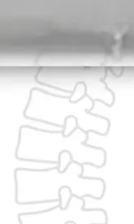
BRADFORD VTS TEACHING DECK
Back Pain
Assessment, Diagnosis and Red Flags
A Comprehensive Teaching Resource for
GP Trainees (ST1–ST3) and IMGs
Aligned to NICE NG59 | National CES Pathway March 2026
www.bradfordvts.co.uk
Disclaimer: This teaching material is intended for educational purposes for GP trainees and
IMGs. It does not constitute formal medical advice. Clinical decisions should always be based
on individual patient assessment and current national guidelines. Content ard lisoautum..
Content is verified against NICE NG59 (last updated December 2020), NICE CKS Back Pain Low
(last revised October 2024), and the National CES Pathway (March 2026).

Slide 2

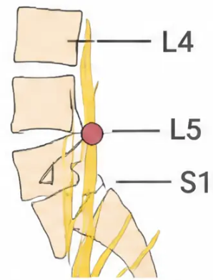







BRADFORD VTS TEACHING DECK
www.bradfordvts.co.uk
Anatomy, Epidemiology & Diagnostic Triage
Spinal structure, UK burden of disease, and NICE NG59 classification
SPINAL ANATOMY
• 33 vertebrae: 7 cervical · 12 thoracic · 5 lumbar · 5 sacral (fused) · 3–4 coccyx (fused)
• Greatest mechanical load: L3–S1 — the most common region for pain
• Cauda equina begins at L1/L2 — bundle of nerve roots, not spinal cord
UK EPIDEMIOLOGY
5%
70–80%
150M
90%
of all GP consultations
working days lost
per year (UK)
lifetime prevalence
recover within 6 weeks
NICE NG59 — DIAGNOSTIC TRIAGE
Non-Specific Low Back Pain
Nerve Root Pain
Serious Spinal Pathology
>95% of cases · Age 20–55 · Mechanical ·
Manage in primary care
Leg pain > back pain · Dermatomal ·
SLR positive · Consider referral at 6 weeks
Red flags present · Malignancy / infection /
fracture / CES · Urgent investigation

Slide 3




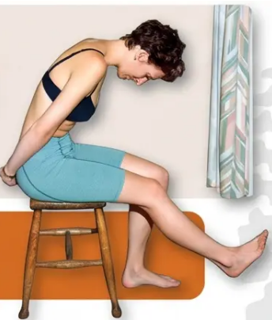


BRADFORD VTS TEACHING DECK
www.bradfordvts.co.uk
History Taking and Clinical Examination
Classifying back pain starts before you touch the patient
IPPA Examination Sequence
Key History Points
① LOOK
Gait (antalgic = nerve root); lumbar lordosis;
correctable scoliosis; muscle bulk
1. Onset Sudden or gradual? Any precipitating event?
② PALPATE
Spinous process percussion → vertebral pathology;
paraspinal spasm; SIJ tenderness
2. Site and Radiation Lumbosacral only / to thigh / to foot or toes?
3. Character Mechanical (varies with movement) vs. constant/non-mechanical?
③ MOVE
Flexion (Schober’s test: ≥5 cm increase); extension;
side flexion; rotation in sitting
4. Aggravating / Relieving Factors Worse at rest or night → serious
pathology; better leaning forward → stenosis
④ SPECIAL TESTS
5. Associated Symptoms Bowel/bladder changes, leg weakness,
sensory disturbance
• SLR: positive if leg pain reproduced at <70° — indicates L4/L5/S1 root irritation
• Crossed SLR: highly specific for disc prolapse
6. Systemic Symptoms Weight loss, fever, night sweats → serious pathology
• Femoral Stretch: anterior thigh pain — tests L2, L3, L4
• FABERE/Patrick’s: SIJ and hip
7. Past History Malignancy, TB, immunosuppression, steroid use, IVDU
⑤ NEUROLOGICAL
8. Impact Work, sleep, daily activities, psychological wellbeing
• Power: L4 (dorsiflexion), L5 (hallux extension /
walk on heels), S1 (plantarflexion / tip-toes)
9. Previous Episodes and Treatment What helped before?
10. Yellow Flags Illness beliefs, catastrophising, fear-avoidance
• Reflexes: Knee jerk L3/L4 • Ankle jerk S1
• Sensation: dermatomal distribution
Mechanical pain: varies with movement and time of day
Non-mechanical pain: constant, worse at rest or night → investigate
TOP TIP: SLR is positive when it reproduces LEG
pain — not just back pain — at less than 70°

Slide 4
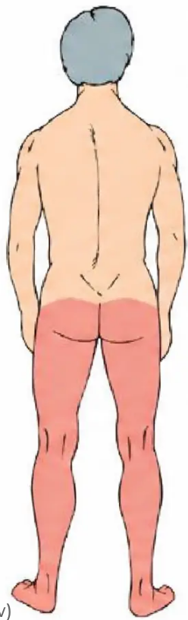

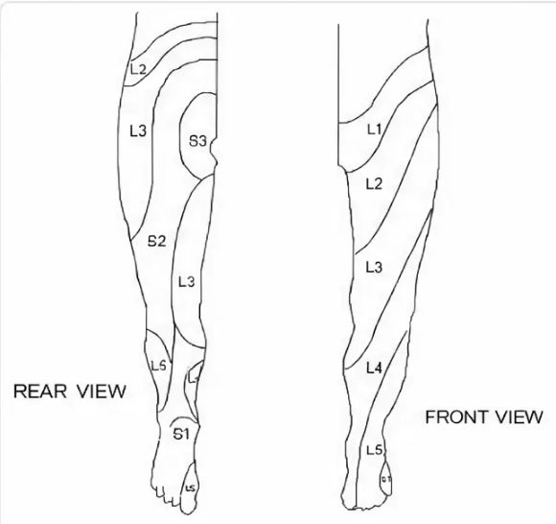





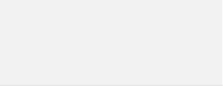











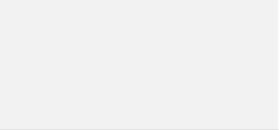







BRADFORD VTS TEACHING DECK
Radiculopathy Patterns
& Specific Conditions
L4 · L5 · S1 Nerve Root Mapping | Spinal Stenosis | Ankylosing Spondylitis | Piriformis Syndrome
L4
L5 (most common)
S1 (most common)
Pain /
Paraesthesia
Anterior thigh → medial leg and foot
Lateral leg → dorsum of foot → big toe
Posterior thigh → lateral/ posterior leg → lateral foot → little toe
Weakness
Knee extension, ankle dorsiflexion
Hallux extension (walk on heels), foot dorsiflexion — foot drop if severe ⚠️
Plantar flexion (walk on tip-toes), foot eversion
Reflex
Knee jerk ↓ / absent
No specific reflex (tibialis posterior occaionally)
Ankle jerk ↓ / absent
Key Warning
SLR positive
⚠️
SLR positive
Foot drop can be IRREVERSIBLE — refer early if weakness present
🧠 Memory: STAND on S1 · SIT on S2 · S3 = 'you know what' | L4 disc → L5 root compression (disc compresses root below)
Lumbar Spinal Stenosis
Ankylosing Spondylitis
Piriformis Syndrome
Age >60 | Neurogenic claudication
Onset <40 | Young men | HLA-B27
Sciatica mimic | Normal neurology
• Bilateral leg pain/weakness on walking a predictable
distance
• Gradual insidious onset, morning stiffness >30-60
min
• Sciatic nerve passes through/adjacent to piriformis
in <10% of population
• WORSE downhill (extension narrows canal),
BETTER leaning forward
• IMPROVES with exercise and activity (opposite to
mechanical LBP)
• Distribution similar to sciatica but worse during/after
exercise
• 🛒 'Shopping trolley sign' — key distinguishing feature
• Alternating buttock pain, reduced chest expansion
• Reflexes, motor and sensory testing NORMAL
• Distinguish from vascular claudication: check ABI
and pulses
• Schober's test reduced | FABERE/Patrick's test positive
• SLR NEGATIVE — key differential from true disc prolapse
• → Refer to rheumatology
• Pain on resisted abduction/external rotation of hip

Slide 5









BRADFORD VTS TEACHING DECK
Red Flags and Cauda Equina Syndrome
Mandatory Section · National CES Pathway March 2026 · NiCE NG59
CES — Emergency Referral Criteria
Red Flags — Serious Spinal Pathology
Age <20 or >55 at first presentation
Violent trauma, or any trauma in elderly / osteoporotic patients
Constant, progressive, non-mechanical pain — no relief with rest
Take
IMMEDIATE
action!
Thoracic pain (less commonly mechanical)
Past history of malignancy (prostate, breast, lung, renal, thyroid)
Systemic steroids or immunosuppression
Drug misuse or HIV
1. Difficulty initiating micturition or impaired sensation of urinary flow
2. Altered perianal / perineal / genital sensation — saddle anaesthesia
Systemically unwell — fever, malaise, unexplained weight loss
3. Severe or progressive neurological deficit of both legs
Night sweats
4. Loss of sensation of rectal fullness
Persisting severe restriction of lumbar flexion
5. Sexual dysfunction — loss of erection / ejaculation / genital sensation
Widespread neurological signs
Structural deformity
Emergency MRI within 4 hours of request — National Standard
Bladder scan: PVR >200 ml makes CES 20× more likely; PVR >600 ml → catheterise
Red flags prompt urgent investigation — assess the full clinical picture.
Negative physical exam does NOT exclude CES if subjective symptoms are present

Slide 6
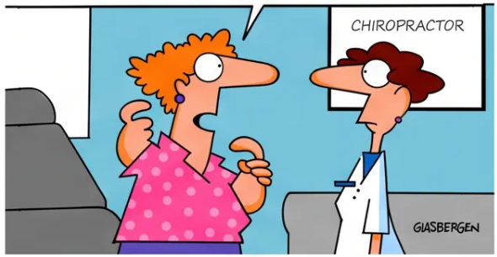



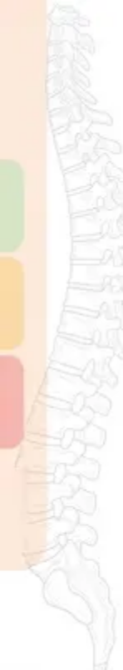




BRADFORD VTS TEACHING DECK
www.bradfordvts.co.uk
Psychosocial Factors & STarT Back Tool
Yellow flags predict chronicity more reliably than physical signs
SCA focus: explore ICE and
psychosocial barriers at first
presentation
● Yellow Flags
● Blue Flags
◆ STarT Back Tool
Occupational risk factors
Psychosocial risk factors
Keele University — NICE NG59 endorsed
Beliefs — Pain always means damage;
catastrophising
Heavy perceived workload, low
pay
9-item questionnaire at first presentation
Use for new episodes only
Distress — Depression, anxiety,
fear-avoidance
Poor management attitudes
Loss of confidence to return to
work
Low risk
Simple reassurance +
self-management advice
Illness behaviour — Sick role adoption,
learned helplessness
Anxiety/depression about
returning to work
Physiotherapy +
psychosocial support
Work factors — Low job satisfaction,
poor employer support
Medium risk
Off work >6 weeks
Intensive combined physical
& psychological programme
Relationships — Family reinforcing
sick role
High risk
→ 10–40% chance still
absent at 1 year
Legal/financial — Litigation, disability
payments
GPs think they explore psychosocial
factors well — but they don’t. Use this tool.
Off work 6–12 months
→ 90% may never return to
any work
More predictive of poor outcome
than physical signs
SCA focus: explore ICE and psychosocial
barriers at first presentation

Slide 7

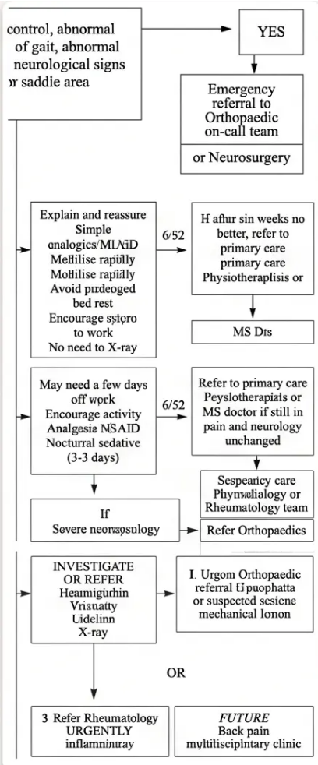















BRADFORD VTS TEACHING DECK
www.bradfordvts.co.uk
Investigations and Referral Guidelines
NICE NG59 | When to image, when to test, when to refer
Imaging: NICE NG59 Guidance
Bloods: When Red Flags Present
Do NOT Routinely Image
Blood Tests for Red Flags
- FBC (full blood count)
No X-ray, CT, or MRI for non-specific low back pain without red flags.
When Imaging IS Appropriate
- ESR and CRP (inflammatory markers)
- Calcium and alkaline phosphatase
X-Ray when: Significant trauma · Elderly with mild trauma · Prolonged steroid use ·
Known osteoporosis · Age over 70 with new back pain · Red flags present
- PSA (men — for prostate cancer)
- Protein electrophoresis (myeloma screen)
MRI when: Progressive neurological symptoms (foot drop, bilateral weakness) ·
Radicular pain not improving at 6 weeks · Suspected CES → emergency
MRI within 4 hours · Red flags present
If red flags present and plain X-ray is normal:
consider bone scan, CT, or MRI — do not be
falsely reassured by a normal X-ray.
CT: Alternative to MRI when MRI unavailable or contraindicated
Referral Pathways
Tier 2 — URGENT (2-Week Wait)
Tier 1 — EMERGENCY (Same Day)
Tier 3 — ROUTINE
EMERGENCY — Same Day
URGENT — 2-Week Wait
ROUTINE Referral
- Cauda equina syndrome symptoms (any
of the 5 CES criteria) → Emergency MRI
within 4 hours
- Sudden onset bilateral radicular leg pain
(no CES) → MSK triage
- Nerve root pain not resolving after 6 weeks
→ MRI, physio, nerve root block, orthopaedic
opinion
- Red flags suggesting malignancy or
infection → appropriate specialty
- Spinal stenosis not responding to conservative
management → orthopaedic or neurosurgery
Clinical referral pathway —
adapted from Bradford VTS
- Progressive bilateral leg weakness
- Suspected epidural abscess or spinal
nerve tumor with acute neurological deficit
- Progressive motor weakness in single
nerve root → spinal surgery within 1–2
weeks
- Suspected inflammatory arthropathy
→ rheumatology
Refer by telephone if face-to-face
would cause delay.
- Severe neurological symptoms (more
than one nerve root affected)
- Chronic LBP not responding to primary care
→ pain clinic or MSK service

Slide 8



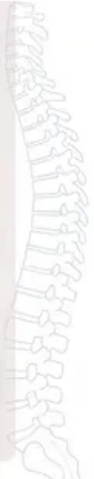
BRADFORD VTS TEACHING DECK
Top Tips & Common Pitfalls
Clinical pearls for GP practice — and errors that cost marks and patients
Top Tips
Common Pitfalls
What to do in clinical practice
Errors that harm patients and fail exams
● Strip to underwear on second presentation — Full
examination is mandatory if a patient returns with ‘simple’
back pain. You may be the first to find a red flag.
● Paracetamol first — WRONG — NICE NG59: NSAIDs are first-
line pharmacological treatment. Do NOT prescribe
paracetamol alone for low back pain.
● True sciatica: leg pain beats back pain — If back pain
dominates, reconsider the diagnosis. Start neuro exam seated
— SLR may already be positive.
● Prescribing gabapentinoids — Explicitly NOT recommended
for back pain or sciatica. No proven benefit; significant harm
potential; now a controlled drug.
● Refer early if weakness develops — Foot drop from L5
compression can become irreversible. Don’t watch and wait
once motor signs appear.
● Routine X-ray for simple back pain — Not indicated. High
radiation dose (= 120 chest X-rays), does not change
management, and can cause patient harm through labelling.
● Use the STarT Back Tool — GPs overestimate their psychosocial
assessment skills. Use the validated 9-item tool at first
presentation for every new episode.
● Missing progressive neurological deficit — Always test hallux
extension (L5). Foot drop can become permanent. Careful,
documented serial examination is essential.
● Safety-net every back pain patient — Every single patient must
hear: “If you develop difficulty passing urine, numbness around
your bottom, or leg weakness — go to A&E immediately.”
● Dismissing yellow flags — Psychosocial factors predict
chronicity MORE reliably than physical signs. Ignoring them is
the single biggest predictor a patient who neever returns to work.

Slide 9













BRADFORD VTS TEACHING DECK
AKT Exam Pearls
High-yield facts for your AKT — know these cold
NICE NG59 — Pharmacology Rules
✕ DO NOT
✓ FIRST LINE
✕ DO NOT
✕ DO NOT
✕ DO NOT
Paracetamol alone
NSAIDs
Gabapentinoids
Benzodiazepines
Spinal fusion
Not first-line for LBP
First-line pharmacological
treatment
No benefit for LBP or
sciatica — controlled drug risk
Not for sciatica
Not for non-specific LBP
Nerve Root Patterns — Know the Difference
L4/L5 Disc → L5 Root
L5/S1 Disc → S1 Root
CES — Emergency Standard
SLR: Reduced / Positive
SLR: Reduced / Positive
MRI within: 4 hours of request
Ankle jerk: ✓ Present
Ankle jerk: ✕ Absent
Pathway: National CES Pathway 2026
Weakness: Plantar flexion, foot eversion
PVR >200ml: 20× more likely CES
Weakness: Hallux extension, foot dorsiflexion
Sensory loss: Lateral foot and little toe
Sensory loss: Dorsum of foot
PVR >600ml: Catheterise
⚠ Foot drop risk — refer early if weakness
Emergency referral — by phone if face-to-face causes delay

Slide 10








BRADFORD VTS TEACHING DECK
Quick Recall
High-Yield Summary — Back Pain Assessment, Diagnosis and Red Flags
Diagnostic Triage (NICE NG59)
NICE NG59 — Do NOT
- ✕ Routine imaging for non-specific LBP
- Simple back pain → reassure, keep active, analgesia
- ✕ Paracetamol alone as first-line
- Nerve root pain → conservative 6 weeks, then consider MRI
- ✕ Gabapentinoids for back pain or sciatica
- Serious pathology → red flags → urgent investigation
- ✕ Spinal fusion for non-specific LBP
Red Flag Age Limits
- ✕ Benzodiazepines for sciatica
- First episode outside age 20–55 → red flag
Yellow Flags — Key Domains
- Age >55 with new back pain → consider malignancy, fracture, stenosis
- Catastrophising · fear-avoidance · depression
- Age <20 → consider scoliosis, infection, inflammatory
- Low job satisfaction · illness behaviour
- Use STarT Back Tool at every first presentation
Nerve Root Quick Map
Referral Speed Guide
- L4 → knee jerk lost · medial foot · quad weakness
- L5 → no reflex lost · dorsum foot · hallux extension weak
- Same day → CES symptoms · bilateral progressive weakness
- S1 → ankle jerk lost · lateral foot · plantar flexion weak
- 2-week wait → unilateral radiculopathy progressing · red flag malignancy
- Routine → radiculopathy not resolved at 6 weeks
CES — Emergency Triggers
Safety-Net — Say This Every Time
- Bladder dysfunction · saddle anaesthesia · bilateral leg weakness
- “If you develop difficulty passing urine, numbness around your
bottom or genitals, or leg weakness — go to A&E immediately.”
- Bowel loss of fullness · sexual dysfunction
- → Emergency MRI within 4 hours (National CES Pathway 2026)
Disclaimer: This teaching material is intended for educational purposes for GP trainees and IMGs preparing for AKT and SCA examinations. It does not constitute formal medical advice
or replace clinical judgement. All content has been verified against NICE NG59 (last updated December 2020), NICE CKS Back Pain Low (last revised October 2024), and the National
CES Pathway (March 2026). Guidelines change — always check current national guidance before applying to clinical practice.
www.bradfordvts.co.uk
© Bradford VTS Teaching Deck | Back Pain — Assessment, Diagnosis and Red Flags

