Slide 1



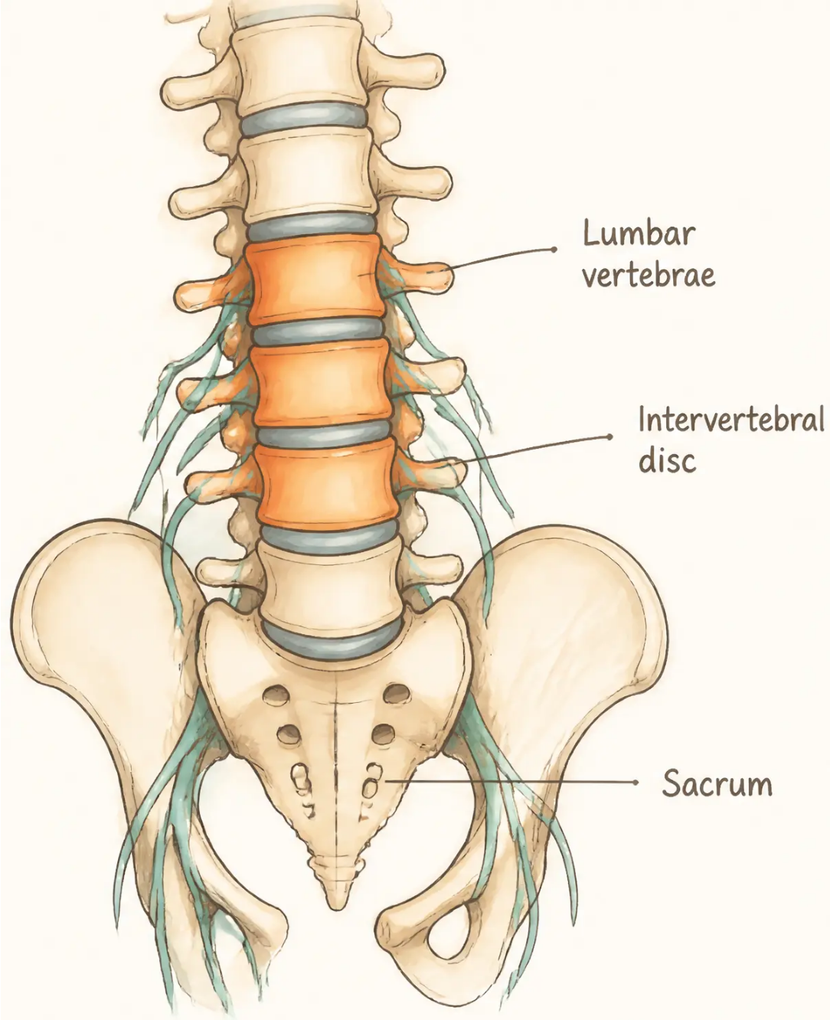



BRADFORD VTS TEACHING DECK
Back Pain in
General Practice
A Complete Clinical Guide for GP Trainees
Created June 2026 · Updated to NICE NG59 (2020) Standards
www.bradfordvts.co.uk
Disclaimer:
Always double check this advice and drug doses with
the latest NICE and BNF guidance. This document is
for educational purposes only.
Bradford VTS Teaching Deck
Back Pain in General Practice
Slide 2 of 33

Slide 2
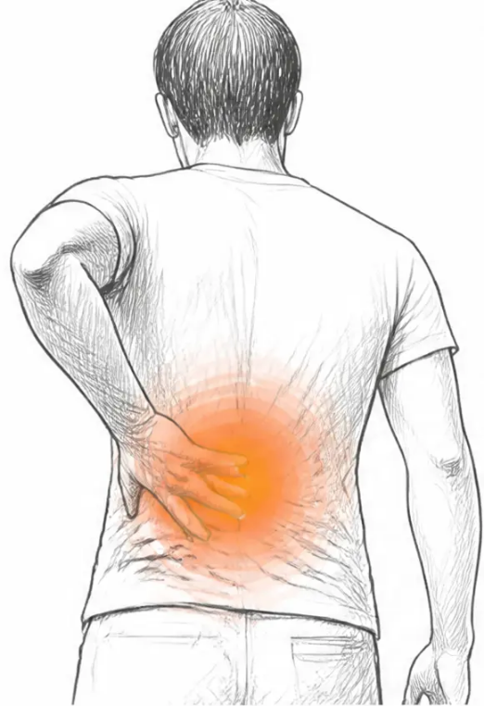









BRADFORD VTS TEACHING DECK
The Scale of the Problem
Back pain in general practice — why this matters
~250
85%
back pain consultations
of back pain has NO definitive
diagnosis — even with imaging
per GP per year
The second most common reason
Imaging does not equal answers.
for GP consultation — after the common cold
Most LBP remains non-specific.
80-90%
14 million
800,000
of adults experience
GP consultations
inpatient bed days
back pain in their lifetime
per year in the UK
per year
Most prevalent ages 30-50
£1 billion
£3 billion
£8 billion
7 million
NHS annual cost
DWP disability benefits
Lost production annually
Physiotherapy
Direct cost of managing
Paid to people with back
Productivity losses due to
sessions/year
back pain in the NHS
pain-related disability
sickness absence and presenteeism
High demand on MSK services
www.bradfordvts.co.uk
Back Pain in General Practice — Bradford VTS Teaching Deck
Slide 3 of 33

Slide 3
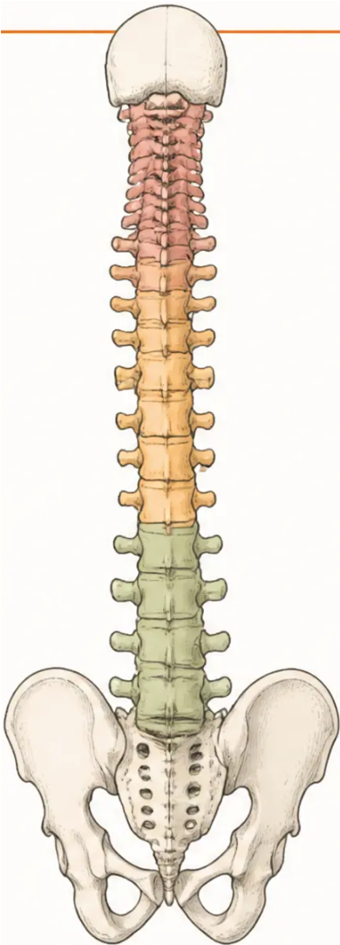

















BRADFORD VTS TEACHING DECK
Classification of Back Pain
Three main categories — understanding where your patient sits changes everything
THE THREE MAIN CATEGORIES
SUB-TYPES BY ORIGIN
Specific Spinal Pathology
Neurogenic
< 1% of cases
Nerve root compression, cord compression
Tumour · Infection · Fracture · Inflammatory disease
(e.g. Ankylosing Spondylitis)
Spondylogenic
Rare but must not be missed — red flag territory
Trauma, infection, tumours, metabolic —
disc degeneration, facet joint disease,
osteoporosis
Nerve Root Pain / Radiculopathy
~5–10% of cases
Disc prolapse · Foraminal stenosis
Viscerogenic
Leg pain worse than back pain — true sciatica
Referred from aorta, kidneys, uterus, bowel
Non-Specific Mechanical LBP
Vasculogenic
~90–95% of cases
Vascular claudication — AAA,
peripheral ischaemia
Most common presentation · Benign · Diagnosis of exclusion
The vast majority of what GPs see every day
Psychogenic
90–95% of back pain is non-specific mechanical LBP —
benign, self-limiting, and manageable in primary care.
Psychosomatic, situational,
litigation-related
www.bradfordvts.co.uk
Back Pain in General Practice — Bradford VTS Teaching Deck
Slide 4 of 33

Slide 4








BRADFORD VTS TEACHING DECK
Back Pain in General Practice
Key Message: Avoid Medicalisation
Do NOT medicalise back pain.
Most back pain should be self-managed. Degenerative change is
NORMAL with age — it does not necessarily cause symptoms.
Normalise. Don’t catastrophise.
Degenerative Disc
Disease Is Ageing
20–30% of People
Have Disc Herniation
on MRI — With No Symptoms
Image Only to Exclude
Serious Pathology
Like grey hair or wrinkles —
degeneration on imaging is a
normal part of getting older, not
a pathological diagnosis.
Routine imaging for non-specific
LBP is not recommended by
NICE NG59. It medicalises normal
findings and increases anxiety.
A positive scan does not equal a
cause of pain. Imaging findings
must correlate with
clinical examination.
Pitfall to Avoid: “Telling a patient their scan shows ‘degenerative disc disease’ frames
normal ageing as a disease — this increases fear-avoidance behaviour and drives chronicity.”
www.bradfordvts.co.uk
Back Pain in General Practice — Bradford VTS Teaching Deck
Slide 5 of 33

Slide 5











BRADFORD VTS TEACHING DECK
Structured History Taking
What to ask — and why it matters
The Pain Itself
Safety Screening
The Person Behind the Pain
• Acute, subacute, or chronic (≥3 months)?
• Always ask about bladder symptoms
— urinary retention? incontinence?
• Occupation — physical demands, prolonged
sitting, lifting
• Acute on chronic?
• Back pain alone, or leg pain too?
• Financial or legal context:
disability benefits? compensation claim?
• Always ask about bowel symptoms
— incontinence? loss of control?
• Worse sitting? Worse with movement?
• Leg pain: above or below the knee?
(Below = more likely true radiculopathy)
• Saddle area numbness?
— perineum, anus, genitals
• Work satisfaction — a key yellow flag
• Health beliefs:
“Does movement feel dangerous to them?”
• Night pain — serious pathology until
proven otherwise
• Bilateral leg weakness or
gait disturbance?
• Social support — family over-protective
or absent?
• Sensory changes — distribution and
character
• Claudication pattern? (worse walking,
better leaning forward)
These symptoms = Cauda Equina
screening — do not miss
• Previous episodes — pattern of time off work?
Key Message:
“To know as much about the patient who has the back pain as about the back pain the patient has.”
www.bradfordvts.co.uk
Back Pain in General Practice — Bradford VTS Teaching Deck
Slide 6 of 33

Slide 6






BRADFORD VTS TEACHING DECK
Benign Mechanical Back Pain
The most common presentation — ~90–95% of all low back pain cases
CLASSIC CLINICAL FEATURES
KEY MESSAGE
Worse in the morning — improves with activity
Unlike inflammatory back pain, which remains stiff and sore throughout
Mechanical LBP is a
clinical diagnosis.
Varies with posture and movement
Sitting, bending, lifting may aggravate; gentle movement relieves
Lower lumbar region, may radiate to buttocks and thighs
Imaging is rarely needed and
frequently misleading.
Does not typically shoot below the knee — distinguishes from true radiculopathy
Dull, poorly localised pain
Difficult for the patient to point to one exact spot
No specific attributable pathology
A normal MRI does not rule out
pain. An abnormal MRI does not
confirm its cause.
A diagnosis of exclusion — serious causes must be actively screened out
No neurological signs on examination
Reflexes, power, and sensation should be intact
Not inflammatory
Not neurological
Not sinister pathology
Back Pain in General Practice — Bradford VTS Teaching Deck
www.bradfordvts.co.uk
Slide 7 of 33

Slide 7



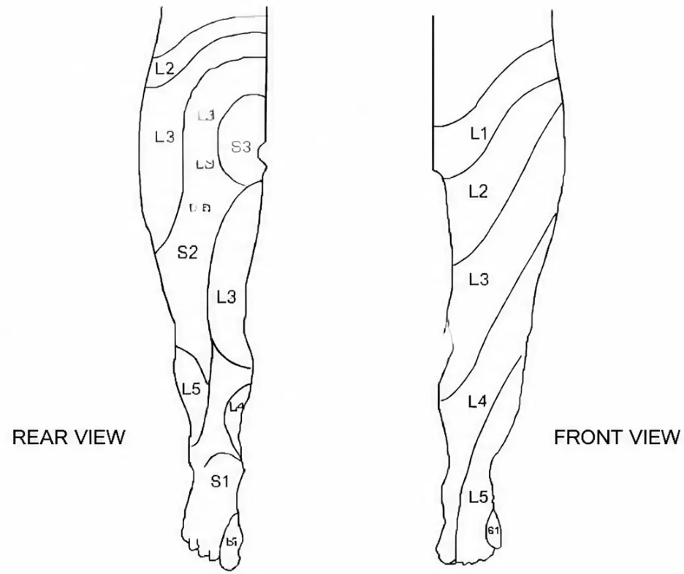
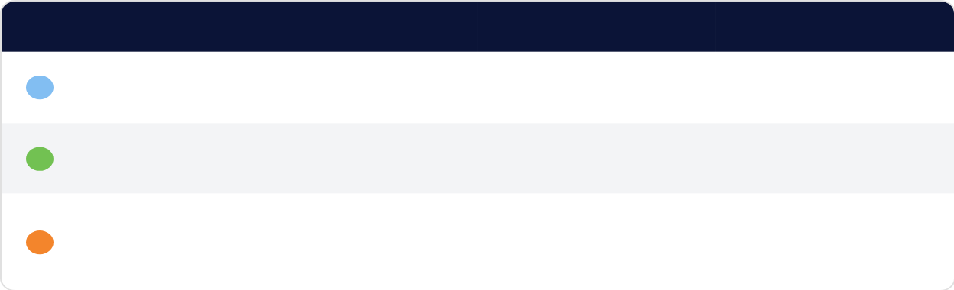





Nerve Root Pain & Radiculopathy
BRADFORD VTS TEACHING DECK
Identifying True Sciatica by Level
True Sciatica — Key Features
Dermatomal Distribution — Lower Limb
• 🦶 Leg pain WORSE than back pain — the defining feature
• Pain radiates from buttock → below the knee → heel or sole of foot
• Paraesthesia (tingling/numbness) along a dermatomal distribution
• If L2–L4 affected: pain in the anterolateral thigh (femoral nerve roots)
Start examination with the patient SITTING — the seated position
already loads the nerve root
CLINICAL FINDINGS BY ROOT LEVEL
Level
Motor Weakness
Reflex
Sensory Area
Knee extension
(quadriceps)
Knee jerk ↓
or absent
Medial leg to foot
L4
Foot & great toe
dorsiflexion
Normal
Dorsum of foot,
lateral leg
L5
Plantar flexion,
foot eversion
Ankle jerk ↓
or absent
Lateral border foot,
little toes
S1
Clinical Vignette: 30-year-old postman — 3 months minor back pain → acute right leg pain
with sensory symptoms along back of leg to sole and little toe. SLR positive at 50°,
ankle jerk absent, reduced sensation lateral two toes.
→ S1 Disc Prolapse with Root Irritation
True sciatica = leg pain worse than back pain. Leg below the knee = more likely true radiculopathy.
www.bradfordvts.co.uk
Back Pain in General Practice — Bradford VTS Teaching Deck
Slide 8 of 33

Slide 8
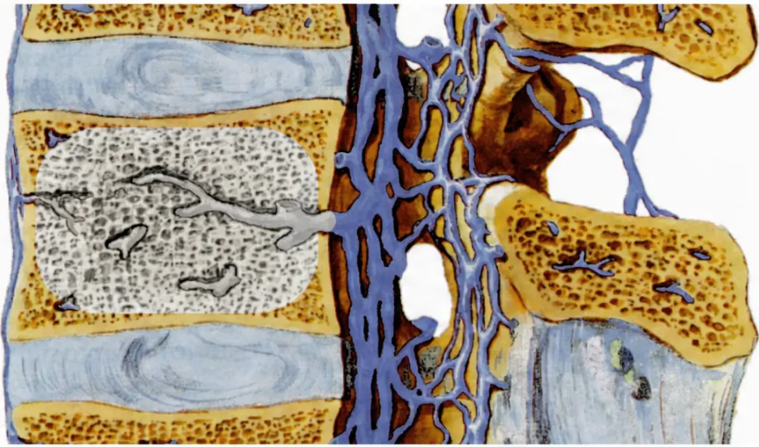














BRADFORD VTS TEACHING DECK
Back Pain in General Practice
Disc Degeneration Without Root Irritation
Internal disc pathology causing pain — without nerve root compression
CLINICAL VIGNETTE
55-year-old self-employed joiner
• 6 years of chronic back pain
• Recurrent episodes — managed with analgesics and osteopath
• After heavy lifting: cannot get out of bed
• Acute back pain with bilateral gluteal pain
THREE SOURCES OF PAIN
• Sitting is very painful; bending causes pain
On Examination:
Within the Disc
• Stiff lumbar spine
Annular tears · Disc resorption · Osteophyte formation
• SLR positive at 40° bilaterally
Facet Joints
• No neurological signs
Synovitis · Capsular laxity · Articular cartilage degeneration
Diagnosis:
Muscles & Ligaments
Disc Degeneration WITHOUT Root Irritation
Stretch · Tear · Haematoma formation
MANAGEMENT APPROACH
Conservative management first — physiotherapy, NSAIDs, graduated exercise, and self-management.
Imaging rarely changes management and frequently misleads.
Back Pain in General Practice — Bradford VTS Teaching Deck
www.bradfordvts.co.uk
Slide 9 of 33

Slide 9

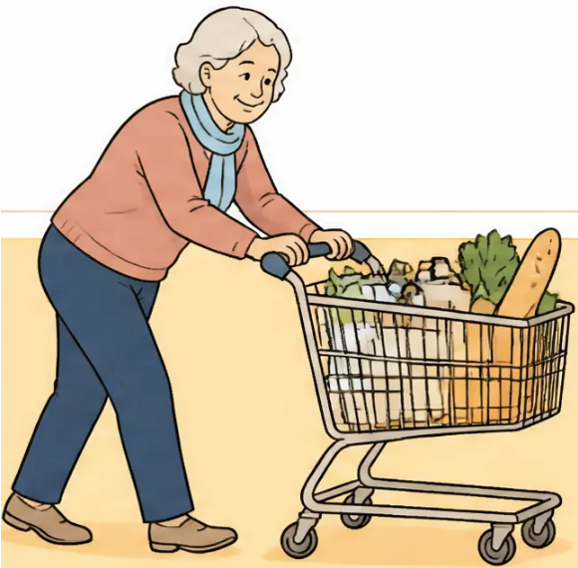
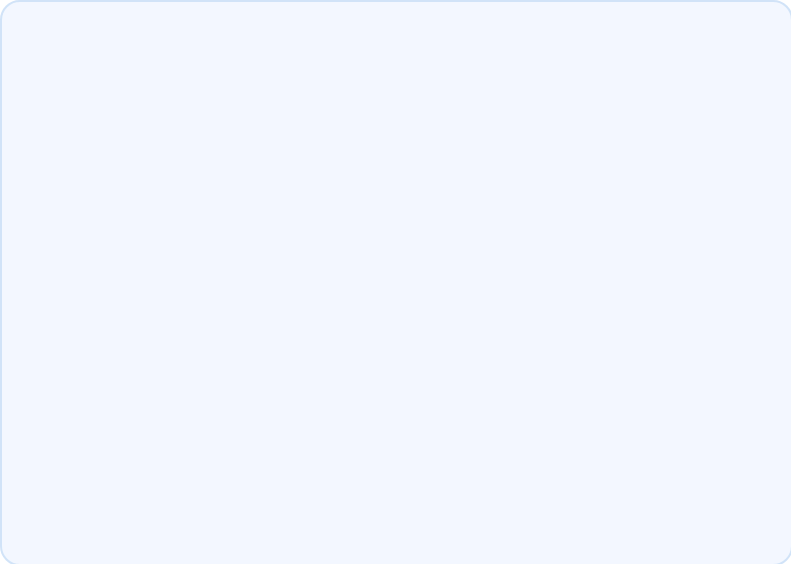

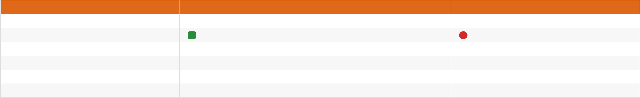

BRADFORD VTS TEACHING DECK
Lumbar Spinal Stenosis & Claudication
Recognising neurogenic claudication — and distinguishing it from vascular disease
CLINICAL VIGNETTE
CLASSIC FEATURES
A 70-year-old woman, keen walker. Six
months of pain in the back of both legs
and calves. Pain worsens after walking
a quarter of a mile. Leg pain worse
than back pain. Pain is better when
bending forwards — for example,
holding onto a supermarket trolley.
Ankle jerks reduced bilaterally.
Normal sensation. Normal peripheral
pulses.
• Bilateral leg pain — often worse
than back pain
• Pain on walking on flat ground
• Relieved by leaning forward or sitting
The Shopping Trolley Sign
• Bilateral reduced ankle jerks
Pain relieved by leaning forward — the
hallmark of neurogenic claudication
from spinal stenosis
• Normal peripheral pulses
Diagnosis: Spinal Canal Stenosis
• Subtle onset; often elderly patients
Neurogenic Claudication (Spinal Stenosis)
Vascular Claudication (PVD)
Pain on walking
Yes
Yes
Relieved by leaning forward
✔ Yes — key differentiator
✖ No
Relieved by simply stopping
Slow — need to sit or lean
Quick on stopping
Peripheral pulses
Normal
Reduced or absent
Ankle-Brachial Index
Normal
Reduced
Neurological signs
May be present
Absent
Green Flag — Safe to manage in primary care initially: Normal pulses + forward-lean relief + bilateral leg symptoms in an older
patient = spinal stenosis until proven otherwise. Refer if progressive neurological deficit or confirmed on MRI/CT.
www.bradfordvts.co.uk
Back Pain in General Practice — Bradford VTS Teaching Deck
Slide 10 of 33

Slide 10






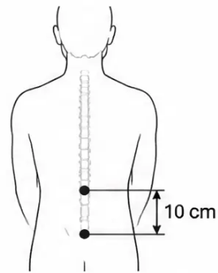


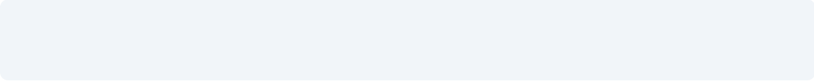



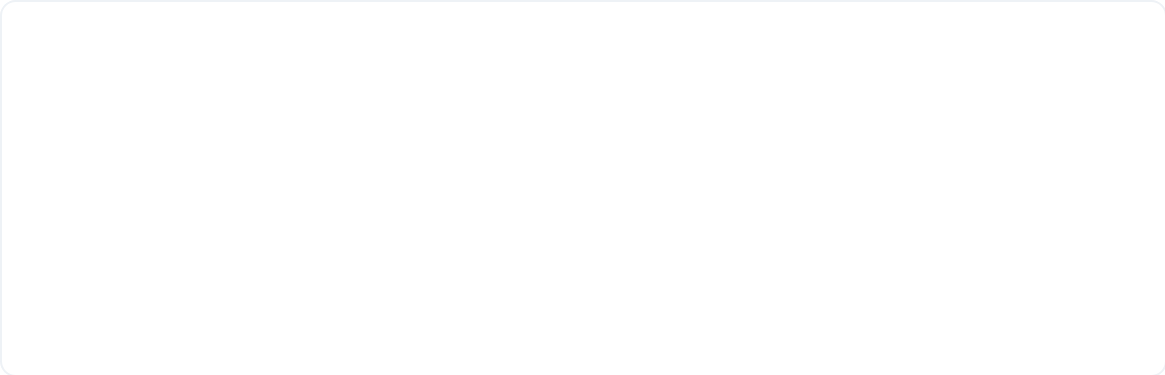

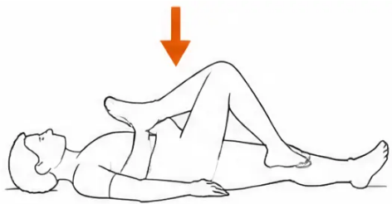




BRADFORD VTS TEACHING DECK
Inflammatory Back Pain: Ankylosing Spondylitis
When back pain is NOT mechanical — think inflammation
FEATURES SUGGESTING INFLAMMATORY CAUSE
KEY EXAMINATION TESTS
Morning stiffness > 30 minutes
Schober’s Test — Lumbar Flexion
(Mechanical LBP improves within minutes — inflammatory
stiffness lingers)
• Mark L5 and a point 10 cm directly above
Alternating side-to-side lumbar pain
• Ask patient to bend forward maximally
• Measure the new distance between the two marks
(Sacroiliac joint involvement — pain shifts left to right)
Normal: distance increases by ≥ 5 cm
Chest / sternocostal pain
Abnormal: increase of < 5 cm = restricted
lumbar flexion
(Reduced chest expansion — costovertebral joint involvement)
Sacroiliac joint tenderness
FABER Test
(Palpation over SI joints reproduces pain)
(Flexion, ABduction, External Rotation)
Onset usually under 40 years
• Patient supine; place foot on opposite knee
(figure-4 position)
(Young adult with chronic back pain — always consider AS)
• Gently press down on the flexed knee
Bloods: ESR, CRP, HLA-B27
Positive: pain reproduced in the sacroiliac region
Suggests: sacroiliac joint disease
(Elevated inflammatory markers; HLA-B27 positive in ~90% of AS)
CLINICAL REMINDER: Morning stiffness > 30 minutes that improves with activity is the hallmark differentiator
from mechanical LBP. Don’t miss early AS in a young adult presenting with “simple” back pain.
www.bradfordvts.co.uk
Back Pain in General Practice — Bradford VTS Teaching Deck
Slide 11 of 33

Slide 11
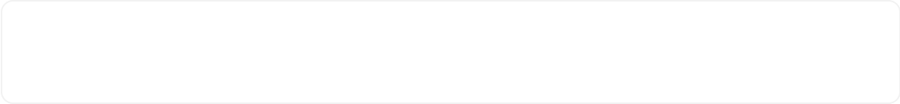
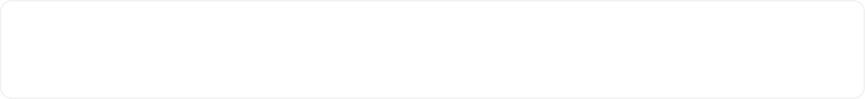


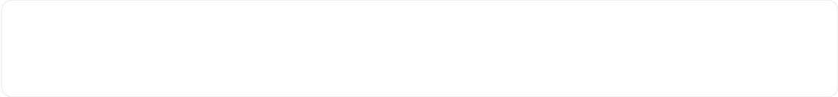
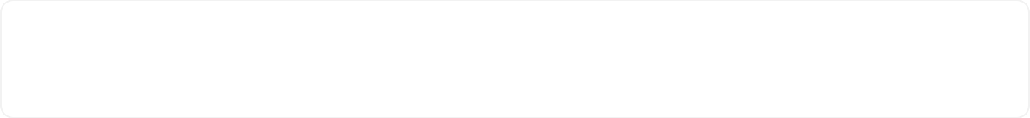

BRADFORD VTS TEACHING DECK
Physical Examination: The 10-Step Approach
A structured sequence — always examine with the patient adequately undressed
LOOK
REFLEXES
01
06
Posture, scoliosis, kyphosis, muscle wasting. Check
skin for café-au-lait spots, hairy patches, psoriasis.
Knee jerk = L3/L4. Ankle jerk = L5/S1. Asymmettry
or absence is clinically significant.
FEEL
MOTOR POWER
02
07
Bone tenderness suggests serious pathology — fracture,
infection, malignancy. Assess paraspinal muscle tenderness.
Hip flexors, knee extensors, ankle dorsiflexors (L4/L5),
plantarflexors (S1). Foot drop = urgent referral.
PERCUSSION
SENSATION
03
08
Lightly percuss neck to sacrum. Significant pain =
infection, fracture, or neoplasm. Note exaggerated response.
Pin-prick along dermatomal distribution.
Use a dermatome map as reference.
MOVE
HIPS
04
09
Flexion (Schober’s test — less than 5 cm increase =
abnormal), extension, lateral flexion, seated rotation.
Internal rotation is often the first sign of hip disease —
hip pathology can closely mimic low back pain.
STRAIGHT LEG RAISE
PULSES + ABDOMEN
05
10
Supine, passive leg raise with knee extended. Positive
if pain below 45°. Dorsiflex foot to confirm L5/S1 root irritation.
Peripheral pulses and abdominal exam to exclude
vascular claudication and AAA (pulsatile mass).
🔑 Key Message:
“Always examine with the patient adequately undressed — to underwear if back pain returns at a second
consultation. You cannot examine a dressed back properly.”
Additional tests: Femoral stretch test (L2–L4) · Piriformis test · Functional overlay tests (axial loading, seated SLR) · FABER test for sacroiliac joint
www.bradfordvts.co.uk
Back Pain in General Practice — Bradford VTS Teaching Deck
Slide 12 of 33

Slide 12












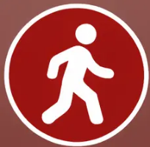


BRADFORD VTS TEACHING DECK
www.bradfordvts.co.uk
SURGICAL EMERGENCY — SAME-DAY REFERRAL
Cauda Equina Syndrome
Recognise it. Act immediately. Do not delay.
Urinary
Retention
Bowel
Incontinence
Saddle
Anaesthesia
Bilateral Leg
Weakness
Gait
Disturbance
Most common feature
Loss of anal
sphincter tone
Numbness — anus,
perineum, genitalia
Widespread
motor deficit
Any walking
difficulty
Any ONE of these features is sufficient to act.
Do NOT wait for imaging before referring.
Immediate same-day emergency referral to spinal surgery or A&E.
Delay causes permanent neurological damage — permanent bladder/bowel dysfunction and paralysis.
Causes: Large central disc prolapse • Cauda equina tumour • Epidural abscess • Epidural haematoma
www.bradfordvts.co.uk
Back Pain in General Practice — Bradford VTS Teaching Deck
Slide 13 of 33

Slide 13




BRADFORD VTS TEACHING DECK
Red Flags for Serious Spinal Pathology
Features requiring urgent investigation or specialist referral
Take
IMMEDIATE
action!
PATIENT HISTORY
PAIN CHARACTERISTICS
ASSOCIATED FEATURES
● Age under 20 or over 55
at first presentation
● Constant, progressive
non-mechanical pain
(not relieved by rest or movement)
● Unexplained weight loss
● Systemically unwell —
fever, night sweats
● History of malignancy
● Long-term systemic steroids
or immunosuppression
● Severe night pain —
wakes from sleep
● Significant recent trauma
(RTA, fall from height)
● Known osteoporosis or
previous fragility fracture
● Thoracic back pain
(not lumbar)
● Structural deformity
● Widespread neurological symptoms
● HIV / IV drug use
(infection risk)
● Pain unresponsive to
2–4 weeks of treatment
● Sphincter disturbance →
see Cauda Equina slide
Red flags do NOT mean automatic referral to spinal surgery — they mean the diagnosis
must be clarified. Urgency depends on the specific combination of flags and clinical context.
www.bradfordvts.co.uk
Back Pain in General Practice — Bradford VTS Teaching Deck
Slide 14 of 33

Slide 14






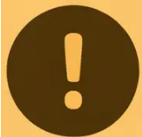
BRADFORD VTS TEACHING DECK
Back Pain in General Practice
Slide 15 of 33
Yellow Flags
Psychosocial Risk Factors for Chronicity and Long-Term Disability
Identify these early — the first 6 weeks are your window of opportunity.
INDIVIDUAL & COGNITIVE
INTERPERSONAL
ENVIRONMENTAL &
SOCIAL
• Belief that pain and activity are harmful
• Over-protective or unsupportive family
• Poor job satisfaction
• Catastrophic thinking — "I'll end up
in a wheelchair"
• Learned helplessness
• Disability payments, litigation, or
compensation claims
• "External controller" personality —
believes recovery is outside their control
• Extended bed rest and activity avoidance
• Low mood, depression, or anxiety
• Problems with insurance claims
• Opioid dependency
• Sick role behaviour — identity built
around being unwell
• Malingering (rare but exists)
• Previous back pain with significant
time off work
Key Message:
Yellow flags are MORE predictive of long-term disability than the severity of the initial pain.
Identify and address them early — the first 6 weeks are crucial in preventing chronicity.
www.bradfordvts.co.uk
Back Pain in General Practice — Bradford VTS Teaching Deck
Slide 15 of 33

Slide 15









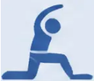







Blue Flags
OCCUPATIONAL HEALTH
Perceived Work-Related Barriers to Recovery
WORK-RELATED BARRIERS
40%
● High perceived workload
still off work at 1 year
after 4–12 weeks
of sick leave
longer sick leave =
lower chance of
full recovery
Work feels overwhelming or unmanageable
● Low pay or insecure employment
Patients do NOT need to be pain-free to return to work —
activity helps recovery.
Financial anxiety compounds pain avoidance
● Poor management attitudes
MDT Rehabilitation Approach
Employer unsympathetic to back pain
● Lack of workplace support
No adjustments offered or discussed
Physiotherapy
Psychology
CBT for pain beliefs,
fear-avoidance behaviour
Occupational Health
Graduated return to work,
light duties planning
Graduated exercise
programme, core stability
● Fear of re-injury
Loss of confidence about returning to physical tasks
Green — Safe to Manage in Primary Care
● Work-related depression
Most blue flag situations can be addressed proactively in GP —
early occupational health referral and MDT planning prevents long-term disability.
Low mood driven by job situation, not just pain
Key Message: Early active rehabilitation — not prolonged rest — is the evidence-based approach.
Address occupational barriers before they become permanent.
www.bradfordvts.co.uk
Back Pain in General Practice — Bradford VTS Teaching Deck
Slide 16 of 33

Slide 16

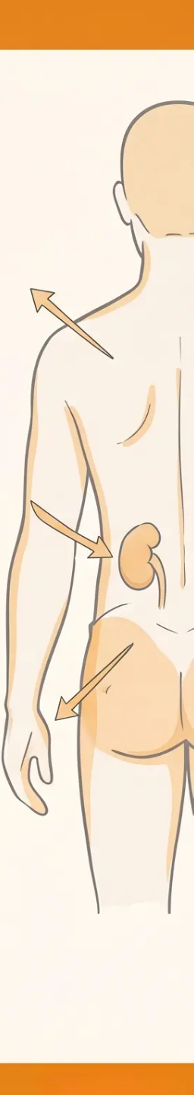













BRADFORD VTS TEACHING DECK
Common Pitfalls: Referred Non-Spinal Pain
Not all back pain comes from the spine — always consider these diagnostic traps
⚠️ Pitfall: Attributing back pain to a spinal cause before excluding serious non-musculoskeletal
pathology can be dangerous — and is a common GP trainee error.
AAA — Do Not Miss
Renal Colic / Pyelonephritis
Hip Disease Mimicking LBP
Tearing or ripping back pain
Pulsatile abdominal mass
Unilateral loin-to-groin radiation
Systemically unwell, fever, rigors
Urinary symptoms may be present
Groin and anterior thigh pain
Worse on hip internal rotation
Test hip movements — often first sign
Collapse / haemodynamic instability
➔ EMERGENCY — call 999
Pleuritic Pain
Uterine / Pelvic Pathology
Peripheral Vascular Disease
Sharp, worse with deep inspiration
May radiate to back or shoulder tip
Consider PE, pneumonia, pneumothorax
Fibroids, endometriosis
Cyclical pattern may be a clue
Lower back and pelvic pain combined
Leg pain on walking — like stenosis,
NOT relieved by leaning forward
Check peripheral pulses — key differentiator
Key Differentiator to Remember:
Neurogenic claudication (spinal stenosis) ➔ relieved by leaning forward (shopping trolley sign)
Vascular claudication (PVD) ➔ NOT relieved by leaning forward — check pulses’
www.bradfordvts.co.uk
Back Pain in General Practice — Bradford VTS Teaching Deck
Slide 17 of 33

Slide 17

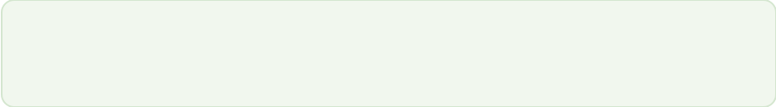
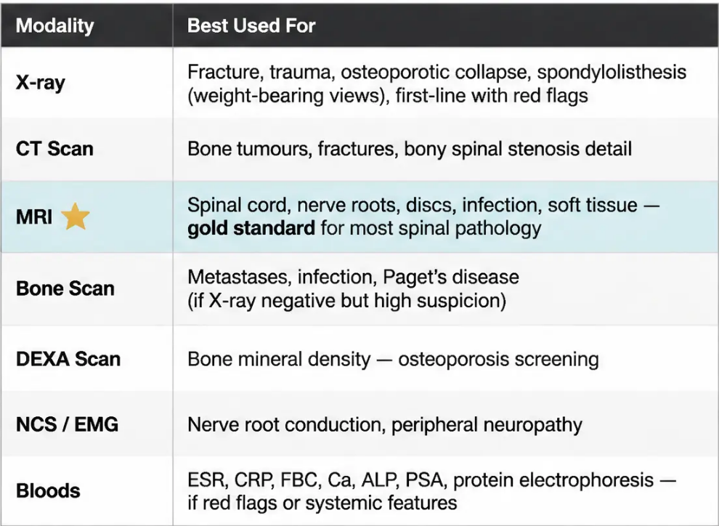

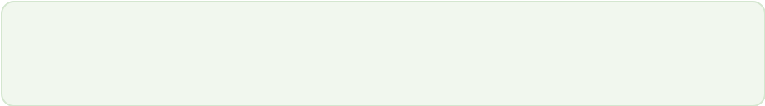

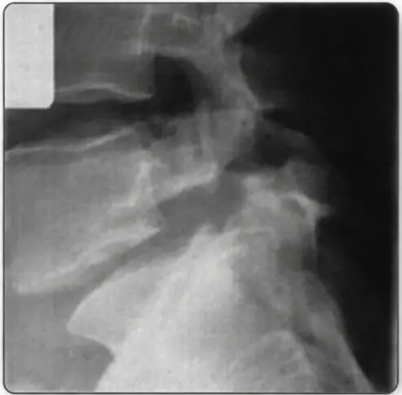




BRADFORD VTS TEACHING DECK
Back Pain in General Practice
Investigations & Imaging Guidance
NICE NG59 — When to image, and when not to
NICE NG59 KEY RECOMMENDATION:
Do NOT routinely offer imaging for non-specific low back pain.
Image only if: red flags are present • considering surgery or invasive treatment • results will change management
WHEN IS IMAGING APPROPRIATE?
WHICH MODALITY FOR WHICH INDICATION?
Red flags are present
(e.g. suspected malignancy, infection, fracture)
Surgery or invasive treatment is being considered
(MRI required before surgical planning)
Results will genuinely change management
(not just to reassure patient or clinician)
Pitfall:
20–30% of asymptomatic people have disc herniation on MRI.
A positive scan does NOT equal a cause of pain.
Imaging must correlate with clinical findings.
Spinal imaging —
clinical correlation is essential
www.bradfordvts.co.uk
Investigations and Imaging Guidance
Slide 18 of 33

Slide 18

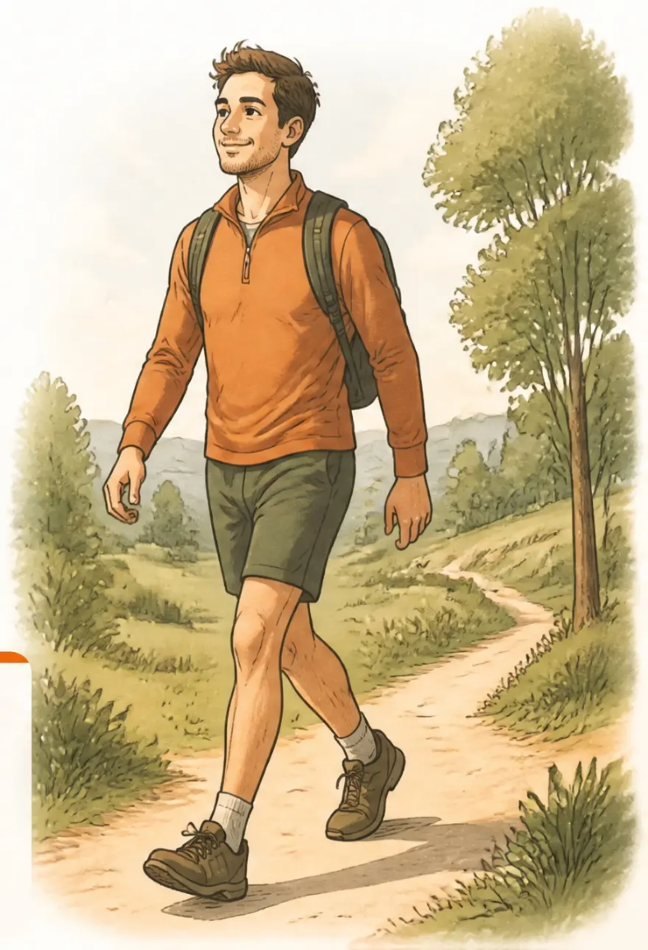





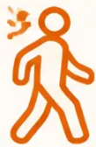



BRADFORD VTS TEACHING DECK
Management — NICE NG59
Management: The Stay Active Principle
Non-specific low back pain — NICE NG59 core recommendations
>95% of back pain is
non-specific mechanical LBP
The aim is symptom relief and early mobilisation —
not rest, not imaging, not medicalisation.
NICE NG59 — Green: Safe to manage in primary care
Stay Active
Avoid Bed Rest
Self-Management First
Encourage normal activity
from day one. Bed rest
is harmful — it worsens
outcomes and delays
recovery.
Do NOT advise patients
to rest until pain-free.
Inactivity prolongs
disability and
reinforces fear-avoidance.
Self-management is the
cornerstone. Empower
patients — you are not
broken, you will get
better, keep moving.
The key message: You are not broken. You will get better. Keep moving.
www.bradfordvts.co.uk
Back Pain in General Practice — Bradford VTS Teaching Deck
Slide 19 of 33

Slide 19
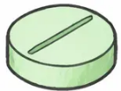
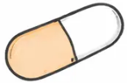
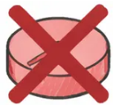










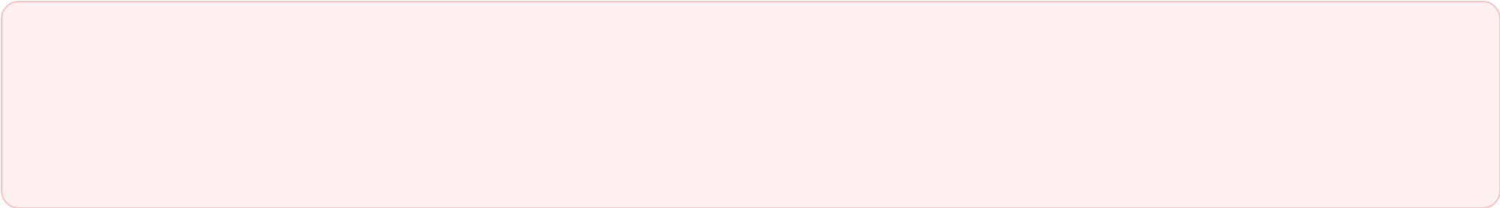








BRADFORD VTS TEACHING DECK
Drug Management: NICE NG59 Standards
www.bradfordvts.co.uk
Pharmacological recommendations for non-specific low back pain — updated to current NICE NG59 guidance
FIRST-LINE ANALGESIA
NSAIDs
Weak Opioid
Strong Opioid
Recommended
SECOND-LINE ONLY
NSAIDs
Only if NSAIDs contraindicated or insufficient
e.g. Ibuprofen 400 mg three times daily with food
Weak Opioids ± Paracetamol
• Use lowest effective dose for shortest duration
CLINICAL
CORRECTION
• Consider PPI gastroprotection
e.g. Codeine + paracetamol — short-term use only
• Check renal function, cardiovascular risk, and contraindications
Lower systemic risk
Paracetamol alone is NOT
recommended as first-line for
acute LBP — NICE NG59
Older teaching stated:
"paracetamol first,
NSAIDs second."
Topical NSAIDs
e.g. Diclofenac gel — for localised pain
This has been
UPDATED by
NICE NG59.
DO NOT OFFER — NICE NG59
Opioids for Chronic
LBP (≥3 months)
Strong Opioids
Gabapentinoids
Muscle Relaxants
NSAIDs are now
FIRST-LINE.
Not for
non-specific LBP
Do not start or continue —
NICE NG59
Gabapentin / Pregabalin —
not recommended for
LBP or sciatica
Diazepam, methocarbamol —
not routinely recommended;
dependence risk
Back Pain in General Practice — Bradford VTS Teaching Deck
Based on NICE NG59 (2016, updated December 2020)
Slide 20 of 33

Slide 20




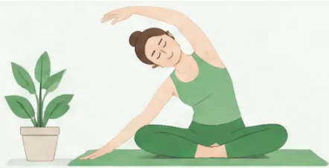
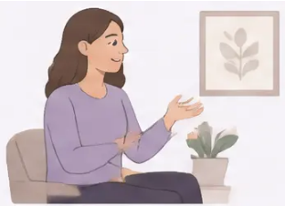
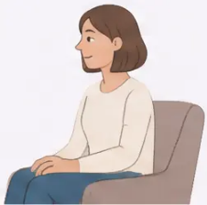
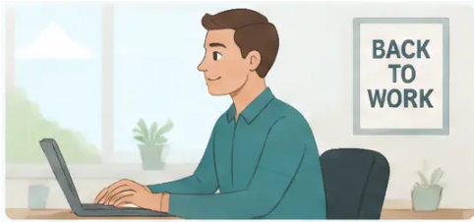














BRADFORD VTS TEACHING DECK
Non-Pharmacological Management
NICE NG59 — What to offer as part of a treatment package
NICE NG59 strongly recommends exercise therapy as first-line treatment for both acute and
chronic low back pain. Exercise is among the most effective treatments available.
Older teaching that 'exercises have no evidence' is OUTDATED — this has been corrected in current guidance.
Exercise Therapy
Psychological Therapies
Occupational Health & MDT
• Any exercise the patient will stick to
• CBT for chronic pain
• Early return-to-work planning
• Aerobic, strengthening, yoga, Pilates, swimming
• Address catastrophic thinking and fear-avoidance
• Graduated activity and light duties
• Core stabilisation (physiotherapy-led)
• MDT rehabilitation programme for chronic LBP
• Pain beliefs and health behaviour work
• Graduated activity increase
• Self-efficacy building
• Combined physical + psychological +
occupational approach
• Manual therapy — spinal manipulation and
mobilisation as part of a package (not standalone)
• Self-management education — staying active,
natural history, pain strategies
• Social support and coping strategies
STRONGLY RECOMMENDED
RECOMMENDED — especially chronic LBP
RECOMMENDED — chronic and complex LBP
NOT recommended by NICE NG59 for routine use:
Acupuncture
Traction
TENS
Short-wave diathermy
If in doubt — offer exercise first. It is the intervention with the strongest evidence base.
www.bradfordvts.co.uk
Back Pain in General Practice — Bradfod VTS Teaching Deck
Slide 21 of 33

Slide 21





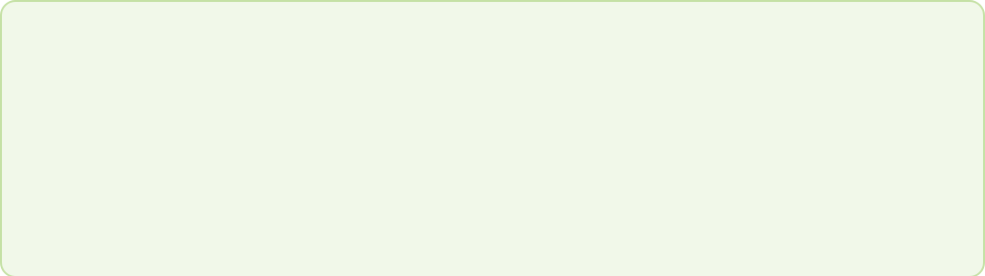


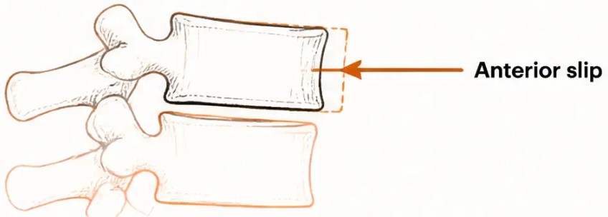


BRADFORD VTS TEACHING DECK
Spondylolisthesis: Types and Features
Forward slippage of one vertebra on another — classification and what to look for in primary care
CLASSIFICATION
CLINICAL FEATURES
Type I — Dysplastic
Congenital
● Back pain ± leg pain (if radiculopathy present)
Congenital abnormalities of the upper sacrum
● Often asymptomatic — found incidentally on imaging
Type II — Isthmic
● Palpable step-deformity at affected level
(if significant slip)
Most common in
young adults
Lesion in pars interarticularis — lytic or fatigue
fracture, or elongated intact pars
● Degenerative type: insidious onset, elderly, female,
L4/L5 most common
Type III — Degenerative ★
Commonest in
primary care
Facet joint degeneration — most common type seen in GP practice
● Symptoms may mimic disc prolapse or spinal stenosis
Typically at L4/L5 — elderly women most affected
Type IV — Traumatic
Post-trauma
Primary Care Management
Acute fracture in the vertebral arch
Most spondylolisthesis is managed conservatively:
Type V — Pathological
Physiotherapy · Exercise therapy · Analgesia (NSAIDs)
Systemic cause
Generalised or localised bone disease
Refer if: severe or recurrent leg and back pain, or
progressive neurological symptoms
Pitfall
Degenerative spondylolisthesis is often found incidentally —
do not over-medicalise an asymptomatic finding. Correlate
imaging with clinical symptoms.
www.bradfordvts.co.uk
Back Pain in General Practice — Bradford VTS Teaching Deck
Slide 22 of 33

Slide 22

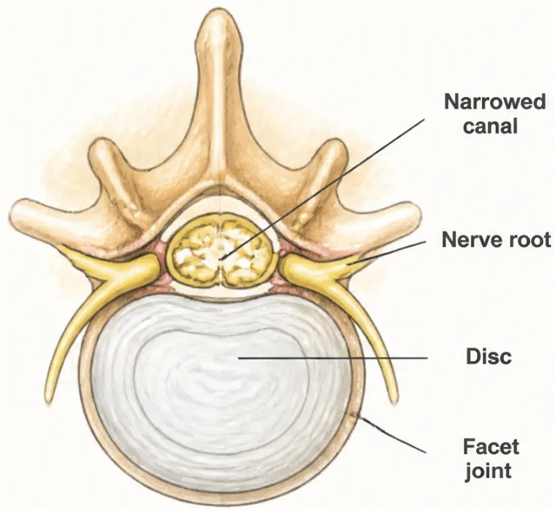






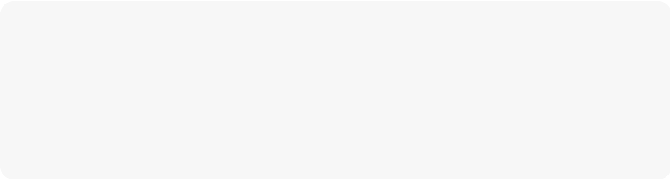
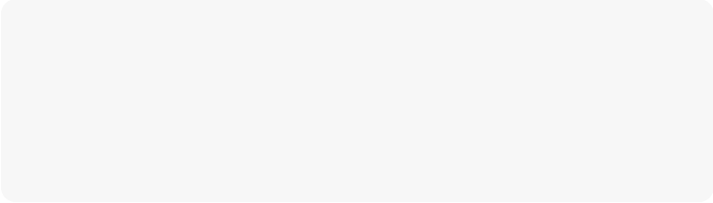


BRADFORD VTS TEACHING DECK
Back Pain in General Practice
Management of Spinal Canal Stenosis
Tailoring treatment to symptom severity and functional impact
Conservative First
When Conservative Fails
● Physiotherapy & Exercise
● Referral Criteria
Core stability exercises, stretching, and
graduated activity programme. Flexion-based
exercises are generally better tolerated than
extension.
• Progressive neurogenic claudication not
responding to conservative care
• Significant neurological deficit (motor
weakness, foot drop)
• Failed conservative management over
adequate trial period
● Analgesia
NSAIDs for pain relief — use lowest effective
dose for shortest duration. Consider
gastroprotection. Regular review of response.
● Decompression Surgery
Laminectomy ± discectomy — the primary
surgical option. Relieves pressure on the
spinal canal and nerve roots. Good outcomes
in carefully selected patients.
● Epidural Steroid Injections
Useful for symptom relief in neurogenic
claudication. Performed by pain clinic or
spinal team. Provides temporary but
meaningful relief in selected patients.
● Interspinous Distraction Devices
Examples: COFLEX, X-STOP procedures.
Suitable for mild-to-moderate stenosis with
claudication. Less invasive alternative to full
laminectomy in selected patients.
KEY CLINICAL PRINCIPLE
Most patients with spinal stenosis can be managed conservatively. Surgery is reserved for
those with progressive symptoms or significant functional limitation — not offered routinely.
www.bradfordvts.co.uk
Back Pain in General Practice — Bradford VTS Teaching Deck
Slide 23 of 33

Slide 23













BRADFORD VTS TEACHING DECK
Surgical Options & Referral Indications
When to refer, how urgently, and what surgery can offer — a GP's guide
● URGENT / EMERGENCY REFERRAL
Cauda Equina Syndrome
Same-day emergency referral to spinal surgery / A&E — no delay, do not wait for imaging
Rapidly Progressive Neurological Deficit
e.g. foot drop, significant limb weakness — urgent same-day referral
● RELATIVE INDICATIONS (after failed conservative treatment)
• Significant disc prolapse with persistent severe radiculopathy — after ≥6 weeks conservative management
• Recurrent sciatica significantly impacting quality of life
• Spinal canal stenosis with significant claudication not responding to conservative care
• Spondylolisthesis with severe recurrent leg and back pain
SURGICAL PROCEDURES — GP AWARENESS
Microdiscectomy / Fenestration
Spinal Fusion
Disc prolapse with radiculopathy — most common
procedure; good outcomes when carefully selected
For instability or degenerative disc disease —
evidence is modest; select patients carefully
(single level, narrow disc, short duration)
Dynamic Stabilisation
Vertebroplasty
e.g. Wallis procedure, disc replacement —
alternatives to fusion in selected cases
Painful osteoporotic vertebral fractures or
vertebral metastases / myeloma
PITFALL TO AVOID:
Spinal fusion has only a SMALL role in managing chronic back pain from degenerative disc disease. Cochrane evidence shows
modest benefit. Do not refer for fusion as routine management of chronic mechanical LBP. Psychological factors — high neuroticism,
compensation claims — predict poor surgical outcomes.
www.bradfordvts.co.uk
Back Pain in General Practice — Bradford VTS Teaching Deck
Slide 24 of 33

Slide 24
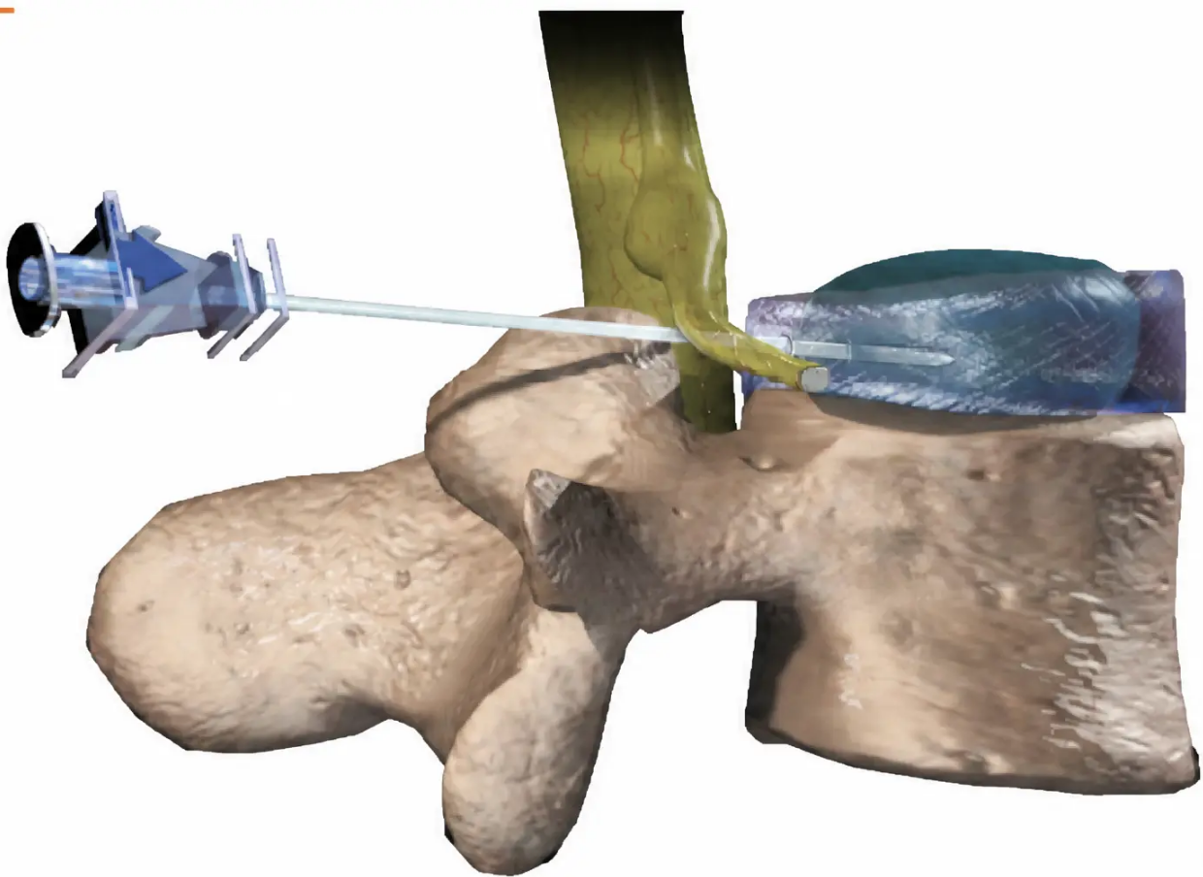








BRADFORD VTS TEACHING DECK
Back Pain in General Practice
Spinal Injections & Pain Management
What GPs need to know about interventional options and pain clinic referral
INTERVENTIONAL OPTIONS
Epidural Steroid Injections
For radicular pain and neurogenic claudication from spinal
stenosis. Provides short-to-medium-term symptom relief.
Facet Joint Injections
For back pain with suspected facet joint origin.
Diagnostic and therapeutic.
Nerve Root Blocks
Targeted single-level injection for specific radiculopathy.
Useful when one level is clearly implicated.
Trigger Point Injections
For myofascial pain with identifiable tender trigger points.
PAIN CLINIC REFERRAL
Consider pain clinic referral when:
• Chronic LBP not responding to primary care management after adequate trial
• Complex pain management needs (opioid dependency, neuropathic component)
• Assessment for suitability of invasive procedures
• Patients with significant functional impairment despite optimised conservative care
Pain clinic teams offer multidisciplinary assessment — they are not just for injections.
Epidural/nerve root injection: needle targeting
Clinical Reminder:
the disc–nerve root interface
Injections provide symptom relief — they do not treat the underlying cause.
They are most useful as a bridge to rehabilitation, not as a standalone treatment.
Back Pain in General Practice — Bradford VTS Teaching Deck
www.bradfordvts.co.uk
Slide 25 of 33

Slide 25












BRADFORD VTS TEACHING DECK
Psychosocial Pain & Waddell's Signs
Understanding non-organic pain — and why psychological drivers matter as much as physical ones
Key Clinical Principle
"Do NOT dismiss this pain as 'all in their head' — these patients have real suffering.
Address the psychological drivers alongside the physical."
CATEGORIES
CLINICAL APPROACH
Psychosomatic
Address abnormal beliefs actively
Tension syndrome (fibrositis) — genuine pain amplified
by psychological distress. Real pain, real suffering —
psychological state lowers the pain threshold.
Work on catastrophising, fear of movement, and unhelpful
health beliefs — not just the physical pain.
Build self-efficacy
Psychogenic Modification
The goal is confidence in movement, not avoidance.
"Your back is strong — let's work on it together."
Organic pain made significantly worse by psychological
overlay. The physical component is real but the
psychological component multiplies it.
Avoid medicalisation
Repeated imaging, referrals, and passive treatments
reinforce the sick role and entrench chronicity.
Situational
Litigation reaction, exaggeration for compensation —
the 'litigation trough' where doctor, lawyer, therapist
and insurer can together perpetuate disability.
MDT approach for complex cases
CBT, physiotherapy, occupational health, and psychological
support together — not in isolation.
Pitfall to Avoid
"The patient who fails surgery often had unaddressed psychosocial drivers from the very beginning."
Psychological factors — high neuroticism, compensation claims, catastrophising — predict poor surgical outcomes. Identify them early."
www.bradfordvts.co.uk
Back Pain in General Practice — Bradford VTS Teaching Deck
Slide 26 of 33

Slide 26









BRADFORD VTS TEACHING DECK
Referral Criteria for Secondary Care
When to refer, how urgently, and who can stay in primary care
SAME-DAY EMERGENCY
URGENT – Days to 2 Weeks
ROUTINE – After 6 Weeks
• Cauda equina syndrome –
any single feature present
• Red flags suggesting malignancy,
infection, or fracture
• MRI-confirmed large disc prolapse
with significant clinical signs
• Rapidly progressive
neurological deficit
• Significant spinal canal stenosis
• New neurological deficit –
foot drop or significant
limb weakness
• Spondylolisthesis with severe
recurrent leg and back pain
• Suspected spinal cord
compression
• Osteoporotic fractures not settling
after 6–8 weeks
• Suspected serious structural
pathology on clinical assessment
• No response to 6 weeks of adequate
conservative management
Do NOT wait for imaging before referring.
DO NOT REFER – Manage in Primary Care (unless worsening)
• Multi-level disc disease with facet joint problems
• Moderate spinal canal stenosis (not progressive)
• Minor–moderate disc bulge with radicular symptoms (improving)
• Spondylolisthesis with moderate, stable back and leg pain
Before Referring – Ask Yourself:
Do I have an accurate diagnosis? ●
● What is the functional limitation? ●
● What will secondary care add right now?
www.bradfordvts.co.uk
Back Pain in General Practice – Bradford VTS Teaching Deck
Slide 27 of 33

Slide 27
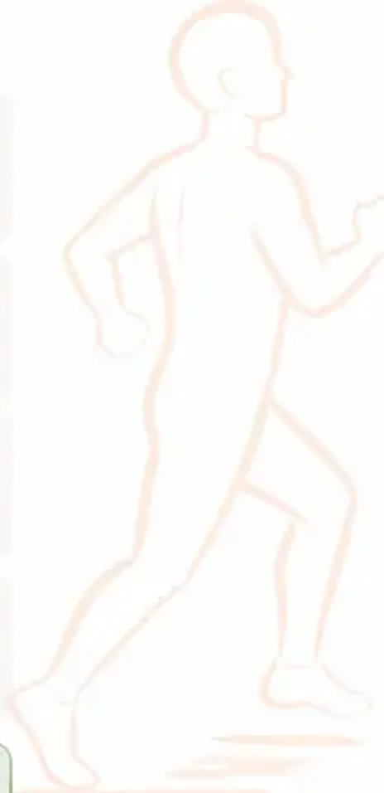





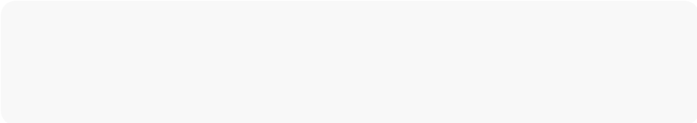

BRADFORD VTS TEACHING DECK
Back Pain in General Practice
Managing Expectations in the Consultation
How to run a good back pain consultation — Bradford VTS approach
Take a Thorough History
Always Examine
Explore health beliefs AND the nature of the problem.
What does the patient think is wrong? What do they fear?
Even if examination rarely changes the diagnosis —
patients expect it. It builds trust and creates
opportunities for positive feedback.
Challenge Abnormal Beliefs
Address Catastrophic Thinking
Actively address and reframe unhelpful beliefs.
Beliefs drive recurrent presentations and
demanding requests.
“Am I going to end up in a wheelchair?” Reassure
with evidence. Normalise. Don't catastrophise.
Explain Why Imaging Isn’t Needed
Explain Why Referral Isn’t Necessary
Patients often expect an X-ray. Explain that
degenerative changes on imaging don't equal the
cause of pain — and often cause more worry.
Most patients expect a specialist referral. Explain the
self-management approach and its strong evidence base.
Ask About Medication — Don’t Assume
Build Self-Management
Ask if they want medication rather than assuming.
Many patients don't want it — and it opens a
better conversation.
This is the cornerstone. Empower the patient to be the
agent of their own recovery — staying active,
understanding their pain.
The Key Message for Every Back Pain Patient:
‘You are not broken. You will get better. Keep moving.’
The evidence firmly supports active management over passive treatments.
www.bradfordvts.co.uk
Back Pain in General Practice — Bradford VTS Teaching Deck
Slide 28 of 33

Slide 28


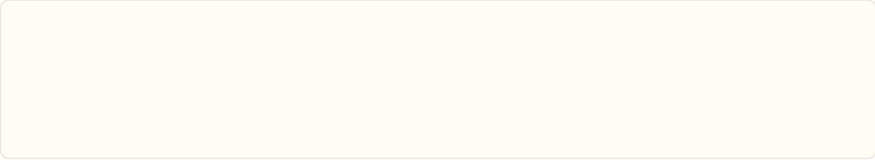


BRADFORD VTS TEACHING DECK
Top Tips for Back Pain in GP
Eight clinical pearls for daily practice — straight from the consultation room
01 Undress the Patient
05 Not All Leg Pain Is Sciatica
A patient returning a second time with 'simple' back pain
should be examined to underwear. You cannot examine
a dressed back properly.
Remember: facet joint disease, hip pathology, SIJ
dysfunction, piriformis syndrome, and vascular causes
can all mimic sciatica.
02 True Sciatica = Leg Pain Worse Than Back Pain
06 Don't Image to Reassure
Start examination with the patient sitting on the couch —
this loads the nerve root and gives useful clinical
information immediately.
Explain why imaging adds nothing for non-specific
mechanical LBP — and often leads to over-treatment
and increased anxiety.
03 Refer Early if Weakness
07 The First 6 Weeks Are Critical
With radiculopathy, re-examine regularly. Foot drop
can be irreversible if referral is delayed — do not wait.
Address yellow flags early. Waiting until 6 months
means the patient is already chronic and far harder
to rehabilitate.
04 Physio Is More Than Exercise
08 Prescribe Exercise Like Medication
Physiotherapists are excellent at managing the
psychological aspects of chronic pain. Don't
underestimate the value of a physio referral.
Exercise therapy is the most evidence-based treatment
for chronic LBP. Be as enthusiastic prescribing it as
you would be prescribing an NSAID.
Key Message: You are not broken. You will get better. Keep moving.
The evidence firmly supports active management over passive treatments.
Back Pain in General Practice — Bradford VTS Teaching Deck
www.bradfordvts.co.uk
Slide 29 of 33

Slide 29

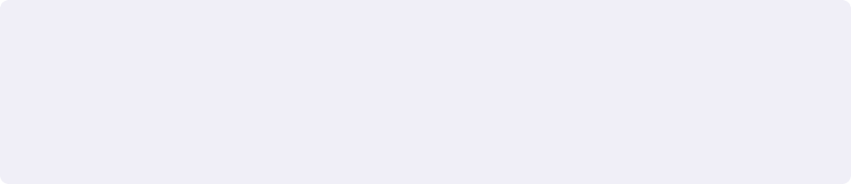


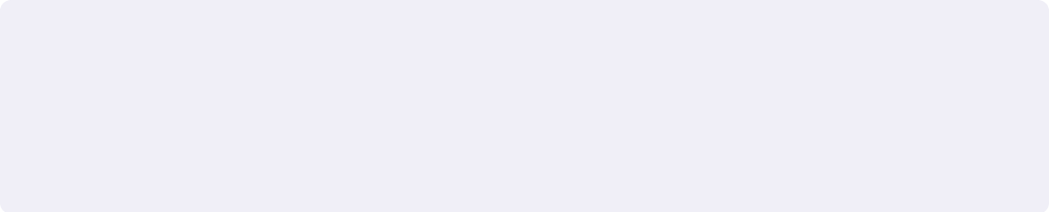


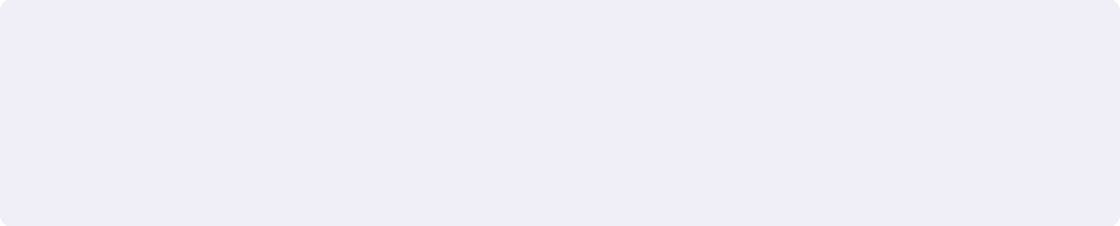




BRADFORD VTS TEACHING DECK
AKT
Exam Pearls: AKT Focus
High-yield facts for the Applied Knowledge Test — based on NICE NG59
💜 These facts are frequently tested in the AKT — know them cold
💜 NSAIDs Are First-Line
💜 No Routine Imaging
NSAIDs (e.g. ibuprofen) are first-line for acute
LBP — NOT paracetamol alone. NICE NG59
updated this.
Do NOT routinely offer imaging for non-specific LBP.
Image only if red flags present, or if results will
change management.
💜 No Opioids for Chronic LBP
💜 Exercise IS Evidence-Based
Do NOT offer opioids for chronic (≥3 months)
non-specific LBP. NICE NG59 explicitly
recommends against this.
NICE NG59 explicitly recommends exercise therapy
for LBP. Older teaching that "exercises have no
evidence" is outdated and wrong.
💜 No Gabapentinoids for LBP
💜 Cauda Equina = Same-Day Emergency
Bladder/bowel dysfunction + saddle anaesthesia =
immediate same-day surgical referral. No delay.
SLR positive = <45°
Knee jerk L3/L4 • Ankle jerk L5/S1
Schober's test: <5 cm increase = abnormal
Governing guideline: NICE NG59 — Low Back Pain and Sciatica in Over 16s (last reviewed December 2020)
www.bradfordvts.co.uk
Back Pain in General Practice — Bradford VTS Teaching Deck
Slide 30 of 33

Slide 30













BRADFORD VTS TEACHING DECK
SCA EXAM FOCUS
Exam Pearls: SCA Focus
Consultation skills, patient-centred communication, and safety netting
ICE FRAMEWORK FOR BACK PAIN
Ideas
Concerns
Expectations
"What do you think might
be causing your back pain?"
"Is there anything specific
worrying you — some people
fear serious causes like
cancer or paralysis?"
"What were you hoping we
might do today?"
(manage expectations around
imaging and referral)
Safety-Netting Language
Shared Decision-Making Prompts
Use these exact phrases in your SCA
Collaborative language that scores marks
• "Come back straightaway if you develop any difficulty passing urine
or numbness around the bottom area — that needs same-day assessment."
• "I'd like to share what the evidence shows about this type of back pain..."
• "If the pain doesn't improve within 4-6 weeks of staying active and
taking anti-inflammatories, please come back and we'll review."
• "There are a few options here — shall I talk you through them?"
• "If you notice any weakness in your legs or feet — please don't wait,
call us the same day."
• "How does that sound to you? Does that fit with what you
were thinking?"
Addressing Imaging or Referral Requests
SCA Pitfalls — Do NOT Do These
• "I completely understand you'd like a scan. Let me explain why, in your
situation, it's unlikely to help — and could actually lead to more worry..."
• Failing to ask about bladder and bowel symptoms — missing cauda equina
• "The changes we'd see on a scan are often normal changes — a bit like
wrinkles on the inside — and treating them surgically tends not to
make things better."
• Failing to explore or address yellow flags and psychosocial factors
• Ordering imaging without red flags — medicalises the problem
• Not safety-netting clearly at the end of the consultation
The SCA rewards patient-centred thinking: explore ideas and concerns, share decisions,
safety-net explicitly, and never miss cauda equina screening.
www.bradfordvts.co.uk
Back Pain in General Practice — Bradford VTS Teaching Deck
Slide 31 of 33

Slide 31





BRADFORD VTS TEACHING DECK
www.bradfordvts.co.uk
Back Pain in General Practice
Quick Recall
12 Key Learning Points — Back Pain in General Practice
01 95% of LBP = non-specific mechanical
07 Foot drop = urgent same-day referral
02 NSAIDs first-line — not paracetamol alone
08 Shopping trolley sign = spinal stenosis
03 No opioids for chronic LBP
09 Leg pain > back pain = sciatica
10 Yellow flags predict chronicity — act early
04 No routine imaging — red flags only
05 Exercise IS evidence-based treatment
11 Schober's test: <5 cm increase = abnormal
06 Cauda equina = same-day emergency
12 Bladder/bowel symptoms — always screen
Keep moving. You are not broken. You will get better.
The core message for every back pain consultation
www.bradfordvts.co.uk
Back Pain in General Practice — Bradford VTS Teaching Deck
Slide 32 of 33

Slide 32

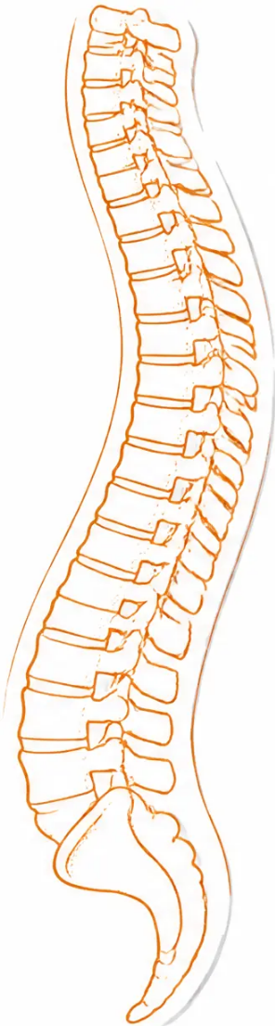







BRADFORD VTS TEACHING DECK
Back Pain in General Practice — Complete Clinical Guide for GP Trainees
Clinical Disclaimer
Always double-check this advice and drug doses with the latest NICE and
BNF guidance before applying in clinical practice. Drug recommendations
and clinical guidelines change over time. This document is for educational
purposes only and does not replace individual clinical judgement.
Compiled June 2026. Clinical standard: NICE NG59 (Low Back Pain and Sciatica
in Over 16s, last reviewed December 2020) and BNF current edition.
FURTHER LEARNING RESOURCES
Bradford VTS Website
NICE NG59 Guideline
BNF Online
www.bradfordvts.co.uk
nice.org.uk — Low Back Pain & Sciatica
bnf.nice.org.uk
"You are not broken. You will get better. Keep moving."
— The key message for every back pain consultation
www.bradfordvts.co.uk
Back Pain in General Practice — Bradford VTS Teaching Deck — June 2026
Slide 33 of 33

