Slide 1

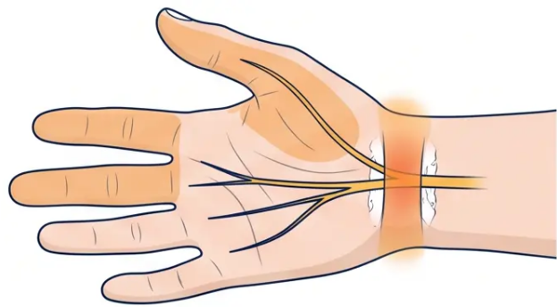











BRADFORD VTS TEACHING DECK
www.bradfordvts.co.uk
Quick Reference Conditions · Slide 32 of 35
Carpal Tunnel Syndrome
Clinical features, stepwise management and surgical indications
Symptoms: Pain, paraesthesia and
numbness in thumb, index, middle and half
of ring finger — median nerve distribution
Key Pattern: Nocturnal symptoms most
characteristic — waking patient at
night; hand-shaking relieves symptoms
Clinical Tests: Positive Tinel's sign
(tapping wrist) · Positive Phalen's test
(wrist flexion for 60 seconds)
1st Line
2nd Line
3rd Line
Nocturnal Wrist Splinting
Corticosteroid Injection
Surgical Decompression
• Neutral-position wrist splint worn at
night
• Methylprednisolone injection into carpal
tunnel
• Refer if: persistent or severe symptoms
despite conservative treatment
• Trial period: 6–12 weeks
• Performed by specialist or GP with
appropriate skills
• Urgent referral if: thenar wasting present
(indicates significant nerve damage)
• Maintains wrist in neutral to reduce
carpal tunnel pressure during sleep
• Provides medium-term symptom relief
• Procedure: division of flexor retinaculum
under local anaesthetic
• Patient education: correct splint
positioning is essential
• Can be repeated — but not indefinitely
• High success rate — most patients
achieve lasting relief
Simple, non-invasive — start here for all
mild-to-moderate cases
Consider if splinting fails or symptoms are
moderate-to-severe
⚠ Thenar wasting = do not delay — refer promptly
NICE CKS Carpal Tunnel Syndrome · Aug 2022
⚠ Bilateral or atypical presentation — consider alternative diagnosis or nerve conduction studies
32 / 35

Slide 2











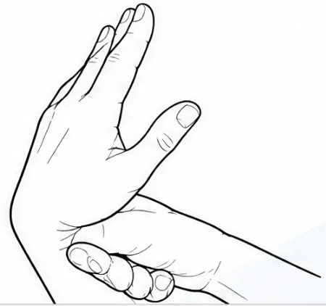









Carpal Tunnel Syndrome Scoring
AKT: Score ≥5 = diagnose CTS clinically.
Sensitivity 85%, PPV 90% — comparable to
nerve conduction studies.
Kamath & Stothard Clinical Questionnaire · Sensitivity 85% · PPV 90%
CLINICAL SCORING ITEMS
Symptom / Finding
Score
Classic CTS Symptoms
Nocturnal pain
+1
• Tingling / numbness in thumb, index, middle,
radial ring finger
Nocturnal tingling
+1
Morning tingling
+1
• Worse at night and on waking — “flick sign”
Trick movements to relieve symptoms
• Triggered by holding newspaper, phone,
steering wheel
+1
★No tingling in little finger
+3
• Worsens in pregnancy
Tingling with newspaper / steering wheel
+1
Tingling during pregnancy
+1
Wrist splint provided relief
+2
No neck pain scores 0 — does not add to or subtract from total
Score < 3
Score 3–4
Score ≥ 5
CTS Unlikely
Borderline
Diagnose CTS — No NCS Needed
TREATMENT PATHWAY
Wrist Splint — especially nocturnal
Corticosteroid Injection — short-term relief
Carpal Tunnel Decompression — persistent / severe
Bradford VTS · MSK Common Conditions & Key Points
www.bradfordvts.co.uk · June 2026

