Slide 1


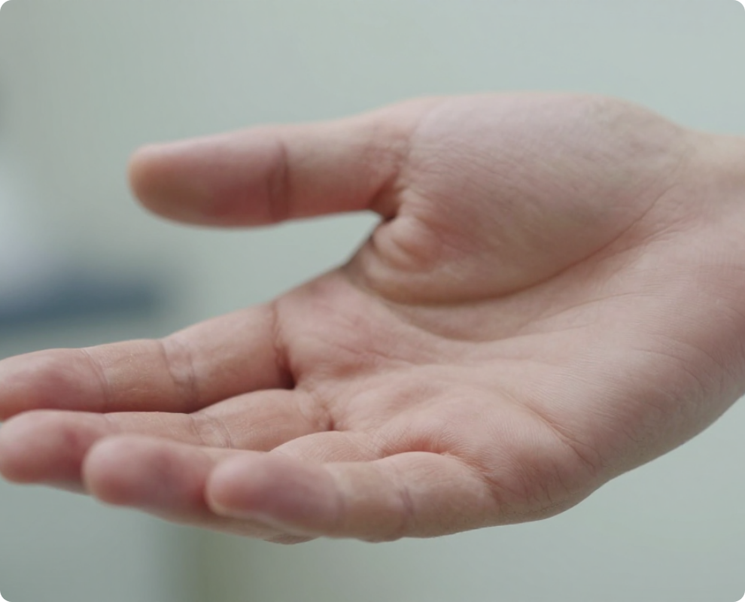
BRADFORD VTS TEACHING DECK
GP Trainee Teaching Module
•
ST1-ST3 & IMGs
Hand Injuries in GP – bites, trauma & fractures
A systematic guide to assessment, diagnosis, and management for AKT and SCA examination preparation.
Disclaimer: For educational purposes only. Clinical management must follow the latest NICE NG38 and BNF protocols.
June 2026 | Updated to NICE NG38 (2025) Standards
www.bradfordvts.co.uk

Slide 2





Attribution and Source Material
HAND INJURIES IN GENERAL PRACTICE
INTERNAL REFERENCE ONLY
2026 Evidence-Based Update
Original Source Material
All clinical content has been rigorously reviewed and updated to meet current June 2026 standards for UK General Practice.
The core clinical framework for this teaching module was originally developed in 1991. It provides the systematic "Look, Feel, Move" approach essential for primary care assessment.
NICE NG38 (2025): Non-complex fractures management (current version)
Clinical Lead: Mr Michael Flowers FRCS
BNF Standards: Antibiotic dosing for human and animal bites
BSSH Guidelines: Patient information and surgical referral criteria
Department: Consultant A&E, Leeds General Infirmary (LGI)
Bradford VTS: Tailored for AKT and SCA exam high-yield focus
Scope: Hand injuries - Initial assessment and types
www.bradfordvts.co.uk

Slide 3







Introduction: The GP’s Role in Hand Injuries
HAND INJURIES IN GENERAL PRACTICE
1
Clinical Assessment & Identification
15% of A&E Attendances Determine injury severity and identify structural damage (tendons, nerves, vessels). Missing these leads to significant long-term morbidity.
2
Triage & Primary Care Management
Manage simple injuries (stable fractures, minor lacerations) within the practice while accurately identifying cases requiring specialist Orthopaedic or Plastics referral.
3
Psychological Support & Reassurance
Hand injuries cause intense anxiety regarding functional loss. Reassurance is an active clinical intervention that must begin from the first point of contact.
Key Principle: Most hand injuries are minor clinically but major functionally and economically. One third of workplace accidents involve the hand. Always consider the patient's occupation and dominance.
www.bradfordvts.co.uk

Slide 4







Systematic Assessment: Essential History
HAND INJURIES IN GENERAL PRACTICE
Patient Profile
Mechanism of Injury
Timing & Prophylaxis
Dominance: Vital for determining management priorities and rehab goals.
Crush Element: High risk of vascular injury and compartment syndrome.
Wound Age: Wounds > 12 hours old must not be closed primarily due to infection risk.
Occupation: High functional demand (musician, surgeon) vs. heavy manual work affects prognosis.
Fight Bite: Human tooth injury over MCPJ. High infection risk; do not close primarily.
Tetanus Status: Td/IPV booster required if last dose was > 10 years ago.
Skiing Injury: Hyper-extension/rotation suggests UCL rupture (Skier's Thumb).
Prone Wounds: Consider immunoglobulin for high-risk, contaminated mechanisms.
Age: Influences bone quality and potential for functional recovery.
TOP TIP: THE GLASS RULE
Always assume a glass injury has cut everything in its path (nerves, tendons, vessels) until stopped by bone. Explore all lacerations thoroughly.
www.bradfordvts.co.uk

Slide 5










Systematic Assessment: LOOK
HAND INJURIES IN GENERAL PRACTICE
Resting Posture & Cascade
Observation & Perfusion
The normal resting hand shows a cascade of increasing flexion from the index finger to the little finger.
Swelling & Bruising: Note location (fracture sites) and severity (risk of compartment syndrome).
Any disruption of this natural curve is a diagnostic "red flag" for underlying structural damage.
Skin Color: Pale or dusky digits indicate potentially critical vascular compromise.
Digital Perfusion: Assess every injured finger individually via capillary refill.
Droop of Finger
Asymmetry
Suggests extensor tendon injury.
Suggests flexor tendon injury or fracture.
Target Refill Rate:
Mallet Deformity
Rotational Deformity
DIP joint droop (extensor mechanism).
Scissoring on flexion = fracture.
Normal < 2 Seconds
AKT Tip: Disruption of the cascade at rest is often the only sign of a complete flexor tendon division.
www.bradfordvts.co.uk

Slide 6








Systematic Assessment: FEEL
HAND INJURIES IN GENERAL PRACTICE
Temperature & Moisture
Sensation Testing
Assess for neurovascular status and autonomic function:
Assess digital nerves using light touch or two-point discrimination:
Denervated Skin: Becomes dry rapidly after injury.
Test both radial and ulnar borders of every injured digit.
Plastic Test: A plastic surface (e.g., pen) slides easily over denervated skin within minutes.
Compare to the contralateral side or uninjured fingers.
Capillary Refill: Normal is < 2 seconds; assess digital perfusion.
Pediatric Use: Highly useful in children who cannot cooperate with sensory testing.
Local Tenderness
Systematic palpation to identify structural damage:
Fracture Sites: Scaphoid (snuffbox), metacarpal necks, phalanges.
EXAM PEARL: THE JUMP PHENOMENON
Tendon Insertions: Point tenderness at FDP/FDS attachment sites.
Critical for AKT/SCA: A completely divided nerve may still conduct sensation on Day 1 because nerve ends are in contact. Always re-assess sensation at 48–72 hours if a nerve injury is suspected. Apparent normal sensation on Day 1 does NOT exclude division.
Joint Stability: Collateral ligaments of MCP and PIP joints.
www.bradfordvts.co.uk

Slide 7

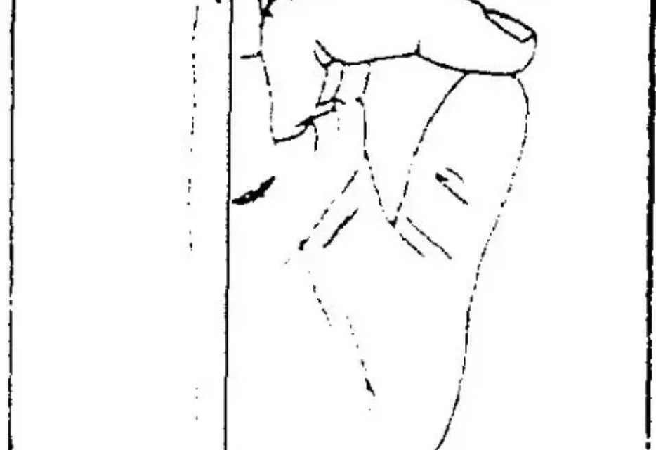








Systematic Assessment: MOVE
HAND INJURIES IN GENERAL PRACTICE
Active Movement Principle
Always test active movement (patient's own effort), not passive movement. Passive movement may mask complete tendon ruptures if the joint is moved by the examiner.
Common Pitfall: The 90% Rule
A tendon that is 90% divided can still function fully at initial assessment. However, it is structurally weak and will rupture completely during normal use later.
Ask the patient to make a full fist.
Ask the patient to extend fully.
Document function carefully at the first visit, even if initially intact, to protect both the patient and your clinical record.
www.bradfordvts.co.uk

Slide 8









Testing Individual Tendons
HAND INJURIES IN GENERAL PRACTICE
FDP
FDS
Extensors & Thumb
THE DIP FLEXOR
THE PIP FLEXOR
EXTENSOR SYSTEM
Hold the PIP joint in extension; ask the patient to flex the DIP joint in isolation.
Hold other fingers in full extension; ask to flex the PIP joint of the injured finger only.
Ask patient to extend finger at MCPJ against resistance.
THUMB (FPL)
Only one flexor to the thumb; test DIP flexion against resistance.
"Flexor Digitorum Profundus is the only tendon that flexes the DIP joint."
"Neutralizes FDP by keeping it at full stretch in other digits."
"Always test against resistance to reveal partial tears or weakness."
CRITICAL GP PEARL: A tendon that is 90% divided can still function fully—but it will rupture later. Always document function at the first visit, even if initially intact.
www.bradfordvts.co.uk

Slide 9













X-ray Indications and Rules
HAND INJURIES IN GENERAL PRACTICE
When to X-ray
Standard Rules
Suspected Fracture
Two Views Minimum
Point tenderness, clinical deformity, or high-energy mechanism.
Always obtain views at 90° (AP + Lateral/Oblique) to avoid missing displacement.
Crush Injuries
Individual Finger Lateral
High risk of multiple fractures and compartment syndrome.
Must be specifically requested; routine hand X-rays only provide oblique finger views.
Bite Wounds
Always exclude retained tooth fragments or joint penetration.
Follow-up Imaging
Foreign Bodies
Ensure healing is satisfactory and alignment is maintained in potentially unstable fractures.
Plain X-ray identifies radio-opaque glass or metal fragments.
Dislocations
Scaphoid Warning: 40% are occult on initial X-ray. If clinical suspicion persists (snuffbox tenderness), immobilise and repeat X-ray in 10–14 days or consider MRI/CT.
Confirm reduction and exclude associated avulsion fractures.
www.bradfordvts.co.uk

Slide 10






Fracture Stability and NICE NG38
HAND INJURIES IN GENERAL PRACTICE
Stable Fractures
Unstable Fractures
Simple transverse fractures of the shaft
Spiral or long oblique fractures (prone to shortening)
Non-displaced extra-articular fractures
Intra-articular fractures (risk of joint step-off)
Minimal angulation within acceptable limits
Fracture-dislocations (e.g., Bennett’s fracture)
No rotational deformity noted on examination
Crush injuries with multiple fracture fragments
Primary Care: Neighbour Strapping / Buddy Taping
Urgent Referral: Orthopaedic / Hand Clinic Review
NICE NG38 (2016/2025): Non-complex fractures should be assessed for stability. Potentially unstable injuries or those with rotational deformity must be reviewed in a specialist hand clinic. June 2025 surveillance confirms current guidelines remain valid for clinical practice.
www.bradfordvts.co.uk

Slide 11





Fingertip Injuries: Subungual Haematoma
HAND INJURIES IN GENERAL PRACTICE
Management: Trephining
Referral Criteria
Indication: Extremely painful pressure from blood trapped under the nail bed.
Size: Haematoma involves > 50% of the nail bed area.
Laceration: Suspicion of a significant underlying nail bed laceration or avulsion.
Procedure: Pierce the nail plate over the haematoma using a heated paperclip or a high-gauge hypodermic needle.
Fracture: Associated distal phalanx fracture (tuft fracture) with nail bed displacement.
Outcome: Immediate decompression provides instant and significant pain relief.
Nail Integrity: Nail is loose or partially avulsed from the proximal fold.
Post-Op: Simple dressing; monitor for infection.
Top Tip: Trephining is a simple, highly effective GP procedure. Always ensure the patient is warned about the "fountain" of blood once the nail is breached!
www.bradfordvts.co.uk

Slide 12








Laceration Management and Closure
HAND INJURIES IN GENERAL PRACTICE
Assessment & Cleaning
Closure Protocol
Explore ALL lacerations over tendons under LA; concealed injuries are common.
Use non-absorbable sutures (3-0 or 4-0 nylon) for primary closure.
Irrigate thoroughly with normal saline; ensure all debris/contaminants are removed.
Suture Removal: 10 days for palmar surface; 10–14 days for dorsal hand.
Perform formal excision and debridement if the wound is heavily contaminated.
Apply non-adherent dressing and bulky wool bandage; elevate to reduce swelling.
The 12-Hour Rule: Wounds >12 hours old must NOT be closed primarily due to high infection risk.
REFER IF:
• Suspected tendon or nerve injury
• Arterial injury requiring repair
TOP TIP: Tendon Exploration
• Significant skin loss (needs grafting)
A tendon that is 90% divided can still function fully at first. Document tendon function at the initial visit, even if it appears intact.
• Contaminated human/animal bites
• Foreign bodies that cannot be palpated
www.bradfordvts.co.uk

Slide 13















Human Bites: The "Fight Bite"
HAND INJURIES IN GENERAL PRACTICE
Identification & Risk
BNF FIRST-LINE ANTIBIOTICS
Assume any laceration over the MCPJ (middle/ring finger) is a tooth injury from a punch until proven otherwise.
Co-amoxiclav 625mg TDS (5–7 days)
Penicillin allergy: Metronidazole + Doxycycline
High Infection Risk: Eikenella corrodens, Streptococci, and Anaerobes are frequently involved.
Red Flag: Referral Criteria
Mechanism: Tooth penetrates joint/tendon when fist is clenched; bacteria are trapped when hand relaxes.
Refer Urgently (Same Day A&E) if:
Joint (MCPJ) entered by tooth
Signs of Septic Arthritis
Tendon/Nerve involvement suspected
Management Protocol
Exam Pearl: AKT Focus
X-ray Required: To exclude tooth fragments or joint penetration.
NO Primary Closure: Closure traps organisms; leads to severe infection. Leave wound open.
Key Answer: For a "fight bite," the correct management is X-ray, no primary closure, and Co-amoxiclav. Never close a human bite acutely in the GP surgery.
Clean: Copious irrigation with normal saline.
www.bradfordvts.co.uk

Slide 14









Animal Bites Management
PRIMARY CARE PROTOCOL & INFECTION RISK
Microbiology & Risk
Antibiotic Regimen (BNF)
High Infection Risk: Especially from cats (deep puncture) and dogs (crush).
First-line Therapy:
Co-amoxiclav 625mg TDS
Key Pathogens: Pasteurella multocida (common in both) and Capnocytophaga (dogs).
Duration: 3–5 days (prophylaxis) or 7–10 days (treatment).
Penicillin Allergy:
Rabies Risk: Assess travel history for bites sustained abroad; consult local HPT for prophylaxis.
Metronidazole 400mg TDS
PLUS
Doxycycline 100mg BD
Immediate Wound Management
Tetanus: Ensure status is up to date (booster if >10 years).
Thorough Irrigation: Wash wound extensively with normal saline or tap water.
Debridement: Remove devitalized tissue if necessary.
Primary Closure: Generally avoid, especially for dog bites; leave open to drain.
Top Tip: Wound Closure Rule
Never be in a hurry to suture an animal bite. Closing the wound traps Pasteurella or Capnocytophaga in a low-oxygen environment, significantly increasing the risk of abscess formation and deep space infection.
www.bradfordvts.co.uk

Slide 15










Antibiotic Summary (BNF-Verified)
HAND INJURIES IN GENERAL PRACTICE
Indication
First-line Antibiotic (BNF)
Duration
5–7 days
Human Bite / "Fight" Bite
Co-amoxiclav
High risk: Eikenella corrodens
625mg three times a day (TDS)
5–7 days
Animal Bite
Co-amoxiclav
Pasteurella / Capnocytophaga
625mg three times a day (TDS)
5–7 days
Penicillin Allergy
Metronidazole + Doxycycline
For bite prophylaxis/treatment
400mg TDS + 100mg BD (twice daily)
5–7 days
Standard Infected Wound
Flucloxacillin
Suspected Staph. aureus
500mg four times a day (QDS)
AKT Focus: Bite Prophylaxis
For human or animal bites, clinical assessment of "high risk" wounds warrants antibiotic prophylaxis. Co-amoxiclav is the standard first-line choice in the BNF. Never close human bites primarily — antibiotics are a safety measure, not a substitute for proper wound management.
www.bradfordvts.co.uk

Slide 16









Extensor Tendon & Central Slip Injuries
HAND INJURIES IN GENERAL PRACTICE
General Extensor Injuries
The Central Slip Hazard
Diagnosis: Characteristic "droop" of the finger at rest is the hallmark sign.
Location: Injury occurs at the PIP joint; may appear normal on initial presentation.
Exploration: Always explore lacerations on the back of the hand under LA if they lie over tendons.
Consequence: Missed central slip injuries lead to a delayed Boutonnière deformity.
Clinical Trap: A tendon that is 90% divided can still function initially but will rupture later.
Management Action
Treat ALL suspected central slip injuries immediately with 4–6 weeks of PIP joint extension splinting. Early intervention is vital for prevention.
www.bradfordvts.co.uk

Slide 17






Mallet Finger Management
HAND INJURIES IN GENERAL PRACTICE
Soft-Tissue Mallet
Bony Mallet
Extensor mechanism injury at the DIP joint without associated fracture.
Avulsion fracture of the dorsal base of the distal phalanx involving the extensor insertion.
DIP joint splinted in full extension
Bony fragments heal faster than tendon
Splinting must be continuous (24/7)
DIP splinted in full extension
If joint flexes, healing tissue ruptures
Refer if >30% joint surface involved
Duration: 6 Weeks Continuous
Duration: 4 Weeks Continuous
Critical Rule: Restarting the Timer
If the DIP joint flexes even once during the treatment period (e.g., during cleaning or splint changes), the treatment has failed. The 6-week (or 4-week) timer must be restarted from day zero immediately.
www.bradfordvts.co.uk

Slide 18








Flexor Tendon Injuries
HAND INJURIES IN GENERAL PRACTICE
Testing Individual Tendons
Zone 2: "No Man's Land"
FDP (Profundus): Hold PIP in extension; ask patient to flex ONLY the DIP joint.
Extends from distal palmar crease to the FDS insertion.
Tendon lies within a tight fibrous flexor sheath; injuries here have high risk of scarring and poor outcomes.
FDS (Superficialis): Hold all other fingers in full extension; ask to flex PIP of injured finger.
Modern consensus: Refer all Zone 2 injuries for formal surgical repair within 12–24 hours.
Note: A 90% divided tendon may still function normally on Day 1 but will rupture later.
"Rugby Finger" (Jersey Finger)
AKT Focus: Zone 2
Mechanism: Sudden forced extension of a flexed digit (e.g., grabbing a jersey).
Zone 2 flexor injuries are historically complex due to the fibrous sheath. AKT candidates must identify this zone as requiring urgent specialist referral rather than GP management.
Presentation: Closed avulsion of FDP from distal phalanx (Ring finger 75%).
RED FLAG: Urgent Referral
Pitfall: Often dismissed as a "strained finger" — check DIP flexion!
Any inability to flex DIP or PIP joints in isolation after a laceration or trauma requires same-day A&E/Plastics referral.
www.bradfordvts.co.uk

Slide 19








Boxer’s Fracture: 5th Metacarpal Neck
HAND INJURIES IN GENERAL PRACTICE
Overview & Mechanism
Management Strategy
Fracture of the neck of the 5th metacarpal.
Conservative:Most cases do NOT require reduction or plaster immobilization.
Mechanism: Impact with a clenched fist against a hard object (e.g., a wall or another person).
Neighbour Strapping:Buddy tape the 5th finger to the 4th (ring) finger.
Presentation: Loss of the 5th MCPJ knuckle prominence, swelling, and localized tenderness.
Mobilization:Encourage early active range of motion as pain permits.
Referral Criteria
Angulation exceeding 50°.
Rotational Deformity:Fingers cross when making a partial fist.
AKT PEARL: Accepted volar angulation is up to 40–50° without functional deficit.
Associated multiple metacarpal fractures.
PITFALL: Do not over-immobilize. Prolonged casting of boxer's fractures leads to stiffness; functional strapping and early movement provide superior recovery.
www.bradfordvts.co.uk

Slide 20











Phalangeal Fractures and the Safe Position
HAND INJURIES IN GENERAL PRACTICE
Management Principles
The "Safe Position"
Stable Fractures: Manage with neighbour strapping (buddy taping) to the adjacent finger.
Also known as the Edinburgh Position or Intrinsic Plus position. Used when splinting is required.
Mobilization: Encourage early active range of movement to prevent stiffness.
MCP JOINTS
IP JOINTS
90° Flexion
0° Extension
Immobilization: Reserved for unstable, displaced, or intra-articular fractures (requires referral).
THUMB POSITION
Top Tip: Neighbour Strapping
Fully Abducted
Ensure padding (gauze/cotton) is placed between fingers to prevent skin maceration. Straps should not be too tight to avoid digital ischaemia.
Rationale: MCPJ collateral ligaments are longest in flexion; IPJ volar plates are most prone to shortening in flexion. This position prevents permanent contractures and stiffness.
www.bradfordvts.co.uk

Slide 21





Bennett’s Fracture
HAND INJURIES IN GENERAL PRACTICE
Clinical Definition
HIGH RISK OF DISPLACEMENT
Why is it Unstable?
An intra-articular fracture-dislocation occurring at the base of the thumb (1st) metacarpal.
The small volar fragment remains attached to the trapezium, but the metacarpal shaft is pulled proximally and radially by the Abductor Pollicis Longus (APL) tendon.
Mechanism: Axial load on a partially flexed thumb (e.g., punch, fall).
Anatomy: Fracture involves the volar-ulnar aspect of the metacarpal base.
Will not remain reduced with simple casting.
Management: Urgent orthopaedic referral for surgical fixation (ORIF or K-wires).
Dislocation: Subluxation of the CMC joint due to muscle pull.
AKT FOCUS: EXAM PEARL
Recognize Bennett's as a surgical emergency in hand trauma. Even if it looks "stable" on initial X-ray, the pull of the APL muscle ensures progressive displacement. Never manage conservatively in Primary Care.
www.bradfordvts.co.uk

Slide 22






Scaphoid Fracture Assessment
HAND INJURIES IN GENERAL PRACTICE
Clinical Presentation
Diagnostic Dilemma
Mechanism: Fall on Outstretched Hand (FOOSH).
40% OCCULT fractures are radiologically negative on Day 1.
Key Sign: Tenderness in the anatomical snuff box.
Protocol: Clinical suspicion = Treat as fracture.
Pain on axial loading of the thumb or resisted supination.
Action: Thumb spica cast + repeat X-ray at 10–14 days.
AVN Risk: Blood supply enters distally; proximal pole is at high risk of necrosis if fracture is missed.
Gold Standard: Early MRI or CT if diagnosis remains uncertain.
AKT EXAM PEARL
X-ray negative does NOT mean fracture negative. If there is snuff box tenderness following trauma, the patient must be immobilised in a thumb spica and followed up with repeat imaging or MRI. Missing this leads to non-union and permanent disability.
www.bradfordvts.co.uk

Slide 23








Gamekeeper’s and Skier’s Thumb
ULNAR COLLATERAL LIGAMENT (UCL) ASSESSMENT
Mechanism & Presentation
Management Pathways
Mechanism: Forced radial deviation/abduction (e.g., ski pole catching, fall on outstretched thumb).
Partial Tear: Stable on stress testing. Manage with thumb spica cast or rigid splint for 4–6 weeks.
Anatomy: Rupture of the UCL at the thumb MCP joint.
Complete Tear: Significant laxity. Often requires surgical repair to restore pinch grip strength.
Symptoms: Pain, swelling, and tenderness specifically on the ulnar aspect of the thumb MCPJ.
Stener Lesion: Adductor aponeurosis prevents ligament healing. Absolute indication for surgery.
Chronic form: "Gamekeeper's" refers to repetitive stress; "Skier's" is the acute injury.
X-ray: Essential to exclude associated avulsion fractures (bony mallet of the thumb).
EXAM PEARL: AKT RECALL
TOP TIP: CLINICAL TESTING
Instability Criteria: Refer to orthopaedics if laxity is > 30° compared to the other side or if there is no clear endpoint on valgus stress. A missed Stener lesion leads to permanent weakness.
Test for instability using valgus stress at the MCPJ in both full extension and 30° flexion. Always compare with the uninjured side to establish baseline laxity.
www.bradfordvts.co.uk

Slide 24




PIP Joint Dislocation & Boutonnière Deformity
HAND INJURIES IN GENERAL PRACTICE
PIP Joint Dislocation
Boutonnière Deformity
Mandatory X-rays: Always obtain views before and after reduction to confirm position and check for fractures.
The Mechanism: Central slip injury causes lateral bands to slip volar, resulting in PIP flexion and DIP hyperextension.
Referral Trigger: Fracture-dislocation with a bony fragment > 30% of the joint surface requires surgical review.
Early Detection: Difficult to see initially. High index of suspicion for all hyperextension/jammed finger injuries.
Simple Reduction: Manage with neighbour strapping (buddy taping) and early mobilization to prevent stiffness.
Prevention: Treat all suspected central slip injuries with immediate 4–6 weeks of PIP extension splinting.
"Spindled Finger": Swelling can persist for months; an extension night splint is helpful if ROM is limited.
Chronic Deformity: Extremely difficult to manage once established; primary care prevention is vital.
Top Tip: If the patient cannot actively extend the PIP joint after a "jammed finger" injury, assume a central slip injury and splint immediately.
www.bradfordvts.co.uk

Slide 25















Compartment Syndrome of the Hand
HAND INJURIES IN GENERAL PRACTICE
PRIMARY DIAGNOSTIC CRITERIA
Pain Out of Proportion
Earliest sign: Pain on passive stretch of fingers.
P
Pain
P
Pressure (Tense)
P
Paraesthesia
P
Pallor
P
Paralysis (Late finding)
SURGICAL
EMERGENCY
Immediate A&E Referral
Remove all rings/bandages
Urgent Fasciotomy
HIGH-RISK MECHANISMS
Crush injuries and high-energy trauma are at highest risk. Do not wait for late signs like pallor or pulselessness to refer.
www.bradfordvts.co.uk

Slide 26






The Jump Phenomenon in Nerve Injuries
HAND INJURIES IN GENERAL PRACTICE
A critical clinical trap in acute hand assessment: initial sensory testing can be misleadingly normal even in the presence of a completely divided nerve. This physiological delay in deficit is known as the "Jump Phenomenon".
Day 1 (Acute Injury)
Day 2 – 3 (Follow-up)
Sensation Present
Sensation Absent
Nerve ends remain in direct contact immediately after injury.
Inflammatory response causes nerve ends to retract and separate.
Divided ends are bathed in physiological fluid (electrolyte-rich).
Physiological fluid bridge is lost or disrupted.
The fluid/contact allows continued conduction of electrical impulses.
Axonal conduction ceases across the gap.
Patient may report normal or near-normal sensation.
Sensory deficit becomes clinically obvious (dry skin, numbness).
EXAM PEARL: AKT FOCUS
Never discharge a patient with a suspected nerve injury based on normal Day 1 sensation. Re-assess sensation at 48–72 hours. Document "normal sensation on Day 1" as a baseline, but warn of potential delayed deficit.
www.bradfordvts.co.uk

Slide 27










Referral Criteria and Urgency
HAND INJURIES IN GENERAL PRACTICE
Same-Day Referral / A&E
Emergency
01
Vascular injury (pale/ischaemic digit)
Suspected tendon or nerve injury
Open fractures or joint penetration
Compartment syndrome (crush mechanism)
IMMEDIATE
"Fight bite" entering the MCPJ
Amputated digits (reimplantation risk)
Urgent Orthopaedics / Plastics
Within Days
02
Bennett’s fracture (unstable CMC base)
Complete UCL rupture (Stener lesion)
Unstable/displaced phalangeal fractures
Fracture-dislocations of PIP joints
URGENT
Significant nail bed/pulp tissue loss
Zone 2 Flexor tendon injuries
Hand Clinic / Specialist Review
Standard Urgent
03
Clinically suspected Scaphoid fracture
Boutonnière deformity (missed slip)
Persistent "spindled" finger/PIP sprain
Suspected nerve division (Day 2-3 review)
SPECIALIST
Complex mallet finger (bony/volar sublux)
Foreign body removal (deep/organic)
www.bradfordvts.co.uk

Slide 28














Top Tips for GPs
HAND INJURIES IN GENERAL PRACTICE
Reassurance First
Scaphoid Clinical Diagnosis
Anxious patients are poor historians. Calm them before assessing to ensure an accurate mechanism of injury.
Negative X-ray does not exclude fracture. Snuffbox tenderness = clinical fracture; immobilise and repeat imaging.
The Glass Rule
The "Safe Position"
Assume glass has cut everything in its path until stopped by bone. X-ray all glass-related lacerations.
Immobilise MCP joints in 90° flexion and IP joints in full extension to prevent collateral ligament contracture.
Mallet Finger Continuity
Stable Phalangeal Fractures
DIP extension must be 6 weeks continuous. If the joint flexes even once, the timer restarts at zero.
Most stable fractures require only neighbour strapping (buddy taping) and early mobilization, avoiding rigid casts.
The "Fight Bite" Alert
Spindled Finger Management
Any MCPJ laceration from a punch is a human bite. Never close primarily; provide Co-amoxiclav and X-ray.
Persistent PIP swelling after sprain can last months. Use extension night splinting to maintain range of motion.
Document Tendon Tests
Deep Foreign Bodies
A 90% divided tendon may function initially but will rupture later. Documenting normal initial function protects you.
If you cannot feel it, refer. Probing for deep objects in a GP setting is risky and often unsuccessful.
www.bradfordvts.co.uk

Slide 29






Exam Pearls: AKT Focus (Part 1)
HAND INJURIES IN GENERAL PRACTICE
MALLET FINGER
BITE MANAGEMENT
SCAPHOID FRACTURE
Soft-tissue mallet: 6 weeks continuous extension splinting.
First-line (BNF): Co-amoxiclav 625mg TDS for 5–7 days (Human/Animal).
Initial X-rays are negative in 40% of clinical fractures (radiologically occult).
Bony mallet: 4 weeks continuous extension splinting.
Penicillin Allergy: Metronidazole 400mg TDS + Doxycycline 100mg BD.
Clinical diagnosis: Tenderness in anatomical snuff box = treat as fracture.
If the joint flexes even once during the treatment period, the timer MUST be restarted from zero.
"Fight bites" (human bite over MCPJ) require X-ray for tooth fragments and must NEVER be closed primarily.
Management: Thumb spica cast + repeat X-ray at 10–14 days OR immediate MRI/CT if available.
www.bradfordvts.co.uk

Slide 30




Exam Pearls: AKT Focus (Part 2)
HAND INJURIES IN GENERAL PRACTICE
Bennett's Fracture
Safe Position
Jump Phenomenon
Definition: Intra-articular fracture-dislocation at the base of the thumb metacarpal.
MCP Joints: 90° flexion (keeps collateral ligaments at maximal length).
Day 1: Sensation may remain present despite complete nerve division.
IP Joints: Full extension (prevents volar plate contractures).
Mechanism: Nerve ends remain in contact and conduct initially.
Instability: Highly unstable injury; will displace if not fixed surgically.
Rationale: This position prevents stiffness in the most functionally limiting postures.
Clinical Rule: Re-check sensation at 48–72 hours as ends separate.
Management: Requires urgent orthopaedic referral for ORIF or K-wiring.
www.bradfordvts.co.uk

Slide 31







Exam Pearls: SCA Focus
HAND INJURIES IN GENERAL PRACTICE
Addressing Anxiety with ICE
SCA Safety-Netting Protocol
Ideas: "What's worrying you most about this injury today?"
Infection: "If you develop increasing pain, redness, or a fever in the next 48 hours, go straight to A&E."
Concerns: "Many people worry about long-term movement — that's very understandable."
Vascular:
"If your finger turns blue, cold, or pale, call 999 immediately."
Expectations: "What do you think needs to happen today for you to feel reassured?"
Nerve/Sensation: "Come back in 48-72 hours so we can re-check the feeling in your finger (Jump Phenomenon)."
Functional Review: "If your movement isn't gradually improving over the next 2 weeks, please book an earlier follow-up."
Shared Decision-Making (SDM)
For minor sprains or stable injuries:
Mallet Splints: "Remember, if the splint comes off or the finger bends even once, the 6-week clock must restart."
"Most finger sprains settle with time and buddy strapping. I suggest we wait a week to see if it improves, but I want to review you then to be certain. Does that sound like a plan you're happy with?"
www.bradfordvts.co.uk

Slide 32











Red Flags in Hand Injuries
HAND INJURIES IN GENERAL PRACTICE
Normal / Reassuring
Red Flags: Urgent Action
Normal Cascade of Flexion
EMERGENCY
Fingers rest in increasing flexion from index to little finger.
Vascular Compromise
Bilateral Perfusion
Pale, dusky, or cold digit; pulsatile bleeding.
Capillary refill < 2 seconds; digits are pink and warm.
EMERGENCY
Improving Localized Pain
Compartment Syndrome
Pain out of proportion; pain on passive stretch of fingers.
Pain is well-controlled with standard primary care analgesia.
Intact Active Movement
Infection & Sepsis
Fever + swollen red digit (Septic Arthritis or Tenosynovitis).
Patient can make a full fist and extend all joints against resistance.
Structural Loss
Complete loss of active movement (tendon rupture) or progressive numbness.
www.bradfordvts.co.uk

Slide 33






Common Pitfalls to Avoid
HAND INJURIES IN GENERAL PRACTICE
Closing a Human Bite
Intact Function vs. Intact Tendon
"Fight bites" should NEVER be closed primarily. Closure traps anaerobic organisms, leading to severe deep space infection or septic arthritis.
A 90% divided tendon can still function fully during assessment. It will rupture later if not identified. Always explore lacerations over tendons.
Missing Mallet Finger
Relying on Initial Scaphoid X-ray
Always test active DIP extension. A "jammed finger" story requires formal exclusion of extensor mechanism disruption before discharge.
40% of scaphoid fractures are radiologically occult on Day 1. Snuff box tenderness is a clinical diagnosis; immobilize regardless of X-ray.
Premature Splint Removal
Mallet treatment requires 6 weeks of continuous extension. If the joint flexes even once, the timer must be restarted from zero.
Failure to Re-check Sensation
"Jump Phenomenon": Day 1 sensation may be normal due to nerve contact. Always re-assess at 48-72 hours if nerve injury is suspected.
www.bradfordvts.co.uk

Slide 34






Quick Recall Summary
HAND INJURIES IN GENERAL PRACTICE
INJURY TYPE
KEY MANAGEMENT RULE
Mallet Finger
6 weeks continuous extension splinting (4 weeks for bony). Restart timer if joint flexes.
"Fight Bite" (Human)
NO primary closure. Co-amoxiclav 625mg TDS. X-ray for tooth fragments. Refer if joint entered.
Scaphoid Suspicion
Snuff box tenderness = Clinical Fracture. Immobilise and re-image even if initial X-ray is negative.
Safe Position
Immobilise with MCP joints at 90° flexion and IP joints in full extension to prevent contracture.
Zone 2 Flexor Injury
High risk of poor outcome. Refer same-day to Plastics/Ortho for formal surgical repair.
Nerve Sensation
Beware "Jump Phenomenon". Sensation can be normal on Day 1. Re-check at 48-72 hours to confirm.
www.bradfordvts.co.uk

Slide 35




Final Disclaimer and Resources
HAND INJURIES IN GENERAL PRACTICE
Educational Disclaimer
This teaching deck is designed for educational use by GP trainees (ST1-ST3) and International Medical Graduates (IMGs) within the Bradford VTS framework. While every effort has been made to ensure clinical accuracy, this material does not replace professional clinical judgment.
Mandatory Protocol: Clinical decisions must always follow your local Trust or Practice protocols and the most recent national standards, specifically NICE NG38 (2016; 2025 reviewed) and the current BNF.
Clinical content verified against June 2026 standards.
For more teaching decks and clinical resources:
www.bradfordvts.co.uk
Created: June 2026 | Bradford VTS Teaching Deck
www.bradfordvts.co.uk

