Slide 1


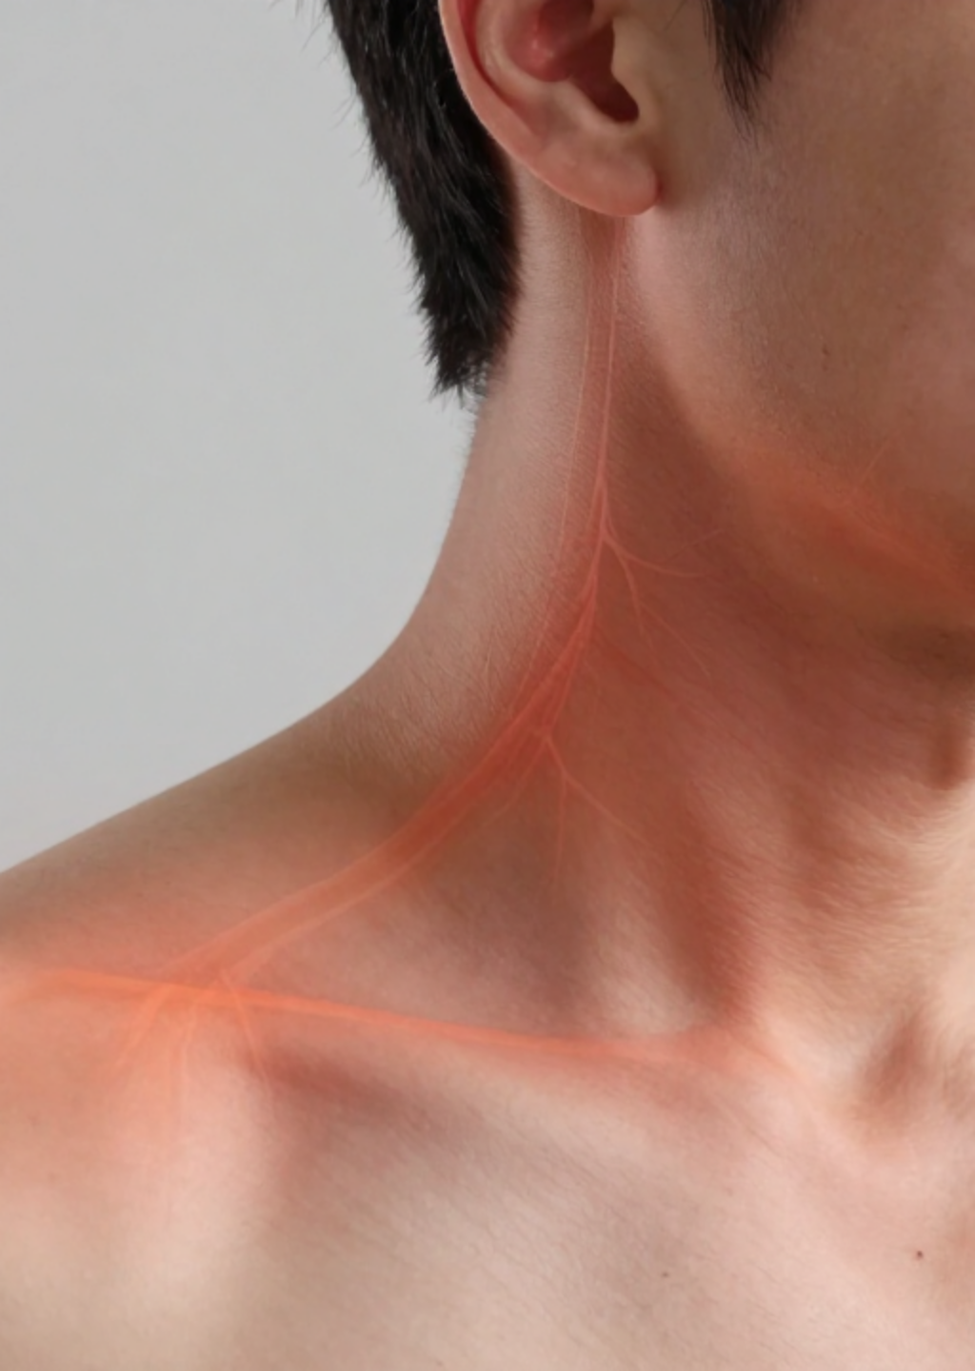


BRADFORD VTS TEACHING DECK
Polymyalgia Rheumatica (PMR) and Giant Cell Arteritis (GCA) for GPs
High-Yield Clinical Guide for GP Trainees (AKT & SCA Focus)
Created June 2026
Updated to NICE CKS PMR (May 2026) standards
www.bradfordvts.co.uk
⚠ Disclaimer: Always double check this advice and drug doses with the latest NICE/BNF guidance. This document is for educational purposes only.

Slide 2















BRADFORD VTS TEACHING DECK
Overview: The PMR and GCA Spectrum
NICE Guideline Update & Exam Focus
Disease Spectrum
Epidemiology & Demographics
Polymyalgia Rheumatica (PMR)
Inflammation of soft tissues and bursae around shoulder and hip girdles. NO vessel involvement.
1 in 133
1 in 500
PMR PREVALENCE (UK >50S)
GCA PREVALENCE (UK >50S)
Giant Cell Arteritis (GCA)
Medium/large vessel vasculitis affecting the temporal artery and other cranial vessels.
70–80 yrs
3:1
PEAK AGE OF ONSET
FEMALE PREDOMINANCE
Closely linked inflammatory conditions existing on a single clinical spectrum.
The Clinical Overlap
Up to 20% of PMR patients develop GCA symptoms.
AKT EXAM PEARL
Up to 50% of GCA patients have concurrent PMR features.
PMR prevalence ~0.75%; GCA ~0.2% in over-50s. F:M ratio 2:1. Both occur exclusively in patients aged >50.
CRITICAL: GCA can cause irreversible blindness.
This is a medical emergency.
Updated May 2026 / NICE TA
www.bradfordvts.co.uk
Page 2

Slide 3







BRADFORD VTS TEACHING DECK
PMR: Clinical Features & Diagnosis
NICE CKS (May 2026) Diagnostic Criteria & Exam Focus
CLINICAL PRESENTATION
Core Diagnostic Criteria (ALL Must Be Present)
Typically rapid onset (days to weeks). Systemic features include fatigue, anorexia, weight loss, and low-grade fever.
1
Age ≥ 50 years
2
Bilateral shoulder and/or pelvic girdle aching
KEY EXAMINATION FINDING
3
Morning stiffness lasting > 45 minutes
Pain is in soft tissues/bursae, NOT joints. Full range of movement is typically preserved.
4
Raised inflammatory markers (ESR or CRP)
5
Duration of symptoms > 2 weeks
AKT / SCA CRITICAL FOCUS
Range of movement is PRESERVED in PMR. If movement is limited or joint swelling is present, consider RA or OA as the primary diagnosis. PMR pain is extra-articular (subacromial/trochanteric bursae).
6
Rapid response to 15mg prednisolone (≥70% within 1 week)
Updated May 2026 / NICE TA
www.bradfordvts.co.uk
Page 3

Slide 4







BRADFORD VTS TEACHING DECK
PMR: Essential Investigations
NICE Guideline Update & Exam Focus
Acute Phase & General Baseline
Excluding Important Mimics
FBC, ESR, CRP: Essential markers; expect marked elevation.
ANA, RF, anti-CCP: Exclude Rheumatoid Arthritis (RA).
U&E, LFT: Pre-steroid baseline; check for GCA hepatic granulomas.
Electrophoresis + Bence Jones: Exclude Myeloma.
TFT: Exclude hypothyroidism (fatigue/myalgia mimic).
Creatine Kinase (CK): Exclude Polymyositis.
Bone Profile: Baseline Calcium, Phosphate, and ALP.
Urine Dipstick: Exclude vasculitis (blood/protein).
Pre-Treatment Screening
HbA1c / Glucose: Baseline before long-term steroids.
PURPLE AKT BOX: KEY PEARLS
CXR: Consider to exclude malignancy (atypical cases).
CK = NORMAL in PMR (raised in polymyositis — key differential).
Range of Movement = PRESERVED in PMR. If limited, consider RA.
ESR and CRP: Typically markedly elevated (often ESR >40mm/hr).
Updated May 2026 / NICE TA
www.bradfordvts.co.uk
Slide 4

Slide 5
















BRADFORD VTS TEACHING DECK
PMR: Starting Treatment and Tapering
NICE Guideline Update & Exam Focus
Initial Prednisolone Strategy
Suggested Reduction Schedule
Starting Dose: 15mg once daily (oral)
Dose (Prednisolone)
Duration
Lab Goal: ESR/CRP normalization within 3–4 weeks
3 weeks
15mg / day
IM Alternative: Depo-Medrone 120mg every 3–4 weeks
3 weeks
12.5mg / day
Critical Response Check
4–6 weeks
10mg / day
Expect ≥70% improvement in pain/stiffness within 1 week.
• If <70% at 1 week: Increase to 20mg daily.
• If still failing: RECONSIDER DIAGNOSIS.
Every 4–8 weeks
Reduce by 1mg
AKT Note: The dramatic "melting away" of symptoms is highly diagnostic for PMR.
Average treatment duration: 12–24 months.
Common struggle: Reducing below 7.5mg/day (flare risk).
DON’T FORGET: Bone Protection Strategy (see next slide)
Page 5

Slide 6












BRADFORD VTS TEACHING DECK
Managing Steroid Complications
NICE Guideline Update & Exam Focus
Bone Protection Strategy
Systematic Monitoring
Age >65 or Prev. Fragility Fracture
METABOLIC
CARDIOVASCULAR
Immediate intervention required
Blood Glucose: Baseline & 4-weekly for first 3 months (Steroid Diabetes).
Monitor Blood Pressure and Weight regularly (Steroid-induced HTN/Weight gain).
Start Bisphosphonate immediately (e.g., Alendronate 70mg weekly)
Add Calcium (1000mg) + Vitamin D (800 IU) daily
DEXA scan not required before starting
OCULAR
DERMAL
Inform patient regarding Cataract risk; report visual deterioration.
Monitor for skin thinning and easy bruising; advise on skin care.
Age < 65 & No Previous Fracture
Stratified assessment approach
Start Calcium and Vitamin D immediately
Annual Review Checklist
Arrange DEXA Scan to assess BMD
ESR/CRP
HbA1c
BP/Weight
Bone Health
Mental Health
Add Bisphosphonate if DEXA confirms low BMD
DAS28 Equiv
Updated May 2026 / NICE TA
www.bradfordvts.co.uk
Page 6

Slide 7







BRADFORD VTS TEACHING DECK
Giant Cell Arteritis: Clinical Features
NICE Guideline Update & Exam Focus
Cranial Symptoms
Visual Emergencies
Amaurosis Fugax: Transient monocular vision loss (warning sign).
Severe Headache: Abrupt onset, typically temporal and throbbing.
Scalp Tenderness: Pain when combing hair or lying on a pillow.
Artery Changes: Temporal artery may be tender, thickened, nodular, or non-pulsatile.
Diplopia: Double vision due to cranial nerve ischaemia.
Jaw Claudication: Pain in jaw muscles on chewing; resolves on resting.
Permanent Loss: Sudden, painless loss of vision.
Ischaemic Pain: Can rarely affect the face, tongue, or throat.
Systemic & Overlap
Never rely on a normal temporal artery exam to exclude GCA.
Constitutional: Fever, malaise, anorexia, weight loss.
PMR Overlap: 40–50% of GCA patients have proximal girdle aching.
AKT PEARL
Jaw claudication is the most specific symptom of GCA (LR 4.2). Amaurosis fugax is a critical warning sign of impending permanent blindness. Start high-dose steroids immediately if suspected; do not delay for tests.
Updated May 2026 / NICE TA
www.bradfordvts.co.uk
Page 7

Slide 8






BRADFORD VTS TEACHING DECK
GCA: Investigations and Diagnosis
NICE Guideline Update & Exam Focus
Laboratory Markers
AKT PEARL
Gold Standard & Imaging
ESR & CRP: Markedly elevatedESR typically >50mm/hr, often >100mm/hr. CRP is more sensitive for monitoring.
Temporal Artery Biopsy (TAB): Gold standardSensitivity 50-70%. Negative biopsy doesn't exclude GCA due to "skip lesions". Biopsy within 7-10 days.
Full Blood Count (FBC):
Normocytic anaemia and reactive thrombocytosis (high platelets) are common.
Temporal Artery Ultrasound (TAUS):
Looking for the "Halo Sign" (mural oedema). Non-invasive and increasingly used in specialist centers.
Liver Function (LFTs):
Mild elevation of ALP and Bilirubin in ~30% of patients.
Specialist Imaging (MRI/PET):
MRI for mural inflammation or PET/CT for suspected Large Vessel GCA (Aorta).
CRITICAL CLINICAL MANDATE
DO NOT DELAY STEROIDS while waiting for biopsy or ultrasound results.
Inflammatory changes persist in the artery for 7–10 days after starting treatment.
Updated May 2026 / NICE TA
www.bradfordvts.co.uk
Page 8

Slide 9





BRADFORD VTS TEACHING DECK
GCA: Immediate Management
NICE Guideline Update & Exam Focus
VISUAL SYMPTOMS PRESENT
NO VISUAL SYMPTOMS
RED FLAGS
STEROID THERAPY
Amaurosis fugax, sudden vision loss, or diplopia.
Start Prednisolone 40–60mg daily (min 0.7mg/kg/day) immediately.
IMMEDIATE ACTION
ISCHAEMIC PROTECTION
Same-day hospital admission (Ophthalmology + Rheumatology).
Aspirin 75mg daily + PPI gastroprotection.
HOSPITAL TREATMENT
URGENT REFERRAL
IV Methylprednisolone 500mg–1g daily for 3 days.
Urgent Rheumatology assessment (same/next day).
ORAL STEP-DOWN
DIAGNOSTIC TEST
Transition to High-dose Prednisolone (60mg/day) after IV pulse.
Temporal Artery Biopsy within 7–10 days; do not delay steroids.
CRITICAL SAFETY-NETTING
"If your vision changes at all — even briefly — go to A&E immediately."
Updated May 2026 / NICE TA
www.bradfordvts.co.uk
Page 9

Slide 10
















BRADFORD VTS TEACHING DECK
GCA: Tocilizumab and Steroid Reduction
NICE Guideline Update & Exam Focus
Tocilizumab (Actemra)
Steroid Reduction Schedule
NICE TA (2020):
Start tapering after 4 weeks at initial dose (40–60mg) once ESR/CRP have normalised.
Approved for newly diagnosed or relapsing GCA.
Mechanism:
Phase
Reduction Step
Target Dose
IL-6 receptor antagonist; reduces systemic inflammation.
Initial Phase
10mg every 2 weeks
Until 20mg/day
Key Benefit:
Achieves sustained remission and significantly reduces total cumulative steroid dose.
Mid Phase
2.5mg every 2–4 weeks
Until 10mg/day
Administration:
162mg subcutaneous weekly injection; specialist-initiated.
Maintenance
1mg every 1–2 months
Until stopped
GP Role:
Monitoring FBC, lipids, and LFTs in shared care.
AKT PEARL
Relapse: Increase back to last effective dose. Do not restart schedule from beginning.
Tocilizumab is a steroid-sparing agent that reduces relapse rates compared to steroids alone. Always check for IL-6 inhibitor in GCA drug history.
Visual symptoms at ANY stage: Same-day A&E admission.
Updated May 2026 / NICE TA
www.bradfordvts.co.uk
Page 10

Slide 11


















BRADFORD VTS TEACHING DECK
PMR vs GCA and Referral Criteria
NICE Guideline Update & Exam Focus
Feature
PMR
GCA
When to Refer PMR
Vessels
No involvement
Temporal + Cranial arteries
Age < 60 years or atypical onset (> 2 months)
No shoulder girdle involvement or stiffness
Normal or extreme inflammatory markers
Vision Loss
Rare (only if GCA develops)
High Risk (up to 20%)
Incomplete response (< 70% improvement at 20mg)
Multiple relapses or on steroids > 2 years
Headache
Unusual
Key Feature (Temporal)
Steroids contraindicated or not tolerated
Jaw Claudication
No
Highly Specific
When to Refer GCA
ALL suspected cases require specialist referral
Initial Pred.
15mg Daily
40–60mg Daily
Visual symptoms: Same-day admission (A&E)
No visual symptoms: Urgent outpatient (within days)
Emergency
No
YES - Medical Emergency
Refer for Temporal Artery Biopsy / Ultrasound (7–10d)
Tocilizumab
Not routinely
NICE Approved (2020)
Consideration of IL-6 inhibitors (Tocilizumab)
AMBER BOX: Low-dose steroids (15mg) for PMR may mask developing GCA. Always screen for headache and visual changes at review.
Updated May 2026 / NICE TA
www.bradfordvts.co.uk
Page 11

Slide 12















BRADFORD VTS TEACHING DECK
AKT Exam Pearls
NICE Guideline Update & Exam Focus
PMR Diagnostic Trio
1
Diagnosis requires: Age ≥50, bilateral shoulder/pelvic girdle pain, and morning stiffness >45 minutes. Expect a dramatic ≥70% response to 15mg Prednisolone within 1 week.
70% response = Key Criteria
Pred 15mg OD
GCA Emergency Markers
2
Jaw claudication is the most specific symptom. If visual loss is present, escalate to IV Methylprednisolone immediately. No visual symptoms start Oral Prednisolone 40–60mg.
Jaw Pain = High Specificity
IV Pulsed if Blindness Risk
Essential Lab Differentials
3
Creatine Kinase (CK) is NORMAL in PMR; raised CK suggests Polymyositis. For GCA, do not delay steroids for biopsy results; negative TAB does not exclude GCA due to skip lesions.
CK = Normal in PMR
Skip Lesions in TAB
Long-term Management
4
All patients on steroids ≥3 months must start Bone Protection (Bisphosphonate + Ca + Vit D). 20% of PMR patients develop GCA; always screen for new headaches or jaw pain.
Bone Protection Day 1
Tocilizumab = Steroid Sparing
Updated May 2026 / NICE TA
www.bradfordvts.co.uk
Page 12

Slide 13










BRADFORD VTS TEACHING DECK
SCA Exam Pearls: Communication and Safety
NICE Guideline Update & Exam Focus
Communication Strategy
Safety-Netting Actions
ICE (IDEAS, CONCERNS, EXPECTATIONS)
"You mentioned you've been getting headaches — can you tell me more about those? Any pain when chewing?"
CRITICAL SAFETY-NET
"Most importantly — if you ever get a sudden headache, jaw pain when eating, or any change in your vision, even briefly, please go straight to A&E immediately."
EXPLAINING THE DIAGNOSIS
"This is a condition called polymyalgia rheumatica — it causes inflammation around the shoulder and hip muscles. It's very treatable with steroids."
BONE PROTECTION EXPLANATION
"I'm also going to start you on a tablet to protect your bones, and calcium and vitamin D tablets."
STEROID COUNSELING
"Steroids are very effective, but I want to explain some side effects to watch for — raised blood sugar, blood pressure, and bone thinning. We'll monitor all of these."
SCA EXAM PITFALL
Failing to screen for GCA symptoms (headache, jaw claudication, visual loss) in a patient presenting with classic PMR symptoms.
Updated May 2026 / NICE TA
www.bradfordvts.co.uk
Page 13

Slide 14












BRADFORD VTS TEACHING DECK
Red Flags & Common Pitfalls
NICE Guideline Update & Exam Focus
RED FLAGS
RED FLAGS
COMMON PITFALLS
Any visual symptoms in PMR/GCA → same-day A&E — risk of permanent blindness
Starting prednisolone 15mg for GCA — dose is TOO LOW; GCA needs 40–60mg
Jaw claudication → strongly suggests GCA → start steroids immediately
Delaying steroids in GCA while waiting for biopsy result — blindness can occur in hours
Age <50 with PMR-like symptoms → not PMR — investigate aggressively (malignancy, myositis)
Normal temporal artery exam does NOT exclude GCA — clinical picture overrides
CK raised → not PMR → investigate for polymyositis/dermatomyositis
Negative temporal artery biopsy does NOT exclude GCA (skip lesions; sensitivity ~50–70%)
No response to 20mg prednisolone → reconsider diagnosis urgently — malignancy, infection, other
Not asking about GCA symptoms at every PMR review — headache, jaw pain, vision changes
Fever + raised CRP in PMR → exclude infection before assuming flare (steroids can mask infection)
Forgetting bone protection — bisphosphonate + Ca + Vit D from day one in all patients
New headache + scalp tenderness in established PMR → suspect developing GCA → increase steroids + refer urgently
Not checking blood glucose/BP regularly while on long-term steroids
VISION
Accepting incomplete response (<70%) without re-evaluating the diagnosis — refer
URGENT
SAME DAY
Not knowing about tocilizumab for GCA — NICE-approved 2020, examinable for AKT
Updated May 2026 / NICE TA
www.bradfordvts.co.uk
Page 14

Slide 15















BRADFORD VTS TEACHING DECK
Top Tips and Final Disclaimer
NICE Guideline Update & Exam Focus
PMR Triad: Bilateral shoulder/hip girdle pain + morning stiffness >45 min + raised ESR/CRP in patients >50.
Diagnostic Response: Expect at least 70% improvement in symptoms within 1 week of starting 15mg prednisolone.
Preserved ROM: Range of movement is typically preserved in PMR; limited movement suggests RA or OA.
GCA Vigilance: Always screen for headache, jaw claudication, and visual changes at every PMR review.
Visual Emergency: Any new visual symptoms require same-day hospital admission to prevent blindness.
Don't Delay: Start high-dose steroids immediately in suspected GCA; biopsy can be done within 7–10 days.
Bone Protection: Start bisphosphonates + Ca/Vit D from day one for any patient on long-term steroids.
Steroid Monitoring: Check blood glucose at baseline and monitor regularly for steroid-induced diabetes.
Tocilizumab (NICE 2020): Now approved for GCA to reduce steroid load and relapse rates; specialist-initiated.
Referral: Refer PMR if age <60, atypical features, incomplete response, or still on steroids after 2 years.
⚠ Disclaimer: Always double check this advice and drug doses with the latest NICE/BNF guidance. This document is for educational purposes only and should be used in conjunction with clinical judgment and local protocols.
Updated May 2026 / NICE TA
www.bradfordvts.co.uk
Page 15

