Slide 1


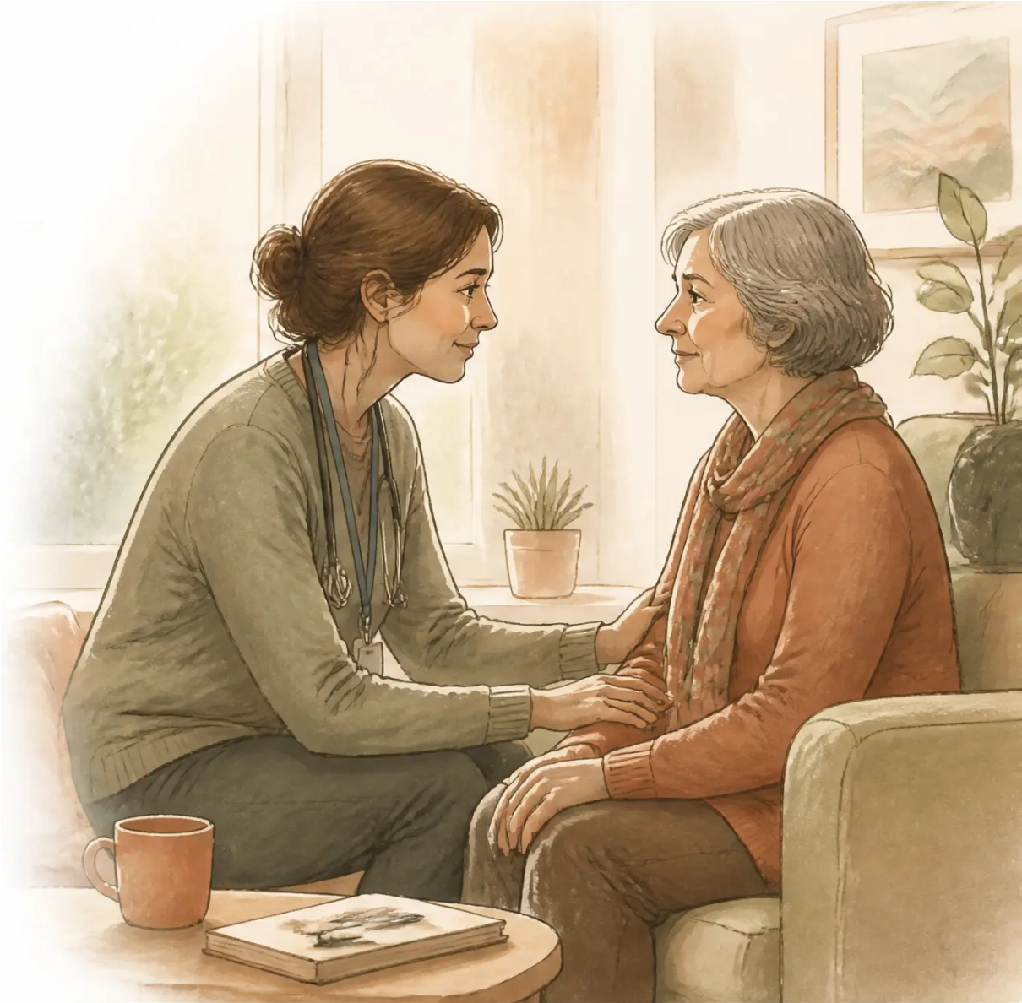
Bradford VTS Teaching Deck — Deck 5
COMMUNICATION SKILLS · SELF-CARE · RESILIENCE IN END-OF-LIFE CARE
Death and Dying Conversations
— and Looking After Ourselves
Communication skills, self-care, and resilience
in end-of-life care for GPs & trainees
Created June 2026
For educational purposes only. All clinical decisions should
be based on individual patient assessment and current
national guidelines.
www.bradfordvts.co.uk
Bradford VTS Teaching Deck | June 2026

Slide 2








Bradford VTS Teaching Deck — Death and Dying Conversations
Learning
Objectives
01 Initiate and navigate death and dying conversations with confidence
02 Use structured frameworks: SPIKES, NURSE, and the Serious Illness
Conversation Guide
By the end of this session,
you will be able to:
03 Discuss prognosis sensitively and honestly
04 Recognise + address your own emotional responses to death & dying
05 Build personal resilience and prevent compassion fatigue
06 Recognise when colleagues may be struggling
www.bradfordvts.co.uk
Bradford VTS Teaching Deck | June 2026

Slide 3
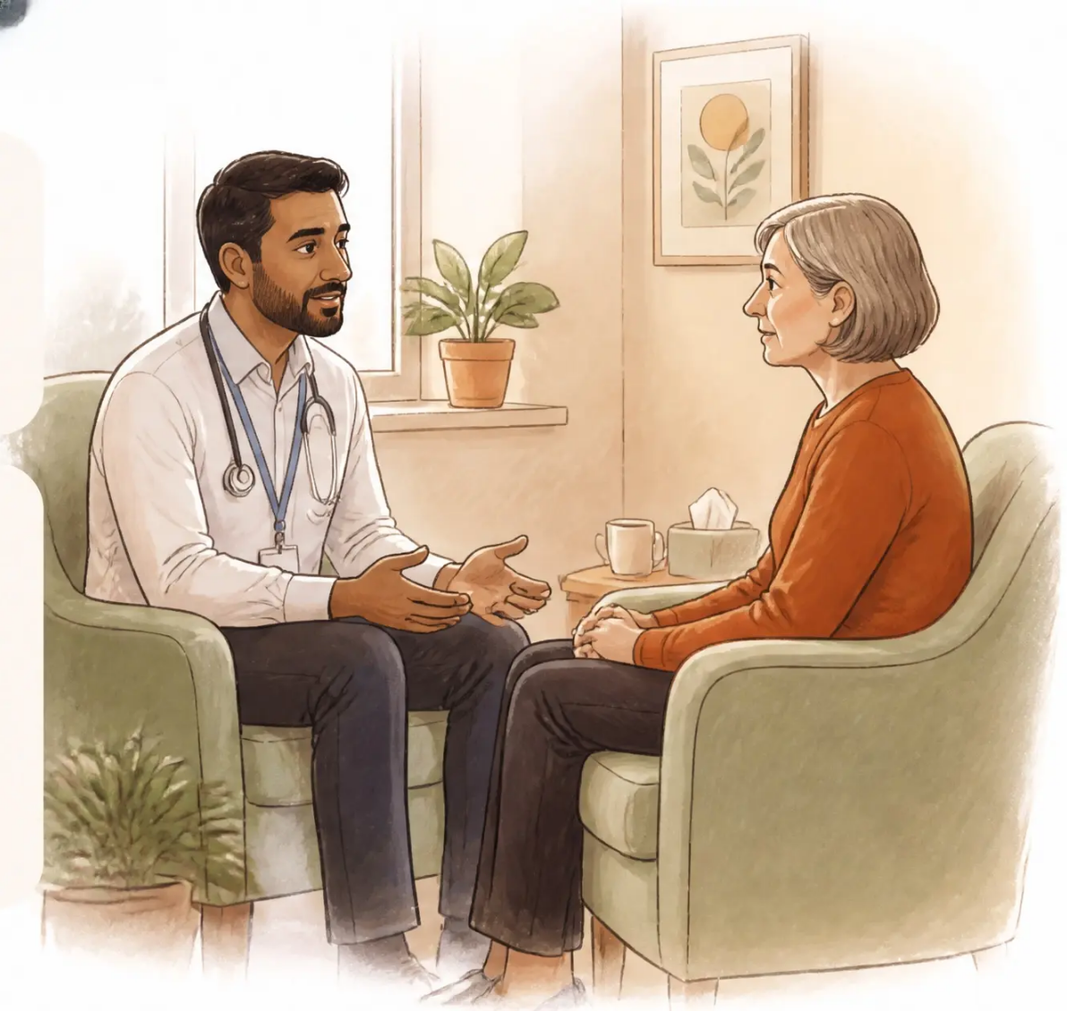







Bradford VTS Teaching Deck — Deck 5 • Death and Dying Conversations
Why These Conversations Matter
70%
of people in the UK say they
would like to die at home
Yet only ~23% actually do
NHS England data
Earlier conversations =
Better quality of life
Less aggressive
treatment
Fewer
hospitalisations
Better bereavement
outcomes
Higher quality
of life
Bernacki & Block, 2014
“ The conversation IS the intervention.
”
www.bradfordvts.co.uk
Bradford VTS Teaching Deck | June 2026

Slide 4

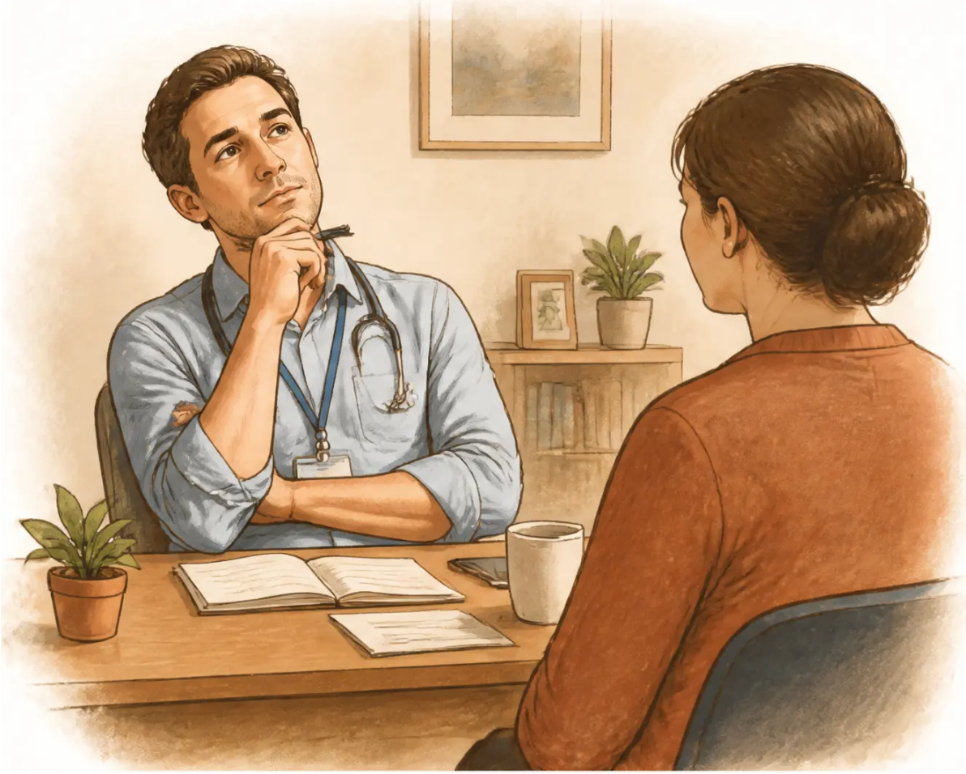












Bradford VTS Teaching Deck — Deck 5 • Death and Dying Conversations
What Makes These Conversations Hard?
Fear of causing distress
Worry about taking away hope or upsetting the patient
Not knowing what to say
Fear of silence or saying the wrong thing
Time pressure
Consultations feel too short for such weighty conversations
Personal anxiety about death
Clinician's own mortality discomfort shapes the encounter
Lack of training
Prognostic communication rarely taught explicitly
Cultural and language barriers
Different norms around disclosure, family roles, and directness
Patient or family avoidance
Collusion and denial can make it hard to open the door
Key insight: Patients generally want to talk. It is often the clinician who avoids the conversation.
www.bradfordsvts.co.uk
Bradford VTS Teaching Deck | June 2026

Slide 5

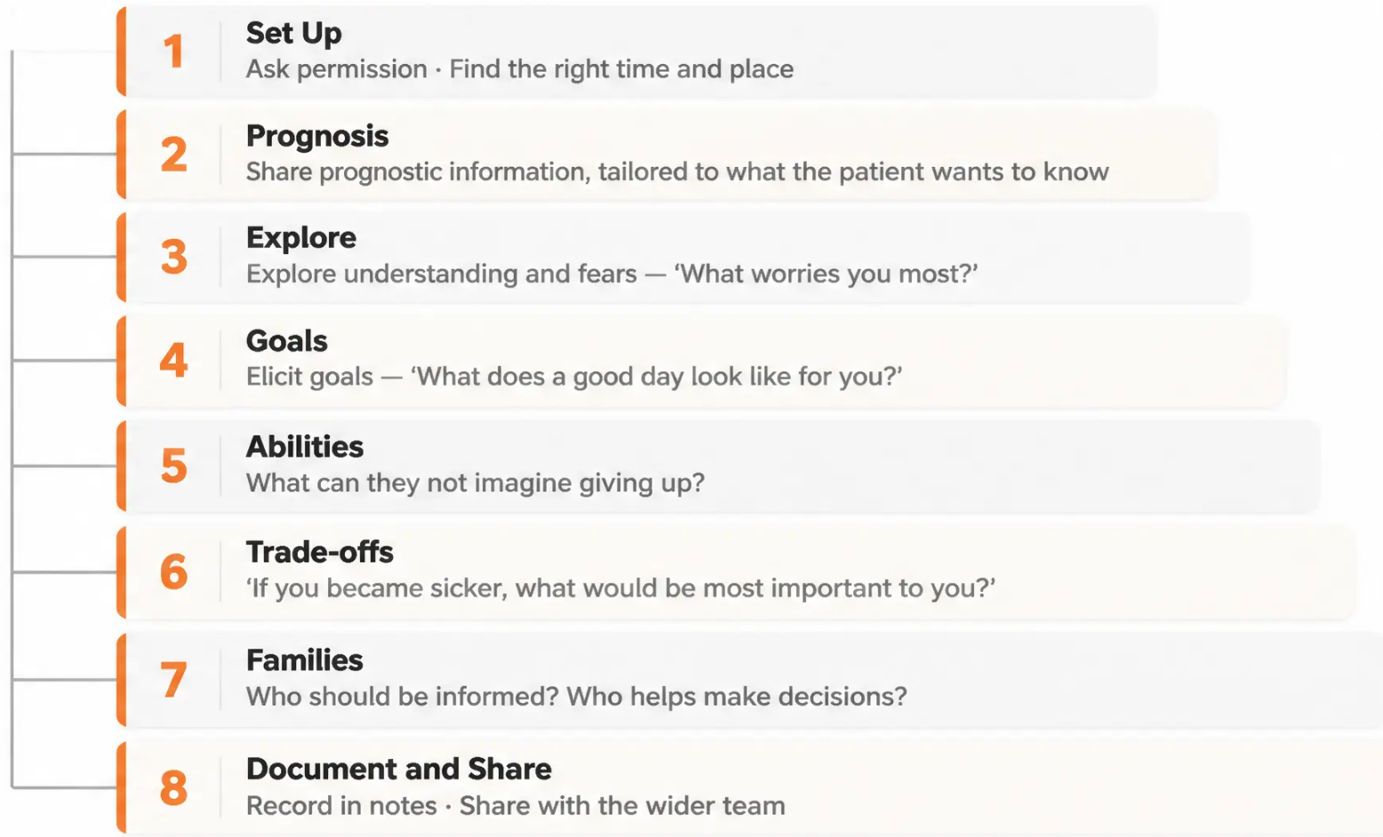


Bradford VTS Teaching Deck — Deck 5 - Death and Dying Conversations
5 / 31
The Serious Illness Conversation Guide
(SICG)
Developed by Ariadne Labs — evidence-based framework for prognostic conversations
Key insight
The conversation itself is the
intervention — patients who have
early serious illness conversations
report better quality of life, fewer
hospitalisations, and better
bereavement outcomes for families.
(Bernacki & Block, 2014)
www.bradfordvts.co.uk
Bradford VTS Teaching Deck | June 2026

Slide 6







Bradford VTS Teaching Deck — Deck 5 · Communication Skills
Slide 6 of 31
The SPIKES Framework — Breaking Bad News
A structured approach to one of medicine’s most important conversations
S
SET UP
P
PERCEPTION
Private space, sit down, no interruptions —
create the right conditions
Ask what they already know — calibrate
before you disclose
I
INVITATION
K
KNOWLEDGE
Ask how much information they want —
respect their autonomy
Give information in plain language, small
chunks, check understanding
E
EMOTIONS
S
SUMMARY & STRATEGY
Name the emotion — hold silence —
presence is therapeutic
Summarise clearly, safety-net, agree next
steps, offer follow-up
Never give bad news standing up, in a corridor, or over the phone
www.bradfordvts.co.uk
Bradford VTS Teaching Deck | June 2026

Slide 7


Communication Frameworks
The NURSE Framework
Responding to High Emotional Intensity
N
Name
“I can see this is very frightening for you.”
When emotions
run high —
stop the clinical
agenda.
Presence and
acknowledgement
are therapeutic.
U
Understand
“I can understand why this feels so overwhelming.”
R
Respect
“You have coped with so much already.”
S
Support
“I want you to know we will be with you through this.”
E
Explore
“Can you tell me more about what worries you most?”
www.bradfordvts.co.uk
Bradford VTS Teaching Deck | June 2026

Slide 8






Bradford VTS Teaching Deck — Deck 5 · Death and Dying Conversations
8 / 31
The ‘Surprise Question’ and Prognostic Communication
PRINCIPLES FOR SENSITIVE DISCLOSURE
THE CLINICAL TOOL
1 Ask first
How much do you want to know? Respect the patient’s choice.
“Would I be surprised
if this patient died in the
next 12 months?”
2 Use honest ranges
‘Weeks to months’ — avoid false precision or false certainty.
3 Plain language always
‘Your illness is not going to get better’ — clear, kind, direct.
NO → Not surprised
YES → Would be surprised
They are likely in their
last year of life →
Begin proactive
conversations NOW
Continue monitoring —
revisit the question
regularly
4 Acknowledge uncertainty
‘I can’t tell you exactly when, but I want to help you plan.’
5 Reframe hope
Toward what IS achievable — comfort, time with family,
meaningful goals.
General Practice Palliative Care — widely adopted in UK primary care
www.bradfordvts.co.uk
Bradford VTS Teaching Deck | June 2026

Slide 9




Bradford VTS Teaching Deck — Deck 5 • Death and Dying Conversations
Navigating the 'How Long Have I Got?' Question
One of the most common — and most feared — questions in palliative care.
Helpful Phrases
1 Acknowledge the courage it takes to ask
Name what just happened — 'That's such an important question to ask.'
'We're thinking in terms of
months rather than years...'
2 Check what they already sense
Ask what they already feel or believe about their illness.
'The illness is progressing —
we want to help you make the
most of the time you have.'
3 Ask what they want to know
Some want detail. Some want approximation. Some don't want a number at all.
4 Give an honest prognostic range
'I don't want to give a number
that could be wrong, but I do want
to be honest with you.'
Use plain, kind language — 'weeks to months" rather than exact timelines.
5 Bridge to what matters most
"Whatever the timeline — how can we make sure you're comfortable?"
www.bradfordvts.co.uk
Bradford VTS Teaching Deck | June 2026

Slide 10

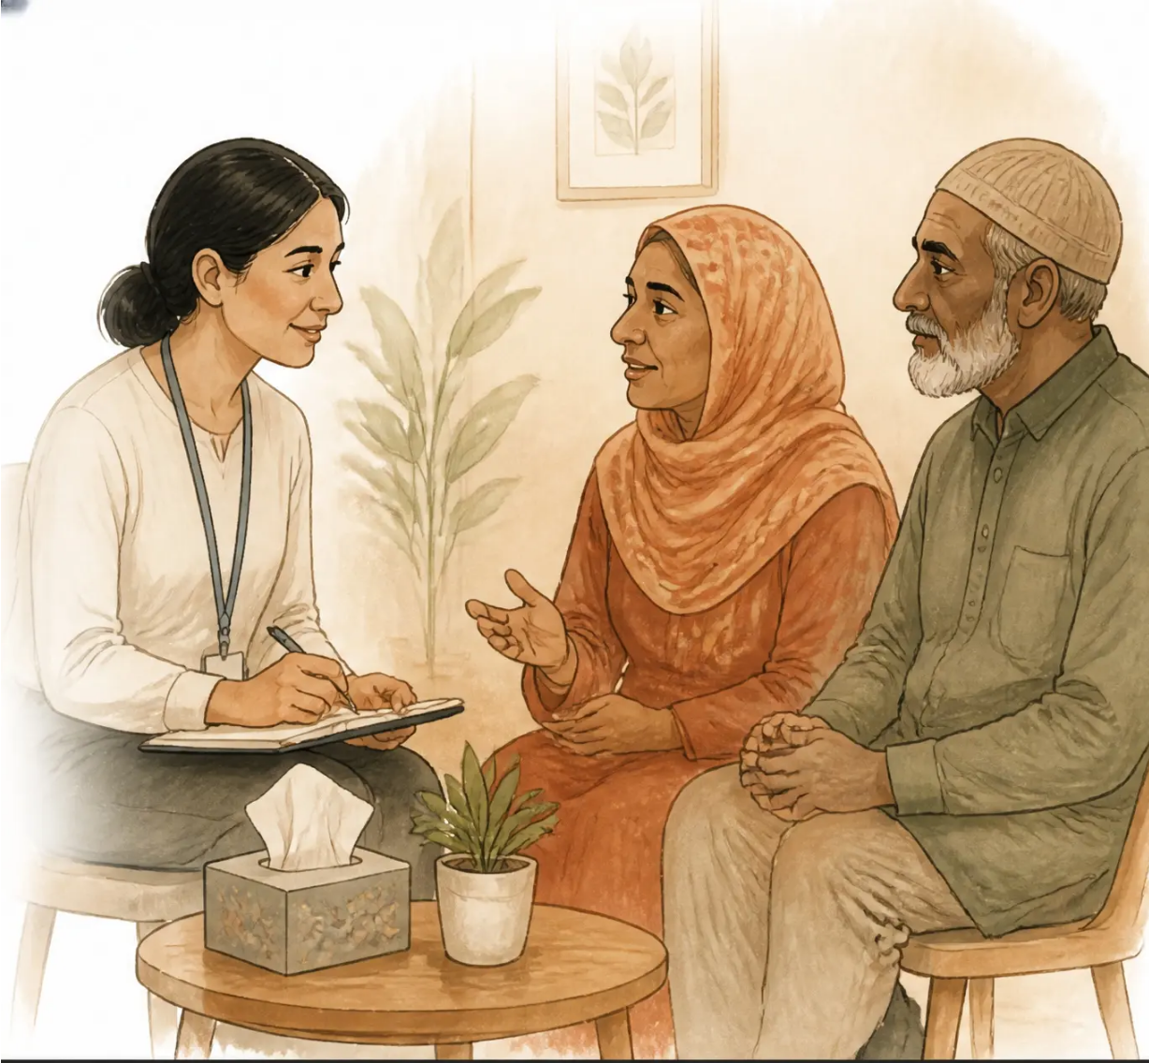

Bradford VTS Teaching Deck — Deck 5 · Death and Dying Conversations
10 / 31
Cultural Competence in Death and Dying Conversations
Death and dying are deeply cultural. Ask — don't assume.
TOPICS THAT VARY CULTURALLY
● Disclosure of terminal diagnosis — some families prefer to
protect the patient from bad news
● Language — direct use of "death" vs. euphemistic or indirect terms
● Decision-making — individual autonomy vs. family-centred approaches
● Preferred place of death — home is not a universal preference
● Post-death rituals — washing, timing, who may be present;
religious beliefs about suffering and afterlife
KEY PRINCIPLE
Always ask: 'What is most important to you
and your family as we approach this time?'
Cultural generalisations can be harmful — every patient is an individual.
www.bradfordvts.co.uk
Bradford VTS Teaching Deck | June 2026

Slide 11




Bradford VTS Teaching Deck — Death and Dying Conversations
11 / 31
Breaking Bad News by Telephone
◆ Confirm identity and safety
Check who you’re speaking to — and that they are
somewhere private and safe.
◆ Warn first
‘I have something difficult to tell you...’ — give them
a moment to prepare.
◆ Speak clearly and compassionately
Plain language, no jargon. Short sentences.
Pause between each.
◆ Hold the silence
Don’t rush to fill pauses — silence on the phone
is still therapeutic.
◆ Offer what comes next
Ask what they want to do. Offer an in-person appointment.
◆ Check they are not alone
Before ending — are they safe? Is someone with them?
◆ Document in full
Record the call, what was said, and what was agreed.
Avoid where possible:
Routine telephone disclosure of cancer diagnosis, unexpected death
notification, or major prognostic changes — always offer an in-person
alternative when you can.
www.bradfordvts.co.uk
Bradford VTS Teaching Deck | June 2026

Slide 12




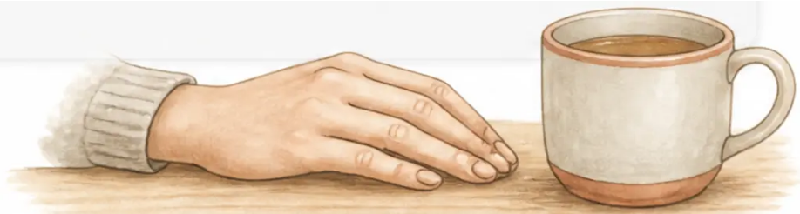

Bradford VTS Teaching Deck — Death and Dying Conversations
12 / 31
Conversations After a Death
WITH THE BEREAVED FAMILY
DOCUMENTATION
● Express condolences genuinely — avoid formulaic language
● Complete MCCD accurately and promptly
● Acknowledge the death directly: "Your mother died peacefully..."
● If cause of death is uncertain → refer to Coroner
● Offer a face-to-face appointment to answer questions
● Notify deregistration from practice register
● Complete learning: SEA for sudden/unexpected
deaths; Mortality M&M for complex cases
● Provide practical information: MCCD, funeral, benefits
● Safety-net: check family vulnerability and support network
If it's not documented — it didn't happen.
Presence and honesty matter more than perfect words.
www.bradfordvts.co.uk
Bradford VTS Teaching Deck | June 2026

Slide 13
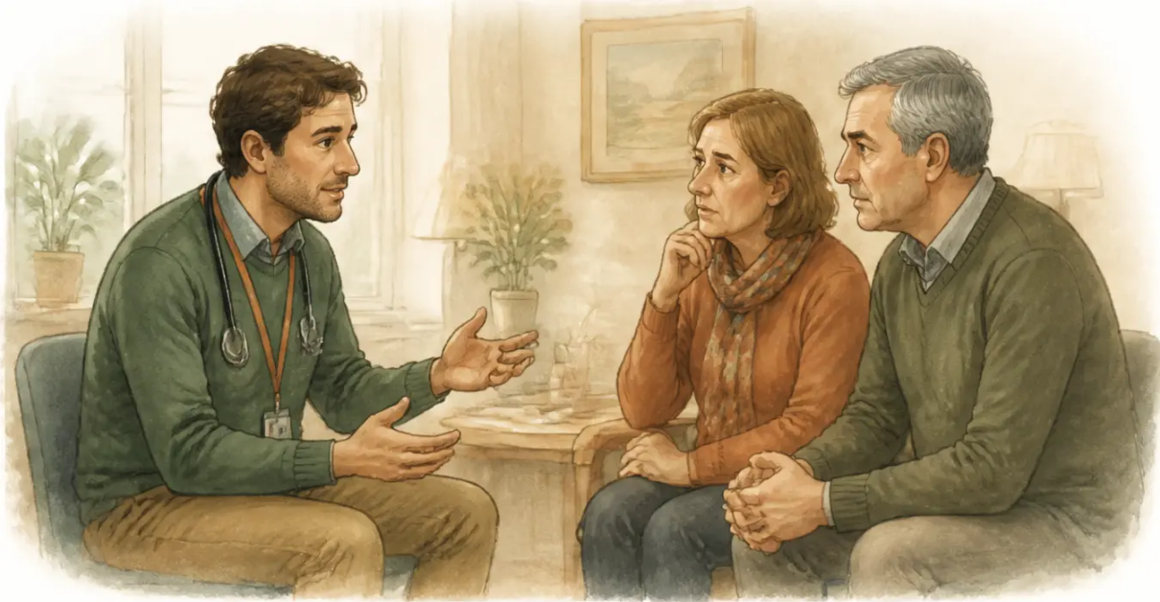






Bradford VTS Teaching Deck — Death and Dying Conversations
Collusion and the Family Who Say 'Don't Tell Him'
Step 1 Meet the family separately
Acknowledge their love and care. Explore what they
fear will happen if the patient is told.
Step 2 Explain why honesty is usually kinder
Patients often already sense the truth — secrecy
creates isolation, not protection.
Step 3 Negotiate a shared approach
Agree together: 'Let's find out what your father
actually wants to know.'
WHY COLLUSION IS USUALLY HARMFUL
Step 4 Explore gently with the patient
'Some people like to know everything —
how do you feel about that?'
— Denies the patient agency over their own final decisions
— Patient often already knows — but feels unable to speak
— Prevents ACP, ADRT, and DNACPR conversations
Step 5 Patient autonomy is the guiding principle
Approach with compassion and patience —
but the patient's right to know must be respected.
— Can lead to family guilt and complicated grief after death
Collusion usually comes from love. Address it with compassion — but patient autonomy wins.
www.bradfordvts.co.uk
Slide 13 of 31 | Bradford VTS Teaching Deck | June 2026

Slide 14
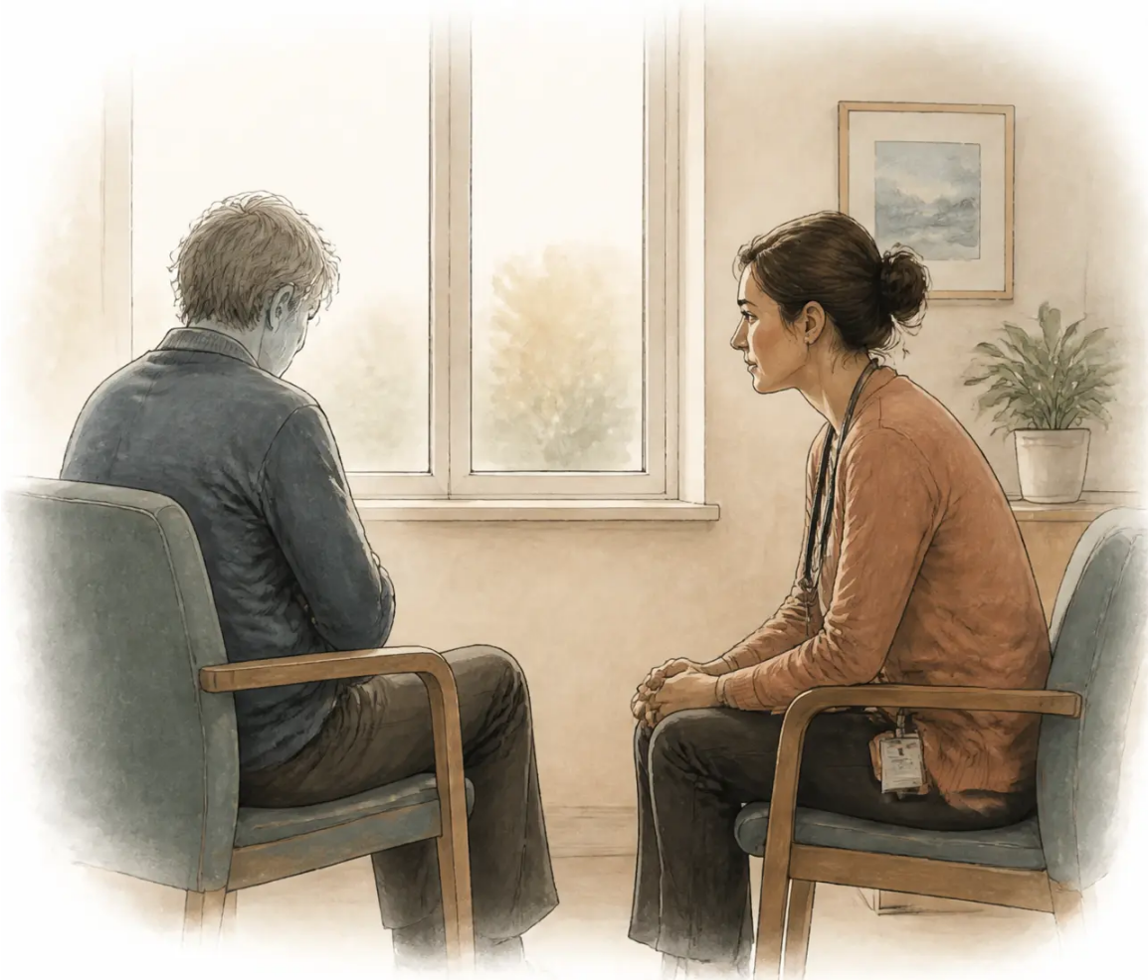

Bradford VTS Teaching Deck · Deck 5 · Death and Dying Conversations
The Withdrawn, Uncommunicative Patient
SIGNS TO NOTICE
Avoiding eye contact or giving one-word answers
Cancelling appointments or becoming non-compliant
Sudden change in mood or behaviour
Flat affect that feels different from their usual self
HOW TO ENGAGE
Allow silence — resist the urge to fill it with clinical tasks
Use open, gentle questions: "How are you really getting on?"
Acknowledge difficulty: "This must be an incredibly hard time..."
Consider whether depression or delirium is masking withdrawal
Silence in this context is not awkward — it is therapeutic. Hold it.
www.bradfordvts.co.uk
Slide 14 of 31 · Bradford VTS Teaching Deck · June 2026

Slide 15

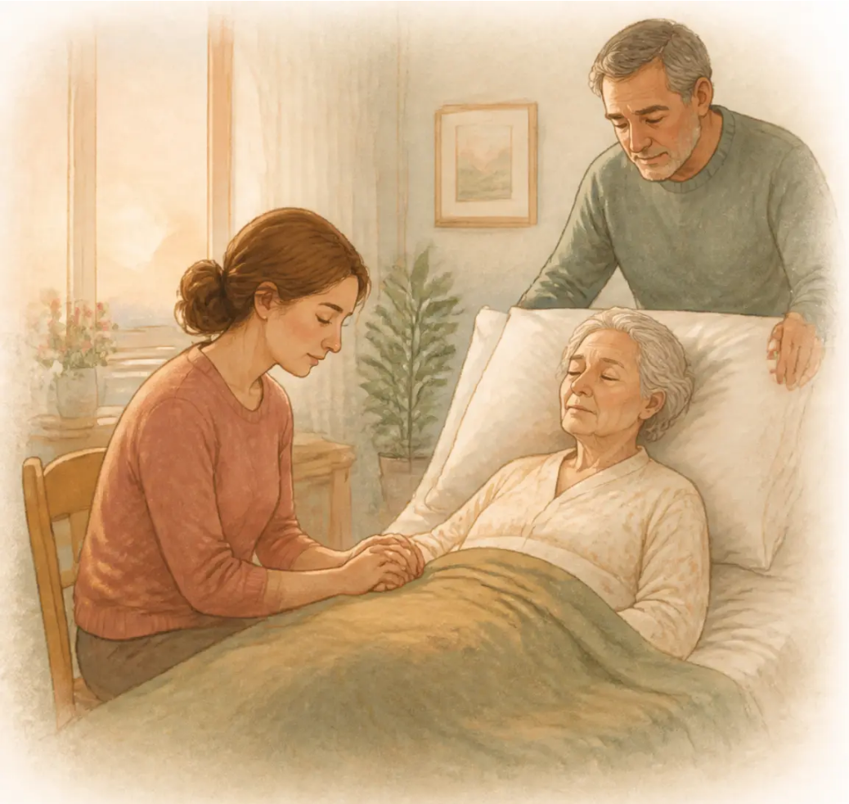

Bradford VTS Teaching Deck — Deck 5
Supporting Families Through the Dying Process
WHAT FAMILIES NEED
● Practical — What to expect as death approaches; who to call; keeping vigil
● Emotional — Normalise anticipatory grief; acknowledge complexity of feelings
● Relational — Encourage meaningful conversations now — what needs to be said?
● After death — MCCD; funeral directors; bereavement support
SIGNS THAT DEATH IS APPROACHING
● Reduced consciousness; increased sleep
● Mottling and cooling of the skin; Cheyne-Stokes breathing
● Reduced urine output; loss of interest in food and drink
● Rattling breathing from secretions — reassure families this is normal
Explain to families: the patient is not usually distressed by these signs.
www.bradfordvts.co.uk
Bradford VTS Teaching Deck | June 2026

Slide 16










Bradford VTS Teaching Deck — Deck 5 · Death and Dying Conversations
Looking After Ourselves — Why It Matters
Compassion
Fatigue
Emotional depletion from sustained
empathic engagement
You can't pour
from an empty cup.
Burnout
Chronic exhaustion, cynicism, and
reduced efficacy from work demands
Moral
Distress
Suffering when you feel unable to
provide the care you know is right
Working with dying patients is one of
the most meaningful — and most taxing —
aspects of general practice.
Vicarious
Trauma
Cumulative emotional impact of
witnessing suffering and loss repeatedly
ONS 2023: GP workload-related burnout
is at record levels. Palliative care
conversations are among the most
emotionally demanding clinical tasks.
Clinician
Grief
Clinicians grieve patients too — and
often without acknowledgement
www.bradfordvts.co.uk
Bradford VTS Teaching Deck | June 2026 | Slide 16 of 31

Slide 17


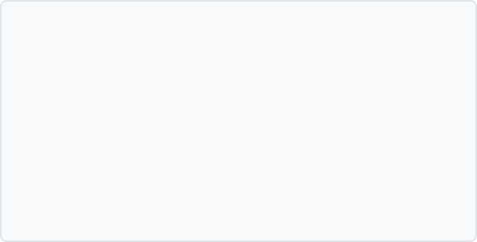

17 / 31
Bradford VTS Teaching Deck — Deck 5 · Death and Dying Conversations
Recognising Compassion Fatigue
SIGNS TO WATCH FOR
Know the signs — in yourself and in your colleagues
Emotional Numbness, detachment from patients, dread of certain
consultations, loss of satisfaction in work
Physical Persistent exhaustion, disrupted sleep,
somatic symptoms
Cognitive Difficulty concentrating, intrusive thoughts,
growing cynicism
Behavioural Withdrawing from colleagues, avoiding difficult
consultations, increased use of alcohol or other
coping substances
COMPASSION FATIGUE vs BURNOUT
Compassion Fatigue
Burnout
Caused by caring too deeply.
Over-empathising. Can resolve
with targeted support and
recovery.
Caused by systemic overload.
Requires both personal and
structural response.
Compassion fatigue is caused by caring — it can be healed.
www.bradfordvts.co.uk
Bradford VTS Teaching Deck | June 2026

Slide 18






Bradford VTS Teaching Deck — Death and Dying Conversations
18 / 31
Resilience Is Not About Being Tough
Resilience is NOT:
Resilience IS:
✔ The ability to recover, adapt and grow
through adversity
❌ Getting on with it / toughening up
❌ Suppressing emotions
✔ Built through CONNECTION, not isolation
❌ Never needing support
✔ Supported by psychological safety in teams
The most resilient clinicians acknowledge emotional impact AND
have strong peer support networks. Isolation is the greatest risk factor for burnout.
www.bradfordvts.co.uk
Bradford VTS Teaching Deck | June 2026

Slide 19
















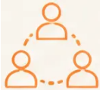


Bradford VTS Teaching Deck — Deck 5
Practical Self-Care Strategies
DAILY · WEEKLY
Brief debrief after
a hard consultation
Mindful transition
between work and home
Physical activity, sleep,
good nutrition
‘Bookending’ — a brief
ritual to start and
close your day
MONTHLY · ONGOING
Reflective practice
and Balint Groups
Schwartz Rounds —
whole-team narrative
reflection
Protected CPD time
for personal wellbeing
Clinical supervision
or mentoring
LONG-TERM
Seek help early:
BMA Doctors for Doctors ·
GP Health Service
(free & confidential)
Build a peer
support network
Protect non-clinical time —
boundaries matter
www.bradfordvts.co.uk
Bradford VTS Teaching Deck | June 2026

Slide 20



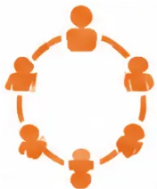





Bradford VTS Teaching Deck — Deck 5 • Team Wellbeing
Team-Based Approaches to Wellbeing
Individual resilience is not enough — teams must be psychologically safe.
Schwartz Rounds
Balint Groups
Regular multi-professional reflective
meetings. Share the emotional experience
of patient care. Normalise feelings and
build team cohesion.
Small group reflective learning for GPs.
Focus on the doctor–patient relationship.
Peer facilitated. Helps process difficult
interactions including death and dying.
Evidence: reduces burnout · improves communication · increases empathy
GP training standard · RCGP recognised
Significant Event Analysis (SEA)
Mortality & Morbidity (M&M)
Review unexpected deaths or difficult
end-of-life care incidents. Non-blaming
approach. Identifies learning and
improves system-level care.
Review of unexpected deaths in hospital
and primary care settings. Systems-level
learning. Supports quality improvement
and team reflection.
RCGP appraisal requirement
Primary care and hospital setting
www.bradfordvts.co.uk
Bradford VTS Teaching Deck | June 2026 | Slide 20 of 31

Slide 21

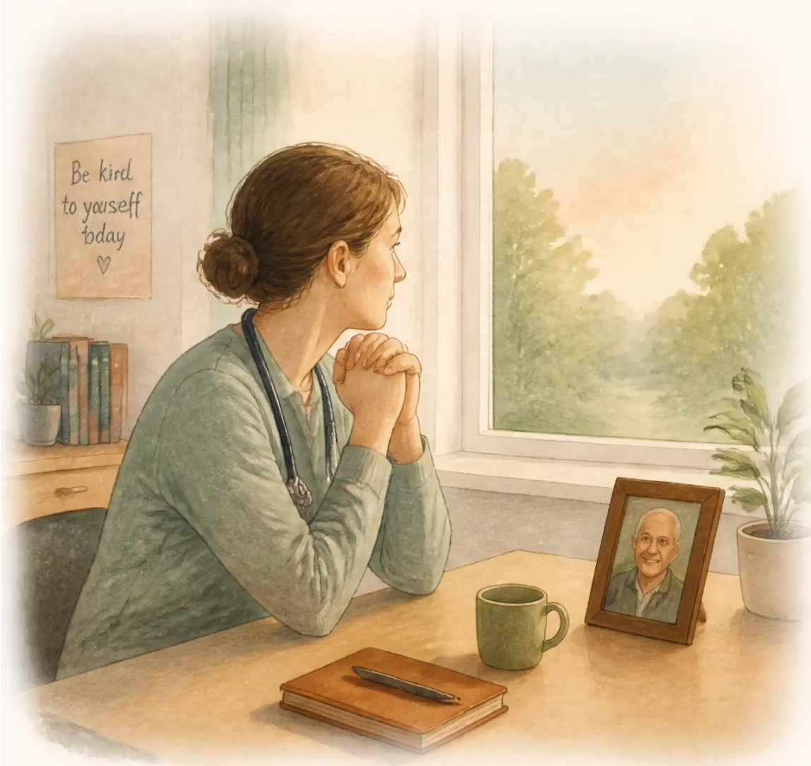
Bradford VTS Teaching Deck — Deck 5 · Death and Dying Conversations
21 / 31
What to Do When a Patient Dies
Practical Self-Care
1 Allow yourself to feel
This is normal and human. Grief in clinicians is real, even when it goes unnamed.
2 Name it briefly with a colleague
“Mrs Jones died last week — I’m sad about that.” Simple
acknowledgement matters more than you think.
3 Write a brief reflective note
A few sentences in your own words, if it helps. Not a
clinical document — just a human one.
4 Attend the funeral if you wish
Many GPs do. It is not unprofessional — it is humane.
Follow your instinct.
5 Review the case for learning — without self-blame
If there are clinical learning points, address them. But
separate learning from punishment.
6 Seek support if grief feels recurrent or intense
Supervision, a trusted colleague, or BMA Doctors for Doctors.
You do not need to carry this alone.
“GP grief is real — but rarely named. Many GPs carry years of patient losses without acknowledgement.”
www.bradfordvts.co.uk
Bradford VTS Teaching Deck | June 2026

Slide 22
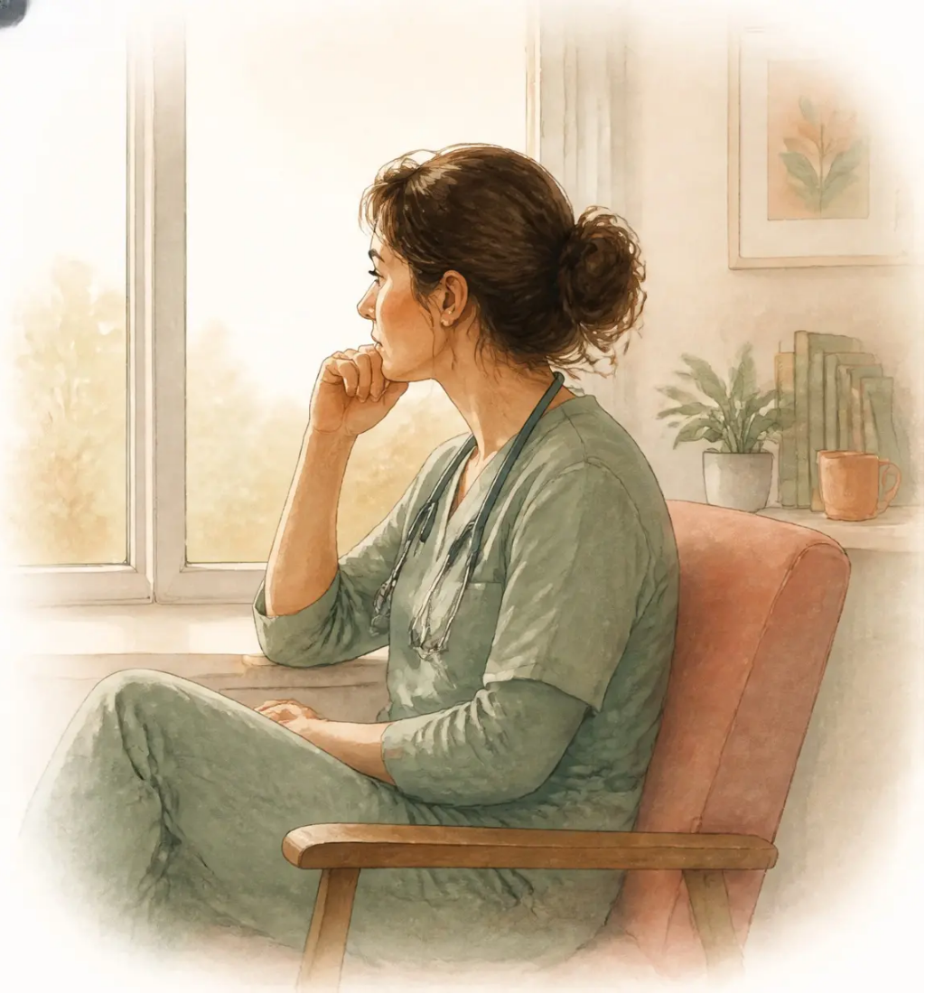


Bradford VTS Teaching Deck — Death and Dying Conversations
22 / 31
Cultural and Faith Competence for Yourself
Your own beliefs about death and dying are present in
every serious illness conversation — whether you realise
it or not.
● What does death mean to you personally — and what do you fear?
● Do your values about life and death shape how you
communicate prognosis?
● Are there patients or conversations you find yourself avoiding?
Reflective Practice Exercise
Recommended for GP Training Appraisal
Think of the last patient who died under your care.
How did you feel? What did you do with those feelings? What would have helped?
www.bradfordvts.co.uk
Bradford VTS Teaching Deck | June 2026

Slide 23
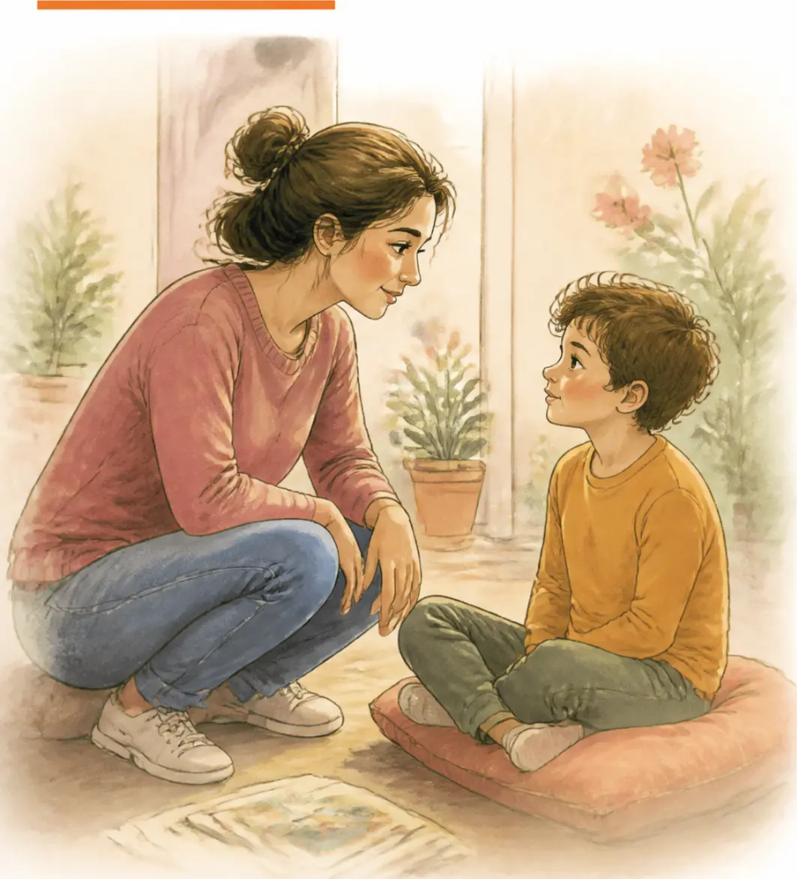







Bradford VTS Teaching Deck — Deck 5 · Death and Dying Conversations
23 / 31
Communicating with Children About Death and Dying
Children are perceptive — they know something is wrong
even if not told. Age-appropriate honesty is always better
than exclusion.
AGE GUIDANCE
Under 5
Ages 5–12
Adolescents
Simple, honest
language. Focus on
safety and
reassurance.
More explanation
welcomed. Include
in rituals if the
child wishes.
Treat almost as
adults. Acknowledge
the complexity of
their feelings.
SAY THIS
NOT THIS
♡ Grandad has died.
✕ Passed away / gone to sleep
♡ It's okay to ask anything.
✕ We'll explain when you're older
♡ You didn't cause this.
✕ Be strong for Mum
Refer to: Winston's Wish (winstonswish.org) · Child bereavement services · School liaison
www.bradfordsvts.co.uk
Bradford VTS Teaching Deck | June 2026

Slide 24
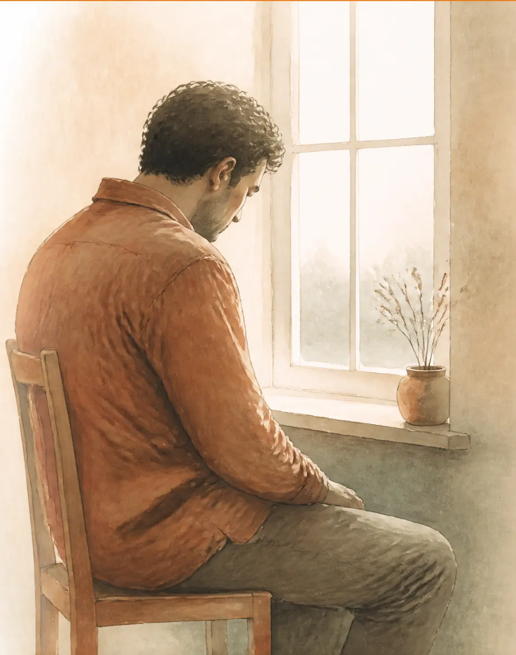

Bradford VTS Teaching Deck — Deck 5 | Death and Dying Conversations
The Spiritually Distressed Patient
Spiritual pain = suffering that arises when life loses meaning and purpose
HOW IT PRESENTS
“Why is this happening to me?”
“I’ve been such a bad person.”
“I’m afraid of what comes next.”
“What was the point of my life?”
YOUR ROLE
● Acknowledge the depth of the suffering — do not minimise or rush to fix
● Create space for reflection — silence and presence are powerful
● Refer to chaplaincy or community faith leader (with patient consent)
Spiritual pain is a clinical problem — ensure your Specialist Palliative Care team is aware.
www.bradfordvts.co.uk
Bradford VTS Teaching Deck | June 2026 | Slide 24 of 31

Slide 25
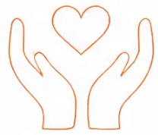







Bradford VTS Teaching Deck — Deck 5 • Death and Dying Conversations
Top Tips — Death & Dying Conversations
01 ASK, don't assume
05 Reframe hope
How much do you want to know?
Toward achievable goals, not cure
02 The conversation IS the intervention
06 Name collusion
It improves outcomes — don't delay it
Address it compassionately but directly
03 Protect the time
07 Know your own reactions
Never start a serious illness conversation
at the end of a busy clinic
Self-awareness is a clinical skill
04 Hold the silence
08 Debrief after
Silence is therapeutic — resist the urge
to fill it
Don't carry difficult conversations alone
www.bradfordvts.co.uk
Bradford VTS Teaching Deck | June 2026 | Slide 25 of 31

Slide 26













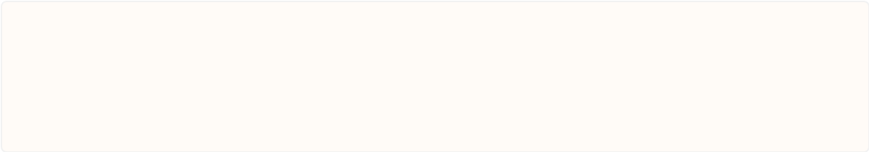
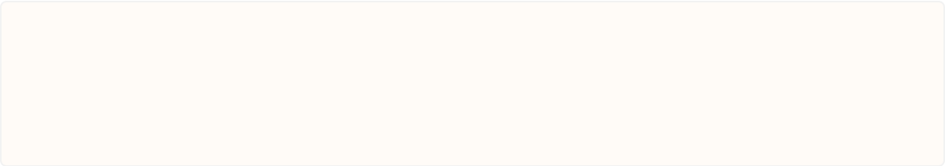


Bradford VTS Teaching Deck — Deck 5
AKT Exam Pearls
AKT Exam Pearls
Key frameworks and concepts for your Applied Knowledge Test
FRAMEWORK
FRAMEWORK
SPIKES — Breaking Bad News
NURSE — Responding to Emotions
Set-up · Perception · Invitation · Knowledge · Emotion ·
Summary/Strategy
Name · Understand · Respect · Support · Explore
EVIDENCE-BASED
DISTINCTION
Compassion Fatigue vs Burnout
Serious Illness Conversation Guide
Ariadne Labs. Evidence: improves QoL, reduces
aggressive treatment at end of life
Compassion fatigue = caused by caring.
Burnout = caused by system factors
TEAM WELLBEING
REFLECTIVE PRACTICE
Schwartz Rounds
Balint Groups
Whole-team reflective meetings. Evidence: reduce
burnout, improve communication
Doctor-patient relationship focus.
Standard in GP training
APPRAISAL
PRINCIPLE
Significant Event Analysis (SEA)
Cultural Competence
Required for unexpected deaths in general practice —
RCGP appraisal requirement
Always ask patient preferences.
Do not assume based on culture or religion
www.bradfordvts.co.uk
Bradford VTS Teaching Deck | June 2026 | Slide 26 of 31

Slide 27












Bradford VTS Teaching Deck — Deck 5
SCA Exam Pearls
SCA
Simulated Consultation Assessment — Communication in Practice
Opening a Serious Illness Conversation
Responding to ‘How Long Have I Got?’
“I’d like to talk with you about what lies
ahead — is that okay?”
Acknowledge courage → check what they sense →
give honest range → bridge to what matters most
Collusion Scenario
Emotional Response in Consultation
Acknowledge family love → explain risks of collusion →
negotiate with family, then approach patient gently
STOP the clinical agenda → use NURSE first →
return to clinical tasks only when emotions are acknowledged
Spiritually Distressed Patient
After a Death — Family Consultation
Don’t try to answer — create space, sit with
the distress, refer to chaplaincy with patient consent
Offer face-to-face meeting → express genuine
personal condolences → avoid formulaic language
Self-care signposting: BMA Doctors for Doctors — 0330 123 1245 · GP Health Service
www.bradfordvts.co.uk
Bradford VTS Teaching Deck | June 2026

Slide 28







Bradford VTS Teaching Deck — Death and Dying Conversations
28 / 31
Red Flags
Warning signs that demand your attention — in practice, in patients, and in yourself.
Clinician avoiding a dying patient's consultations
Child of dying parent receiving no support
Discomfort driving avoidance — a patient safety issue
Risks complicated childhood grief — refer proactively
Family collusion blocking ACP decisions
Terminal prognosis broken by letter or phone message
Patient denied agency over their own final choices
Never acceptable — always face-to-face where possible
Signs of compassion fatigue or burnout in a colleague
Prognostic information given without privacy
Emotional depletion is a patient safety risk — act early
Corridor or waiting room disclosure — a serious failure
If you recognise any of these — stop, reflect, and seek support.
www.bradfordvts.co.uk
Bradford VTS Teaching Deck | June 2026

Slide 29






Bradford VTS Teaching Deck — Death and Dying Conversations
29 / 31
Common Pitfalls
Mistakes that are easy to make — and easy to avoid with awareness
❌ Giving information before checking understanding
❌ Medicalising grief
Ask what the patient already knows and wants to know —
always.
Not every response to loss needs a diagnosis
or prescription.
❌ Rushing through silence
❌ Ignoring the family
Silence in this context is therapeutic —
hold it, don't fill it.
Families have needs too — don't focus
solely on the patient.
❌ False reassurance
❌ Insufficient time
"I'm sure it'll be fine" when it won't —
erodes trust and causes harm.
Serious illness conversations need at least
20 minutes — protected, not rushed.
❌ Not documenting the conversation
If it's not documented, it didn't happen.
Record all serious illness conversations in the notes — date, content, patient's response, next steps.
Bradford VTS Teaching Deck
www.bradfordvts.co.uk
| June 2026

Slide 30
Bradford VTS Teaching Deck — Deck 5
Quick Recall
Framework
Core Use
SPIKES
Breaking bad news
NURSE
Responding to emotions
SICG
Serious illness and prognostic conversations
Surprise Question
Identify patients in their last year of life
Schwartz Rounds
Team resilience and reflective practice
Balint Groups
Doctor–patient relationship reflection
SEA
Significant event analysis after unexpected deaths
FOR SUPPORT
BMA Doctors for Doctors — 0330 123 1245
GP Health Service — gphealth.nhs.uk
Samaritans — 116 123
www.bradfordvts.co.uk
Bradford VTS Teaching Deck | June 2026

Slide 31





Bradford VTS Teaching Deck — Deck 5
Disclaimer and Resources
Ariadne Labs — Serious Illness Conversation Guide
ariadnelabs.org
DISCLAIMER
BMA Doctors for Doctors — Wellbeing Support
0330 123 1245
This teaching deck is for educational
purposes only. All clinical decisions
should be based on individual patient
assessment and current national
guidelines.
GP Health Service
gphealth.nhs.uk
Winston's Wish — Child Bereavement
winstonswish.org
Not a substitute for clinical judgement
or up-to-date NICE/RCGP guidance.
Cruse Bereavement Care
cruse.org.uk
RCGP End of Life Care Toolkit
rcgp.org.uk
www.bradfordvts.co.uk
Bradford VTS Teaching Deck | Created June 2026
Slide 31 of 31

