Slide 1



Bradford VTS Teaching Deck — Deck 4
End of Life Care | June 2026
Dying with Dignity —
Decision Making,
DNACPR & Ethics
This Bradford VTS teaching deck explores ethical frameworks,
legal requirements, and clinical practices for end-of-life care,
updated to June 2026 guidance.
www.bradfordvts.co.uk | Created June 2026
For educational purposes only. Clinical decisions must be based on
individual patient assessment and current national guidelines.
Bradford VTS Teaching Deck
www.bradfordvts.co.uk | Created June 2026

Slide 2




Bradford VTS Teaching Deck — End of Life Care
Deck 4
By the end of this session, you will be able to:
Learning Objectives
Apply the four ethical principles to end-of-life decisions
Understand the legal framework for decision-making —
MCA 2005 and HRA 1998
Explain DNACPR decisions clearly to patients and families
Describe what is currently legal in the UK regarding
end-of-life choices in 2026
Discuss the Terminally Ill Adults (End of Life) Bill
and its current status
Support patients and families to achieve a dignified death
www.bradfordvts.co.uk
Created June 2026

Slide 3












Bradford VTS Teaching Deck — Deck 4
End of Life Care
The Four Ethical Principles
Beauchamp & Childress — the foundation of medical ethics
Non-maleficence
Beneficence
DO NO HARM
ACT IN BEST INTERESTS
Avoid CPR that only prolongs suffering or
causes harm without benefit.
Good palliative care is a positive act of
benefit — not a withdrawal of care.
Respect for Autonomy
Justice
PATIENT'S WISHES FIRST
FAIR AND NON-DISCRIMINATORY
Informed patient decisions take precedence —
even decisions we disagree with.
No discrimination based on age, disability,
or cost. Fair distribution of resources.
Clinical note: No single principle always overrides the others — end-of-life decisions require careful balancing of all four.
Bradford VTS Teaching Deck
www.bradfordvts.co.uk | Created June 2026

Slide 4








Bradford VTS Teaching Deck — End of Life Care
Deck 4
| June 2026
The Human Rights Act 1998
in End-of-Life Care
Key articles that shape clinical decision-making at end of life
Article 2 Right to Life
Does not require futile life-prolonging treatment
Article 3 Freedom from Degrading Treatment
Supports good palliative care as a right, not a privilege
Article 8 Respect for Private & Family Life
Supports patient autonomy in care and treatment decisions
Article 10 Freedom of Expression
Right to honest information about one's own condition
Article 14 Freedom from Discrimination
Non-cancer patients have equal rights to good end-of-life care
The Human Rights Act supports both appropriate DNACPR
decisions and patient autonomy — it does not mandate
resuscitation at all costs.
Bradford VTS Teaching Deck
www.bradfordvts.co.uk
| Created June 2026

Slide 5









The Mental Capacity Act 2005 — Key Principles
5 / 31
A framework for protecting autonomy and guiding best interests decisions
Two-Stage Capacity Test
Presumption of capacity
All adults are assumed to have capacity unless
proven otherwise
Stage 1 — Diagnostic
Is there an impairment or disturbance of
the mind or brain?
Support decision-making first
Every practicable step must be taken to help
a person decide
If NO → person has capacity. Stop here.
Unwise ≠ Incapable
A person's right to make an eccentric or
unwise decision must be respected
Stage 2 — Functional
• (a) Understand the information
Best interests
• (b) Retain it long enough to decide
Any act or decision for someone lacking
capacity must be in their best interests
• (c) Weigh it up to reach a decision
• (d) Communicate the decision
Least restrictive option
Cannot do ANY ONE of these →
lacks capacity for this decision
Always choose the option that least restricts
the person's rights and freedoms
Capacity is decision-specific and time-specific — reassess for every clinical decision
Bradford VTS Teaching Deck
www.bradfordvts.co.uk | Created June 2026

Slide 6







Bradford VTS Teaching Deck — Deck 4
End of Life Care | June 2026
Who Makes Treatment Decisions?
Capacity determines who holds decision-making authority
Has Capacity
Lacks Capacity
• Clinical team makes best interests decisions
(MCA 2005, s.4)
• Their informed decision is paramount
• Right to refuse any treatment, including
life-sustaining treatment
• Consider prior expressed wishes — verbal and written
• Consult those close to the patient
• DNACPR discussions must involve
the patient directly
• Check for valid Advance Decision to Refuse
Treatment (ADRT)
• Check for Lasting Power of Attorney —
health and welfare powers only
• Encourage formal ADRT if refusing CPR
• Clinician advises — patient decides
• Best interests = personal, social, emotional —
not just medical
Key Legal Principle
Family members do NOT have the legal right to make decisions for incapacitated adults —
unless they hold a valid Health and Welfare Lasting Power of Attorney (LPA).
Bradford VTS Teaching Deck
www.bradfordvts.co.uk | Created June 2026

Slide 7


















Advance Decisions to Refuse Treatment (ADRT)
| A legally binding right to refuse — understanding what makes it valid
Requirements for a Valid ADRT
ADRT vs DNACPR — Key Differences
ADRT
DNACPR
● Written — must be documented in writing, not verbal only
Made by
The patient
The responsible clinician
● Signed by the patient — patient signature required
Legally binding
under MCA 2005
Clinical advice —
not legally binding on its own
Legal status
● Witnessed — a witness must also sign the document
● Explicit statement — must specifically state “even if
life is at risk” for life-sustaining treatment refusals
Patient's autonomous
refusal of specific treatment
Clinical decision about
CPR appropriateness
Purpose
● Freely made — must not have been made under duress
or coercion, and must not have been revoked
A competent patient wishing to refuse CPR should be
encouraged to make a formal ADRT —
not rely on the DNACPR form alone.
An ADRT can only refuse treatment — it cannot
demand or require specific treatments.
Bradford VTS Teaching Deck
www.bradfordvts.co.uk | Created June 2026

Slide 8






Bradford VTS Teaching Deck — Deck 4 | End of Life Care
The DNACPR Decision — Fundamentals
DNACPR — Do Not Attempt Cardiopulmonary Resuscitation
A clinical decision — not an abandonment of care.
When CPR is appropriate to attempt
• A realistic chance of a successful outcome exists
• The patient has expressed a wish for CPR to be attempted
• No explicit decision has been made and wishes are unknown —
default is to attempt
When DNACPR is appropriate
• Death is the expected, inevitable result of irreversible illness
• CPR would clearly fail — patient is in terminal phase
• The patient has made a competent, informed refusal of CPR
DNACPR is not about giving up — it is about
preventing harmful and futile interventions.
Bradford VTS Teaching Deck
www.bradfordvts.co.uk
| Created June 2026

Slide 9






Bradford VTS Teaching Deck | End of Life Care
Five Principles Underlying DNACPR Decisions
Rotherham DNACPR Policy framework — applied to everyday clinical practice
01
02
03
Anticipate Circumstances
When CPR Will Fail
Communication
A DNACPR decision is only valid if
arrest circumstances can be
reasonably anticipated.
Do not offer CPR as an option or
burden patients with deciding about
a futile intervention.
Open, honest, and compassionate —
patient decides how much
information they want.
04
05
Quality of Life
Presumption to Resuscitate
When CPR could succeed but with
poor quality of life outcome, patient's
wishes are paramount.
When no explicit decision exists
and wishes are unknown, default is
to attempt CPR.
No single principle overrides the others — clinical judgement requires balancing all five.
Bradford VTS Teaching Deck
www.bradfordvts.co.uk | Created June 2026

Slide 10

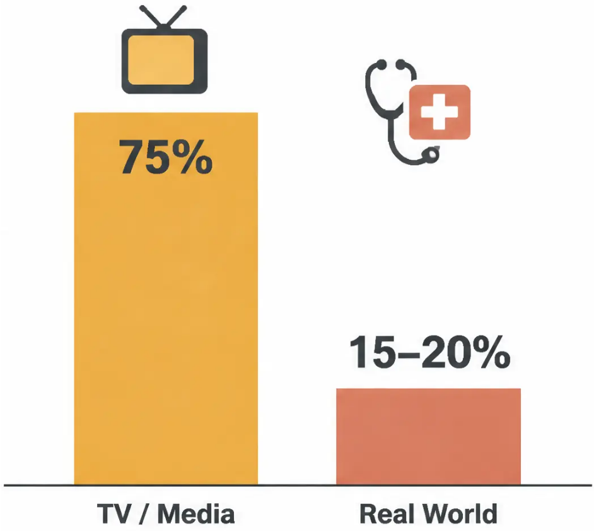


Bradford VTS Teaching Deck — End of Life Care
Factors Associated with CPR Failure
What the evidence tells us — and what patients need to hear
~15%
Survival to hospital discharge following in-hospital CPR
Immediate ROSC ~38% · Survival at 24 hours ~25%
FEATURES ASSOCIATED WITH NEAR-ZERO CHANCE OF SUCCESS
Advanced malignancy
Immobility / poor performance status
Pneumonia
Renal failure
Dementia
Age over 70 (relative factor)
Hypotension
Patients often hold unrealistic expectations
shaped by television. Honest conversation matters.
Primary respiratory arrest (vs cardiac)
Most successful CPR outcomes involve acute reversible respiratory failure or prompt treatment of VF/VT in otherwise well patients.
Bradford VTS Teaching Deck
www.bradfordvts.co.uk
Created June 2026

Slide 11
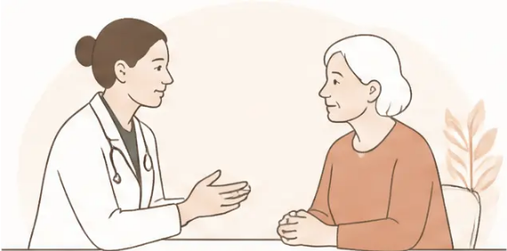









Communicating DNACPR Decisions — The Approach
Slide 11 | Bradford VTS
When to Discuss
Language Matters
Illness trajectory is uncertain
When prognosis is unclear and planning ahead matters
Patient or carer asks about CPR
Avoid These Phrases
Respond honestly and compassionately to the question raised
• "Are you happy with that?" — implies patient is granting consent
• "We're stopping everything" — DNACPR does not stop all care
Patient wants to be informed
• "Doing everything" — never describe CPR as this
When patient has stated they wish to know all healthcare decisions
Use These Instead
• "We will focus all our care on keeping you comfortable..."
When Discussion May Not Be Appropriate
• "Everything we do will be aimed at your comfort and dignity"
• Emphasise what the team WILL do — not what they won't
• Patient is clearly dying and has chosen comfort care
• Patient prefers not to discuss; has given authority to clinical team
DNACPR is not the end of care —
it is a redirection of care toward what matters most.
• Patient in terminal phase — harm of discussion outweighs benefit
Bradford VTS Teaching Deck
www.bradfordvts.co.uk
Created June 2026

Slide 12





Bradford VTS Teaching Deck — Deck 4 | End of Life Care
12 / 31
The Legal Status of a DNACPR Order
A DNACPR form is clinical advice — not a legally
binding document.
CRITICAL — UNLAWFUL PRACTICE
It guides the care team but cannot override a patient's
valid legal rights.
Blanket DNACPR notices
applied to groups of patients
are UNLAWFUL.
A competent patient wishing to refuse CPR should be
supported to make a formal ADRT — which IS legally
binding.
CQC Review 2021 and Parliamentary & Health
Service Ombudsman 2022 confirmed this
following COVID-era misuse.
The DNACPR form alone is not a substitute for a formal
Advance Decision.
Family members cannot legally override a clinical
DNACPR decision.
Every DNACPR decision must be:
Unless they hold a valid Health and Welfare Lasting
Power of Attorney.
✓ Made individually
✓ Documented clearly
Courts may be involved in complex disputes — but
routine decisions rest with the responsible senior
clinician.
✓ Communicated to the patient
Bradford VTS Teaching Deck
www.bradfordvts.co.uk
| Created June 2026

Slide 13







Bradford VTS Teaching Deck — Deck 4 | End of Life Care
13 / 31
The Role of Family and Relevant Others
Partners in care — not proxy decision-makers
Who counts as a 'relevant other'?
Relatives, carers, advocates, representatives, and welfare LPA holders.
When the patient has capacity
Family may only be involved with the patient's agreement.
Their consent is required before any discussion.
When the patient lacks capacity
Family can share information about the patient's previously
expressed wishes — they are a valuable source, not a decision-maker.
The critical legal point
Family members CANNOT legally override a clinical DNACPR decision
unless they hold a valid Health and Welfare LPA. The decision rests
with the most senior responsible clinician.
Involve family sensitively — they are partners in care, not proxy
decision-makers (unless LPA holder).
Bradford VTS Teaching Deck
www.bradfordvts.co.uk | Created June 2026

Slide 14


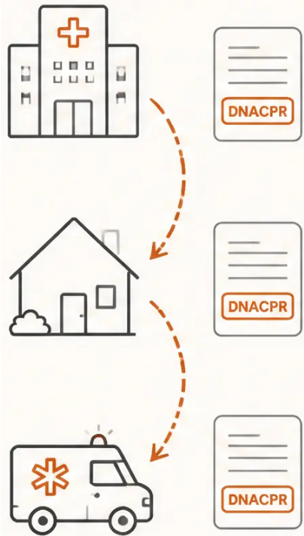








Bradford VTS Teaching Deck — Deck 4 | End of Life Care
DNACPR Documentation and Transfer
Getting the paperwork right — every setting, every handover
Maintaining the Form
• Must travel with the patient across all care settings
• Community DNACPR: family must know where the form is kept
• Out-of-hours services must be informed — proactively, not reactively
On Transfer of Care
• Receiving clinician must review and reconfirm or revoke
• Yorkshire/Humber regional agreement: black-and-white copies
acceptable, but the form following the patient must be the original
• Ambulance crews must have access — never assume it is known
Cancelling a DNACPR
• Mark the form with two diagonal lines
• Write "CANCELLED" clearly, then sign and date
• Do not destroy — retain in records for audit trail
UPDATED PRACTICE →
ReSPECT Form — Replacing Paper DNACPR in Many NHS Trusts
• Integrates DNACPR, preferred care, and treatment escalation plans in one document
• Reduces fragmentation — one conversation, one form, one plan that travels with the patient
Bradford VTS Teaching Deck
www.bradfordvts.co.uk
Created June 2026

Slide 15













Bradford VTS Teaching Deck — Deck 4 | End of Life Care
Slide 15 of 31
What is Currently Legal in the UK (2026)?
Know the boundaries — and how to advise patients confidently.
LEGAL
ILLEGAL
Advance Decisions to Refuse Treatment (ADRT)
Written, signed, witnessed refusal — legally binding
under MCA 2005
Physician-assisted dying / assisted suicide
Aiding or abetting suicide — up to 14 years
imprisonment (Suicide Act 1961)
Withdrawal / withholding of treatment
When judged not in the patient's best interests
Voluntary euthanasia
Intentional killing — unlawful regardless of
patient consent
Terminal / palliative sedation
Proportionate sedation for symptom control
Doctrine of double effect
Medication for symptom relief that may
incidentally hasten death — legal if intent is
symptom control
Assisting travel to die abroad
e.g., accompanying a patient to Dignitas —
legally complex; potential criminal liability
Voluntarily stopping eating and drinking (VSED)
Patient's autonomous decision; clinician
provides comfort care
The Terminally Ill Adults (End of Life) Bill passed the Commons in 2025 but failed in the
Lords — assisted dying remains illegal in the UK as of June 2026.
Bradford VTS Teaching Deck
www.bradfordvts.co.uk | Created June 2026

Slide 16








The Terminally Ill Adults (End of Life) Bill 2024–2026
Slide 16 of 31
The Terminally Ill Adults
(End of Life) Bill 2024–2026
What was proposed — and what happened
NOT LAW
October 2024 — Bill Introduced
Kim Leadbeater MP introduced the Terminally Ill Adults (End of
Life) Bill. It would have allowed terminally ill adults — expected
to die within 6 months — to request assisted dying, subject to
strict safeguards.
As of June 2026
• Mental capacity confirmed
Assisted dying remains
illegal in the UK
• Two independent doctors' approval
• High Court judicial review
• 14-day reflection period
June 2025 — Passed the House of Commons
The Bill passed all stages in the House of Commons and
moved to the House of Lords for scrutiny.
Aiding or abetting a suicide carries
up to 14 years imprisonment under
the Suicide Act 1961.
2025–2026 — Failed in the House of Lords
The Bill ran out of Parliamentary time and was not passed by
the House of Lords. Supporters have pledged to reintroduce
legislation in a future Parliament.
Do not raise assisted dying as a
clinical option — it is not currently
legal.
If a patient raises the topic: acknowledge
their distress, explain the current legal
position, and offer specialist palliative
care referral.
Focus on excellent symptom
control, dignity, and meeting
unmet needs.
Bradford VTS Teaching Deck — End of Life Care
www.bradfordvts.co.uk | Created June 2026

Slide 17













Bradford VTS Teaching Deck — End of Life Care
International Comparison
Assisted dying laws in context — for comparative understanding only
Switzerland
Oregon, USA
Netherlands
(Dignitas)
(Death with Dignity
& Belgium
Act, 1997)
ASSISTED SUICIDE –
NON-RESIDENTS PERMITTED
ASSISTED SUICIDE –
RESIDENTS ONLY
VOLUNTARY EUTHANASIA +
ASSISTED SUICIDE
Altruistic assistance is not
punishable. Over 400 Britons
have travelled over the years.
No residency requirement for
Dignitas clinic.
Terminal prognosis of six
months or less required.
Patient self-administers
medication. Residency and
capacity criteria apply.
Both legal with strict safeguards.
Netherlands extended to children
aged 12 and over. Belgium includes
psychiatric suffering as qualifying
condition.
Canada
United Kingdom
(MAID, 2016 /
(2026)
expanded 2021)
MEDICAL ASSISTANCE IN DYING (MAID)
ASSISTED DYING — NOT LEGAL
Available for grievous and
irremediable medical conditions.
Expanded significantly in 2021
beyond terminal illness.
Terminally Ill Adults Bill passed the
Commons (2025) but failed in the
House of Lords. Assisted dying
remains a criminal offence as of
June 2026.
Note: These legal systems reflect different cultural and ethical frameworks — they cannot be directly transplanted to UK practice.
Bradford VTS Teaching Deck
www.bradfordvts.co.uk
| Created June 2026

Slide 18














Bradford VTS Teaching Deck — Deck 4 | End of Life Care
Dying with Dignity
Core Values
Intrinsic worth
Every patient has value regardless of disability, prognosis, or dependency.
Unmet need, not a desire to die
A "request to die" is often pain, fear, loss of dignity, or feeling a
burden — each is addressable.
Relieving suffering, not preserving life at all costs
A doctor's primary role is comfort and care — not biological prolongation.
Patient-led palliative care
What does THIS patient value? Goals of care are theirs to define.
Clinical Principle
When a patient says 'I want to die' — explore the underlying meaning:
Pain /
symptoms
Depression /
fear
Feeling
a burden
Loss of
independence
Spiritual
crisis
Each is addressable. Never dismiss it as merely a desire for euthanasia.
Bradford VTS Teaching Deck
www.bradfordvts.co.uk
| Created June 2026

Slide 19








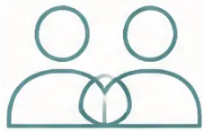

Bradford VTS Teaching Deck — End of Life Care
Making EOL Decisions
A Five-Step Clinical Framework
1
2
3
4
5
Assess Treatment
Success
Agree Patient
Outcomes
Limit to Quality
of Care
Involve the
Patient
Communicate
with Family
Realistic CPR survival?
What matters most
to this patient?
Appropriate
investigation and
intervention level
Shared decision-making
throughout
Sensitively, with
patient's consent
Future quality of life?
Useful opening question: ‘How do you see the future?’ — ‘Have you thought about where you’d like to be if things take a turn for the worse?’
Bradford VTS Teaching Deck
www.bradfordvts.co.uk
Created June 2026

Slide 20



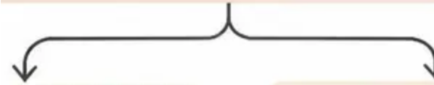








Bradford VTS Teaching Deck — End of Life Care
The Doctrine of Double Effect
— Explained
Clinical Scenario
Patient in final hours — intractable
pain and agitation
High-dose morphine and midazolam
syringe driver commenced
Ethical and legal justification for symptom relief that may
incidentally hasten death — when intent is everything.
An action intended to produce a good effect is ethically
permissible even if it foreseeably produces a bad effect —
provided the four conditions below are met.
Foreseen but
Unintended ⚠
Primary Intent ✓
Relieve pain and distress
May slightly hasten death
(evidence suggests
minimal difference)
Symptom control
➊ The action itself is not intrinsically wrong
Giving morphine for pain relief is a legitimate medical act
➋ The agent intends only the good effect
Intent is symptom control — not to hasten death
Ethical and Legal ✓
➌ The bad effect is not the means to the good
Provided intent is symptom control —
document clearly
Death does not cause the relief — relief comes from the medicine
➍ The good and bad effects are proportionate
Well-titrated palliative sedation does not significantly
hasten death — document intent at every step.
Symptom burden justifies the small risk of hastening death
Bradford VTS Teaching Deck
www.bradfordvts.co.uk | Created June 2026

Slide 21





Bradford VTS Teaching Deck — End of Life Care
21 / 31
Terminal and Palliative Sedation
Proportionate relief of suffering — ethical, legal, and carefully documented
Continuous Deep Sedation (CDS)
DEFINITION
Ethically permissible for refractory, intractable suffering
at end of life — requires careful justification and ongoing review.
Proportionate sedation to relieve
refractory suffering in patients who
are dying.
Must be distinguished from intentional killing
The clinical and ethical distinction lies entirely in
documented intent and proportionality.
Legal and ethical in the UK when the intent is
symptom control — governed by the doctrine
of double effect.
Family discussion is essential
Explain what CDS involves, why it is being used,
and what the patient will experience.
The intent must be symptom relief —
not to hasten death.
Documentation and review
Document clinical reasoning, intent, dose titration,
and regular reassessment — refer to NICE NG31
and local trust protocols.
Bradford VTS Teaching Deck
www.bradfordvts.co.uk | Created June 2026

Slide 22
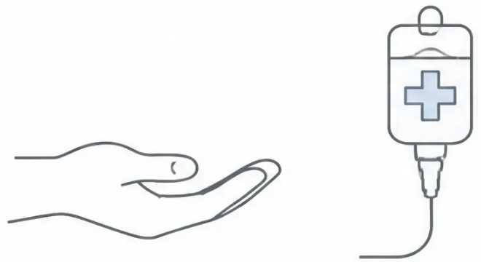


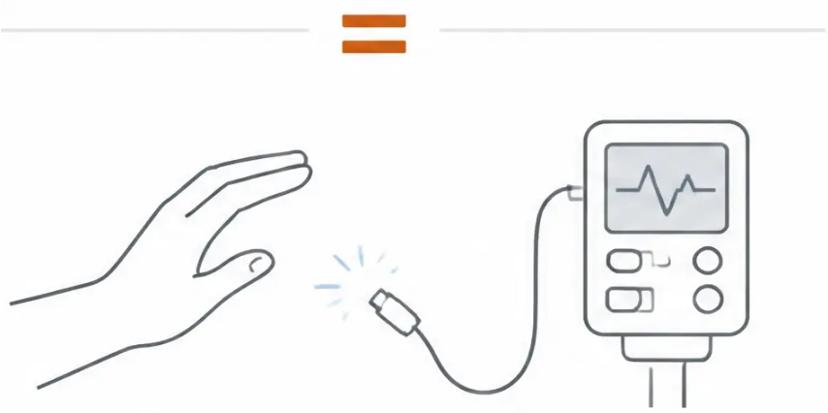

Bradford VTS Teaching Deck | End of Life Care
Slide 22 of 31
Withdrawing and Withholding Treatment
Legal and ethical equivalence — and why this matters clinically
Withdrawing and withholding treatment are
legally and ethically equivalent — neither
constitutes intentional killing.
Withdrawal of clinically ineffective or burdensome
treatment is both ethical and legal.
Not starting a treatment
Feeding and hydration may be withdrawn if not in
the patient's best interests.
Airedale NHS Trust v Bland [1993]; Mental Capacity Act 2005
'Killing vs Letting Die' — the legal distinction:
When treatment is withdrawn, the cause of death is the underlying
disease — not the clinical act of withdrawal.
There is no legal or ethical obligation to provide treatment
that only prolongs dying.
Stopping a treatment already started
Bradford VTS Teaching Deck
www.bradfordvts.co.uk
| Created June 2026

Slide 23
















Bradford VTS Teaching Deck — End of Life Care
23 / 31
Difficult Conversations — Framework
Using SPIKES and NURSE to guide honest, compassionate end-of-life discussions
SPIKES — Breaking Bad News Model
For DNACPR Discussions
Set Up
• Explain honestly what CPR involves and what it does not guarantee
Private space, no interruptions, sit at patient level
Perception
• Share realistic survival statistics —
“About 15 in 100 people survive to leave hospital”
“What do you understand about your illness so far?”
• Reassure clearly: “All other care continues —
this only relates to CPR”
Invitation
“How much detail would you like me to share today?”
• Focus on what you will provide: comfort, dignity,
symptom control, round-the-clock support
Knowledge
Share information clearly, in plain language,
without jargon — pause and check in
• Offer to return — “We don’t have to decide
everything today”
Emotions
Acknowledge and name the emotion —
“This is clearly very hard to hear”
Avoid: “Are you happy with that?” — it implies
the patient is granting consent.
Summary & Safety-net
Use instead: “I want to make sure you feel
heard and supported in this.”
Recap key points, confirm understanding,
agree next steps
NURSE model (for responding to emotion): Name • Understand • Respect • Support • Explore
Bradford VTS Teaching Deck
www.bradfordvts.co.uk
| Created June 2026

Slide 24








Bradford VTS Teaching Deck | End of Life Care
Self-Care for Clinicians
End-of-life conversations take an emotional toll — recognise it, name it, address it.
Reflect and Debrief
Build Your Support
Structure
Recognise Moral
Distress
• Balint groups, Significant
Event Analysis (SEA),
clinical supervision
• Formal communication
skills training — Breaking
Bad News courses, GSF
training
• Moral distress arises
when you cannot provide
the care a patient
deserves
• Debrief with colleagues
after difficult
consultations —
normalise this practice
• Know your own moral and
ethical positions; do not
impose them on patients
• Conscientious objection is
valid — but you must
refer, never abandon
You cannot pour from an empty cup — your wellbeing
directly affects the quality of care you deliver.
Bradford VTS Teaching Deck
www.bradfordvts.co.uk | Created June 2026

Slide 25
















Bradford VTS Teaching Deck — End of Life Care
Top Tips
Eight essential takeaways for safe, compassionate end-of-life practice
01 Explore what "I want to die" really means —
it is almost always a communication of
unmet need: pain, fear, or feeling a burden.
02 Never describe CPR as "doing everything" —
excellent palliative care is doing
everything.
03 Document DNACPR reasoning carefully —
include clinical basis, who was consulted,
and the decision-making process.
04 Blanket DNACPR notices are unlawful —
every decision must be made individually
and communicated to the patient.
05 Encourage competent patients refusing
CPR to make a formal ADRT — a DNACPR
form alone is not legally binding.
06 "Double effect" is legal — document your
intent clearly when titrating palliative
medicines for symptom control.
07 Assisted dying is NOT currently legal
in the UK (June 2026) — the bill passed
the Commons but failed in the Lords.
08 ReSPECT form replaces paper DNACPR
in many trusts — it integrates DNACPR,
treatment escalation, and preferred
care in one document.
Bradford VTS Teaching Deck
www.bradfordvts.co.uk | Created June 2026

Slide 26














Bradford VTS Teaching Deck — Deck 4
AKT Exam Pearls
EXAM PREPARATION
AKT Exam Pearls
High-yield facts for your Applied Knowledge Test
1. MCA 2005 — 5 Principles
2. Advance Decision (ADRT)
Capacity is presumed. Two-stage test:
impairment → can’t understand / retain /
weigh / communicate.
Must be written, signed, witnessed.
Must state “even if life is at risk.”
Legally binding under MCA.
3. DNACPR Form
4. CPR Survival Rate
Clinical advice only — NOT legally binding.
Individual decision required.
Never blanket.
In-hospital survival to discharge: ~15%.
TV portrays ~75%.
Share realistic figures with patients.
5. Doctrine of Double Effect
6. Blanket DNACPR — Unlawful
Legal if primary intent is symptom control.
Document intent clearly. Does not significantly
hasten death when well-titrated.
CQC 2021 + PHSO 2022: blanket DNACPR
notices declared unlawful.
Every decision must be individual.
7. Assisted Dying (UK 2026)
8. Human Rights Act — Art. 2
Right to life does NOT mandate futile CPR.
Supports appropriate DNACPR when
clinically justified.
NOT law. Bill passed Commons 2025,
failed in Lords.
Assisted dying remains illegal as of June 2026.
Bradford VTS Teaching Deck.
www.bradfordvts.co.uk | Created June 2026.

Slide 27

















Bradford VTS Teaching Deck — Deck 4 | End of Life Care
SCA Exam Pearls
SCA
Communication, consultation skills & documentation — what the examiner wants to see
Explore 'I want to die' with ICE
Reframe DNACPR positively
Always explore Ideas, Concerns and Expectations.
It is usually fear, pain, or feeling a burden — not a
desire for euthanasia.
Avoid 'stopping everything.' Frame it as a shift in
focus — toward comfort, dignity, and quality of care.
Say what you WILL do
Involve Palliative Care early
Always explain what you will provide: comfort,
symptom control, dignity, 24/7 support. Not just
what won't happen.
Don't wait for a crisis. Refer to Specialist Palliative
Care proactively — it signals excellent patient-
centred care.
ReSPECT is a process, not a form
Check the LPA before accepting family decisions
Build the ReSPECT conversation over several
consultations — it is not a single event.
Verify a valid health and welfare LPA before
treating family as proxy decision-makers.
Document capacity with reasoning
If patient raises Dignitas / assisted dying
Write your reasoning, not just your conclusion.
Show you applied the two-stage MCA test
explicitly.
Acknowledge their distress. Explain the current
legal position calmly. Offer specialist palliative
care referral.
Bradford VTS Teaching Deck
www.bradfordvts.co.uk | Created June 2026

Slide 28












Red Flags
Bradford VTS Teaching Deck | End of Life Care
Red Flags
Situations requiring urgent clinical or safeguarding attention
Patient reporting uncontrolled pain or distress
Family attempting to override patient's expressed wishes
May underlie an 'I want to die' request — explore fully
Capacitous patient's refusal of CPR is legally paramount
Blanket DNACPR applied without individual assessment
DNACPR form not travelling with the patient
Declared unlawful — CQC 2021, PHSO 2022
Ambulance crew and receiving teams must be aware
ADRT not recognised by new clinical team
on admission or transfer
Clinician failing to assess capacity before making
a best-interests DNACPR decision
Always check on every handover
Capacity must be assessed and documented
Patient travelling abroad for assisted dying without clinical team involvement
Raises safeguarding concerns — ensure team is involved
Bradford VTS Teaching Deck
www.bradfordvts.co.uk | Created June 2026

Slide 29













Bradford VTS Teaching Deck — Deck 4
End of Life Care
Common Pitfalls
Frequent errors that can compromise patient care — and your exam performance.
DNACPR means "do not treat"
"Poor prognosis" is enough documentation
It applies only to CPR — all other care, comfort,
and treatment continues.
Clinical reasoning must be explicit — prognosis
alone is not a sufficient justification.
Telling the family before the patient
Using double effect to justify euthanasia
A capacitous patient must be involved first — family
discussion follows, with patient consent.
Intent must genuinely be symptom relief —
not hastening death as the goal.
Dementia automatically means no capacity
Waiting for a crisis to start EOL conversations
Capacity is decision-specific and time-specific —
always assess for each individual decision.
These conversations should happen proactively,
well before the terminal phase.
Confusing "withdrawing treatment" with "killing"
Withdrawal of burdensome or ineffective treatment is legally and ethically distinct from intentional
killing — causation lies with the underlying disease.
Bradford VTS Teaching Deck
www.bradfordvts.co.uk
Created June 2026

Slide 30
















Bradford VTS Teaching Deck — End of Life Care
Quick Recall — Key Concepts
Essential facts for AKT and SCA revision — know these cold.
Term
Key Fact
MCA 2005
Five principles; capacity = ability to understand, retain, weigh, and communicate a decision
ADRT
Legally binding refusal; must be written, signed, witnessed; must state “even if life is at risk”
DNACPR
Clinical advice only — NOT legally binding; must be individual, never applied as a blanket policy
Double Effect
Legal when intent is symptom control; document the clinical intent clearly
CPR Survival
~15% survive to hospital discharge (in-hospital); TV portrays ~75% — correct patient expectations
Assisted Dying UK 2026
NOT law — Terminally Ill Adults Bill passed Commons 2025, failed in House of Lords
Blanket DNACPR
Declared unlawful — CQC 2021 and PHSO 2022; every decision must be individual
ReSPECT Form
Replaces paper DNACPR in many NHS trusts; integrates DNACPR, treatment escalation, and preferred care
Bradford VTS Teaching Deck
www.bradfordvts.co.uk | Created June 2026

Slide 31


Bradford VTS Teaching Deck — Deck 4
End of Life Care
Disclaimer & Resources
For educational use only — always apply to individual patient context
KEY GUIDELINES & RESOURCES
DISCLAIMER
➊ Mental Capacity Act 2005 and Code of Practice
Department of Health | Updated statutory guidance
This teaching deck is intended for
educational purposes only. Clinical
decisions must always be based on
individual patient assessment, current
national guidelines, and local trust
protocols. Content reflects guidance
available as of June 2026.
➋ BMA / Resuscitation Council (UK) / RCN Joint Statement on CPR Decisions
2021 update | Jointly published guidance
➌ NICE NG31: Care of Dying Adults in the Last Days of Life
National Institute for Health and Care Excellence | 2015
➍ GMC: Treatment and Care Towards End of Life
Good practice in decision making | 2010, with updated guidance
➎ CQC Report on Inappropriate DNACPR Notices
Care Quality Commission | 2021
Created June 2026 | Bradford VTS
➏ Parliamentary and Health Service Ombudsman Report
www.bradfordvts.co.uk
Blanket DNACPR during COVID-19 | 2022
Bradford VTS Teaching Deck | End of Life Care
www.bradfordvts.co.uk | Created June 2026

