Slide 1




BRADFORD VTS TEACHING DECK
Terminal Care and Anticipatory Prescribing
in Palliative Care
Updated to NICE NG31 (2015) and current BNF
June 2026
Disclaimer: Always double check this advice and drug doses with the
latest NICE/BNF guidance. This document is for educational purposes only.
www.bradfordvts.co.uk
Terminal Care & Anticipatory Prescribing | June 2026

Slide 2





Why Good Terminal Care Matters
The consequences of poor care — and the goal we should always aim for
When Care Goes Wrong
The Goal We Aim For
■ Patient and family unaware death is imminent —
no chance to say goodbye
Every person dies with dignity
■ Conflicting messages from different team
members cause confusion and distress
Symptoms are controlled with compassion
■ Symptoms go uncontrolled — pain, agitation,
breathlessness, secretions
Families are supported, informed,
and at peace
■ CPR initiated inappropriately — traumatic,
undignified death
■ Family left with complex grief, complaints,
and lasting trauma
www.bradfordvts.co.uk
Terminal Care & Anticipatory Prescribing | June 2026

Slide 3













Recognising the Dying Phase
NICE NG31 — Care of Dying Adults in the Last Days of Life
NICE NG31 — 2015
“If a person may be
entering the last
days of life...”
The multiprofessional team should agree together
that a patient may be entering the last days of life
Gather information across four domains:
...the team must agree,
assess, and act — together
Physiological
Social
Spiritual
Psychological
Dying is a clinical diagnosis — made with care,
compassion, and systematic assessment
Multiprofessional consensus
is essential
Terminal Care & Anticipatory Prescribing
www.bradfordvts.co.uk
Slide 3 of 24

Slide 4




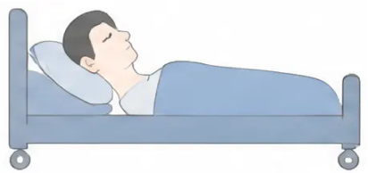
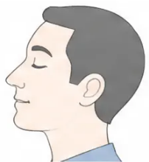
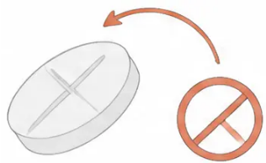




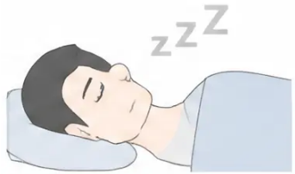

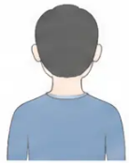


Clinical Indicators of the Dying Phase
Use clinical judgement — multiple signs are usually present together
Bedbound
Semi-conscious
Cannot Swallow Tablets
Unable to mobilise without full assistance
Only responsive to voice or touch
No longer able to take oral medication
Sips Only
Increasing Drowsiness
Withdrawn from Environment
Refusing food; accepting only sips of fluid
Sleeping most of the time; difficult to rouse
Profound fatigue; loss of interest in surroundings
No single sign is diagnostic — assess the whole clinical picture alongside the four NICE NG31 questions (see next slide)
www.bradfordvts.co.uk
Terminal Care & Anticipatory Prescribing | June 2026

Slide 5



Four Clinical Questions and Reversible Causes
NICE NG31 — Before diagnosing dying, ask and exclude
THE FOUR CLINICAL QUESTIONS
⚠️ MUST EXCLUDE BEFORE DIAGNOSING DYING (MID PHD)
1. Could this patient be entering the
last days of life?
Metabolic disturbance (uraemia, hyponatraemia)
Infection (e.g. UTI, pneumonia, sepsis)
Drug toxicity or opioid accumulation
2. Was this deterioration expected?
3. Is further life-prolonging treatment
inappropriate?
Pulmonary embolism or new acute illness
Hypercalcaemia
Dehydration
4. Have potentially reversible causes
been excluded?
Treat aggressively any reversible cause —
if consistent with the patient's wishes.
Source: NICE NG31 (2015)
Terminal Care & Anticipatory Prescribing |
www.bradfordvts.co.uk
Slide 5 of 24

Slide 6







Communication with Patients and Families
Honesty, clarity, and compassion in the dying phase
Talking to the Patient
Talking to the Family
• Use plain, honest language — explain
what is happening
• Be direct — do not use euphemisms
that create false hope
• Explore what matters most: place of
death, family presence, spiritual needs
• Explain what to expect: breathing
changes, reduced consciousness,
mottling
• Ask about unfinished business and
personal wishes
• Offer regular contact and a named
clinician to speak to
• Document their wishes clearly in
the care record
• Explain anticipatory medications —
they do not hasten death
Pitfall to avoid: Never give conflicting messages — appoint one lead clinician
to communicate with the family throughout.
www.bradfordvts.co.uk
Terminal Care & Anticipatory Prescribing
Slide 6 of 24 | June 2026

Slide 7







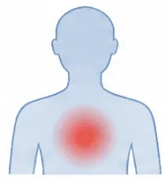

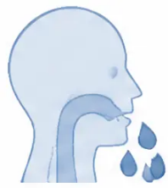
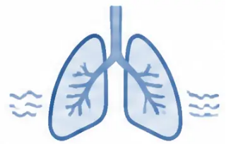
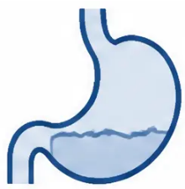
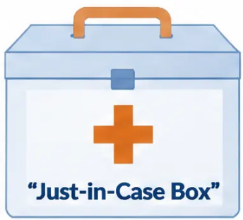
Anticipatory Medications: The Just-in-Case Box
NICE NG31
Recommended
Prescribing ahead — so symptoms are controlled the moment they arise
Anticipatory medications are prescribed in advance for symptoms commonly occurring in
the last days and hours of life. They allow community nurses — or trained family members —
to give relief immediately, without waiting for a new prescription or GP visit.
NICE NG31 recommends these for all patients identified as dying at home or in a care home.
Pain
Agitation
Secretions
Breathlessness
Nausea
Morphine /
Diamorphine
Midazolam
Hyoscine
Butylbromide
Morphine /
Diamorphine
Haloperidol
www.bradfordvts.co.uk
Slide 7 of 24
Terminal Care & Anticipatory Prescribing | June 2026

Slide 8






















The Standard Five Anticipatory Medications
The "Just-in-Case Box" — prescribed in advance for symptoms in the last days of life
Morphine or Diamorphine
SC injection · PRN dose =
1/6 of total daily opioid
Diamorphine preferred in
syringe driver — more soluble
PAIN
AGITATION
Midazolam
SC injection · 2.5–5 mg PRN
every 2–4 hours
Max 20 mg/24 hr initially;
seek specialist advice above this
Haloperidol
SC injection · 1.5–3 mg PRN
Max 5 mg/24 hr via
syringe driver
NAUSEA
Hyoscine Butylbromide
(Buscopan)
SC injection · 20 mg PRN
every 4 hours
Max 120 mg/24 hr via
syringe driver
SECRETIONS
Morphine or Diamorphine
SC injection · As for pain —
same prescription
One prescription covers both
pain and breathlessness
BREATHLESSNESS
All SC routes: many uses are off-label but endorsed by
NICE NG31 and local palliative medicine consultants.
Document when prescribing.
www.bradfordvts.co.uk
Terminat Care & Anticipatory Prescribing | Slide 8 of 24

Slide 9






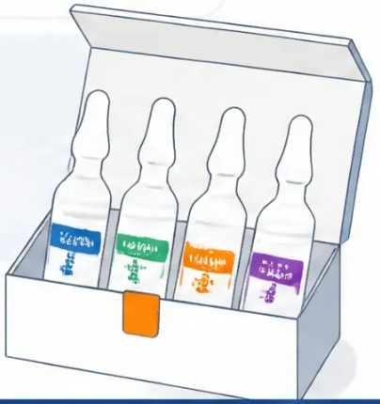


Standard Prescription and SC Administration
Example ampoule quantities · Morphine vs Diamorphine · Local formulary notes
Morphine or Diamorphine?
Standard Just-in-Case Prescription
Diamorphine is more soluble — preferred in syringe
drivers where multiple drugs are mixed. Some areas
now use SC morphine instead. Always check your
local formulary.
Morphine 10mg/ml injection 5 x 1ml ampoules
(or: Diamorphine 5mg — 5 x 5mg ampoules
+ water for injection 10 x 10ml)
Off-Label but Best Practice
Most SC uses here are outside product licence.
They are endorsed by NICE NG31 and local
palliative medicine consultants. Document this
when prescribing.
Midazolam 5mg/ml injection 5 x 2ml ampoules
(= 10mg per ampoule)
Haloperidol 5mg/ml injection 5 x 1ml ampoules
PRN Frequency Rule
SC morphine or diamorphine should not be given
more frequently than every 2 hours without
medical review. Document every dose given.
Hyoscine butylbromide 5 x 1ml ampoules
20mg/ml injection
www.bradfordvts.co.uk
Terminal Care & Anticipatory Prescribing | Slide 9 of 24

Slide 10















Dose Calculations: PRN and Syringe Drivers
Converting oral morphine → subcutaneous diamorphine
A — Oral Morphine PRN
B — SC Diamorphine PRN
C — CSCI Diamorphine/24hr
D — PRN from Driver Dose
Total daily oral morphine ÷ 6
PRN oral morphine dose ÷ 3
Total daily oral morphine ÷ 3
CSCI diamorphine dose ÷ 6
= diamorphine in syringe
driver / 24hr
= PRN oral morphine dose
= SC diamorphine PRN dose
= SC diamorphine PRN dose
MST 30mg BD = 60mg/day
10mg oral morphine PRN
MST 30mg BD + 3 × 10mg PRN used
90mg diamorphine/24hr CSCI
60 ÷ 6 = 10mg oral morphine PRN
60 + 30 = 90mg ÷ 3 =
90 ÷ 6 = 15mg diamorphine PRN
10 ÷ 3 = 3.3mg → round to 2.5–5mg SC
30mg diamorphine CSCI
💡 The two key numbers: oral → SC diamorphine = ÷ 3 | any daily dose → PRN = ÷ 6
⚠️ SC morphine/diamorphine PRN: do not repeat more frequently than every 2 hours without medical review
www.bradfordvts.co.uk
Slide 10 of 24
Terminal Care & Anticipatory Prescribing | June 2026

Slide 11




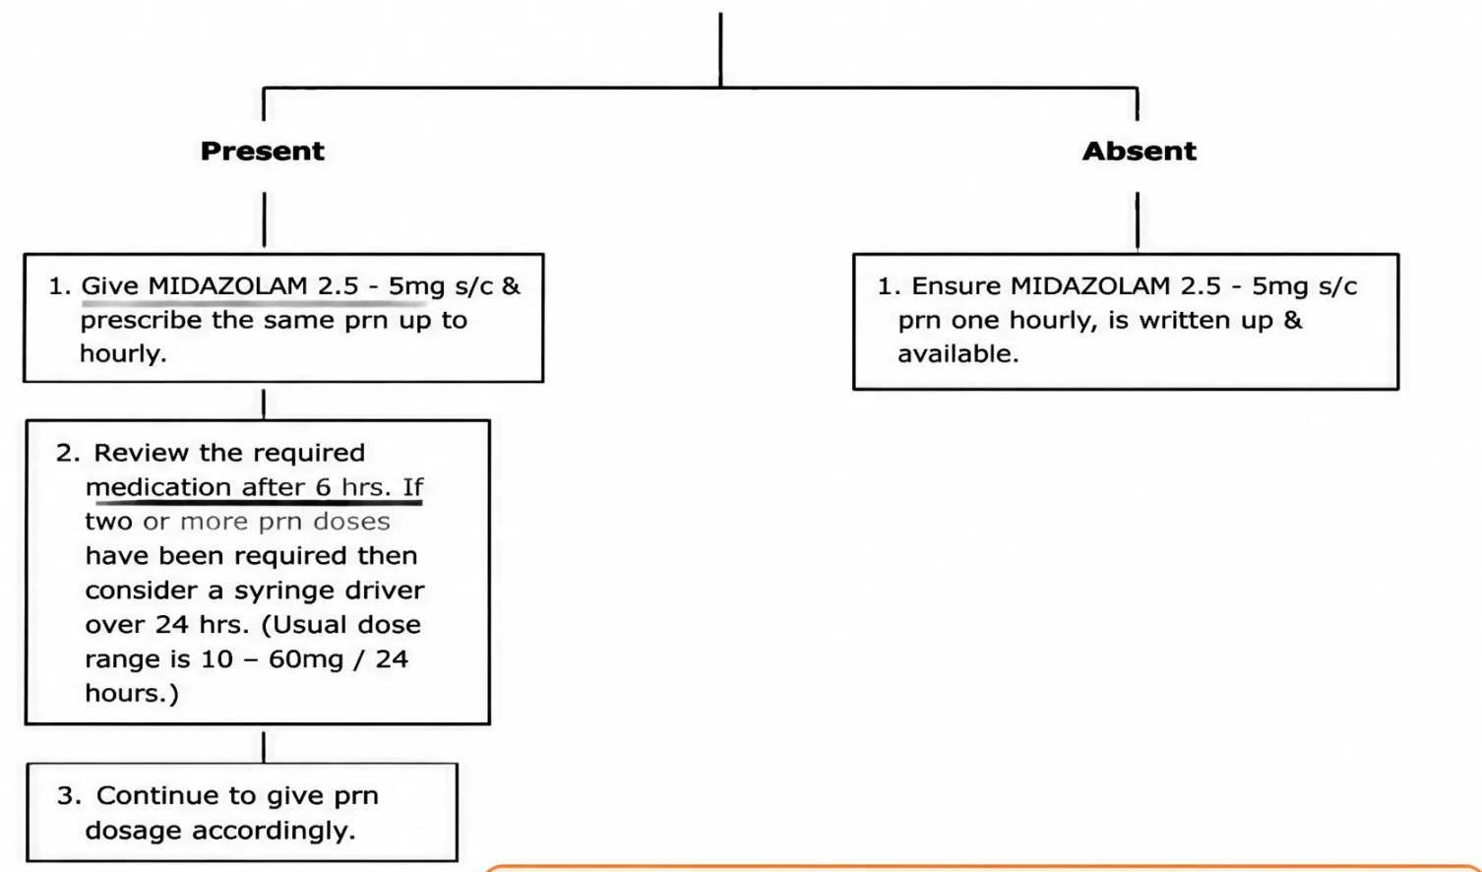

Managing Terminal Restlessness and Agitation
Assess first — treat the cause, not just the symptom
Midazolam Management Pathway
EXCLUDE FIRST
Urinary retention (most common —
catheterise if suspected)
Constipation / overflow
Uncontrolled pain (use PAINAD tool)
Opioid toxicity (reduce, don't increase)
Respiratory distress
Metabolic causes
Refractory agitation: Seek specialist palliative
care input urgently.
(hypercalcaemia, uraemia)
Levomepromazine 12.5–25mg SC may be considered. Continuous
sedation only after full specialist assessment.
Anxiety / psychological distress
Only prescribe Midazolam once
reversible causes are addressed
www.bradfordvts.co.uk
Terminal Care & Anticipatory Prescribing
June 2026

Slide 12



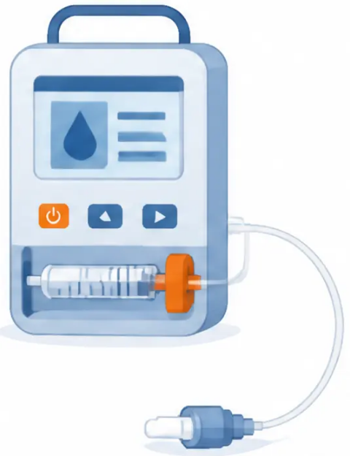


Managing Pain in the Last Days
Non-verbal assessment • Subcutaneous opioids • Syringe driver
Assessing Pain Without Words
Subcutaneous Opioids
◆ Watch for facial grimacing, furrowed brow,
or clenched jaw on touch or movement
◆ Give morphine or diamorphine SC PRN
at the pre-calculated dose (1/6 of total
daily opioid)
◆ Note restlessness, guarding, or rigid posture —
these signal pain even in unconscious patients
◆ Allow minimum 2 hours between SC PRN
doses — document every dose given
◆ Listen for vocalisation — moaning, groaning,
or gasping during care
◆ Start a syringe driver (CSCI) when ≥3 PRN
doses are needed in 24 hours — or when
the patient can no longer swallow
◆ Use the PAINAD scale (Pain Assessment in
Advanced Dementia) as a structured
observational tool
◆ A syringe driver is not giving up — it is the
most reliable way to maintain continuous
comfort
Never withhold analgesia because a patient
cannot communicate their pain
A syringe driver does not mean the end of active care — explain to families that it
simply delivers medication continuously so the patient stays comfortable without
needing to swallow tablets
www.bradfordvts.co.uk
Terminal Care & Anticipatory Prescribing
12 / 24

Slide 13
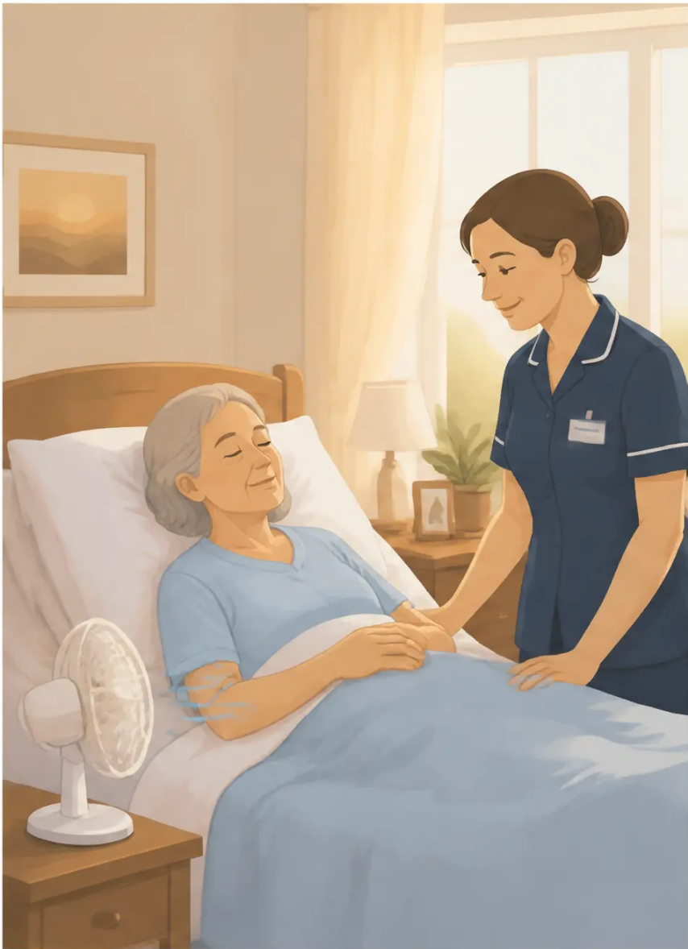












Managing Breathlessness
Last days of life — reducing distress, not hastening death
Non-Drug First
Fan or open window
Upright positioning
Calm reassurance
Air movement reduces the
sensation of breathlessness —
evidence-based
Sitting forward reduces
effort of breathing
Anxiety amplifies
breathlessness — a calm
presence helps
Morphine or Diamorphine SC
Medication
Midazolam SC
2.5–5mg PRN
2.5–5mg PRN
• Reduces perception of respiratory distress
• For breathlessness with anxiety or
panic component
• Does NOT hasten death when used
appropriately
• Often combined with low-dose
morphine for best effect
Oxygen has a weak evidence base in the dying phase — only use it if
the patient finds it subjectively helpful. A fan is usually more effective.
www.bradfordvts.co.uk
Terminal Care & Anticipatory Prescribing | Slide 13 of 24

Slide 14


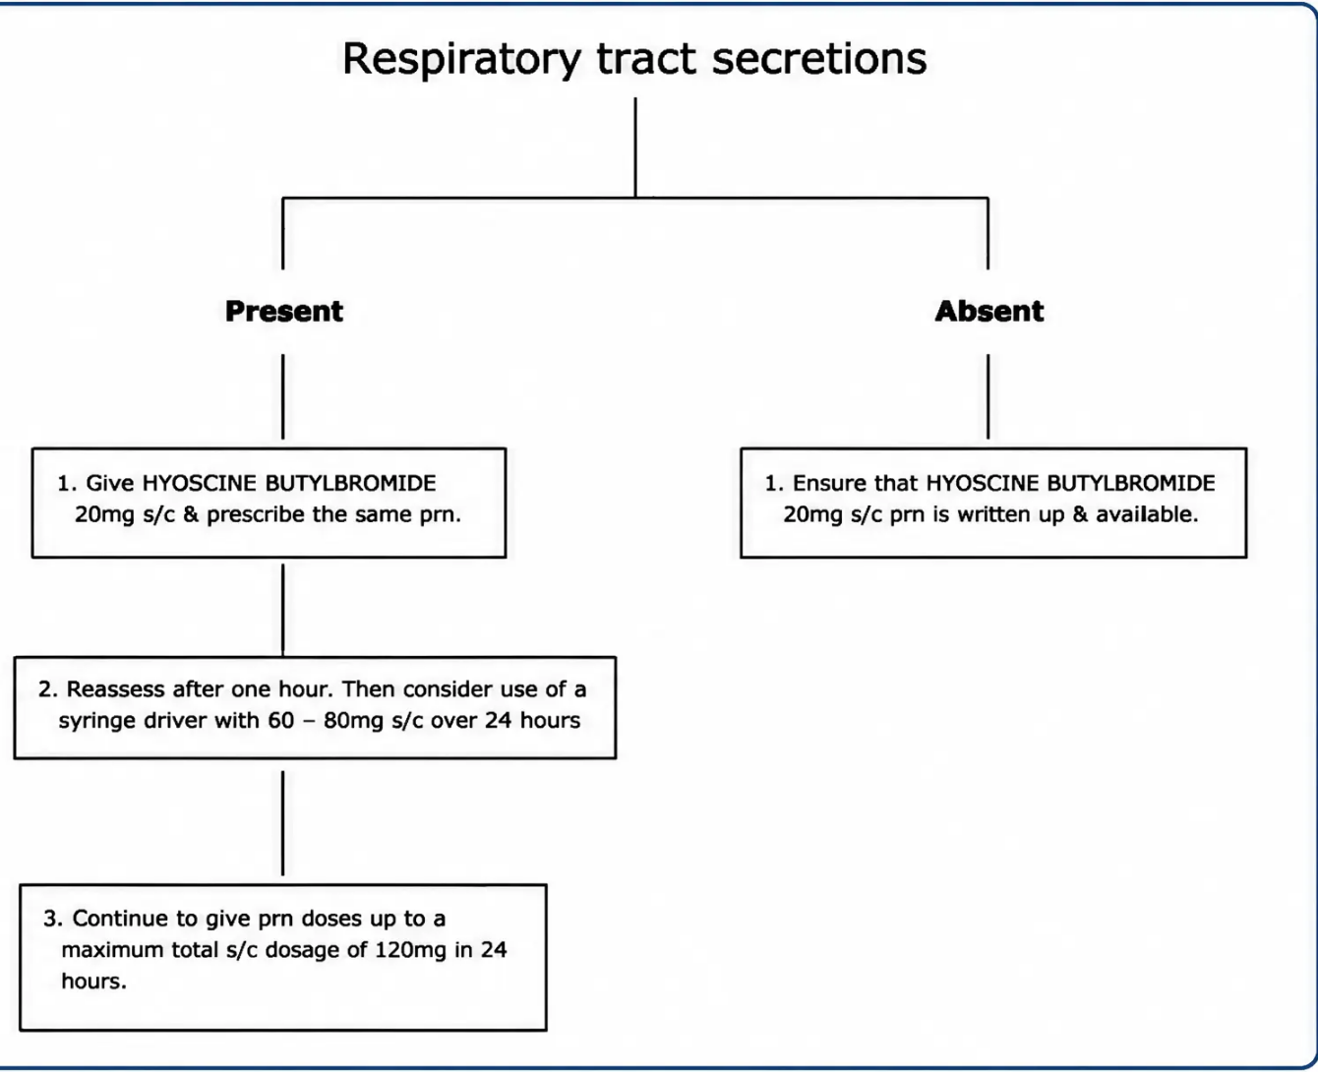





Managing Noisy Respiratory Secretions
Clinical Decision Flowchart — Respiratory Tract Secretions
"Death Rattle" — Assessment, Communication & Management
Reassure the Family First
• The noise is caused by throat muscles relaxing —
not by drowning or distress
• This is distressing to hear but the patient
is unaware of it
Repositioning
• Turn patient to lateral (recovery) position —
allows secretions to drain naturally
Hyoscine Butylbromide (Buscopan)
• 20mg SC PRN every 4 hours — reduces
secretion production
• CSCI (syringe driver): 60–120mg over 24 hours
• Alternative: Hyoscine hydrobromide 400mcg
SC PRN (sedating — suits some patients)
Do NOT suction the oropharynx —
it is distressing and usually ineffective
Terminal Care & Anticipatory Prescribing
www.bradfordvts.co.uk
Slide 14 of 24

Slide 15














Managing Nausea and Vomiting
Last Days of Life — Symptom Control
Assess the cause first:
Opioid-induced
Metabolic (e.g.
hypercalcaemia, uraemia)
Raised intracranial
pressure
Bowel obstruction
FIRST-LINE
IF HALOPERIDOL INSUFFICIENT
● Haloperidol
● Levomepromazine
PRN: 1.5–3 mg SC as needed
PRN: 6.25 mg SC as needed
CSCI (24 hr driver): 2.5–5 mg/24 hr
CSCI (24 hr driver): 5–12.5 mg/24 hr
Best for: opioid-induced nausea,
metabolic causes
Broad antiemetic — also sedating
Useful when multiple causes or
refractory nausea
Antidopaminergic — works on
chemoreceptor trigger zone
Clinical tip: Both drugs can be combined in a syringe driver with morphine or diamorphine —
check compatibility before mixing. Always reassess if nausea persists despite treatment.
Terminal Care & Anticipatory Prescribing
June 2026
www.bradfordvts.co.uk
Slide 15 of 24

Slide 16







Clinically Assisted Hydration (NICE NG31)
What to consider — and how to talk about it
When to Consider Hydration
When It May Not Help
• Dehydration may be contributing to
distressing symptoms such as agitation,
confusion, or dry mouth
• Reduced food and fluid intake is a natural
part of the dying process — the body is
shutting down, not starving
• A short trial of subcutaneous or intravenous
fluids is reasonable if the patient has capacity
to request it or family and team agree it may
help
• Excess fluids in the dying phase can worsen
respiratory secretions, oedema, and
discomfort
• Oral hygiene and mouth care should always
accompany any decision — they are as
important as a drip
• A drip does not extend life in the dying phase
• Starting fluids solely because the family
requests it — without clinical indication —
is not recommended
• NICE NG31: clinically assisted hydration is
not mandatory — clinical judgment must
guide the decision
Talking to families:
“The body naturally reduces its need for food and fluids as part of dying — this is not causing
suffering. A drip won’t change what is happening, but if you feel it would help your peace of
mind, we can discuss a short trial and review it together.”
Terminal Care & Anticipatory Prescribing
www.bradfordvts.co.uk
Slide 16 of 24

Slide 17

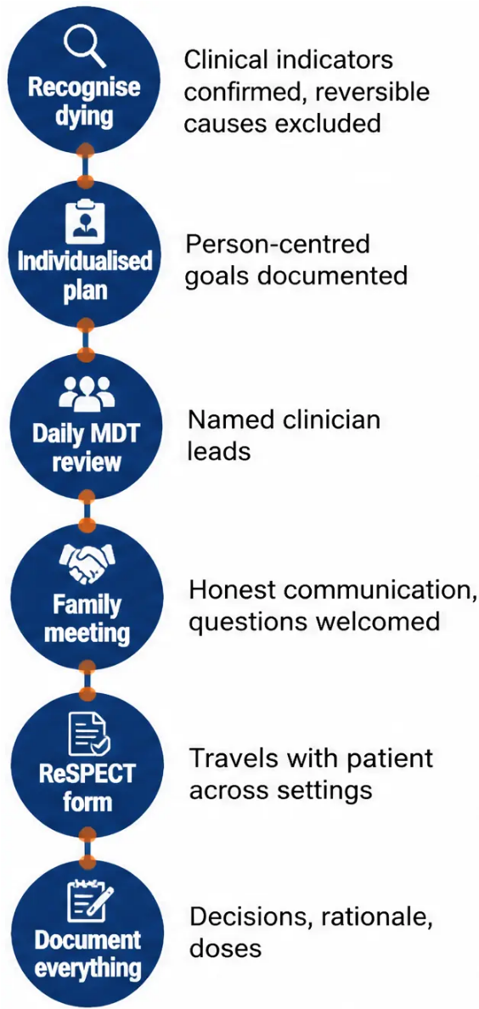


The Individualised Care Plan for Dying
Replacing the LCP — NICE NG31 (2015) gold standard
WHY THE LCP (LIVERPOOL CARE PLAN) WAS WITHDRAWN
The Liverpool Care Pathway was withdrawn in 2013 following the
Neuberger Review — not because it was harmful, but because of
poor implementation and lack of individualisation.
WHAT REPLACED IT
NICE NG31 (2015) mandates an individual, person-centred care plan —
reviewed daily, tailored to the person’s physical, psychological, social
and spiritual needs.
KEY COMPONENTS
• Named responsible clinician overseeing the care plan
• Regular MDT review and family communication — at least daily contact offered
• ReSPECT form completed and travels with the patient across all settings
• All decisions, discussions and rationale clearly documented in the medical record
THE CORE PRINCIPLE
Every plan is unique to that person. There is no tick-box checklist —
only thoughtful, documented, compassionate care.
Key message: The LCP was not bad care — it was badly implemented.
NICE NG31 replaced it with something better: genuine individualisation.
www.bradfordvts.co.uk
Terminal Care & Anticipatory Prescribing | Slide 17 of 24

Slide 18











Top Tips for Terminal Care
Essential practice points for GP trainees
01
02
03
04
Prescribe before
you need to
Always rule out
the treatable
Explain the
pump clearly
Opioids don't
hasten death
Anticipatory meds must be in
the home before crisis hits –
not ordered at 2am
Agitation? Check for urinary
retention, constipation,
uncontrolled pain first
"It keeps medicine going
continuously – the kindest
way to stay comfortable"
Appropriate doses for pain and
breathlessness: do not shorten
life – evidence is clear
05
06
07
08
Don't forget
the mouth
Invest in family
communication
Explain the rattle
early
Record every
decision
Dry mouth is one of the most
distressing symptoms – oral
swabs, ice chips, lip balm
Prepare them for what dying
looks like – breathing
changes, mottling, jaw relaxing
"This is not distressing your
dad – it's the throat relaxing.
He doesn't know."
Every discussion, every dose,
every family conversation –
dated, timed, signed
www.bradfordvts.co.uk
Top Tips for Terminal Care
Terminal Care & Anticipatory Prescribing | June 2026

Slide 19









AKT Exam Pearls
AKT
High-yield facts for the Applied Knowledge Test
These are the facts that appear repeatedly in AKT questions on palliative care — know them cold.
01
02
NICE NG31 (2015)
The Four Anticipatory Medications
Current gold standard for care of dying adults in the last days of life
Morphine / Diamorphine · Midazolam · Haloperidol · Hyoscine butylbromide
03
04
SC Diamorphine PRN = Oral Morphine PRN ÷ 3
SC Diamorphine CSCI / 24hr = Total Oral Morphine / 24hr ÷ 3
Converting from oral to subcutaneous route
For syringe driver calculations
05
06
PRN SC Opioid Frequency
Midazolam SC PRN
Do NOT give more frequently than every 2 hours
without medical review
2.5–5 mg SC PRN for agitation or breathlessness ·
Max 20 mg/24hr initially
07
08
Hyoscine Butylbromide SC PRN
Liverpool Care Pathway — withdrawn 2013
Neuberger Review → replaced by NICE NG31
individual care plans
20 mg SC PRN every 4 hours for respiratory secretions
⚠ Reversible causes must be excluded before diagnosing dying — this principle appears in both AKT and clinical practice
www.bradfordvts.co.uk
Terminal Care & Anticipatory Prescribing · Slide 19 of 24

Slide 20













SCA Communication Pearls
What to say — and how to say it
SCA — Consultation Skills
Explaining the Syringe Driver
Explaining Respiratory Secretions
Explaining Anticipatory
Medications
“This pump keeps giving medicine
continuously under the skin, so your
mum doesn't have to take tablets she
can't swallow — it's the kindest way to
keep her comfortable.”
“The noise you can hear is just the
throat muscles relaxing — it is not
causing any distress. Your dad
doesn't know this is happening.”
“We're writing up some medicines just
in case — so the nurses don't have to
wait if your wife gets uncomfortable. It
doesn't mean we expect her to need
them.”
Addressing “Are You Giving Up?”
Explaining Opioids and Death
“We're not giving up on your mum at
all. We're making sure she has
everything she needs to be as
comfortable as possible. Her body is
shutting down naturally.”
“The medicines we give won't speed
up dying. Research shows they don't.
They're just there to make sure
there's no suffering.”
www.bradfordvts.co.uk
Slide 20 of 24
Terminal Care & Anticipatory Prescribing | June 2026

Slide 21













Red Flags in Palliative Care
Act promptly — these signs demand immediate clinical review
Agitation Escalating
Despite Midazolam
Family Requesting CPR —
DNACPR in Place
Review for urinary retention, opioid toxicity,
uncontrolled pain — seek specialist
palliative care input urgently
Urgent family meeting required — recheck
documentation, communicate clearly and
compassionately
Rapidly Escalating
Opioid Requirements
Sudden Unexpected
Improvement
Consider opioid-induced hyperalgesia or
toxicity — reduce dose, consider opioid
rotation, seek specialist advice
May indicate a reversible cause not yet
identified — reassess urgently before
confirming diagnosis of dying
When in doubt — stop, reassess, and escalate to specialist palliative care
www.bradfordvts.co.uk
Terminal Care & Anticipatory Prescribing | June 2026

Slide 22














Common Pitfalls to Avoid
Errors that cause avoidable suffering — learn to recognise them
Midazolam first,
questions later
Delaying anticipatory
prescribing
Still using the Liverpool
Care Pathway
Prescribing midazolam for agitation
without excluding urinary retention,
constipation, or uncontrolled pain first
Waiting until a crisis at 2am before
writing up the just-in-case box —
causes avoidable suffering
The LCP was withdrawn in 2013.
Use individual, person-centred
care plans per NICE NG31
No preparation for what
dying looks like
Continuing unnecessary
medications
Forgetting mouth care
Saying "medicines will keep them
comfortable" without explaining
breathing changes, mottling, colour
change, jaw relaxation
A dry mouth causes significant
distress even in apparently
unconscious patients — oral
swabs, ice chips, lip balm are
essential
Stop statins, antihypertensives,
oral hypoglycaemics, iron, vitamins —
keep only symptom control drugs
💡 The golden rule: If in doubt — assess first, medicate second. Document everything.
www.bradfordvts.co.uk
Terminal Care & Anticipatory Prescribing
Slide 22 of 24 | June 2026

Slide 23













Quick Recall Summary
Everything you need to remember — in one place
Recognising Dying
The Four Anticipatory Drugs
● Bedbound + semi-conscious
● 💊 Morphine / Diamorphine — pain & breathlessness
● 💊 Midazolam — agitation & anxiety
● Sips only — refusing food & tablets
● 💊 Haloperidol — nausea
● Increasing drowsiness / profound fatigue
● 💊 Hyoscine butylbromide — secretions
● NICE NG31: exclude reversible causes first
Dose Calculations
Core Principles
● LCP withdrawn 2013 → use NICE NG31 individual care plans
● SC diamorphine CSCI = oral morphine total ÷ 3
● PRN diamorphine = CSCI dose ÷ 6
● Prescribe anticipatories before crisis
● Mouth care = essential, every patient
● PRN oral morphine = total daily oral ÷ 6
● Opioids in correct doses do not hasten death
● PRN SC: not more than every 2 hours
● Syringe driver = comfort, not giving up
Terminal Care & Anticipatory Prescribing
www.bradfordvts.co.uk
Slide 23 of 24 | June 2026

Slide 24



BRADFORD VTS TEACHING DECK
Final Disclaimer and Guidance
Please read carefully before clinical application
This teaching deck is produced for educational purposes only and is intended for use by GP
trainees and healthcare professionals in a supervised learning context.
The clinical information, drug doses, and prescribing guidance contained in this presentation are based on
NICE NG31 (2015) — Care of Dying Adults in the Last Days of Life — and the British National Formulary (BNF)
as current at the time of production (June 2026).
Always verify all drug doses, routes of administration, and clinical recommendations against the most current
version of the BNF and relevant NICE guidance before applying to individual patients. Clinical guidelines are
subject to revision; local formularies and palliative care protocols may differ from the information presented here.
This material does not constitute personal medical advice and should not replace clinical judgment, specialist
palliative care input, or individualised patient assessment. For complex or refractory symptom management,
always seek input from your local specialist palliative care team.
Adapted and updated for Bradford VTS educational use, June 2026.
Key Reference: NICE NG31 — Care of Dying Adults in the Last Days of Life (2015) — nice.org.uk/guidance/ng31
Drug Doses: British National Formulary (BNF) — bnf.nice.org.uk
www.bradfordvts.co.uk
www.bradfordvts.co.uk
Terminal Care & Anticipatory Prescribing | Bradford VTS Teaching Deck
June 2026 | Slide 24 of 24

