Slide 1


BRADFORD VTS TEACHING DECK
Adolescent
Gynaecology
What You Need to Know
in Primary Care
Created May 2026
Updated to current NICE 2024/2025 standards
www.bradfordvts.co.uk
⚠️ For educational purposes only. Always verify with current
NICE/BNF guidance.
www.bradfordvts.co.uk

Slide 2

BRADFORD VTS TEACHING DECK
www.bradfordvts.co.uk
Attribution & Source Information
Source Material:
Adolescent Gynaecology — GP Training Teaching Deck
Original Source:
RCGP Learning / Dr Emma Park
Processed and Updated: May 2026
Clinical Currency: Updated to current NICE 2024/2025 standards, including NICE
NG88 (2024 surveillance), NICE CKS November 2024, and NICE NG23 (2024)
*Clinical guidelines underpinning this deck:
NICE NG88
NICE CKS HMB
NICE CKS PCOS
NICE CKS Amenorrhoea
NICE CKS Dysmenorrhoea
BritSPAG
BNF Current
⚠️ For educational purposes only. Always verify with current NICE/BNF guidance before clinical application.
2 / 30

Slide 3





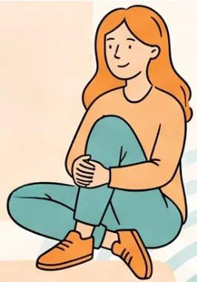
Why a Different Approach to Adolescents?
Adolescent Health Principles · GP Training
Brain development
continues to age 25
Long-term conditions
emerge now
11.7 million
Risk-taking and decision-
making still maturing
First signs appear in
adolescence
young people aged
10–24 in the UK
Health behaviours
are set for life
Gynaecological
problems are common
= 1 in 5 of the population
This is the window for
lasting impact
Serious pathology is rare —
but distress is real
Contraception may take priority over diagnosis — always personalise your approach

Slide 4





Consulting Skills with Young Women
Practical principles for every consultation
Offer Time Alone
Normalise Screening
Avoid Unnecessary VE
Cultural Sensitivity
Always offer to see the
young person without
parents or carers present
— even briefly. Make it
routine, not exceptional.
Frame STI and pregnancy
screening as standard
practice: “This is
something I offer all young
people your age —
nothing to worry about.”
Vaginal examination is
rarely needed. Prefer self-
swab, HVS, or pelvic
ultrasound. Minimise
invasive procedures —
physical and emotional
impact matters.
Consider fertility
implications and cultural
context. Acknowledge
concerns about
contraception, family
expectations, and
confidentiality with
sensitivity.
www.bradfordvts.co.uk

Slide 5

Heavy Menstrual Bleeding:
Definition and Causes
NICE NG88 · Updated 2024
Causes in Adolescents
Anovulatory Cycles
DEFINITION
Most common cause • HPO axis immature in first 2 years post-menarche
Excessive menstrual blood loss
that interferes with quality of life
Bleeding Disorders
von Willebrand disease — more common in adolescents than adults 🚩
• Duration greater than 7 days
• Changing super pad or tampon more
than every 2 hours
• Or causing symptomatic anaemia
Pregnancy / STIs
Always exclude • STI screen and pregnancy test mandatory
Hormonal Causes
Hormonal contraception • Stress • Significant weight change
Key: the patient's experience and quality of life
defines HMB — not a volume measurement
Systemic / Endocrine
Structural Lesions
Fibroids, polyps — very rare in this age group
Bleeding disorders are disproportionately common in
adolescent HMB — always consider von Willebrand disease,
especially at first presentation or with family history.
Menorrhagia
Bradford VTS • Adolescent Gynaecology • www.bradfordvts.co.uk

Slide 6







Heavy Menstrual Bleeding: Investigations
NICE NG88 · Updated 2024
Full Blood Count
Clotting Screen
STI Screen
Screen for iron-deficiency
anaemia
Essential at first presentation or with family history
of bleeding — consider von Willebrand disease
Always offer — normalise as
routine for all young women
Pregnancy Test
TFTs · Ferritin
Ultrasound
Always exclude pregnancy —
urine or serum HCG
If clinically indicated — thyroid disease
or iron depletion suspected
NOT routine — only if
structural cause suspected
Bleeding disorders — including von Willebrand disease — are more common in adolescents
with HMB than in adults. Don't skip the clotting screen at first presentation.
Clinical Tip
Bradford VTS · Adolescent Gynaecology
6 / 30
www.bradfordvts.co.uk

Slide 7





NICE NG88 · Updated 2024
Heavy Menstrual Bleeding: Management
Treatment options — in order of preference
FIRST LINE — PREFERRED
NON-HORMONAL OPTIONS
IF CONTRACEPTION ACCEPTABLE
LNG-IUS (Mirena)
Tranexamic Acid
Hormonal Options
OR Mefenamic Acid (NSAID)
Preferred 1st-line hormonal option
1 LNG-IUS (already covered — 1st choice)
2 Combined Oral Contraceptive (COC)
3 Depo-Provera (injectable progestogen)
Try each for 3-6 months before changing
If no contraception required
• Also provides contraception
• Reduces blood loss by up to 90%
• Try for 3-6 months before reassessing
• Tranexamic acid 1g QDS during menses only
• Mefenamic acid 500mg TDS during menses
• Take at onset of period — not continuous
NICE NG88
www.bradfordvts.co.uk
⚠️ Refer if no improvement after primary care management

Slide 8


PCOS: Definition and Prevalence
NICE CKS PCOS — current 2024
DEFINITION
6–10%
A complex endocrine disorder linked to insulin
resistance and metabolic syndrome — the most common
hormonal condition in women of reproductive age.
of women of reproductive age
CAUSE
affected by PCOS
Multifactorial — genetic and environmental factors
interact. Not a single disease, but a syndrome with a
spectrum of presentations.
IMPORTANT
Prevalence and severity are higher in South Asian
women — consider this when assessing risk and
communicating diagnosis.

Slide 9




NICE CKS PCOS · Current 2024
PCOS: Rotterdam Criteria
Diagnosis requires 2 of 3 criteria — not all three
2 out of 3 criteria required for diagnosis
01
02
03
Irregular or Absent Ovulation
Hyperandrogenism
Polycystic Ovaries on USS
Oligomenorrhea or amenorrhea
Infrequent or absent menstrual cycles
Clinical: hirsutism, acne, alopecia
Biochemical: raised testosterone
≥12 follicles (2-9mm) per ovary
OR ovarian volume >10mL
Important: Polycystic ovaries on USS alone do NOT make the diagnosis. You can diagnose PCOS without polycystic ovaries on scan.
Bradford VTS Teaching Deck · Adolescent Gynaecology
www.bradfordvts.co.uk

Slide 10



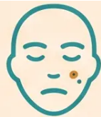
PCOS: Adolescent Pitfalls
NICE CKS PCOS · Current 2024
USS Unreliable
Early On
Anovulation
≠ PCOS (Yet)
Acne Alone
≠ PCOS
High follicle counts are
NORMAL post-menarche.
Ultrasound is unreliable for
PCOS diagnosis within the
first 3 years after menarche.
Irregular, anovulatory cycles
are entirely normal in the
first 1-2 years after
menarche. Do not diagnose
PCOS prematurely.
80–90% of adolescents
have acne. Acne alone is
NOT a diagnostic criterion
for PCOS in this age group.
• Oligomenorrhea
at age ≥15
• LH • FSH •
Testosterone • SHBG
• Prolactin • TFTs •
Fasting glucose • HbA1c
• Free androgen
index
When to Investigate:

Slide 11










NICE CKS PCOS • Current 2024
PCOS: Management and Screening
Lifestyle First
Endometrial Protection
Hyperandrogenism
Always the starting point
Mandatory in oligomenorrhea/amennorrhea
Acne • Hirsutism • Alopecia
• Weight management improves all
features of PCOS
• Regular physical activity
• Dietary advice — low glycaemic index
• Address mental health and body image
• Even modest weight loss (5–10%) can
restore ovulation
• COC pill — first choice for most adolescents
• Cyclical progestogen — at least every 3 months
• LNG-IUS — also effective and provides
contraception
• To induce withdrawal bleed: Medroxy-
progesterone acetate 10 mg daily × 12 days
• If endometrial thickness < 10 mm on USS →
advise ongoing endometrial protection
• COC pill — improves acne and hirsutism
• Co-cyprindiol (Dianette) for severe
symptoms
⚠️ Dianette carries higher VTE risk —
use cautiously
• Review and step down to standard COC
when symptoms controlled
• Do NOT start metformin in primary care
ANNUAL SCREENING CHECKLIST
Fasting glucose / HbA1c
— screen for T2DM
Lipid profile —
cardiovascular risk
BMI —
weight trend
Blood pressure —
cardiovascular risk
Mental health — anxiety,
depression, body image
Do NOT start metformin in primary care without specialist input
Bradford VTS • www.bradfordvts.co.uk • Updated to NICE 2024/2025 standards

Slide 12



Primary Amenorrhea
Referral Criteria
NICE CKS Amenorrhea - Current Guidance
DEFINITION Failure to begin menstruating by the age threshold — determined by the presence or absence
of secondary sexual characteristics.
No Secondary Sexual Characteristics
Normal Secondary Sexual Characteristics
• No breast development
• No pubic or axillary hair
• No growth spurt
• No menstruation
• Breast development present
• Pubic hair present
• Growth occurred normally
• No menstruation by age 16
→ Refer Refer to paediatric gynaecology or endocrinology
→ Refer Refer to gynaecology for investigation
Always Refer If Any of the Following Are Present:
Androgen excess
or thyroid signs
Suspected genital
malformation
Turner syndrome /
AIS suspected
Puberty lasting 5+
years without menarche
• Growth retardation
• Galactorrhoea
Bradford VTS - Adolescent Gynaecology - www.bradfordvts.co.uk
12 / 30

Slide 13




Secondary Amenorrhea
Assessment and Referral Pathways
≥6 months (regular cycles) · ≥12 months (oligomenorrhoeic)
Manage in Primary Care
Refer to Gynaecologist
Refer to Endocrinologist
PCOS
Elevated FSH/LH ×2 —
suggests POI
Prolactin >1000 mIU/L (or
500–1000 on two occasions)
Hypothyroidism
Post-uterine or cervical surgery
Low FSH / LH
Pregnancy (exclude first)
Suspected Asherman's
syndrome
Raised testosterone — not
explained by PCOS
Features of Cushing's
syndrome
Use term: POI (Premature Ovarian
Insufficiency)
NOT ‘premature menopause’ —
NICE NG23, 2024
Exclude pregnancy before any
further investigation
Features of late-onset CAH
⚠️ Osteoporosis risk in prolonged amenorrhea — see next slide for management
Bradford VTS Teaching Deck • Adolescent Gynaecology
13 / 30
www.bradfordvts.co.uk

Slide 14




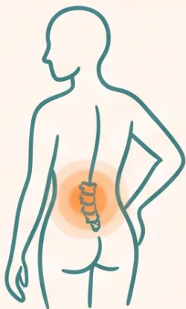
Amenorrhea: Osteoporosis Risk and POI
NICE NG23 updated 2024 • NICE CKS Amenorrhea (current)
Who Is at Risk?
NICE NG23 - 2024 UPDATE
Premature ovarian insufficiency (POI)
Use POI (Premature
Ovarian Insufficiency)
POI: Loss of ovarian oestrogen → accelerated bone loss
Hypothalamic Amenorrhea (weight loss, over-exercise)
Hypothalamic: Low oestrogen + poor nutrition = compounding risk
Hyperprolactinemia
Premature Menopause
This term is no longer recommended — NICE 2024
Hyperprolactinemia: Suppresses oestrogen production
Management Steps
1.
Treat the underlying cause
Address the root condition first
2.
Correct Vitamin D & ensure adequate calcium
Supplement if deficient; advise dietary calcium
3.
Offer COC or HRT if amenorrhea persists >12 months
Oestrogen replacement protects bone density
4.
Review at least annually
Trial COC/HRT withdrawal at 6-12 months once cause resolved
Bradford VTS Teaching Deck • Adolescent Gynaecology
14 / 30
www.bradfordvts.co.uk

Slide 15

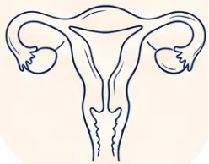




DYSMENORRHOEA • NICE CKS CURRENT
Primary vs Secondary Dysmenorrhea
Primary Dysmenorrhea
No underlying pathology
Secondary Dysmenorrhea
Underlying pathology present
Onset: Starts from 6 months post-menarche; present
from early periods
Onset: Pain develops after years of previously
painless periods — this is the key distinguishing feature
Timing of pain: Begins just before or at the onset of
menses; lasts up to 72 hours; eases as menses
progresses
Timing of pain: May be present throughout the
cycle, not just menses
Character: Deep, persistent pelvic pain; may be
severe and progressive
Character: Cramping, colicky lower abdominal pain
Excess prostaglandin production → uterine
muscle spasm
• Endometriosis
• Fibroids
• Adenomyosis
• Pelvic Inflammatory Disease (PID)
• Nausea and vomiting
• Migraine
• Bloating
• Emotional symptoms
Dyspareunia • Vaginal discharge • IMB • PCB
• Rectal pain or bleeding
Expected. Treatable. Not dismissible.
New pain after pain-free years = investigate.
Bradford VTS Teaching Deck • Adolescent Gynaecology
www.bradfordvts.co.uk

Slide 16



Dysmenorrhoea: Management
NICE CKS Dysmenorrhoea · Current
ENDOMETRIOSIS
Refer — No Response to 1st + 2nd Line
Consider endometriosis
Specialist gynaecology review
Don't Miss It
Step 3
Affects ~10% of women
Average UK delay to
diagnosis: 7–8 years
Empirical treatment minimum 6 months before escalation
2nd Line — Hormonal
Many cases begin in
adolescence
Step 2
Combined oral contraceptive pill
Progestrone-only methods (e.g. LNG-IUS)
Diagnosis: laparoscopy
(gold standard)
Consider contraceptive needs alongside symptom control
USS only detects large
deposits — a normal USS does
NOT exclude endometriosis.
1st Line — NSAIDs
Step 1
Mefenamic acid 500mg three times daily
Naproxen 500mg twice daily
Start 1–2 days before menses begin
Severe dysmenorrhoea that
disrupts school or daily life is
never just normal periods’
Take regularly, not just when pain peaks
www.bradfordvts.co.uk · Bradford VTS Teaching Deck · Adolescent Gynaecology
16

Slide 17

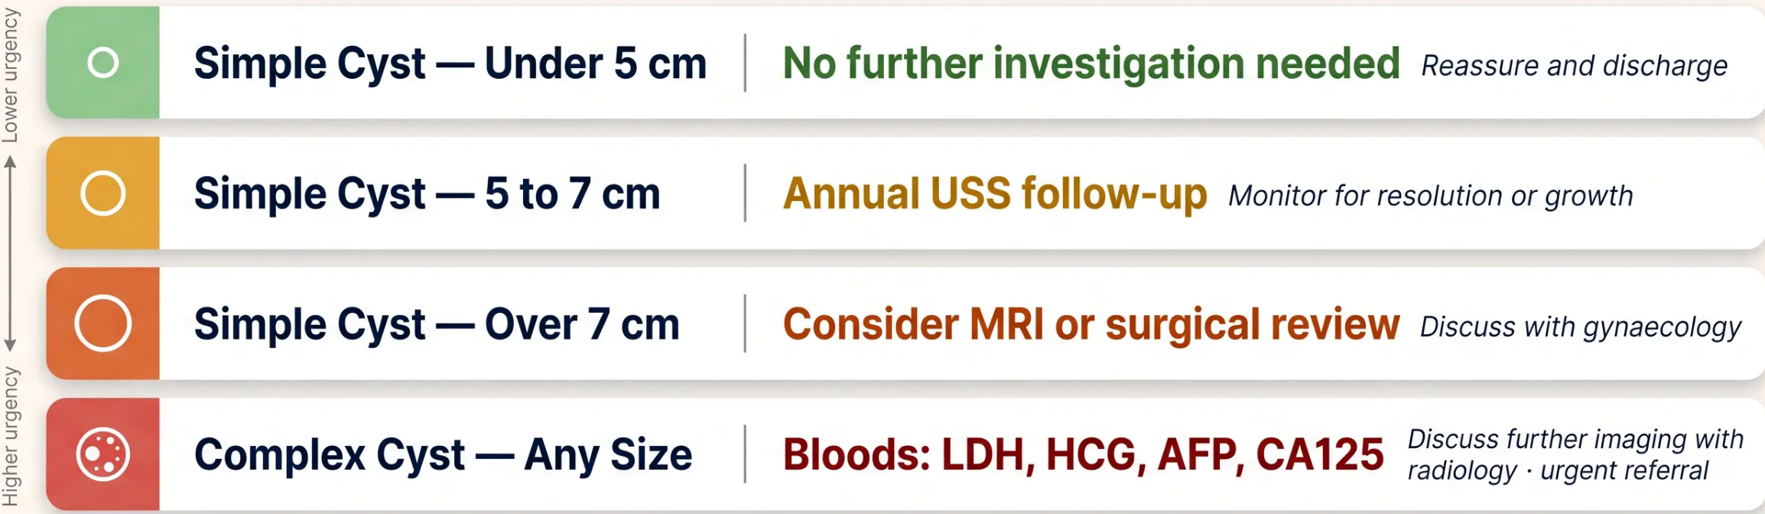
BritSPAG Guideline — Current
Ovarian Cysts in Adolescents
Post-menarche management protocol by cyst size and type
Most ovarian cysts in adolescents are functional and resolve spontaneously
Found incidentally on USS — reassurance is the most important intervention
www.bradfordvts.co.uk · Bradford VTS Teaching Deck · May 2026

Slide 18




NICE CKS • CURRENT GUIDELINE
Cervical Ectropion
Assessment and Management
WHAT IS IT?
A normal variant — columnar epithelium visible on the ectocervix.
Common during puberty and with OCP use. Not pathological.
ALWAYS EXCLUDE STI FIRST
Cervical ectropion does NOT replace the need for STI screening.
Chlamydia and gonorrhoea must be excluded before attributing
symptoms to ectropion.
✔ Self-swab for chlamydia and gonorrhoea — highly acceptable
in young women
✔ Check HPV vaccination history and advise if incomplete
✔ Refer only if bleeding is persistent despite STI exclusion
✔ Under-25s are not eligible for cervical smear screening — this is
correct policy; do not delay STI investigation
Normal variant — STI screen is still mandatory
Bradford VTS Teaching Deck • Adolescent Gynaecology • May 2026
www.bradfordvts.co.uk

Slide 19

STIs in Young Women:
Screening and Treatment
Current UKHSA Data • BNF / BASHH 2024 Guidance
2/3
Annual NCSP Screening
of all new chlamydia diagnoses are in
under-25s (UKHSA)
Recommended for all sexually active under-25s —
offer routinely, not punitively
Chlamydia
Gonorrhoea
First-line treatment (BNF current)
First-line treatment (BASHH 2024)
Doxycycline 100mg BD × 7 days
Ceftriaxone 1g IM — single dose
Azithromycin 1g single dose — second line only
Ciprofloxacin — do NOT use (widespread resistance)
Resistance concerns now favour doxycycline over azithromycin
Always arrange partner notification
⚠️ Consider safeguarding for under-16s — document discussions and refer if concerned
www.bradfordvts.co.uk • Bradford VTS Teaching Deck • May 2026

Slide 20

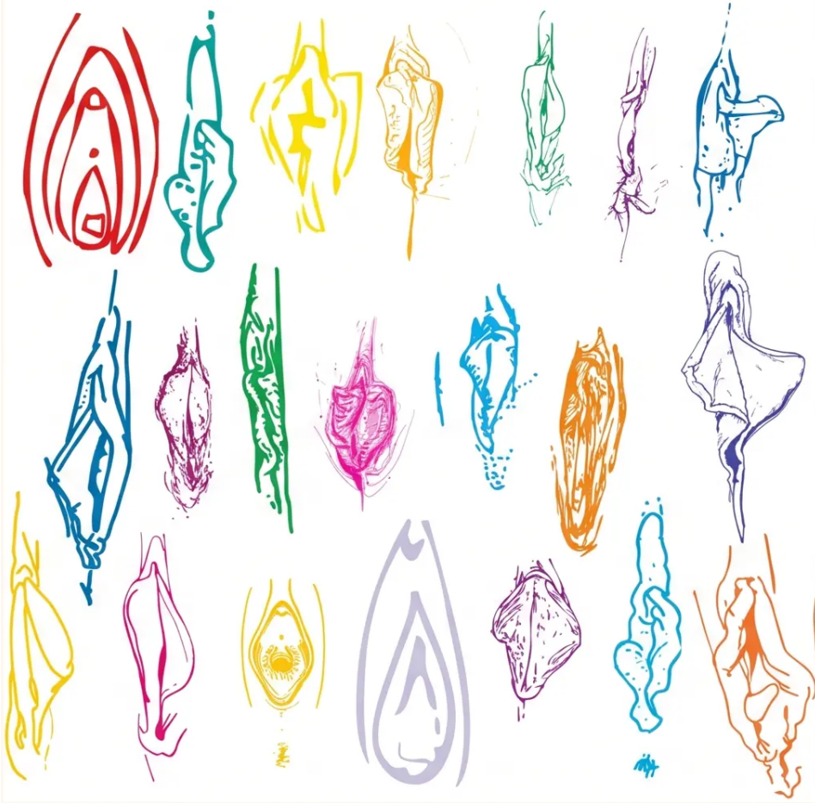
Labial Development and Body Image
RCOG / BritSPAG Position Statement · Current
Illustrating the natural diversity of labial anatomy —
reassurance tool for clinical consultations
Wide Range of Normal
— Labial anatomy varies significantly between individuals
— Development continues through puberty into early adulthood
— Reassure: there is no single 'normal' appearance
Labiaplasty in Minors
— 5× increase in NHS labiaplasty operations over 10 years
— RCOG & BritSPAG: FGCS should NOT normally be offered to under-18s
— Reason: labial development is incomplete — surgery risks long-term harm
— Address body image concerns; consider psychological support referral
In Consultation
— Use normalising, non-shaming language
— Validate concern; provide reassurance with evidence
— Explore media/social media influence on body image
Bradford VTS Teaching Deck · Adolescent Gynaecology · May 2026
www.bradfordvts.co.uk · Slide 20 of 30

Slide 21






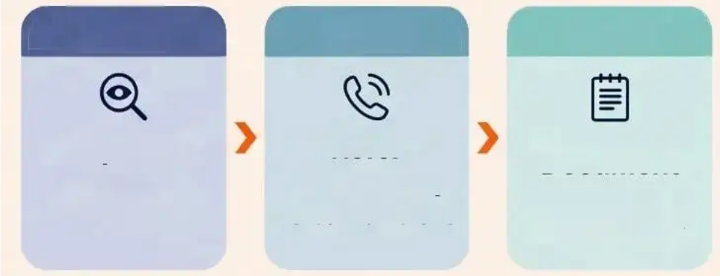



FGM Awareness andMandatoryReporting
FGM Act 2003·Serious Crime Act 2015·WHO Definition
DEFINITION - WHO Definition
MANDATORY REPORTING
Female Genital Mutilation (FGM) encompasses all procedures
partial or total removal of external female genitalia,or other injury to female genital organs,for non-medical reasons.
Any suspicion of FGM in a girl under
18 must be reported to:
OPolice
Block 2 —UK Legal Status
•Children's Services
·FGM is illegal in the United Kingdom under the FGM Act 2003 and Serious Crime Act2015
This duty applies to all regulated health and social care professionals
·Performing, assisting, or failing to protect a girl from FGM are all criminal offences
Step 1 Step 2 Step 3
Block 3 —Who Is at Risk
RECOGNISING RISK
Suspect orDisclose
·Girls from communities where FGM is practised
Refer
Document
Immediately
·Planned travel abroad—especially during school holidays
Record in notes; do not delay
·Family members who have undergone FGM
Any girl under 18
Police +Children's
Services
FGM Act 2003·Serious Crime Act 2015·Bradford VTS Teaching Deck·www.bradfordvts.co.uk

Slide 22





CASE STUDIES
Slides 22 / 30 • Bradford VTS
HMB & PCOS in Adolescents
CASE 1 Heavy Menstrual Bleeding
CASE 2 Possible PCOS
"14-year-old presents with heavy periods
since menarche. Soaking a pad every 1–2
hours. Feeling tired and dizzy."
"17-year-old with 6-month history of irregular
periods, persistent acne, and weight gain.
BMI 28. Concerned about fertility."
Key Actions
Rotterdam Diagnostic Workup
• FBC — check for anaemia
• Clotting screen — consider von Willebrand disease
• STI screen + pregnancy test (always)
• TFTs / ferritin if indicated
• USS only if structural cause suspected
• LH, FSH, testosterone, SHBG, free androgen index
• Prolactin, TFTs
• Fasting glucose / HbA1c, lipid profile
• USS — only if ≥3 years post-menarche (unreliable before this)
• Apply Rotterdam criteria: 2 of 3 features required
LNG-IUS is first-line hormonal treatment
(NICE NG88) — also provides contraception
80-90% of adolescents have acne — acne
alone does NOT diagnose PCOS
Anovulatory cycles are normal in first 2 years post-menarche
Do NOT start metformin in primary care without specialist input
NICE CKS PCOS (2024) • NICE NG88 (2018, updated 2024) • Bradford VTS Teaching Deck • www.bradfordvts.co.uk

Slide 23



Case Studies — Dysmenorrhea & Amenorrhea
*NICE CKS Dysmenorrhea · NICE CKS Amenorrhea · current
CASE 3
CASE 4
15-year-old · Severe Dysmenorrhea
13-year-old · Secondary Amenorrhea × 6 months
Severe period pain not responding to ibuprofen. Missing school each cycle.
Previously regular periods. No menses for 6 months. Denies pregnancy.
HISTORY POINTS
HISTORY POINTS
• Duration and cycle regularity
• Pain timing relative to menses onset
• Associated symptoms: nausea, bloating, dyspareunia
• Weight changes, exercise levels, stress
• Diet, eating patterns (eating disorder screen)
• Symptoms of thyroid disease or androgen excess
MANAGEMENT STEPS
• Step up to mefenamic acid 500mg TDS or naproxen 500mg BD
• Start 1–2 days before expected menses
• Second line: COC or progesterone-only method
• Empirical treatment for ≥6 months before further investigation
INVESTIGATIONS
• Pregnancy test — always first
• FBC, TFTs, LH, FSH, prolactin, testosterone
• If FSH/LH elevated ×2 → consider POI
REFERRAL DECISION
KEY CLINICAL DECISION
Manage in primary care: PCOS · Hypothyroidism · Pregnancy
No response to NSAIDs + hormonal treatment → Refer ·
Consider endometriosis
Refer to gynaecologist: Elevated FSH/LH ×2 (POI suspected)
*Average UK delay to diagnosis: 7–8 years — don't dismiss
*Use term POI — NOT 'premature menopause' (NICE NG23 2024)
www.bradfordvts.co.uk · Bradford VTS Teaching Deck · Adolescent Gynaecology · May 2026

Slide 24







BRADFORD VTS·CLINICAL TIPS
Top Tips for GPs
Ten things to get right when consulting with young womeninprimary care
Anovulatory cycles are normal for the first 2 yearspost-menarche—don't over-investigate
06
Avoid vaginal examination in young peopleunless
01
Absolutely necessary—self-swab andUSS are preferred
Always exclude STI before attributingsymptomsto hormonal or structuralcauses
Under-25s are not eligible for cervicalsmear
02
07
screening—don't delay STI investigation for thisreason
LNG-IUS(Mirena)is first-line for HMB inadolescents—and provides contraception
Always offer STI screening asroutine:"Thisissomething l offer all young women”
03
08
FGM in a child under 18 = mandatory referral to police and children's services—know your local pathway
09
04
Oligomenorrhoea at age15 or older warrants
investigation:thinkPCOS,thyroid,eating disorder
Never dismiss severe period pain as "normal"一endometriosis starts in adolescence
05
10
Use “"Premature Ovarian Insufficiency(POI)"—not “premature menopause”(NICENG23,2024)
BradfordVTSTeachingDeck·AdolescentGynaecology·www.bradfordvts.co.uk·UpdatedtoNICE 2024/2025 standards 24/30

Slide 25
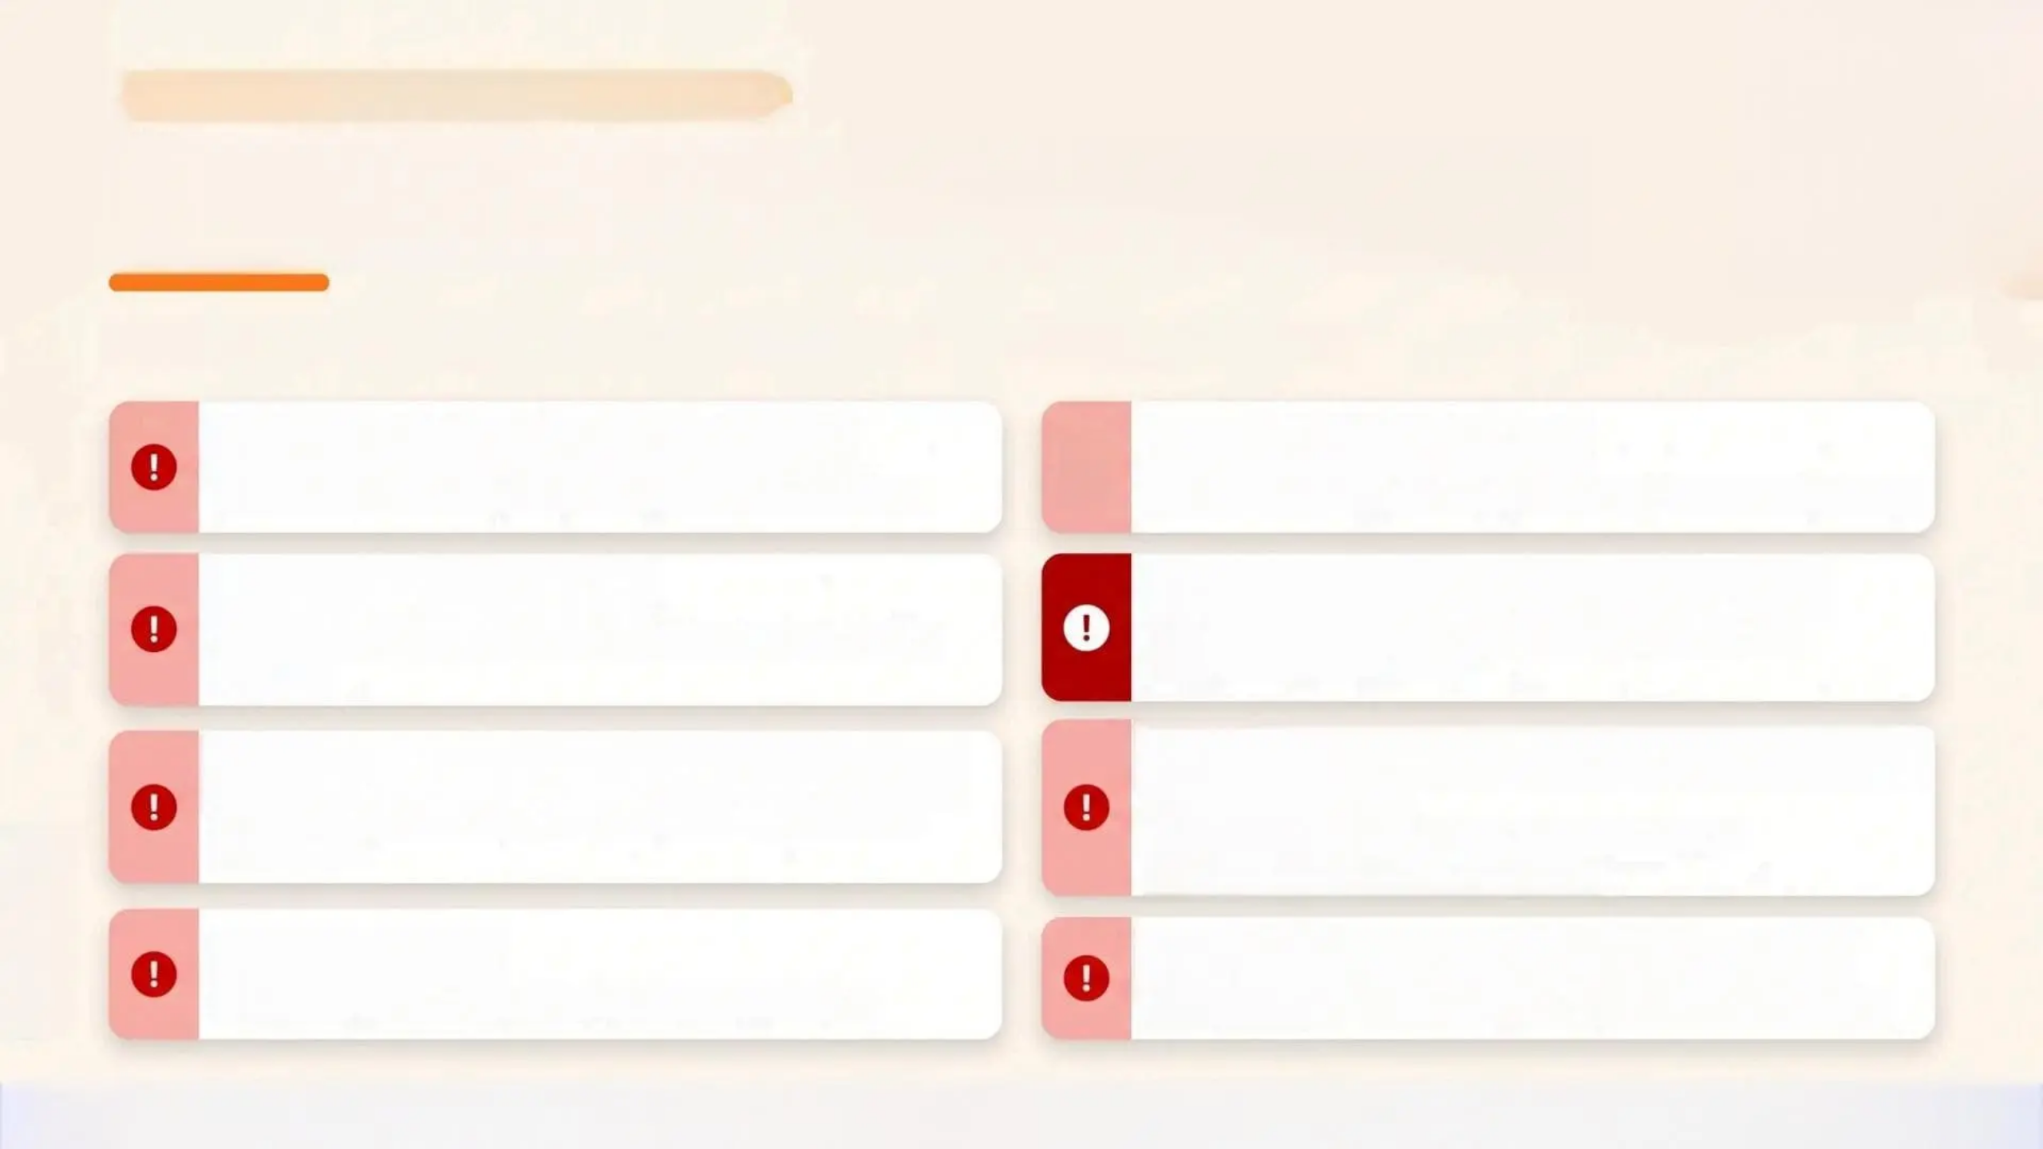







BRADFORD VTS·ADOLESCENT GYNAECOLOGY
RedFlags:When toRefer Urgently
The following presentations require urgent orimmediate referral—do not delay
Complex Ovarian Cyst (any size)
Prolactin>1000 mlU/L
!
Or 500-1000 mlU/L on two occasions—refer to endocrinology
RequestLDH,HCG,AFP,CA125—discuss with radiology
Primary Amenorrhoea
Suspected FGM in a Child Under 18
Nomensesby age14(no 2°features)or age16(normal 2°features)
Mandatory immediate referral to police and children’s services—FGM Act 2003
Suspected Genital Tract Malformation
Severe Dysmenorrhoea—No Response to Treatment
Or chromosomal anomaly—Turner syndrome,androgeninsensitivity
NSAIDs+hormonal treatment failed→consider
endometriosis;refer for laparoscopy
Galactorrhoea
Persistent Unexplained PV Bleeding
Especially with amenorrhoea—exclude prolactinoma
Exclude malignancy even in young women—donot dismiss
NICENG88·BritSPAG·NICENG23·FGM Act 2003/Serious Crime Act 2015www.bradfordvts.co.uk

Slide 26


AKT Exam Pearls
AKT
Key facts and treatment protocols — know these for the exam
HMB • NICE NG88
Chlamydia • BNF Current
LNG-IUS (Mirena) is the first-line pharmacological
option for heavy menstrual bleeding
Doxycycline 100mg BD × 7 days = first-line.
Azithromycin single dose is second-line only
PCOS • Diagnosis
Gonorrhoea •BASHH 2024
Rotterdam criteria: 2 of 3 required — not all three.
Polycystic ovaries alone ≠ PCOS
Ceftriaxone 1g IM single dose = first-line.
Do NOT use ciprofloxacin — widespread resistance
Amenorrhoea • Referral
Cervical Screening
Primary amenorrhoea: refer by age 14 (no secondary
characteristics) or age 16 (2ndary characteristics present)
Under-25s are not eligible for cervical smear
screening — this is correct policy, not a gap
Terminology • NICE NG23 2024
Ovarian Cysts • BritSPAG
Use POI (Premature Ovarian Insufficiency) — NOT
'premature menopause'
Simple ovarian cyst under 5cm: no further
investigation required — reassurance only
Bradford VTS • Adolescent Gynaecology
www.bradfordvts.co.uk

Slide 27








BRADFORD VTS TEACHING DECK
SCA Exam Pearls
Consulting skills · Communication · Patient-centred care
SCA Focus
See Them Alone
Normalise Screening
Always offer to see the young person
without parents — every time, without
exception.
Say: ‘This is something I offer all young
women your age’ — removes stigma from STI
testing.
Fertility Sensitivity
Validate the Pain
Address fertility concerns sensitively —
especially Depo-Provera (delayed return up
to 12-18 months).
Endometriosis: validate pain, explain the
diagnostic delay, and outline the laparoscopy
pathway clearly.
Body Image Language
PCOS Holistically
Reassure about labial variation — use
affirming, non-shaming language. ‘There is a
wide range of normal.’
Address fertility, weight, mental health, and
long-term metabolic risk — not just the
menstrual cycle.
www.bradfordvts.co.uk · Bradford VTS Teaching Deck · May 2026

Slide 28


Common Pitfalls
Adolescent Gynaecology — Mistakes to Avoid in Primary Care
⚠️ Clinical Awareness
Unnecessary vaginal examination
Urgent referral for simple cysts <5cm
Self-swab, HVS, and USS are preferred in young
women — VE only if absolutely essential
BritSPAG: simple cyst under 5cm requires no further
investigation — reassurance is appropriate
Azithromycin for chlamydia
Forgetting bleeding disorders in HMB
Doxycycline 100mg BD × 7 days is now first-line —
azithromycin no longer recommended routinely
Von Willebrand disease is more common in adolescents
— always consider clotting screen at first presentation
Diagnosing PCOS on USS alone
Starting metformin in primary care
USS is unreliable within 3 years of menarche —
Rotterdam criteria require 2 of 3 features
Do not initiate metformin for PCOS without
specialist input — refer first
Dismissing severe dysmenorrhoea
Calling it 'premature menopause'
Endometriosis begins in adolescence — average
UK delay to diagnosis is 7-8 years
Use 'Premature Ovarian Insufficiency (POI)' — per
NICE NG23 updated 2024
Bradford VTS Teaching Deck • Adolescent Gynaecology • May 2026 • www.bradfordvts.co.uk
Updated NICE 2024/2025

Slide 29

CONSULTING SKILLS
Patient Communication and Reassurance
What to say — and how to say it
IRREGULAR PERIODS
STI SCREENING
“It’s completely normal for periods to be
irregular when you first start — but I want to
make sure we keep an eye on things together.”
“I’d like to do a quick swab test — it’s
something I offer all young people routinely.
Nothing to worry about.”
PERIOD PAIN
BODY VARIATION
“Period pain that stops you going to school
isn’t something you should just put up with.
Let’s work out what’s going on.”
“Vulvas come in all shapes and sizes. What
you’re describing is a completely normal
variation — you don’t need any treatment.”
Normalise • Validate • Reassure • Never dismiss

Slide 30


Quick Recall
Core clinical facts · Bradford VTS Adolescent Gynaecology
HMB — NICE NG88
PCOS — ROTTERDAM
PRIMARY AMENORRHOEA
SECONDARY AMENORRHOEA
LNG-IUS (Mirena) is first-
line pharmacological
treatment
2 of 3 criteria required
— not all 3
Refer by age 14 (no
secondary characteristics)
or age 16 (normal
secondary characteristics)
Manage PCOS,
hypothyroidism,
pregnancy in primary
care — refer POI
DYSMENORRHOEA
OVARIAN CYST — BRITSPAG
CHLAMYDIA / GONORRHOEA
CHLAMYDIA / GONORRHOEA
TERMINOLOGY
TERMINOLOGY
NSAIDs → COC → refer if
no response; consider
endometriosis
Simple cyst < 5 cm: no
investigation needed
Doxycycline 100 mg BD ×
7 days · Ceftriaxone 1 g IM
single dose
Use POI — not ‘premature
menopause’ (NICE
NG23, 2024)
⚠️ This deck is for educational purposes only. Always verify clinical advice, drug doses, and management pathways against the latest NICE guidelines and BNF before applying in clinical practice.
www.bradfordvts.co.uk · Created May 2026 · Updated to NICE 2024/2025 standards

