Slide 1

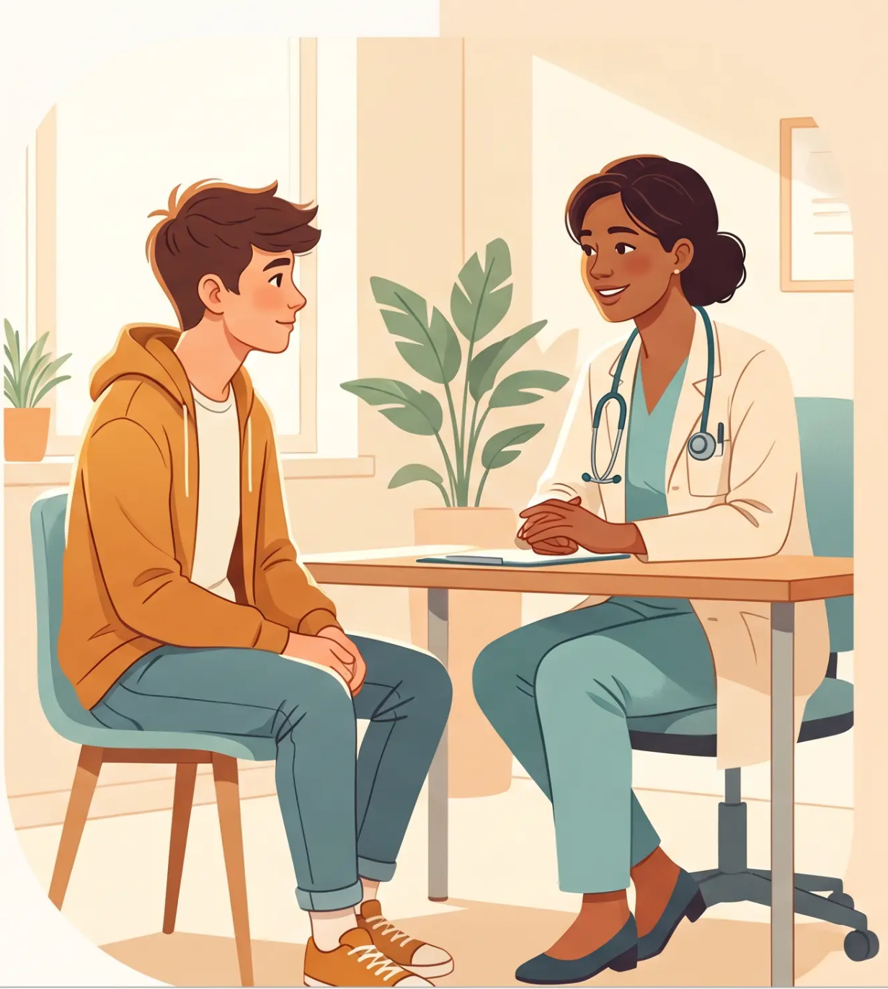
BRADFORD VTS TEACHING DECK
GP TRAINING • ADOLESCENT HEALTH
Consulting with
Young People
What GPs Need to Know
www.bradfordvts.co.uk
Created May 2026
Updated to current GMC 0-18 and NICE 2024/2025 standards
*Δ For educational purposes only. Always verify drug doses and guidance
with current BNF/NICE resources.
Bradford VTS • Consulting with Young People • May 2026

Slide 2
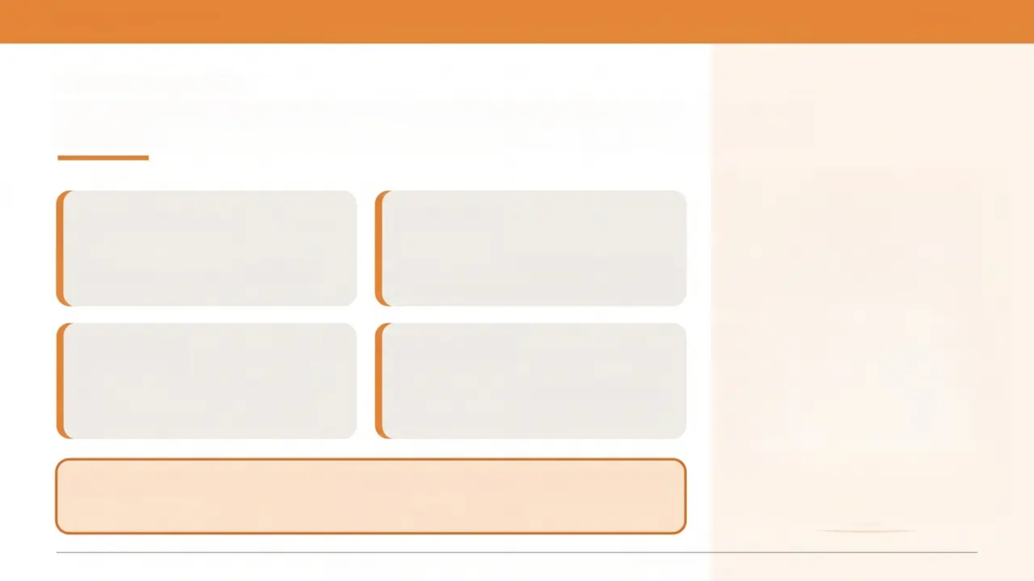
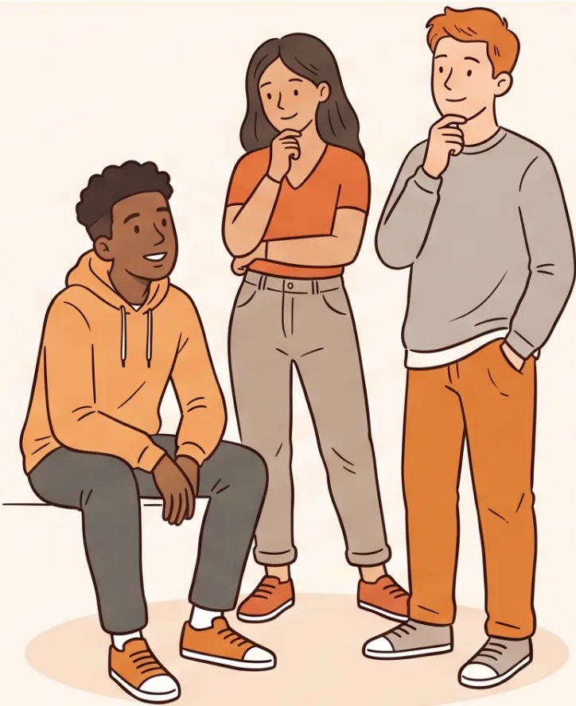
BRADFORD VTS TEACHING DECK
www.bradfordvts.co.uk
ADOLESCENT HEALTH
Why Young People Are a Distinct Group
13-15%
1 in 3
young people presenting to GP have a
diagnosable mental health problem
of the population are adolescents
1 in 3
>50%
with a mental health problem are
actually identified by their GP
of adult mental health conditions are
diagnosable by age 14
Death rates in 15-19 year olds now EXCEED those in 1-4 year olds
Main causes: accidents, violence, suicide
GMC 0-18 Years Guidance | NICE NG185 | RCGP Adolescent Health

Slide 3
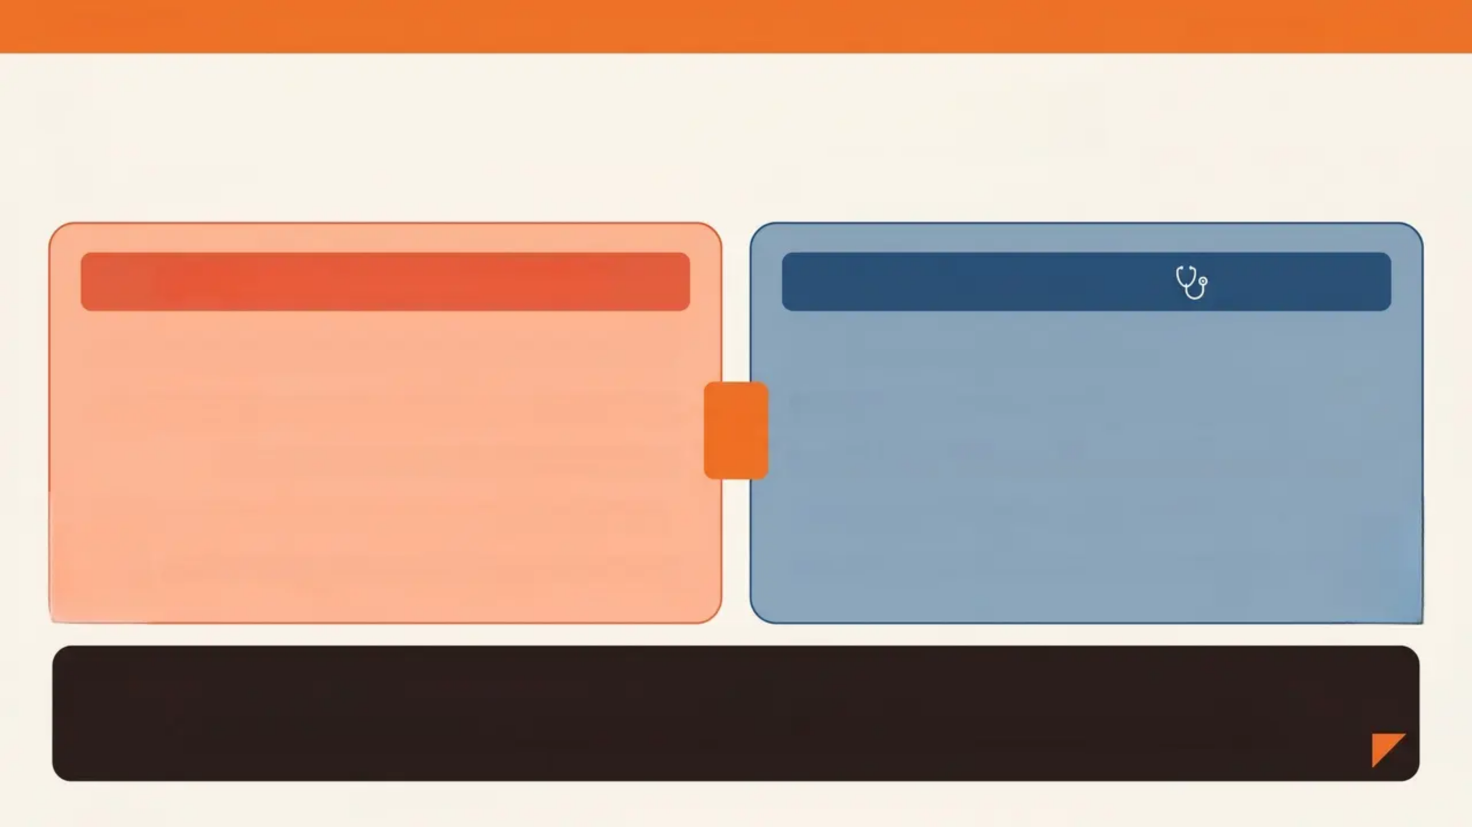
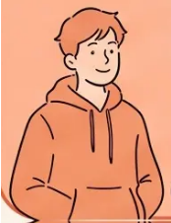
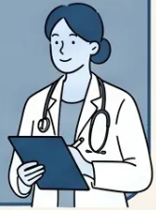

BRADFORD VTS
www.bradfordvts.co.uk
What Young People Actually Want
Two agendas. One consultation. Whose wins?
YOUNG PERSON'S AGENDA 🤗
GP'S AGENDA 🩺
Sexual health — contraception, relationships, identity
Lifestyle — smoking, alcohol, drugs, diet
Mental health — self-esteem, exam stress, belonging
VS
Sexual health — STI and pregnancy prevention
Appearance — acne, body image, weight
Mental health — suicide prevention, school behaviour
Minor illness — important to them, even if “minor”
Risk reduction — safety, harm minimisation
Emotional support — to be heard, not lectured
Pathology — diagnosing and managing problems
Young people seek validation, identity support, and emotional care.
“GPs who meet them where they are build trust — and better health outcomes.”
“Bridging the agenda gap is the key consultation skill — GMC 0-18 / RCGP Adolescent Health Guidance”

Slide 4
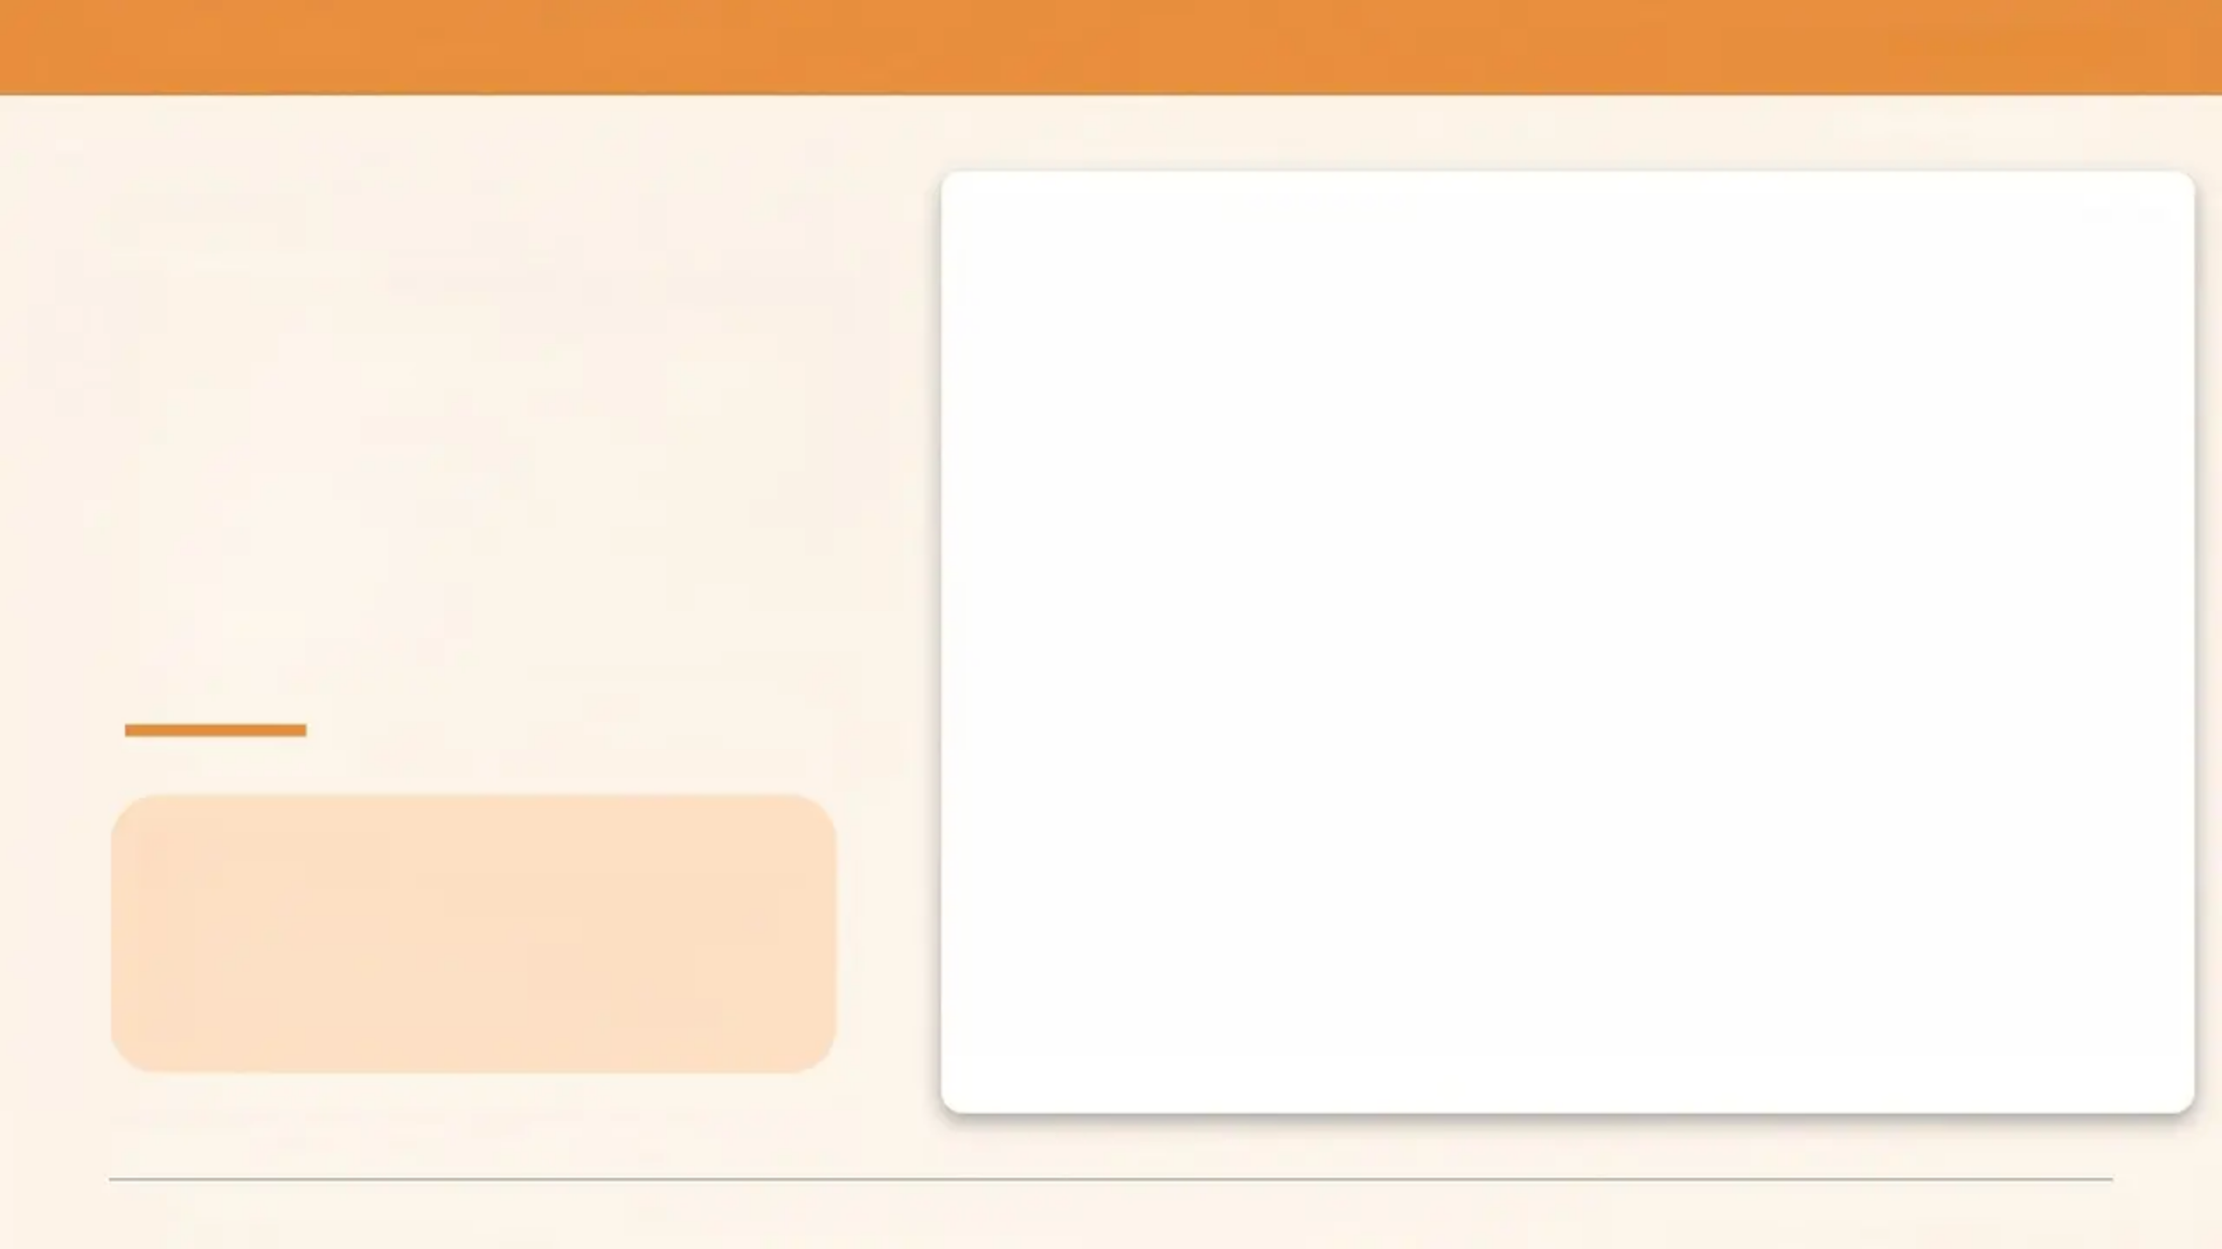
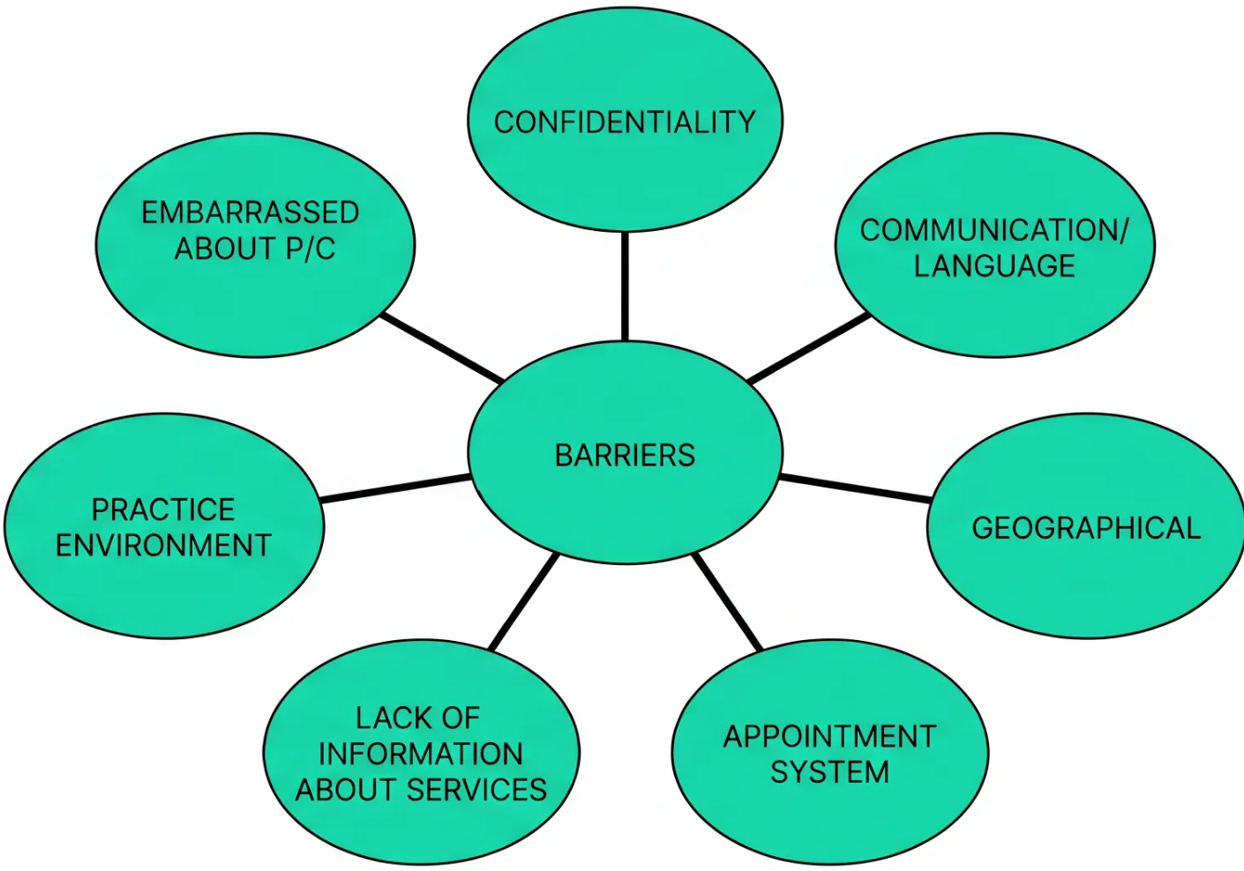
“BRADFORD VTS TEACHING DECK”
www.bradfordvts.co.uk
ACCESS
Barriers to
Accessing
Primary Care
What Helps
- Visible confidentiality posters
- Flexible & direct booking
- Normalising difficult topics
*7 identified barriers — RCGP Adolescent Health Guidance
Consulting with Young People — Bradford VTS Teaching Deck — May 2026

Slide 5


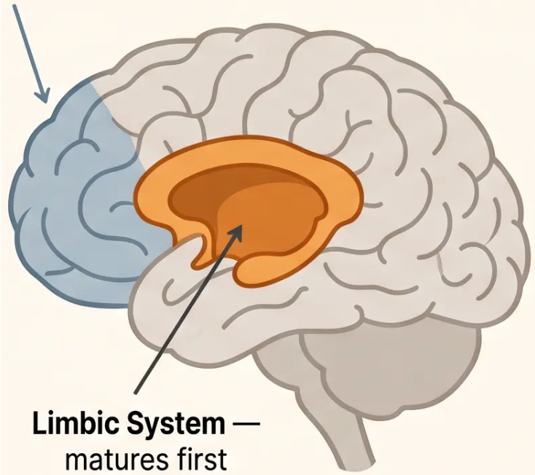


BRADFORD VTS TEACHING DECK
www.bradfordvts.co.uk
The Adolescent Brain
Why Different Communication Matters
Prefrontal Cortex — matures last (~age 25)
SO WHAT FOR YOUR CONSULTATION?
Prefrontal Cortex
• Present-focused beats
future-risk framing
Impulse control · Judgement · Planning
• Relational connection before
information giving
Still developing until ~25
• Emotional validation matters
more than logic
• Peer context is highly relevant
to them
Limbic System
Emotion · Reward · Peer sensitivity
They're not being irrational — their
brain is working exactly as it should.
Dominant in adolescence
Slide 6 of 25 — Adolescent Brain & Communication
Bradford VTS · May 2026

Slide 6
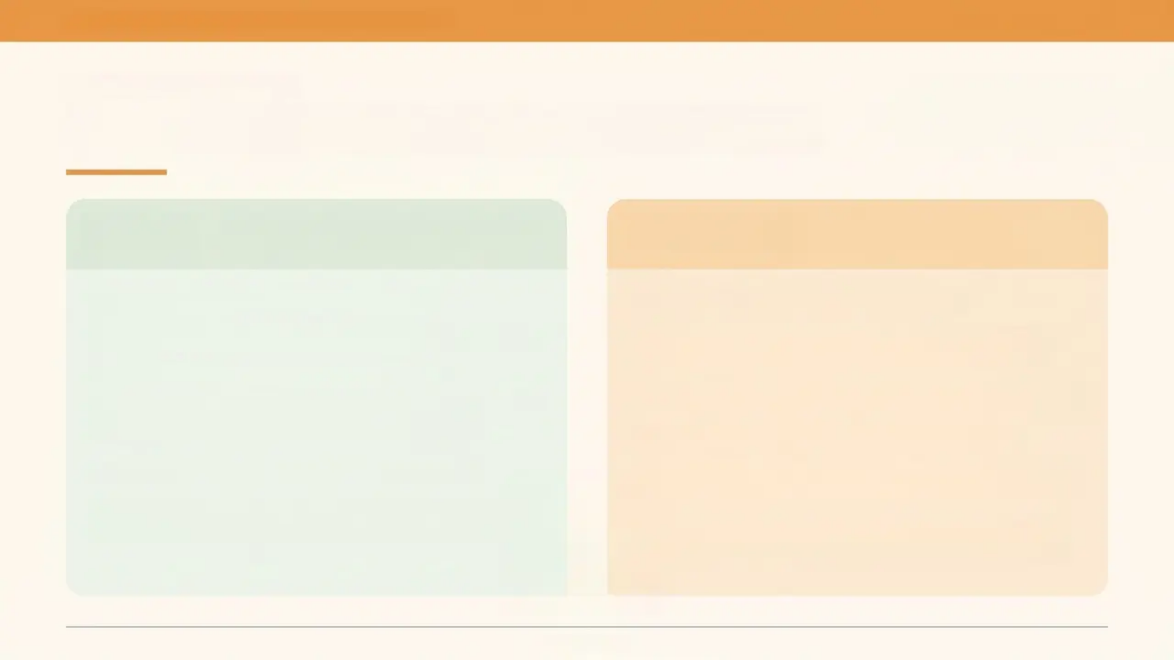
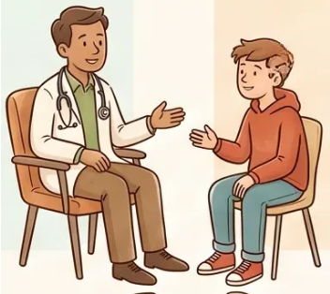
BRADFORD VTS — CONSULTING WITH YOUNG PEOPLE
www.bradfordvts.co.uk
CONSULTATION SKILLS
Communication Skills in Practice
DO
DON'T
Explain confidentiality at the start
Patronise or talk down to them
Use open questions and normalise concerns
Assume — about sexuality, drug use, or
relationships
Match their pace — silence is okay
Be genuinely curious about them as a
person
Focus only on risk; miss the hidden agenda
Use jargon or adult-heavy language
Get their mobile number for follow-up
Rush — they disengage quickly if they feel
hurried
Offer to see them separately from their
parent
Ignore non-verbal cues — body language
matters
Slide 7 of 25

Slide 7
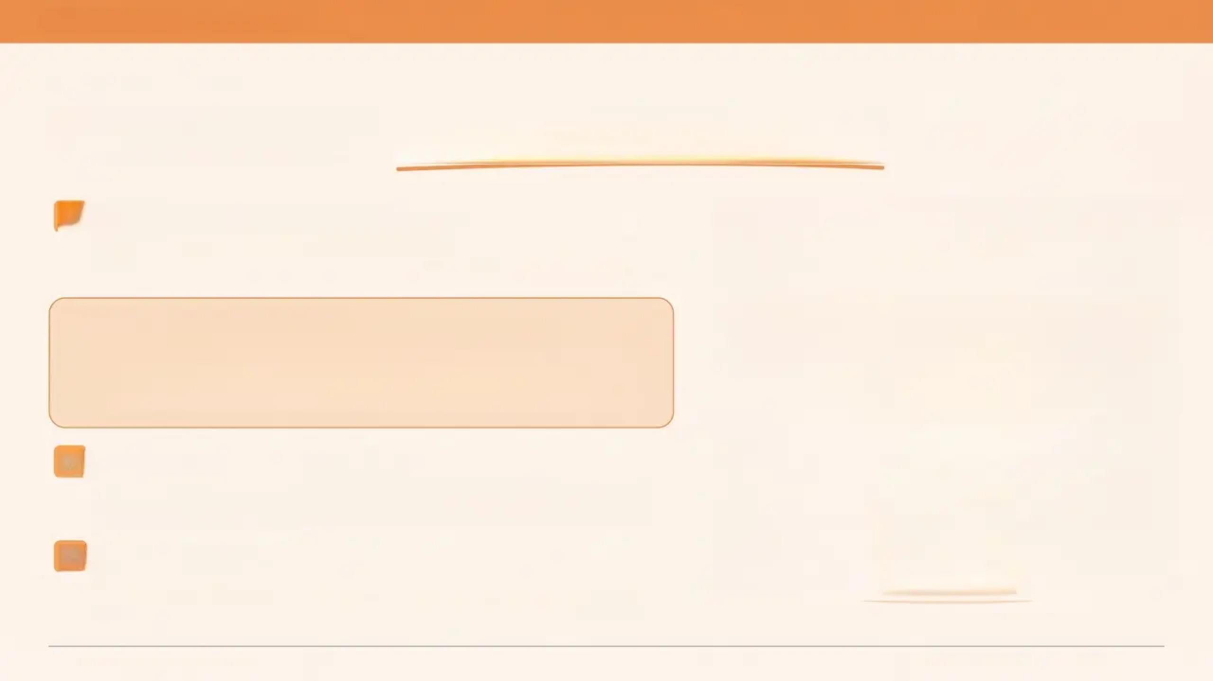
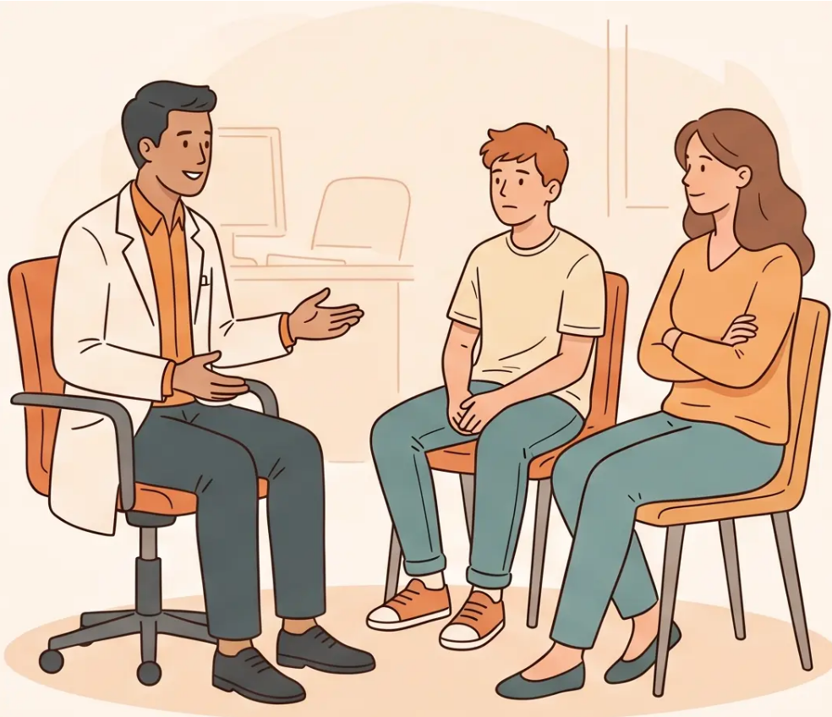
BRADFORD VTS TEACHING DECK
www.bradfordvts.co.uk
CONSULTING SKILLS
Managing the 3-Way Consultation
1
Make it routine — offer every time
See the young person alone as part of every consultation, regardless
of the presenting complaint.
WHAT TO SAY TO THE PARENT
It's great that [Name] has come. As they'll be using this
service, I'll have a chat with them first — and we can
catch up together at the end.
3
If the parent refuses to leave
Defer sensitive topics. Book a separate appointment for the young
person alone. Never force the issue in the room.
4
Always document
Record that you offered a private consultation — even if it wasn't
taken up.
Slide 8 of 25 — Bradford VTS Teaching Deck: Consulting with Young People — May 2026

Slide 8
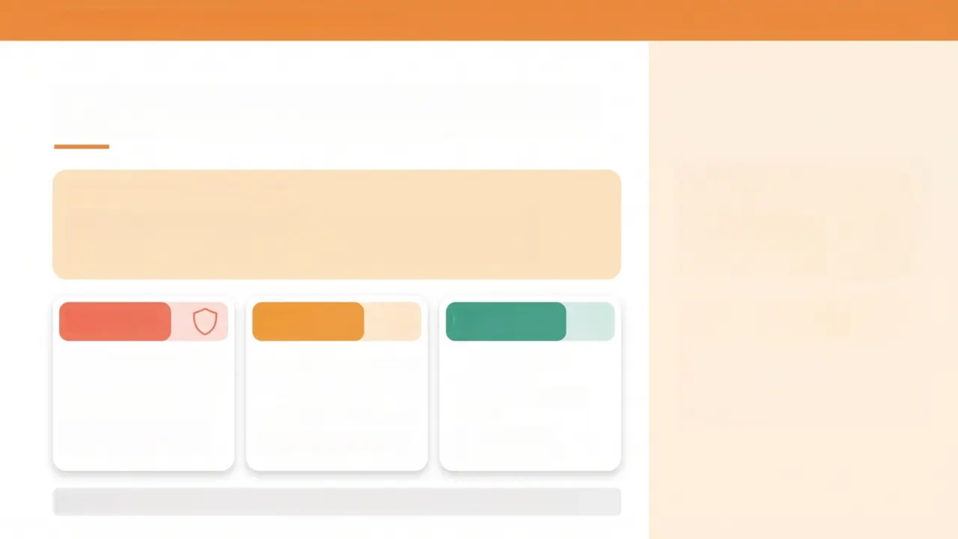
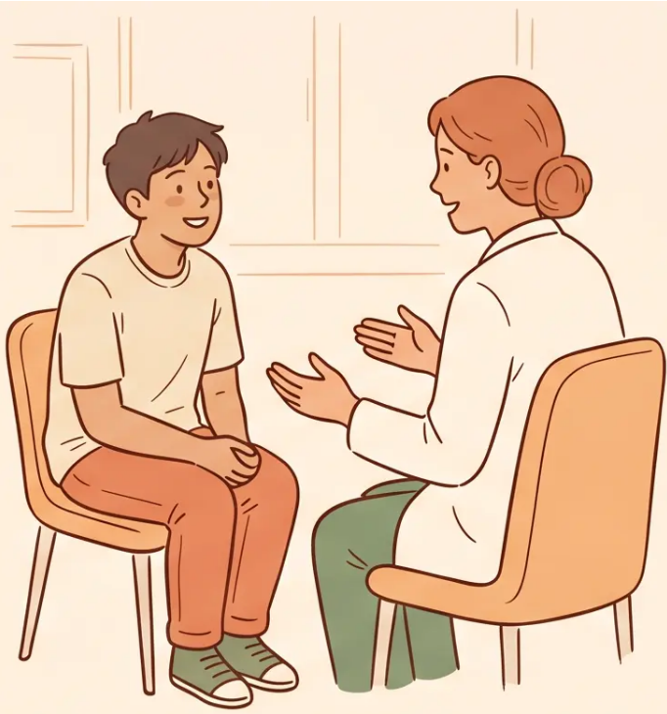


BRADFORD VTS — CONSULTING WITH YOUNG PEOPLE
www.bradfordvts.co.uk
Explaining Confidentiality
SAY THIS — EARLY, EVERY TIME
“What you tell me stays between us — unless I’m
worried you’re not safe.”
Under 13
13-15
16-17
Sexual activity almost
always requires disclosure
Legal inability to consent
Safeguarding duty
overrides confidentiality
Case-by-case assessment
Apply Fraser competence
Public interest test applies
Document your reasoning
Presumed capacity
(MCA 2005)
Disclose only in public
interest
Treat as adult for
consent purposes
Display confidentiality posters visibly — in the waiting room and in your consulting room.

Slide 9
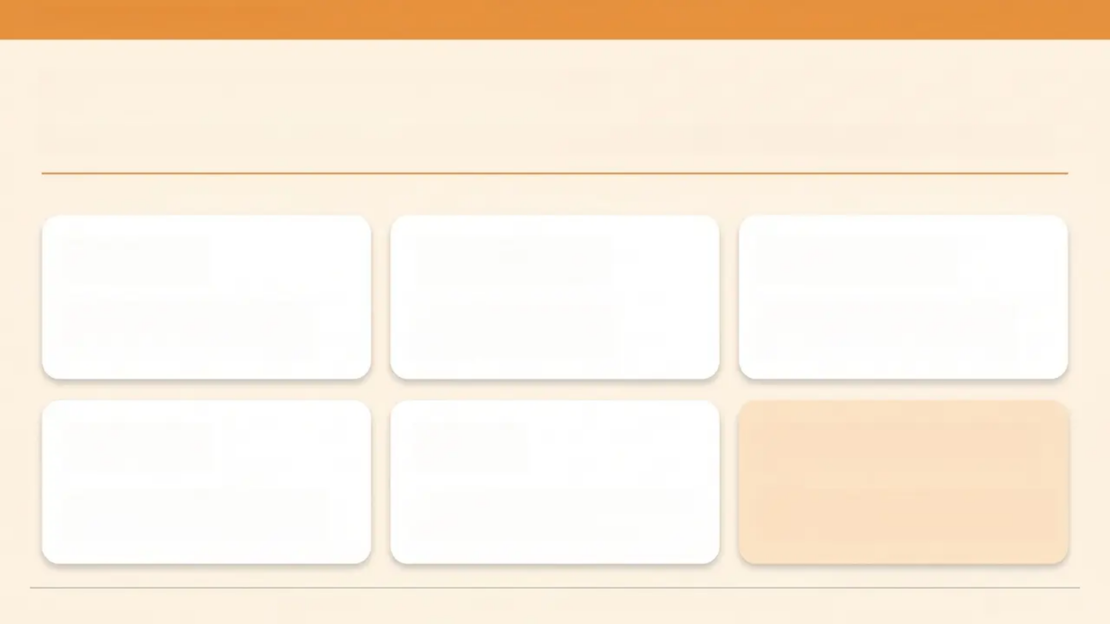
BRADFORD VTS TEACHING DECK
www.bradfordvts.co.uk
The HEADSS Assessment
Validated psychosocial assessment tool for young people — use whenever psychosocial concerns are present
H
Home
E
Education
A
Activities
Who do you live with? Can
you talk to your parents?
How's school going?
Attendance? Grades?
What do you enjoy? Do you
have friends you can trust?
D
Drugs
S
Sex
S
Suicide / Safety
Alcohol, smoking, recreational
drugs — I ask everyone this.
Is it okay if I ask about relationships?
Orientation, contraception?
If the consultation raises concern —
ask directly. It does not increase risk.
HEADSS opens the psychosocial picture without focusing on a single problem.
Slide 10 of 25

Slide 10

BRADFORD VTS
www.bradfordvts.co.uk
Hidden Agendas
The Iceberg of Young People's Consultations
PRESENTING COMPLAINT (visible)
• Headache
• Acne
• Knee injury
surface of the consultation
HIDDEN AGENDA (just below the surface)
Relationship
breakdown
Coming out /
identity questions
Substance use
or self-harm
“Is there anything
else on your mind
today?”
HEALTH PROMOTION OPPORTUNITY (deepest layer)
The single most powerful
question in adolescent
consultations.
Sexual health
Mental health
Substance use
Slide 11 of 25 — Bradford VTS GP Training 2026

Slide 11



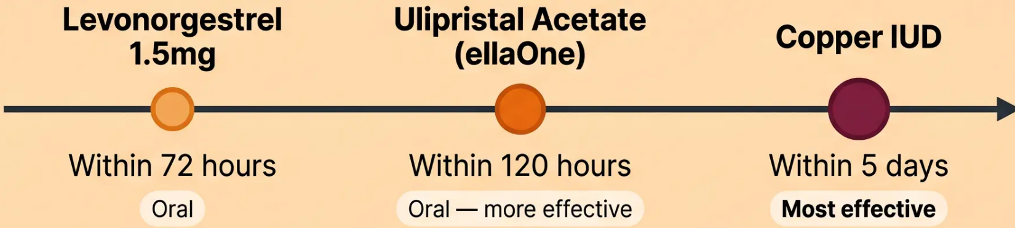
BRADFORD VTS TEACHING DECK
www.bradfordvts.co.uk
Sexual Health
Essentials
NCSP Screening
1st Line Treatment
Annual chlamydia screen
All sexually active under-25s
Opportunistic — offer at every contact
Doxycycline 100mg BD
× 7 days
BNF current — first line
2025 Current
*Azithromycin no longer 1st line
Emergency Contraception
Fraser Guidelines
*Three options — effectiveness increases with each
For contraception in under-16s
✔ Understands the advice
✔ Cannot be persuaded to
tell parents
✔ Likely to have sex with or
without contraception
✔ Physical/mental health at
risk without contraception
✔ Best interests to receive
contraception
*All 5 criteria must be met
*Ulipristal: avoid if on enzyme-inducing drugs. IUD: always consider if within 5 days.
*Sources: BNF current edition • NICE NG3 • NCSP 2025 • GMC 0–18 Years Guidance

Slide 12
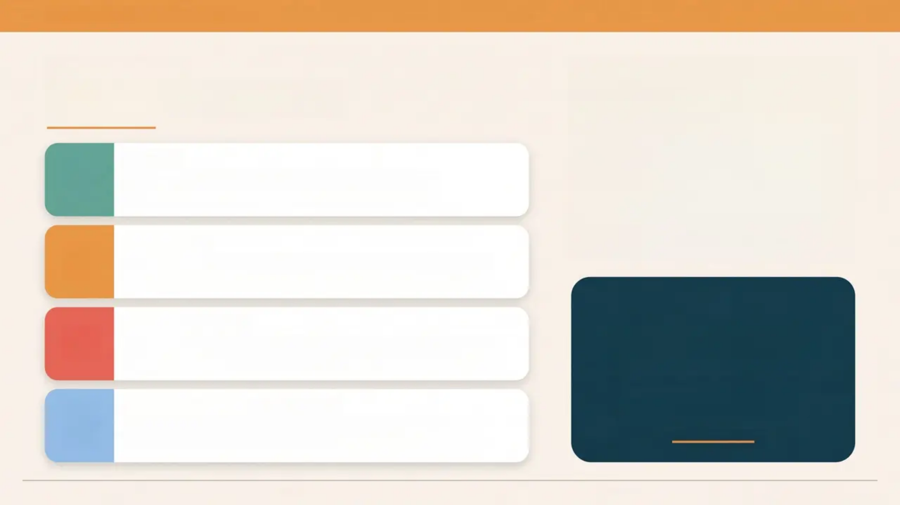
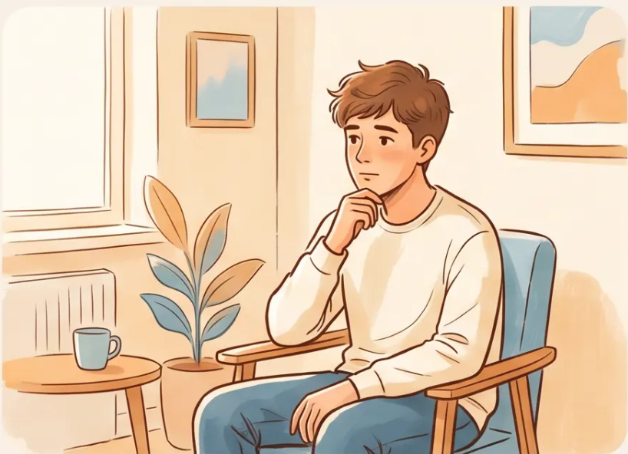




BRADFORD VTS TEACHING DECK
www.bradfordvts.co.uk
MENTAL HEALTH
Quick Reference
PHQ-A
Depression screening for young people —
score ≥10 suggests depression likely
Fluoxetine
Only SSRI licensed for depression in under-18s —
first-line pharmacological treatment
CAMHS Urgent
Asking about suicide
does NOT increase risk
Suicidal intent + plan + access to means → do not
delay referral
It provides relief — and
opens the door to help
HEADSS — Suicide/Safety
If the consultation raises concern — ask directly.
Use the final S in HEADSS
Ref: NICE NG185 · BNF current · GMC 0-18 guidance · Created May 2026

Slide 13
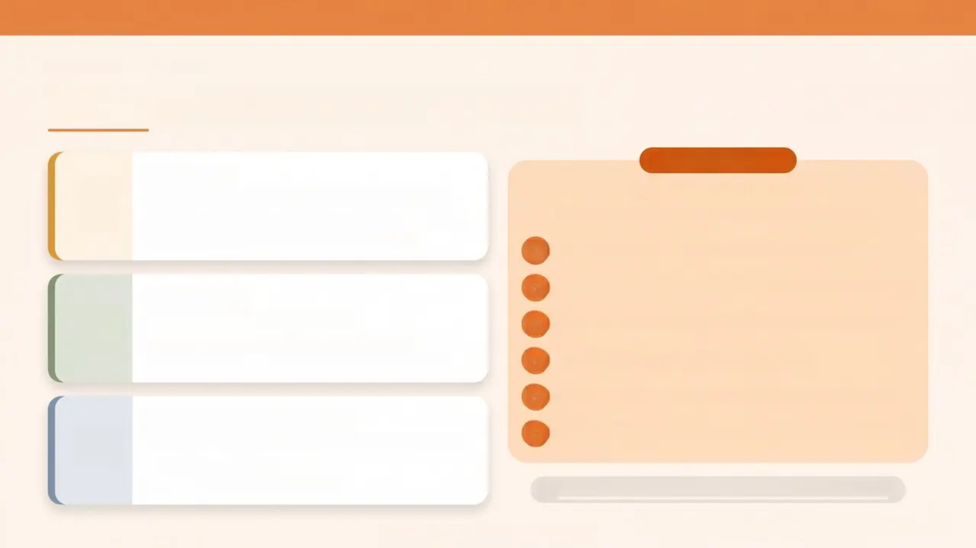













BRADFORD VTS TEACHING DECK
www.bradfordvts.co.uk
CLINICAL REFERENCE
Substance Misuse in Young People
BRIEF INTERVENTION
Alcohol 🍺
*Most common substance misuse in young people
– 70% of drop-in clinic patients report binge drinking
– Brief intervention effective in primary care
The FRAMES Model
*Use in primary care for alcohol and substance misuse
— Feedback — Share personalised risk information
Cannabis 🌿
— Responsibility — Emphasise their choice and autonomy
*Psychosis risk — dose-dependent
– ~50% of 16-year-olds have tried cannabis
– Psychoeducation: explain psychosis link clearly
— Advice — Give clear, non-judgmental advice to change
— Menu — Offer options, not instructions
— Empathy — Warm, reflective, non-confrontational style
Vaping / E-cigarettes 🫁
*Widespread; nicotine dependence + respiratory harm
– Advise against use
– Refer to stop smoking service
— Self-efficacy — Build confidence that change is possible
Screening: CAGE-A / AUDIT-C — low threshold for use
Slide 14 of 25 — Bradford VTS GP Training

Slide 14
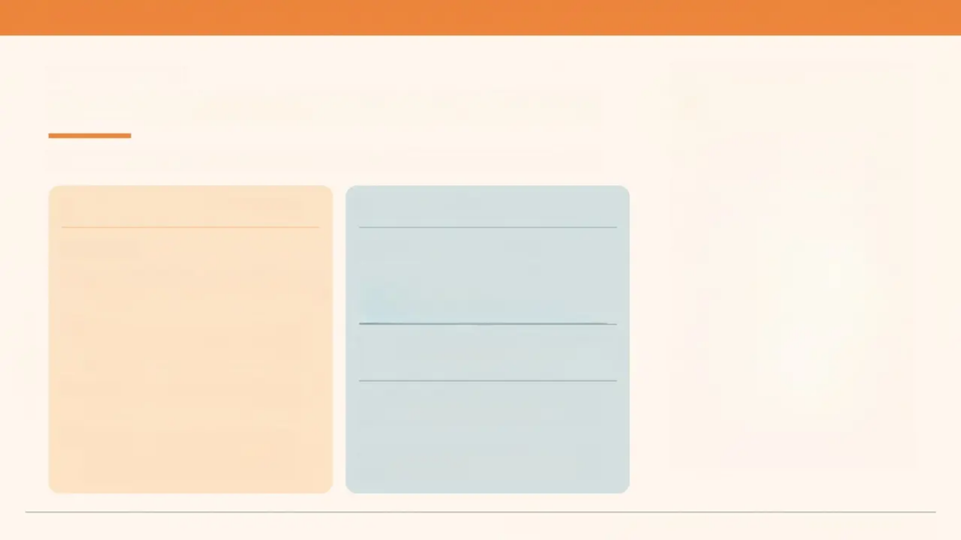
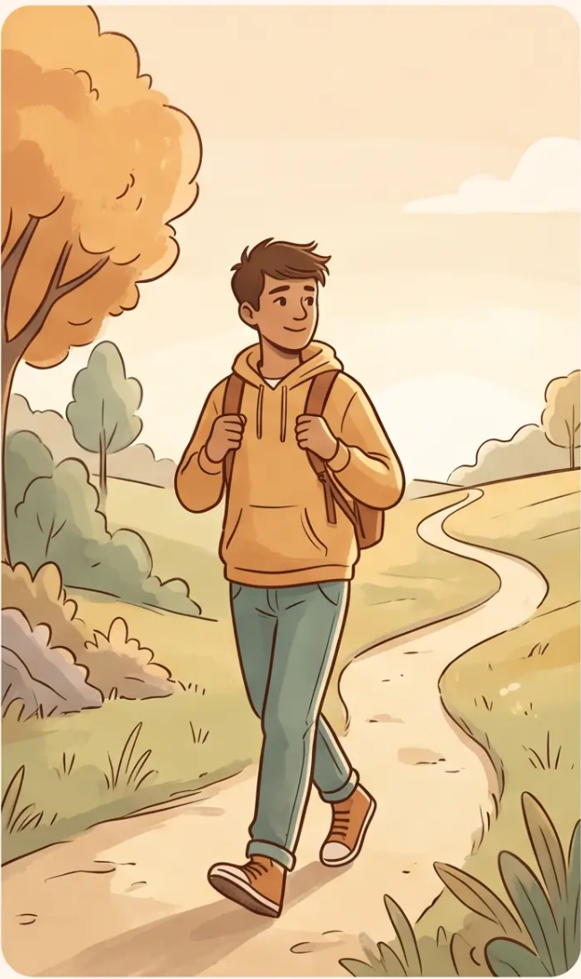




BRADFORD VTS TEACHING DECK
www.bradfordvts.co.uk
CHRONIC DISEASE
Non-Compliance Is Not the Problem
It's often an act of independence — and that's developmentally normal.
Reframing Non-Adherence
Transition Planning
Reframe It
Plan the Transition Early
Non-compliance often = age-
appropriate independence seeking
Age 14-16 → Begin transition
conversations; identify
key contacts
Young people with chronic illness
may resent both their illness and
their doctor
Age 16-17 → Introduce adult service;
joint appointments if possible
Involve them in decisions — use
SMART goals
Age 18 → Formal handover —
avoid the cliff-edge
Acknowledge the burden: “This
is genuinely hard to manage at
your age”
Young people fall through the gap at
18 — plan early, not last-minute.
Non-compliance in chronic illness | Bradford VTS Teaching Deck | May 2026 | Slide 15 of 25

Slide 15
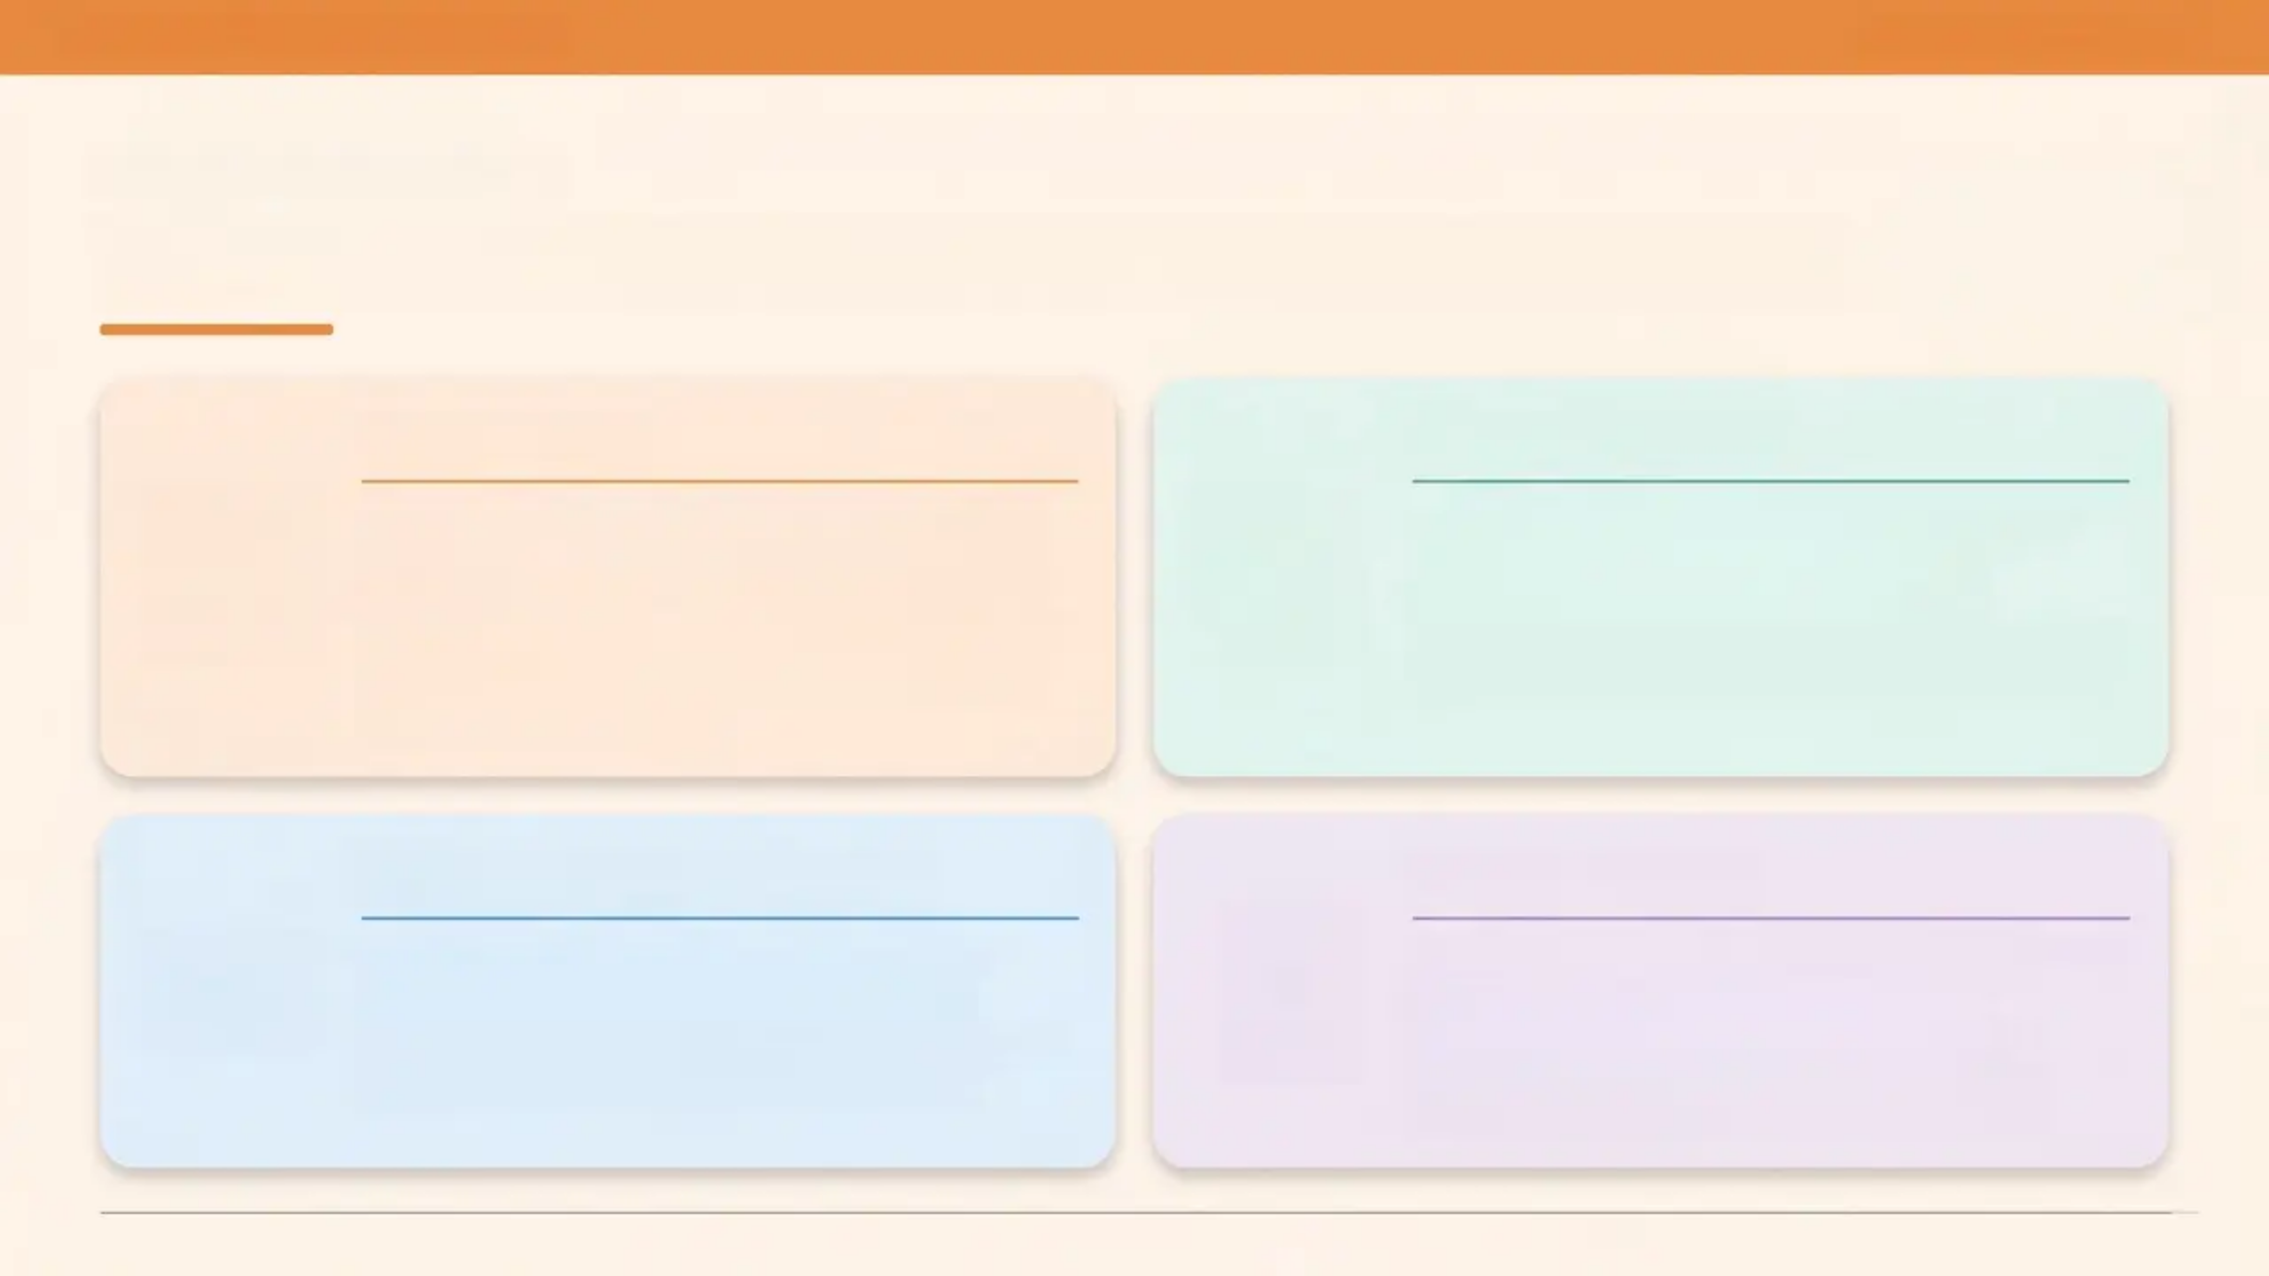




www.bradfordvts.co.uk
PRACTICE DEVELOPMENT
Making Your Practice Young-Person Friendly
Environment
Clinical Practice
• Confidentiality notices visible in waiting room and
consulting room
• Young-person-friendly reception — approachable,
non-intimidating
• Flexible booking: online or phone without speaking to
reception
• Early morning and after-school appointment slots
• Drop-in sessions available
• Opportunistic health promotion at every contact
• Write to all patients on their 14th birthday
introducing services
• Nurse-led drop-in clinic (e.g. Shipley model: 3-6pm)
• PHQ-A and HEADSS embedded in routine reviews
Community Partnerships
Online & Digital
• Partner with local schools and youth services
• Link with Brook, CAMHS, PHSE coordinators
• Know your school nurse and youth worker contacts
• Attend or support young people's health fairs
• Practice website: clear info on what GP can help with
• E-consultation options for sensitive topics
• Text/call follow-up — get their mobile number
• Social media signposting to trusted resources
(YoungMinds, Brook)
Slide 16 of 25 — Bradford VTS Teaching Deck: Consulting with Young People — May 2026

Slide 16
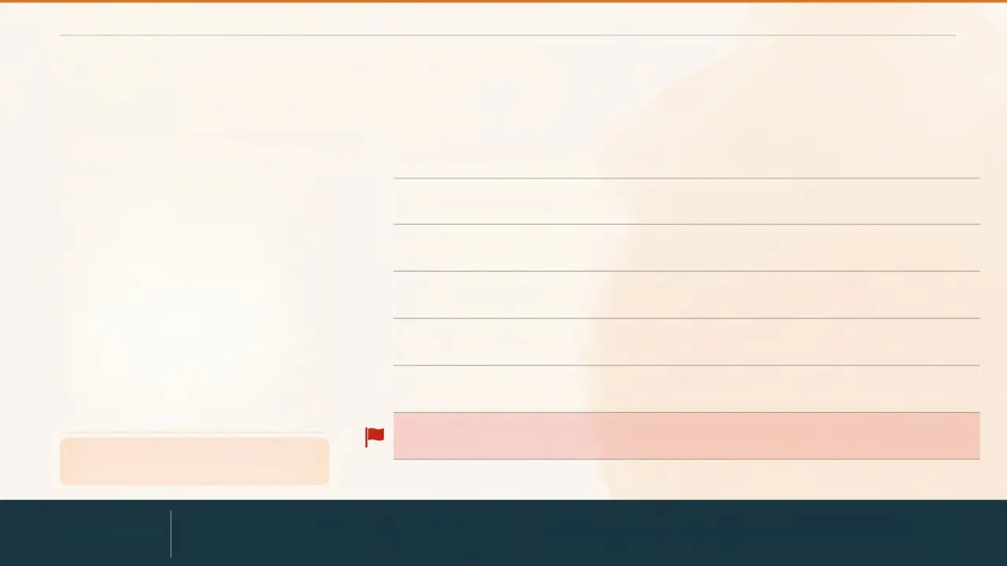
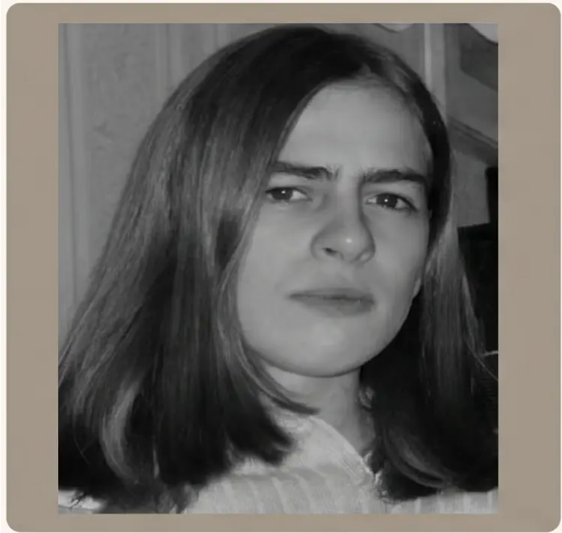
BRADFORD VTS TEACHING DECK
www.bradfordvts.co.uk
CASE STUDY
Tyler
Age 16 — Attends re: knee injury
HEADSS ASSESSMENT REVEALS
H — Home: Living with mum; not talking to dad
E — Education: Attendance down to 60%; struggling with grades
A — Activities: Stopped playing football 3 months ago
D — Drugs: Started smoking cannabis at weekends
S — Sex: Not sexually active; worried about being gay
S — Suicide / Safety: “Sometimes I think no one would miss me”
Seems withdrawn. School attendance
dropping. Parents divorcing.
GP RESPONSE
Acknowledge & validate
& validate
HEADSS safety
assessment
Book 2-week
review
Signpost: Childline • YoungMinds
• Brook • Consider CAMHS referral

Slide 17
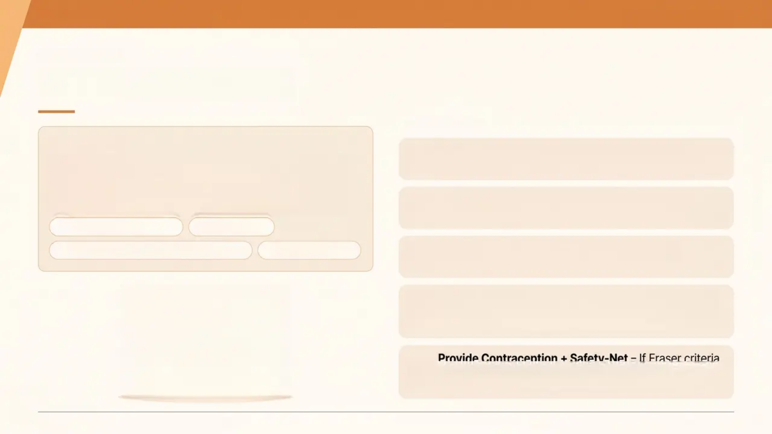
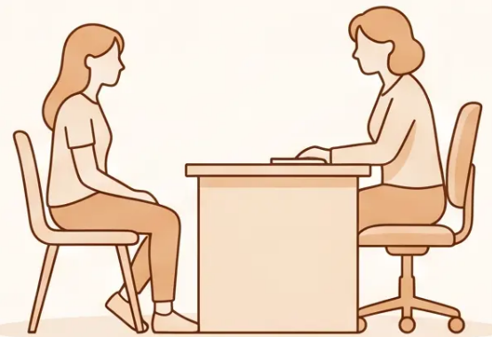
BRADFORD VTS TEACHING DECK
www.bradfordvts.co.uk
CASE STUDY 02
Case Study — Amy
GP RESPONSE
THE SCENARIO
Separate Amy from Mother – 'It's great you've both
come. I'll chat with Amy first – we can all catch up at the end.'
Amy, 17, attends with her mother requesting contraception
for her new boyfriend, aged 20, who she met at Scouts.
Mother dominates the consultation and answers on Amy's
behalf.
Assess the Relationship – Controlling dynamics?
Significant age gap (3 years, met in position of trust at Scouts)?
Age gap concern (17 & 20)
Venue concern
Venue concern (Scouts — position of trust)
3-way consultation
Fraser Assessment – Apply all 5 criteria before
providing contraception. Document clearly.
Safeguarding Check – Age gap + Scouts venue =
potential adult in position of trust. Consider CSERQ15 /
local safeguarding pathway.
Provide Contraception + Safety-Net – If Fraser criteria
met and no safeguarding bar. Arrange follow-up; ensure
Amy knows she can return alone.
Created May 2026 — Updated to current GMC 0-18 and NICE 2024/2025 standards

Slide 18
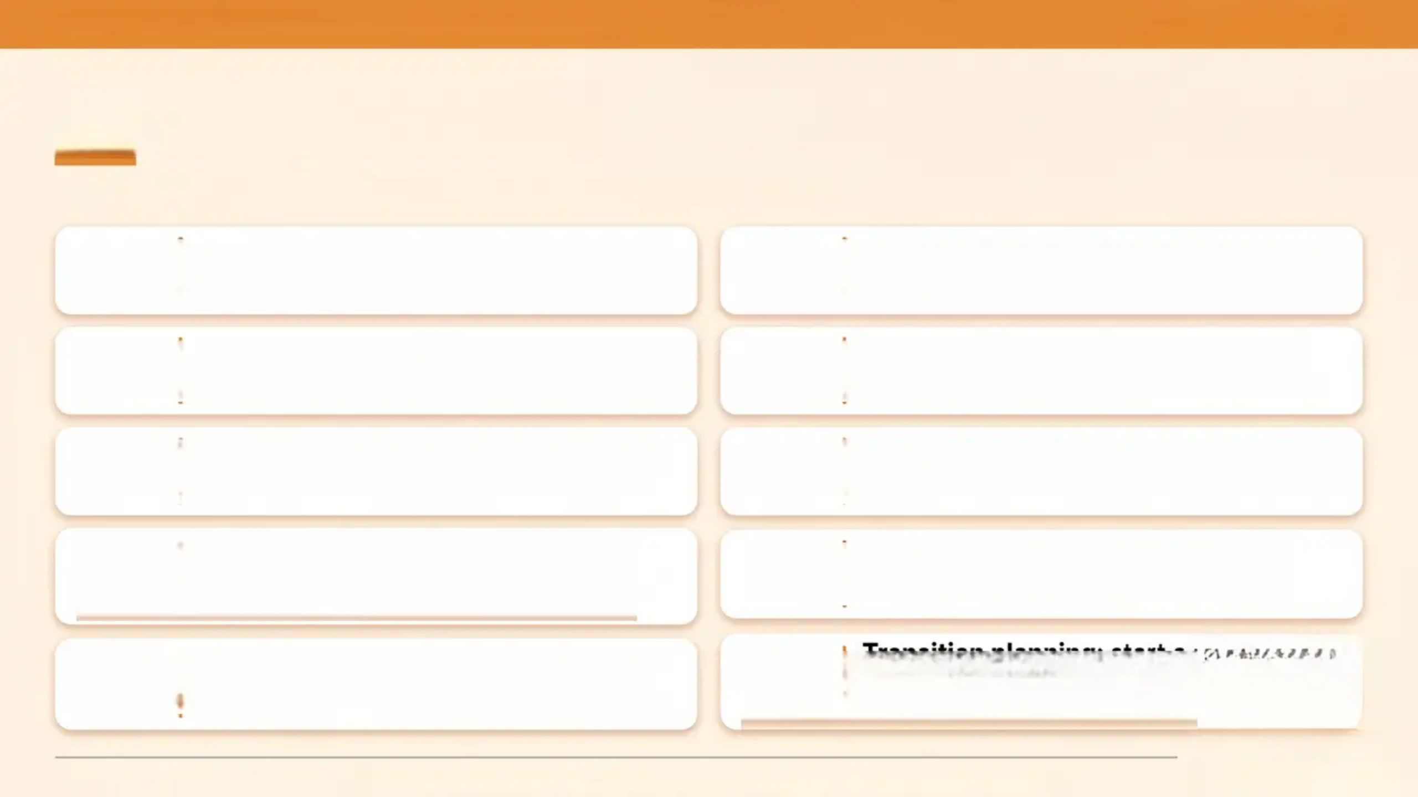
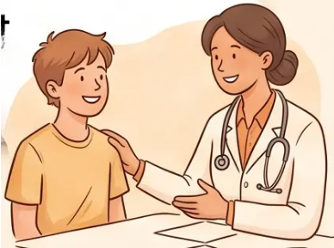
BRADFORD VTS — CONSULTING WITH YOUNG PEOPLE
www.bradfordvts.co.uk
Top Tips for GPs
Ten strategies that make a real difference in every consultation
01
Always offer to see young people alone
— every consultation, every time
06
Get their mobile number — follow-up by
text or call is effective and appreciated
02
Explain confidentiality clearly and early
— it builds trust and opens doors
07
Brief interventions for substance use
work — and they're quick
03
Use HEADSS — it surfaces hidden
agendas efficiently and systematically
08
Involve young people in decisions
about their own health — shared agenda
04
Don't assume — ask about sexuality,
relationships, and substance use
without judgement
09
Know your local services: CAMHS,
Brook, school nurse, youth services
The presenting complaint is often not
the real concern — stay curious
10
Transition planning: start at
14-16; young people fall
through the gap at 18
05
Slide 19 of 25 — Bradford VTS Teaching Deck: Consulting with Young People — May 2026

Slide 19
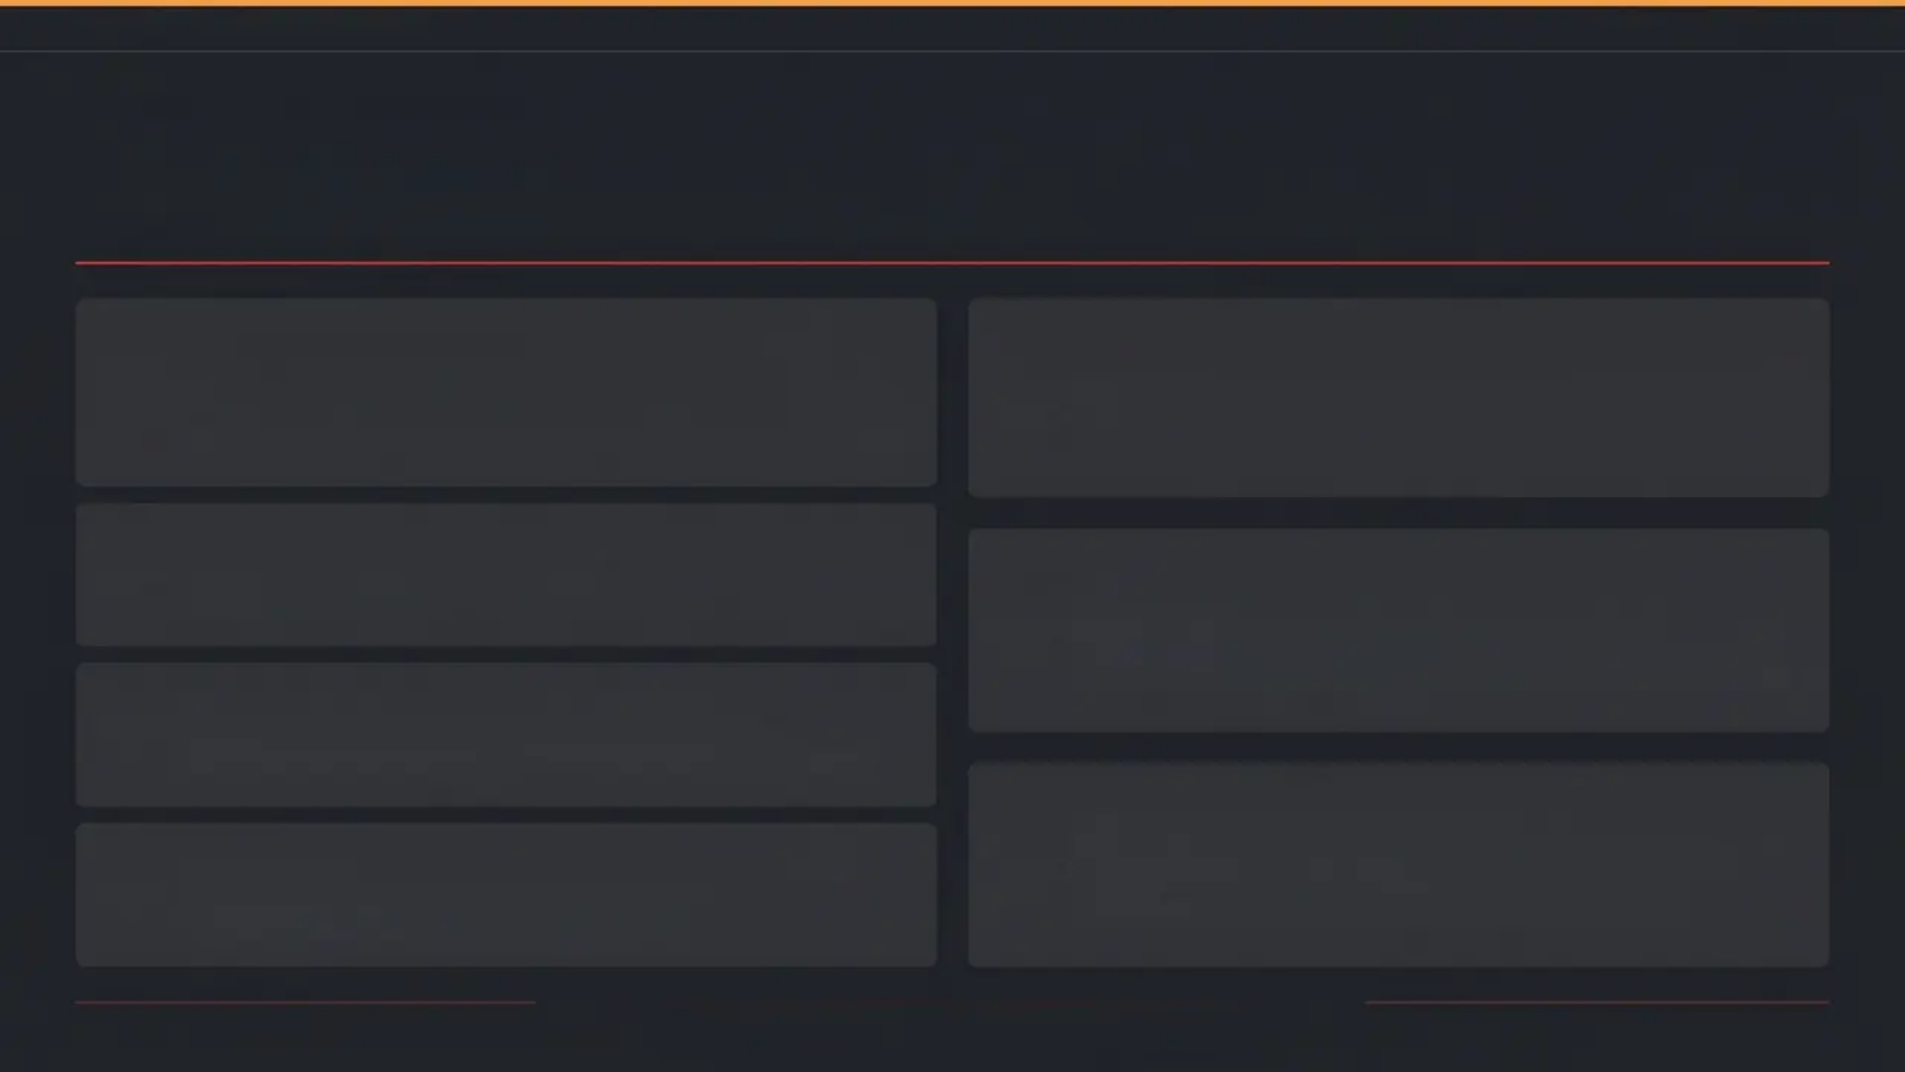








BRADFORD VTS TEACHING DECK
www.bradfordvts.co.uk
Red Flags
Indicators requiring urgent assessment, disclosure, or referral
Passive suicidal ideation or self-harm
disclosure
Psychosis symptoms in young person
Urgent CAMHS / early intervention service — do not delay
Immediate safety assessment + same-day CAMHS contact
Under-13 sexual activity
Young person with chronic illness
deteriorating
Disclosure almost always required — legal inability to consent
Transition / care planning review; check for disengagement
Significant age gap in relationship
Safeguarding concern — consider CSERQ15 assessment
Parent appearing to control or intimidate
young person
Rapidly escalating substance misuse
Safeguarding assessment; offer consultation alone
Urgent review; consider specialist referral
When in doubt — act. Document your reasoning. Seek senior advice.
Bradford VTS • www.bradfordvts.co.uk • May 2026

Slide 20
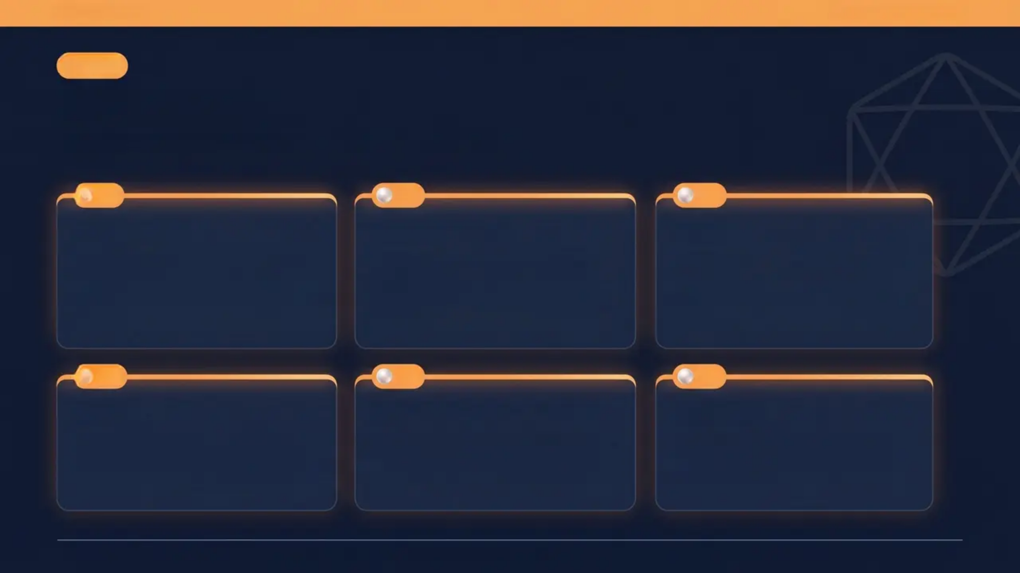
www.bradfordvts.co.uk
AKT
Exam Pearls
High-yield facts for your Applied Knowledge Test
01
02
03
HEADSS
15-19 > 1-4
1 in 3
Validated psychosocial
assessment tool for young
people — the standard framework
in UK primary care
Death rates in 15-19 year olds
exceed those in 1-4 year olds.
Causes: accidents, violence,
violence, suicide
Young people presenting to GP
have a diagnosable mental
health problem — only 1 in 3 are
identified
04
05
06
>50%
Fraser Guidelines
Cu-IUD
Adult mental health problems
begin in childhood or adolescence
— most are diagnosable by age 14
5 criteria required for consent to
contraception in under-16s —
distinct from Gillick competence
Copper IUD: most effective
emergency contraception — up
to 5 days after unprotected sex
Slide 21 of 25 — Bradford VTS Teaching Deck: Consulting with Young People — May 2026

Slide 21
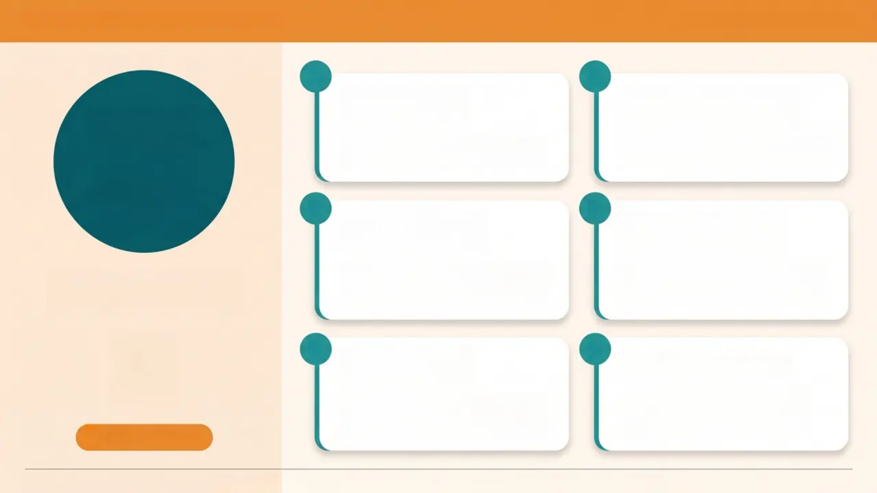
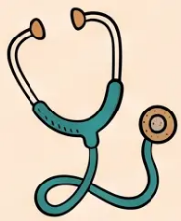

“BRADFORD VTS TEACHING DECK”
www.bradfordvts.co.uk
1
2
SCA
See the Young
Person Alone
Explain
Confidentiality Early
Always offer this as routine — not
an exception. Make it feel normal.
Say it at the start. Demonstrate the
exact phrase in your consultation.
Simulated
Consultation
Assessment
3
Use the HEADSS
Framework
4
Explore the Hidden
Agenda
What examiners want
to SEE you do
Show you know the structure. Use
it when psychosocial issues are
present.
Presenting complaint is rarely the
whole story. Show curiosity — ask
what else is on their mind.
5
Manage 3-Way
Dynamics
6
Avoid Assumptions
Balance the young person's
privacy with the parent's concern.
Show both are held.
Don't presume heterosexuality,
drug-free status, or family
stability. Ask openly.
Clinical Skills
Slide 22 of 25 — Bradford VTS Teaching Deck: Consulting with Young People — May 2026

Slide 22
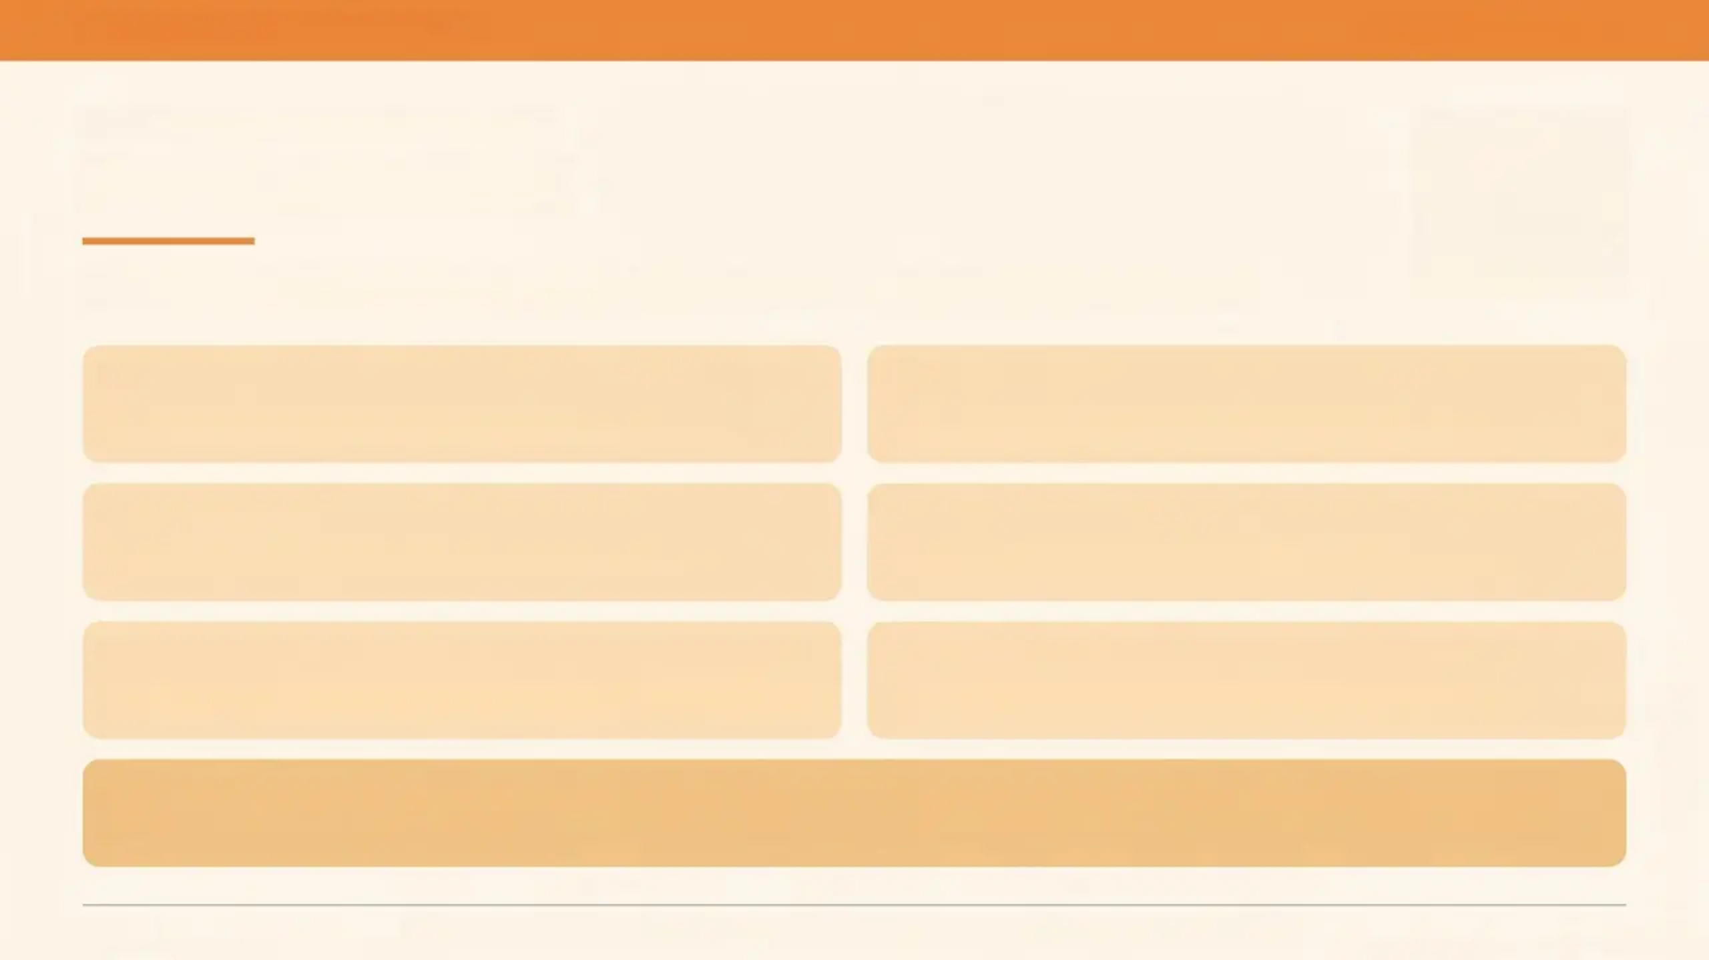
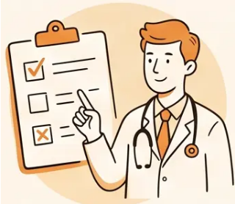
www.bradfordvts.co.uk
CONSULTING WITH YOUNG PEOPLE
Common Pitfalls
Mistakes that are easy to make — and easy to avoid once you know them
Not offering to see the young person
alone when a parent is present
Not explaining confidentiality early — a
lost opportunity to build trust
Using adult-focused communication —
too much information, too risk-focused
Assuming non-compliance with chronic
illness is deliberate disengagement
Focusing only on the presenting complaint
and missing the hidden agenda
Not knowing local CAMHS, Brook, and
young people's service pathways
Missing transition planning — waiting until the young person is already 18 is too late
Slide 23 of 25 — Bradford VTS Teaching Deck: Consulting with Young People — May 2026

Slide 23
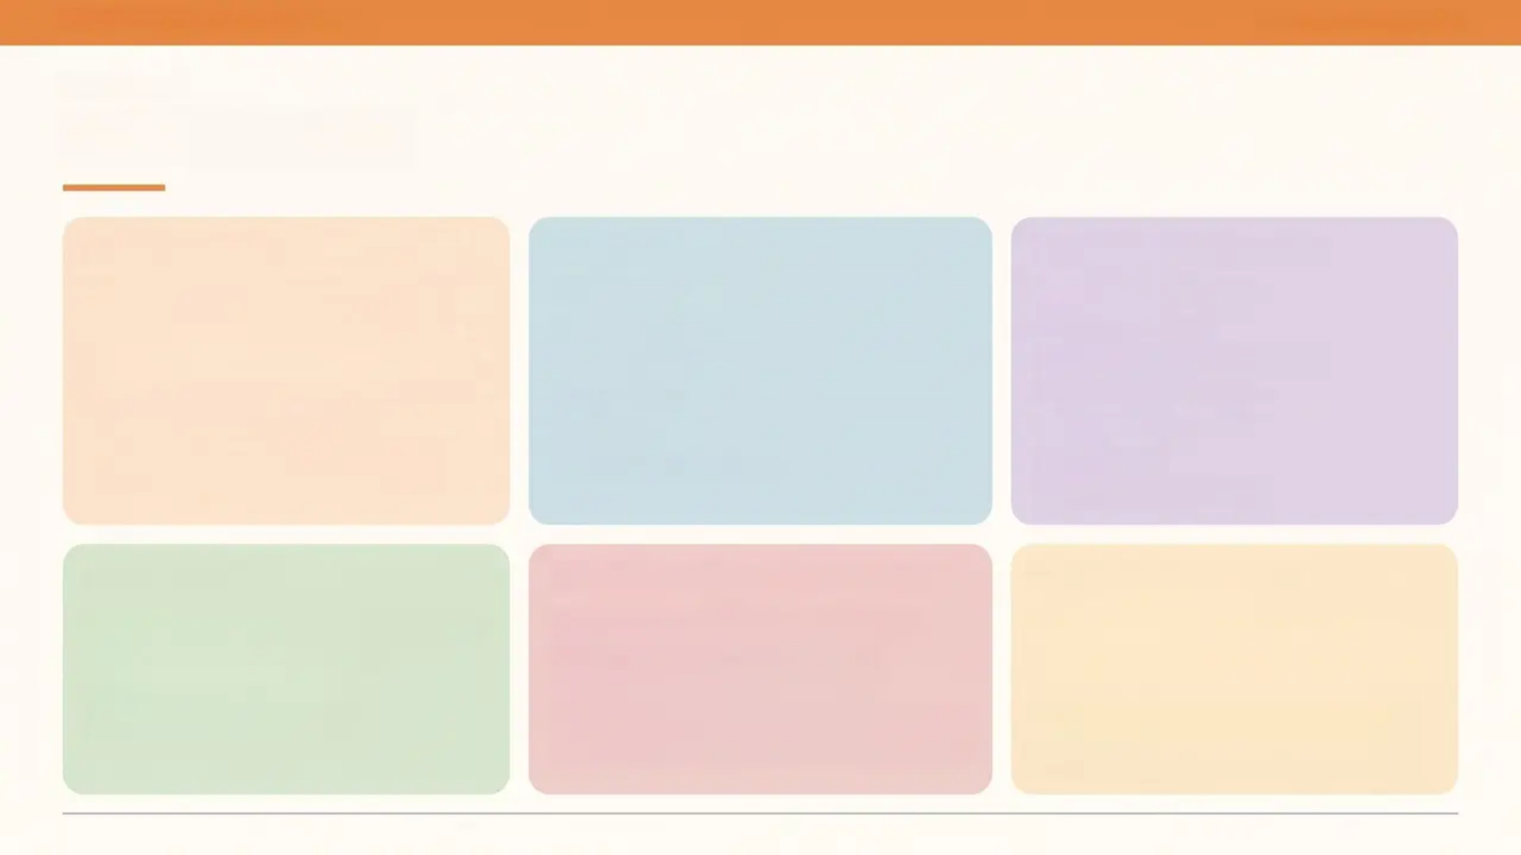
BRADFORD VTS TEACHING DECK
www.bradfordvts.co.uk
REVISION
Quick Recall
KEY STATISTICS
HEADSS
7 BARRIERS TO ACCESS
• Death rates 15-19 exceed those in
1-4 year olds
• Causes: accidents • violence • suicide
• 1 in 3 to GP → mental health problem
• Only 1 in 3 identified by GP
• 50%+ adult MH conditions start in
adolescence
• H — Home
• E — Education
• A — Activities
• D — Drugs
• S — Sex
• S — Suicide / Safety
• Confidentiality fears
• Embarrassment
• Communication / language
• Practice environment
• Lack of information
• Geography
• Appointment system
ALWAYS DO
EMERGENCY CONTRACEPTION
CLINICAL QUICK HITS
• See young person alone — every time
• Explain confidentiality early
• Ask about hidden agenda
• Get their mobile number
• Levonorgestrel 1.5mg → within 72h
• Ulipristal acetate → within 120h
(more effective)
• Copper IUD → within 5 days ✦ most effective
• Fraser Guidelines: 5 criteria for under-16s
• Fluoxetine: only licensed SSRI under-18s
• Chlamydia: doxycycline 100mg BD × 7 days
• PHQ-A: score ≥10 → depression likely
• CAMHS urgent: intent + plan + means
• Transition planning: begin age 14-16
Always verify drug doses and guidelines against current BNF/NICE guidance.

Slide 24
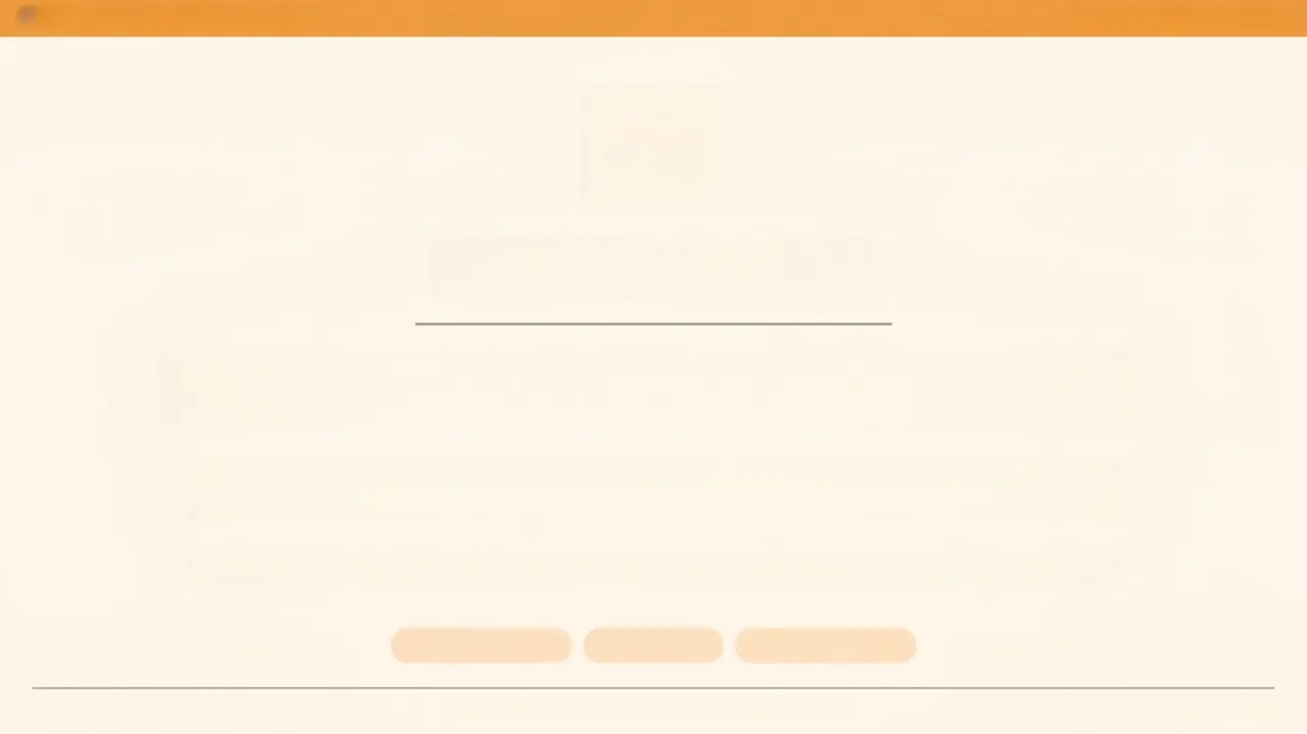

BRADFORD VTS TEACHING DECK
www.bradfordvts.co.uk
Important Notice
Always verify drug doses and clinical advice against the latest NICE
guidelines and BNF before applying in clinical practice.
This teaching deck is intended for educational purposes only and does not
constitute clinical guidance.
Created May 2026 — updated to current GMC 0–18 and NICE 2024/2025 standards.
NICE Guidelines
BNF / BNFC
GMC 0–18 Years
Bradford VTS — GP Training — www.bradfordvts.co.uk
Slide 25 of 25

