Slide 1

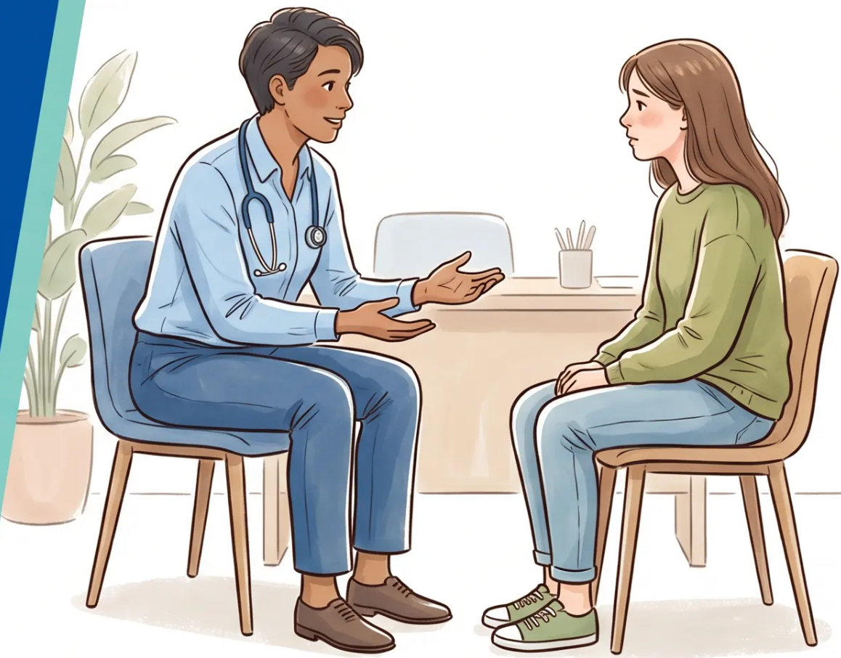
Bradford VTS Teaching Deck
CLINICAL EDUCATION SERIES
Eating Disorders
in Children and
Young People
Updated to NICE NG69 standards (reviewed 2024)
Created May 2026
www.bradfordvts.co.uk
Eating Disorders · Recognition · Treatment · Emergency Action
⚠️ For educational purposes only — always verify with current NICE/BNF guidance
Bradford VTS
NICE NG69 · Junior MARSIPAN · NHS England CYP Standards
May 2026

Slide 2
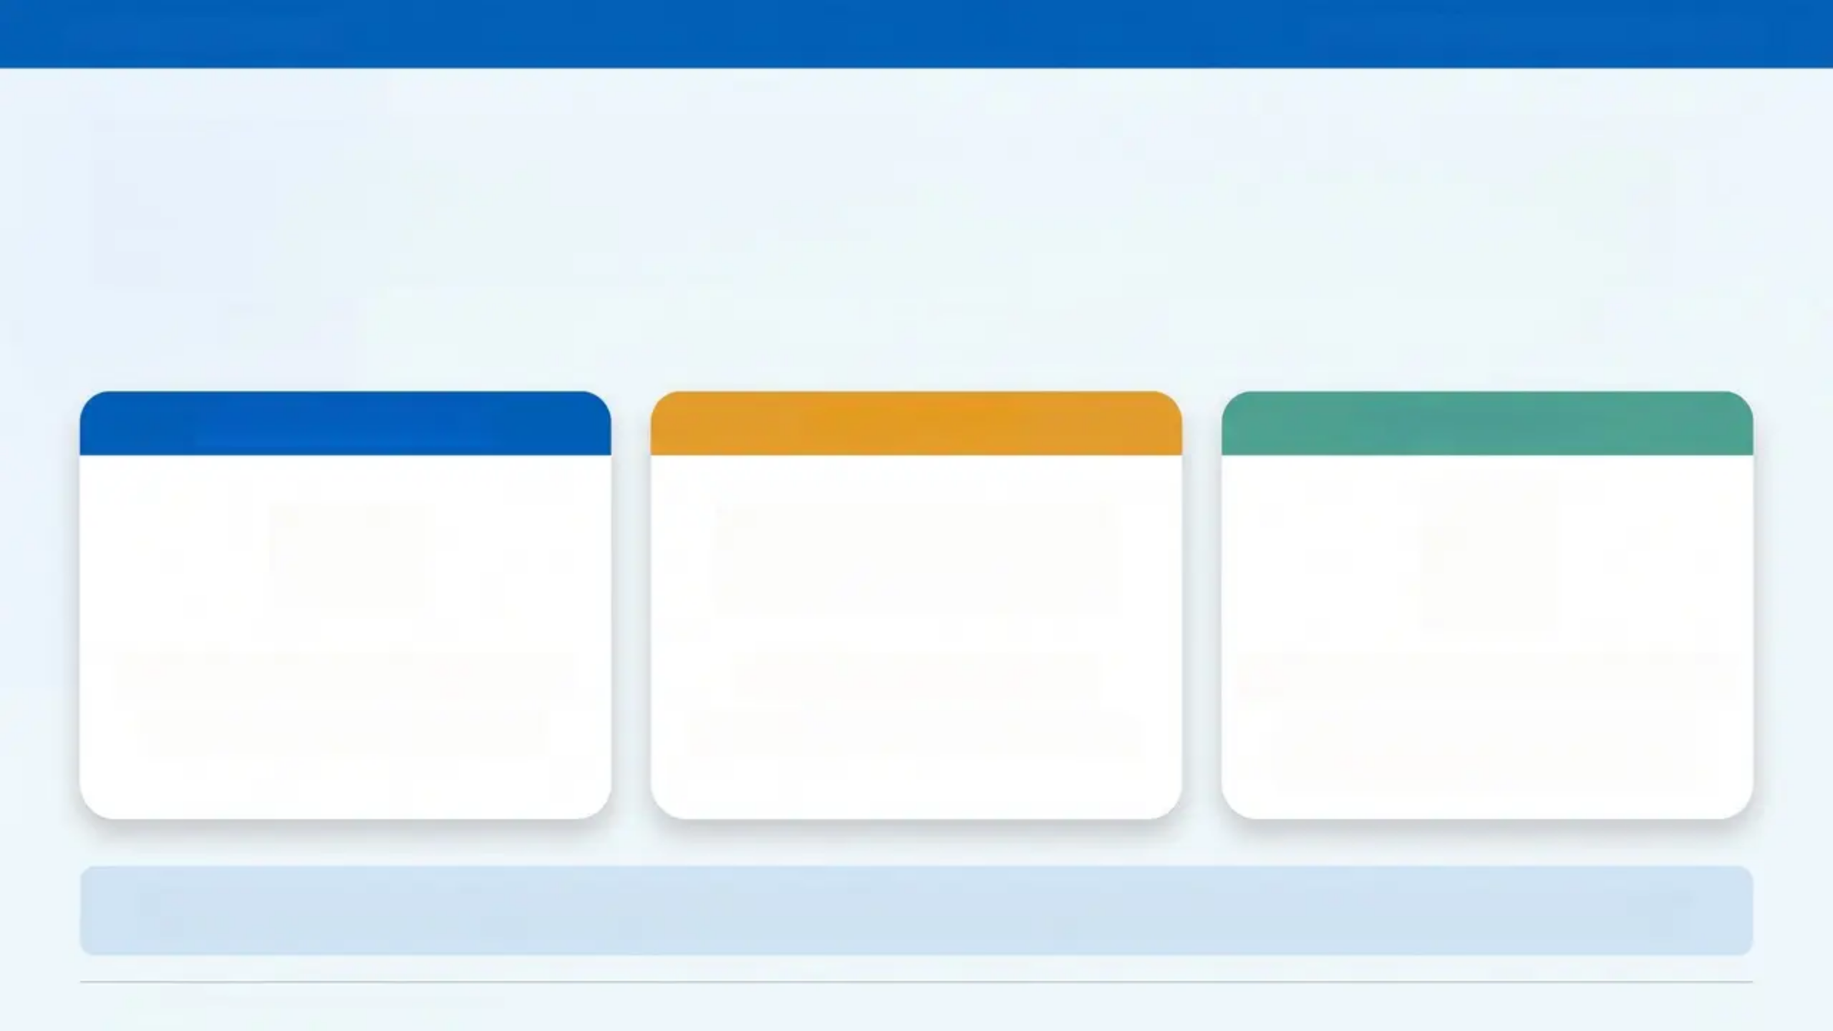

WHY THIS MATTERS
Bradford VTS · Eating Disorders in CYP
Anorexia Nervosa Has the Highest Mortality
Rate of Any Mental Illness.
GPs are often the first — and most critical — point of contact.
Prevalence surge
COVID surge
Early detection
5×
+129%
Prevalence in under-16s
Urgent ED referrals
Early detection saves lives
0.5% (2017) → 2.6% (2023)
During 2020-21 (COVID effect)
Most patients attend GP with
other complaints first
“By the time obvious signs appear, behaviours are deeply ingrained and harder to treat.”
Bradford VTS Teaching Deck — May 2026
Slide 3

Slide 3







NICE NG69 / DSM-5
Types of Eating Disorders
Anorexia
Nervosa
Bulimia
Nervosa
Binge Eating
Disorder
ARFID
Atypical AN
Avoidant/Restrictive/
FID
Do not dismiss
AN
BN
BED
• Restriction →
significantly low
body weight
• Binge eating +
compensatory
behaviours
• Recurrent binges,
loss of control
• Sensory aversion,
fear of
consequences
• All AN criteria met
• BUT weight is
normal or above
• No compensatory
behaviours
• NOT driven by
body image
• Intense fear of
weight gain
• Vomiting,
laxatives,
excessive exercise
• Equally serious —
do not reassure
• Significant
distress and guilt
• More common in
autistic young
people
• Distorted body
image
• Often normal
body weight
Source: NICE NG69 / DSM-5
Bradford VTS · May 2026

Slide 4
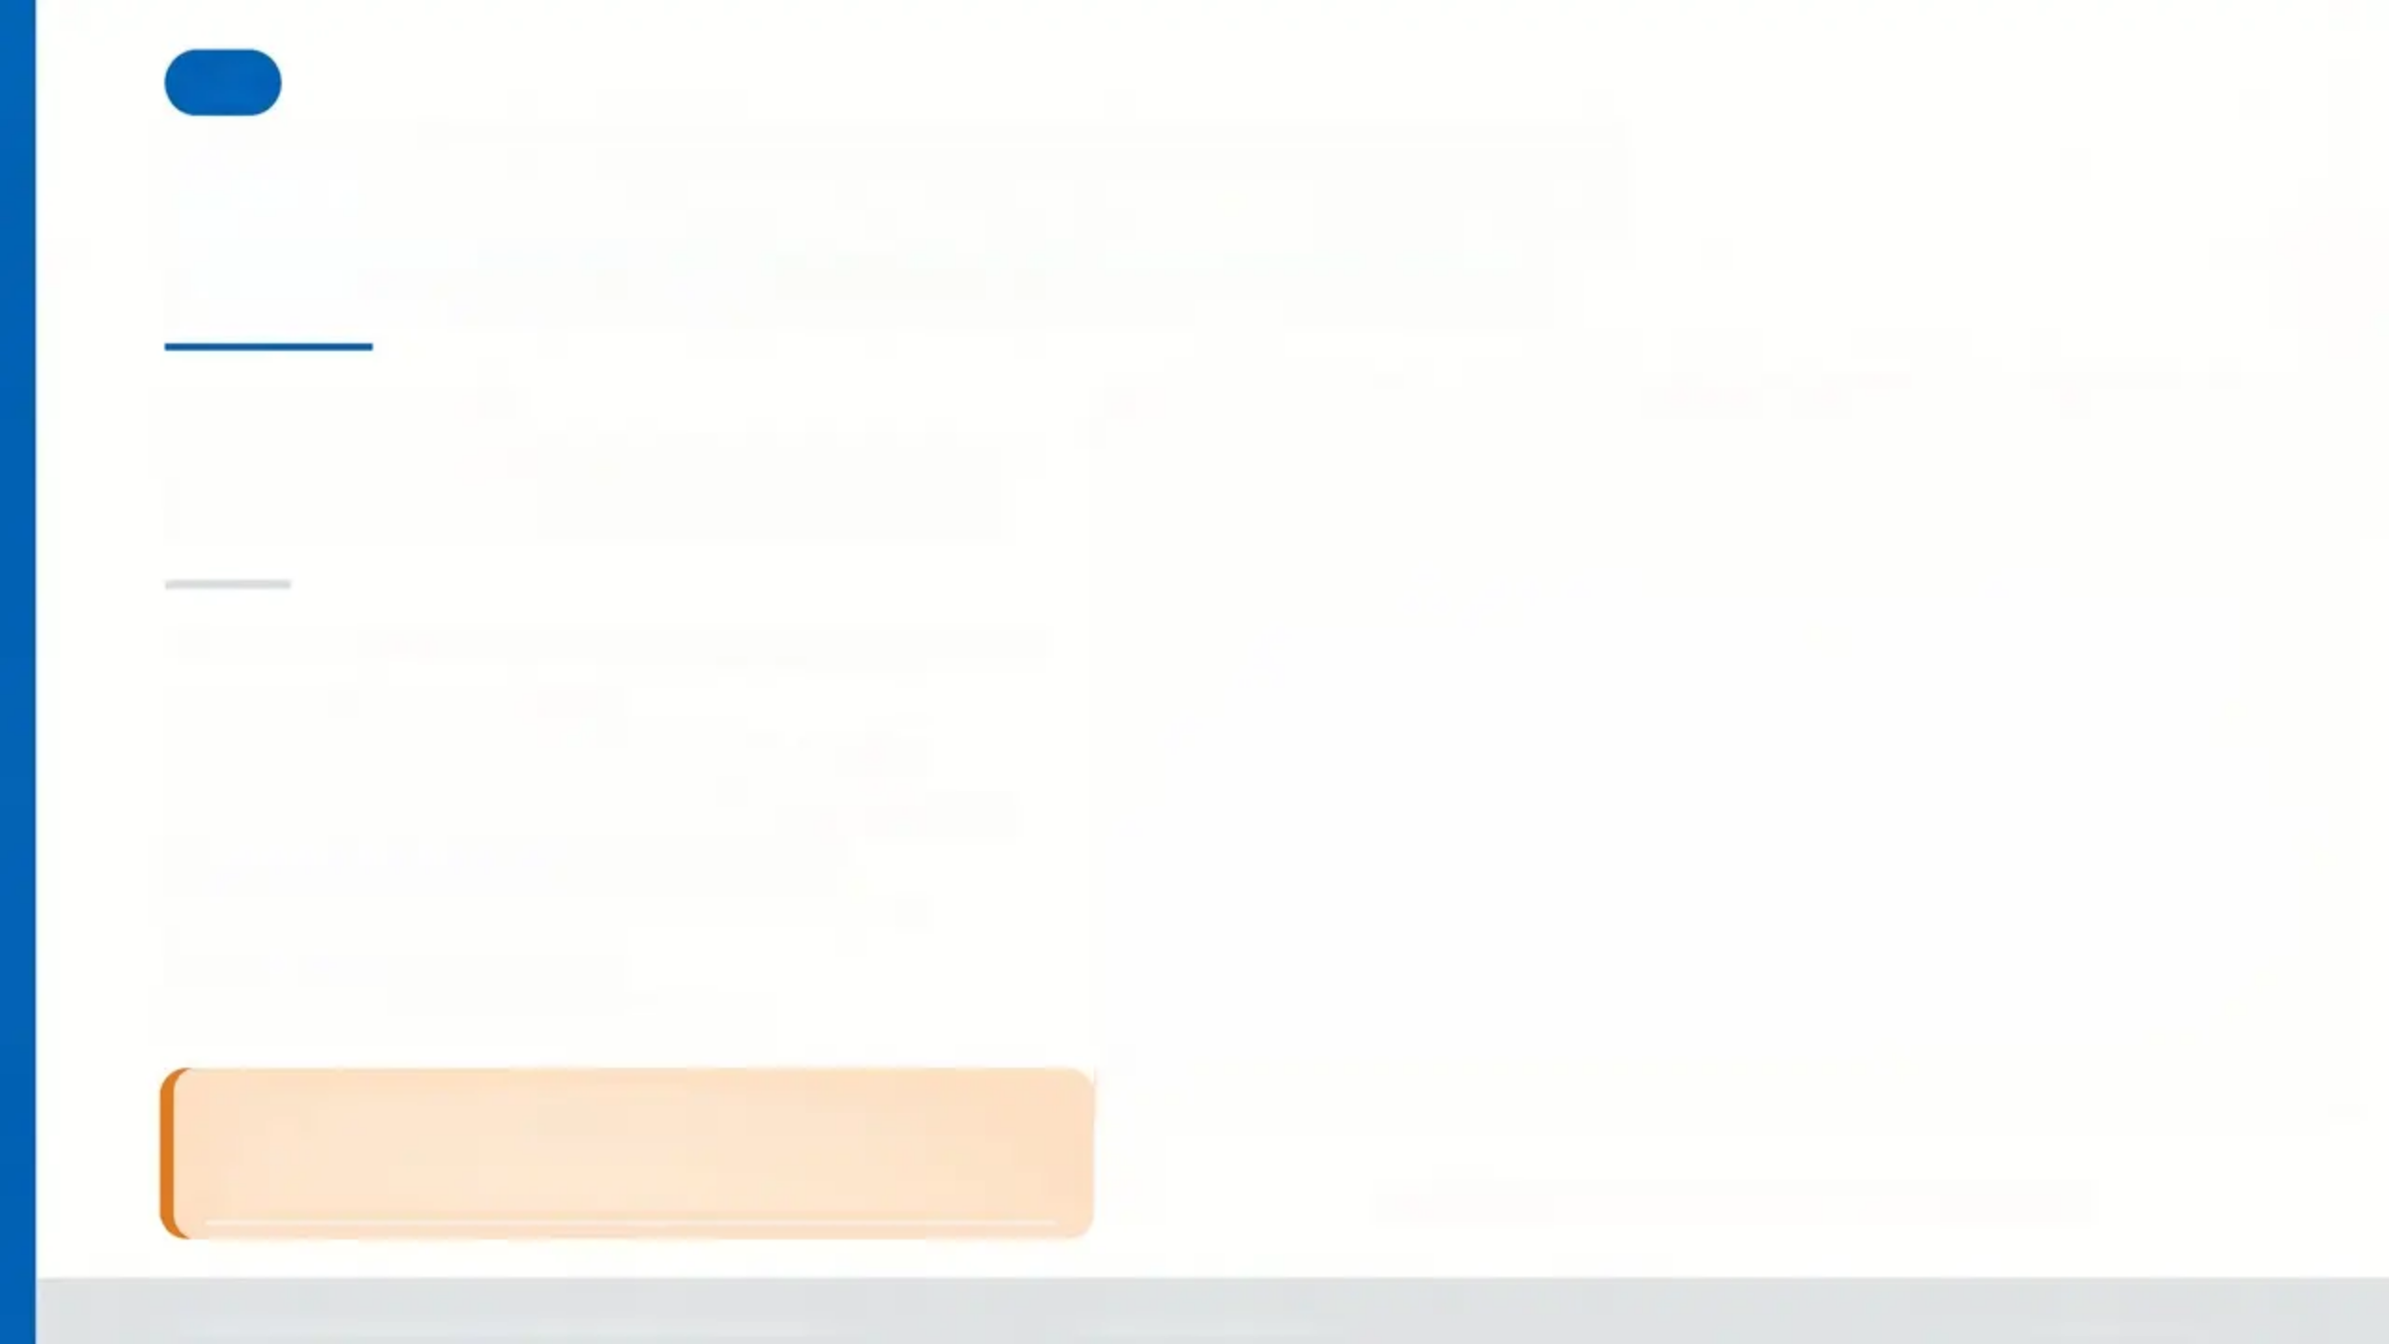
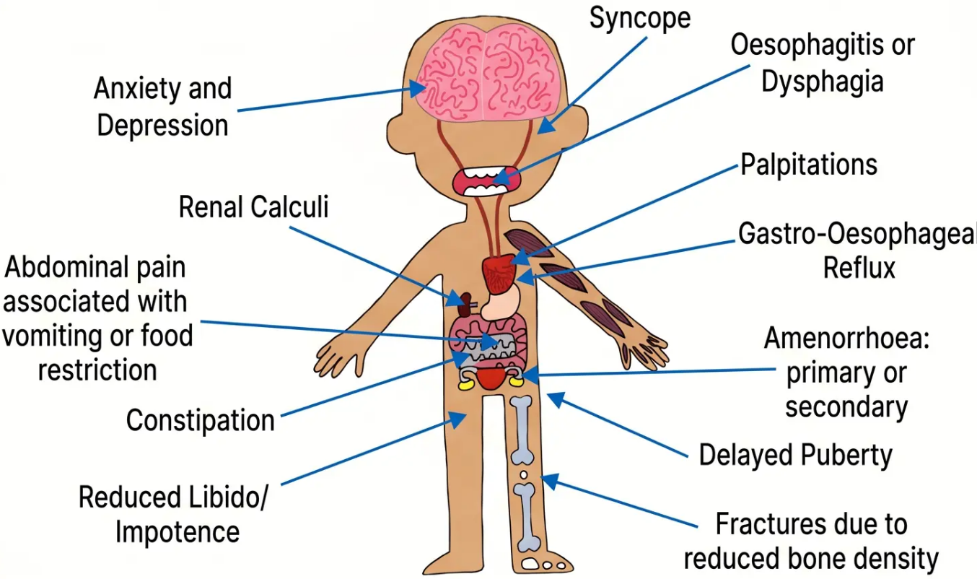
05
Spotting EDs in Primary Care
Patients rarely say “I have an eating disorder”
WHO IS AT RISK?
EDs affect all genders, ethnicities, body
weights, and backgrounds — do not assume.
COMMON NON-SPECIFIC PRESENTATIONS
■ Fatigue and low mood
■ Amenorrhea or menstrual irregularity
■ Dental erosion or frequent dental problems
■ Recurrent headaches or dizziness
■ Abdominal pain, bloating, constipation
■ Parotid gland swelling
■ Fainting or postural symptoms
Think ED when the picture doesn't quite fit.
*The young person with repeated, unexplained somatic
complaints may be presenting indirectly.
Source: Hines, 2020 — Eating Disorder Pocket Guide
Bradford VTS Teaching Deck — Eating Disorders in CYP
NICE NG69 | May 2026
www.bradfordvts.co.uk

Slide 5
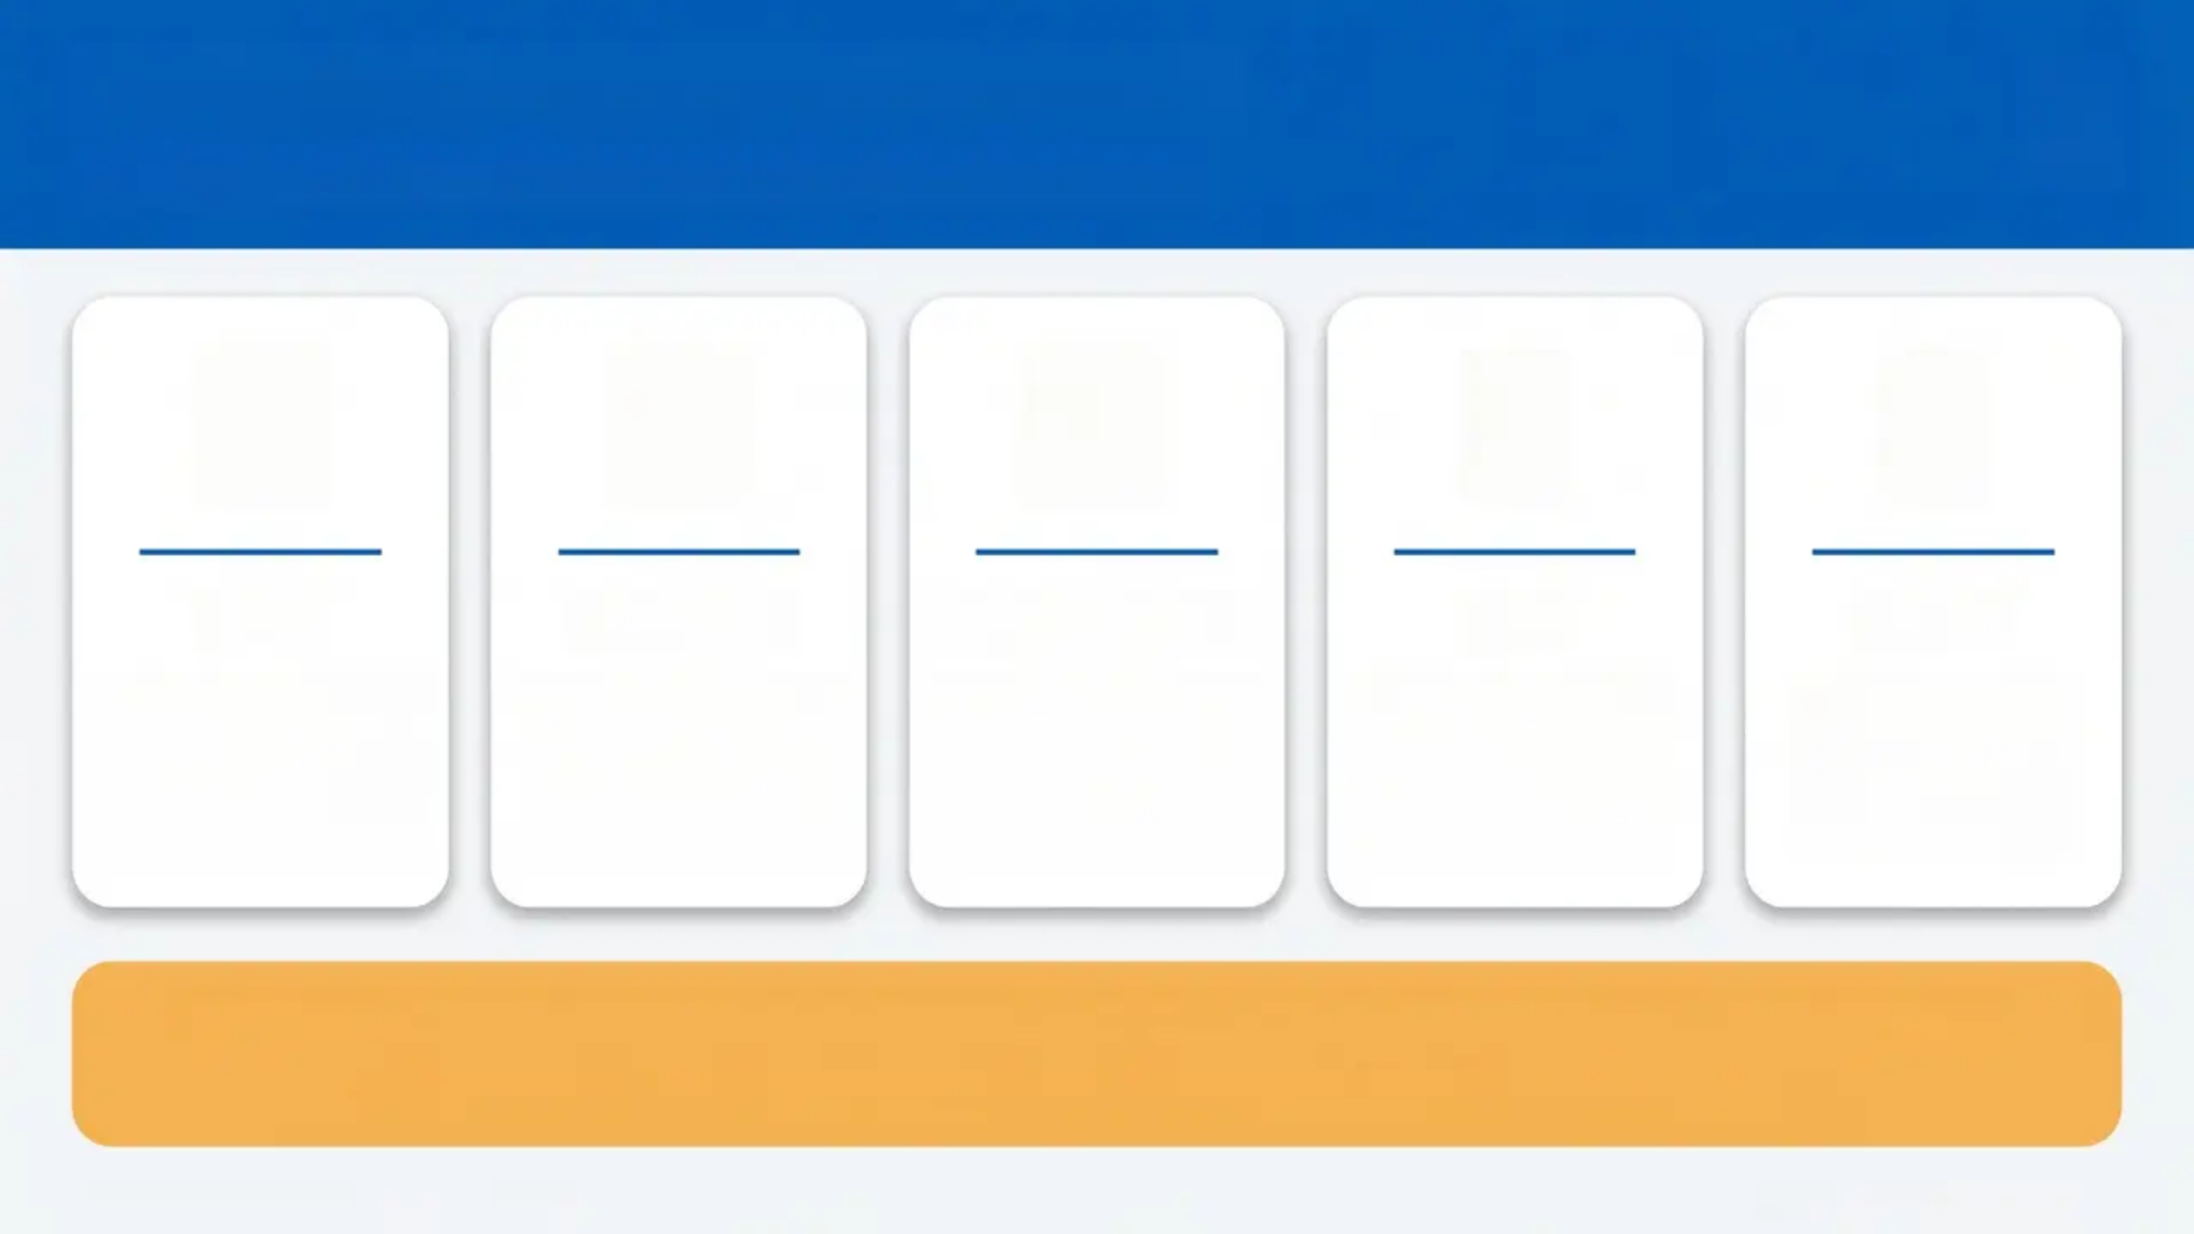

“The SCOFF Questionnaire”
Validated 5-item screening tool for primary care
S
C
O
F
F
Sick
Control
One stone
Fat
Food
Do you make
yourself Sick
because you feel
uncomfortably full?
Do you worry you
have lost Control
over how much
much you eat?
Have you recently
lost more than
One stone in
weight?
Do you believe
yourself to be Fat
when others say
you are thin?
Would you say
that Food
dominates your
life?
Score ≥ 2
Indicates a possible eating disorder — warrants further assessment
SCOFF is a screening tool, not a diagnostic instrument. Patients may underreport.
Bradford VTS — Eating Disorders in CYP
NICE NG69 / NICE CKS 2024

Slide 6
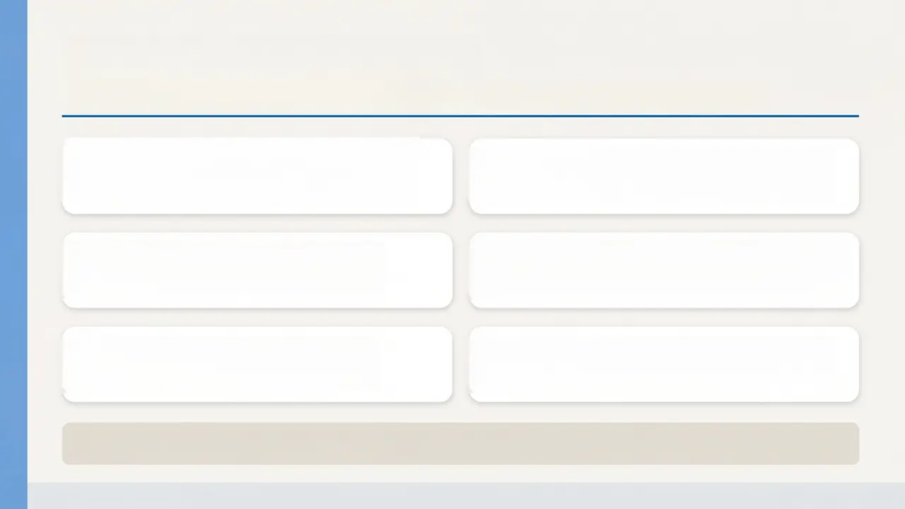
Exploring the Diagnosis
*Questions to use in consultation — AN / BN / disordered eating*
'Have you set yourself strict rules
around food?'
'Do you feel you have a constant
internal battle about what to eat?'
'How do you feel about social
events involving food?'
'How often do you weigh yourself —
and how does it make you feel?'
'Do you find yourself thinking
about food most of the day?'
'Do you have feelings of guilt after
eating certain foods?'
Also explore: Exercise habits • Relationships • Family support • School / occupation
Bradford VTS Teaching Deck
NICE NG69 / DSM-5

Slide 7
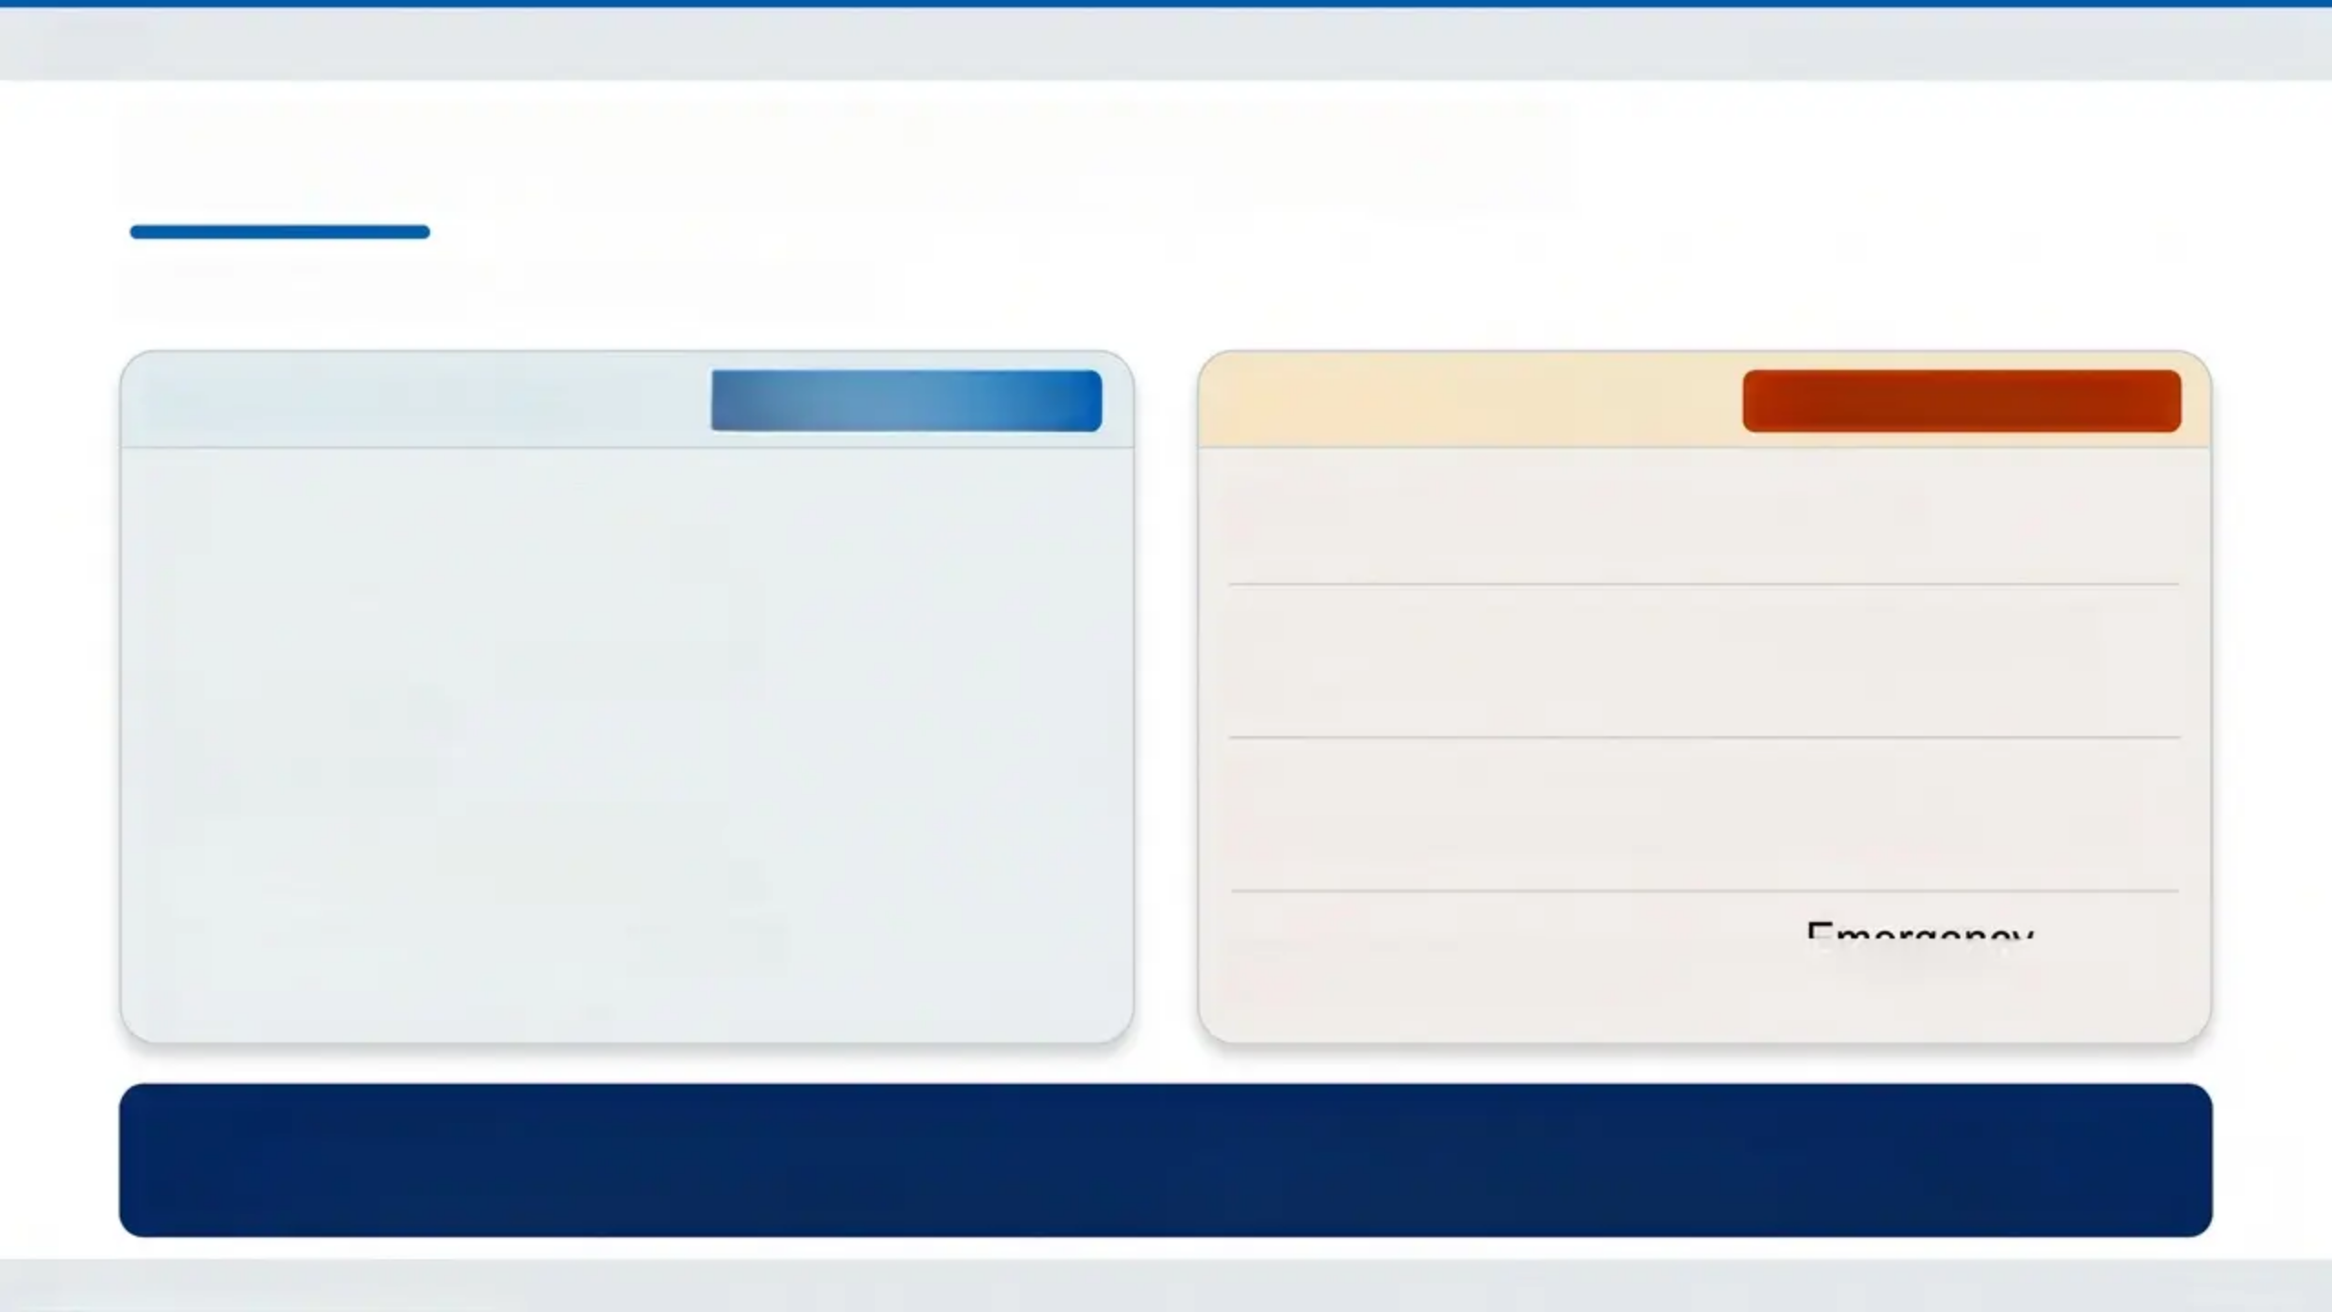
Bradford VTS | Eating Disorders in CYP
Investigations and Physical Risk
NICE NG69 / Junior MARSIPAN
Essential Investigations ALWAYS REQUEST
Danger Thresholds
⚠️ CRITICAL VALUES
• FBC — anaemia screen
• U&Es — electrolyte status
• LFTs — malnutrition marker
• Glucose — hypoglycaemia
• Magnesium
• Phosphate
• Calcium — refeeding risk
• Creatinine — renal function
• Thyroid function tests (TFTs)
• ECG — QTc interval
K < 3.0 mmol/L → Arrhythmia risk
→ Refeeding
syndrome risk
Phosphate < 0.5 mmol/L
→ Cardiac arrhythmia
— immediate review
QTc > 450ms
Emergency
admission
Severe hypoglycaemia →
Normal blood results do NOT rule out a serious eating disorder
Many patients with eating disorders have entirely normal biochemistry — clinical judgement must prevail
Bradford VTS Teaching Deck — May 2026
Slide 8 of 24

Slide 8
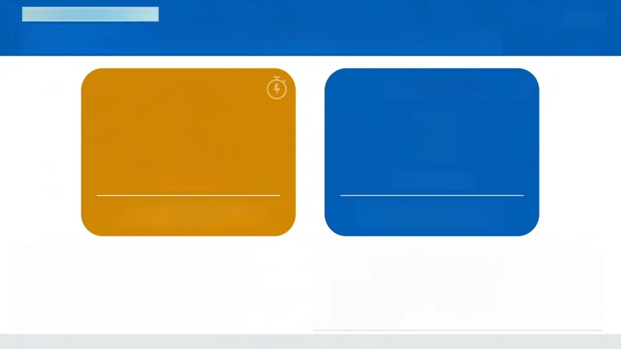

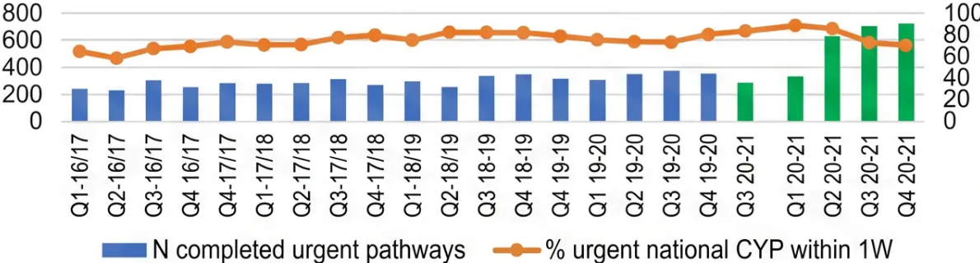
NHS ENGLAND STANDARD
NHS England CYP ED Access Standards
URGENT
ROUTINE
1
4
WEEK
WEEKS
Treatment must start within
1 week of referral
Treatment must start within
4 weeks of referral
- • Refer to community-based, specialist,
age-appropriate CYP ED team — not
generic CAMHS
- • Integrated with inpatient pathway when needed
- • Self-referral available in many areas
Bradford VTS
NICE NG69 / NHS England CYP ED Programme
May 2026

Slide 9
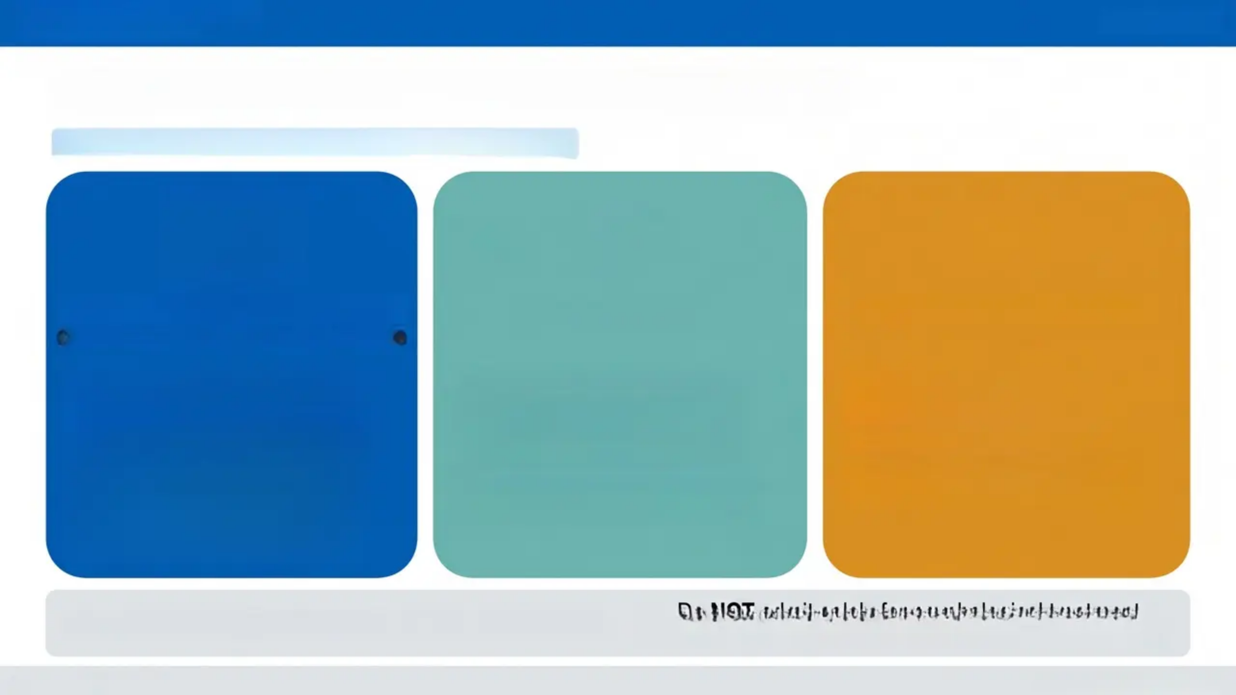
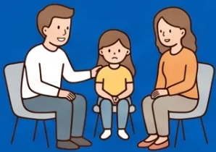


Bradford VTS Teaching Deck
www.bradfordvts.co.uk
NICE NG69
Treatment for Anorexia Nervosa
NHS
NG69 — Children and Young People (Under 18s)
First-Line: Family-Based Therapy
If FBT Not Accepted
Inpatient Admission When...
Maudsley Model — strongest evidence base for under-18s
- Family takes the lead in restoring
nutrition
- Therapist facilitates and supports
the family
- Target healthy weight AND
psychological recovery together
- Dietary rehabilitation alongside
psychological treatment
- Cognitive Analytical Therapy (CAT)
- CBT for Eating Disorders (CBT-
ED)
- Individual psychological therapy
- Engage young person in shared
decision-making
- Physically compromised and
community management
insufficient
- Severe suicide or self-harm risk
- Medical emergency criteria met
(see Junior MARSIPAN)
Do NOT admit solely for psychological treatment —
age-appropriate facilities required
Do NOT discharge solely on reaching healthy weight
Slide 10 of 24
May 2026 — Bradford VTS

Slide 10
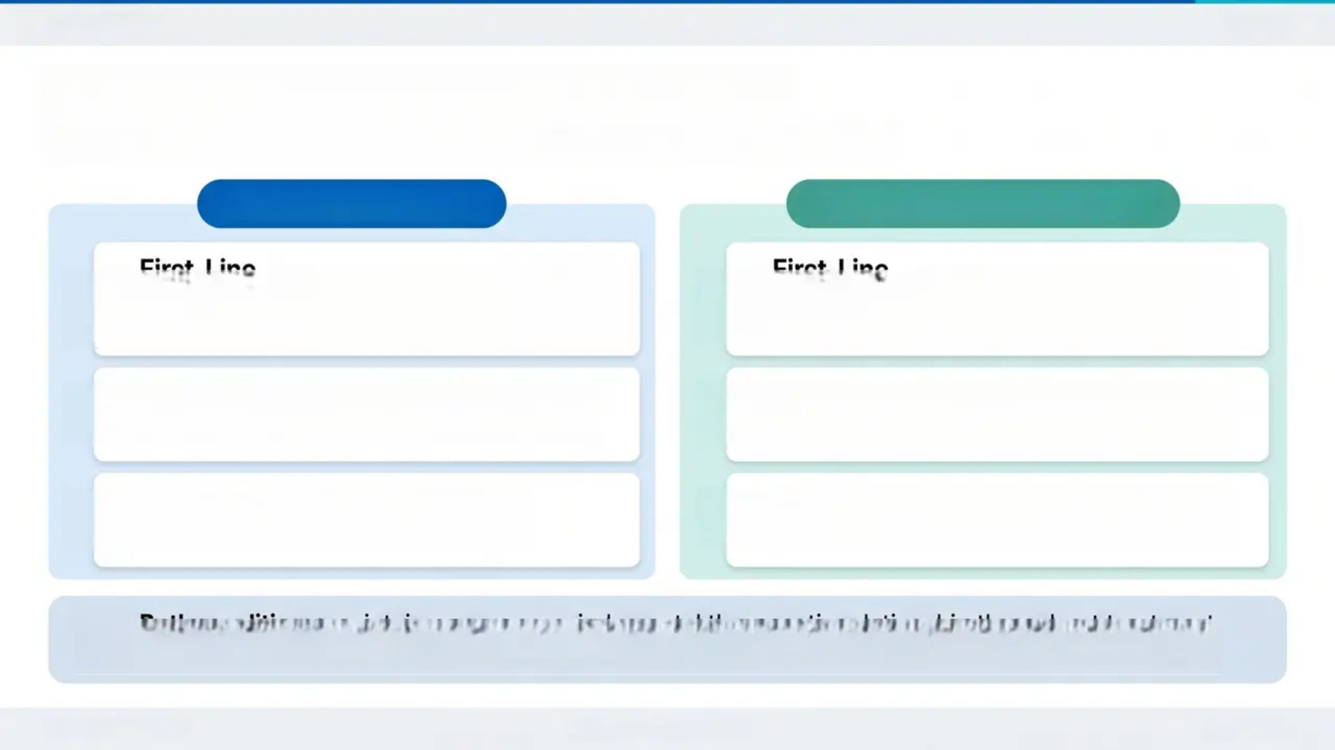
Bradford VTS
11 / 24
Treatment: Bulimia Nervosa & BED
NICE NG69 — Stepped Care for Children and Young People
Bulimia Nervosa (BN)
Binge Eating Disorder (BED)
First-Line
First-Line
1
Family-Based Therapy (FBT)—adapted for BN
*Involves family in disrupting binge-purge cycle
1
Guided self-help—first step for all CYP with
BED
If FBT Not Accepted
2
Psychological Therapy
2
Individual CBT for Eating Disorders (CBT-ED)
Individual or group CBT for Eating Disorders
First Step / Lower Intensity
Physical Health
3
3
Guided self-help as initial intervention
Monitor and manage physical complications
Both conditions: maintain a warm, non-judgmental therapeutic relationship throughout treatment.
Do not attempt specialist ED therapy in primary care.
NICE NG69 | BNF
www.bradfordvts.co.uk
May 2026

Slide 11


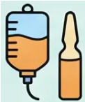





NICE NG69 / BNF
Drug Treatment Considerations
Recommended / Consider
RECOMMENDED
Multivitamin Supplement
Thiamine (Pabrinex) + Phosphate
A
B
Essential before and during refeeding — prevents
refeeding syndrome and Wernicke's encephalopathy
Recommend while awaiting specialist treatment
Use with Caution / Specialist Only
SPECIALIST GUIDANCE REQUIRED
Fluoxetine 60 mg/day
Olanzapine (AN)
A
B
Evidence for BN in adults only
May be considered in specialist settings only
Not routinely recommended for under-18s — seek specialist advice
Not first-line — weight gain utilised therapeutically
Avoid
AVOID IN LOW-WEIGHT PATIENTS
Tricyclic Antidepressants (TCAs)
High-Dose Antipsychotics
A
B
Cardiac arrhythmia risk with electrolyte disturbances
QTc prolongation risk — dangerous in malnourished
patients with electrolyte imbalance
No medication is licensed specifically for anorexia nervosa. Treat comorbid depression and anxiety per standard NICE guidelines. Always check ECG before prescribing.
Bradford VTS Teaching Deck — Eating Disorders in CYP
NICE NG69 reviewed 2024 | www.bradfordvts.co.uk

Slide 12
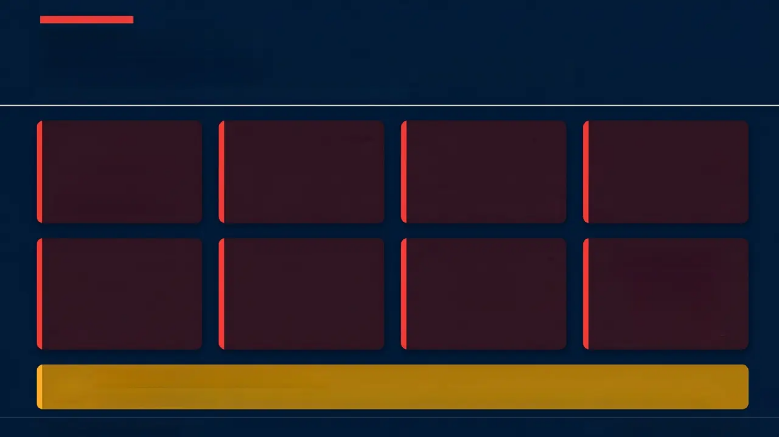

Junior MARSIPAN
Emergency Admission Criteria — Act on ANY Single Criterion
Admit to paediatric medical ward — NOT a psychiatric unit
BMI
Potassium (K⁺)
Phosphate
Magnesium
< 13 kg/m²
< 3.0 mmol/L
< 0.5 mmol/L
< 0.5 mmol/L
(or severe underweight
for age)
arrhythmia risk
refeeding syndrome risk
electrolyte emergency
QTc (ECG)
Heart Rate
Blood Glucose
Clinical Signs
Severe
hypoglycaemia
Organ failure
signs
> 450 ms
< 40 bpm
cardiac arrhythmia risk
severe bradycardia
immediate emergency
inability to manage
safely as outpatient
Refeeding Syndrome Prevention
Give Pabrinex (thiamine/B1) + phosphate supplementation BEFORE and DURING refeeding
Junior MARSIPAN — RCPsych CR168
Bradford VTS | www.bradfordvts.co.uk

Slide 13
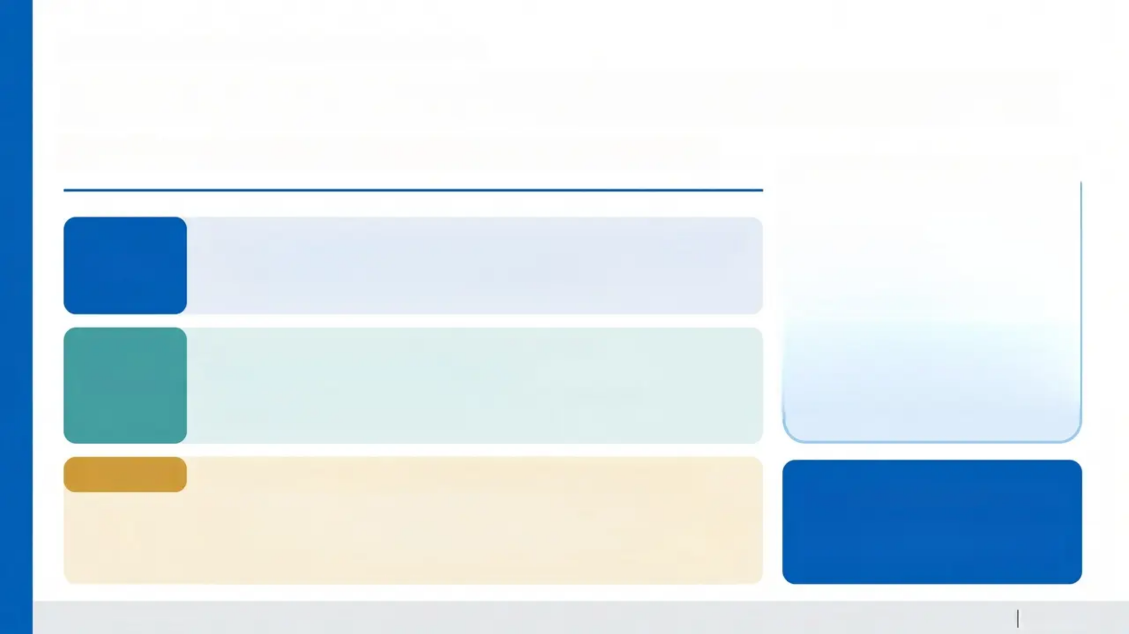
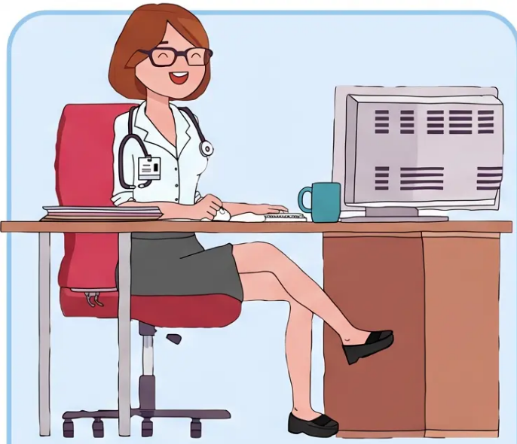

GP ROLE WHILE AWAITING REFERRAL
The Bridge Between Referral and Specialist Care
Your responsibilities don't end when you refer — they shift.
Regular review — at least weekly or fortnightly for higher-risk patients
• Weight, BMI, pulse, blood pressure (lying and standing), temperature
• Repeat bloods and ECG if any clinical concern arises
MONITOR
Signpost to Beat: www.beateatingdisorders.org.uk
• Encourage a daily multivitamin supplement
• Maintain a warm, non-judgmental therapeutic relationship
• Do NOT attempt specialist ED therapy yourself
SUPPORT
SAFETY-NET
• If patient refuses referral: document clearly, continue to encourage,
consider safeguarding — especially for under-16s
• Advise family or carer to contact GP urgently if rapid deterioration occurs
• Safety-net message: “If you feel faint, have chest pain, or stop eating —
come back or go to A&E”
Be Proactive, Not Reactive
Regular review protects your
patient and your clinical position.
Bradford VTS Teaching Deck — Eating Disorders in CYP
NICE NG69 | May 2026

Slide 14
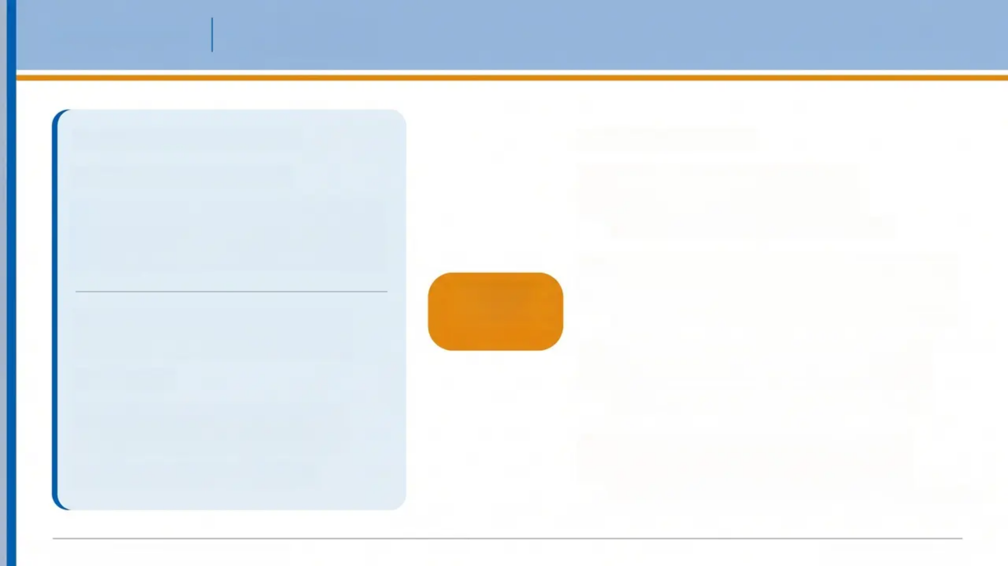
CASE STUDY
Sophie, 15
Slide 15 of 24
CLINICAL SCENARIO CARD
CLINICAL RESPONSE
PRESENTING COMPLAINT
1
SCOFF positive — examine,
investigate (bloods + ECG)
Sophie is 15 years old. She attends
with “stomach problems” and
missed periods.
FBC, U&Es, Mg, PO₄, Ca, glucose, TFTs, ECG
2
Explain concern without confrontation;
use non-judgmental language
What do
you do?
Past history of perfectionism
and sporting excellence
“I’m concerned about your health and want to help you”
3
Urgent referral to CYP ED specialist
team — within 1 week if clinical risk
BMI 17.5
Parents unaware she has
stopped eating family meals
NHS England CYP ED Standard — urgent: 1 week
4
Involve parents sensitively — FBT
requires family engagement
SCOFF score: 4 out of 5
Maudsley FBT depends on family involvement from the start
Bradford VTS — Eating Disorders in CYP
www.bradfordvts.co.uk

Slide 15
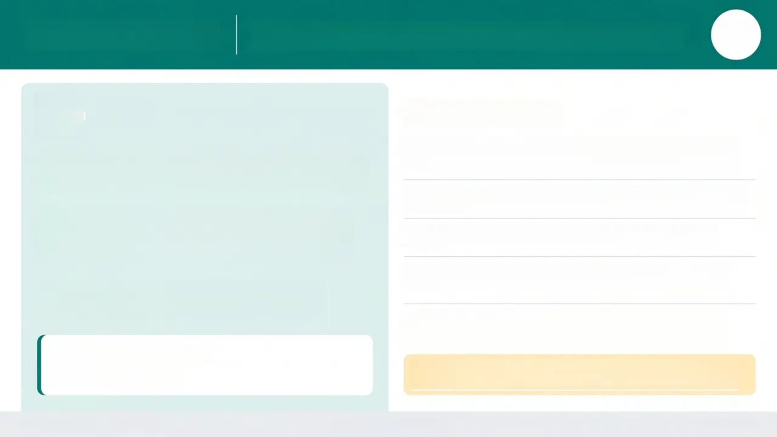

CASE STUDY 2
Age
17
Recognising Bulimia Nervosa in a Young Man
Jake
Your Response
1
Non-judgmental, validating approach — normalise
the disclosure
Jake is 17 years old. He attends with fatigue,
bloating, and constipation — no mention of eating.
2
SCOFF questionnaire + further exploratory questions
On examination: parotid gland swelling and
dental erosion are noted. BMI is 22 — within the
normal range.
3
Bloods + ECG — check electrolytes, QTc interval
4
Urgent referral to CYP ED team — within 1 week if
clinical risk
When gently explored: a 6-month history of
binge-purge cycles emerges.
5
Safety-net — advise patient and family on warning
signs
What is your diagnosis?
Bulimia Nervosa
⚠️ Don't miss it in males. Boys and young men are significantly
under-recognised. BMI 22 does not exclude an eating disorder.
Bradford VTS Teaching Deck
www.bradfordvts.co.uk
May 2026

Slide 16
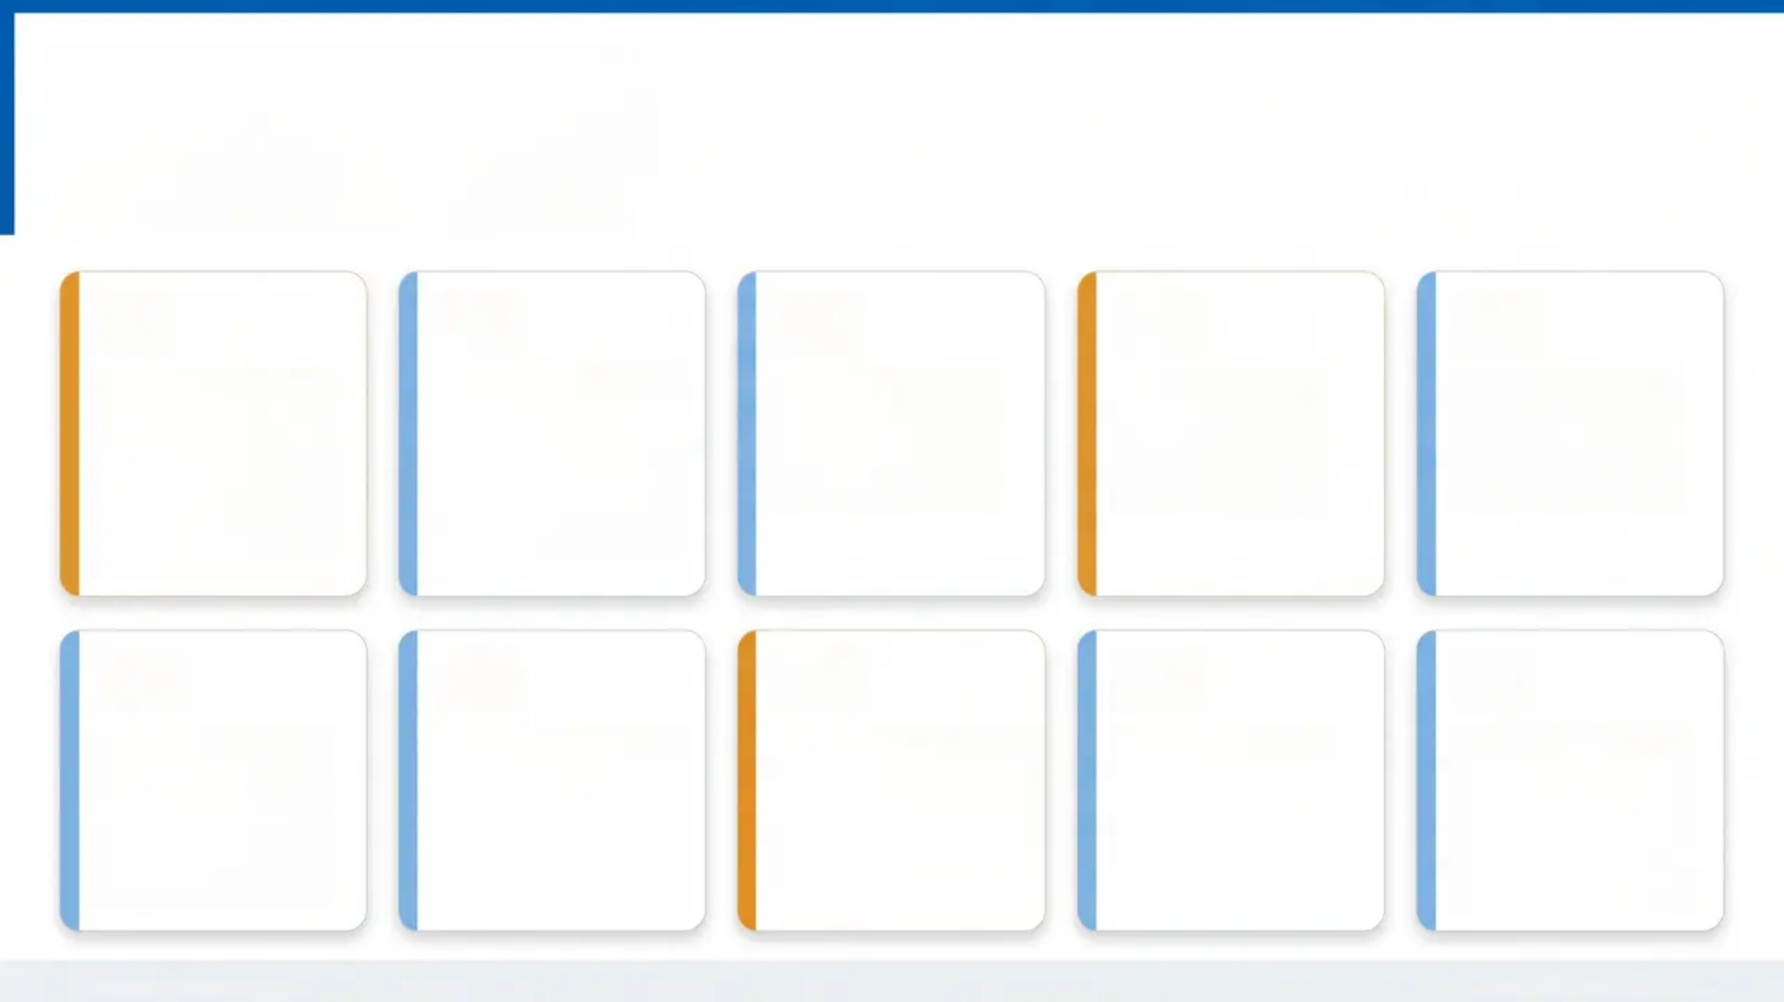
BRADFORD VTS — EATING DISORDERS IN CYP
Top Tips for GPs
10 things you must know
01
02
03
04
05
Anorexia nervosa
has the highest
mortality of any
mental illness —
always take it
seriously
Normal weight
does NOT rule out
an eating disorder
atypical AN, BN,
BED all present at
normal weight
SCOFF ≥2
positives =
suspect eating
disorder → refer
Normal blood
results do NOT
rule out serious
physical risk
Urgent referral:
treatment within
1 week; routine:
within 4 weeks
06
07
08
09
10
Family-based
therapy (FBT) is
first-line for
under-18s with
anorexia nervosa
Do not delay
referral waiting for
blood results —
refer on clinical
suspicion
Always request an
ECG — QTc
prolongation signals
life-threatening
arrhythmia risk
Males and boys are
significantly under-
recognised —
never assume EDs
are female-only
Maintain a warm
therapeutic
relationship with
the patient while
on the waiting list
Bradford VTS Teaching Deck
NICE NG69 (reviewed 2024)

Slide 17
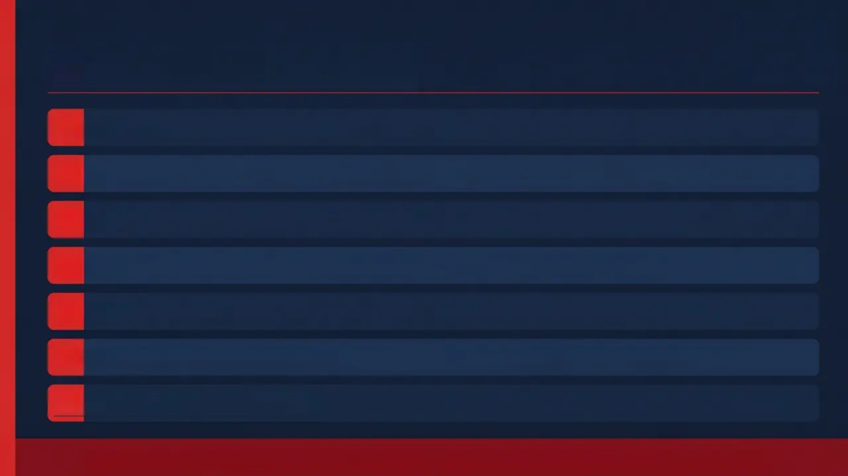
⚠️ EMERGENCY REFERENCE
Red Flags — Act Now
Syncope or cardiac arrhythmia
→ Emergency admission immediately
QTc >450 ms on ECG
→ Urgent medical review — cardiac arrhythmia risk
K⁺ <3.0 mmol/L or Phosphate <0.5 mmol/L
→ Admit — electrolyte emergency
BMI <13 kg/m² (or severe underweight for age)
→ Emergency medical admission
Severe hypoglycaemia
→ Immediate emergency admission
Refusal to eat + rapid weight loss
→ Urgent specialist review — do not wait
Signs of refeeding syndrome
→ Pabrinex + phosphate + medical supervision
Admit to PAEDIATRIC MEDICAL WARD — not psychiatric unit — for medical stabilisation

Slide 18
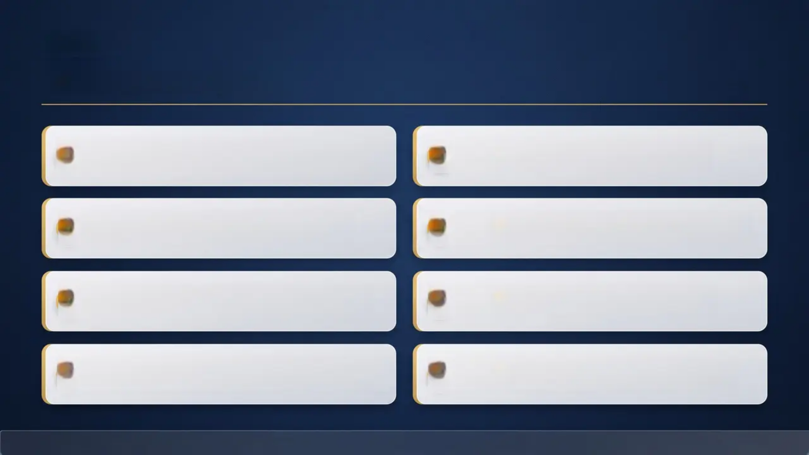

AKT
"Exam Pearls"
First-line AN under-18s: Family-Based
Therapy (FBT) — Maudsley Model
2
AN has the highest mortality of all
mental illnesses
1
SCOFF ≥2 = suspect eating disorder
→ refer for further assessment
Fluoxetine 60mg — evidence for BN in
adults; NOT routinely recommended for CYP
3
4
5
Normal blood results do NOT exclude a
serious eating disorder
6
CYP ED urgent standard: treatment
within 1 week; routine within 4 weeks
Refeeding syndrome prevention: Thiamine
(Pabrinex) + phosphate before/during refeeding
QTc >450ms on ECG = serious cardiac
risk → emergency action required
7
8
Bradford VTS Teaching Deck — Eating Disorders in CYP
www.bradfordvts.co.uk

Slide 19
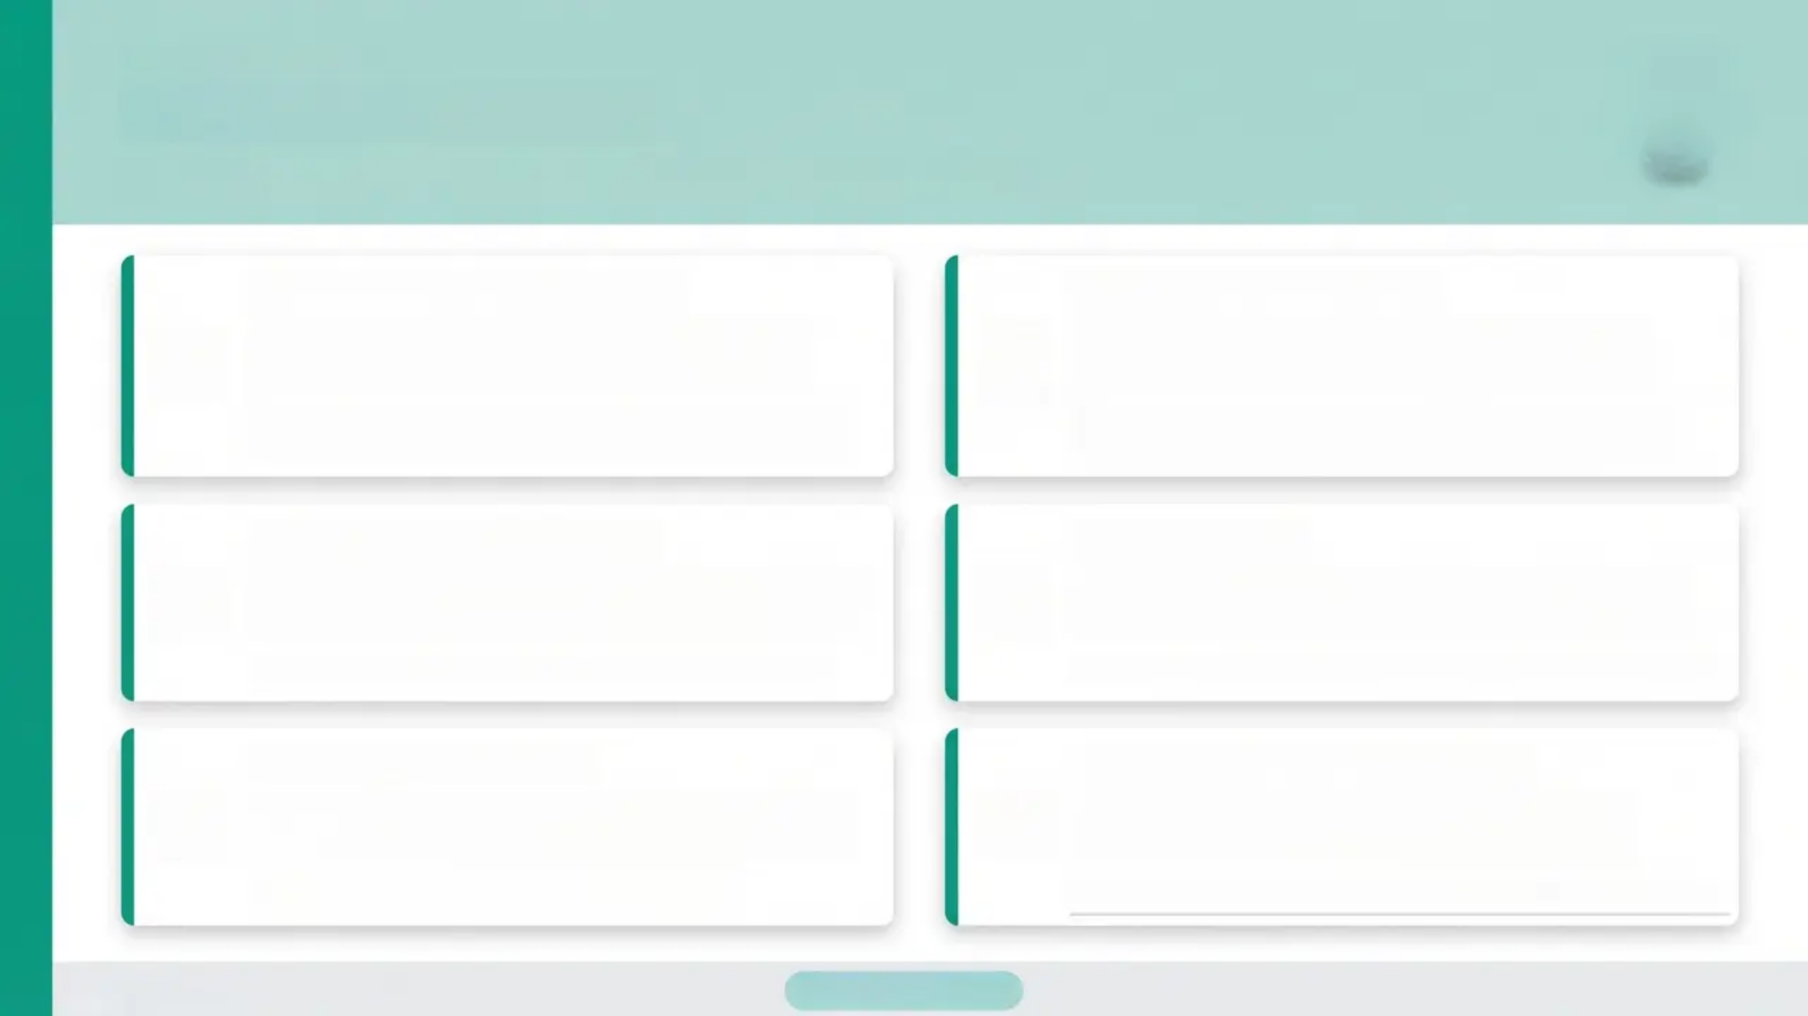






EXAM PREPARATION
Exam Pearls — SCA
SCA
*Simulated Consultation Assessment — Consultation Skills*
Non-Judgmental Language
Explain Referral Calmly
“I’m not going to judge you — I just want to
make sure you’re well.”
“I’d like to refer you to a specialist team —
they’re really good at helping young people.”
Use open, warm language. Avoid clinical labels early in the
conversation.
Be clear about urgency without alarming. Frame referral as
support, not crisis.
Involve Family Sensitively
Safety-Netting
“FBT depends on family engagement — involve
parents early, but with the young person's trust.”
“If you feel faint, have chest pain, or stop eating
— come back or go to A&E.”
Balance confidentiality with safeguarding duty under-16s.
Always give the family a clear action plan and when to escalate.
Address Ambivalence
Recognise the Full Spectrum
“It makes sense that part of you finds it hard to
accept there’s a problem.”
“Recognise BED and ARFID — demonstrate
knowledge beyond AN and BN.”
Validate the internal conflict — don't push; guide.
Examiners reward candidates who don't default AN-only thinking.
Bradford VTS Teaching Deck
NICE NG69 | May 2026
20 / 24

Slide 20
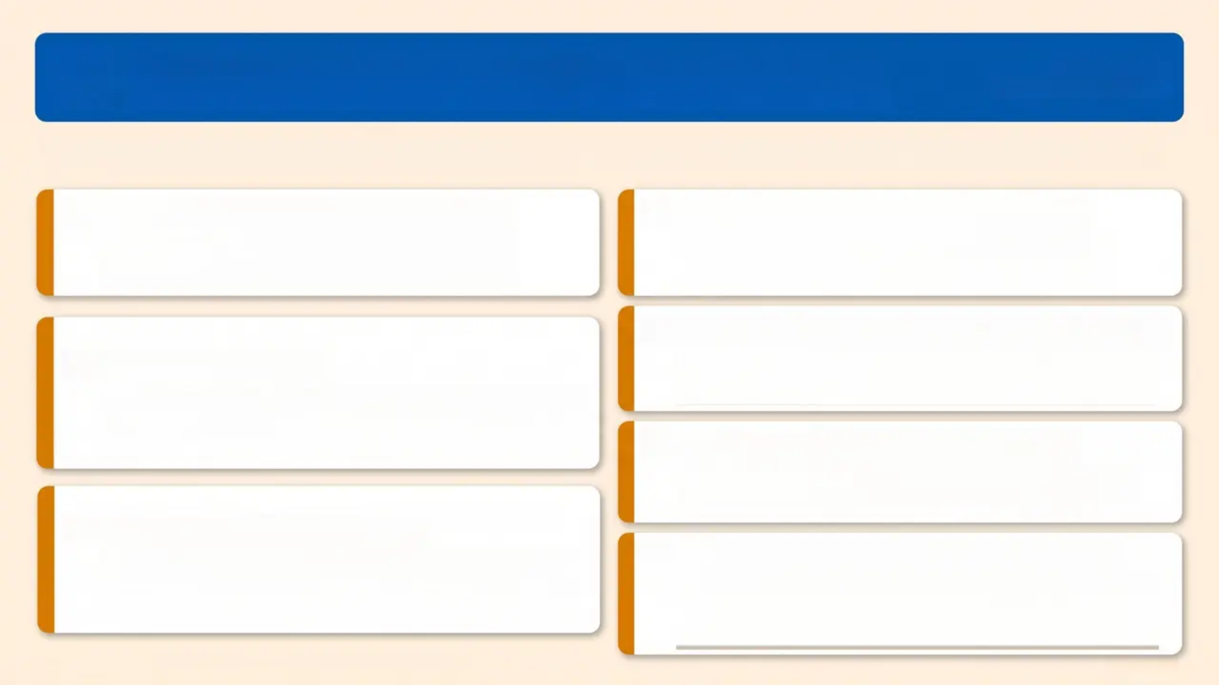

‘Common Pitfalls in Primary Care’
Bradford VTS
www.bradfordvts.co.uk
Errors that lead to missed diagnoses and delayed treatment — recognise and avoid them
Normal weight ≠ no eating disorder
Atypical AN and BN commonly present at
normal or above-normal weight
Don’t wait for the patient to admit it
Refer on clinical suspicion — waiting for the
young person to disclose delays treatment
Don’t attempt specialist ED therapy yourself
Primary care is not the place for eating disorder
psychotherapy without specialist ED training
Don’t skip the ECG
Normal blood results without ECG misses QTc
prolongation — a life-threatening arrhythmia risk
Dietary advice alone is not enough
Nutritional guidance without specialist support
can worsen the condition
Boys and men have EDs too
Males are significantly under-recognised —
never assume eating disorders are female-only
Always involve the family in under-16s
Family-based therapy (FBT) depends on family
engagement — excluding family undermines the
primary treatment pathway
“NICE NG69 | Junior MARSIPAN | Bradford VTS Teaching Deck”
May 2026

Slide 21
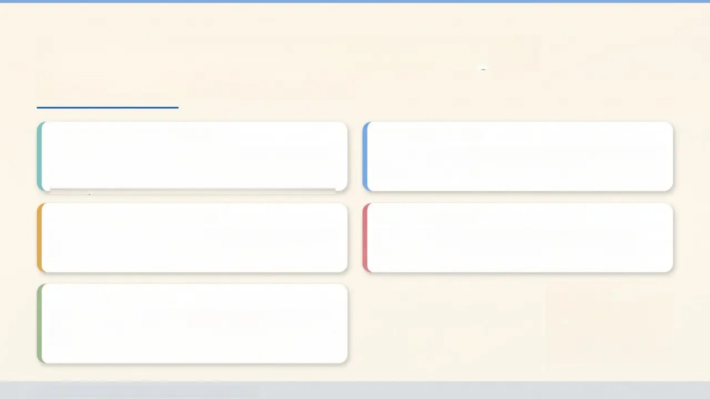
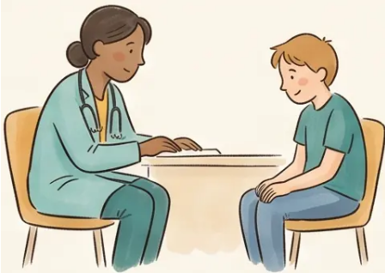
Patient Communication Strategies
What to say — and how to say it
OPENING THE CONVERSATION
ONGOING SUPPORT
'I've noticed some things that concern me about
your health. I want to understand what's going
on for you.'
'While you're waiting, I'll keep a close eye on
things. Let's make an appointment for next week.'
NORMALISING THE DIFFICULTY
REDUCING SHAME
'It sounds like food and eating have become
really difficult. That's something I can help with.'
'You haven't done anything wrong. This is a
health condition, and you deserve help.'
EXPLAINING REFERRAL
'I'd like to refer you to a specialist team —
they're really good at helping young people with
these difficulties.'
Bradford VTS Teaching Deck — Eating Disorders in CYP
www.bradfordvts.co.uk

Slide 22
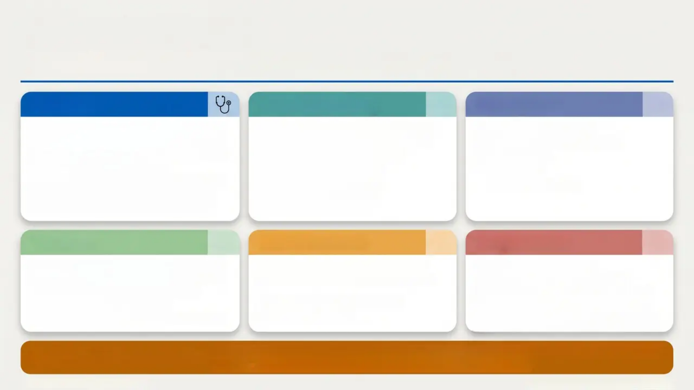






‘Quick Recall’
Core facts for AKT and SCA — eating disorders in CYP
Diagnoses
SCOFF & Screening
Investigations
• AN: Restriction + fear of weight gain + body
image disturbance
• BN: Bingeing + purging; often normal weight
• BED: Bingeing without purging
• ARFID: Sensory/fear avoidance — not body
• Atypical AN: Meets AN criteria — normal
weight; equally serious
• ≥ 2 positives → suspect eating disorder
→ refer
• S — Sick (self-induced vomiting)
• C — Control lost over eating
• O — One stone weight loss
• F — Fat despite being thin
• F — Food dominates life
• FBC, U&Es, LFTs, glucose
• Magnesium, phosphate, calcium
• Creatinine, TFTs
• ECG — always
⚠️ Normal bloods ≠ safe
Treatment
Access Standards
Drug Treatment
• AN under-18s: Family-based therapy (FBT)
— first-line
• BN: FBT adapted; CBT-ED if declined
• BED: Guided self-help first-line
• Individual CBT-ED as alternative throughout
• Urgent: Start treatment within 1 week
• Routine: Start treatment within 4 weeks
• Refer to specialist CYP ED team
• NOT generic CAMHS
• AN: No specific medication
• BN (adults): Fluoxetine 60 mg/day
• BN (CYP): NOT routinely recommended
• Avoid TCAs + high-dose antipsychotics
• Refeeding: Pabrinex + phosphate before
starting
EMERGENCY THRESHOLDS
BMI < 13 • K+ < 3.0 mmol/L • QTc > 450 ms • Bradycardia < 40 bpm • Phosphate < 0.5 mmol/L
Any of the above → Emergency medical admission to paediatric ward
Bradford VTS · www.bradfordvts.co.uk
NICE NG69 · Junior MARSIPAN · May 2026

Slide 23


Bradford VTS Teaching Deck
Eating Disorders in Children and Young People
Created May 2026 · Updated to current NICE NG69 (reviewed 2024) standards
www.bradfordvts.co.uk
Educational Disclaimer
Always verify all clinical guidance and drug doses against the
latest NICE guidelines and BNF before applying in practice.
This deck is produced for GP trainee education only. It does not constitute
clinical advice. Individual patient management must be guided by current
evidence and clinical judgement.
© Bradford VTS · For Educational Use Only · May 2026

