Slide 1


BRADFORD VTS TEACHING DECK
Adolescent
Safeguarding
GP Training Teaching Deck
Updated to NICE NG76 · Working Together
2026 · GMC 0-18 Guidance
www.bradfordvts.co.uk
Created May 2026
Adolescent health · Safeguarding · GP practice
⚠️ For educational purposes only. Always verify with current NICE/BNF guidance.
2 / 30

Slide 2

BRADFORD VTS • ADOLESCENT SAFEGUARDING
Learning Objectives
By the end of this session, you will be able to:
01
02
03
04
05
Define Abuse
Understand
Adolescent
Vulnerability
Apply
Competence
Frameworks
Recognise
CSE
Know When
to Disclose
Physical, emotional,
sexual, neglect &
exploitation —
including online
Spot exploitation
signs using the
SAFEGUARD
mnemonic and
CSERQ15 tool
Navigate referral
decisions,
documentation, and
the STEP framework
Brain development,
risk behaviour, and
why young people
need adult protection
Fraser Guidelines,
Gillick competence,
capacity, and
confidentiality rules
Bradford VTS Teaching Deck — Adolescent Safeguarding
www.bradfordvts.co.uk

Slide 3

NICE NG76 • WORKING TOGETHER 2026
Definitions of Abuse
Physical Abuse
Emotional Abuse
Hitting, shaking, burning, poisoning, suffocating, or
otherwise causing physical harm to a child —
including where a parent fabricates illness.
Persistent emotional ill-treatment — humiliation,
threatening, rejecting, ignoring, or corrupting. Can
occur without any physical abuse.
Sexual Abuse
Neglect
Includes contact and non-contact acts, online
grooming, and exposure to sexual material.
Perpetrators may be adults or peers.
Persistent failure to meet a child's basic physical or
emotional needs — affecting health, development,
or safety.
Exploitation
Includes child sexual exploitation (CSE) and county
lines involvement. Abuse can occur wholly online.
Perpetrators may be peers, not only adults.
Working Together 2026 — new explicit inclusion
www.bradfordvts.co.uk
Source: NICE NG76 (2017, confirmed 2025) • Working Together to Safeguard Children 2026
4 / 30

Slide 4

ADOLESCENT DEVELOPMENT
What is an Adolescent?
10-14
14-17
17-25
EARLY ADOLESCENCE
MIDDLE ADOLESCENCE
LATE ADOLESCENCE
• Physical changes begin
• Puberty onset
• Peak brain remodelling
• Risk-taking at highest
• Ongoing prefrontal cortex
development
• Transitioning to adulthood
Puberty / early stage
Highest vulnerability period
Young adult / emerging maturity
WHO DEFINITION
AYPH DEFINITION
Young
people
10-24
year olds
Adolescence = 10-19 years
Adolescence = 10-25 years
www.bradfordvts.co.uk • May 2026

Slide 5

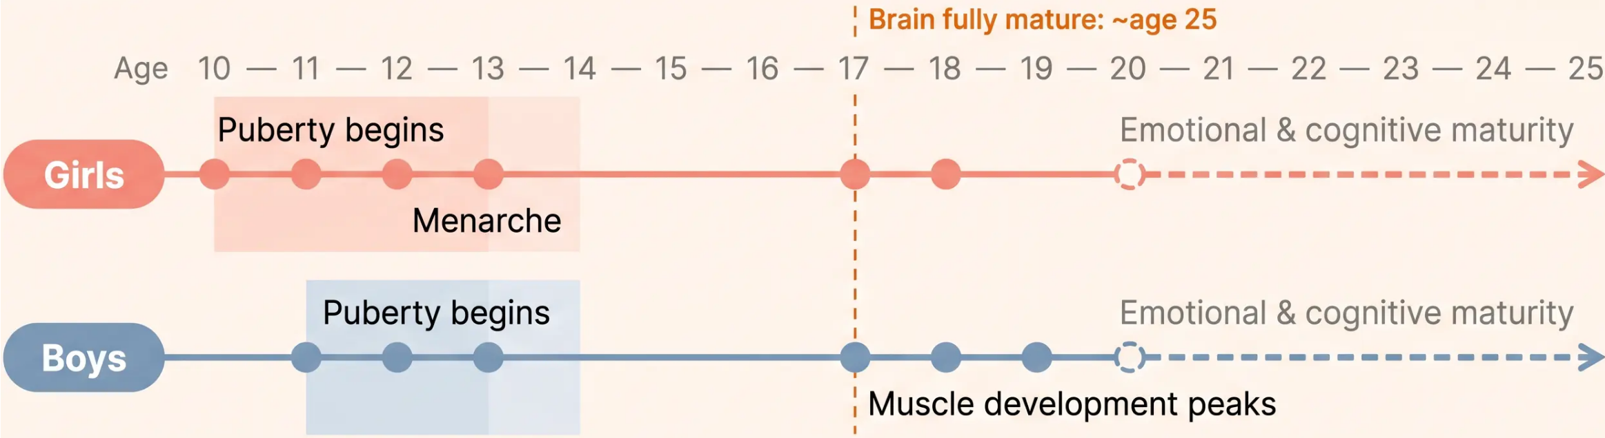

ADOLESCENT DEVELOPMENT · SLIDE 6
Physical Development in Adolescence
Puberty timing and the gap between physical and emotional maturity
🏥 GP Implication
Earlier puberty creates a longer window of physical maturity before emotional readiness.
Puberty timing alone does not indicate emotional or cognitive readiness for sexual activity.
Bradford VTS · Adolescent Safeguarding 2026
6 / 30

Slide 6
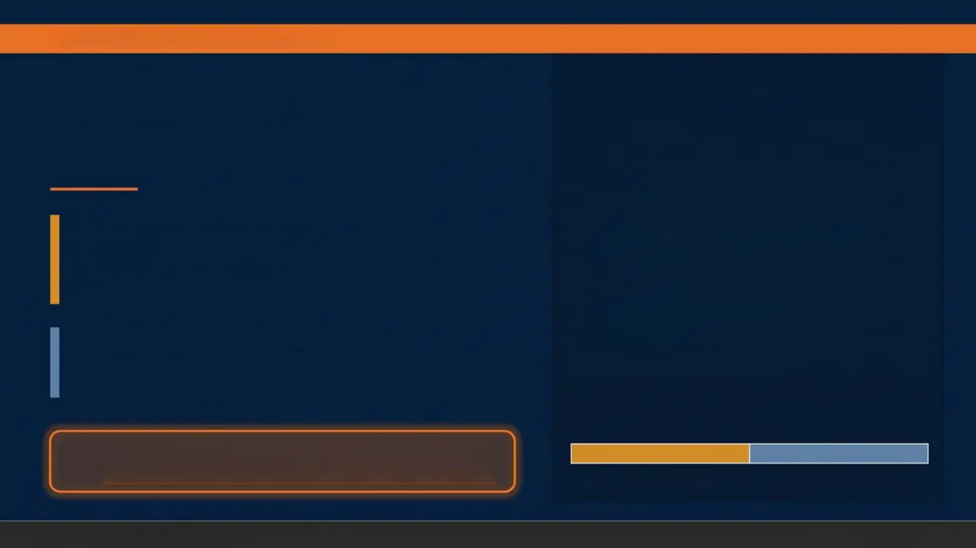
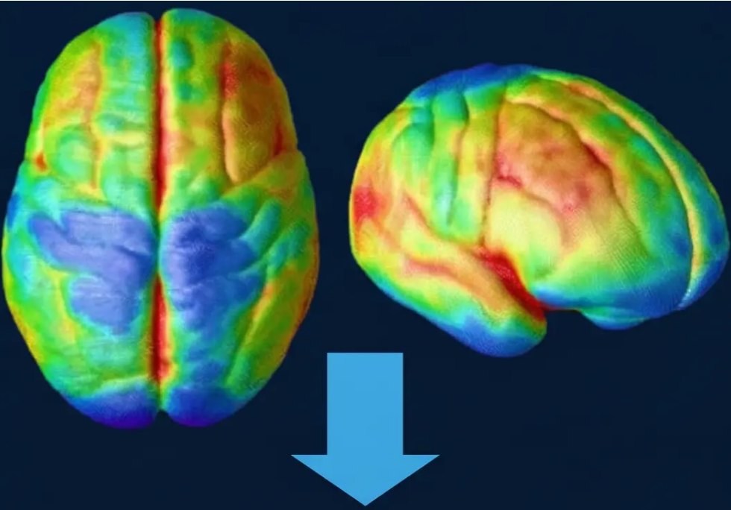

ADOLESCENT DEVELOPMENT - SLIDE 7
The Adolescent Brain
Why Safeguarding Matters
Matures First • LIMBIC SYSTEM
Drives reward-seeking, emotion and sensation • Matures
early in adolescence • Creates strong pull toward risk and
peer approval
Matures Last • PREFRONTAL CORTEX
Controls judgement, impulse and consequence • Not fully
mature until age 25 • The ‘brakes’ lag far behind the ‘accelerator’
MRI evidence: grey matter volume changes across
adolescent development
Clinical implication: adolescents cannot always
protect themselves — adults must recognise and act
Limbic System — Early ↑
Prefrontal Cortex — Late ↑
Bradford VTS • Adolescent Safeguarding
7 / 30
www.bradfordvts.co.uk

Slide 7
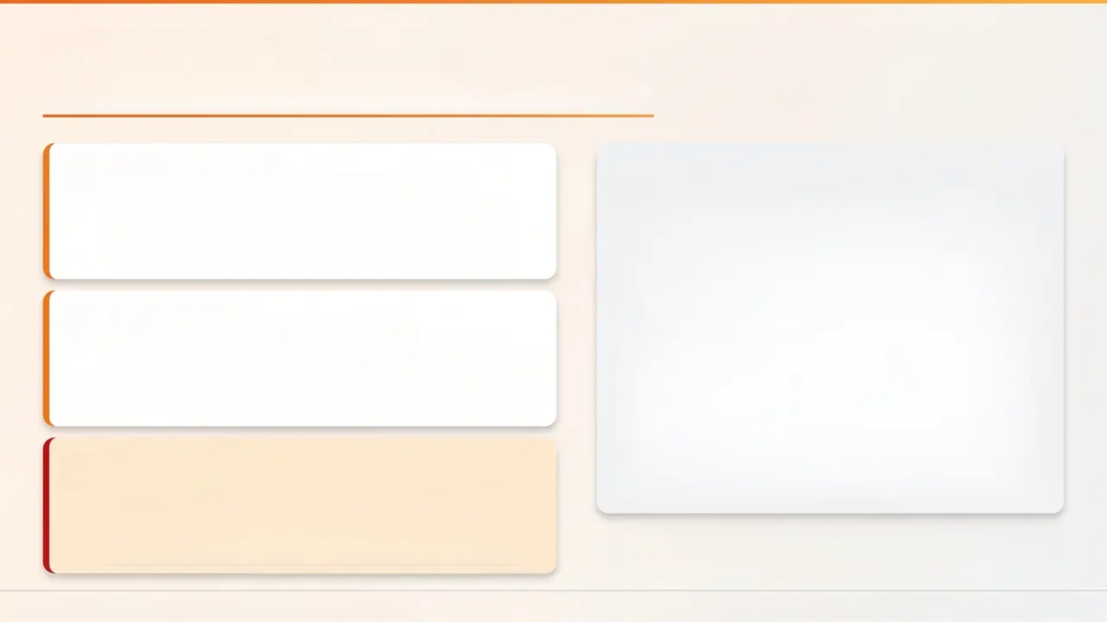

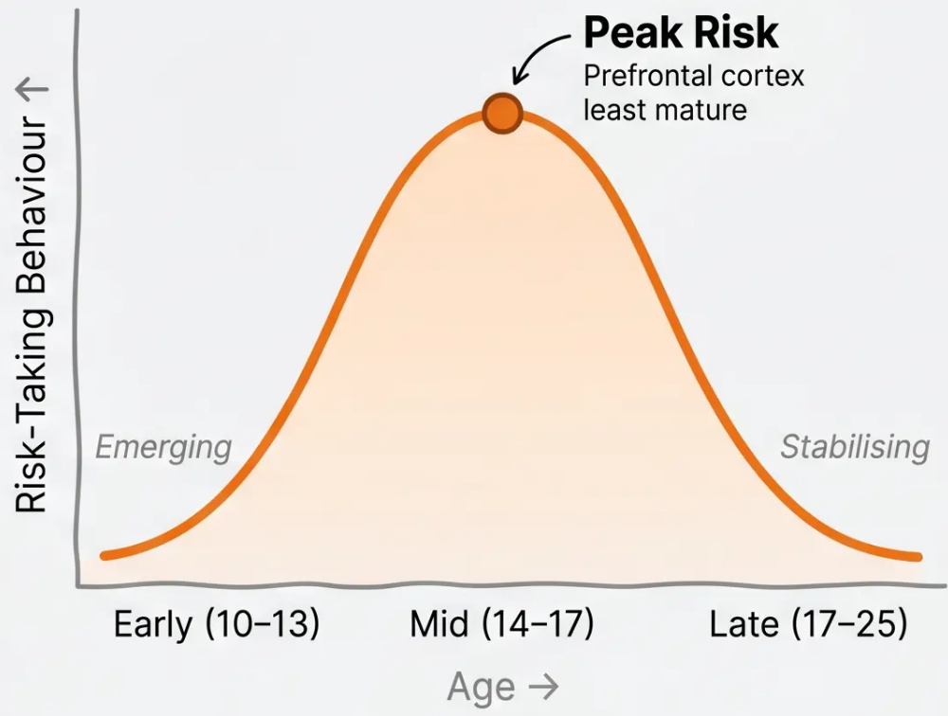


ADOLESCENT DEVELOPMENT
Bradford VTS • May 2026
Cognitive & Emotional Growth
Cognitive Maturation
Risk Weighing Improves With Age
Adolescents gradually develop better cost-benefit
reasoning — but this is incomplete until the mid-
twenties (Steinberg, 2005)
Identity Formation
Identity, Autonomy & Coping
Young people are actively building their sense of self
— adapted communication and non-judgement are
essential in every consultation
Critical Clinical Alert
Abuse Can Mimic Emotional Disorders
Emotional dysregulation, low mood and anxiety in
adolescents may reflect abuse, not primary
psychiatric illness — always consider safeguarding.
The 'Inverted U': risk behaviour peaks in mid-adolescence
— not defiance, but neurodevelopment.
Adolescents are NOT mini-adults — adapt your approach.
Bradford VTS
NICE NG76 • Working Together 2026 • Steinberg 2005

Slide 8







ADOLESCENT DEVELOPMENT • SLIDE 9
Social Development
Peers Become Paramount
Peer relationships take priority over family during mid-
adolescence — acceptance and belonging drive behaviour
Seeking Independence
Young people explore autonomy, sexual identity, and personal
values — this is healthy and expected development
Elongated Transition
The path to adulthood is longer than previous generations —
financial, social and emotional independence arrives later
Belonging = Vulnerability
The intense need for peer acceptance makes adolescents susceptible
to grooming — exploiters exploit this desire for connection
Peer connection is central to adolescent
identity — and to exploitation risk
GP Implication: Grooming works by mimicking healthy peer relationships — young people may not recognise exploitation as abuse
Adolescent Safeguarding
Bradford VTS • www.bradfordvts.co.uk • May 2026

Slide 9
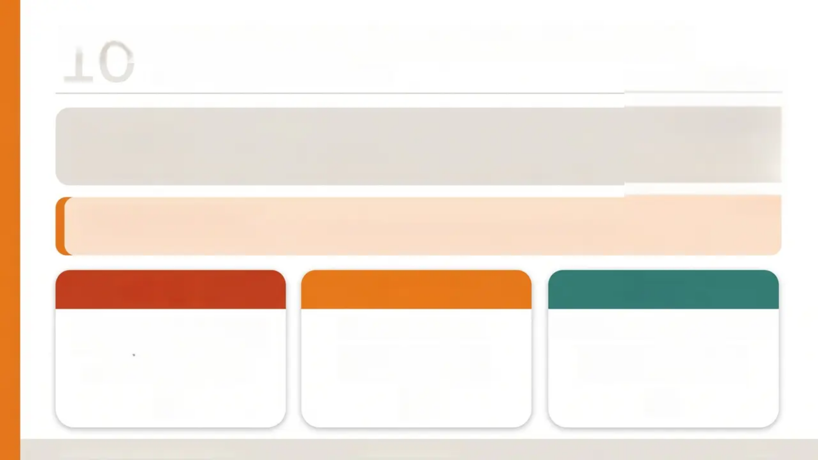
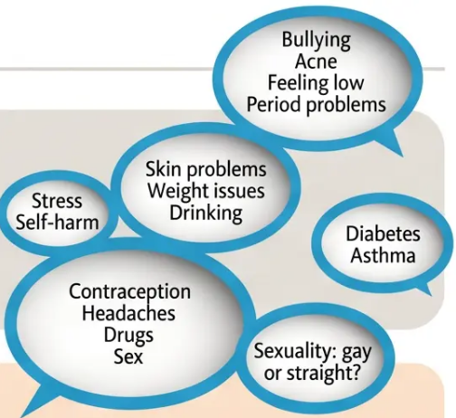



Confidentiality — The Framework
10
GMC 0-18 Years Guidance
GMC principles:
– Always offer to see young people alone
– Never imply services can only be accessed with a parent present
SUGGESTED OPENING PHRASE
What you tell me stays private — unless I'm worried about your safety.
Under 13
13 - 15
16 - 17
Sexual activity should almost
always be disclosed.
Legal inability to consent.
Assess case by case.
Apply Fraser criteria +
public interest test.
Presumed capacity (MCA 2005).
Disclose only with public
interest justification.
Bradford VTS - Adolescent Safeguarding
www.bradfordvts.co.uk
10 / 30

Slide 10
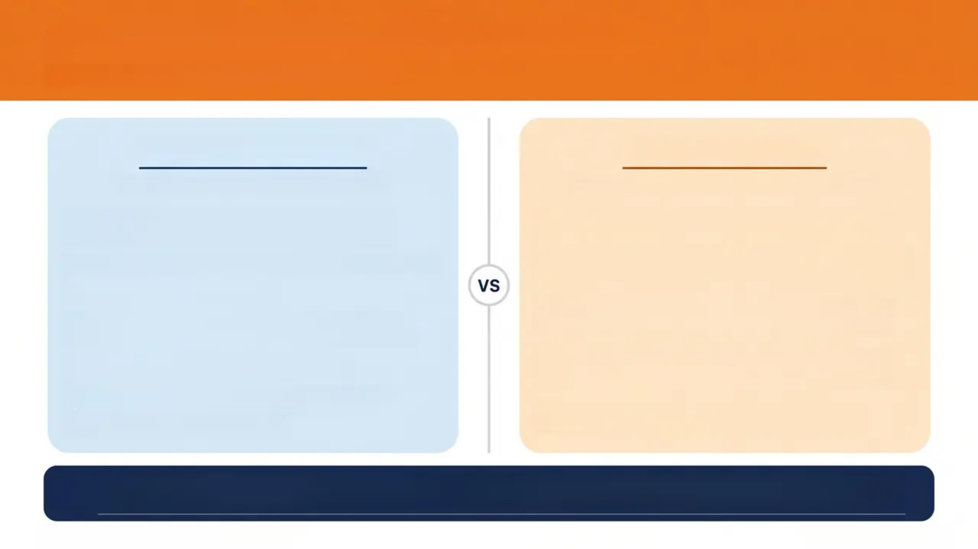

Fraser Guidelines & Gillick Competence
Assessing competence in young people under 16
Gillick Competence
Fraser Guidelines
Applies to all medical decisions under 16
Specific to contraception — all 5 must be met
1
Can understand there is a choice — and
choices have consequences
1
Young person understands the advice given
2
Cannot be persuaded to inform parents /
parents' involvement not in their best interests
Can weigh information and arrive at a decision
2
3
Willing to make a choice
3
Will have sexual intercourse with or without
contraception
4
Understands the nature and purpose of the
intervention
5
Understands risks and side effects
Physical or mental health will suffer without
contraception
4
6
Understands alternatives and their risks
5
Receiving contraception is in their best
interests
7
Free from undue pressure
AKT PEARL: Use ‘Fraser Guidelines’ for contraception questions — not ‘Gillick’. Gillick = general competence
framework. Both require the young person to be free from undue pressure.
GMC 0-18 Years Guidance - Children Act 1989
11 / 30 — Bradford VTS

Slide 11





Consent & Capacity · Slide 12
MCA 2005
Assess Every
Consultation
Consent ≠ Refusal
Capacity
Key Points
A young person may have capacity
to consent to treatment but NOT to
refuse it in certain circumstances —
especially life-threatening
situations.
Capacity is not a fixed status.
Reassess at each visit — do not
assume previous capacity applies
today.
Mental Capacity Act 2005
Fluctuating Capacity
Document Everything
Acute mental illness, intoxication, or
emotional distress can temporarily
impair capacity. Time your
assessment carefully.
Record your capacity assessment
in full — reasoning, findings, and
outcome. A major medicolegal
requirement.
Court of Protection can overrule a young person's refusal if the
decision is life-threatening.
12 / 30

Slide 12

13 / 30
When to Share Information
GMC 0–18 Years — Triggers for Disclosure of Sexual Activity
01
02
03
Immaturity to Consent
Age or Power Difference
Position of Trust
Young person too immature to
understand or meaningfully consent
— especially if under 13.
Partner holds a position of trust or
authority over the young person
(e.g. teacher, coach, carer).
Age gap, age of significant power
imbalance between the young
person and their partner.
04
05
06
Known Abusive History
Force, Threats or Coercion
Under-13 Absolute Rule
Any use of force, threats, coercion,
or administration of drugs or alcohol
to facilitate sexual activity.
Partner is known to police or agencies
as having abusive relationships with
children or young people.
Any sexual activity involving a child
under 13 — presumptive disclosure
applies without exception.
⚠️ Always inform the young person BEFORE sharing — unless doing so would place them or others at risk of harm.
GMC 0–18 Years: Guidance for All Doctors
www.bradfordvts.co.uk

Slide 13
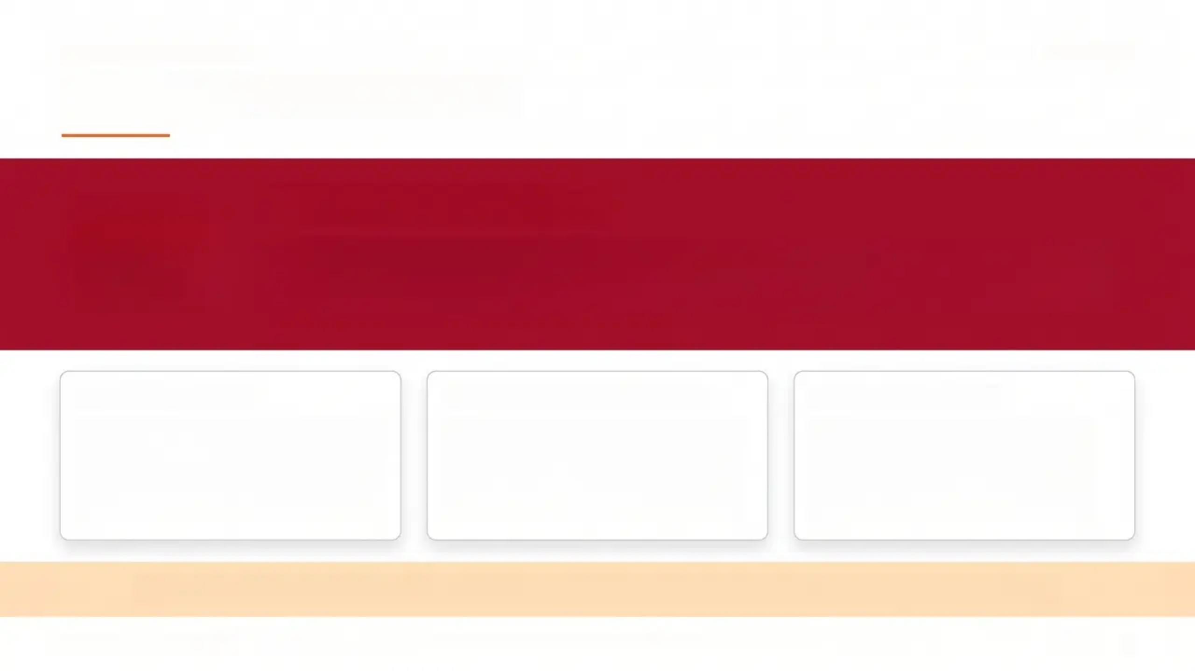
SAFEGUARDING LAW
Slide 14 / 30
The Under-13 Rule
ABSOLUTE RULE
Any sexual activity involving a child under 13
is a presumptive safeguarding disclosure.
LEGAL POSITION
BEFORE NON-DISCLOSURE
DOCUMENT FULLY
A child under 13 cannot legally
consent to sexual activity under
any circumstances — regardless
of apparent willingness.
Always discuss with your
Named Doctor before deciding
not to refer. This decision must
never be made alone.
Record your decision and full
reasoning — whether you
disclose or not. A medicolegal
record is mandatory.
If in doubt — disclose. The threshold for action is reasonable suspicion, not certainty.
bradfordvts.co.uk
Working Together to Safeguard Children 2026 • Children Act 1989
9

Slide 14

DISCLOSURE RESPONSE
Handling Disclosure — STEP Framework
S
SAFETY FIRST
T
TELL
Ensure the young person's immediate safety
before anything else
Inform the young person you will share
concerns — unless doing so puts them at risk
E
ESCALATE
P
PAPERS
Refer promptly to social services or police;
consult your safeguarding lead without delay
Document fully — record facts, not opinions;
use the young person's exact words
SCRIPTED PHRASES
“I'm really glad you told me. I want to make sure
you're safe, and I need to talk to someone else
who can help.”
“I'm going to need to speak with [safeguarding
lead / social services]. I'll let you know what
happens.”
Bradford VTS • Adolescent Safeguarding • May 2026
15 / 30

Slide 15



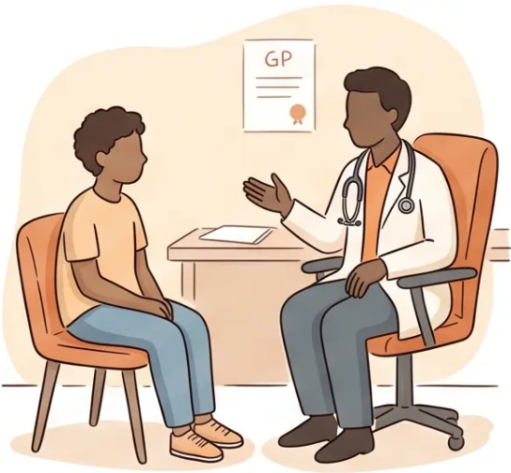


CONSULTING SKILLS
16 / 30
Consulting Alone with Young People
Always offer to see the young
person alone
WHAT TO SAY
Offer this routinely — not only when abuse is suspected
“It’s great that [Name] has come. As they'll
be using this service, I'll have a chat with
them first — we can catch up at the end.”
Never imply they need a parent to
access services
— Suggested phrase to parent/carer
This deters young people from seeking help independently
GMC 0-18 PRINCIPLE
Consider chaperone impact
A chaperone may reduce the young person's openness
— weigh carefully
“Make it clear you are
available to see young
people alone. Do not
give the impression
that services can only
be accessed with a
parent present.”
Safety-net every consultation
Give confidential contact details and signpost to
local services
Bradford VTS Teaching Deck — Adolescent Safeguarding
www.bradfordvts.co.uk

Slide 16
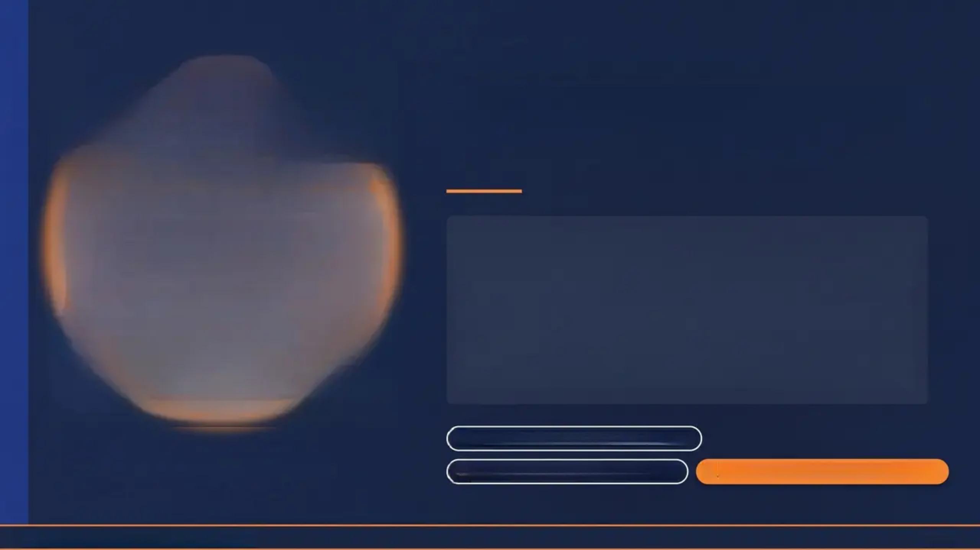




WORKING TOGETHER 2026 • NICE NG76
Child Sexual Exploitation
A Form of Child Sexual Abuse
Sexual exploitation occurs where an individual or
group takes advantage of an imbalance of power
to coerce, manipulate or deceive a child into sexual
activity – in exchange for something the victim
needs or wants, and/or for the financial advantage
or increased status of the perpetrator.
All genders • all ethnicities • all sexualities
“Vulnerability is not a choice.”
Never a “lifestyle choice”—always abuse
Typically identified age 12-17 (NSPCC)
Bradford VTS • Adolescent Safeguarding
17 / 30

Slide 17
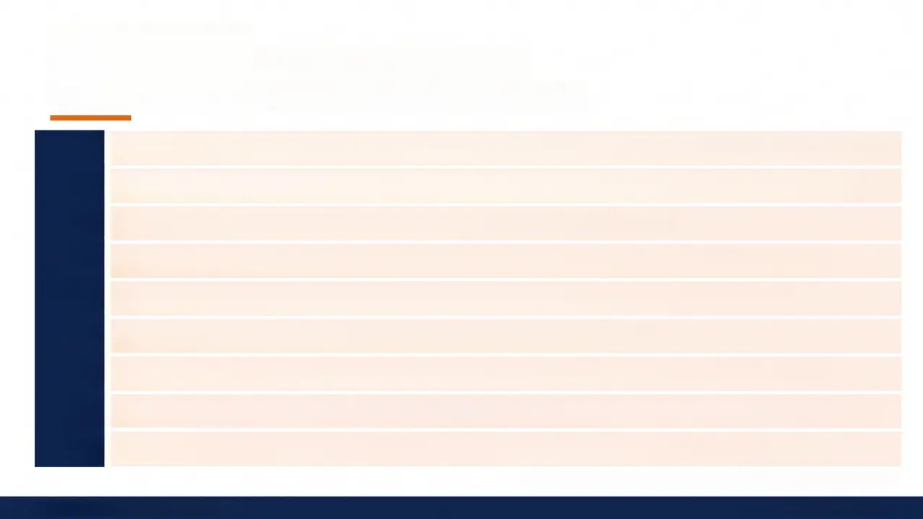
CSE IDENTIFICATION TOOL
The SAFEGUARD Mnemonic
Nine clinical indicators of child sexual exploitation
SAFEGUARD
Sexual health / behaviour STIs, pregnancy, termination, sexualised behaviour
Absent from school Repeatedly missing school or running away from home
Familial abuse Problems at home or family-based abuse
Emotional & physical condition Poor mental health, learning disability
Gangs & older peer groups Involvement in crime, older associates
Use of technology Online exploitation, sexual bullying
Alcohol & drug misuse Substance use as risk factor or tool of coercion
Receipt of unexplained gifts Money, phones, jewellery with no clear source
Distrust of authority Avoidance of professionals, police, services
“Use alongside CSERQ15 screening tool — see Slide 21”
Bradford VTS · Adolescent Safeguarding
www.bradfordvts.co.uk

Slide 18







19 / 30
CSE Risk Factors — Spotting the Signs
Observable indicators that should prompt further enquiry in any consultation
Behaviour & Mood
Relationships & Contact
• Sudden change in behaviour, mood, or friendship group
• Emotional withdrawal, anxiety, or unexplained
aggression
• Marks or injuries concealed beneath clothing
• Close relationships with people significantly older
• Receiving unknown calls or messages from adults
• Being picked up by unknown persons in unfamiliar
vehicles
Absences & Location
Material & Lifestyle Changes
• Missing from home overnight without explanation
• Frequent school absences or exclusions
• Sudden change in school attendance patterns
• Unexplained gifts — phone, jewellery, money, new clothes
• History of previous sexual abuse or being in care
• Migrant or asylum seeker status (heightened vulnerability)
No single sign confirms CSE — a cluster of indicators requires action.
Consult your safeguarding lead early. Refer on reasonable suspicion, not certainty.
Bradford VTS • www.bradfordvts.co.uk

Slide 19
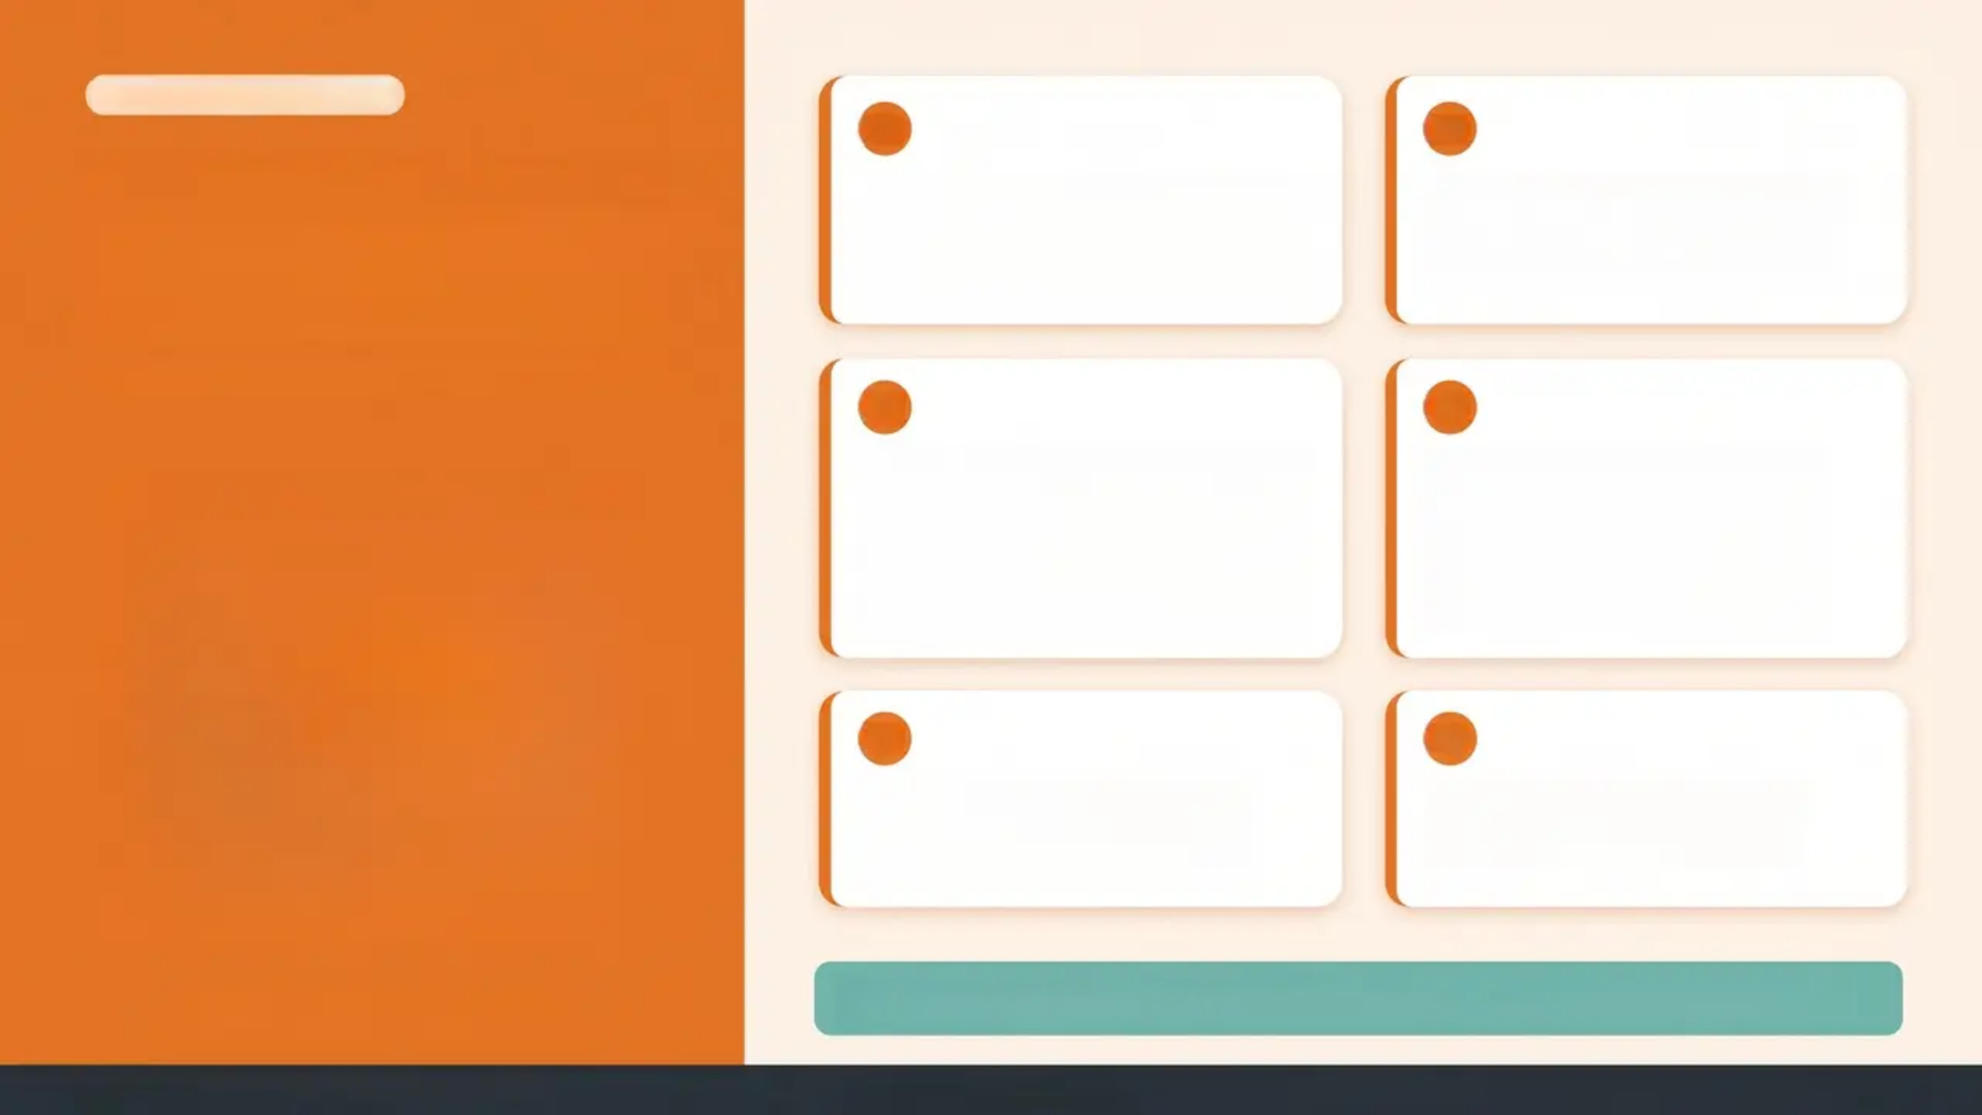



CONSULTATION SKILLS
01
02
Asking the
Right Questions
Are you in a
relationship? Can you tell
me about it?
Are you happy? What's
going well for you?
*Trauma-informed · Non-judgmental · Supportive
03
04
Have you ever felt
scared or uncomfortable
with someone you've
been sexual with?
Has anyone given you
gifts, money, drugs or
alcohol in exchange
for sex?
05
06
Do you feel you could
say no to sex?
Where do you meet?
Who else is there?
*Use open, unhurried language
Use trauma-informed, non-judgmental language throughout
Bradford VTS — Adolescent Safeguarding
www.bradfordvts.co.uk
20 / 30

Slide 20






































CLINICAL SCREENING TOOL
CSERQ15 Screening Tool
Child Sexual Exploitation Risk Questionnaire — 15 indicators
Going missing overnight without permission
1.
9.
Regular alcohol misuse
ACTION THRESHOLD
Age difference ≥4 years with sexual partner
2.
10.
School exclusion or persistent truancy
5+
3.
Controlling or coercive relationship
Physical or sexual hurt by someone
11.
positive responses
= must take action
4.
Frequenting exploitation-known areas
Internet relationships with unknown people
12.
Living outside the family home
1+
5.
13.
STI history (boys)
Parent/guardian with substance misuse or mental health problems
positive response on
core CSERQ4 items
= must take action
6.
14.
STI, pregnancy or termination (girls)
7.
Unable to see friends of own age
15.
(Reserved — clinician judgement)
Poor self-esteem or self-harm history
Do not wait for certainty —
act on reasonable concern
8.
8.
+ Bradford VTS · Adolescent Safeguarding
Slide 21 / 30
www.bradfordvts.co.uk

Slide 21


Key Data — Adolescent Sexual Health
Sources: Natsal-3, 2013 • NSPCC 2024 • Rotherham Independent Inquiry
16
~30%
1,400+
Average age of first
heterosexual intercourse
of 16-24 year olds report
sex before age 16
Children exploited in
Rotherham over 16 years
UK average — both sexes (Natsal-3, 2013)
Natsal-3, 2013
Rotherham Independent Inquiry
12-15
Gender & CSE Identification
“Consensual”
Misidentification
Majority of identified CSE
victims are female
CSE is frequently misidentified
as a lifestyle choice — this is
never acceptable
Average age when CSE
concerns first identified
Boys are significantly
under-recognised and
underidentified
NSPCC 2024
Working Together 2026
Bradford VTS Teaching Deck — Adolescent Safeguarding
www.bradfordvts.co.uk • May 2026

Slide 22


Bradford VTS
Adolescent Safeguarding
Top Tips for GPs
01
02
03
04
Explain
Confidentiality
First
Always Offer
Alone Time
Under-13 =
Disclose
CSE Is Never
a Choice
Routine for all young
people — not only if
abuse is suspected
Almost always refer;
consult named doctor
before deciding not to
Challenge assumptions
— exploitation is
always abuse
Builds trust — say it at
the start of every
consultation
05
06
07
08
Document
Every Concern
Consult Your
SG Lead Early
Use the
SAFEGUARD
Mnemonic
Reassess
Capacity
Each Time
Even if you decide not
to refer — record your
reasoning fully
Safeguarding is shared
— use your practice
lead, don't carry it
alone
Your CSE aide-mémoire
for every adolescent
consultation
Capacity fluctuates —
never assume from a
previous assessment
NICE NG76 · Working Together 2026 · GMC 0-18
www.bradfordvts.co.uk

Slide 23


RED FLAGS
Urgent Safeguarding Action Required
Act on suspicion – do not wait for certainty
Child under 13 – any sexual activity
disclosed or suspected
Repeatedly missing from home
pattern of unexplained absences
Physical abuse evidence
unexplained injuries, inconsistent history
Substance misuse or DV in household
parent/carer with significant risk factors
Disclosure of sexual abuse
do not investigate – refer immediately
Controlled or fearful behaviour
avoiding eye contact with accompanying adult
Significant self-harm in context of exploitation
especially where grooming or coercion is suspected
Bradford VTS · www.bradfordvts.co.uk
Working Together to Safeguard Children 2026

Slide 24
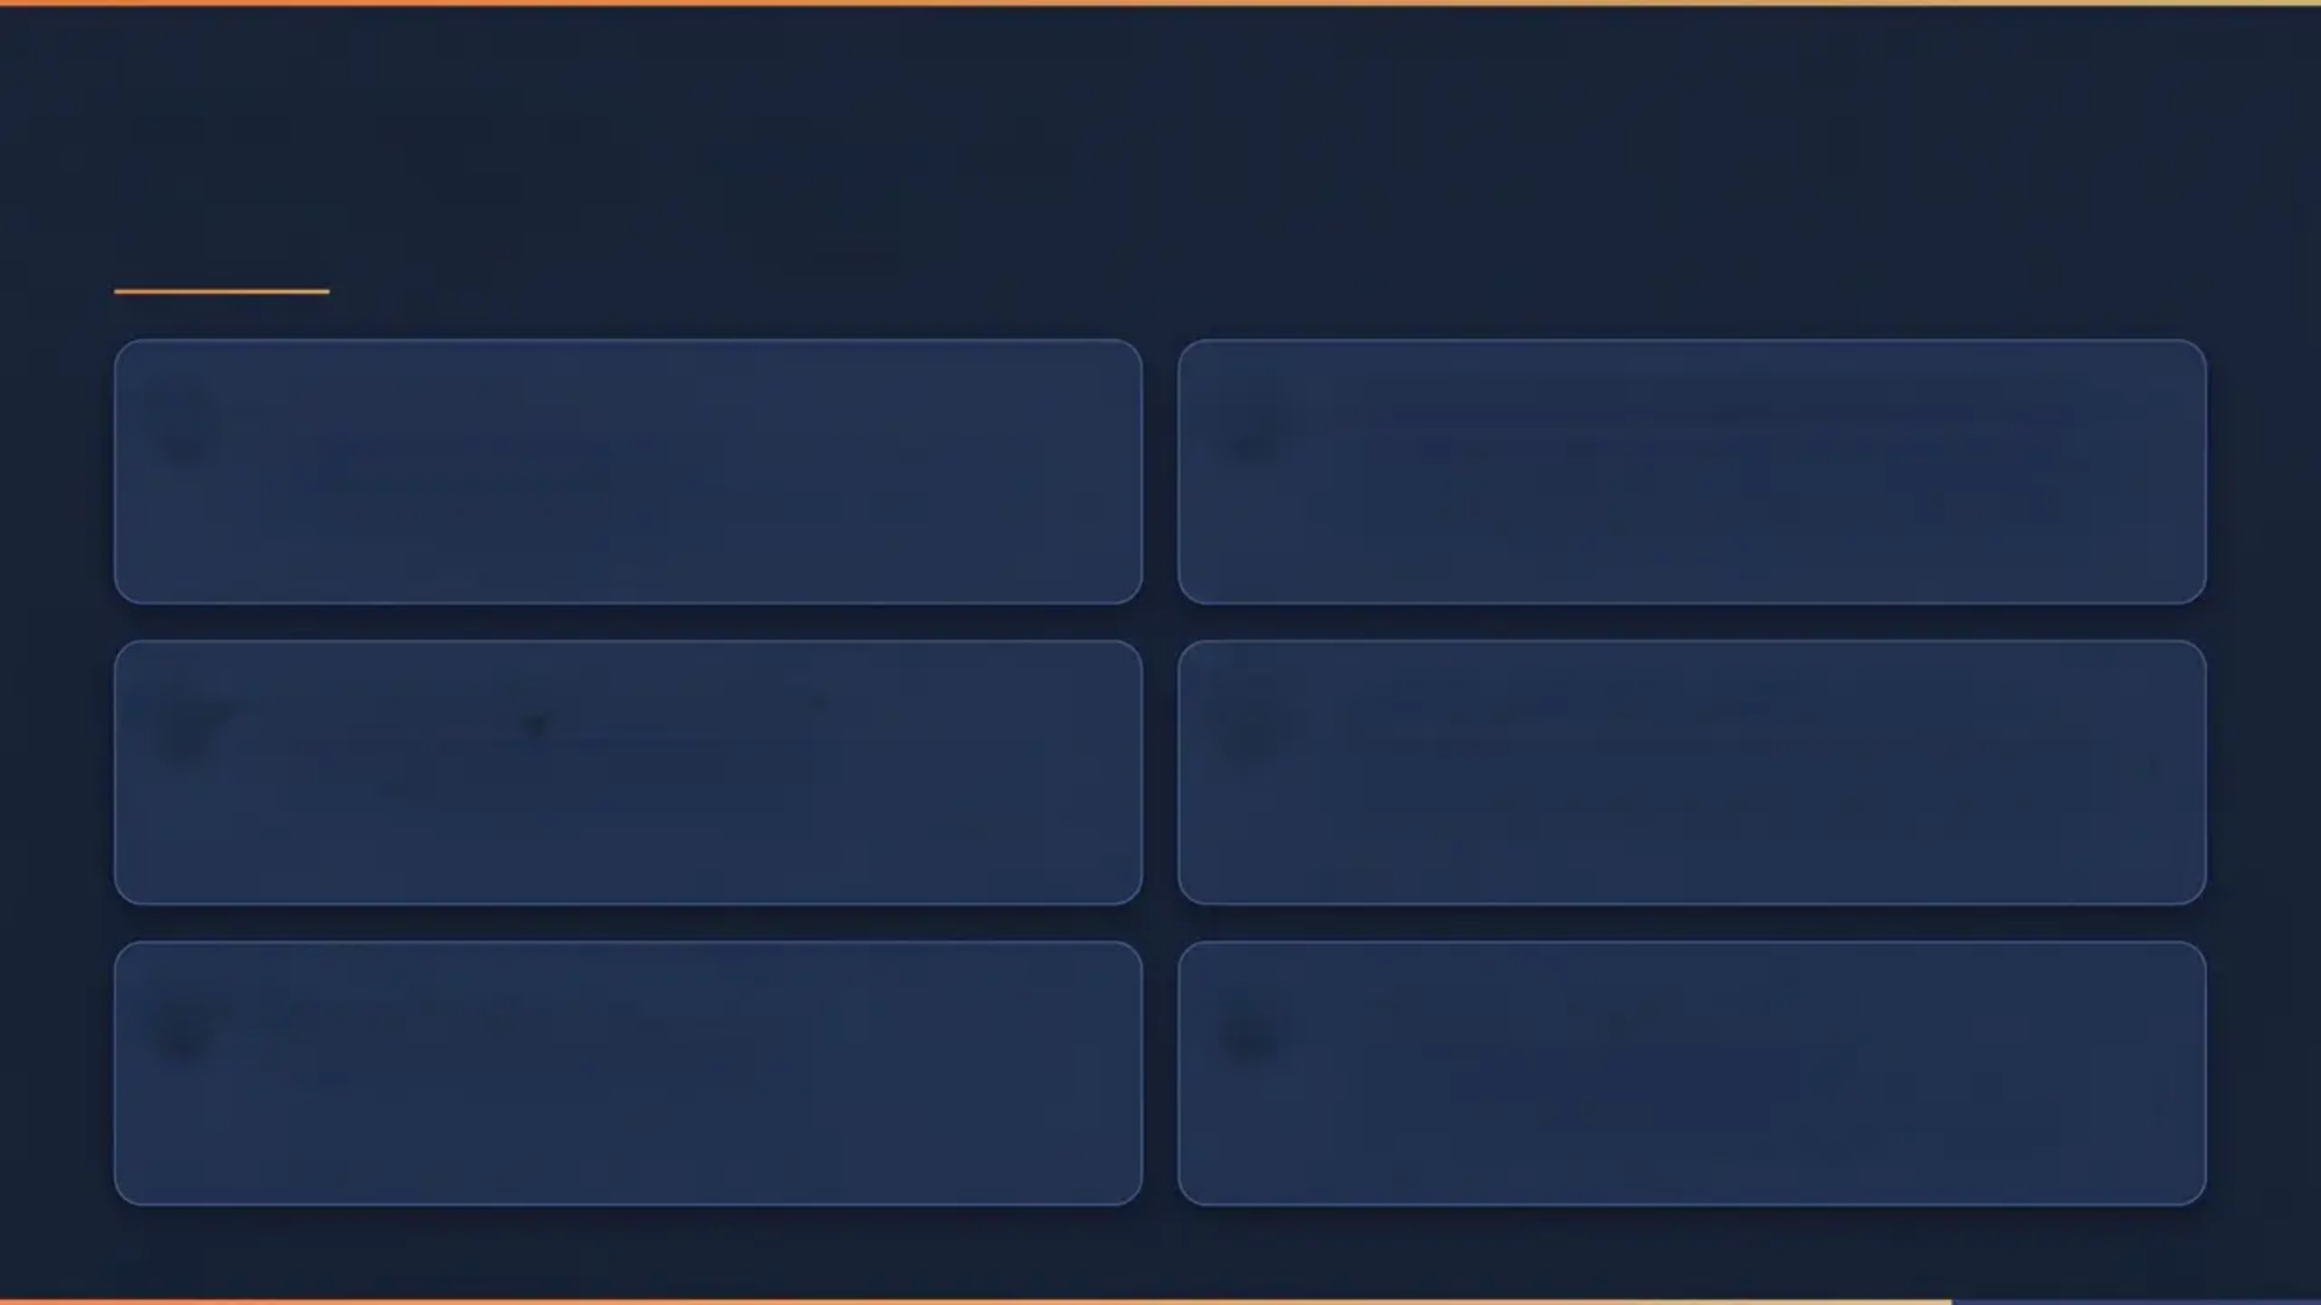







APPLIED KNOWLEDGE TEST
Exam Pearls
Fraser, Not Gillick
Under-13 = Presumptive Disclosure
Fraser Guidelines apply to AKT questions about
contraception — 5 specific criteria. 'Gillick' in an
AKT contraception stem = distractor.
Sexual activity involving a child under 13 requires
safeguarding disclosure — regardless of
apparent consent.
Working Together 2026
Named Doctor = Practice Level
Current statutory safeguarding framework —
updated March 2026. Know the year for MCQs.
Named doctor is the practice-level safeguarding
contact — not the Designated Doctor (who is
CCB/ICB level).
CSERQ15 Threshold: 5+
CSE ≠ Lifestyle Choice
Five or more positive responses on CSERQ15 =
mandatory action. OR 1+ positive on core
CSERQ4 items.
Describing CSE as a 'lifestyle choice' in an AKT
stem = professional failing. Always abuse. Never
acceptable framing.
Bradford VTS • www.bradfordvts.co.uk
25 / 30

Slide 25
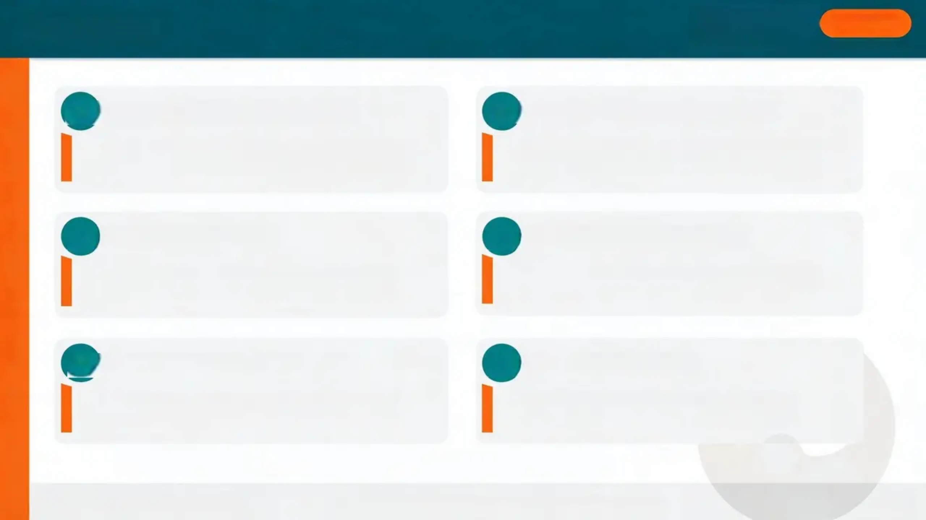

EXAM PEARLS
SCA
MRCGP
Structured Clinical Assessment — Consultation Skills
01
02
Acknowledge, Then Clarify
State Confidentiality Limits
In CSE constutations — resist jumping to action.
Hear the young person first.
“I hepp things private unless I’m worried about
your safety” — say this early and clearly.
03
Manage the Parent
04
Document & Safety-Net
Separate sensitively using structured phrases.
Never exlude without explanation.
Examiners look for documentation awareness
and clear safety-netting plans.
05
06
Patient-Centred Language
Signgst Resources
“I’m here to help, not to judge.” Avoid clinical
detachment — show genuine warmth.
NSPCC Helpline 0808 800 5000 • Childline
0800 1111 • Local MASH
Bradford VTS • www.bradfordvts.co.uk
Working Together to Safeguard Children 2026 • GMC 0-18 Guidance
26/30

Slide 26
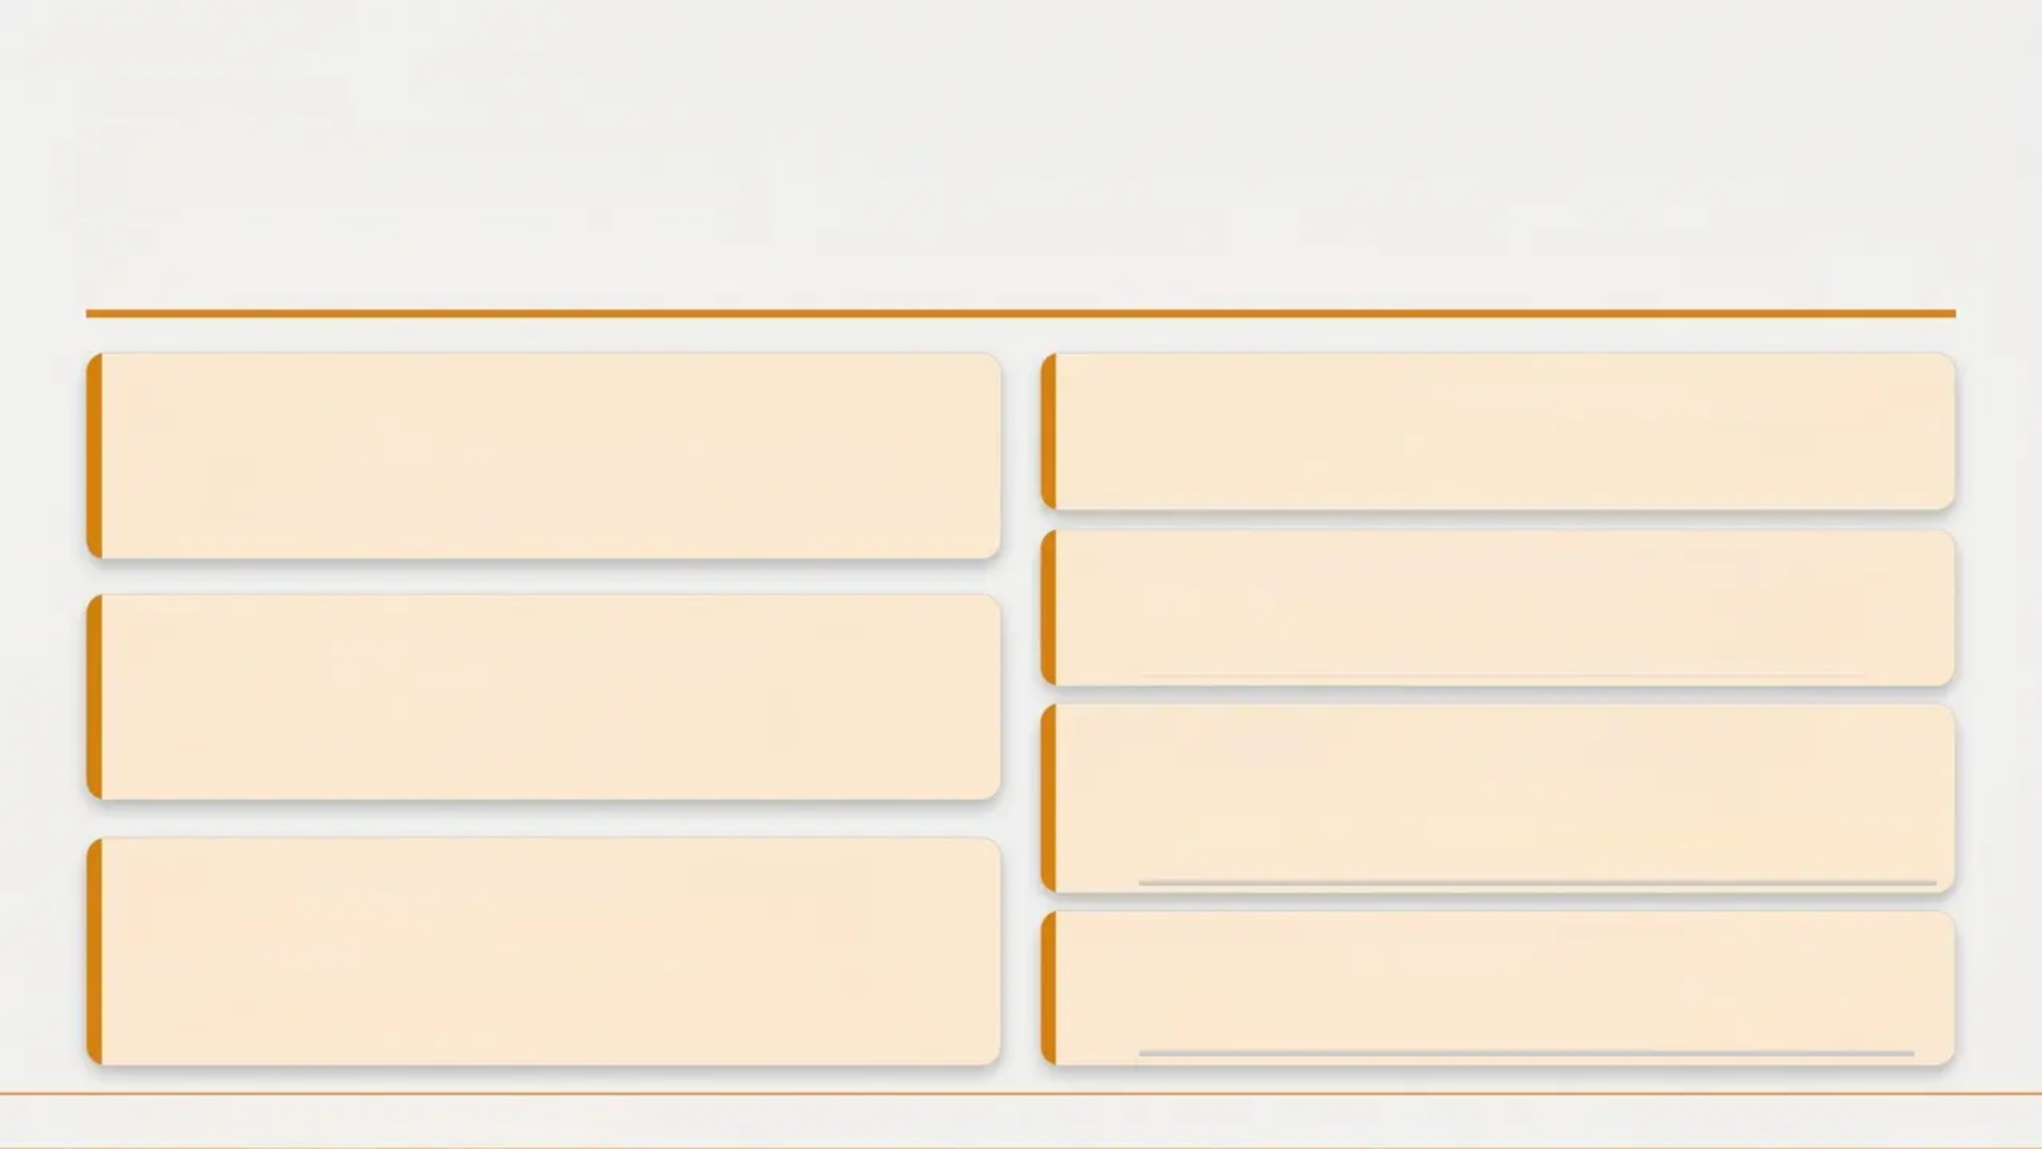
Bradford VTS
Common Pitfalls
Mistakes that put young people at risk — and your practice at medicolegal risk
Not documenting capacity assessments
Assuming CSE is a “lifestyle choice”
Exploitation is always abuse — never a consensual
decision by the young person.
A major medicolegal gap — record your assessment
at every relevant consultation.
Waiting for certainty before referring
Refer on reasonable suspicion — not proof. Delay
causes harm.
Failing to see young people alone
Parental presence actively deters honest
disclosure — offer solo time routinely.
Confusing Gillick competence with
Fraser Guidelines
Gillick = capacity to consent broadly. Fraser = specific
contraception criteria.
Applying Fraser Guidelines only to
contraception
Missing male victims of CSE
They apply to all treatment decisions for under-16s,
not contraception alone.
Boys are significantly under-recognised — apply the
same vigilance regardless of gender.
Bradford VTS · Adolescent Safeguarding · May 2026
27 / 30

Slide 27

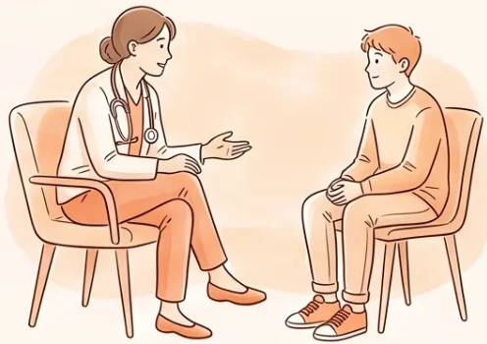
CONSULTING SKILLS
Patient Communication
Useful phrases for building trust and supporting disclosure
CONFIDENTIALITY
REASSURANCE
Everything you tell me is private between
us, unless I'm worried about your safety.
It's not your fault. You haven't done
anything wrong.
NON-JUDGEMENT
BEFORE SHARING
I'm not going to judge you — I just want to
make sure you're okay.
I need to talk to [name] about this, but I'll
tell you first what I'm going to say.
OPENING THE DOOR
Has anything happened that made you
feel unsafe or uncomfortable?
Bradford VTS · Adolescent Safeguarding
www.bradfordvts.co.uk
28 / 30

Slide 28

SUMMARY
Bradford VTS · Adolescent Safeguarding · May 2026
Quick Recall
01
02
03
04
05
Abuse Types
Adolescent
Brain
Fraser
Guidelines
Under-13
Rule
SAFEGUARD
Physical • Emotional
Sexual • Neglect •
Exploitation
Full development
continues to age
25
7 criteria for
competence
under 16
Sexual activity →
almost always
always disclose
9-letter CSE
indicator mnemonic
06
07
08
09
10
CSERQ15
Capacity
CSE
Referral
Threshold
Documentation
5+ positive
responses =
mandatory action
Assess fresh at
every consultation
Never a lifestyle
choice — always
abuse
Record all concerns,
even if no referral
made
Act on suspicion —
not certainty
www.bradfordvts.co.uk
29 / 30

Slide 29



Disclaimer
This teaching deck is produced for educational purposes only. It does not
constitute clinical advice and must not replace professional judgement.
Always verify clinical guidance, drug doses, and safeguarding
thresholds against the latest NICE guidelines, BNF, and local Trust
protocols before applying in practice.
Safeguarding legislation and guidance is subject to change. Check gov.uk
and NICE for the most current versions of Working Together to Safeguard
Children and NICE NG76.
Original source: RCGP Learning (Nov 2019) • Updated May 2026 • Bradford VTS Teaching Programme
Bradford VTS
www.bradfordvts.co.uk

