Slide 1



BRADFORD VTS TEACHING DECK
www.bradfordvts.co.uk
Teenage Mental
Health & Self-Harm
*A Teaching Deck for GP Trainees*
GP REGISTRAR TRAINING
Updated to May 2026 standards. Including NICE
NG225 (Self-Harm, 2022) and NICE NG134
(Depression in Children & Young People, reviewed 2024)
Created May 2026
⚠️ For educational purposes only. Always verify against current NICE/BNF guidance.
Bradford VTS
May 2026

Slide 2
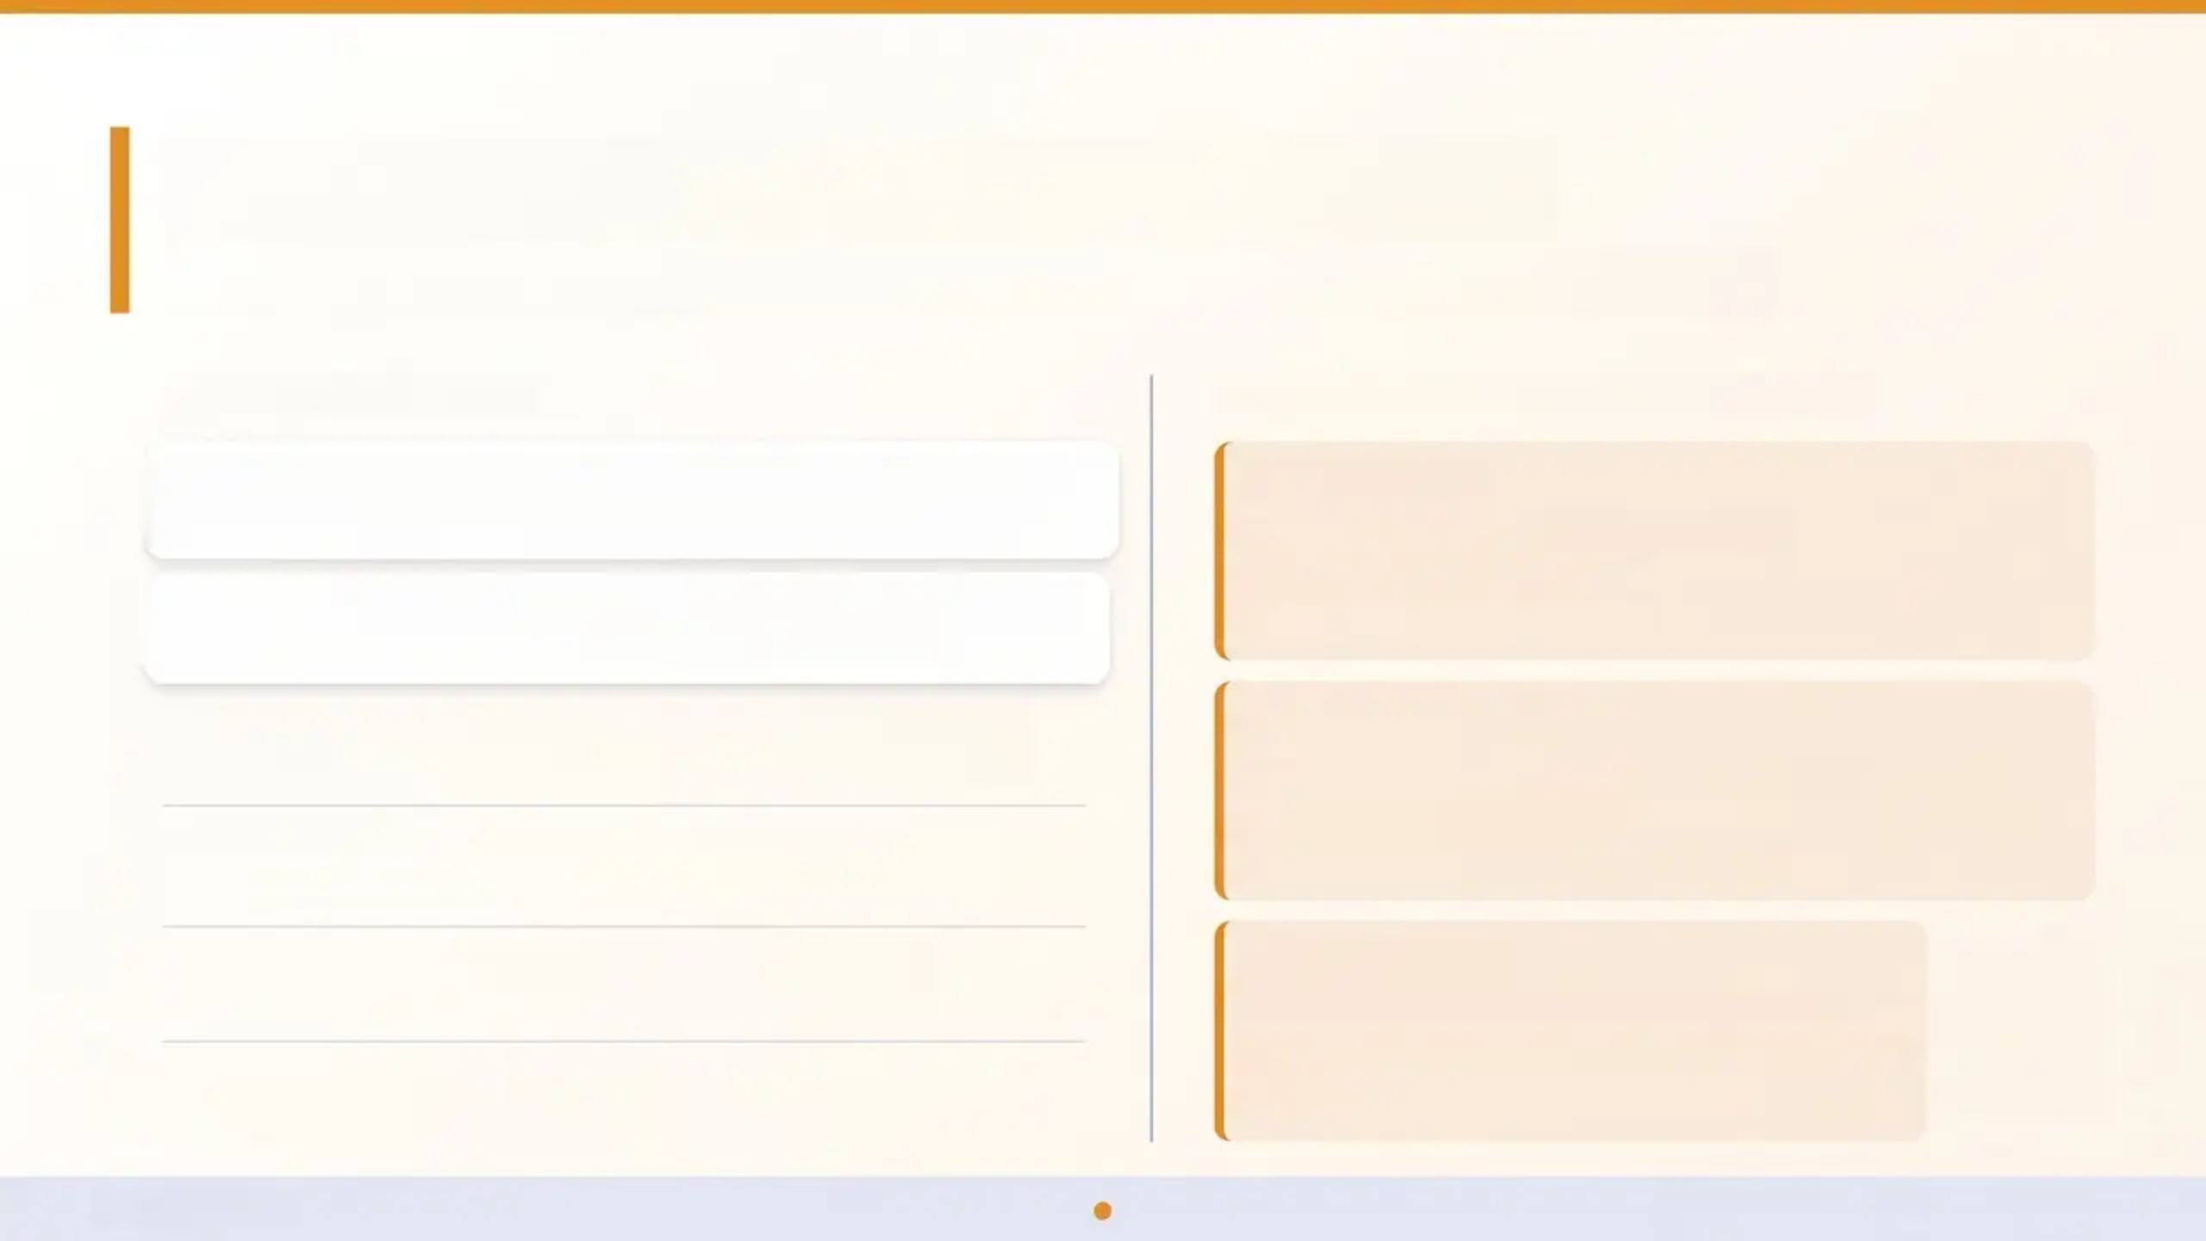

Attribution & Clinical Currency
Sources, guidelines, and frameworks underpinning this teaching deck
CLINICAL GUIDELINES
TRAINING FRAMEWORK & ATTRIBUTION
NICE NG225 Self-Harm: Assessment, Management and
Preventing Recurrence September 2022 — current
CWMT Toolkit
Charlie Waller Mental Health Toolkit
Dr Maryanne Freer, 2012
Consultation framework and problem-solving guide
NICE CKS Self-Harm Primary care knowledge summary
Last revised February 2025
NICE NG134 Depression in Children and Young People
2019 — last reviewed May 2024
Clinical Reference
Young People Who Self-Harm by Cutting
Roberts et al, BMJ, 2013
Epidemiology and clinical approach
NICE NG185 Mental Health of Children and Young People
2021 — current
NICE NG87 ADHD: Diagnosis and Management
Current
Processing Date
Content compiled and verified: May 2026
Updated to reflect NICE NG225 and NG134
(reviewed 2024)
NICE CKS Anxiety Disorders
Current
Bradford VTS
www.bradfordvts.co.uk • May 2026

Slide 3
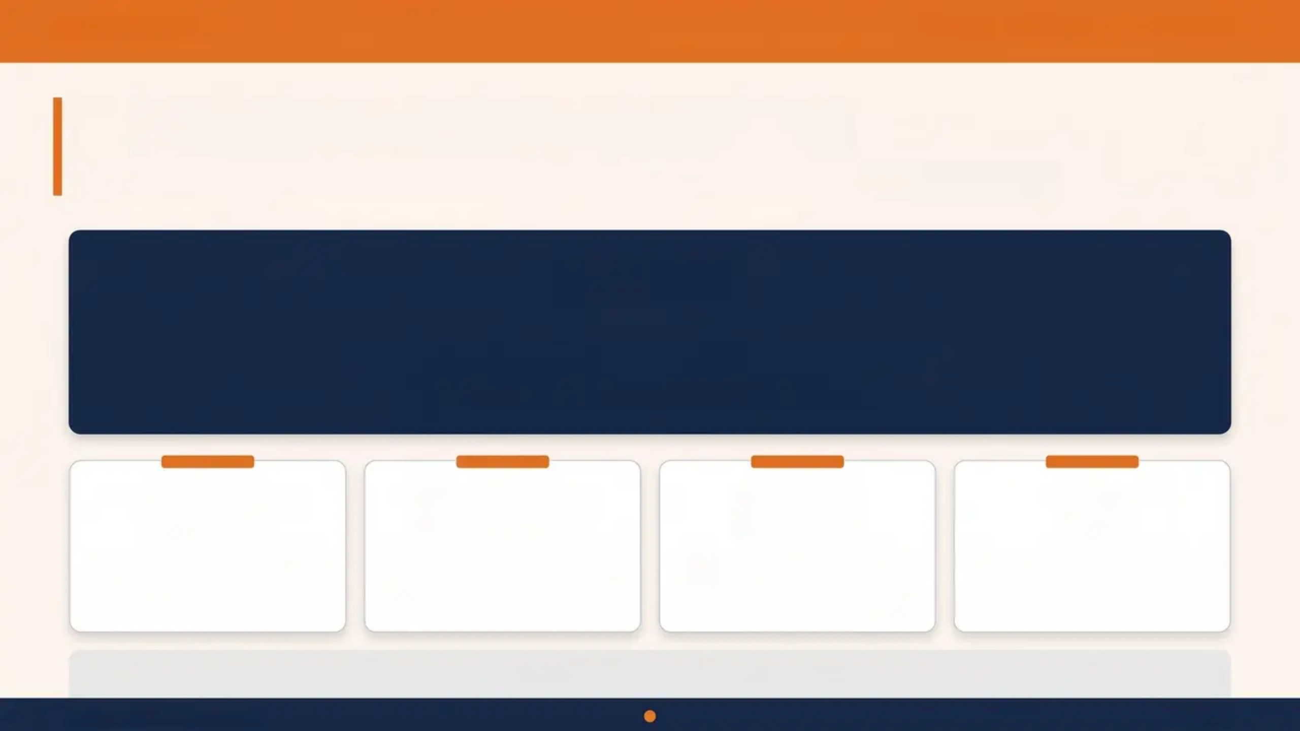
BRADFORD VTS
Teenage Mental Health & Self-Harm
Why This Matters — The Scale
Epidemiology of mental health in young people presenting to primary care
1 in 3
young people presenting to their GP
have a diagnosable mental health condition
50%
1 in 10
30%
#1
of all adult mental health
conditions are diagnosable
by age 14
children aged 5–16 have a
diagnosable mental health
condition (NHS Digital)
of young people with
depression continue into
adulthood
Mental health is the leading
cause of ill health in young
people globally
“The GP surgery is often the first — and sometimes only — point of contact for a young person in crisis.”
Bradford VTS Teaching Deck
May 2026

Slide 4
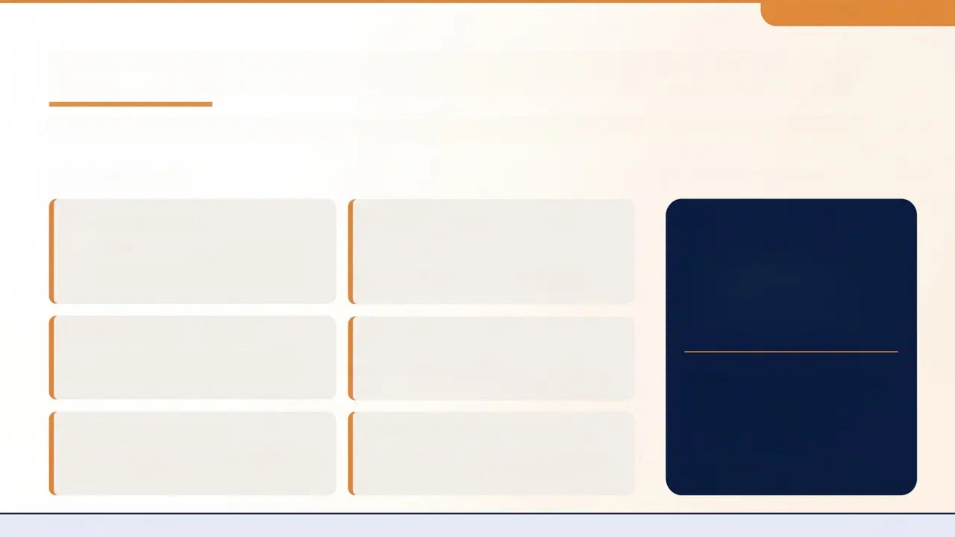







Bradford VTS Teaching Deck
Presentation Challenges in General Practice
Why mental health in young people is easy to miss — and how GPs have a unique advantage
THE CHALLENGES
THE GP ADVANTAGE
Somatization
Irritability Mistaken for
Normal Behaviour
Headaches, abdominal pain, and fatigue
often mask underlying depression or
anxiety
Irritability is a key sign of adolescent
depression — easily dismissed as “typical
teenage behaviour”
“GPs can notice change
over time — that
longitudinal relationship is
a clinical tool in itself.”
Short Consultations
Fear of Labelling
Opening a mental health conversation in
10 minutes requires skill and confidence
GPs may hesitate to assign a diagnosis,
worrying about stigma or over-medicalising
distress
— Recognise gradual deterioration
— Build trust across multiple contacts
Fear of Labelling
— Act before crisis develops
“Will I Open a Pandora's Box?”
GPs may hesitate to assign a diagnosis,
worrying about stigma or over-medicalising
Asking directly about self-harm or suicide
does NOT increase risk — it provides relief
LONGITUDINAL CARE ADVANTAGE
NICE NG134 / NG225 / NG185
Page 4

Slide 5
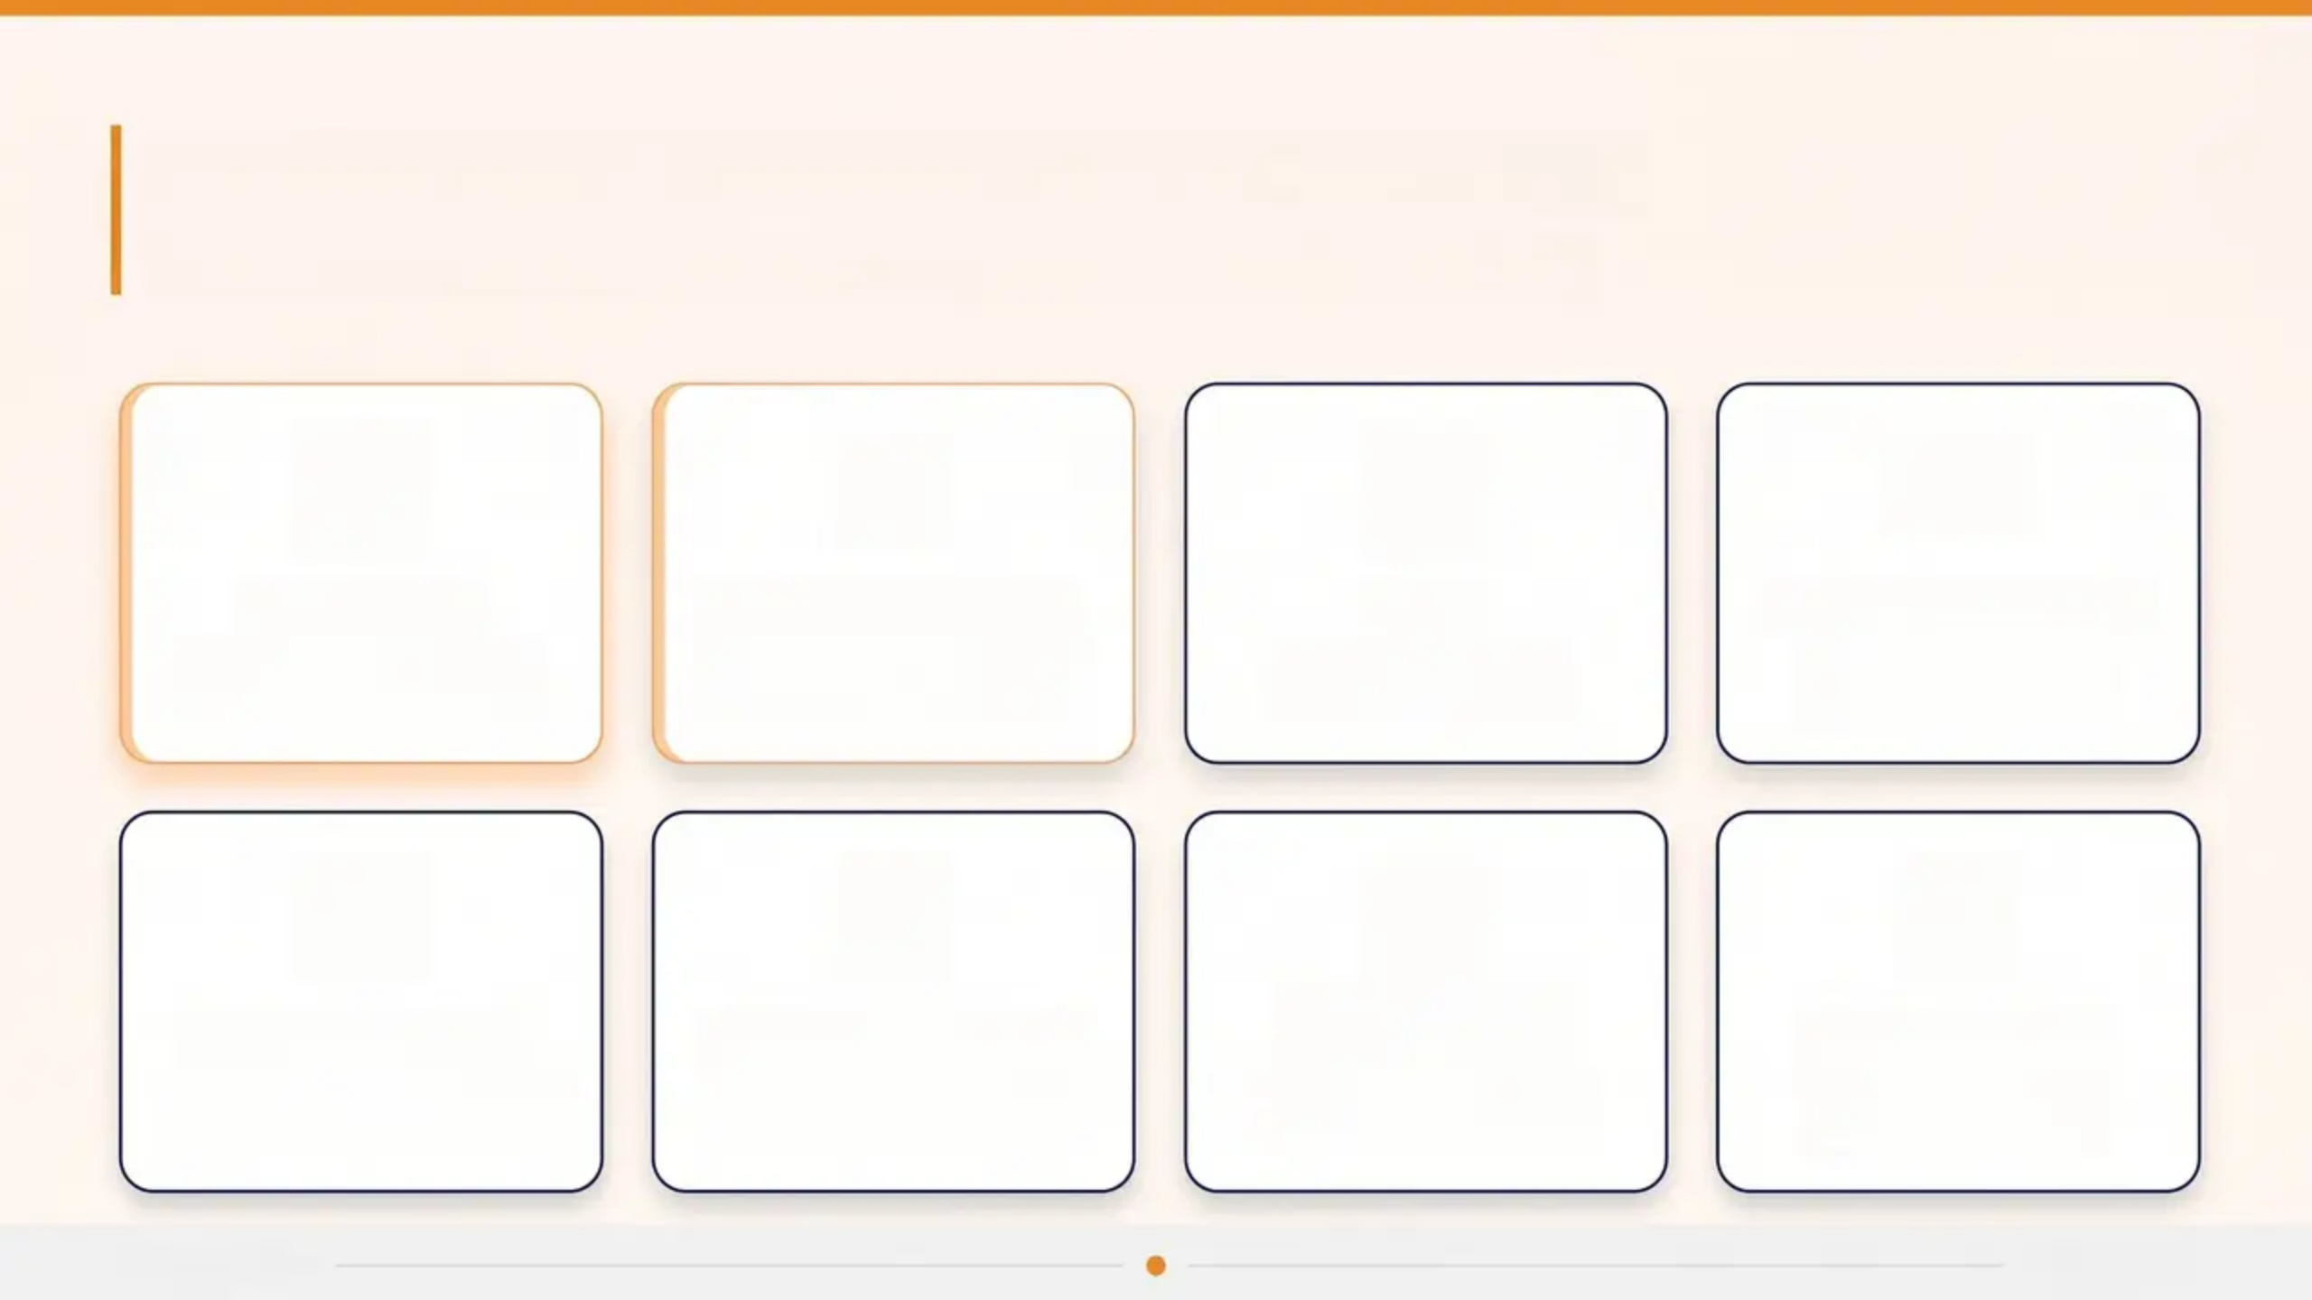








Common Mental Health Presentations
Frequent conditions presenting in young people in primary care
Depression
Anxiety Disorders
ADHD
Conduct Disorders
Most under-diagnosed
in young people
Most common condition
overall
Affects school and
home domains
Behaviour and rule-
breaking patterns
Eating Disorders
Substance Misuse
Emotional
Dysregulation
Trauma & ACEs
Urgent referral if physical
compromise
Often co-presents with
depression
Emerging personality
difficulties
Adverse childhood
experiences
Bradford VTS
Page 5 of 30

Slide 6
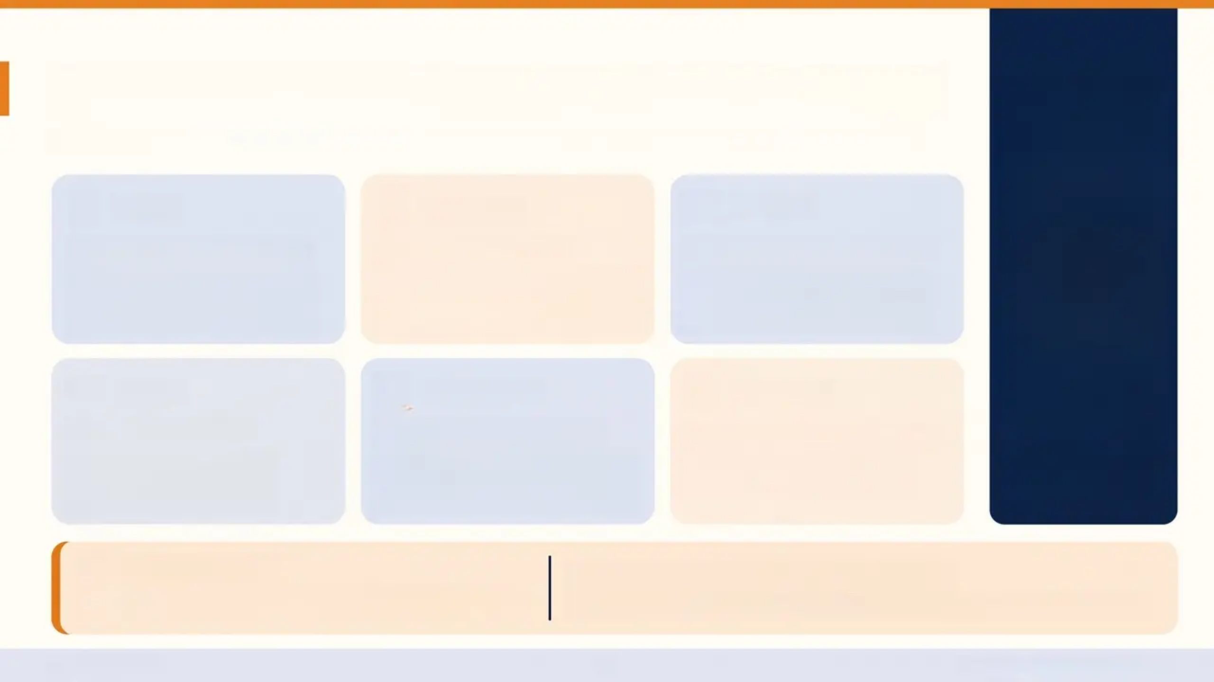








Depression — Key Features in Young People
*How adolescent depression differs from adult presentation — NICE NG134 (reviewed 2024)
Mood
Physical
School
Irritability over Sadness
Somatic Symptoms
School Refusal / Truancy
*Classic "low mood" may be
absent — irritability is often the
dominant mood signal
*Headaches, abdominal pain,
fatigue — somatization is common
and can mask the diagnosis
*Unexplained absence or
reluctance to attend school is a
key behavioural red flag
Social
Behaviour
Appetite
Social Withdrawal
Risk-Taking Behaviour
Weight & Appetite Changes
Loss of interest in friends,
hobbies, and previously
enjoyed activities
Substance misuse, recklessness,
and boundary-testing can be
depressive equivalents
Both loss and gain — monitor
alongside mood trajectory
“Irritability is often the
face of depression in
young people”
Screening Tool
Score ≥ 10 suggests depression
PHQ-A (Adolescent PHQ-9)
Validated for 11–17 year olds • Use at first assessment and follow-up
Bradford VTS
NICE NG134 · Reviewed 2024

Slide 7
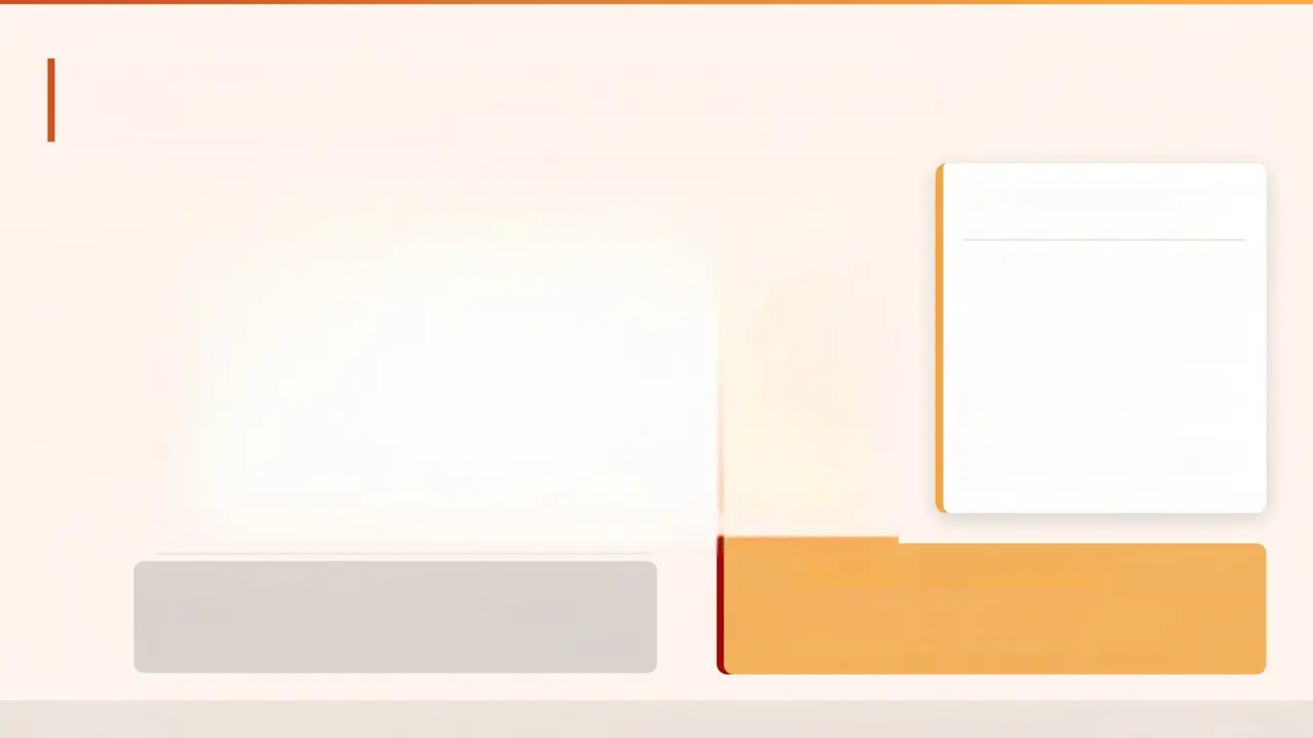
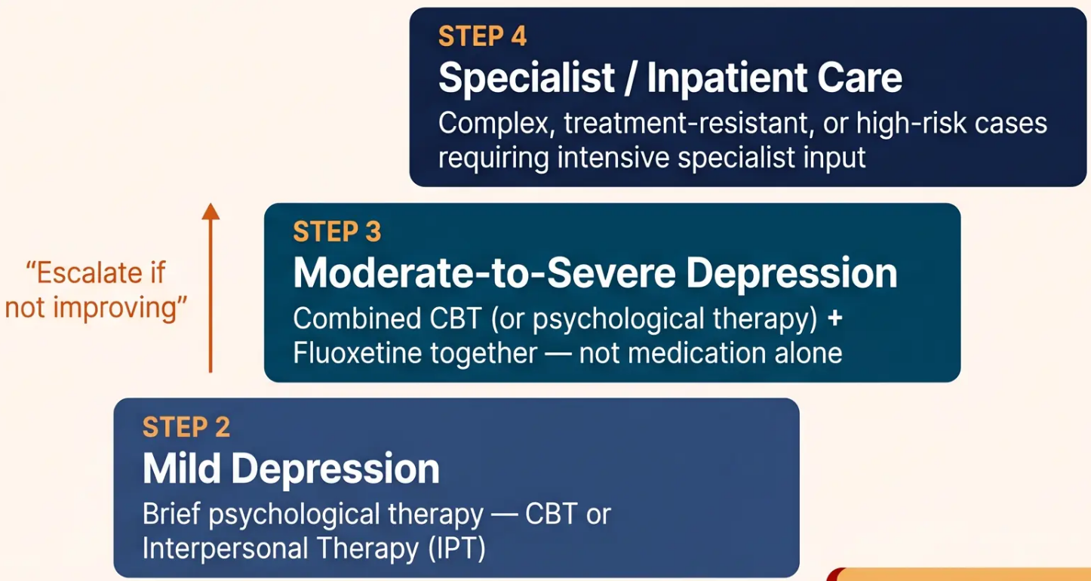

Depression — NICE Stepped-Care Model
NICE NG134 · Reviewed May 2024
FLUOXETINE — PRESCRIBING
ESSENTIALS
Only SSRI licensed for depression
in under-18s in the UK
Start at 10 mg/day → titrate to
20 mg/day (maximum)
Always initiate alongside
psychological therapy
Do NOT use TCAs, venlafaxine,
or MAOIs in under-18s
MHRA Monitoring Requirement
STEP 1
After starting fluoxetine: review weekly for the first 4 weeks
Monitor for: increased agitation • emerging self-harm
Risk is highest in the first 2-4 weeks of treatment
Mild, Non-Persistent Depression
Active monitoring + psychoeducation; review in 2 weeks
Bradford VTS
NICE NG134 · May 2026

Slide 8
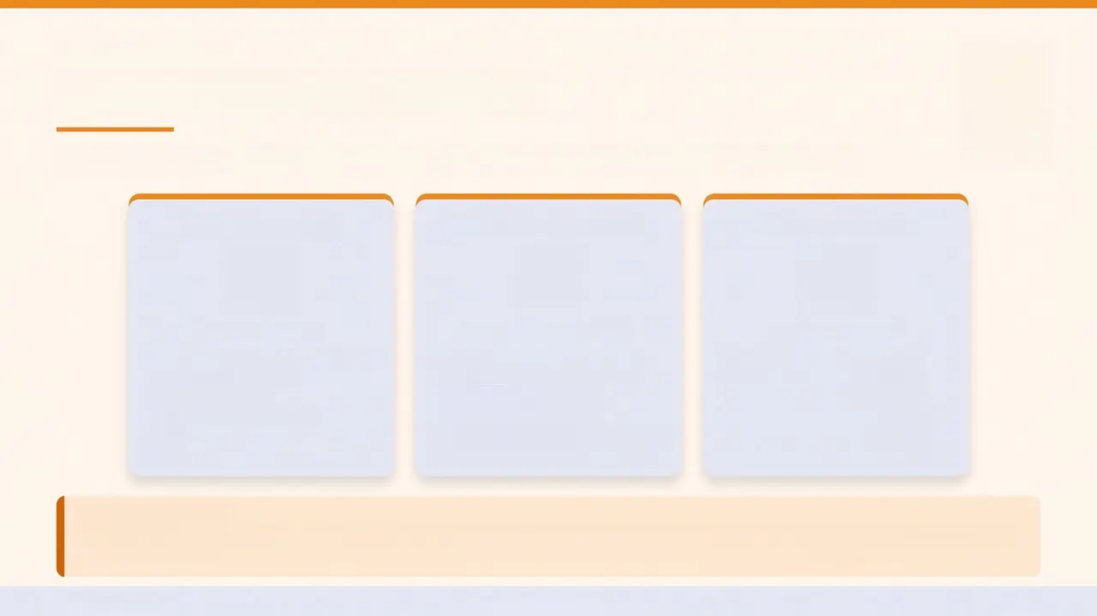



NICE NG185 • NG47
Anxiety in Young People
The most common mental health condition in young people — and often missed
Types of Anxiety
First-Line Treatment
School Refusal
COMMON TYPES
FIRST-LINE TREATMENT
SCHOOL REFUSAL
• Generalised Anxiety Disorder (GAD)
• Social anxiety disorder
• Separation anxiety
• School phobia / avoidance
• OCD
• PTSD
• CBT-based interventions for all
anxiety types (NICE)
• Individual or group format
• Can begin in primary care
• SSRIs for anxiety in under-18s:
off-label — specialist input required
• Urgent MDT approach required
• Early intervention significantly
improves prognosis
• Involves GP, school, CAMHS, family
• Prolonged absence worsens
anxiety and social development
REFER TO CAMHS IF:
Anxiety is persistent, impairing school and social function, and not responding to primary care interventions.
Consider early discussion with CAMHS even before formal referral — advice lines can guide primary care management
Bradford VTS
Anxiety in Young People
8 / 30

Slide 9
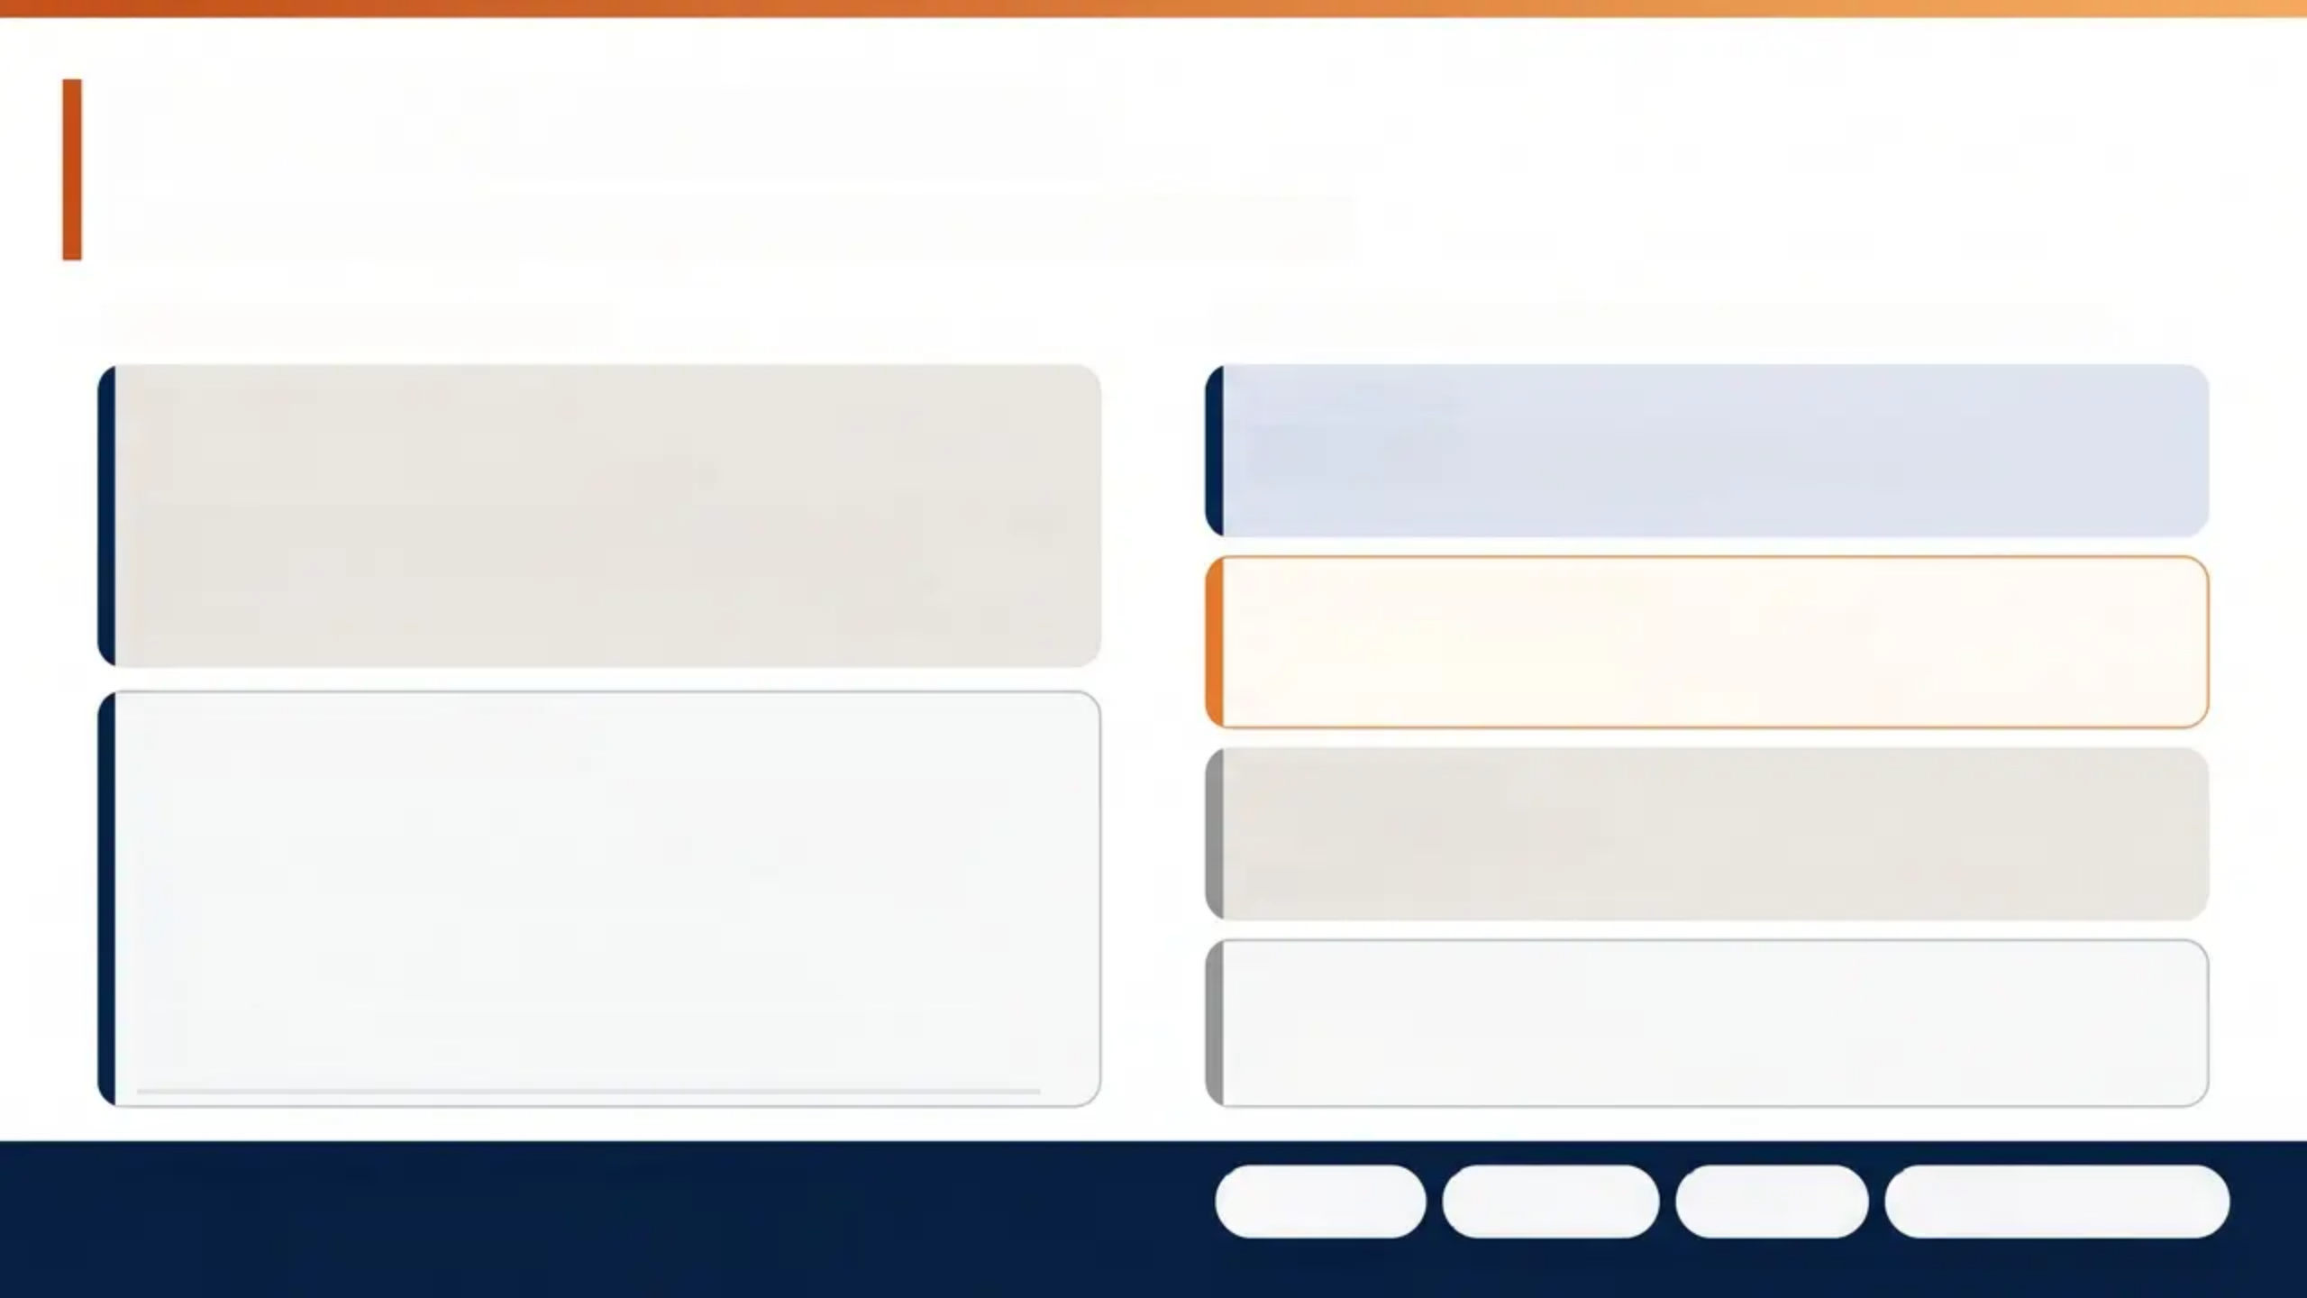

ADHD — The GP Role
Recognition • Referral • Shared Care — NICE NG87
RECOGNITION & REFERRAL
MEDICATIONS — INITIATED BY SPECIALIST ONLY
Diagnostic Criteria
FIRST-LINE
Methylphenidate
• Symptoms present before age 12
• Impairment in two or more settings (home AND school)
• Causing meaningful impact on daily functioning
• Symptoms not better explained by another condition
Stimulant • Most widely used
FIRST-LINE — SEVERE
Lisdexamfetamine
Stimulant • For more severe presentations
GP Responsibilities
• Recognise and refer for specialist ADHD assessment
• Initiate shared care once specialist has confirmed
diagnosis and started treatment
• Annual shared care reviews — prescribing continues in
primary care
• Medication breaks (e.g., summer holidays) to reassess
ongoing need
ALTERNATIVE
Atomoxetine
Non-stimulant • Useful if stimulants not tolerated
NON-STIMULANT
Guanfacine
Non-stimulant • Alternative option
MONITORING ON STIMULANTS —
AT EVERY SHARED CARE REVIEW:
Height
Weight
Pulse
Blood Pressure
Document findings at every review — escalate if growth or cardiovascular concerns arise

Slide 10
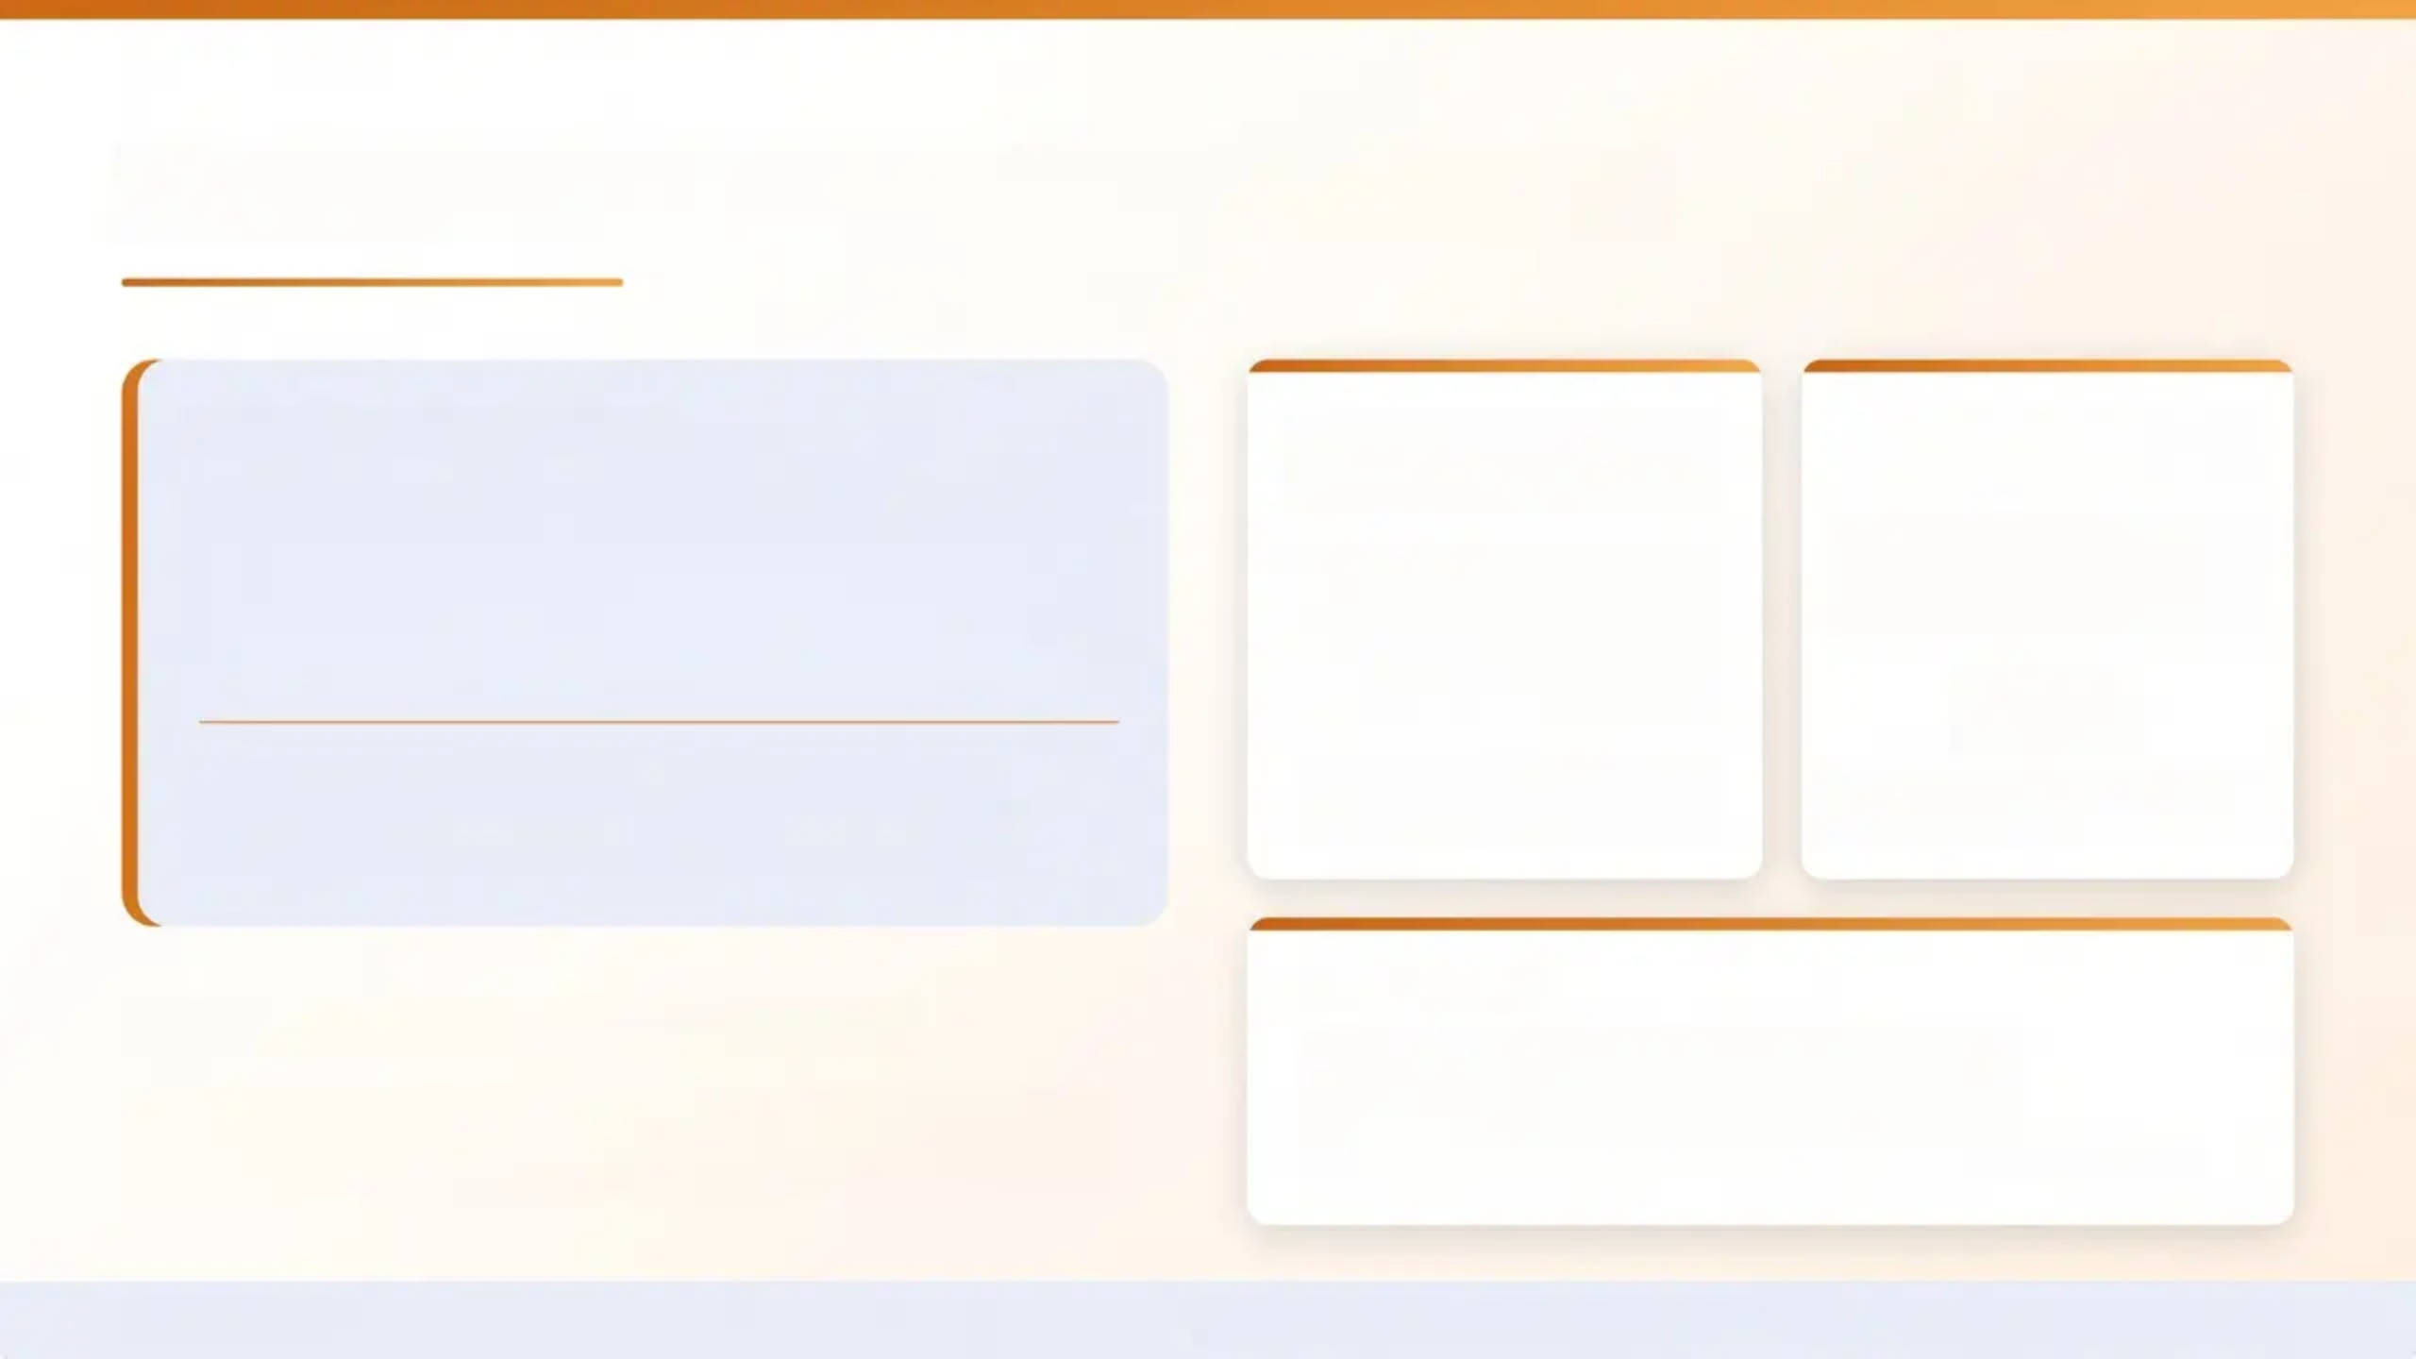

Self-Harm — Definition and Facts
NICE NG225 • Updated 2022
NICE NG225 DEFINITION
25-30%
FEMALE : MALE RATIO
FOR CUTTING
“Any act where a person intentionally
damages or injures their body,
regardless of suicidal intent.”
of UK 15-16 year-
olds report having
self-harmed
6 : 1
Cutting • Burning • Hitting • Scratching
Overdose • Ingestion of substances
at some point in their
lifetime
Male ratio increases for
overdose and more lethal methods
PEAK ONSET
Self-harm ≠ a suicide attempt
12-15 years old
But it is a significant risk factor for completed
suicide — and must always be taken seriously.
The window when GP awareness matters most
Bradford VTS
NICE NG225 • Self-Harm: Assessment, Management and Preventing Recurrence

Slide 11
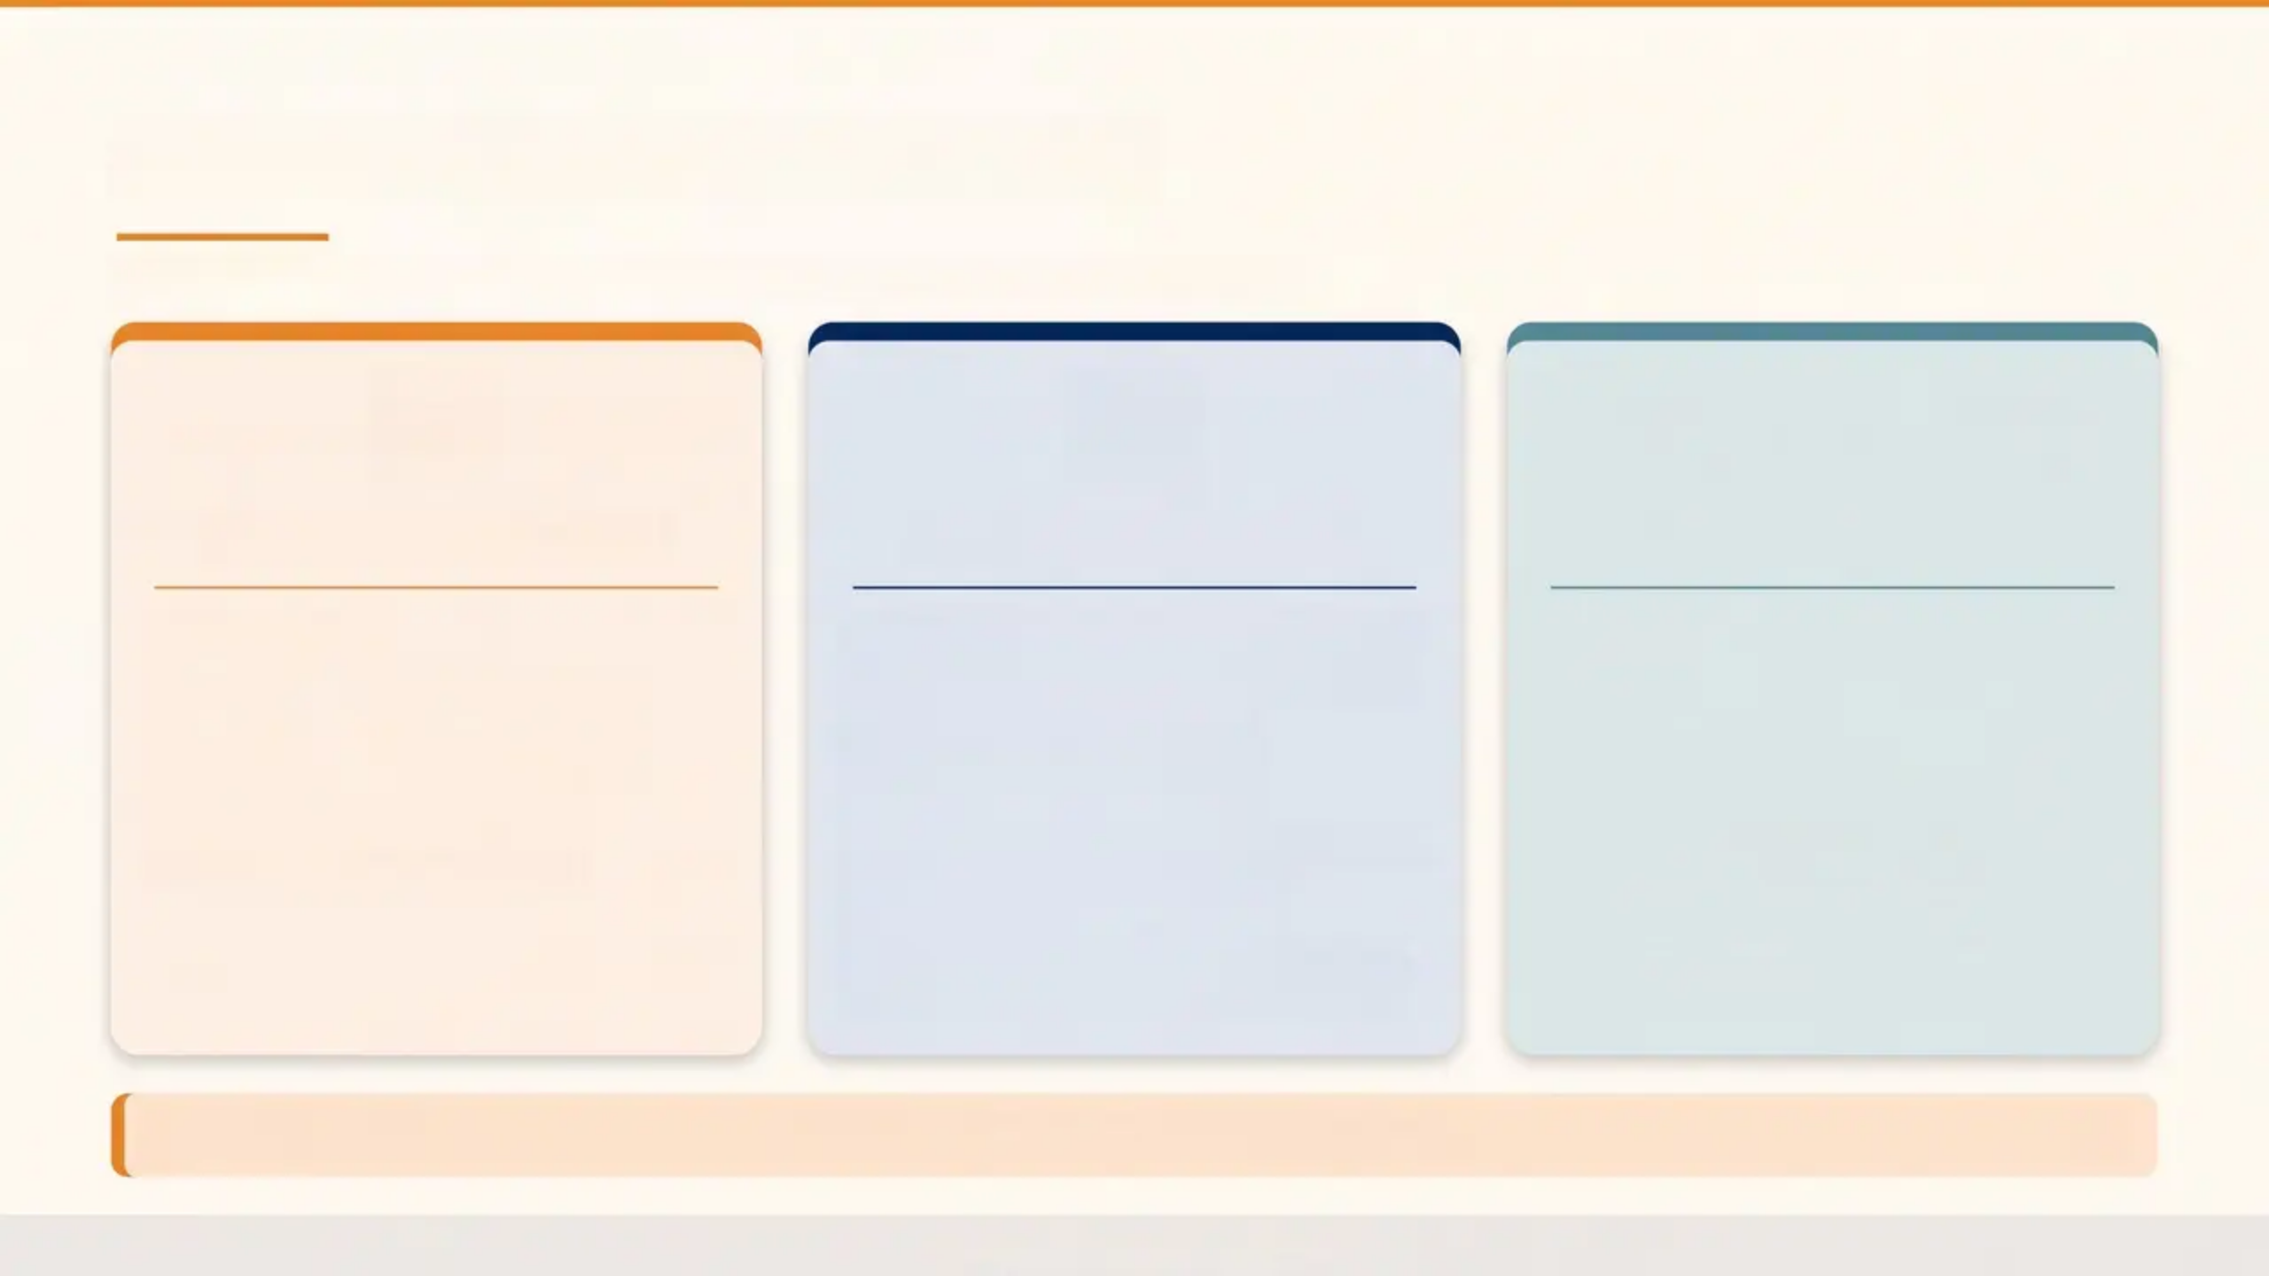



Self-Harm — Risk Factors
*NICE NG225 — factors associated with increased risk in adolescents
SOCIODEMOGRAPHIC
INDIVIDUAL & FAMILY
PSYCHOLOGICAL
■ Female sex
■ Low socioeconomic status
■ LGBTQ+ identity struggles
■ Academic difficulties /
restricted achievement
■ Adverse childhood experiences
(ACEs)
■ Parental separation or
bereavement
■ Physical or sexual abuse history
■ Bullying (peer or online)
■ Family history of mental illness
or suicide
■ Depression or anxiety
■ ADHD
■ Substance misuse
■ Impulsivity / emotional
dysregulation
■ Hopelessness, perfectionism
■ Low self-esteem
⚠️
Risk factors are cumulative — the more factors present, the greater the concern. No single factor predicts self-harm alone.
Bradford VTS
NICE NG225

Slide 12
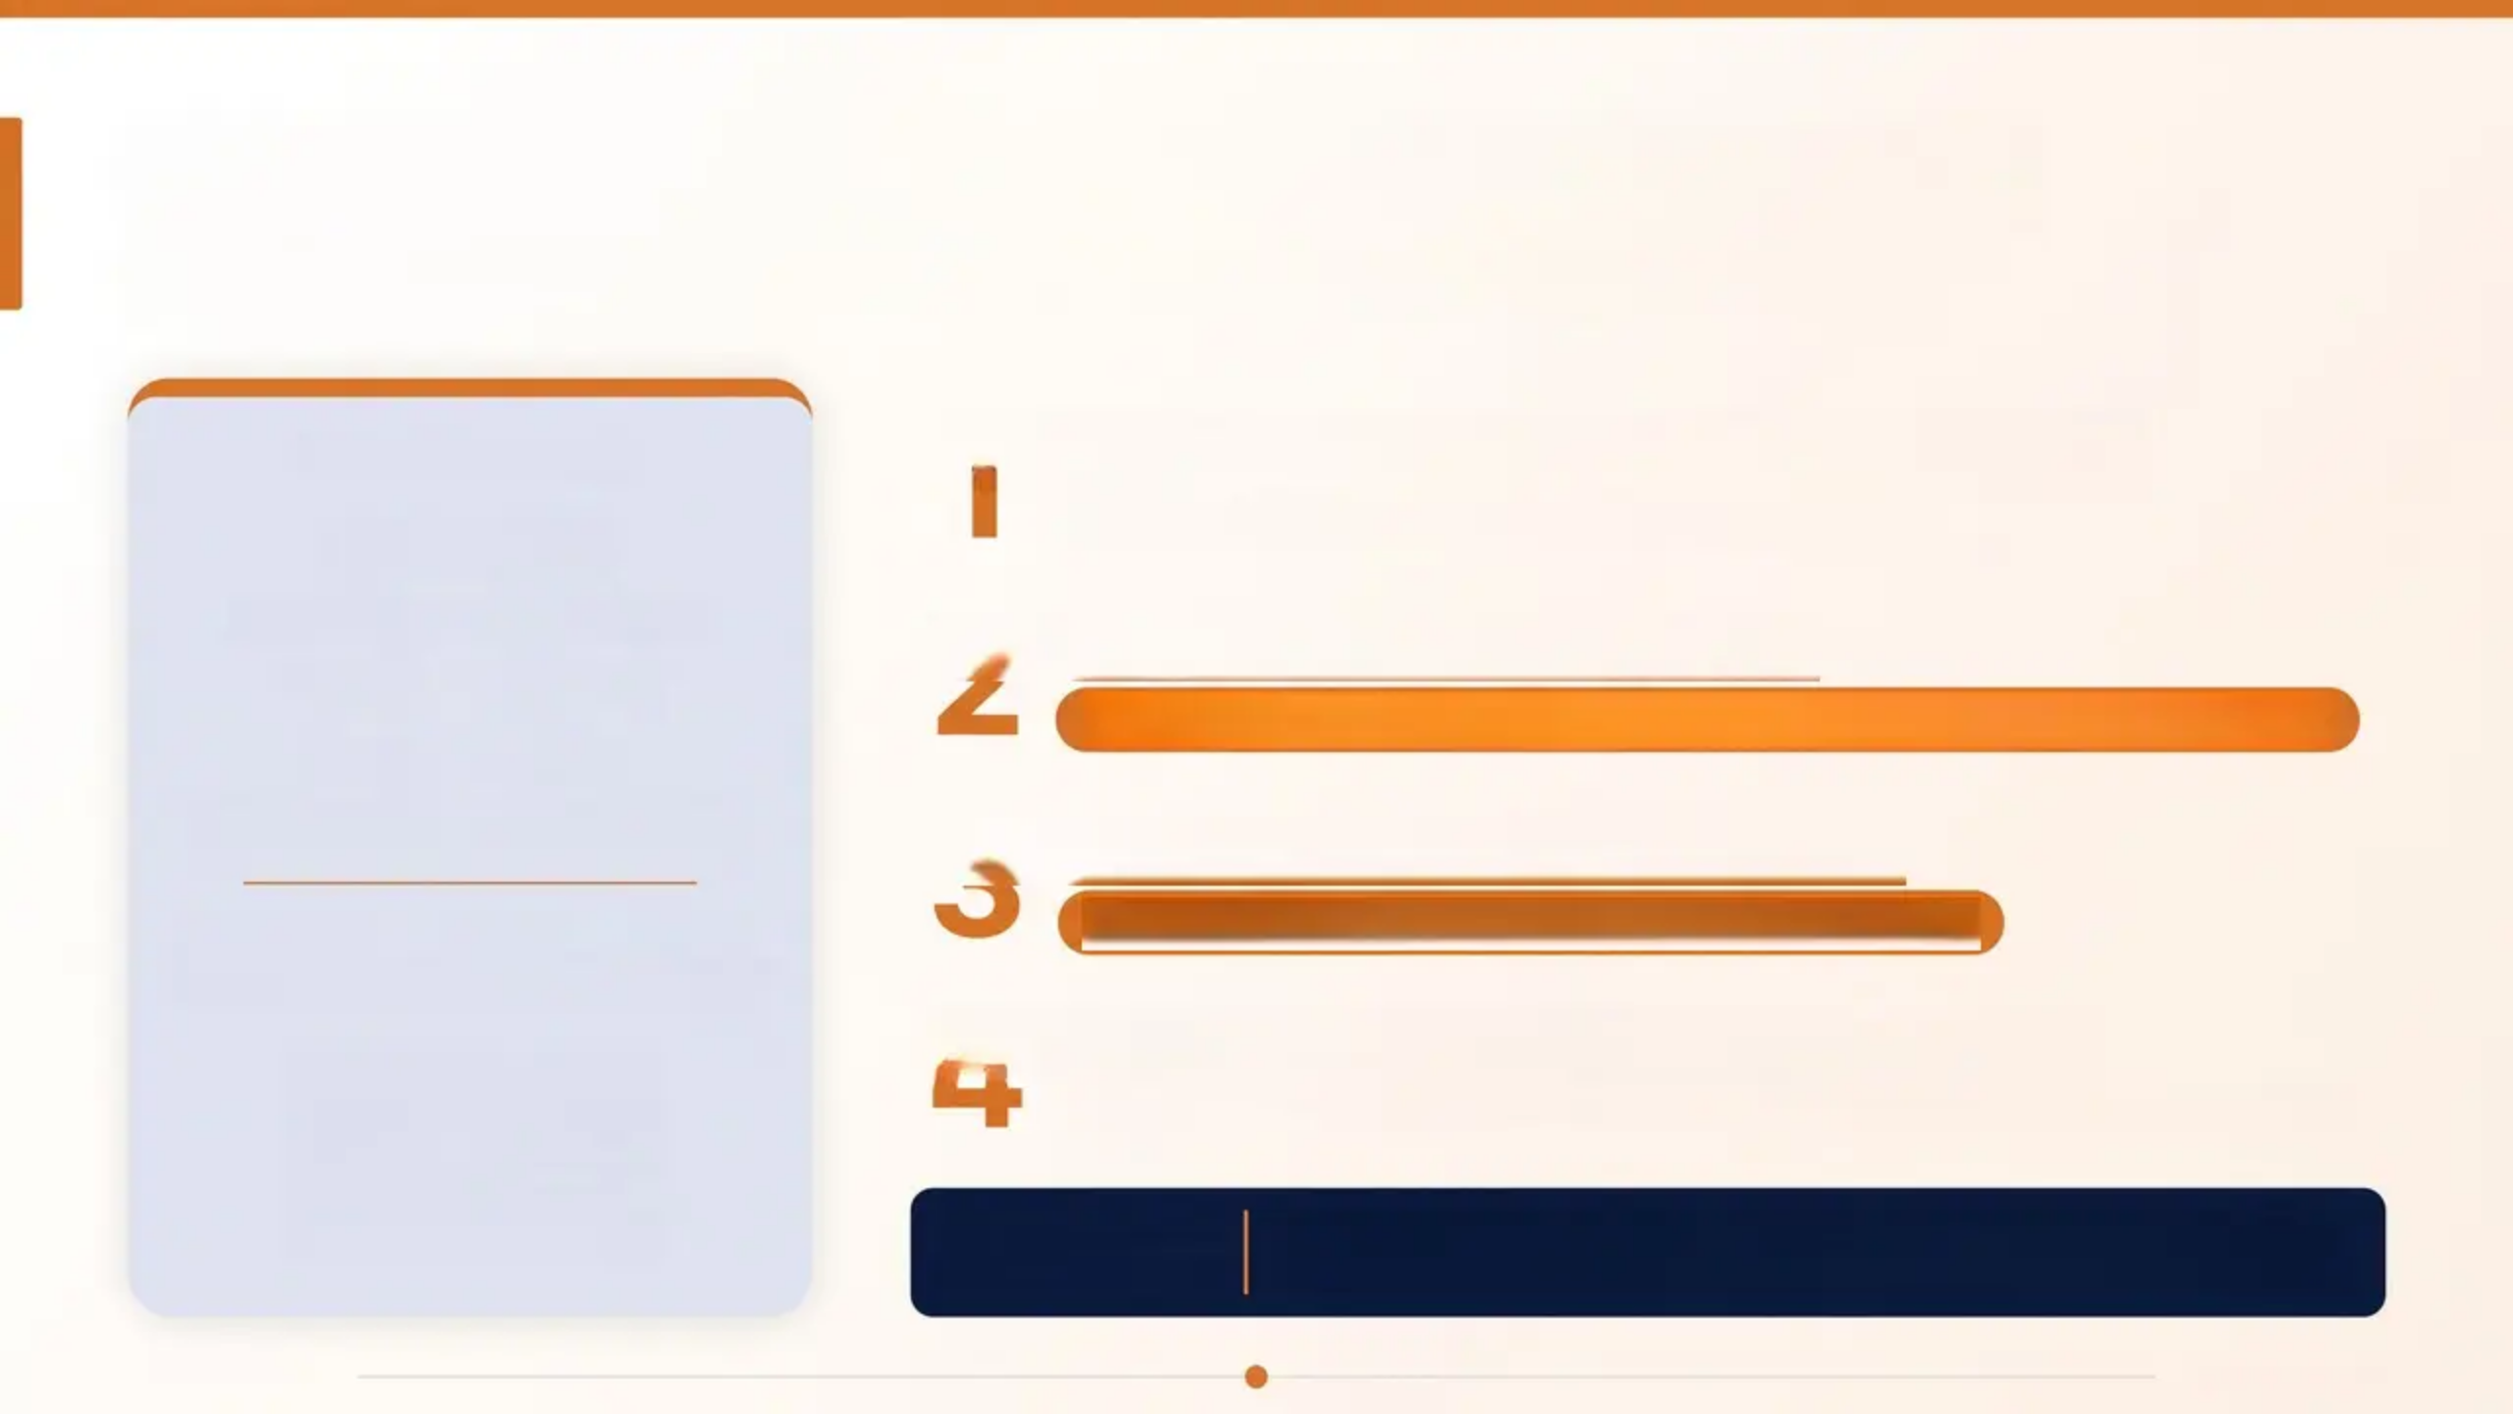
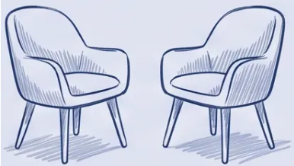
The Initial Consultation — Opening Up
Creating safety for disclosure — a skills-based approach
1
Address the presenting problem first
CASE VIGNETTE
Hayley, 15
Build rapport before raising the sensitive topic
Attends for acne review
Scar visible at wrist
Unaccompanied
Family history of depression
2
Ask permission to explore
“Can I ask about this scar? I’d like to understand how you’re doing.”
3
Be explicitly non-judgmental
“It takes considerable courage
for a young person to attend.”
“I’m not here to judge you. I’m just here to help.”
4
Explain confidentiality and its limits
Young people need to know what stays private — and when it cannot
KEY EVIDENCE
Asking about self-harm or suicide does NOT increase risk —
it provides relief and opens the door to help
Bradford VTS
Page 12 of 30

Slide 13
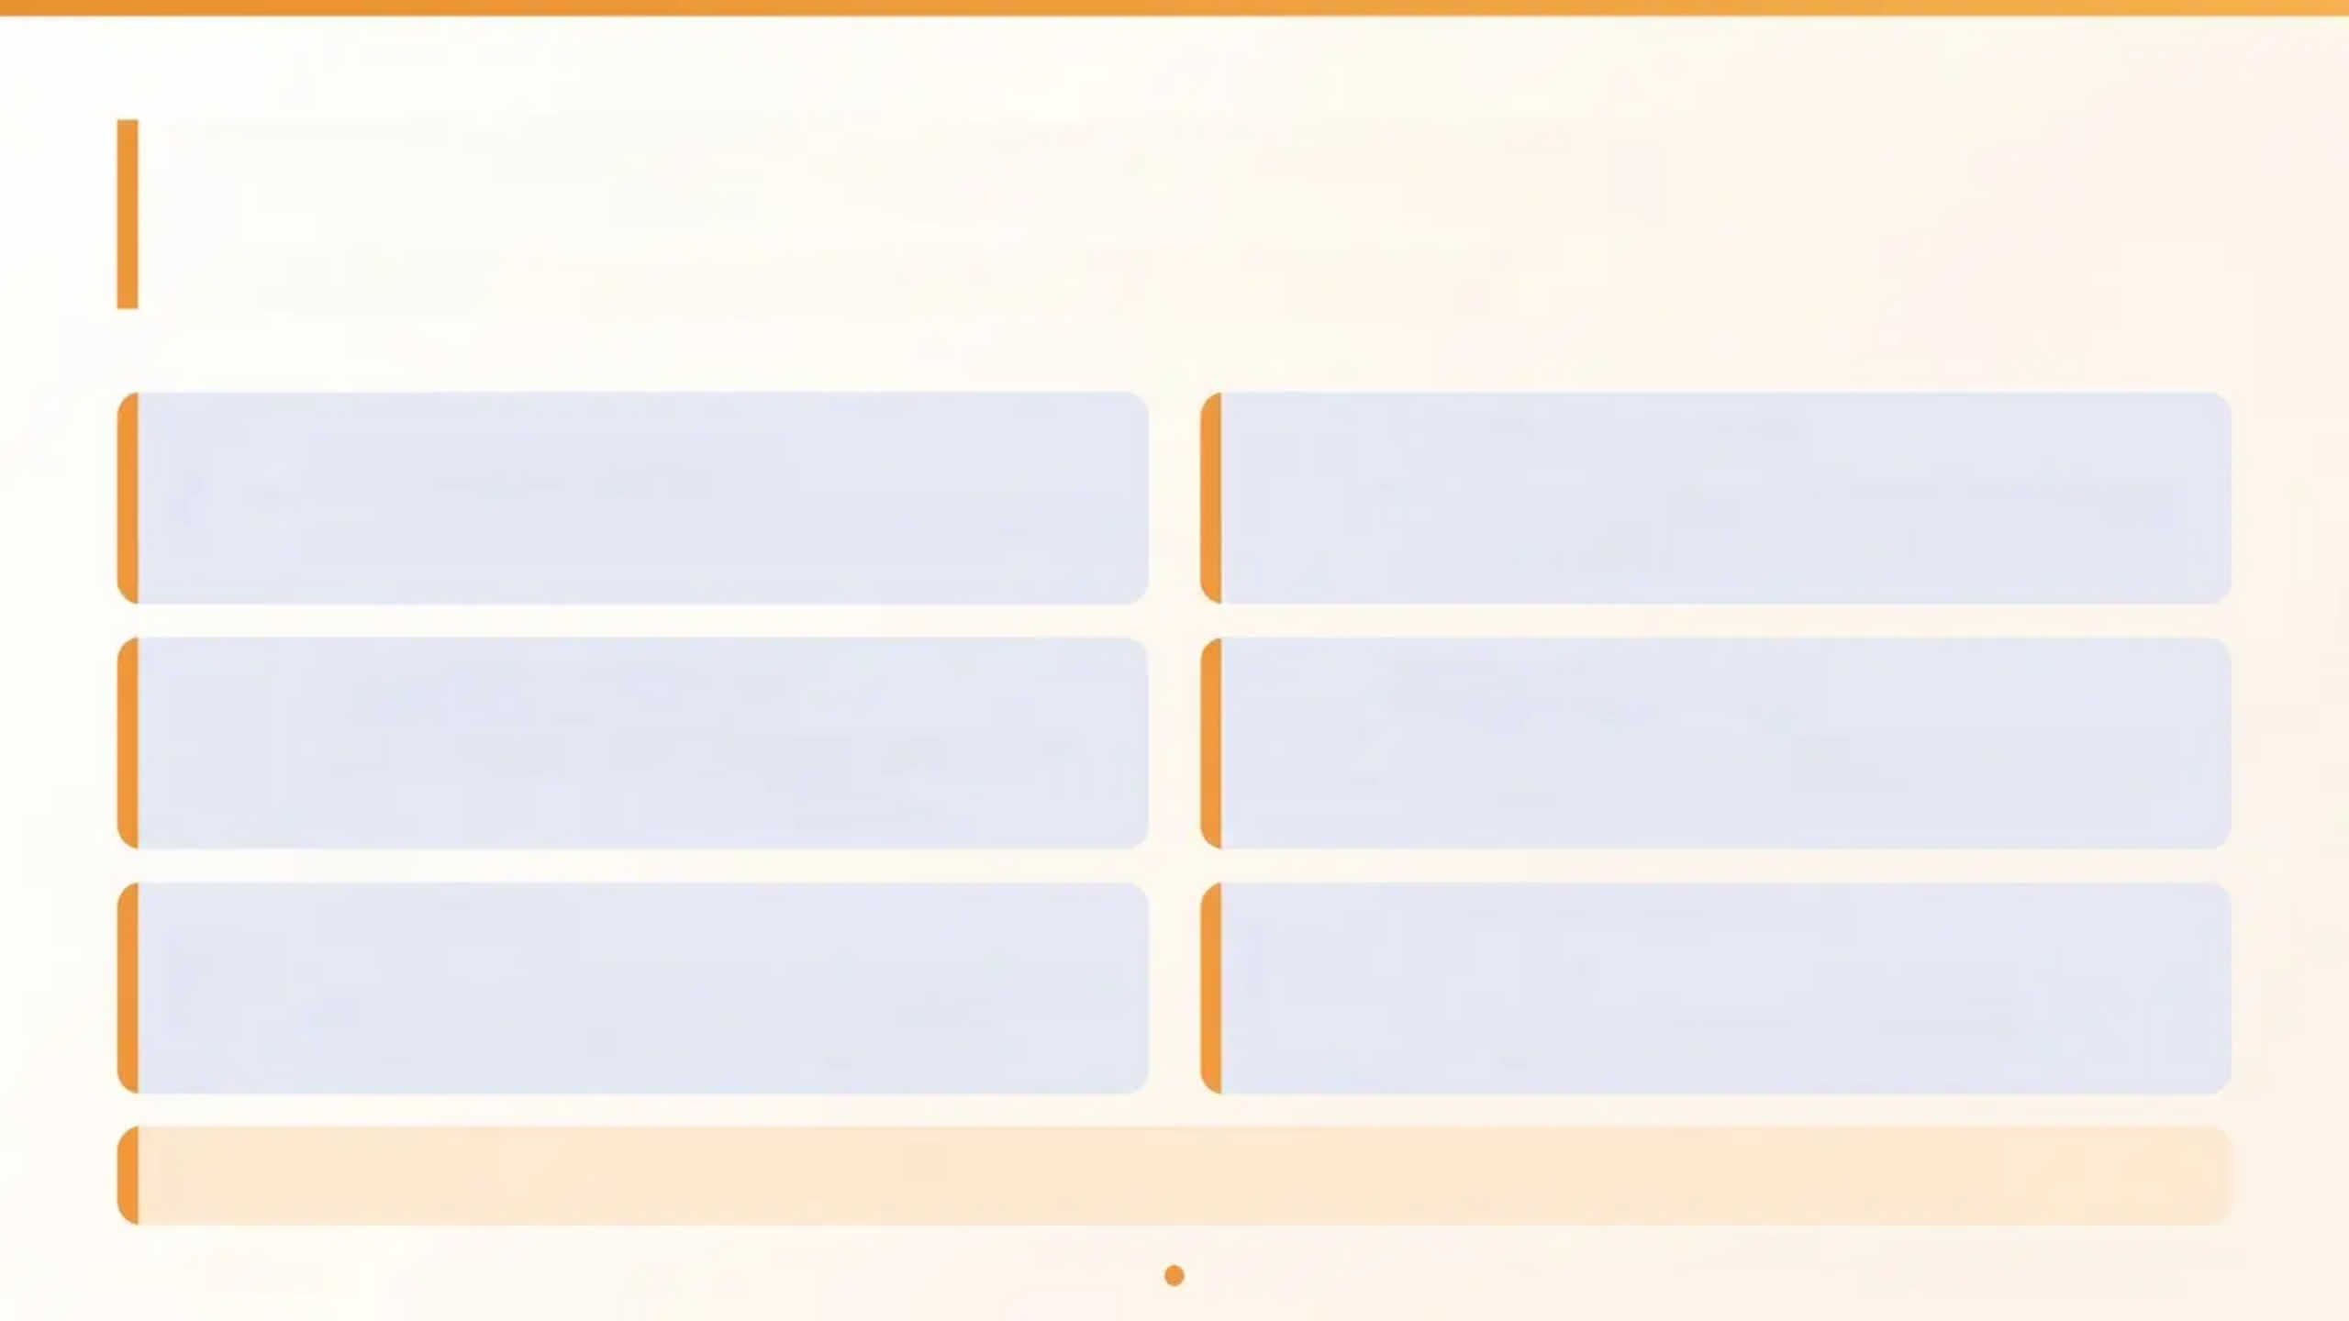






Holistic Self-Harm Assessment
NICE NG225 — Key Areas to Explore in Every Assessment
Onset & Frequency
Suicidal Ideation
“Have you felt life isn't worth living?” Intent,
plan, and timeline must be explored directly.
When did it start? How often? Is it increasing?
Triggers & Feelings
Access to Means
What precedes self-harm? Relief-seeking?
Emotional state before and after?
Medications at home? Sharp objects? Safe
storage discussion is a NICE recommendation.
Escalation
Protective Factors
Deeper cuts? More frequent? New methods?
Increasing severity is a key risk signal.
Trusted adults, future plans, hope,
relationships, reasons to stay safe.
Also Explore:
Sleep & appetite • Safeguarding at home • Support network
Bradford VTS
NICE NG225 • May 2026

Slide 14
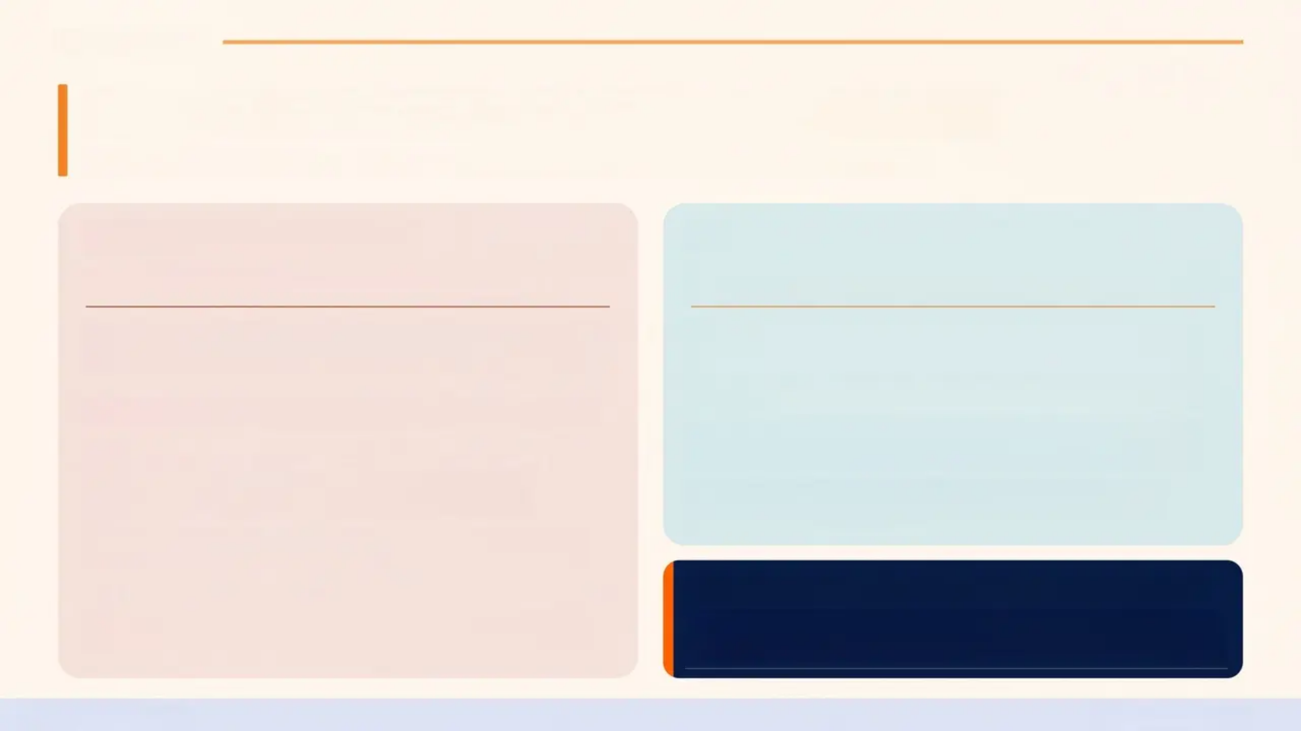
Bradford VTS
Risk Assessment — The NICE Position
*NICE NG225 — Self-Harm: Assessment, Management and Preventing Recurrence (2022)
❌ What NICE says NOT to do
✔ What NICE recommends instead
Do NOT Use Standardised Risk Scales
Conduct a Holistic, Person-Centred Assessment
Risk assessment scales do not reliably predict future
self-harm or suicide in individuals.
■ Psychological state — mental health, suicidal intent,
distress level
Examples of tools NICE advises against using routinely:
— Beck Scale for Suicide Ideation
— Columbia Suicide Severity Rating Scale (as a
standalone decision tool)
— Any numerical score used to “clear” or “discharge”
a patient
■ Physical care needs — nature and severity of any injuries
■ Social circumstances — relationships, home safety,
school, support network
■ Protective factors — hope, future plans, trusted
people, reasons to stay safe
🔴 Urgent same-day CAMHS / crisis team contact if:
A low score does not mean low risk. A high score does
not replace clinical judgement.
Suicidal intent confirmed + specific plan + access to means
→ Do not wait. Do not discharge. Act the same day.
Bradford VTS
NICE NG225 · 2022

Slide 15
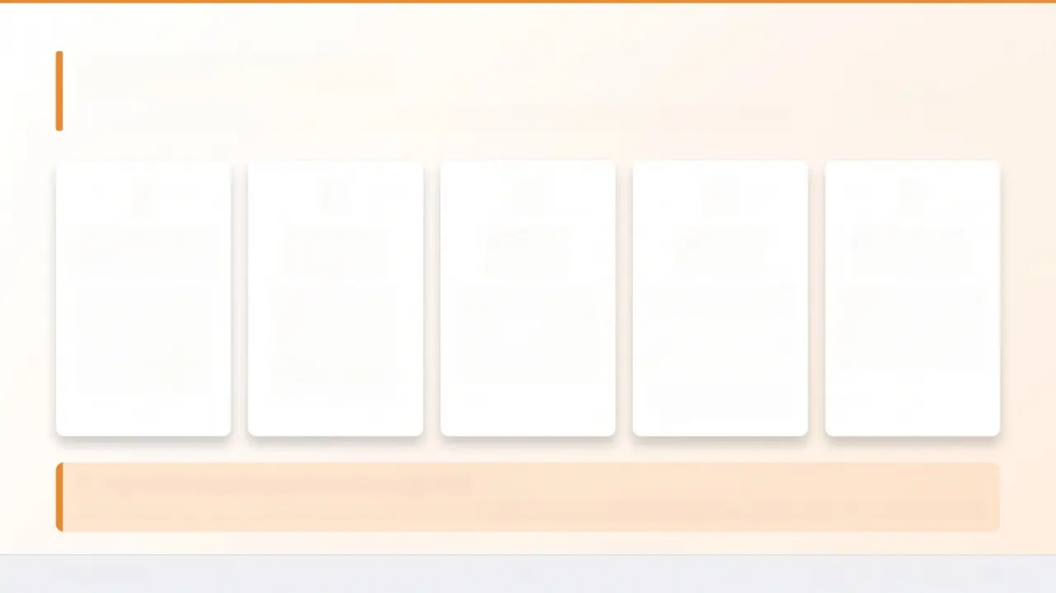

Safety Planning
NICE NG225 — Every person who has self-harmed should leave with a safety plan
1
2
3
4
5
Triggers &
Warning Signs
Coping
Strategies
Trusted
People
Crisis
Contacts
When to Go
to A&E
Identify personal
triggers and early
warning signs
together with the
young person
Distraction,
grounding
techniques,
calling a trusted
friend — agreed
collaboratively
Name at least one
person the young
person can
contact when
distress escalates
Samaritans: 116 123
(free, 24h)
Serious injury,
overdose, or
immediate risk of
harm — do not wait
Childline: 0800 1111
(under-19s)
Local CAMHS crisis
number
Key Means Restriction — NICE NG225 Evidence
Discuss safe storage of medications in the home. Removing access to means is an evidence-based intervention that reduces suicide risk.
Bradford VTS
Safety Planning · Slide 15 of 30

Slide 16
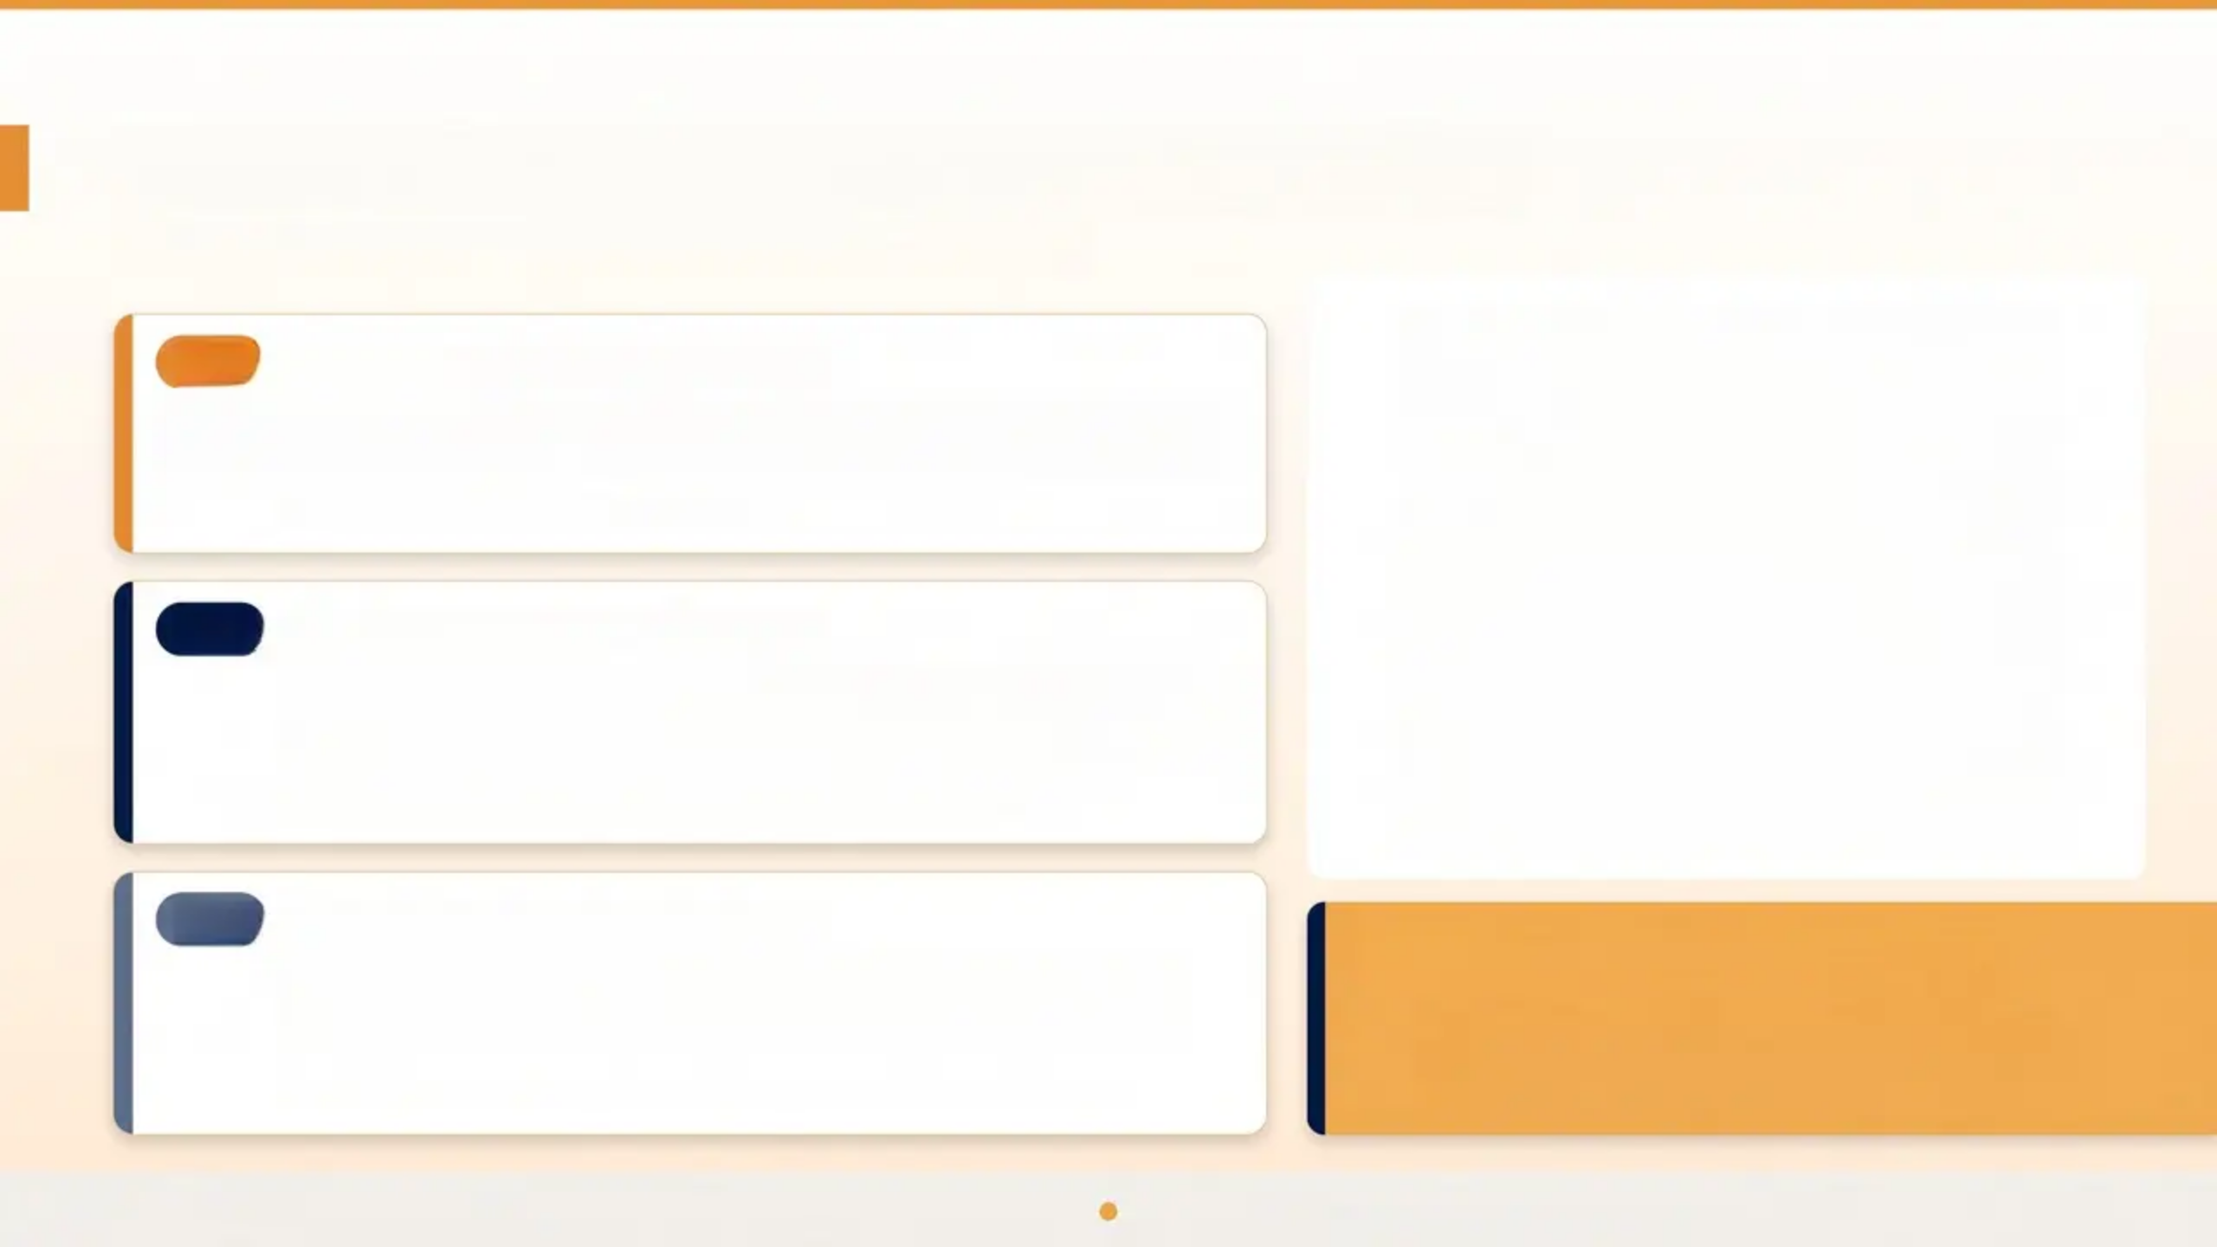
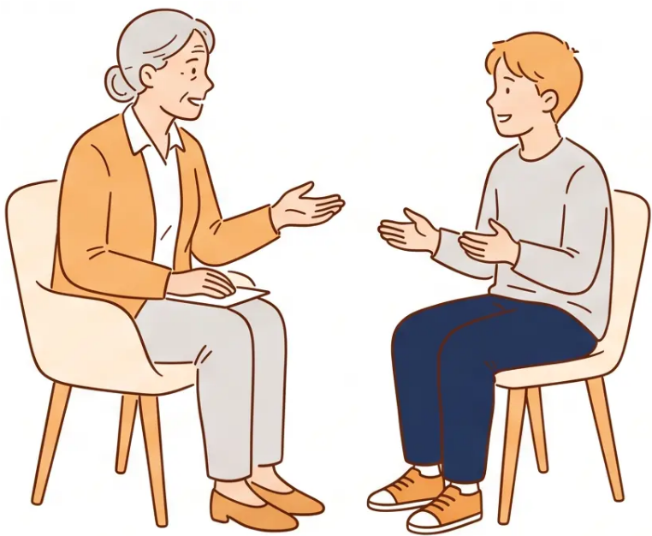
Psychological Treatment for Self-Harm
NICE NG225 — Recommended Psychological Therapies
CBT
Cognitive Behavioural Therapy
First-line psychological therapy for self-harm in young people. Helps
identify and reframe negative thought patterns and develop healthier
coping strategies.
Recommended first-line — NICE NG225
DBT
Dialectical Behaviour Therapy
Especially recommended for recurrent self-harm with emotional
dysregulation. Combines CBT with mindfulness, distress tolerance, and
interpersonal effectiveness skills.
Recommended for recurrent self-harm + emotional dysregulation
MBT
Mentalisation-Based Therapy
Helps young people understand their own and others' mental states.
Useful where emotional dysregulation and interpersonal difficulties
are prominent.
!
Do NOT use antidepressants as a
standalone treatment for self-harm
Antidepressants may be appropriate where a comorbid
diagnosis of depression or anxiety is confirmed – but
must not replace psychological therapy. (NICE NG225)
Group therapy also has evidence – consider alongside individual work
Bradford VTS
NICE NG225 | Page 16 of 30

Slide 17
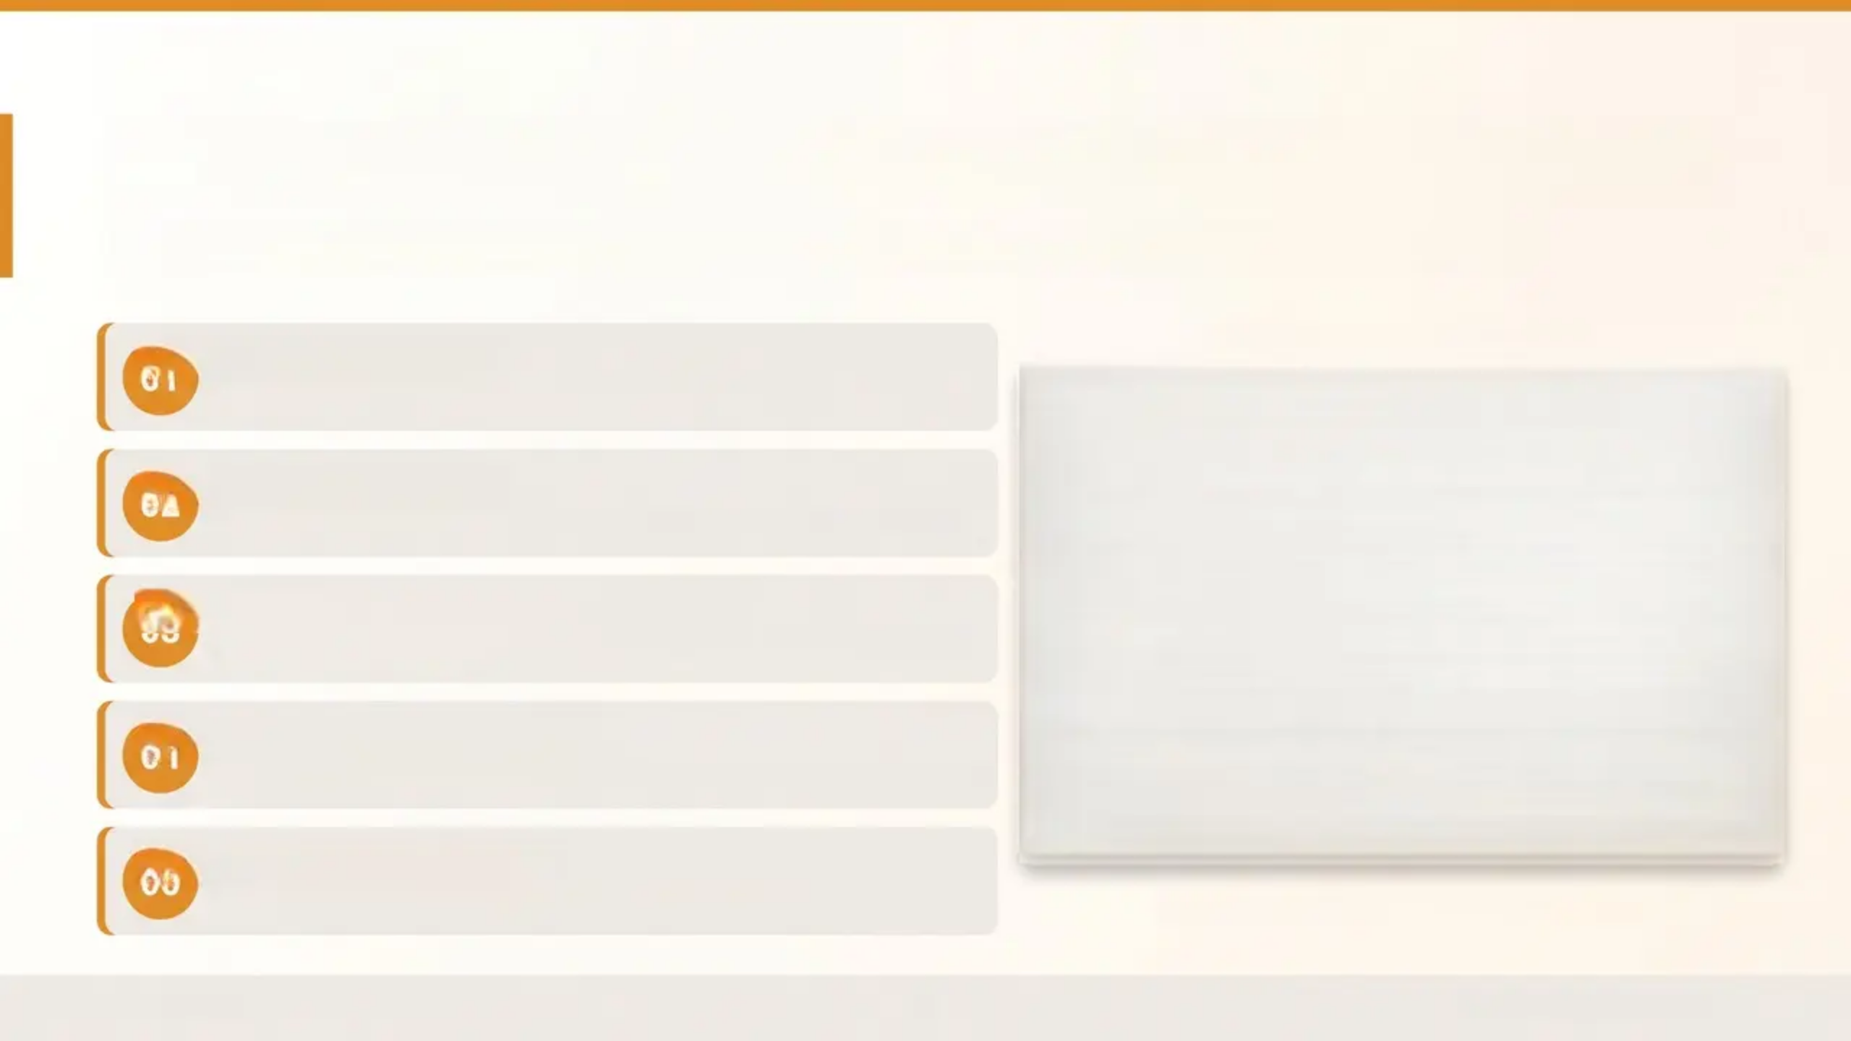
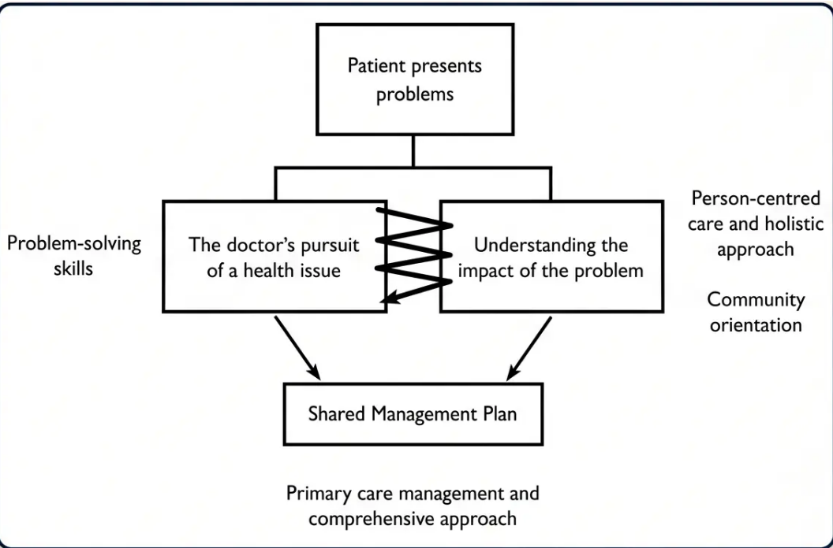
The Mental Health Consultation Framework
CWMT Toolkit — Five Elements of the GP Mental Health Consultation
Agree the Agenda
THE SHARED MANAGEMENT PLAN
01
What does the young person want from today's consultation?
02
Establish the Story
Current presentation, past history, family context – biopsychosocial timeline
03
Explore Understanding and Beliefs
What does the young person think is happening? What are their concerns?
04
Assess Severity and Risk
Validated tool (PHQ-A) combined with clinical judgement – not risk scales alone
05
Develop a Shared Plan
Collaborative, small achievable steps – follow-up booked before leaving
Source: CWMT Toolkit – adapted for primary care
Bradford VTS
NICE NG185 / CWMT Toolkit

Slide 18
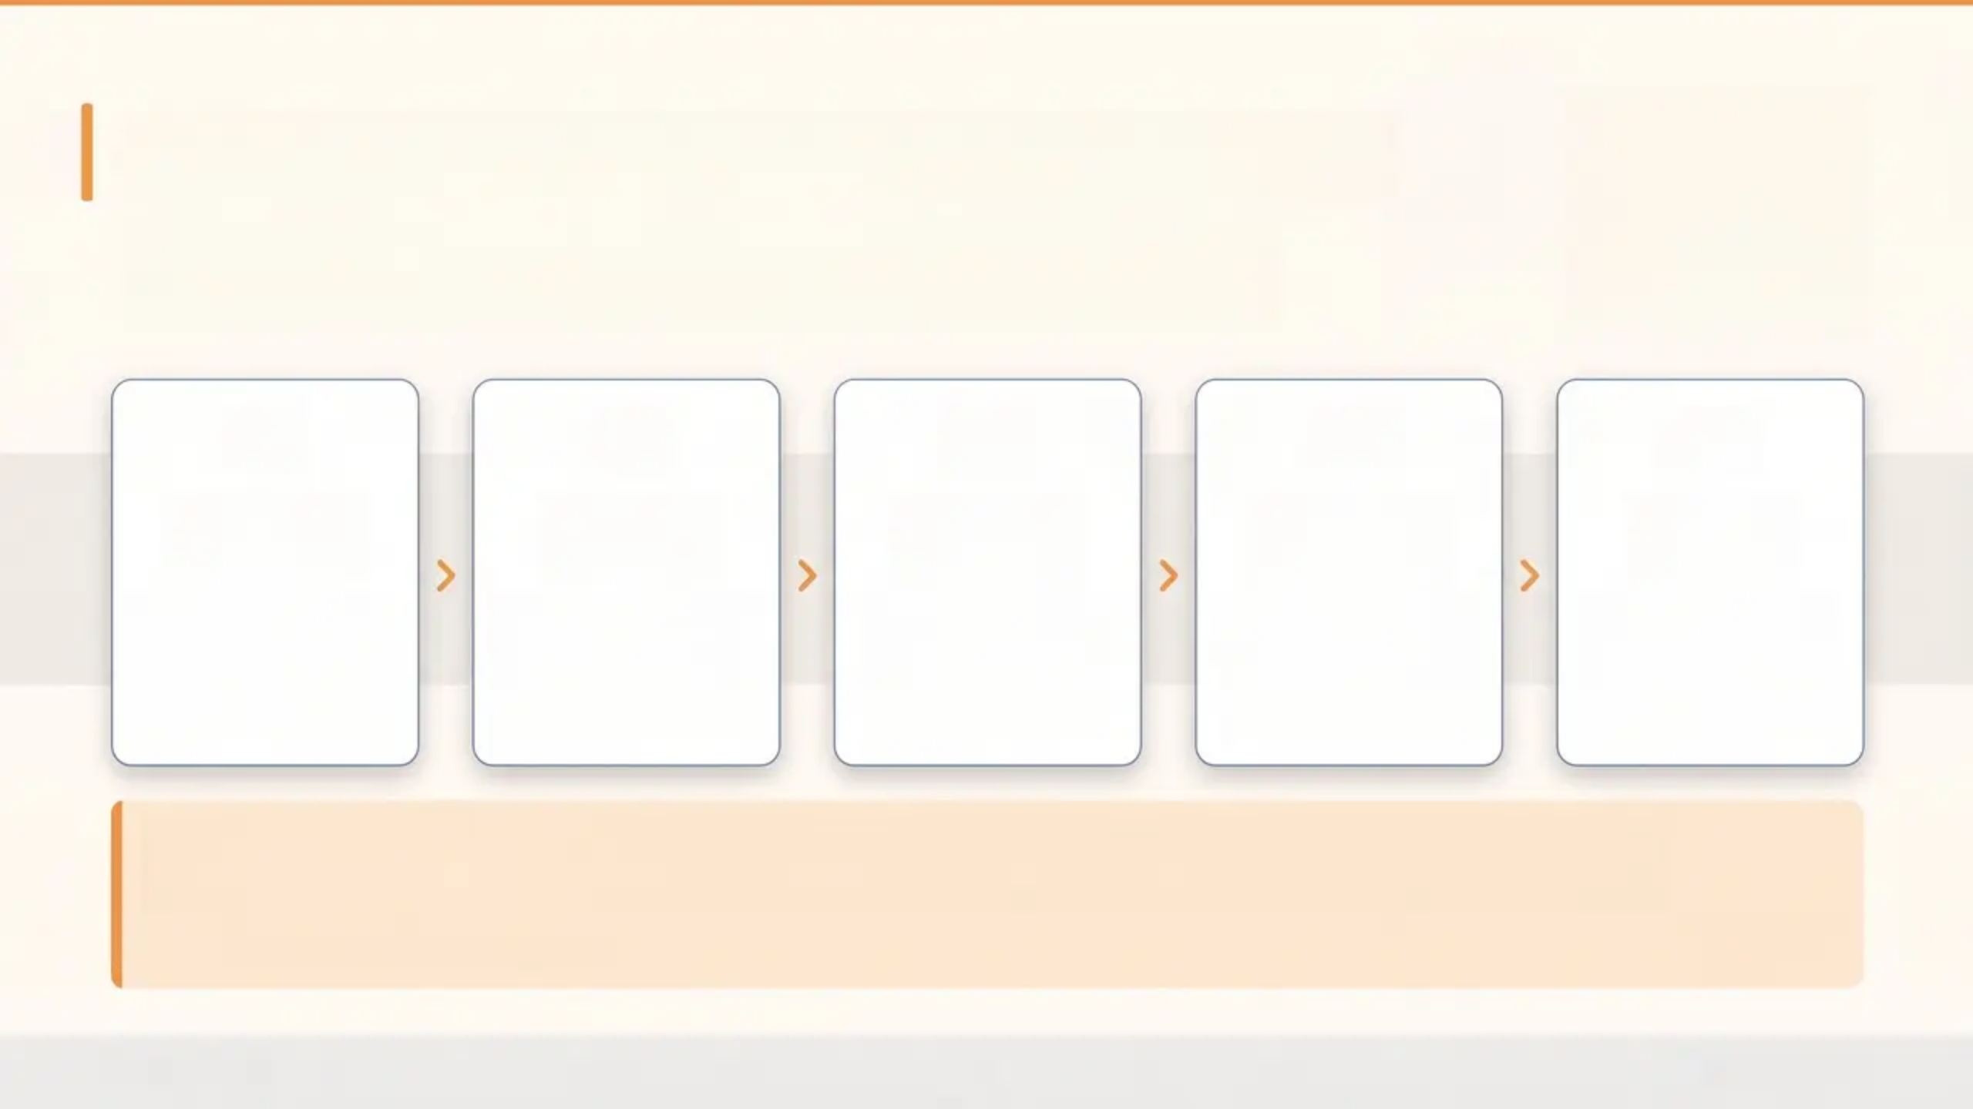
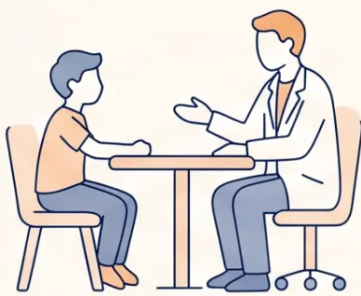
Problem-Solving in the Consultation
A collaborative framework to build self-efficacy and find
manageable next steps — CWMT Toolkit
01
02
03
04
05
Define the
Problem
Generate
Solutions
Weigh the
Options
Agree One
Step
Review
Together
Name it clearly
together — not
“everything is bad” but
one specific difficulty
Brainstorm 3-5
possible options
together — no idea is
wrong at this stage
Consider pros and
cons of each — let
the young person
lead the thinking
Choose ONE small,
achievable action to
try before the next
appointment
Book a follow-up —
acknowledge effort,
adapt if needed,
build on progress
“This keeps the young person in control and builds self-efficacy — the goal is one
manageable step, not a perfect solution.”
CWMT Problem-Solving Guide
Bradford VTS
Page 18 of 30

Slide 19
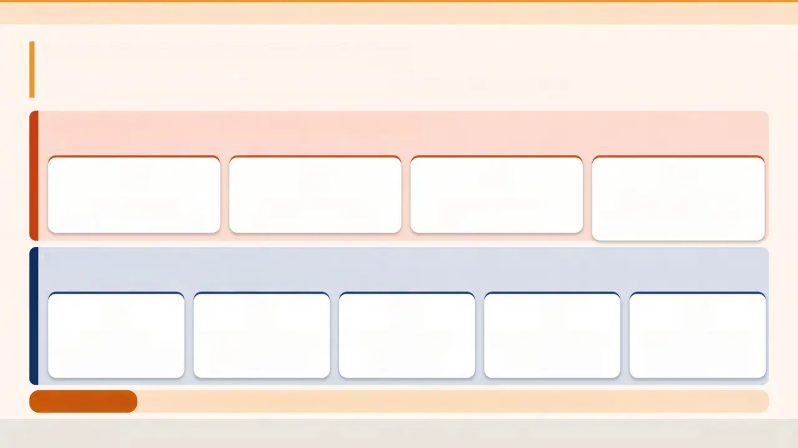










Bradford VTS Teaching Deck
Teenage Mental Health & Self-Harm
When to Refer to CAMHS
Knowing when to escalate — and when to manage in primary care
URGENT — Same-Day CAMHS / Crisis Contact
Act immediately — do not wait for a routine slot
Suicidal Intent
Serious Self-Harm
Psychosis or Mania
Severe Deterioration
Active plan + access to means
Requires medical treatment
First episode — any age
Stopped eating, not leaving home,
complete withdrawal
ROUTINE REFERRAL — Plan and Refer
When primary care management has been exhausted or is insufficient
Depression
Recurrent Self-Harm
Eating Disorder
ADHD Assessment
Complex Trauma
Moderate-to-severe; failed
two primary care treatments
Ongoing despite
primary care support
Any suspected
eating disorder
Diagnosis and
medication initiation
Severe anxiety, ACEs,
or PTSD features
Practical Note:
Know your local CAMHS pathway — waiting times are long. Always provide primary care support while the young person waits.
Bradford VTS
Slide 19 of 30

Slide 20
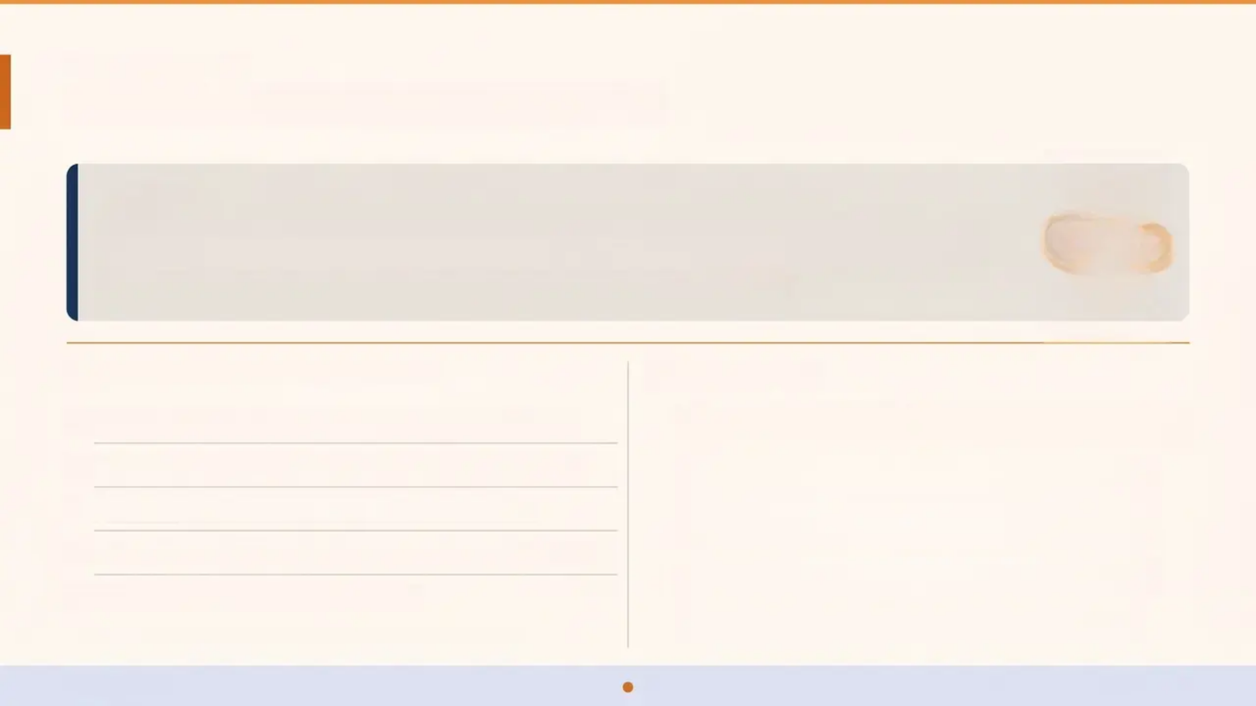
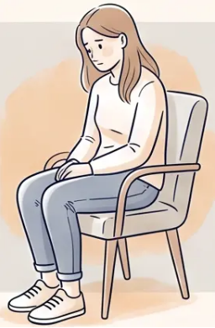
CASE DISCUSSION
Case Discussion — Michelle
THE CASE
Michelle, 16, attends requesting the combined oral contraceptive pill for PMT. During the consultation:
low mood • poor sleep • reduced appetite • weight loss • social withdrawal • poor concentration.
She mentions her mood has been low for several weeks — pre-dating the pill.
What Are the Differentials?
What to Do
1. Depression — most likely; duration, severity, functional impact
1. Screen formally
Use PHQ-A (Adolescent PHQ-9) — score ≥10 suggests depression
2. PMT / COC side effect — possible but mood pre-dates the pill
2. Explore psychosocially
Biopsychosocial history — school, home, relationships, ACEs
3. Eating disorder — weight loss, appetite change: explore
3. Review in 2 weeks
4. Normal adolescent variation — do not dismiss; but do not assume
Active monitoring — do not leave her without a follow-up date
Safeguarding check
5. Substance misuse — explore sensitively
Is she safe at home? Any concerns about abuse or self-harm?
Discuss with CAMHS if needed
'Screen formally — don't anchor on the presenting complaint.'
Moderate-to-severe depression or active self-harm → refer
Bradford VTS
Page 20 of 30

Slide 21
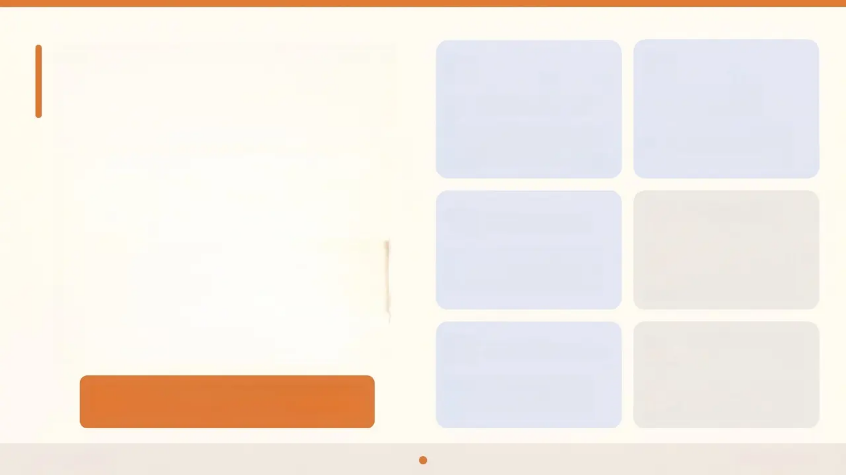


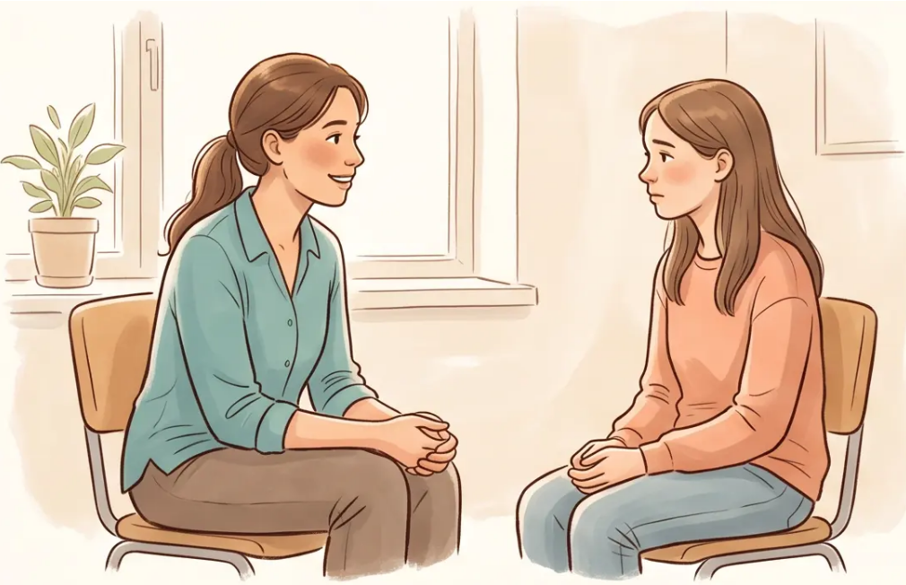




Communicating with
Young People
Normalise Their
Distress
Open Body Language
Sit at the same level; lean
slightly forward; avoid crossing
arms or sitting behind a barrier.
“Lots of young people go
through really difficult times
— you're not alone in this.”
*Practical skills for opening the conversation*
Ask Directly
About Suicide
Silence Is Okay
Give them space to think and
speak. Resist the urge to fill
every pause.
“Have you had thoughts of
hurting yourself or not wanting
to be here?” — asking helps, it
does not plant the idea.
Match Their Pace
Book the Follow-
Up Now
Slow your speech; avoid
clinical jargon; let the young
person lead the narrative.
“I’d like to see you again in two
weeks — let’s book it before
you leave today.”
“Asking about suicide does not increase
risk — it provides relief.”
Bradford VTS
Slide 21 of 30

Slide 22
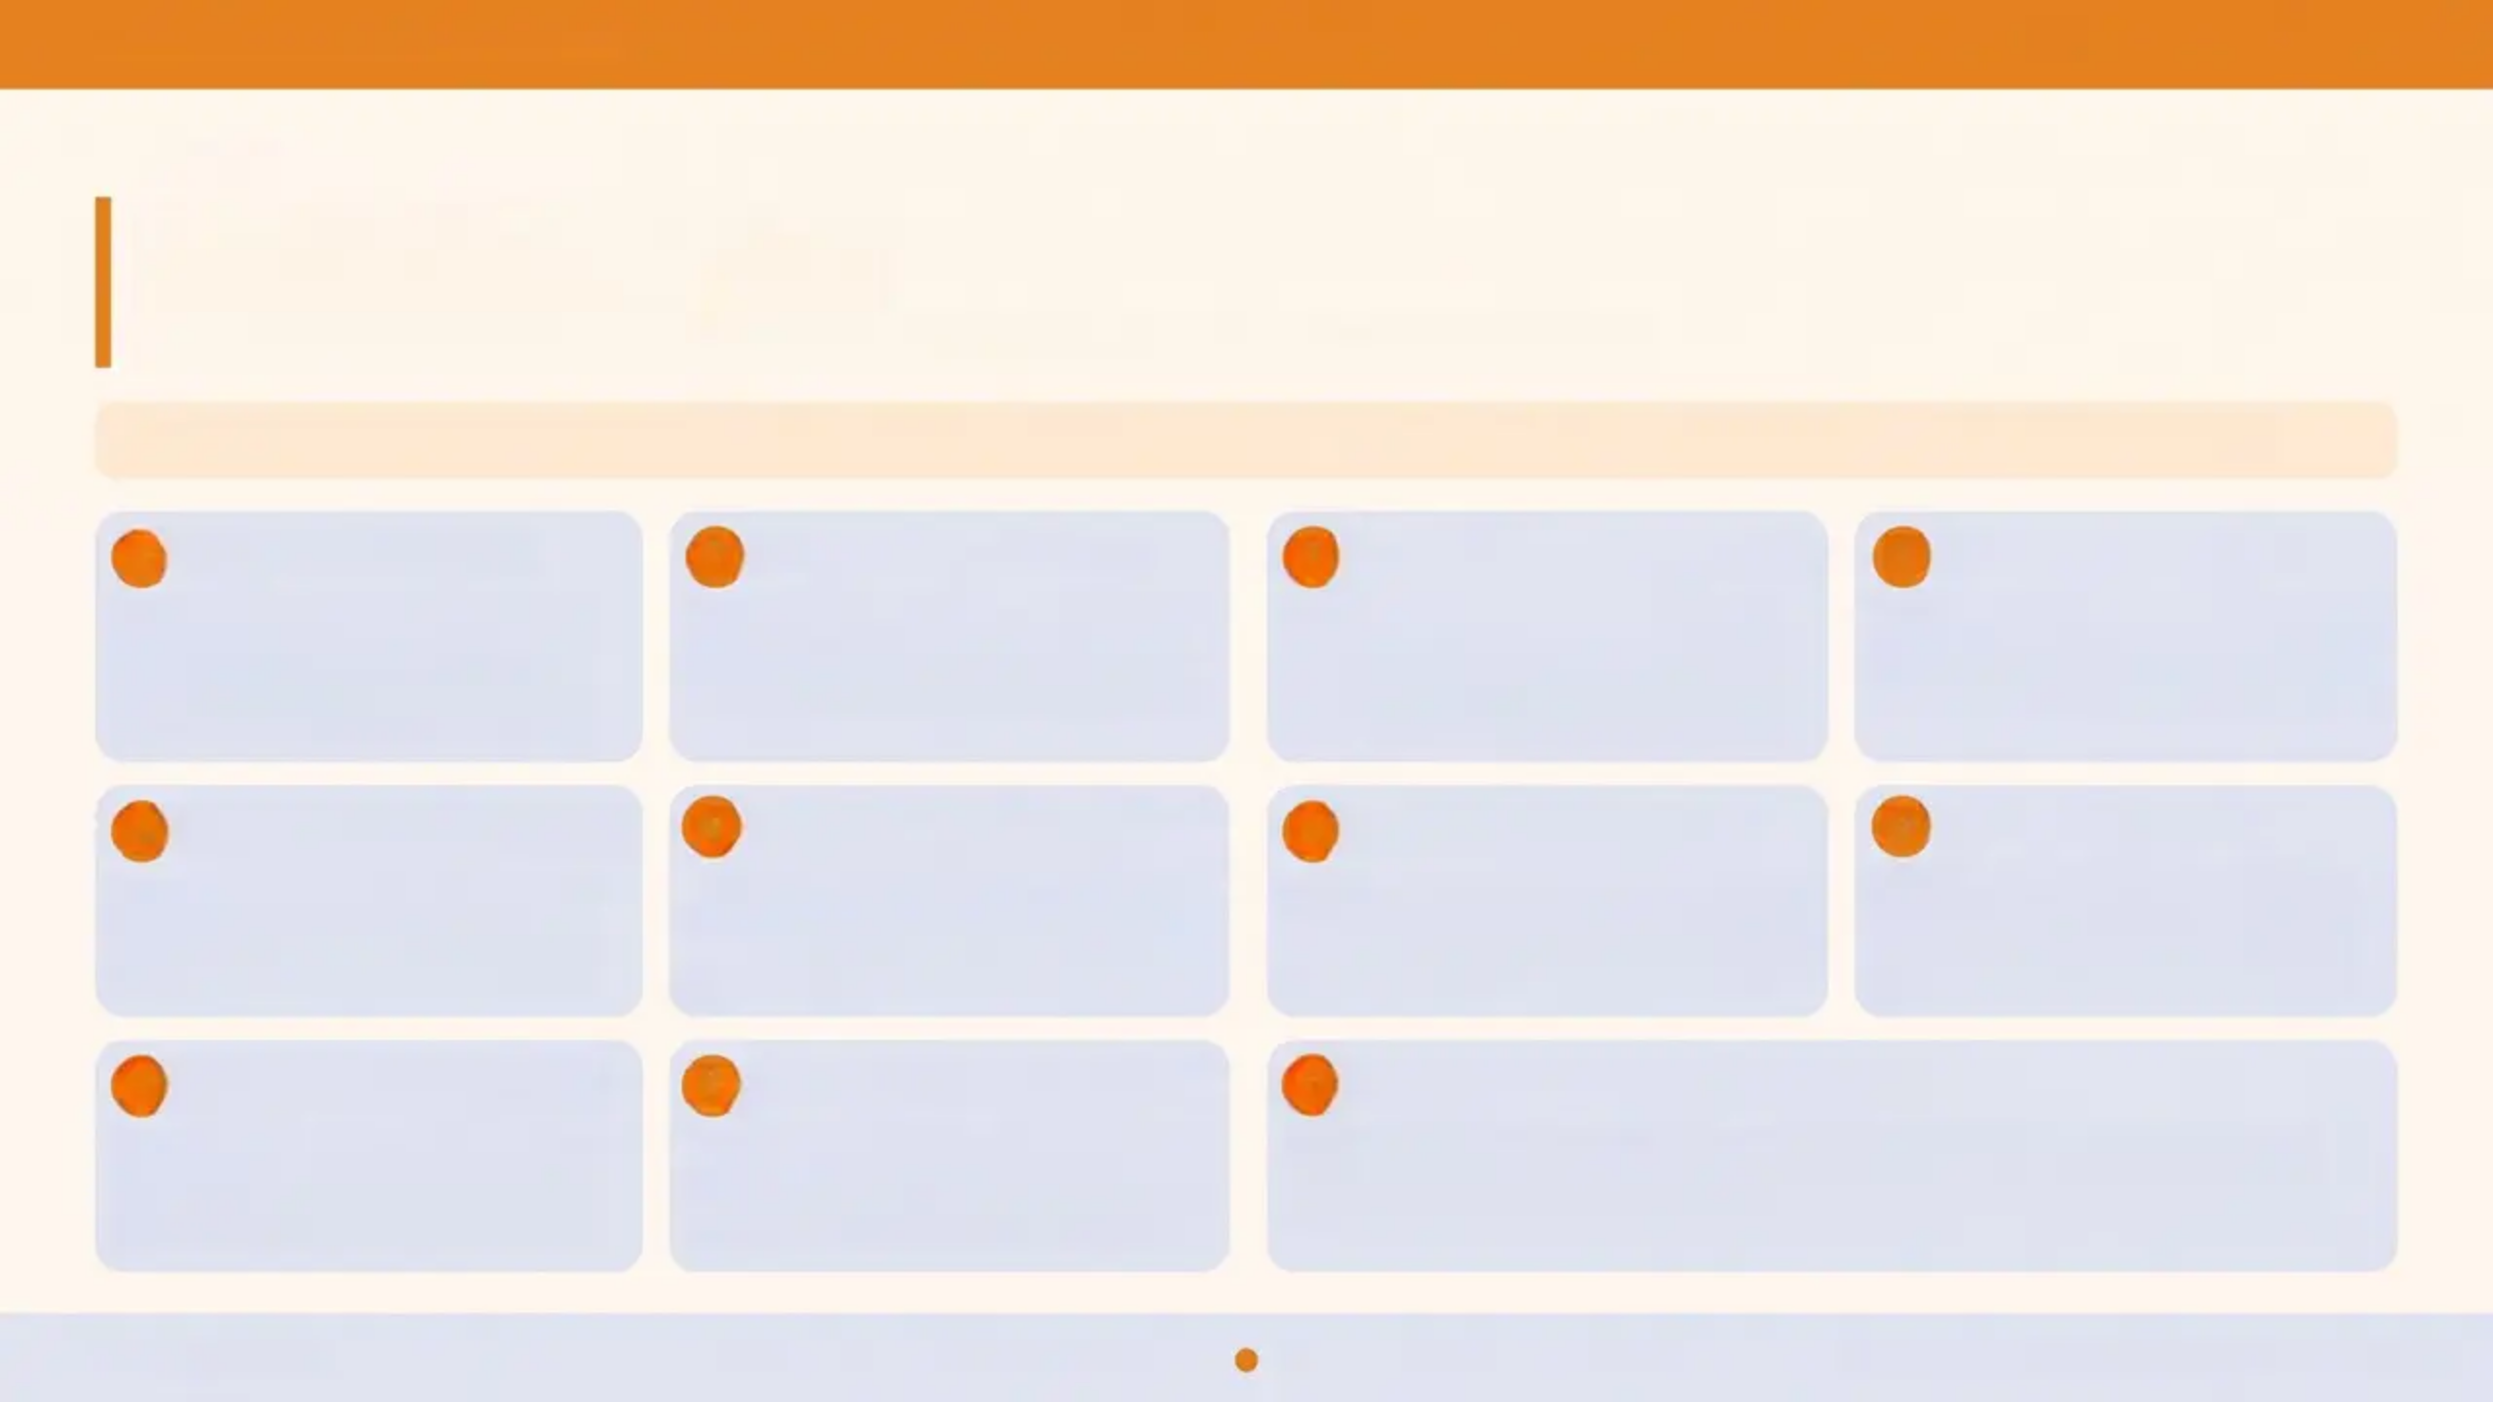
BRADFORD VTS TEACHING DECK
www.bradfordvts.co.uk
22 / 30
Top Tips for GPs
Ten clinical pearls for managing teenage mental health in primary care
MHR A reminder: Monitor weekly for 4 weeks after starting fluoxetine — increased agitation and self-harm risk in under-18s.
2 Fluoxetine is First-Line
3 Irritability Means Depression
1 No Risk Scales Alone
4 Use PHQ-A to Screen
NICE NG225 — holistic, person-
centred assessment always. Risk
scales do not predict future self-
harm.
Only SSRI licensed for depression
in under-18s in the UK. Do not use
TCAs, venlafaxine, or MAOIs.
In young people, irritability often
replaces sadness. Don't mistake it
for rudeness or normal teenage
behaviour.
PHQ-A (adolescent PHQ-9) is your
validated tool. Score ≥10 suggests
depression — use it, document it.
5 Ask About Suicide Directly
6 Always Create a Safety Plan
7 ADHD: Shared Care Only
8 Don't Leave a Void
Asking does not plant the idea —
it provides relief. Silence on this
topic is the greater risk.
Core NICE NG225 recommendation —
co-create every time, with crisis
contacts and coping strategies
agreed together.
ADHD medications are specialist-
initiated. Monitor height, weight, pulse,
and BP at every shared care review.
Review every 2-4 weeks. CAMHS
waits are long — active primary
care management must continue
in the interim.
9 Self-Harm ≠ Attention-Seeking
10 Don't Leave Local CAMHS Pathway
It is always communication of
distress. Validate the young person's
experience before anything else.
Review every 2-4 weeks. CAMHS: Waiting times are long.
Proactively signpost to YoungMinds, Kooth, and Samaritans
management must continue in this while awaiting specialist input.
Bradford VTS
NICE NG225 · NICE NG134 · May 2026

Slide 23
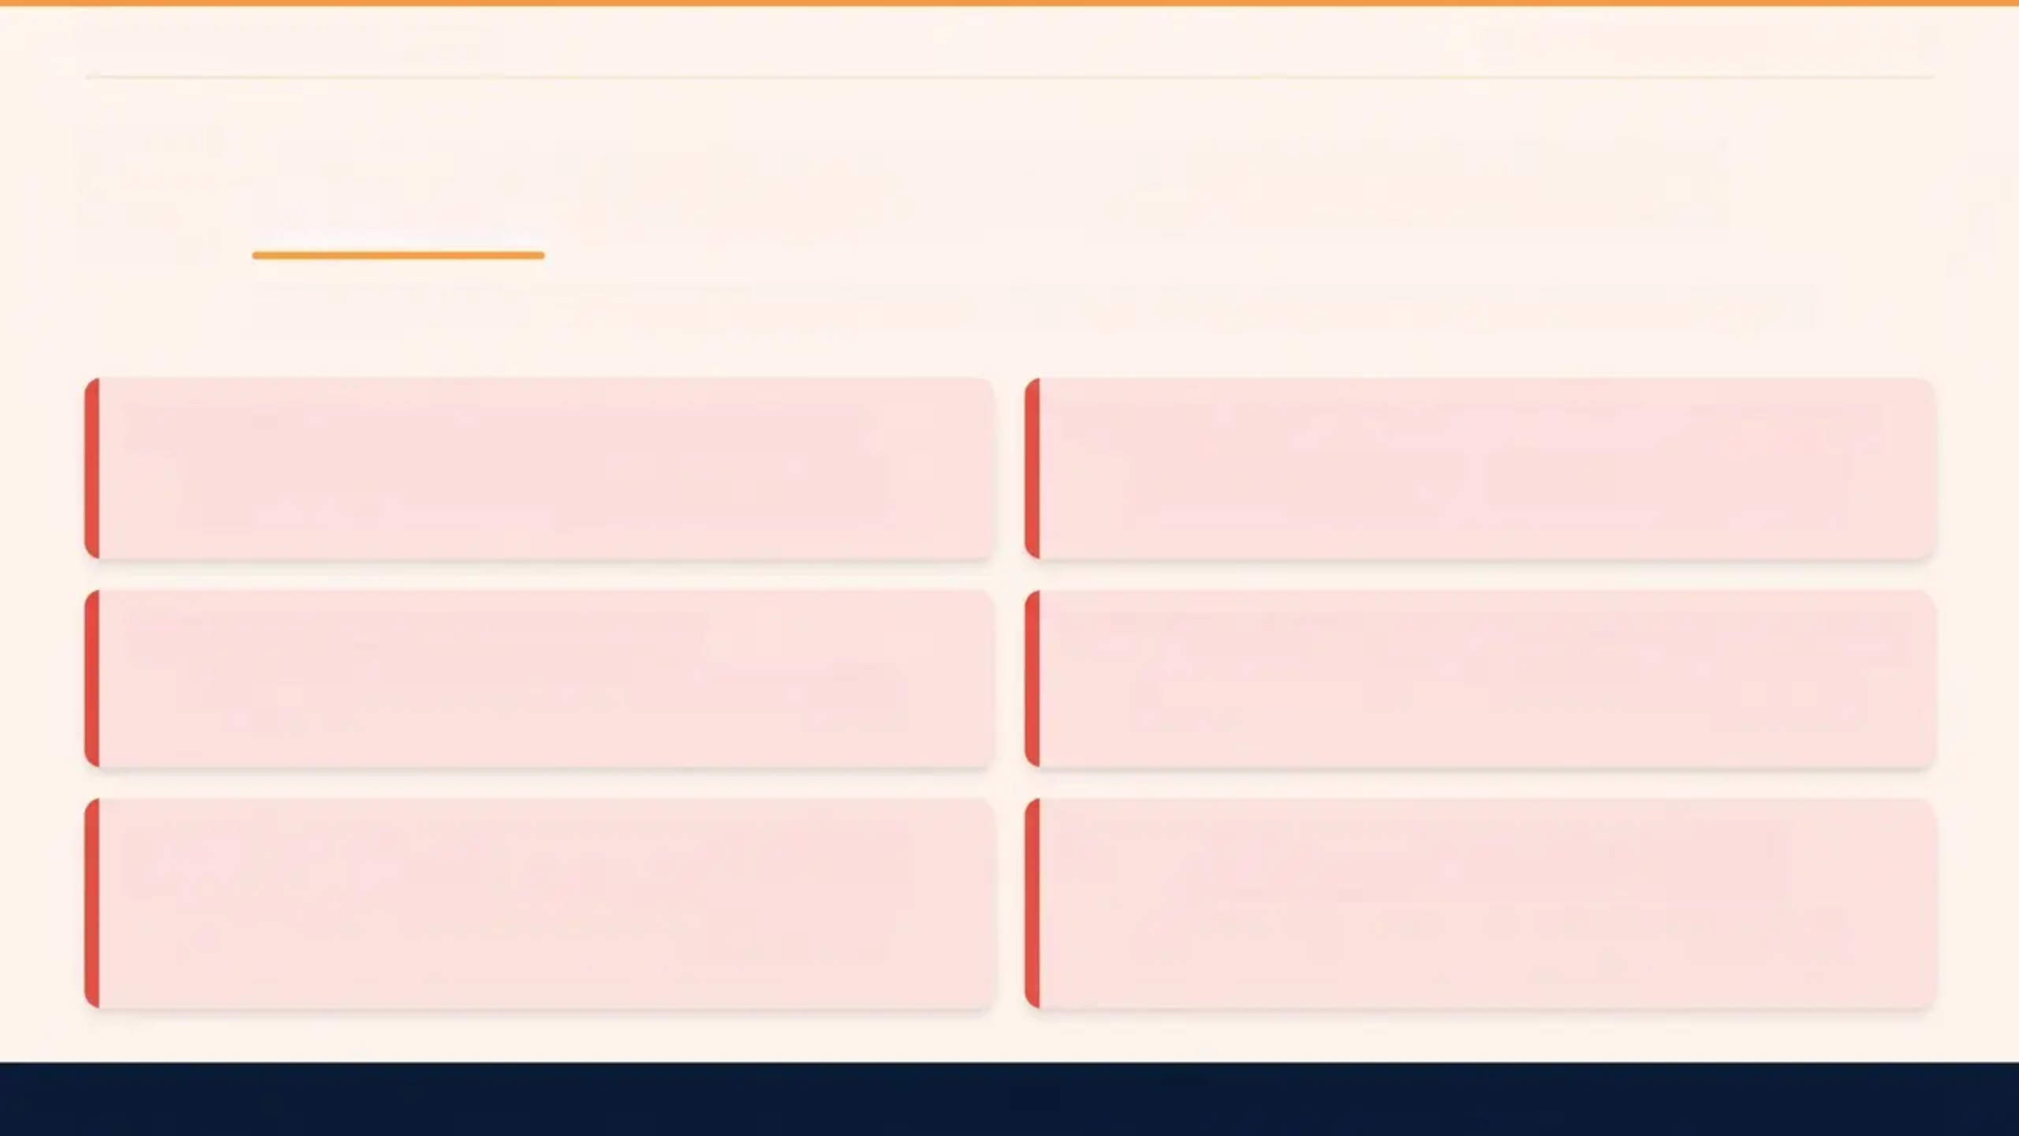

BRADFORD VTS TEACHING DECK
Teenage Mental Health & Self-Harm
Red Flags — Urgent Action Required
The following situations require same-day action — do not wait for routine CAMHS slots
Suicidal Intent with Plan + Access to Means
Same-day CAMHS or crisis team contact — do not
defer
Serious Self-Harm Requiring Medical Treatment
Send directly to A&E — wound care and psychiatric
assessment needed
Psychosis or First Episode Mania
Severe Eating Disorder with Physical Compromise
Urgent specialist review — do not manage alone in
primary care
Urgent medical review — risk of cardiac arrhythmia,
electrolyte crisis
Complete Social Withdrawal — Not Eating, Not
Leaving Home
Disclosure of Abuse During Mental Health
Assessment
Urgent assessment — risk of severe depression or
psychosis
Immediate safeguarding referral — follow local child
protection protocol
CAMHS Urgent Referral: Always explain to the young person what to expect and why
NICE NG225 — Holistic assessment, not risk scales alone

Slide 24
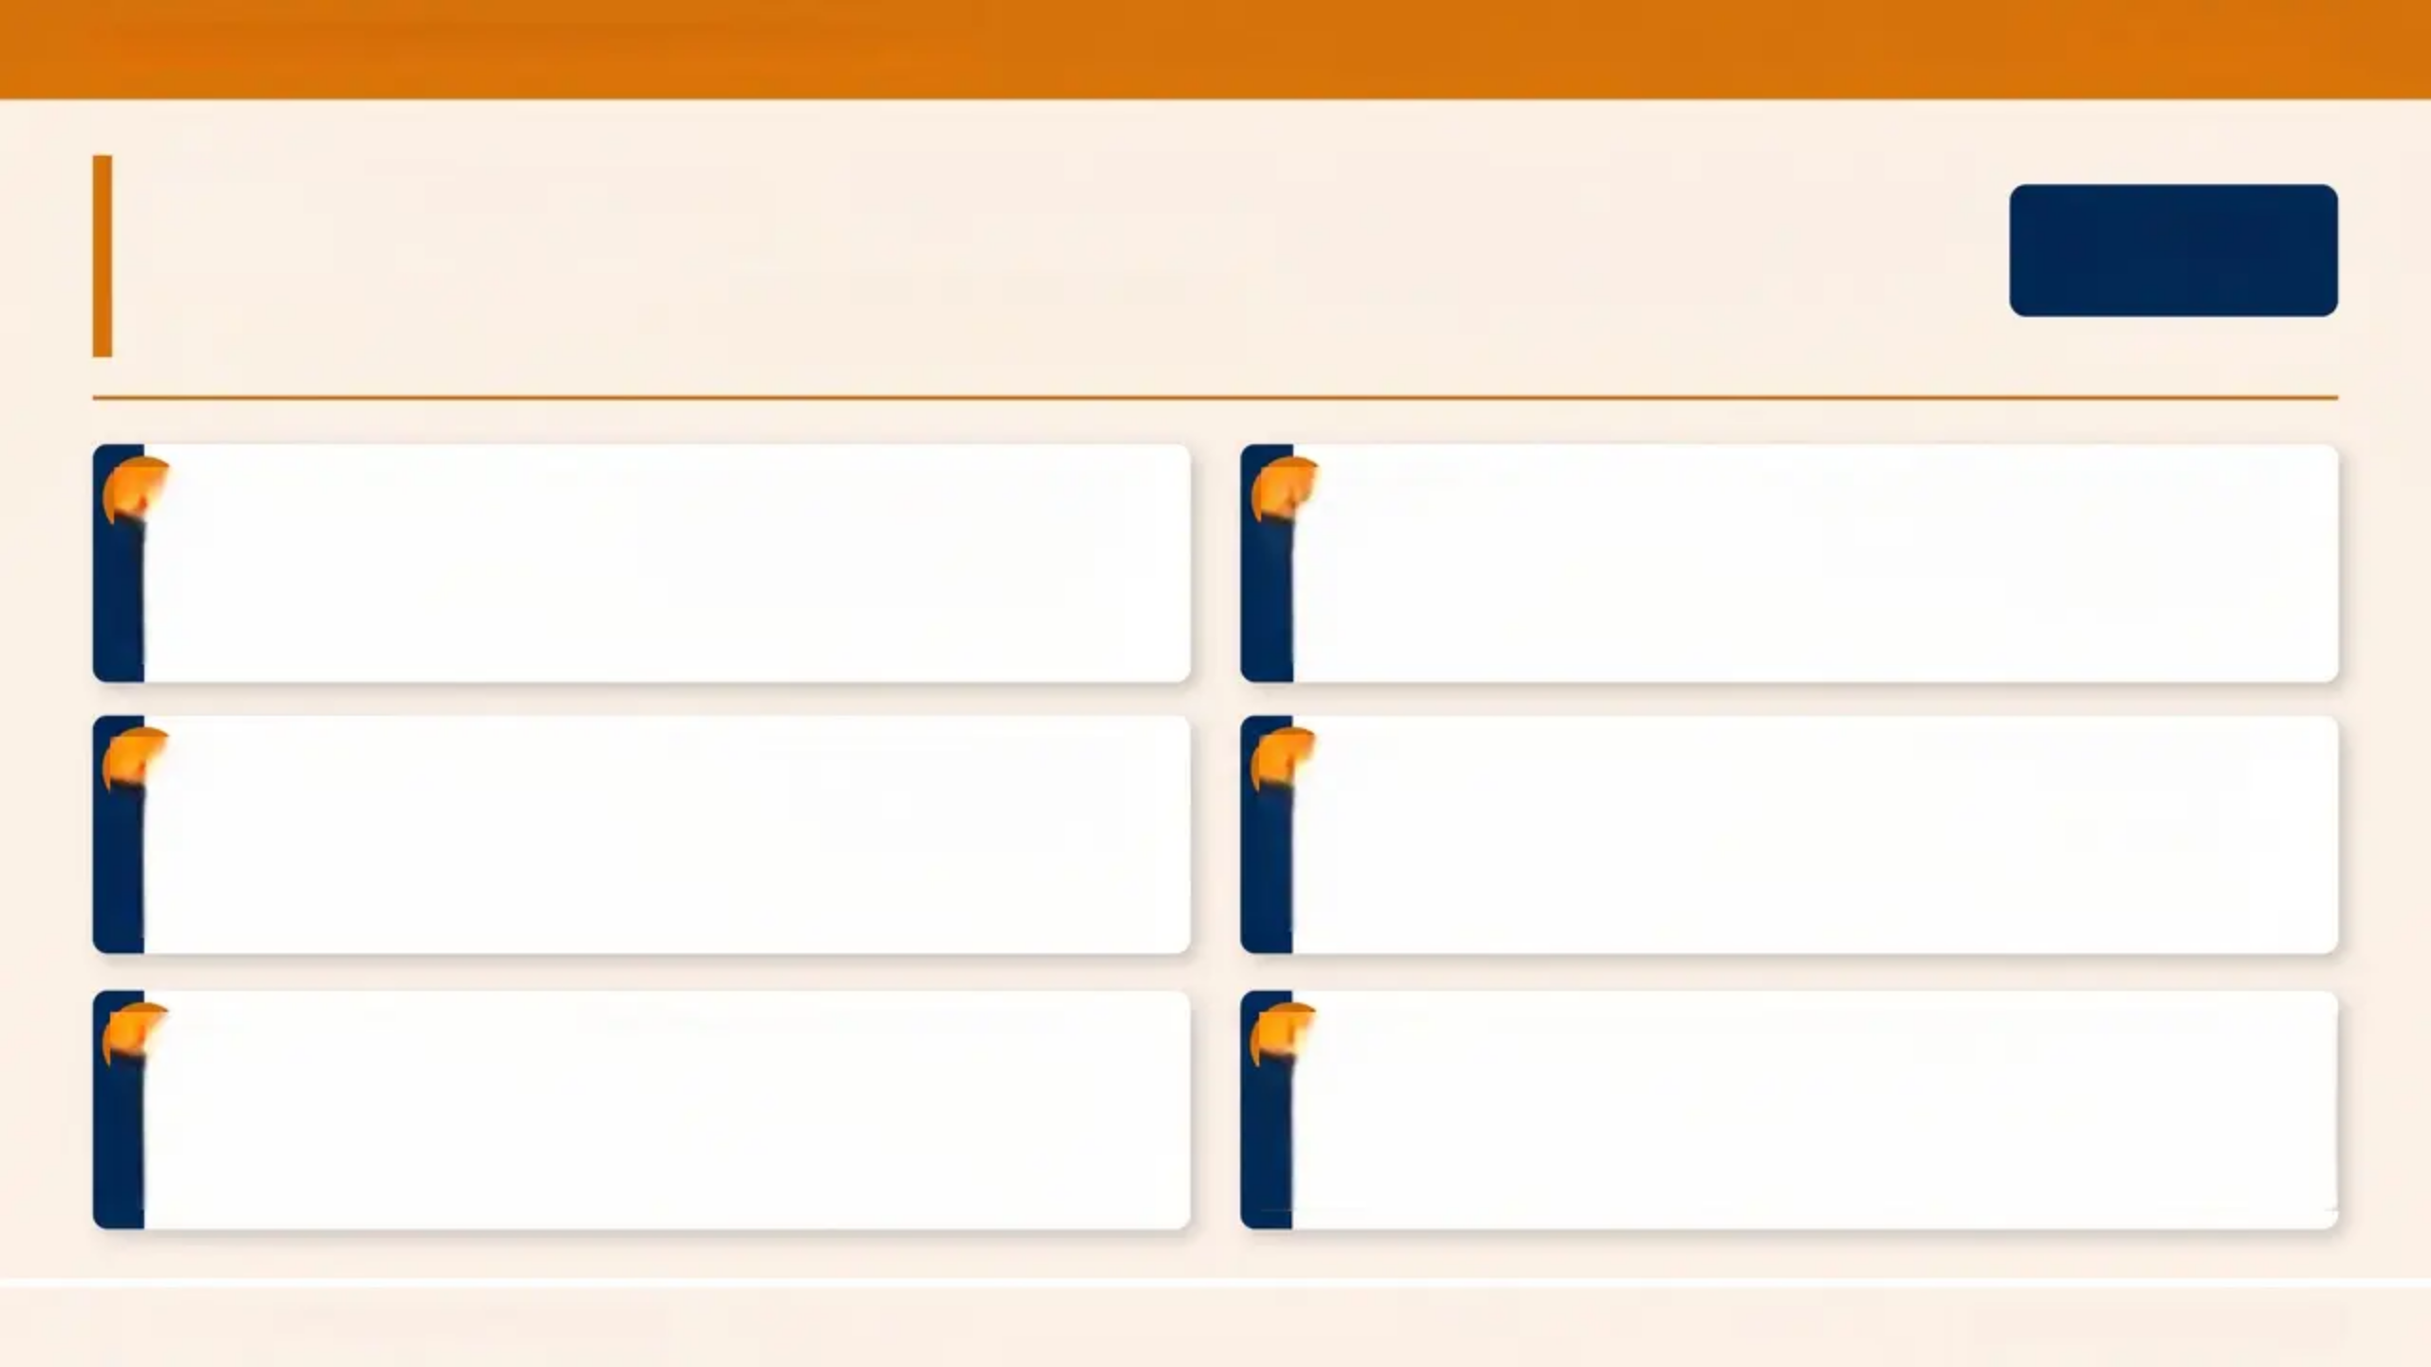

BRADFORD VTS — GP REGISTRAR TRAINING
PAGE 24 OF 30
Exam Pearls
AKT
Applied Knowledge Test (AKT)
NICE NG225 states: do NOT use standardised
risk assessment scales to predict future self-
harm or suicide — holistic, person-centred
assessment is required instead.
NICE NG225
MHRA warning — all SSRIs in under-18s:
monitor weekly for 4 weeks after initiation for
increased agitation, self-harm risk, and suicidal
ideation.
01
04
MHRA warning
Fluoxetine
02
Fluoxetine is the only SSRI licensed for
depression in under-18s in the UK — it is the
first-line antidepressant for moderate-to-severe
depression in young people.
05
DBT (Dialectical Behaviour Therapy) is the
evidence-based treatment for recurrent self-
harm with emotional dysregulation —
recommended in NICE NG225.
Combine Treatment: Moderate-to-severe depression in
young people requires — psychological
therapy (CBT) together with fluoxetine —
medication alone is not recommended.
combined treatment
ADHD diagnosis requires symptoms to be
present before age 12, across multiple settings
(home and school), causing functional impairment
— methylphenidate is first-line medication.
03
06
ADHD
NICE NG225 · NICE NG134 · NICE NG87
Bradford VTS · May 2026

Slide 25
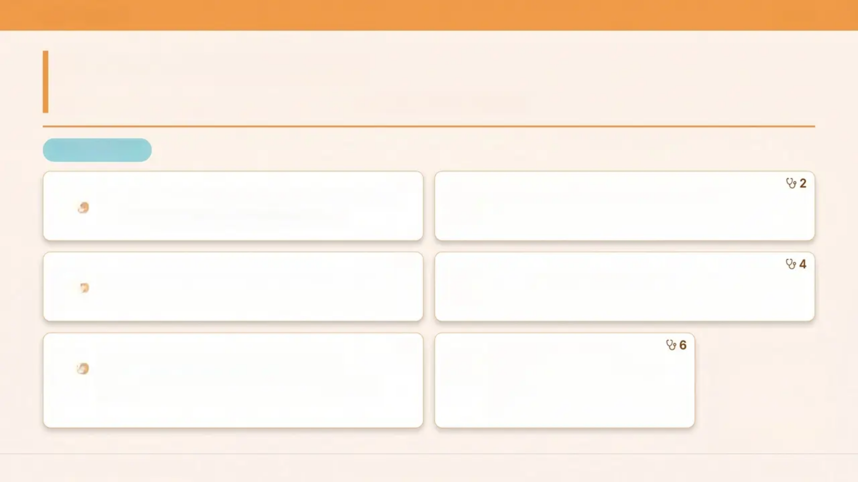







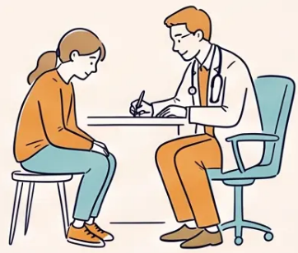
BRADFORD VTS
25 / 30
Exam Pearls — SCA
Consultation Skills · Simulated Consultation Assessment
SCA SKILLS
1
Asking about suicide does NOT increase risk
Acknowledge distress BEFORE problem-solving
It provides relief — ask directly every time
“It sounds like things have been really tough…”
3
Safety plan: co-create, never just list numbers
Demonstrate confidentiality and its limits early
Build it together with the young person in the room
Establish this from the very start of the consultation
5
Hold the uncertainty with
the young person
Involve parents/carers appropriately
Especially under-16s — balance autonomy with
safeguarding
“We’ll watch this together”— not
every answer is immediate
Bradford VTS Teaching Deck
Teenage Mental Health & Self-Harm
May 2026

Slide 26
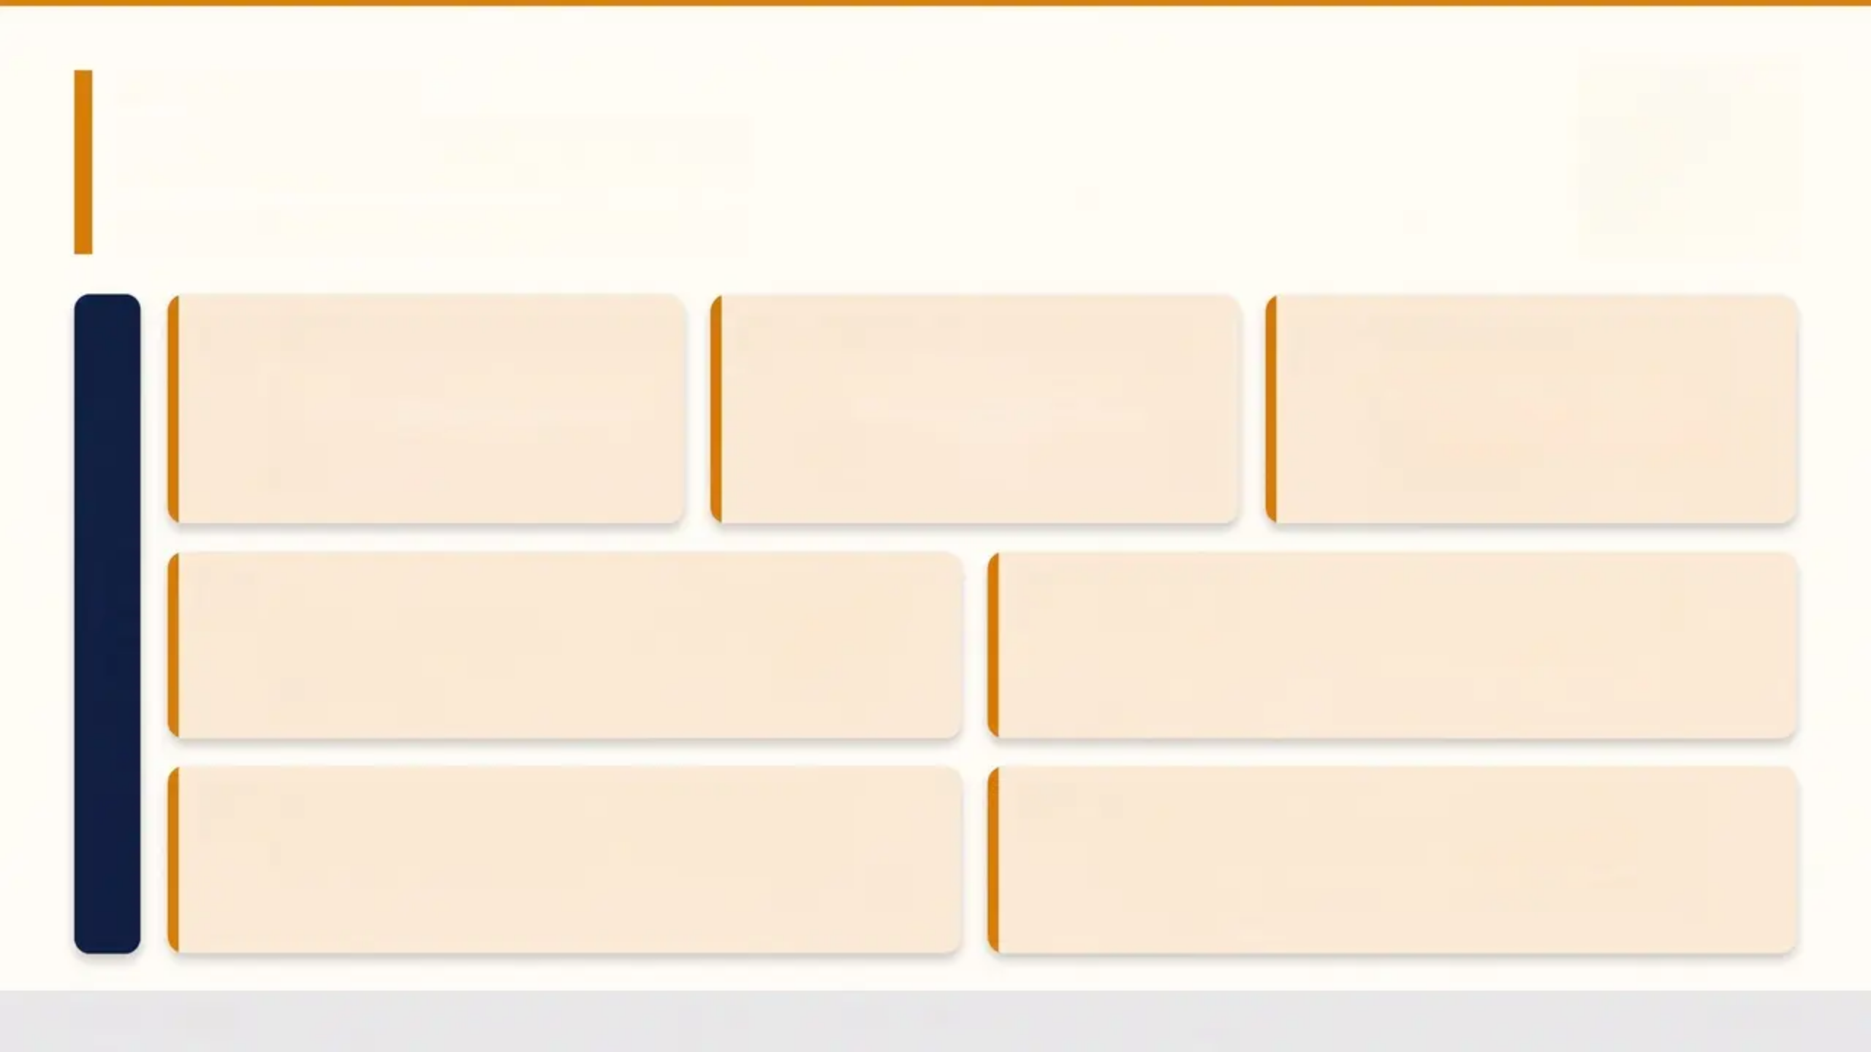








COMMON PITFALLS
Common Pitfalls
What to avoid in clinical practice
Dismissing self-harm as
“attention-seeking”
Using risk scales alone
to determine safety
Prescribing the wrong
SSRI first-line
It is always communication of distress
— validate the young person’s
experience, never minimise.
NICE NG225 explicitly advises against
this — holistic, person-centred
assessment is required.
Fluoxetine is the only SSRI licensed for
depression in under-18s in the UK —
do not default to sertraline or
citalopram without specialist input.
AVOID
Not monitoring after starting fluoxetine
Avoiding the topic for fear of making
things worse
MHRA mandates weekly review for the first four weeks
— monitor for agitation, increased self-harm risk, and
suicidal ideation.
Asking about self-harm or suicide does not increase risk
— it provides relief and opens the door to help.
Waiting for CAMHS without interim
primary care management
Failing to book a follow-up before the
young person leaves
Waiting lists are long — active monitoring, safety
planning, and follow-up must continue in primary care.
Never leave a young person without a named review
date — longitudinal care is a GP's greatest asset.
Bradford VTS
26 / 30

Slide 27
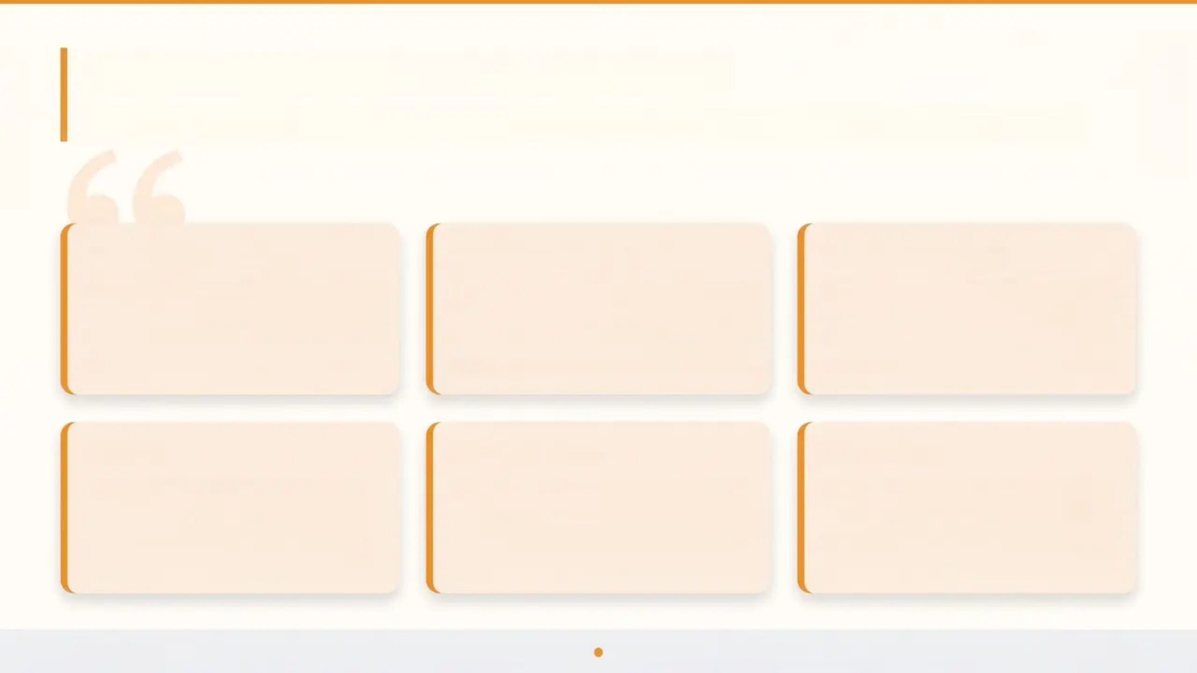
Patient Communication Phrases
Scripts for validation, confidentiality, and follow-up — use these in your consultations
VALIDATION
CONFIDENTIALITY
ASKING DIRECTLY
“It took courage to come
and talk about this —
thank you for trusting me.”
“Everything you tell me
stays between us, unless
I’m worried you’re not safe.”
“Can I ask you directly —
have you had thoughts of
hurting yourself?”
COPING
REASSURANCE
FOLLOW-UP
“What helps when things
get really bad? Even
small things count.”
“We're going to work
through this together. You
won't be doing this alone.”
“I’d like to see you again
in two weeks — let’s book
it before you leave.”
Bradford VTS
Page 27 of 30

Slide 28
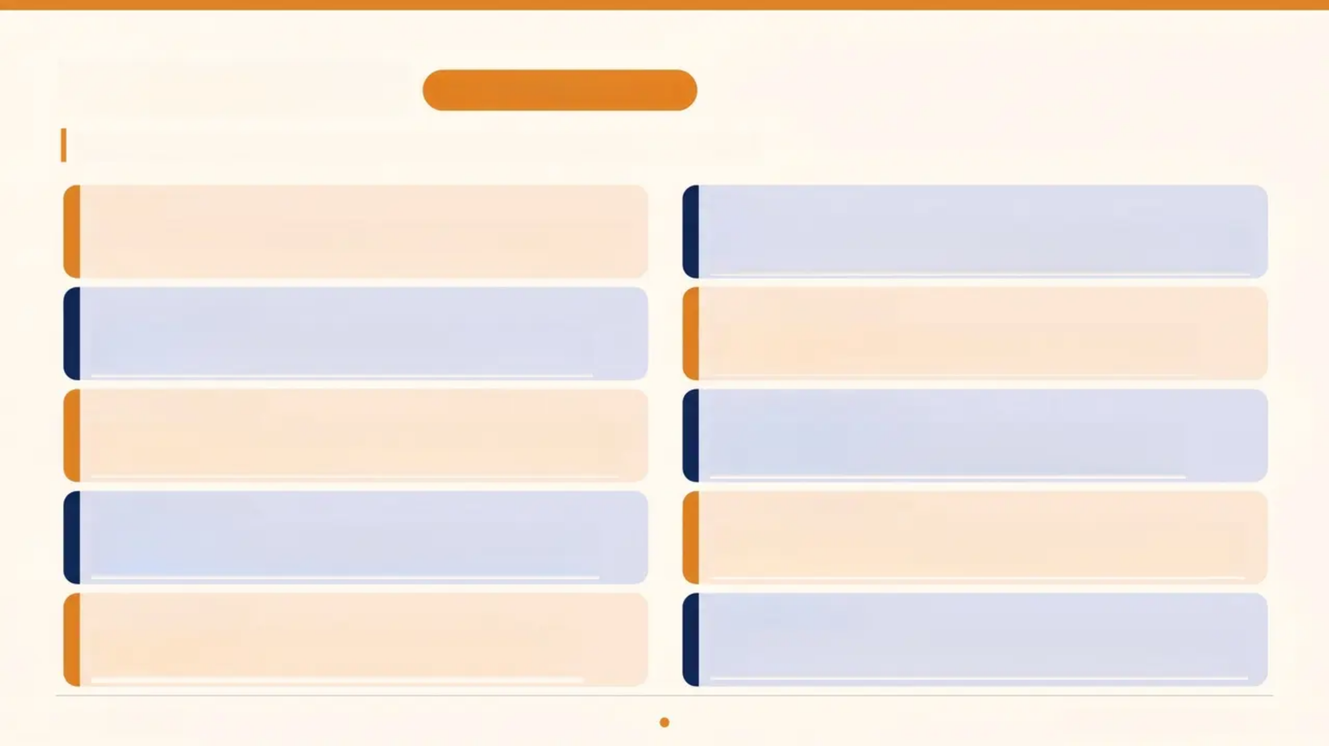
Quick Recall
REVISION ESSENTIALS
Core facts to carry into every consultation — and into the exam
1 IN 3
DBT
Young people attending GP have a diagnosable
mental health condition
Evidence-based therapy for recurrent self-harm
harm with emotional dysregulation
DEPRESSION
SAFETY PLAN
Irritability over sadness; use PHQ-A — score
≥10 suggests depression
Co-create every time; always include crisis
contacts (Samaritans 116 123)
FLUOXETINE
CAMHS URGENT
Only licensed antidepressant for depression in
under-18s in the UK
Suicidal intent + specific plan + access to
means → same-day referral
NICE NG225
ASKING HELPS
No risk scales — use holistic, person-centred
assessment every time
Asking about suicide does NOT increase risk —
it provides relief
SELF-HARM
FOLLOW UP
Female:male ratio 6:1; peak onset age 12-15
years
Review every 2-4 weeks — never leave a young
person without a return date
Bradford VTS
www.bradfordvts.co.uk

Slide 29
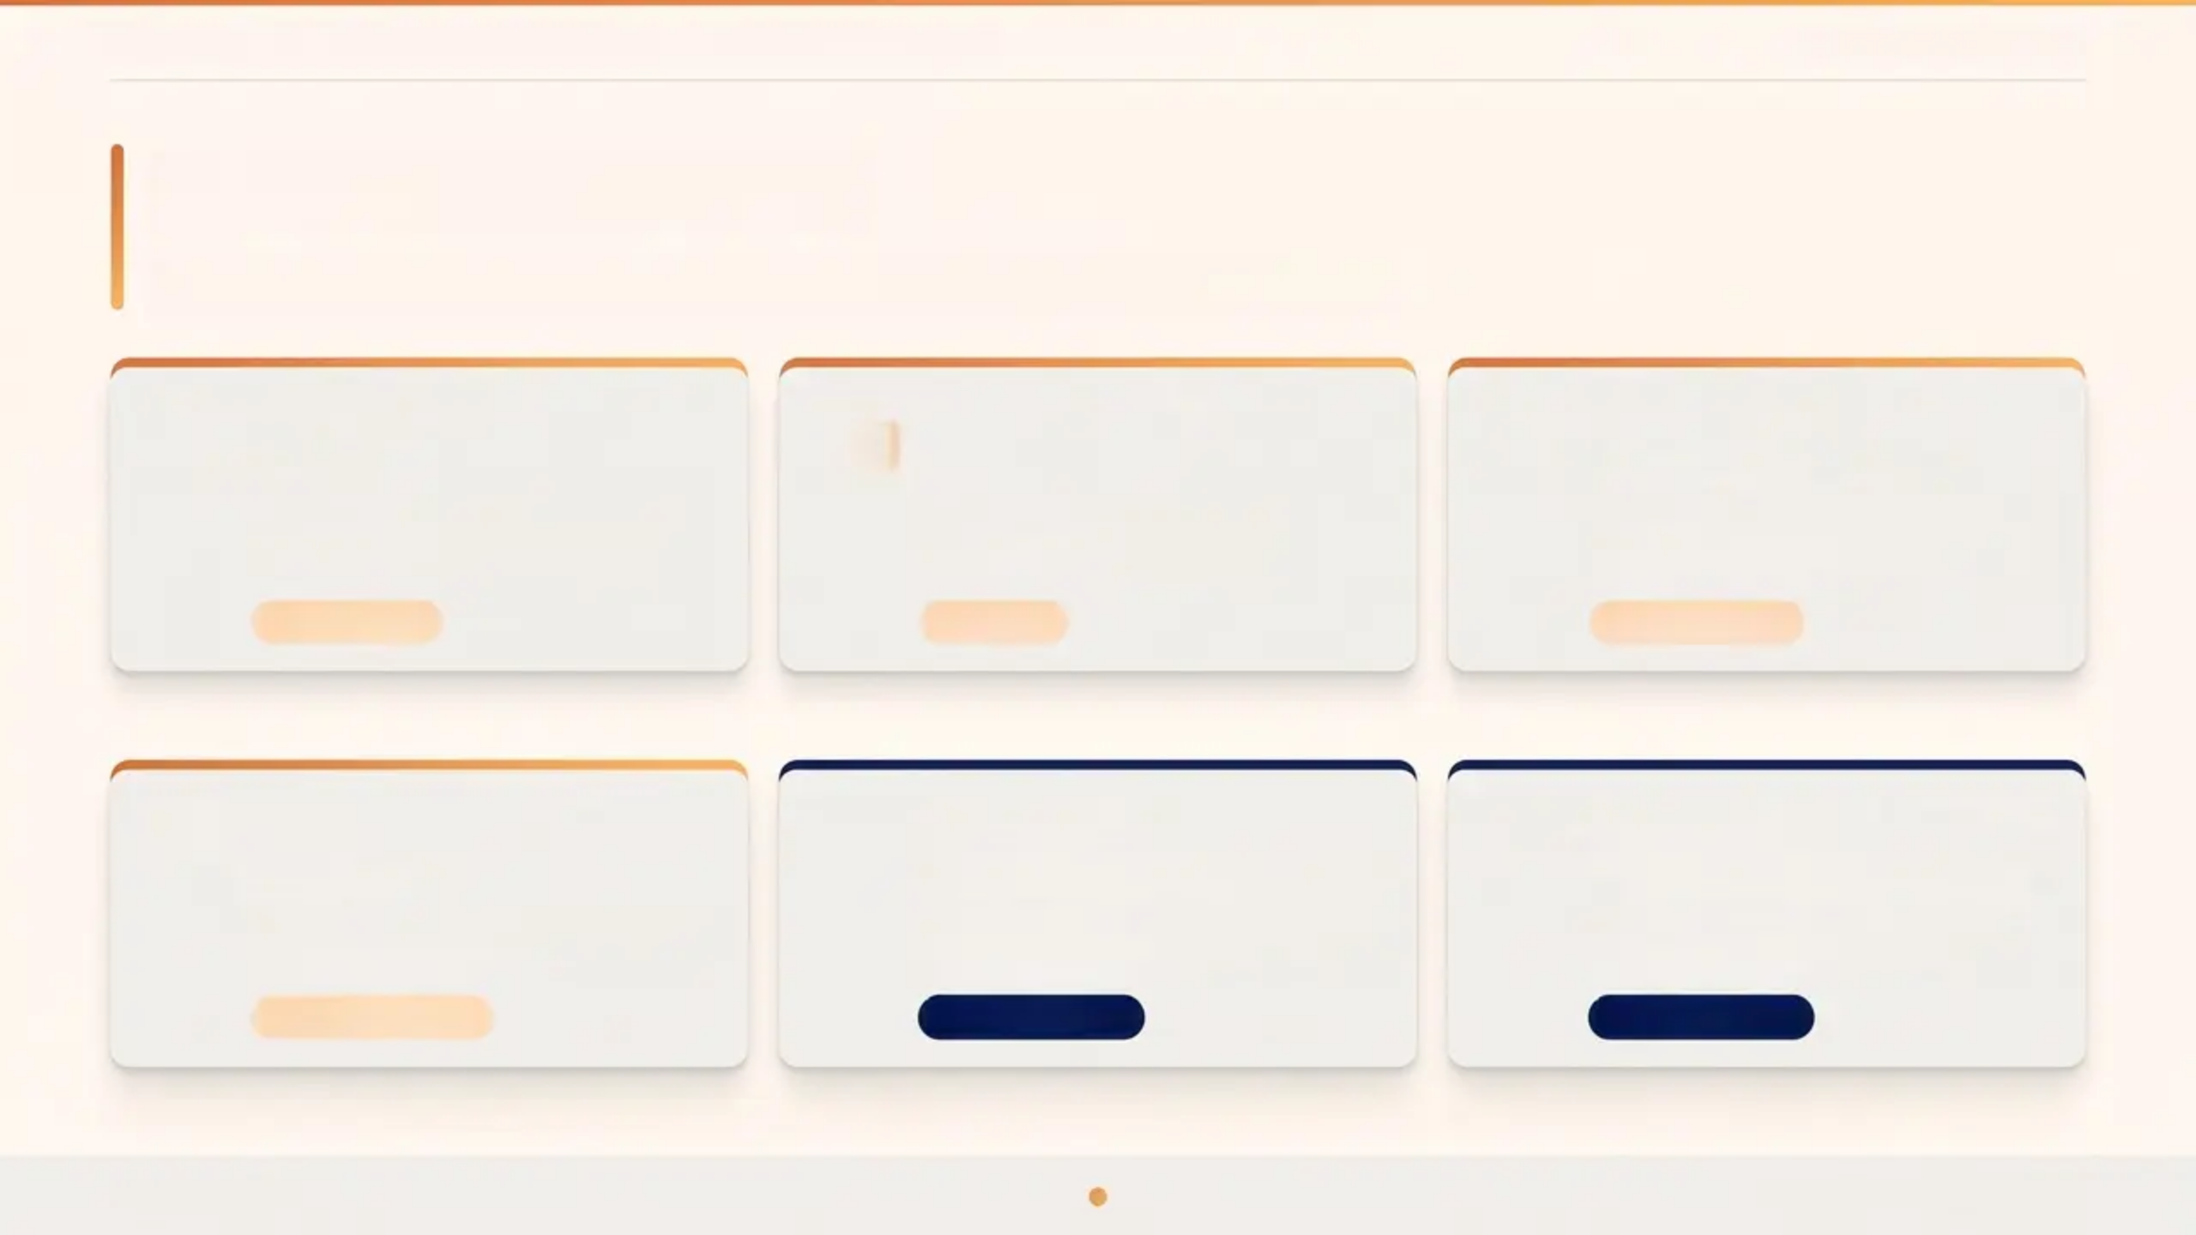






BRADFORD VTS TEACHING DECK — Teenage Mental Health & Self-Harm
www.bradfordvts.co.uk
Useful Resources
Helplines, online support, and clinical guidelines for GP practice
Samaritans
Childline
YoungMinds
116 123
0800 1111
www.youngminds.org.uk
Free to call, 24 hours a day, 7 days
a week
Free, confidential support for
under-19s, 24 hours
Mental health information and
support for young people and parents
Crisis Support
Under-19s
Online Resource
Kooth
NICE NG225
NICE NG134
www.kooth.com
www.nice.org.uk/guidance/ng225
www.nice.org.uk/guidance/ng134
Free, safe, anonymous online mental
health support for young people
Self-Harm: Assessment, Management
and Preventing Recurrence (2022)
Depression in Children and Young
People (reviewed 2024)
Online Counselling
Clinical Guideline
Clinical Guideline
Always check your local CAMHS referral pathway — waiting times and thresholds vary by region. Contact your local CAMHS team directly for up-to-date referral criteria.
Bradford VTS
Page 29 of 30 · May 2026

Slide 30
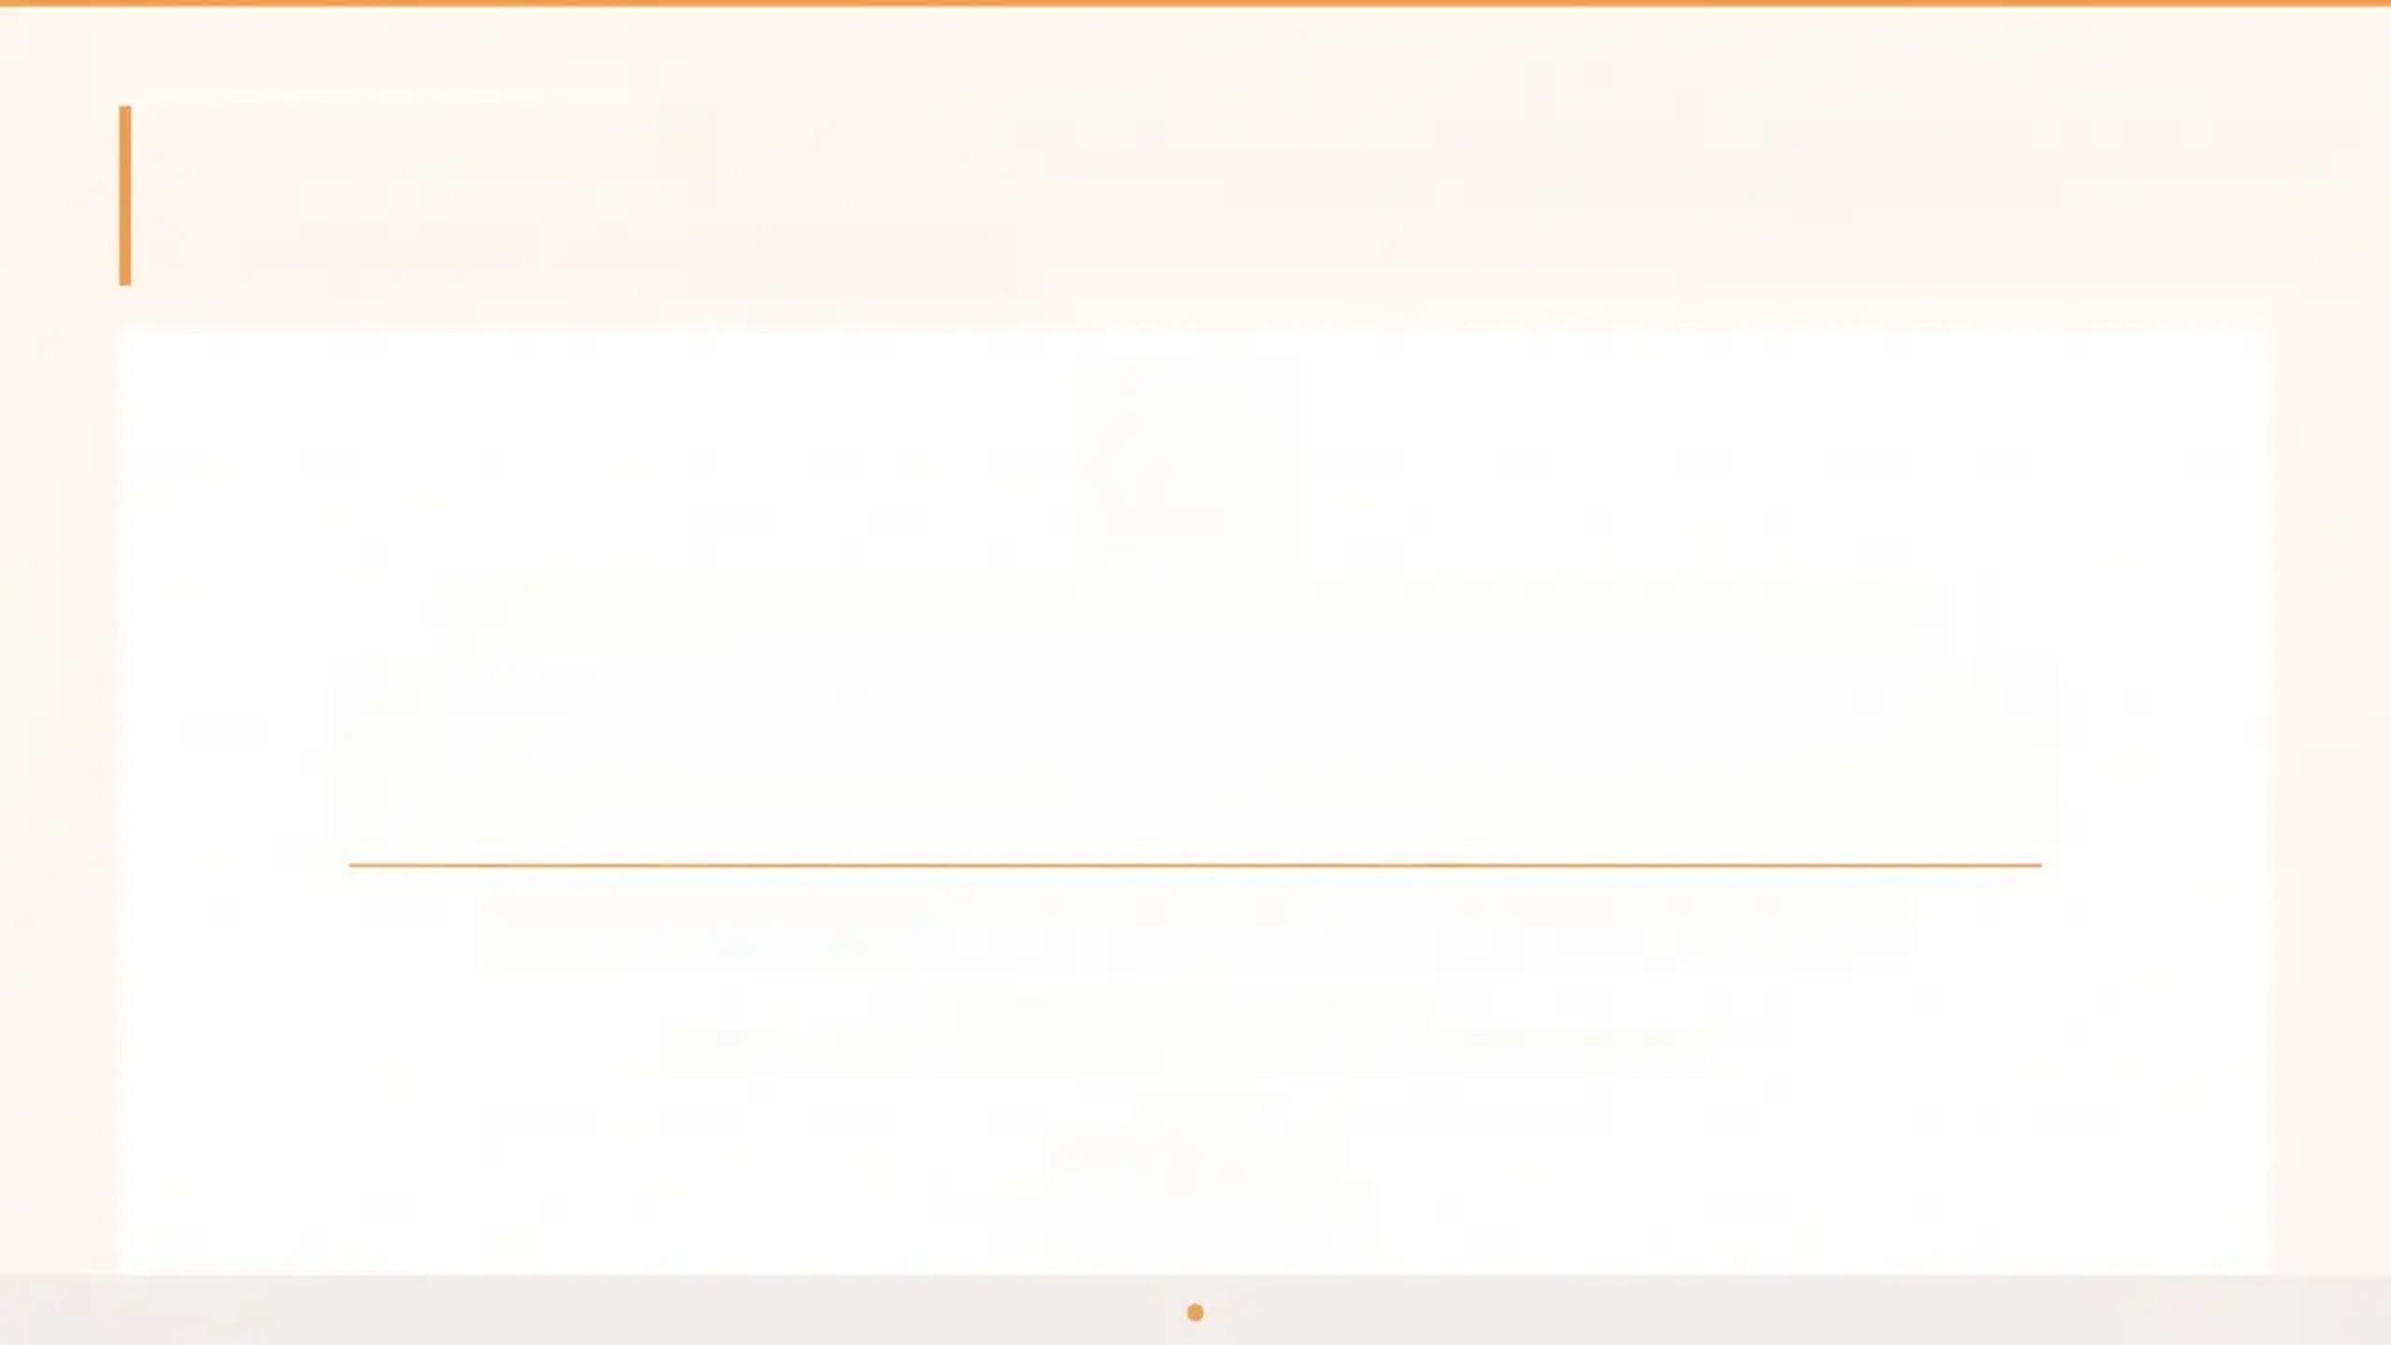

Disclaimer
Please read before using this resource
This resource is intended for educational purposes only.
Always verify all clinical advice, drug doses, and treatment recommendations
against the most current editions of NICE guidance and the British National
Formulary (BNF) before applying to patient care.
Clinical guidelines are subject to change. It is the responsibility of the individual clinician to ensure
their their practice reflects the latest evidence and local protocols.
Sources referenced in this deck
NICE NG225 · NICE NG134 · NICE NG185 · NICE NG87 · NICE CKS · BNF
Bradford VTS
www.bradfordvts.co.uk
Created May 2026
Bradford VTS
Page 30 of 30

