Slide 1



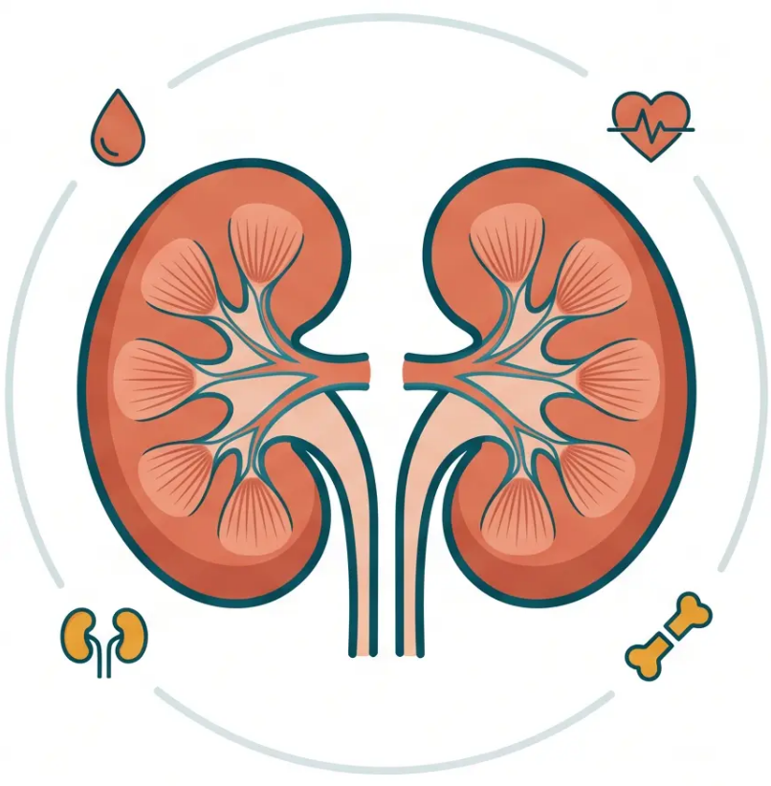


BRADFORD VTS TEACHING DECK
www.bradfordvts.co.uk
CKD:
Referral, Complications
& Progression
Updated to NICE NG203 (2021) & NICE CKS (2025)
AKT & SCA Exam Preparation · Clinical Management
Created May 2026
NICE NG203 · NICE CKS 2025 · UK Kidney Association · BNF May 2026

Slide 2















Timely Referral and NICE Criteria
NICE NG203 (2021) · Why It Matters and Who to Refer
Why Early Referral Matters
NICE NG203 Referral Criteria
Poor vascular access
URGENT — Within 2 Weeks
Tunnelled lines instead of AV fistula – higher infection risk
• Rapidly declining eGFR — suggesting AKI or rapidly progressive CKD
Malnutrition
• Nephrotic syndrome
• Severe hypertension unresponsive to therapy
Malnourishment at dialysis initiation worsens outcomes
Anaemia & calcium dysregulation
ROUTINE Nephrology Referral
Lower Hb and poor calcium control at start of dialysis
• CKD G4 or G5 — eGFR <30 ml/min/1.73m²
Prolonged hospitalisation
• ACR >70 mg/mmol (unless diabetic, already managed)
Longer stays, higher costs, increased early morbidity
• ACR >30 mg/mmol + haematuria
Increased mortality
• Progressive CKD — decline >5 ml/min/yr or >10 ml/min/5yr
• Hypertension resistant to ≥4 agents
Higher early death rates linked to late referral
• Suspected rare/genetic cause (Alport's, APKD) or renal artery stenosis
Lost preparation time
No time for MDT education, modality choice, or fistula formation
Consider Phone or Letter First
• Before formal referral if clinic visit may not be needed
Late referral = within 90 days of needing dialysis
• CKD G3b with borderline ACR or BP – clarify management with
nephrology
*This is the definition – know it for AKT*
NICE NG203 · August 2021 · Bradford VTS · www.bradfordvts.co.uk

Slide 3








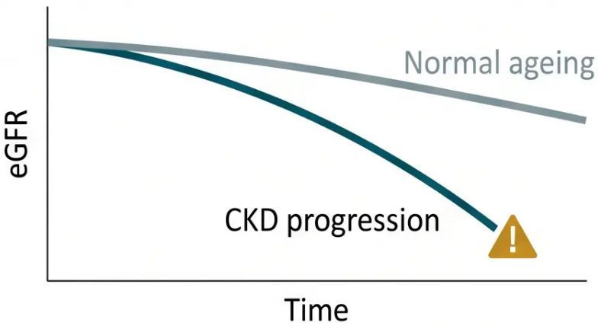





Bradford VTS
Identifying and Preventing CKD Progression
NICE NG203 Definition & Modifiable Risk Factors
3 / 10
MODIFIABLE RISK FACTORS
PROGRESSIVE CKD — DEFINED
Hypertension — most important modifiable factor; target <140/90 or
<130/80 if ACR ≥70
eGFR decline >5 ml/min/1.73m²/year
OR >10 ml/min/1.73m² within 5 years
Proteinuria — ACEi/ARB reduce urinary protein loss and slow progression
*Confirmed by minimum 3 eGFR measurements over
≥90 days*
Diabetes — tight glycaemic control reduces nephropathy progression
Natural age-related decline: ~1 ml/min/year after age 40
Smoking — renal function declines twice as fast; cessation is a clinical priority
Obesity — independent risk factor; weight management advised
NSAIDs — nephrotoxic — avoid in ALL CKD patients
Dehydration / Recurrent AKI — accelerates nephron loss; avoid volume depletion
Non-modifiable factors:
*Underlying CKD aetiology · Genetic factors (e.g. APKD mutations)
www.bradfordvts.co.uk
NICE NG203 (2021) · NICE CKS (2025)

Slide 4









Complications: Anaemia & Cardiovascular Disease
CKD G3b onwards — staged monitoring and active management
Renal Anaemia
Cardiovascular Disease
• Mechanism: Reduced EPO production by damaged
kidneys → normochromic, normocytic anaemia
>50% of CKD G3–G5 deaths are cardiovascular
• Investigate when: Hb below 110 g/L in men and
women
• CKD independently increases CV risk beyond
traditional risk factors
• First exclude: Iron deficiency (ferritin below 100 µg/L
→ oral iron first), B12, folate, haemolysis, blood loss
• LVH develops early — driven by anaemia,
hypertension, and fluid overload
• Statin: Atorvastatin 20 mg — recommended for ALL
CKD patients regardless of baseline cholesterol
> IV Iron if: ferritin <500 + TSAT <20%
IV iron threshold
• BP control: Target below 140/90 (or below 130/80 if
ACR ≥70 mg/mmol)
• ESA therapy: Hb target 100–120 g/L; specialist-
initiated and monitored by nephrology
• Smoking cessation, diabetes management,
antiplatelet therapy if established CVD
• If untreated: LVH, cognitive impairment, reduced
immunity, poor quality of life
Monitor ECG/echo if LVH suspected
NICE NG203 · NICE CKS 2025
Bradford VTS · www.bradfordvts.co.uk

Slide 5















Mineral Bone Disorder & Hyperkalaemia
CKD-MBD Pathophysiology · Monitoring · Hyperkalaemia Management
CKD-MBD
Hyperkalaemia
↓ Active Vitamin D (1,25-dihydroxy)
K⁺ >5.0
mmol/L
Dietary restriction · review K⁺-raising
medications · avoid NSAIDs
↓ Calcium Absorption → Hypocalcaemia
K⁺ >5.5
mmol/L
Restrict dietary potassium · review
ACEi/ARB dose · monitor closely
↑ Phosphate (reduced renal clearance)
K⁺ >6.0
mmol/L
Stop ACEi/ARB · urgent
specialist review
Secondary Hyperparathyroidism (↑PTH)
Bone Fragility · Vascular Calcification
Common Triggers
● ACEi / ARB
● NSAIDs
● K⁺-sparing diuretics
Monitor in G4–G5
● High K⁺ diet
● Calcium ● Phosphate ● PTH ● Vitamin D
Novel K⁺ Binders
G3: Cholecalciferol / Ergocalciferol for deficiency
Patiromer
G4–G5: Alfacalcidol / Calcitriol active analogues, monitor Ca²⁺
Sodium Zirconium Cyclosilicate (SZC)
Avoid bisphosphonates if eGFR <35
Enable continuation of RAASi in hyperkalaemic CKD – specialist initiated
NICE NG203 · NICE CKS 2025
Bradford VTS · www.bradfordvts.co.uk
05

Slide 6









Acidosis, Fluid Overload & Conservative Care
Managing metabolic complications and respecting patient choice
Fluid Overload
& Hypertension
Conservative Care
Metabolic Acidosis
A legitimate and active treatment choice
• Bicarbonate <22 mmol/L →
consider sodium bicarbonate
supplementation
• Sodium and water retention as
nephrons are lost
• Not all CKD ends in dialysis —
conservative management is valid
• Presents as: oedema, pulmonary
congestion, raised BP
• Best suited to: frail elderly, significant
comorbidities, patient preference
• Worsens bone disease and
muscle wasting
• Management: salt & fluid
restriction
• Focus: symptom control, quality of
life, nutrition, psychological support
• Monitor serum bicarbonate
regularly in G4–G5
• Furosemide — dose escalation may
be needed; BP control essential
• Requires: advance care planning +
MDT involvement
⚠ Bicarbonate <18 → urgent
specialist input (red flag)
Loop diuretics remain first-line for fluid
management in CKD
Pre-dialysis counselling is essential
— patient has the right to choose
NICE NG203 · NICE CKS 2025
bradfordvts.co.uk

Slide 7








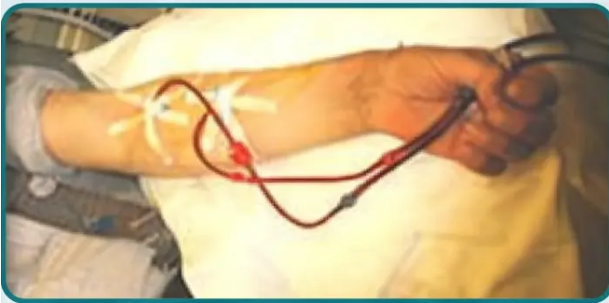




Renal Replacement Therapy & Preparation
Three pathways — and why preparation must begin at G4
‘Haemodialysis’
‘Peritoneal Dialysis’
‘Renal Transplantation’
‘HD’
‘PD’
‘Best long-term outcomes’
• Typical 3× per week, ~4 hours per
session
• Continuous ambulatory (CAPD) or
automated (APD)
• Best long-term survival and quality of
life
• Hospital-based or home haemodialysis
• Living donor preferred over deceased
donor
• Home-based — greater patient
independence
• Requires vascular access — AV fistula
preferred
• Preserves residual renal function
longer than HD
• Pre-emptive transplant (before
dialysis) reduces wait time
• AV fistula needs 3–6 months to
mature — plan early
• Early listing and living donor workup
— begin at G4
• Requires peritoneal catheter insertion
• Good option for patients preferring
home therapy
• Hepatitis B vaccination required if not
immune
Pre-Dialysis
Preparation —
Start at G4
① Patient education — modality choice discussion
AV fistula formation —
3–6 months maturation time
Living donor workup
— begin early
Transplant listing +
Hep B vaccination
Vascular access for haemodialysis
NICE NG203 · Bradford VTS · www.bradfordvts.co.uk
7

Slide 8











Red Flags & Common Pitfalls
Recognise the urgent · Avoid the avoidable
RED FLAGS
COMMON PITFALLS
Rapidly Declining eGFR
Late Referral to Nephrology
>5 ml/min/year — urgent nephrology referral
Don’t wait for G5 or uraemic symptoms — refer at G4
Haematuria + Proteinuria
Checking eGFR Only Once a Year
Possible glomerulonephritis — refer urgently
Progressive CKD missed without serial measurements
Nephrotic Syndrome
Delayed Anaemia Investigation
Urgent 2WW-equivalent referral
Check FBC and ferritin from G3b onwards
Severe Refractory Hypertension
Bone Disease Without PTH/Phosphate Check
Always check Ca, PO₄, PTH before treating
Investigate for renal artery stenosis
Uraemic Symptoms
NSAIDs in CKD
Nausea, confusion, asterixis, itch — urgent review
Nephrotoxic — avoid in all CKD stages
Bicarbonate <18 mmol/L
No AV Fistula Planning
Urgent specialist input required
Fistula needs 3–6 months to mature — plan early
Bradford VTS · www.bradfordvts.co.uk · NICE NG203 · NICE CKS 2025

Slide 9
















Exam Pearls • AKT & SCA Preparation
Know the numbers. Know the conversation.
AKT
SCA
Know the Numbers
Know the Conversation
90 days
→ Late referral = within 90 days of needing
dialysis. Associated with worse outcomes.
Early Specialist Review
Explain why early nephrology referral improves outcomes —
better access, better preparation, better quality of life at
dialysis start.
→ Threshold for anaemia investigation —
same for men and women.
Hb <110 g/L
Modality Choice
→ ESA target range. Initiated and
monitored by nephrology.
Hb 100–120 g/L
Patient has the right to choose between HD, PD, and
transplant. Explore lifestyle, home circumstances, and
preferences. Pre-emptive transplant is the best outcome.
→ Consider sodium bicarbonate
supplementation. Monitor in G4/G5.
Bicarbonate <22
Smoking Cessation
→ AV fistula maturation time. Best
vascular access for HD. Plan early.
Smoking doubles the rate of CKD progression — frame this
as a direct clinical intervention, not just lifestyle advice.
Offer structured cessation support.
3–6 months
Advance Care Planning
• G3 vitamin D: cholecalciferol / ergocalciferol
Appropriate for frail/elderly patients. Conservative
management is a legitimate, active choice. Discuss goals
of care, quality of life, and patient values sensitively.
• G4–G5 vitamin D: alfacalcidol / calcitriol (active analogues)
• Novel K+-binders: patiromer, SZC — enable continuation of RAASi
NICE NG203 • NICE CKS 2025 • Bradford VTS • www.bradfordvts.co.uk

Slide 10




Top Tips & Clinical Summary
Essential takeaways for primary care — Bradford VTS GP Trainee Education
01 — Refer at G4
06 — LVH can develop silently
Don’t wait for G5 or uraemic symptoms to appear
Cardiovascular monitoring is essential in all CKD patients
02 — ACR >70 mg/mmol
07 — Bone disease monitoring
Refer even without haematuria, unless already managed
Check Ca, PO₄ and PTH in ALL G4/G5 patients
03 — ACR >30 + haematuria
08 — Check bicarbonate regularly
Always refer — possible glomerulonephritis
Monitor in G4/G5; treat acidosis with sodium bicarbonate
04 — Progressive CKD
09 — Smoking doubles CKD progression
Decline >5/yr or >10/5yr — refer for specialist assessment
Cessation is a clinical priority — not optional advice
05 — Anaemia starts at G3b
10 — Pre-dialysis prep is a process
Check FBC and ferritin; correct iron first before labelling
as renal anaemia
Start AV fistula planning and patient education at G4
Bradford VTS · www.bradfordvts.co.uk · Created May 2026
NICE NG203 · NICE CKS 2025 · UK Kidney Association · BNF May 2026

