Slide 1




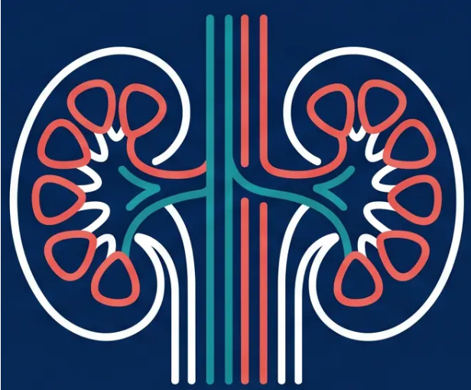
BRADFORD VTS TEACHING DECK
CKD: Diagnosis,
Staging & Assessment
for GP Trainees
Updated to NICE NG203 & CKS 2025 Standards
www.bradfordvts.co.uk · May 2026
May 2026

Slide 2

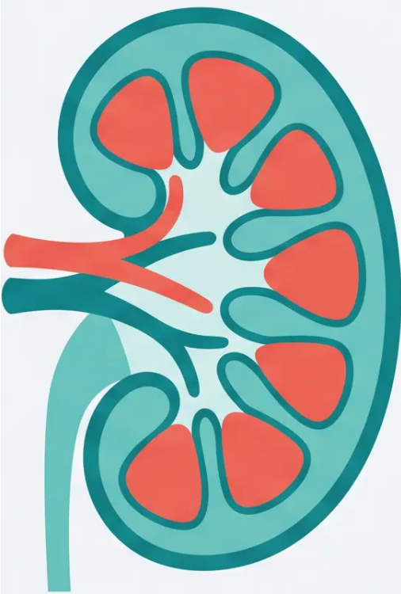





SLIDE 2 · DEFINITION
Definition of Chronic Kidney Disease
NICE NG203 — Structural or functional abnormality present for >3 months
CKD is diagnosed when kidney abnormalities persist for more than 3
months — confirmed by either of two pathways:
PATHWAY 1 · REDUCED KIDNEY FUNCTION
eGFR < 60 ml/min/1.73m²
On two separate occasions, at least 90 days apart
PATHWAY 2 · MARKERS OF KIDNEY DAMAGE
• ACR ≥ 3 mg/mmol
• Haematuria (urological causes excluded)
• Structural abnormality on imaging
• Pathological finding on biopsy
• History of kidney transplant
⚠ G1 and G2 eGFR alone do NOT diagnose CKD — a marker of kidney damage
must also be present
Structural or functional —
either qualifies
Bradford VTS · CKD Teaching Deck
www.bradfordvts.co.uk

Slide 3



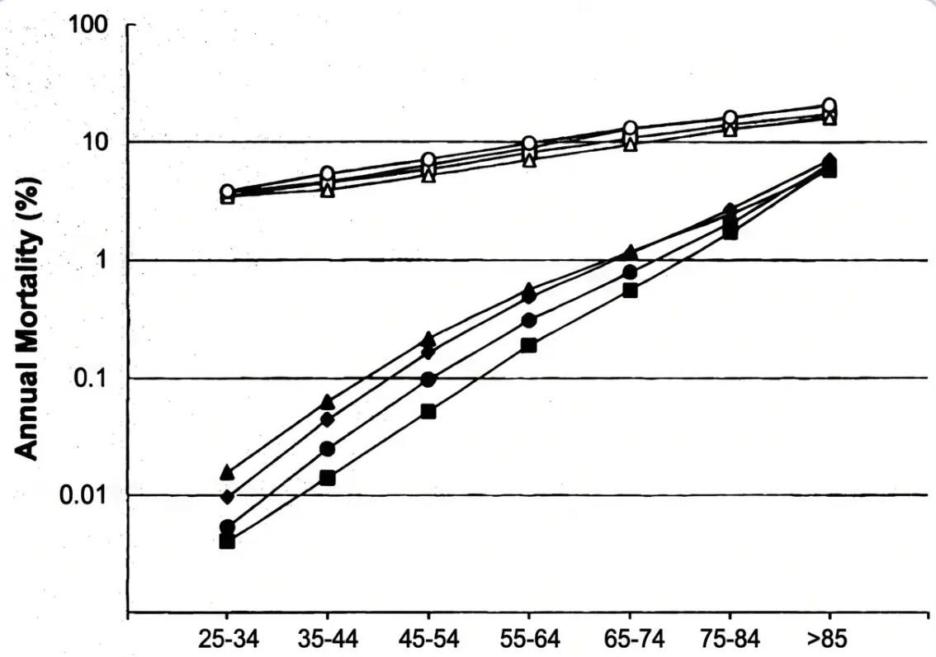

SLIDE 3 · EPIDEMIOLOGY
Epidemiology & Cardiovascular Risk
CKD in the UK — scale, impact, and a surprising truth
10–13%
Annual Mortality by Age — CKD vs General Population
of UK adults have CKD
The majority will never reach end-stage renal failure
● Disproportionate burden — elderly, males, people with
diabetes, hypertension, and South Asian and Black
communities are most affected
● Only 1% of G3 patients will progress to end-stage renal
failure in their lifetime
● Cardiovascular disease is the leading cause of death
in CKD — not kidney failure
CKD is a major independent cardiovascular risk factor
QRISK3 includes CKD — treat CVD risk proactively in all stages
Bradford VTS · CKD Teaching Deck
www.bradfordvts.co.uk

Slide 4








SLIDE 04 · CLASSIFICATION
GFR Classification: G1 → G5
Staging by estimated Glomerular Filtration Rate (eGFR) in ml/min/1.73m²
G1
≥ 90
›
Normal or high
G2
60 – 89
›
Mild reduction
G3a
45 – 59
›
Mild–moderate reduction
G3b
30 – 44
›
Moderate–severe reduction
G4
15 – 29
›
Severe reduction
G5
< 15
›
Kidney failure
Important: G1 and G2 alone do NOT diagnose CKD
Markers of kidney damage must also be present (e.g. ACR ≥3 mg/mmol, haematuria, structural abnormality)
NICE NG203 · Bradford VTS · www.bradfordvts.co.uk

Slide 5














PAGE 5 · ACR STAGING
ACR Classification
Categorising Proteinuria: A1 → A2 → A3
A1
Normal to Mildly Increased
ACR < 3 mg/mmol
A2
Moderately Increased
ACR 3–30 mg/mmol
A3
Severely Increased
ACR > 30 mg/mmol
★
Unified threshold of ≥ 3 mg/mmol applies to ALL patients — regardless of sex or
diabetes status. Previous sex-specific diabetic thresholds are no longer recommended.
NICE 2021 Update:
Bradford VTS Teaching Deck · CKD: Diagnosis, Staging & Assessment
www.bradfordvts.co.uk · May 2026

Slide 6


























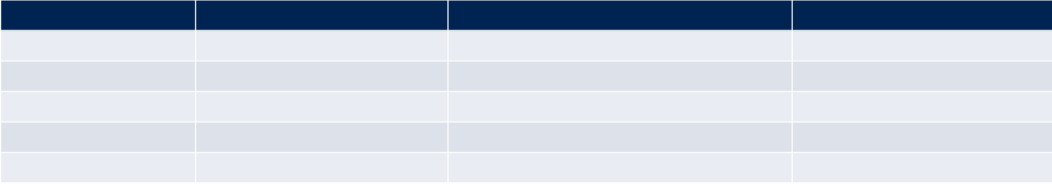



















SLIDE 6 · CLASSIFICATION
Risk Stratification & Monitoring Frequency
Combined G + A categories determine risk of adverse outcomes and dictate annual monitoring frequency
RISK OF ADVERSE OUTCOMES (CKD PROGRESSION · ESRF · CVD · MORTALITY)
A1 — Normal–Mild
< 3 mg/mmol
A2 — Moderate
3–30 mg/mmol
A3 — Severe
> 30 mg/mmol
KEY PRINCIPLE
G and A categories are
always documented
together — e.g. G3a A2.
Risk is determined by the
combination, not either
category alone.
G1 ≥90
Low
Low
Moderate
Low
G2 60–89
Low
Low
Moderate
Moderate
G3a 45–59
Moderate
Moderate
High
High
G3b 30–44
High
High
Very High
Very High
G4 15–29
High
Very High
Very High
Most G3a patients will
die of cardiovascular
disease before reaching ESRF.
G5 < 15
Very High
Very High
Very High
ANNUAL MONITORING FREQUENCY (eGFR + ACR checks per year)
GFR Stage
A1 (Low ACR)
A2 (Moderate ACR)
A3 (High ACR)
G1–G2
1
1
≥1
G3a
1
1
2
G3b
2
2
≥2
G4
2
2
3
G5
4
≥4
≥4
Higher ACR category always increases monitoring frequency at any GFR stage.
Bradford VTS · CKD Teaching Deck
NICE NG203 · 2021
www.bradfordvts.co.uk

Slide 7


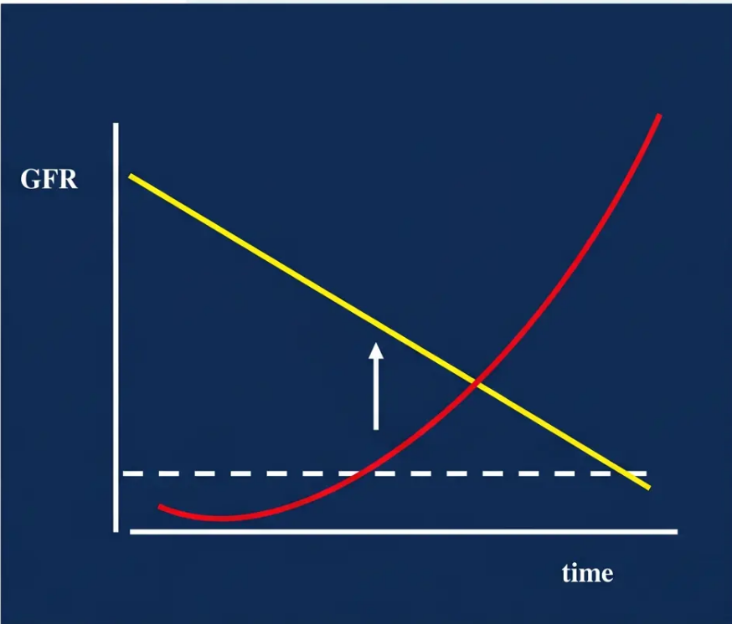

SLIDE 7 · MEASUREMENT
Measuring eGFR:
The CKD-EPI Standard
Replacing MDRD — more accurate, especially at higher GFR values
What is CKD-EPI?
The CKD-EPI equation calculates eGFR using serum creatinine, age, and
sex. It is automatically reported by laboratories when creatinine is requested.
Why CKD-EPI over MDRD?
CKD-EPI is more accurate — particularly at eGFR values above
60 ml/min/1.73m². MDRD underestimates GFR at higher values and is no
longer recommended by NICE NG203.
Important: eGFR >60
At eGFR >60, the equation is less precise. A rise in serum creatinine of
>20% is a more useful marker of deterioration in this range.
GFR trajectory over time — yellow line shows gradual
decline; red curve indicates accelerating loss
Confirming a Low eGFR
A single low eGFR does NOT diagnose CKD. If a new low result is found,
repeat within 2 weeks to exclude AKI before labelling as CKD.
www.bradfordvts.co.uk
NICE NG203 · CKD-EPI Standard

Slide 8









08 / 30
eGFR MEASUREMENT
Race & Ethnicity in eGFR Assessment
✕ OUTDATED PRACTICE
✓ CURRENT GUIDANCE
Race multiplier applied to eGFR
No race correction applied
Multiply eGFR × 1.212 for Black patients
CKD-EPI 2021 equation removes race variable
Used in older MDRD-based reporting
NICE NG203 (2021): eGFR not well validated
in Black, Asian & minority ethnic groups
Clinical judgement required in diverse populations
Assumed higher muscle mass by race
DO NOT USE — OUTDATED
NICE NG203 — CURRENT STANDARD
Do not multiply eGFR × 1.212 for Black patients — this is outdated practice.
NICE NG203 UPDATE
Bradford VTS Teaching Deck
www.bradfordvts.co.uk

Slide 9




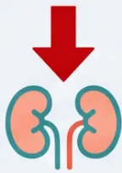







SLIDE 9 · eGFR MEASUREMENT
Caveats & Reliability of eGFR
eGFR has important limitations — know when not to rely on it alone
*The CKD-EPI equation assumes stable muscle mass and steady-state creatinine. These conditions break that assumption.
Acute Kidney Injury
Oedema / Fluid Overload
Pregnancy
Creatinine is rising — eGFR
reflects the past, not now.
Repeat within 2 weeks if
eGFR is unexpectedly low.
GFR increases physiologically.
eGFR underestimates true
function. Use clinical context
and specialist guidance.
Dilutional effects and altered
creatinine distribution reduce
eGFR accuracy. Includes heart
nephrotic syndrome, cirrhosis.
Muscle Wasting / Cachexia
High Muscle Mass
High Protein Intake
Bodybuilders and athletes
produce more creatinine —
eGFR will be falsely low. Cystatin
C may be more accurate.
Includes malnutrition,
amputation, prolonged illness.
Less creatinine produced —
eGFR falsely elevated. True GFR
worse than it appears.
Protein supplements and high-meat
diets transiently raise creatinine.
Advise no dietary restriction needed
for routine testing (meat fasting
rule removed from NICE CKS).
Clinical Pearl: “If eGFR >60 and you suspect deterioration, a rise in serum creatinine >20% is a more reliable marker than the absolute eGFR value.”

Slide 10






SLIDE 10 · DIAGNOSIS & STAGING
CKD in Older Adults
vs Normal Ageing
Clinical Context
NORMAL AGEING
CKD LABEL REQUIRED
• Age >70
• Any age with eGFR <45
• eGFR 45–59 ml/min/1.73m²
• eGFR 45–59 WITH declining trajectory
• Stable over time — no significant
decline
• Proteinuria present (ACR ≥3 mg/mmol)
• Haematuria (non-urological)
• No proteinuria (ACR <3 mg/mmol)
• Structural renal abnormality
• No haematuria
• History of kidney transplant
• No structural abnormality
CKD label may NOT be appropriate
— clinical judgement required
Two abnormal results ≥90 days apart
required to confirm
eGFR 45–59 in a patient aged >70, stable and without damage
markers — consider normal ageing, not CKD
Age-related GFR decline is physiological
— labelling requires clinical judgement
Bradford VTS · CKD Teaching Deck
www.bradfordvts.co.uk

Slide 11















11 / 30
PROTEINURIA
Proteinuria Assessment
& ACR Testing
ACR is the first-line test — more sensitive than PCR at low proteinuria levels
First-Line Test
Specimen Type
ACR over PCR
Urine Albumin:Creatinine
Ratio (ACR)
First morning void —
preferred but not mandatory
ACR is more sensitive at
detecting low-level
albuminuria
Requested when screening for
or monitoring CKD
Avoids orthostatic proteinuria —
gives most reliable result
PCR may be used for quantification
once proteinuria is established
ACR
PCR
CONFIRMED PROTEINURIA
ACR ≥3 mg/mmol on two separate occasions ≥90 days apart – single result alone is insufficient
Bradford VTS Teaching Deck · CKD: Diagnosis, Staging & Assessment
www.bradfordvts.co.uk

Slide 12





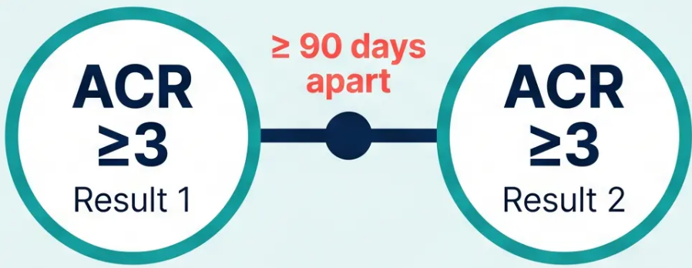







SLIDE 12 · PROTEINURIA ASSESSMENT
ACR Confirmation & False Positives
Two abnormal results needed — and causes
of false elevation must be excluded first
Exclude Before Confirming
Urinary Tract Infection
Send MSU if dipstick positive for protein
CONFIRMATION RULE
Recent Exercise
Avoid testing within 24 hours of
vigorous activity
Menstrual Contamination
Defer testing during menstruation
Fever or Acute Illness
Both results must meet the threshold
to confirm proteinuria
Proteinuria may be transient —
repeat when well
Orthostatic Proteinuria
Common in young adults — confirm
with early morning specimen
One result alone does NOT confirm CKD
Bradford VTS · CKD Teaching Deck
www.bradfordvts.co.uk

Slide 13

















13 / 30
SCREENING CRITERIA
Who to Screen for CKD?
Offer CKD testing to adults in any of these groups (NICE NG203)
Cardiovascular
Disease
Structural Renal
Disease
Diabetes Mellitus
Hypertension
*Type 1 or Type 2
*Any stage or treated
*IHD, heart failure, PVD,
CVD, TIA*
*Stones, BPH, recurrent UTIs
Multi-System
Disease
Family History
Haematuria or
Proteinuria
Nephrotoxin Exposure
CKD G5 or hereditary kidney
disease (e.g. APKD)
Long-term NSAIDs; post-AKI
monitoring
SLE, myeloma, vasculitis
Opportunistic detection
Do NOT offer routine testing based on age, sex, or ethnicity alone — see slide 14
www.bradfordvts.co.uk

Slide 14







14 / 30
SCREENING GUIDANCE · NICE NG203
Routine Testing:
Not Recommended
Do not offer routine CKD testing based solely on any of the following:
Age Alone
Sex Alone
Ethnicity Alone
Obesity Alone
Older age without risk
factors does not
warrant testing
Biological sex alone is
not an indication for
CKD screening
Ethnicity without
associated risk factors
is not sufficient
Only screen if obesity is
accompanied by metabolic
syndrome, diabetes, or
hypertension
* Exception: Obesity with associated metabolic syndrome, diabetes, or hypertension does warrant testing.
Bradford VTS Teaching Deck · CKD Diagnosis, Staging & Assessment
www.bradfordvts.co.uk

Slide 15



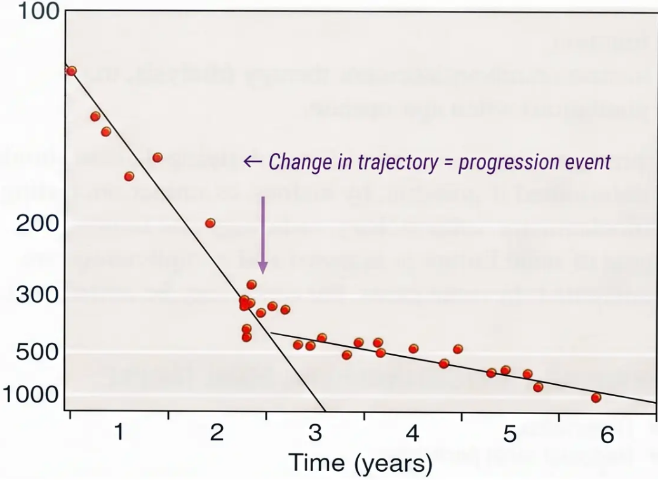




SLIDE 15 · PROGRESSION
Identifying Progressive CKD
Based on NICE NG203 — sustained eGFR decline criteria
Serum creatinine (µmol/l) ← Change in trajectory = progression event
ml/min/1.73m² decline
>5
within 1 year
*Sustained – not a single dip
ml/min/1.73m² decline
>10
within 5 years
*Either criterion is sufficient
Minimum 3 eGFR measurements over ≥90 days
*If new low eGFR found – repeat within 2 weeks to exclude AKI
*Graph: Serum creatinine trajectory showing change in rate of decline
– adapted from clinical reference
Bradford VTS · CKD Teaching Deck
NICE NG203
www.bradfordvts.co.uk

Slide 16












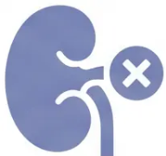
SLIDE 16 · PROGRESSION
Risk Factors for CKD Progression
Know what drives decline — and what you can modify
Uncontrolled Hypertension
High Proteinuria (A3)
Poor Glycaemic Control
Most important modifiable driver
ACR >30 mg/mmol — major risk marker
Especially in type 1 and type 2 diabetes
Smoking
NSAID Use
Outflow Obstruction
Independent vascular and renal risk factor
Nephrotoxic — avoid or minimise in CKD
BPH, stones — address promptly
Bradford VTS · www.bradfordvts.co.uk
NICE NG203 · May 2026

Slide 17


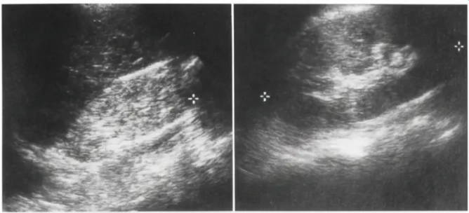






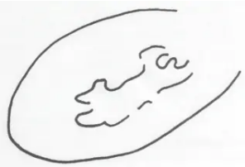
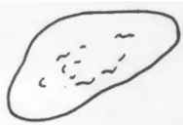


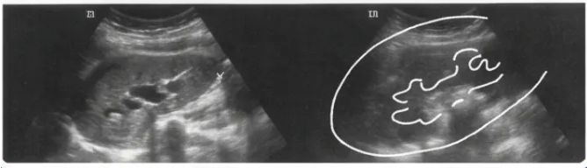



SLIDE 17 · ASSESSMENT
Indications for Renal Ultrasound
When to arrange a renal USS in primary care
Progressive CKD
Haematuria
Urinary Obstruction
Sustained decline in
eGFR over time
Visible or persistent
invisible haematuria
Symptoms or signs of
outflow obstruction
Family Hx of PCKD
eGFR < 30
Before Renal Biopsy
Renal ultrasound — clinical reference
Adults aged over 20
with family history
G4 or G5 — all patients
at this stage
Mandatory imaging
prior to biopsy
Bradford VTS · CKD Teaching Deck
NICE NG203 · 2021
www.bradfordvts.co.uk

Slide 18











SLIDE 18 · REFERRALS
Indications for Nephrology Referral
(Part 1 — When to refer from primary care)
Card 2 — ACR Threshold
(High, Untreated)
Card 1 — eGFR Threshold
Card 3 — ACR with Haematuria
eGFR < 30
ACR > 70
ACR > 30
ml/min/1.73m²
mg/mmol
mg/mmol + haematuria
CKD G4 or G5
Unless already managed
or diabetic in A3 range already treated
Proteinuria AND haematuria together
always warrants nephrology input
Refer with or without diabetes
💡 Consider a phone/letter discussion with nephrology before formal referral if a clinic visit may not be necessary
Bradford VTS · www.bradfordvts.co.uk · NICE NG203 (2021)
18 / 30

Slide 19
















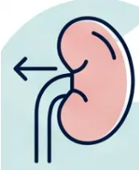
19 / 30 · REFERRAL CRITERIA
Nephrology Referral
Indications — Part 2
See also: Part 1 — Slide 18
Beyond eGFR thresholds — when the clinical picture demands specialist input
Progressive CKD
Refractory Hypertension
Rare / Genetic CKD
Decline >5 ml/min/yr
or >10 ml/min over 5 years
BP uncontrolled despite
4 antihypertensive agents
Suspected hereditary nephropathy,
vasculitis, or unusual presentation
Sustained — not a one-off dip
Consider renal artery stenosis
Renal Artery Stenosis
Metabolic Complications
Flash pulmonary oedema, sudden
deterioration on ACEi/ARB
Acidosis, hyperkalaemia, bone disease
difficult to manage in primary care
Suspect in resistant hypertension
Phone / letter discussion with nephrologist first — formal referral may not always be needed

Slide 20
















20
20 / 30
COMPLICATIONS
Complications of Advanced CKD
Stages G3b–G5 — systemic involvement across multiple organ systems
Anaemia
Bone Disease
Hyperkalaemia
Metabolic Acidosis
Normochromic normocytic;
usually from G3b onwards
Secondary
hyperparathyroidism;
adynamic bone; osteomalacia
Risk rises with declining
eGFR; cardiac arrhythmia
risk
Bicarbonate
supplementation if severe
Hypertension
Malnutrition
Fluid Retention
Cardiovascular Disease
Both a cause and
consequence of CKD
Leading cause of death in
CKD patients
Particularly prevalent in
G4 and G5 stages
Oedema, hypertension,
pulmonary congestion
Bradford VTS Teaching Deck
NICE NG203 · CKS 2025
www.bradfordvts.co.uk

Slide 21


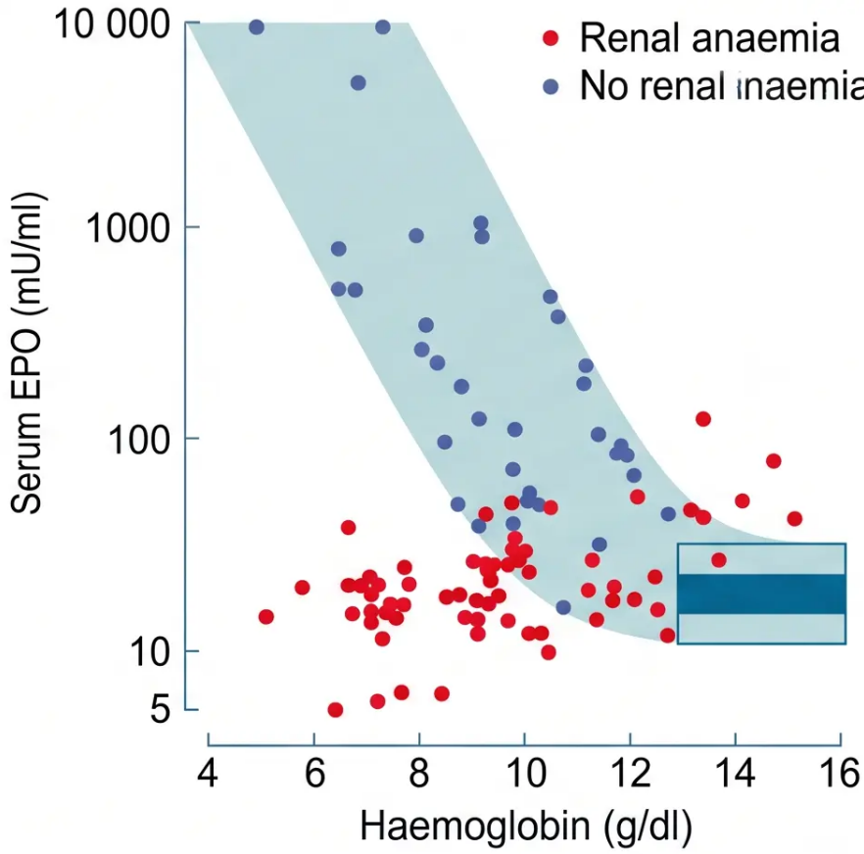

SLIDE 21 · COMPLICATIONS
Assessment of CKD Anaemia
INVESTIGATE WHEN
CLINICAL REFERENCE · EPO vs Hb RELATIONSHIP
Hb < 110 g/L
(applies to both men and women)
Step-by-step exclusions
● Step 1 — Iron deficiency: Serum ferritin < 100 µg/L →
iron deficient → offer oral or IV iron.
TSAT < 20% + ferritin < 500 µg/L → also iron deficient.
● Step 2 — Other nutritional causes: Check B12 and
folate deficiency.
● Step 3 — Other causes: Exclude bleeding, haemolysis,
haematological malignancy before attributing to CKD
Renal anaemia typically from G3b onwards
If anaemia present at G1–G3a, seek an alternative cause
ESA therapy (target Hb 100–120 g/L) — initiated by nephrology / specialist service only
EPO response is blunted in renal anaemia relative to haemoglobin level
Bradford VTS · CKD Teaching Deck
www.bradfordvts.co.uk · May 2026

Slide 22


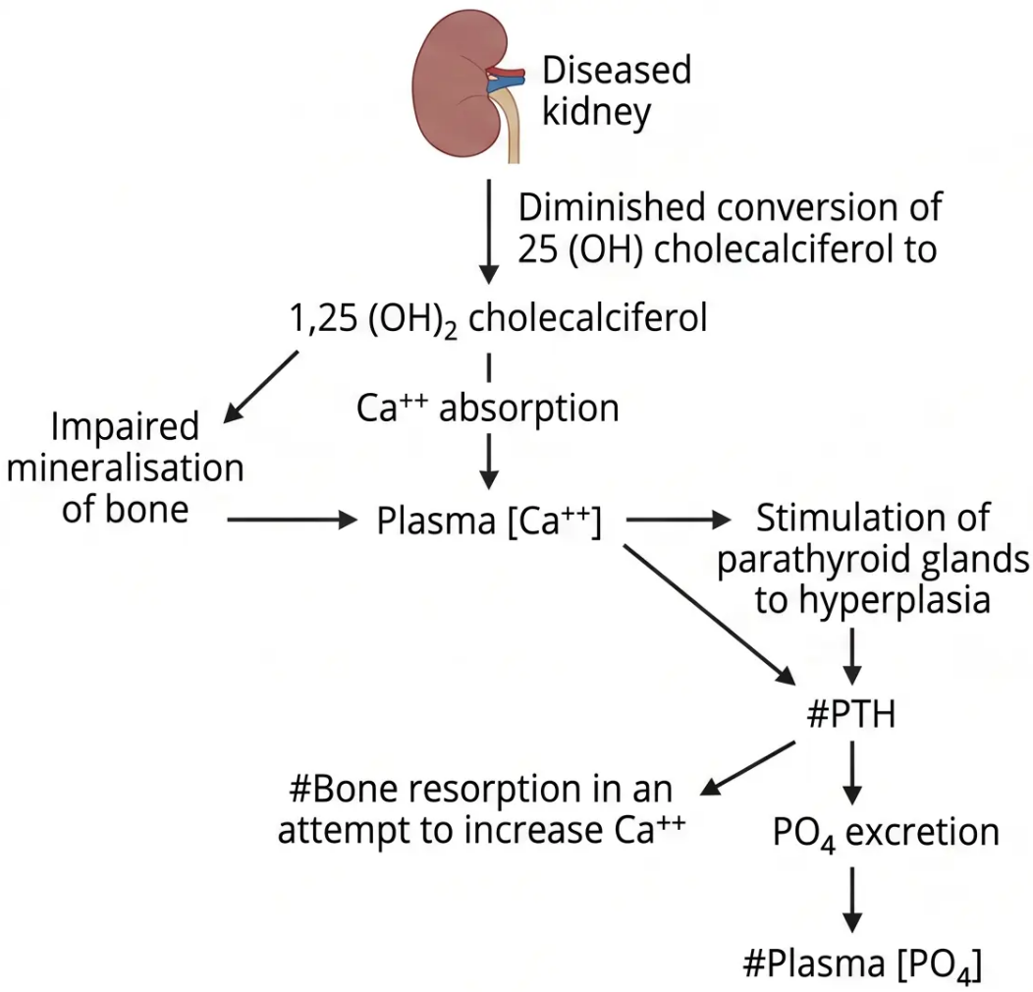

SLIDE 22 · COMPLICATIONS
Bone Disease in CKD:
The Mechanism
Advanced CKD disrupts vitamin D activation,
calcium balance, and phosphate excretion —
triggering a cascade that destroys bone.
① Impaired kidney
Active vitamin D production fails
② ↓ Vitamin D (1,25-OH₂)
Less calcium absorbed from gut
③ ↓ Plasma calcium
Parathyroid glands stimulated
④ ↑ PTH secreted
Bone resorption begins
⑤ ↑ Phosphate retained
Further PTH stimulation
www.bradfordvts.co.uk

Slide 23





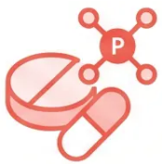







SLIDE 23 / 30
COMPLICATIONS · BONE DISEASE
Management of Bone Disease
Three treatment pillars — dietary, pharmacological, and hormonal correction
Dietary Restriction
Phosphate Binders
Vitamin D Supplementation
Limit dietary phosphate intake
Reduce intestinal phosphate
absorption
Correct deficiency and suppress
PTH activity
Reduce high-phosphate foods: dairy,
processed foods, cola drinks, nuts
Calcium carbonate or sevelamer —
taken with meals
G3
G4–G5
G3b onwards
G4–G5
Cholecalciferol (Vit D3) Alfacalcidol or Calcitriol
or Ergocalciferol – for
deficiency/insufficiency
Active analogues —
pre-dialysis
Monitor for hypercalcaemia when initiating or titrating vitamin D therapy
Bradford VTS Teaching Deck · CKD: Diagnosis, Staging & Assessment
www.bradfordvts.co.uk

Slide 24


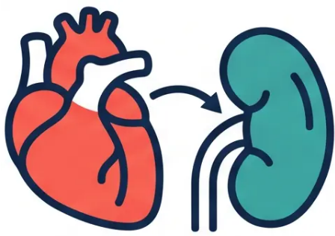


24 / 30
CARDIOVASCULAR RISK
Cardiovascular Risk Management
NICE NG203 RECOMMENDATION
Offer atorvastatin 20 mg
to ALL adults with CKD
Regardless of 10-year CVD risk score
This applies even if QRISK3 < 20% — the old threshold no longer applies.
Statin Therapy
Aspirin
• Atorvastatin 20 mg — first-line for all CKD patients
• Consider in CKD with established CVD
• Offer regardless of baseline CVD risk calculation
• Consider if T2DM + CVD risk >10%
• QRISK3 still useful for overall risk communication
• Weigh bleeding risk vs cardiovascular benefit
• Review for drug interactions (especially in advanced CKD)
• Not routinely offered to all CKD patients
Bradford VTS Teaching Deck · NICE NG203 (2021) · www.bradfordvts.co.uk · May 2026

Slide 25








25 / 30
PHARMACOLOGY · NICE TA1075 & TA942
SGLT2 Inhibitors in CKD
Add-on to maximum tolerated ACEi or ARB therapy — two agents now recommended by NICE
Dapagliflozin
Empagliflozin
10 mg once daily
10 mg once daily
NICE TA1075 · July 2025
NICE TA942 · 2023
ELIGIBLE IF:
ELIGIBLE IF:
● eGFR 20–<45 ml/min/1.73m² (any ACR)
● eGFR 20–<45 ml/min/1.73m²
● eGFR 45–90 with uACR ≥22.6 mg/mmol
● eGFR 45–90 with uACR ≥22.6 mg/mmol
● eGFR 45–90 with Type 2 Diabetes
● Type 2 Diabetes with CKD criteria met
Significantly broadened eligibility vs previous criteria
NICE TA942 — complementary agent to dapagliflozin
AKT PEARL
Add-on
therapy
Max tolerated
ACEi/ARB first
Monitor eGFR
after initiation
eGFR race correction (×1.212) is
OUTDATED — do not apply when
assessing SGLT2i eligibility thresholds
NICE TA1075 (July 2025) · NICE TA942 (2023) · NICE NG203
www.bradfordvts.co.uk

Slide 26













SLIDE 26 · CLINICAL SAFETY
Red Flags in CKD Assessment
Recognise these — refer or act urgently
Rapidly Rising
Creatinine
Visible
Haematuria + CKD
ACR >70 mg/mmol
First-line nephrology
referral threshold
>25% rise — suspect AKI
or renal artery stenosis
Refer — do not attribute
to CKD alone
Nephrotic
Syndrome
Symptoms of
Uraemia
Sudden
Deterioration
on ACEi/ARB
Heavy proteinuria +
hypoalbuminaemia + oedema
Nausea, vomiting,
confusion, asterixis
Suspect renovascular
disease — stop and refer
Also: BP uncontrolled on ≥4 antihypertensives → refer
Bradford VTS Teaching Deck · CKD Assessment
www.bradfordvts.co.uk

Slide 27











SLIDE 27 · COMMON MISTAKES
Common GP Pitfalls
10 mistakes to recognise — and avoid — in CKD management
➏ Forgetting ACEi/ARB review at 2 weeks
➊ Diagnosing CKD on a single eGFR
Recheck eGFR and potassium after starting or dose increase
Must confirm with a second result ≥90 days apart
➐ Missing haematuria + proteinuria = refer
➋ Using MDRD instead of CKD-EPI
ACR >30 mg/mmol with haematuria → nephrology referral
CKD-EPI is the current NICE NG203 standard
➑ Prescribing NSAIDs in CKD ⚠️
➌ Applying race-based eGFR correction ⚠️
Nephrotoxic — avoid in all stages of CKD
Do NOT multiply ×1.212 for Black patients — outdated
➒ Not stopping meds on sick days
➍ Saying ‘Stage 3’ without G+A staging
Hold ACEi/ARB/diuretics/metformin during acute illness
Full staging requires both GFR and ACR category
➓ Checking eGFR without tracking trajectory
➎ Not offering statins to all CKD patients
The rate of decline matters as much as the absolute value
NICE NG203: atorvastatin 20 mg regardless of CVD risk score
Bradford VTS · CKD Teaching Deck · NICE NG203 / CKS 2025
www.bradfordvts.co.uk

Slide 28









28 / 30
CLINICAL PEARLS
Top Tips for Primary Care
Key practice points every GP trainee should know
1
2
3
Always Use G + A Staging
ACR Over PCR — Always
CVD Kills Before Dialysis
ACR is more sensitive at low
proteinuria levels
Most CKD G3a patients die of
cardiovascular disease, not ESRF
e.g. G3a A2 — not just ‘Stage 3’
4
5
6
Two Results,
90 Days Apart
Statins for ALL
CKD Patients
No Race Correction
on eGFR
One low eGFR alone does NOT
diagnose CKD — exclude AKI first
Offer atorvastatin 20 mg regardless
of CVD risk score — NICE NG203
The ×1.212 multiplier for Black
patients is outdated — do not apply
Bradford VTS · CKD Teaching Deck · NICE NG203 / CKS 2025
www.bradfordvts.co.uk

Slide 29











29 / 30
AKT
AKT Exam Pearls
High-yield facts for CKD — know these cold
DEFINITIONS
REFERRAL THRESHOLDS
• CKD = structural or functional abnormality >3 months
• G4 or G5 (eGFR <30) → refer to nephrology
• Requires two abnormal results ≥90 days apart
• ACR >70 mg/mmol → refer (unless already treated,
diabetic A3)
• eGFR <60 OR kidney damage marker (ACR ≥3, haematuria,
structural)
• ACR >30 + haematuria → refer
• Progressive CKD (>5 ml/min/yr or >10 ml/min/5yr) → refer
• G1/G2 alone is NOT CKD — damage marker required
• BP refractory to ≥4 antihypertensives → refer
• Staging: G1–G5 (eGFR) + A1–A3 (ACR) — always use both
BP TARGETS
STATIN & CARDIOVASCULAR
• Standard CKD target: <140/90 mmHg
• Offer atorvastatin 20 mg to ALL adults with CKD
• Regardless of 10-year CVD risk score — no threshold applies
• If ACR ≥70 mg/mmol: target <130/80 mmHg
• Old CG182 targets are superseded — use NG203 values
• Old rule (statin if CVD risk >20%) is outdated — do not use
• ACEi or ARB: first-line in CKD with hypertension or proteinuria
• CKD is an independent cardiovascular risk factor
• Recheck U&Es + creatinine 2 weeks after starting or dose
increase
• CKD patients more likely to die of CVD than reach dialysis
www.bradfordvts.co.uk
NICE NG203 · CKS 2025

Slide 30








30 / 30
SCA PREPARATION
SCA Exam Pearls & Quick Recall
Consulting with confidence — what the examiner wants to hear
Explaining G-A Staging
Sick Day Rules
Cardiovascular Risk
Smoking & Lifestyle
In plain language
The bigger picture
Essential every consultation
Safety-netting essentials
• Your kidneys are working at
about [X]% of normal — that's
your G stage
• Stop ACEi / ARB / diuretics if
vomiting, diarrhoea, or unable
to drink
• CKD itself is a major CVD risk
factor — explain this proactively
• Smoking accelerates CKD
progression — address every visit
• Most CKD G3a patients die from
heart disease, not kidney failure
• Refer to stop smoking service;
offer pharmacotherapy
• We also check for protein
leaking — that's your A stage
• Stop metformin if acutely unwell
or dehydrated
• Offer statin (atorvastatin 20 mg)
regardless of CVD risk score
• Salt restriction helps BP and
proteinuria
• Together they tell us your risk
and how often to monitor you
• Avoid NSAIDs during illness
• Restart medications when eating
and drinking normally for 24–48 hrs
• Address BP, diabetes control,
and lifestyle together
• Regular exercise and healthy
weight reduce CVD burden
• Most people with early CKD
never need dialysis
• Seek help if no improvement
within 24–48 hours
• Use QRISK3 — it includes CKD
as a variable
• Alcohol within recommended
limits
Updated to current NICE NG203 (2021) and NICE CKS (September 2025) standards
www.bradfordvts.co.uk · May 2026 · NICE NG203 / CKS 2025

