Slide 1


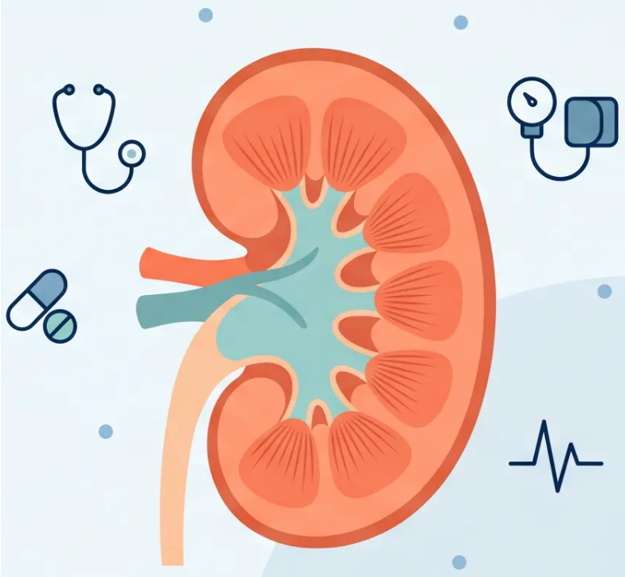

BRADFORD VTS TEACHING DECK
www.bradfordvts.co.uk
CKD Management
in Primary Care
Bradford VTS Teaching Deck for GP Trainees
AKT & SCA Exam Preparation
Updated to NICE NG203 (2021) · NICE CKS (Sept 2025) · NICE TA1075 (July 2025)
Created May 2026
Bradford VTS — CKD in Primary Care
NICE NG203 · TA1075 · CKS 2025

Slide 2
















BP Targets & Initial Management
NICE NG203 — Unified Thresholds by ACR Level
TIER 1 — BP Target Cards
STANDARD CKD
HIGH PROTEINURIA CKD
< 140/90 mmHg
< 130/80 mmHg
Clinic BP
Clinic BP · Target range 120–129 / 70–79
ACR < 70 mg/mmol
ACR ≥ 70 mg/mmol
TIER 2 — ACEi/ARB Indications Panel
When to Start ACEi or ARB
Diabetes + ACR ≥ 3 mg/mmol
Hypertension + ACR ≥ 30 mg/mmol
ACR ≥ 70 mg/mmol
Regardless of BP or CKD stage
Non-diabetic CKD patients
Any patient — regardless of BP or diabetes
Titrate to maximum tolerated dose before adding a second agent
TIER 3 — Correction Callout Box
COMMON MISCONCEPTION — CORRECTED
- Diabetes alone does NOT automatically require the <130/80 target — this is tied to ACR ≥70 mg/mmol
- QOF target of <140/85 has been superseded by NICE NG203 clinical thresholds
— Bradford VTS — CKD in Primary Care
NICE NG203 · Slide 2 of 10

Slide 3












ACE Inhibitor & ARB Monitoring
Indications · U&E Monitoring · Thresholds
INDICATIONS
● Diabetes + ACR ≥3 mg/mmol — irrespective of hypertension or CKD stage
● Non-diabetic CKD + hypertension + ACR ≥30 mg/mmol
● ACR ≥70 mg/mmol — irrespective of BP or diabetes status
Titrate to maximum tolerated dose before adding a second agent.
MONITORING
When to Check
A
What to Check
B
Check U&E 2 weeks after starting
Check U&E 2 weeks after every dose increase
A small rise in creatinine or mild eGFR fall is
expected and acceptable.
Creatinine
eGFR
Potassium (K⁺)
Baseline U&E before starting is essential.
THRESHOLDS
A ✓ ACCEPTABLE — Continue
B ✕ STOP — Seek Specialist Advice
Creatinine rise ≤ 30%
eGFR fall ≤ 25%
Creatinine rise > 30%
eGFR fall > 25%
K⁺ > 6.0 mmol/L → Stop immediately
Monitor and recheck in 4–8 weeks
Consider renovascular disease. If proteinuric, seek
nephrology advice before permanent discontinuation.
Bradford VTS — CKD in Primary Care
Slide 3 of 10
NICE NG203 · www.bradfordvts.co.uk

Slide 4














NICE TA1075 · July 2025
SGLT2 Inhibitors: 2025 Update
Updated Criteria
Prerequisite: Add-on to optimised standard care including highest tolerated licensed
dose of ACEi or ARB (unless contraindicated)
eGFR 20 – <45 ml/min/1.73m²
eGFR 45 – 90 ml/min/1.73m²
Either condition required:
Any patient
♦ uACR ≥22.6 mg/mmol
Regardless of ACR or diabetes status
♦ Type 2 Diabetes
Do not initiate if eGFR <15
Both conditions increase eligibility — either alone is sufficient
Dapagliflozin 10mg OD or Empagliflozin
10mg OD — prescribe least expensive
Not for T1DM without
specialist advice
Glucose-lowering effect reduced if eGFR <45
— may need additional antidiabetic agents
Bradford VTS — CKD in Primary Care
NICE TA1075 · July 2025
4 / 10

Slide 5














Cardiovascular Risk & Lifestyle
NICE NG203 · Protecting the heart in CKD
Aspirin — Offer antiplatelet therapy to CKD patients
with established CVD (not primary prevention)
Atorvastatin 20mg
for ALL CKD patients
Glycaemic control — SGLT2 inhibitors have renal-
protective effects beyond glucose lowering in T2DM
Regardless of 10-year CVD risk score (NICE NG203)
CVD is the leading cause of death in CKD — more
likely than kidney failure for most patients
Not just high-risk — everyone with CKD
Lifestyle Modifications
Stop Smoking
Reduce Salt
Weight Control
Exercise
Diet
Limit Alcohol
Progression doubles
in smokers
Aim <6g/day — lowers
BP & proteinuria
Obesity accelerates
CKD progression
Improves BP and
cardiovascular fitness
Avoid high protein unless
G4/G5 dietician-led
Raises BP; DKA risk
with SGLT2i
Bradford VTS — CKD in Primary Care
Slide 5 of 10
www.bradfordvts.co.uk

Slide 6

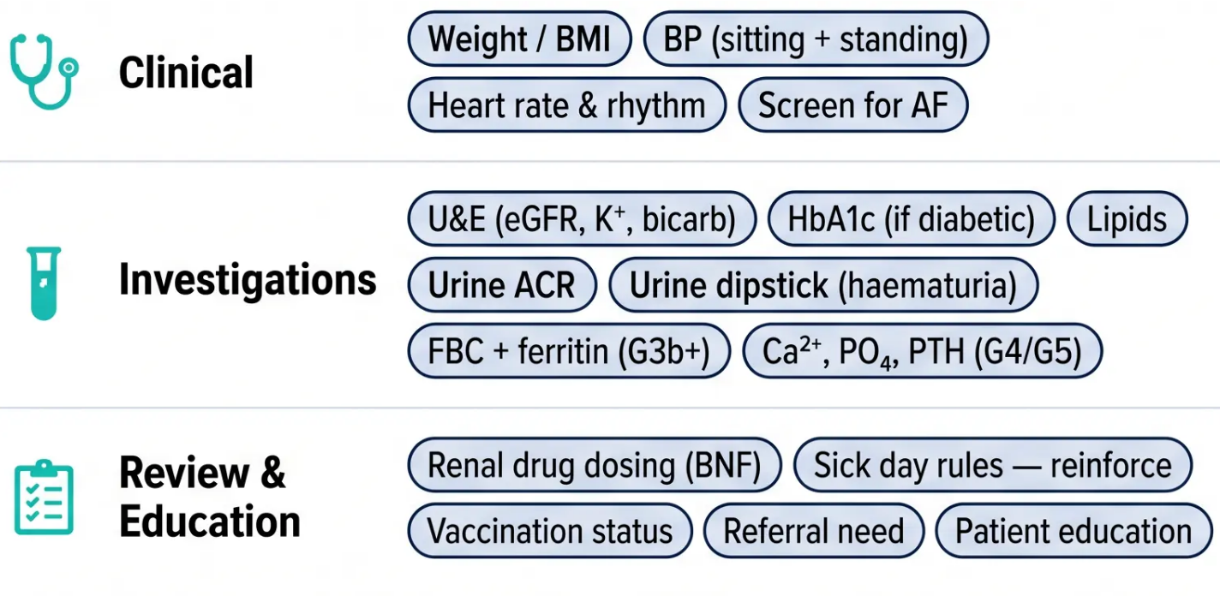




06 / 10
Annual CKD Review
& Vaccination Schedule
Vaccinations
Influenza
Annually — all CKD patients (at-risk group)
Pneumococcal (PPV23)
1 dose; repeat at 5 yrs if CKD progresses
COVID-19
Follow current NHSE guidance
Hepatitis B
Consider G4/G5 pre-dialysis patients
Don’t forget: Urine ACR + dipstick for haematuria — not just eGFR!
NICE NG203 · CKS Sept 2025
Bradford VTS — CKD in Primary Care · www.bradfordvts.co.uk

Slide 7


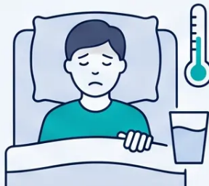







Bradford VTS · Slide 7 of 10
Sick Day Rules
SADMAN + SGLT2
Temporarily withhold these drugs during acute illness (vomiting, diarrhoea, fever, unable to eat or drink)
S
A
D
M
A
N
Sulphonylureas
e.g. gliclazide —
hypoglycaemia risk
ACE Inhibitors
/ ARBs
e.g. ramipril,
losartan
Diuretics
furosemide,
spironolactone
Metformin
lactic acidosis
risk
Aliskiren
direct renin
inhibitor
NSAIDs
including selective
COX-2 inhibitors
+ SGLT2 Inhibitors
⚠️ Risk of euglycaemic DKA — even without high glucose
✔️ Restart when eating and drinking normally for 24–48 hours
e.g. dapagliflozin, empagliflozin
Restart all withheld medications once recovered and tolerating oral intake normally. If no improvement after 2–3 days → seek medical advice.
Bradford VTS — CKD in Primary Care
NICE NG203 · BNF May 2026

Slide 8








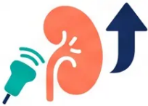



Referral Criteria and Renal Imaging
When to escalate — and when to investigate
Nephrology Referral
Renal Ultrasound (USS)
eGFR <30 ml/min/1.73m² — CKD G4 or G5
Accelerated or rapidly progressive CKD
— unexplained fast decline in eGFR
ACR >70 mg/mmol — unless diabetic and
already appropriately managed
Visible or persistent invisible haematuria
— to exclude structural pathology
ACR >30 mg/mmol + haematuria —
combined proteinuria and blood
Progressive CKD — decline >5 ml/min/yr or
>10 ml/min over 5 years
Symptoms of urinary tract obstruction —
e.g. poor stream, incomplete emptying
Resistant hypertension — uncontrolled on 4 or
more antihypertensive agents
Family history of polycystic kidney disease
— in patients aged over 20
Suspected renovascular disease — e.g.
creatinine rise >30% on ACEi/ARB
eGFR <30 ml/min/1.73m² — GFR stage G4
or G5 — structural assessment
Rare or genetic cause suspected — metabolic
complications difficult to manage in primary care
Bradford VTS — CKD in Primary Care
NICE NG203 · CKS Sept 2025
8 / 10

Slide 9









Red Flags & Common Pitfalls
Slide 9 of 10
*Critical warning signs and avoidable clinical errors in CKD management
Red Flags
Common Pitfalls
Creatinine rise >30% on ACEi/ARB
Stopping ACEi/ARB for minor creatinine rise
Possible renovascular disease — investigate and stop
A rise ≤30% is acceptable and expected
Potassium >6.0 mmol/L
No U&E check after dose change
Stop ACEi/ARB immediately
Monitor at 2 weeks after every start or increase
Rapidly worsening eGFR
NSAIDs prescribed in CKD
Possible AKI — identify and treat precipitant
Both non-selective and COX-2 inhibitors are harmful
BP uncontrolled on ≥4 agents
Not titrating ACEi/ARB to maximum tolerated dose
Refer to nephrology
Add second agent only after maximising first
Uraemic symptoms
Forgetting statin for all CKD patients
Nausea, confusion, fatigue, itching — urgent nephrology review
Atorvastatin 20mg — regardless of CVD risk score
SGLT2i + acute illness
Missing urine ACR in annual review
Euglycaemic DKA risk — withhold as per sick day rules
eGFR alone is insufficient — ACR and dipstick are required
“Sick day rules and medication monitoring prevent the majority of these errors — reinforce at every consultation.
Bradford VTS — CKD in Primary Care
NICE NG203 · TA1075 · CKS 2025

Slide 10













Exam Pearls & Top Tips AKT + SCA
*High-yield facts for exam day — know these cold
AKT Numbers & Facts
SCA Communication Strategies
BP target: <140/90 (standard CKD)
“BP matters more than most realise”
Explain: heart disease kills more CKD patients than kidney failure does
Lower to <130/80 only if ACR ≥70 mg/mmol
ACEi/ARB indications:
“Medications need watching”
DM + ACR ≥3 · non-DM + HT + ACR ≥30 · ACR ≥70 (any)
ACEi/ARB monitoring: U&E at 2 weeks — reassure a small creatinine rise is expected
Acceptable creatinine rise on ACEi: ≤30%
“Sick day rules — give it in writing”
eGFR fall ≤25% — do NOT stop for this
Reinforce SADMAN + SGLT2 at every review; provide written leaflet
Dapagliflozin (TA1075):
“New kidney tablet — dapagliflozin”
eGFR 20–<45 (any) · or eGFR 45–90 with uACR ≥22.6 or T2DM
Explain renal-protective benefit beyond glucose control; now for non-diabetic CKD too
Statin: Atorvastatin 20mg — ALL CKD patients
“Smoking is the one thing you can change today”
Regardless of 10-year CVD risk score
Renal function declines twice as fast in smokers — use this as a motivator
Sick day: SADMAN + SGLT2
“This is manageable”
S-A-D-M-A-N = Sulphonylureas, ACEi/ARBs, Diuretics, Metformin, Aliskiren, NSAIDs
Empower patient: most G1–G3 patients will never need dialysis with good control
Know your numbers. Explain your reasoning. Pass with confidence.
Bradford VTS · CKD in Primary Care · May 2024 · www.bradfordvts.co.uk

