Slide 1

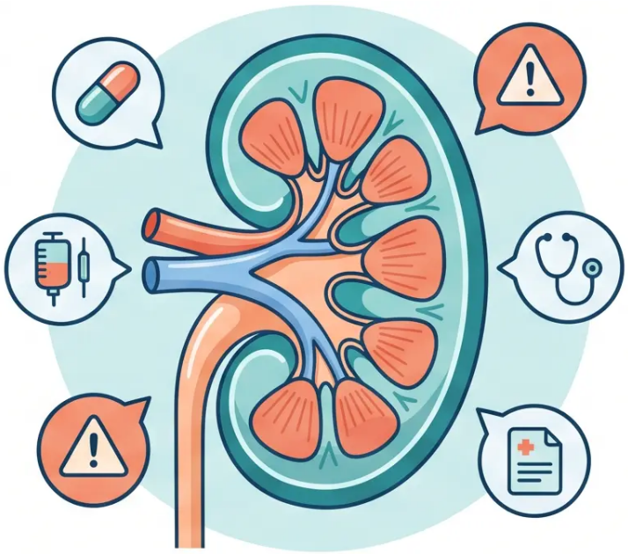



GP TRAINEE TEACHING DECK
www.bradfordvts.co.uk
Prescribing and
Medications in Chronic
Kidney Disease
Comprehensive guide for GP trainees on CKD
prescribing, covering BNF 2026 updates, dose
adjustments, and exam pearls for AKT and SCA.
Created May 2026
BNF-Verified (May 2026)
NICE NG203 Updated
Bradford VTS — Teaching Resource
Not for clinical use — educational purposes only.

Slide 2
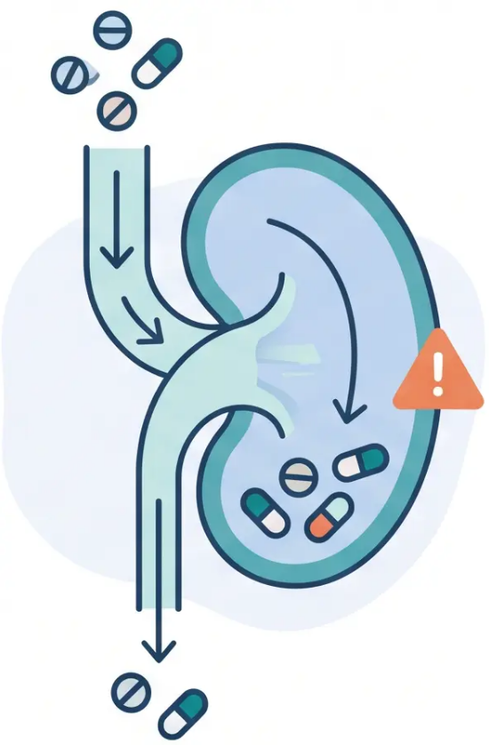






FOUNDATIONS
Principles of Prescribing in CKD
Why CKD changes everything about how we prescribe
Drug Accumulation
Reduced renal clearance → drugs and metabolites build up → toxicity risk
Altered Pharmacokinetics
Reduced clearance, altered volume of distribution, changed protein binding
Always Check the BNF Appendix
Every drug, every time — check renal impairment guidance before prescribing
Use eGFR or Creatinine Clearance
Drug-specific — some use eGFR, others use CrCl (Cockcroft-Gault). Never assume.
KEY PRINCIPLE
Dose adjustment is drug-specific — never assume the same reduction applies to all drugs.
Bradford VTS — CKD Prescribing
2 / 10
www.bradfordvts.co.uk

Slide 3
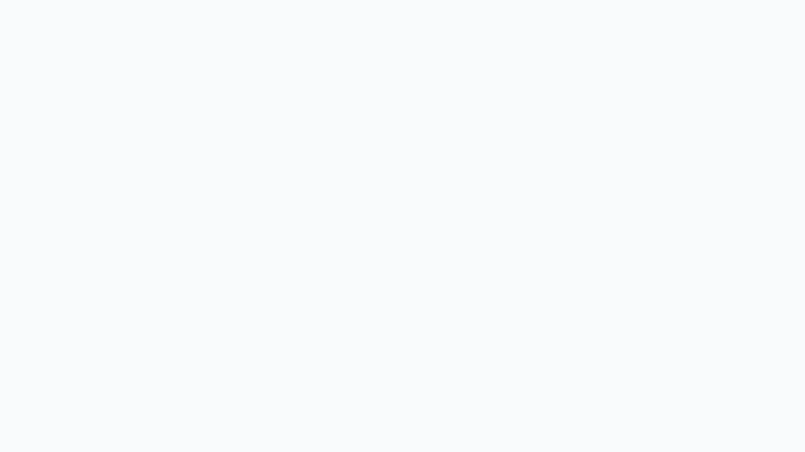





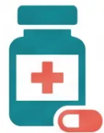









Nephrotoxic Drugs to Avoid
Key agents that cause AKI or worsen existing CKD — always check before prescribing.
NSAIDs
aminoglycosides
lithium
iodinated contrast
amphotericin
AVOID in CKD
EXTREME CAUTION
USE WITH CAUTION
MONITOR CLOSELY
USE LIPID FORM
Reduce renal blood flow.
Worsen CKD progression.
Cause AKI. Ibuprofen
sold OTC — counsel
patients specifically.
Direct nephrotoxicity.
Accumulate in renal
tubular cells. Require drug
level monitoring and renal
function checks.
Risk of contrast-induced
nephropathy.
Pre-hydration essential.
Withhold nephrotoxic
drugs beforehand.
Accumulates in CKD.
Nephrotoxic at high levels.
Requires therapeutic
drug monitoring. Narrow
therapeutic index.
Nephrotoxic. Use lipid
formulation if no
alternative available.
Monitor renal function
closely during treatment.
⚠ NSAIDs are the most clinically important — patients may self-medicate with OTC ibuprofen or naproxen. Always counsel.
Bradford VTS — CKD Prescribing
www.bradfordvts.co.uk
BNF May 2026 | NICE NG203

Slide 4
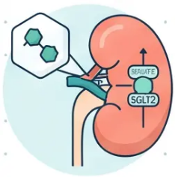


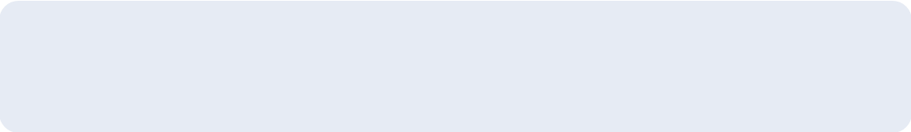








DIABETES PRESCRIBING IN CKD
Diabetes Medications: Metformin & SGLT2 Inhibitors
BNF May 2026 · NICE NG203 · NICE TA1075 (July 2025)
Metformin
SGLT2 Inhibitors
Risk of lactic acidosis with declining renal function
Cardio-renal protection beyond glucose lowering
eGFR
Dapagliflozin (NICE TA1075, July 2025)
≥45
Normal dose. No restriction.
◆ 10mg OD — for CKD: eGFR 20–<45 (any patient)
◆ eGFR 45–90 with uACR ≥22.6 mg/mmol OR Type 2 diabetes
eGFR
30-45
Use with caution. Halve dose.
Increased monitoring.
◆ Do not initiate below eGFR 15 ml/min
Reduced glucose-lowering efficacy if eGFR <45 — may need additional agent
eGFR
Empagliflozin (NICE TA942, 2023)
CONTRAINDICATED — risk of
lactic acidosis.
<30
◆ CHF indication: avoid if eGFR <20 ml/min
◆ Diabetes indication: avoid if eGFR <30 ml/min
Sick Day Rule: Stop metformin if vomiting,
diarrhoea, or dehydration.
Sick Day Rule: Stop SGLT2i during acute illness — risk of
of euglycaemic DKA even without hyperglycaemia.
AKT Pearl: Dapagliflozin TA1075 — eGFR 20–<45 (any patient) or eGFR 45–90 + uACR ≥22.6 or T2DM. Know the thresholds.

Slide 5










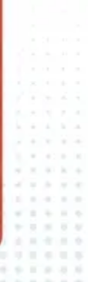
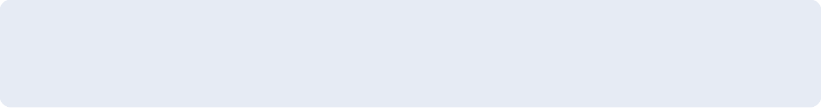
SLIDE 05 — PRESCRIBING IN CKD
Antibiotics & Allopurinol Adjustments
BNF-verified dose adjustments — May 2026
Amoxicillin
Allopurinol (Gout)
• eGFR <30 → max 500mg twice daily
• eGFR <30 → initial dose 100mg;
increase cautiously
• eGFR <10 → max 500mg once daily
Risk of convulsions at high doses
• eGFR 10–29 → reduce daily dose below
100mg or extend dose interval
Co-amoxiclav
Monitor urate levels regularly
• eGFR 10–30 → 250/125mg or 500/125mg twice daily
• eGFR <10 → 250/125mg or 500/125mg once daily
Avoid 400/57 suspension if eGFR <30
Nitrofurantoin — AVOID
Clarithromycin
eGFR <45 ml/min → Contraindicated
• eGFR 30–60 → half normal dose for MR preparations
• Reduced urinary concentration → ineffective
• eGFR <30 → half normal dose; max 14 days; avoid MR preparations
• Risk of peripheral neuropathy
Ciprofloxacin
Use instead: Trimethoprim or Pivmecillinam
• eGFR 30–60 → 250–500mg every 12 hours
“NO Nitro below 45”
• eGFR <30 → 250–500mg every 24 hours
Bradford VTS — Prescribing in CKD
www.bradfordvts.co.uk

Slide 6
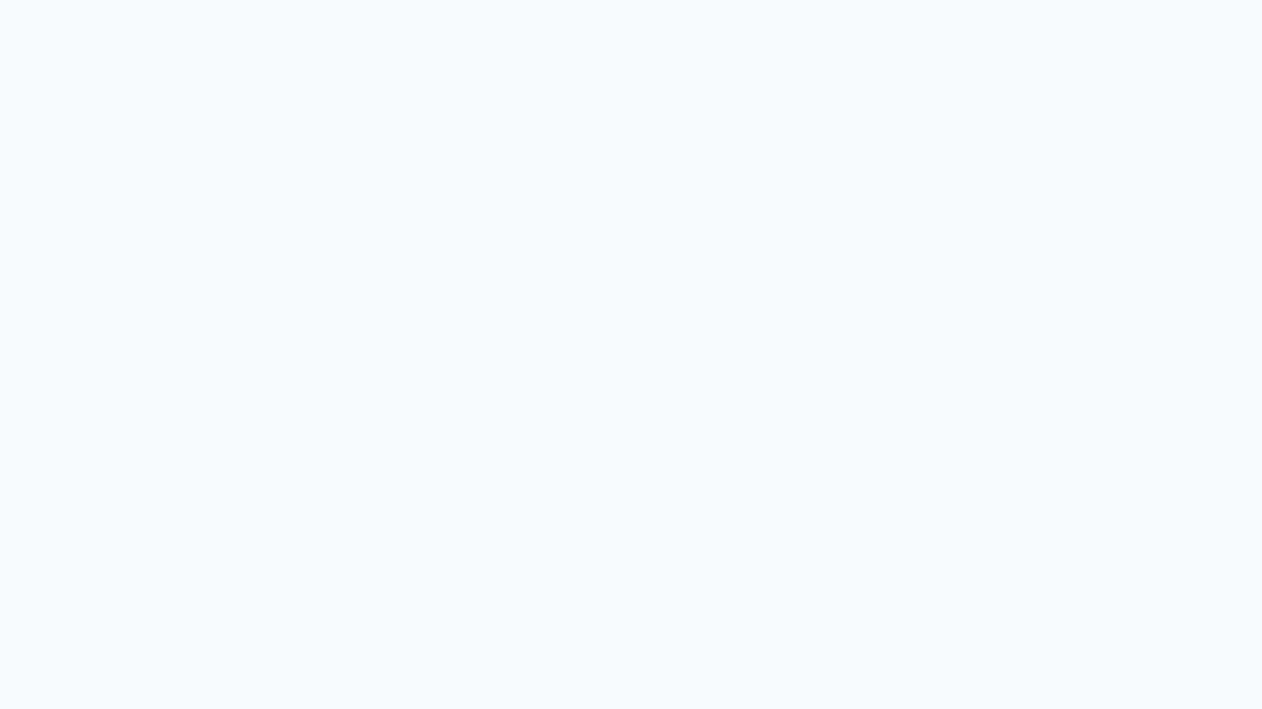
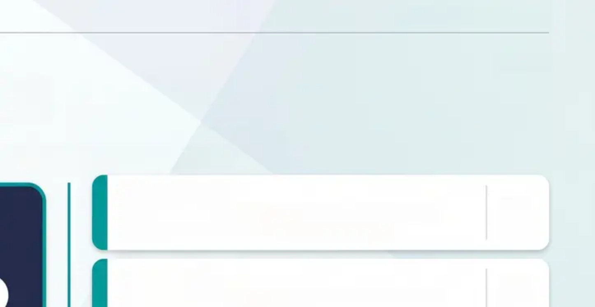

















Bradford VTS
www.bradfordvts.co.uk
ANTICOAGULATION · CKD PRESCRIBING
06 / 10
Anticoagulants in CKD
*DOAC dose adjustments — know the thresholds, know the rules
Rivaroxaban
APIXABAN — DOSE REDUCTION RULE
eGFR 15–49: dose reduction required (check
2 of 3 Criteria
BNF per indication) or eGFR <15: Avoid
Dabigatran
Age ≥ 80 years
Weight ≤ 60 kg
eGFR 30–49 (high bleed risk): 110–150 mg BD
eGFR <30: Contraindicated
Serum Creatinine ≥ 133 μmol/L
Edoxaban
eGFR 15–50: Reduce to 30 mg OD
If 2 or more criteria met → Reduce to 2.5 mg BD
eGFR <15: Avoid
Standard dose: 5 mg BD (AF indication)
Warfarin
eGFR 15–29: use 2.5 mg BD regardless
No dose adjustment — but INR more labile in CKD
eGFR <15: not recommended
Uraemia → platelet dysfunction; monitor closely
AKT Pearl: “Apixaban ‘2 of 3’ rule is one of the most frequently tested topics in AKT — memorise the three criteria and the dose: 2.5 mg BD”
Bradford VTS — CKD Prescribing Teaching Deck · May 2026
BNF-Verified · NICE NG203

Slide 7














SLIDE 7 OF 10
Other Medications Requiring Adjustment
eGFR-guided dose adjustments — digoxin, bisphosphonates, fibrates, diuretics, and more
Digoxin ⚠
Alendronic Acid 🚫
eGFR <60: reduce maintenance dose
eGFR <35 ml/min: AVOID
Monitor plasma levels + potassium; toxicity risk rises
with hypokalaemia
Check eGFR before initiating — do not prescribe below
this threshold
Avoid if eGFR <35
Calceos (Ca 500mg / Vit D3)
Fibrates (Bezafibrate / Fenofibrate)
eGFR <20 ml/min: CONTRAINDICATED
● Bezafibrate: eGFR 15–40 → 200mg every 1–2 days;
avoid MR if eGFR <60; eGFR <15 → avoid
Risk of hypercalcaemia and vascular calcification in
advanced CKD
● Fenofibrate: eGFR 30–59 → max 67mg micronised
OD; eGFR <30 → avoid
Contraindicated if eGFR <20
Diuretics
Baclofen & Domperidone
Bendroflumethiazide: largely ineffective if eGFR <30
(may still be used for BP alongside loop diuretic)
Baclofen: use smaller doses (start 5mg/day); eGFR
<15 → use only if benefit clearly outweighs risk
Furosemide: higher doses may be needed in CKD —
monitor U&E closely
Domperidone: eGFR <30 → reduce to once or
twice daily
BNF-Verified (May 2026) · NICE NG203
Bradford VTS — CKD Prescribing Deck | May 2026
www.bradfordvts.co.uk

Slide 8
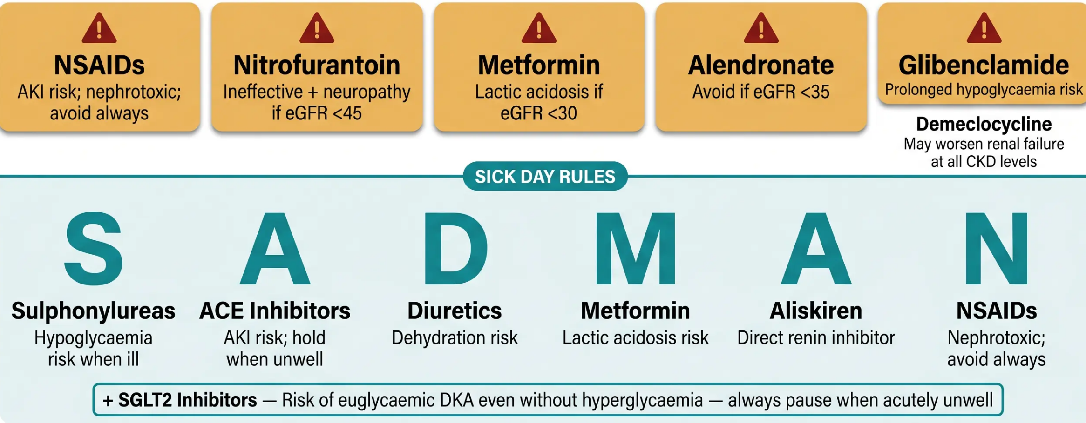
CKD PRESCRIBING — SAFETY
Contraindications & SADMAN Rules
Drugs to always avoid — and what to pause when your patient is acutely unwell
Bradford VTS — www.bradfordvts.co.uk
BNF May 2026 | NICE NG203

Slide 9







EXAM PREPARATION — AKT
AKT Mnemonics & Exam Pearls
High-yield memory aids for eGFR thresholds, monitoring rules, and DOAC contraindications.
◆ Apixaban Dose Reduction
NO Nitro Below 45
Reduce to 2.5mg BD if ≥ 2 of: Age ≥ 80 · Weight ≤ 60 kg · Creatinine ≥ 133 μmol/L
Nitrofurantoin — avoid if eGFR < 45 ml/min
Ineffective + peripheral neuropathy risk
◆ Dabigatran
Contraindicated if eGFR < 30 ml/min
Met Stops at 30
◆ ACEi / ARB Monitoring
Metformin — contraindicated if eGFR < 30
Acceptable creatinine rise ≤ 30% · eGFR fall ≤ 25% · Stop if K⁺ > 6.0 mmol/L
Review at eGFR 45 — dose reduce or extra caution
◆ Dapagliflozin (NICE TA1075)
Bone Pill Stops at 35
eGFR 20–< 45: any CKD patient · eGFR 45–90: uACR ≥ 22.6 or T2DM
Alendronic acid — avoid if eGFR < 35 ml/min
◆ Dabigatran
eGFR 30–49 (high bleed risk): 110–150mg BD
No NSAIDs in CKD — Ever
◆ Edoxaban
Nephrotoxic — cause AKI, worsen hypertension, fluid retention
eGFR 15–50: reduce to 30mg OD · Avoid if eGFR < 15
Bradford VTS — AKT Exam Preparation.
BNF May 2026 · NICE NG203
www.bradfordvts.co.uk

Slide 10
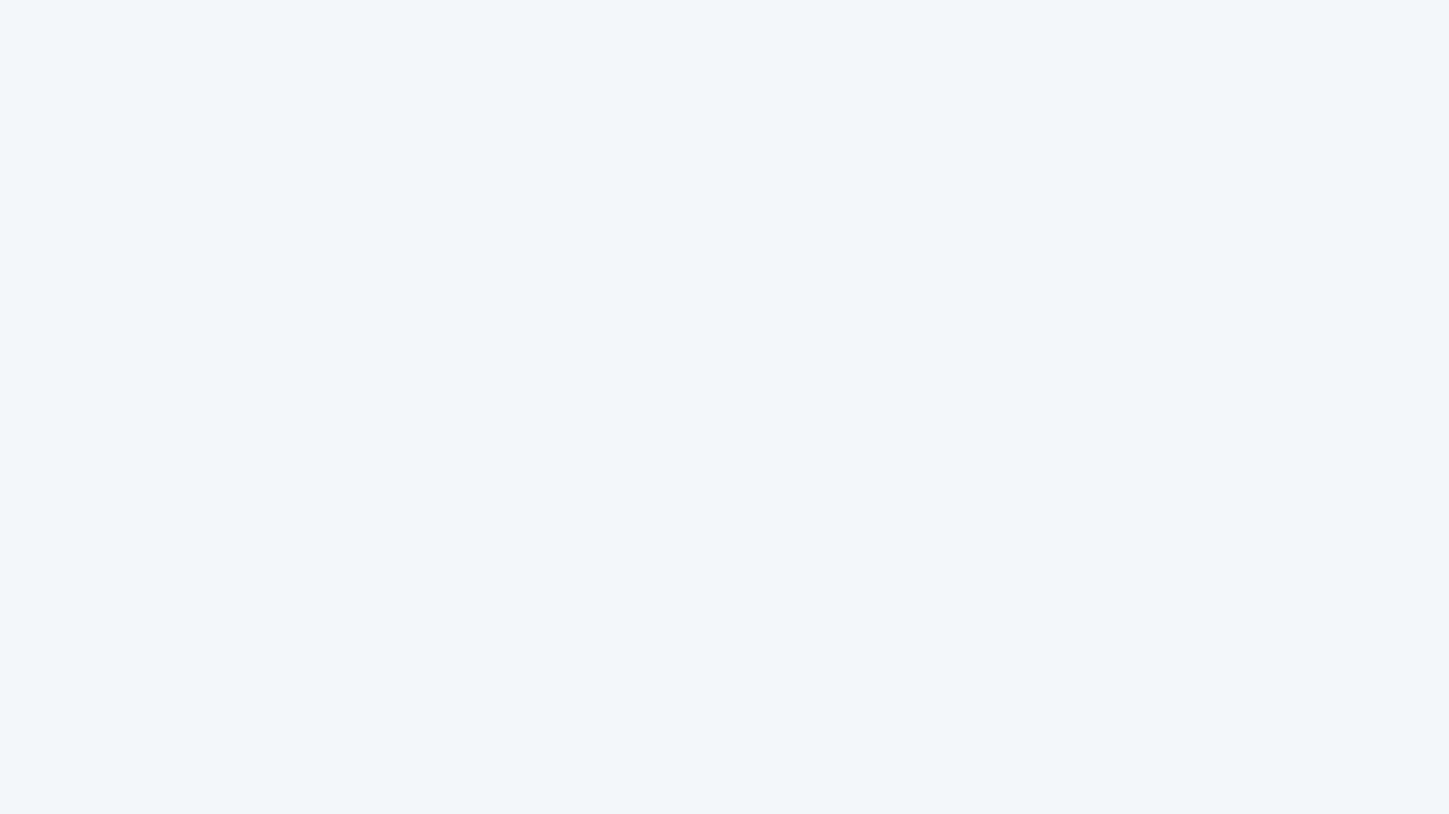
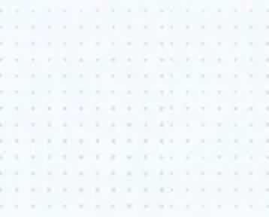












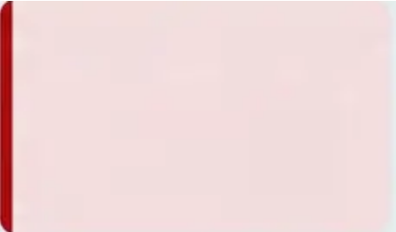


Bradford VTS
www.bradfordvts.co.uk
EXAMINATION SKILLS
SCA Advice & Red Flags
Communication, counselling, and clinical safety for GP trainees
SCA — Patient Communication
OTC Medication Safety
Monitoring Explanation
Sick Day Rules
SGLT2i Sick Day Rule
Explain which drugs to stop when
unwell — SADMAN + SGLT2i.
Use plain language: “If you’re
vomiting or can’t keep fluids
down, stop these tablets.”
Counsel specifically on ibuprofen
and naproxen — available without
prescription. “Never take anti-
inflammatory painkillers — they
they can damage your kidneys.”
Explain why U&E checks are
needed: “This tablet protects your
kidneys, but we need to check
your blood results 2 weeks after
starting.”
Warn patients: “Stop this tablet if
you are unwell — it can cause a
serious condition called DKA even
if your blood sugar seems
normal.”
Clinical Red Flags
Red Flags
Creatinine Rise >30%
NSAIDs Discovered
in CKD
Anticoagulant
Dose Error
K+ >6.0 mmol/L
SGLT2i + Acute Illness
After starting ACEi/ARB —
suspect renal artery
stenosis. Stop and refer
urgently.
On ACEi/ARB or potas-
sium-sparing diuretic —
stop immediately.
Urgent review.
Risk of euglycaemic DKA
even without hyper-
glycaemia. Stop SGLT2i;
urgent assessment.
Risk of acute AKI — stop
immediately. Review
analgesia alternatives.
Both underdosing and
overdosing are dangerous
in CKD. Always verify dose
against current eGFR.
Bradford VTS — CKD Prescribing Teaching Deck - Slide 10 of 10
BNF May 2026 - NICE NG203 - Not for clinical use — educational purposes only.

