Slide 1
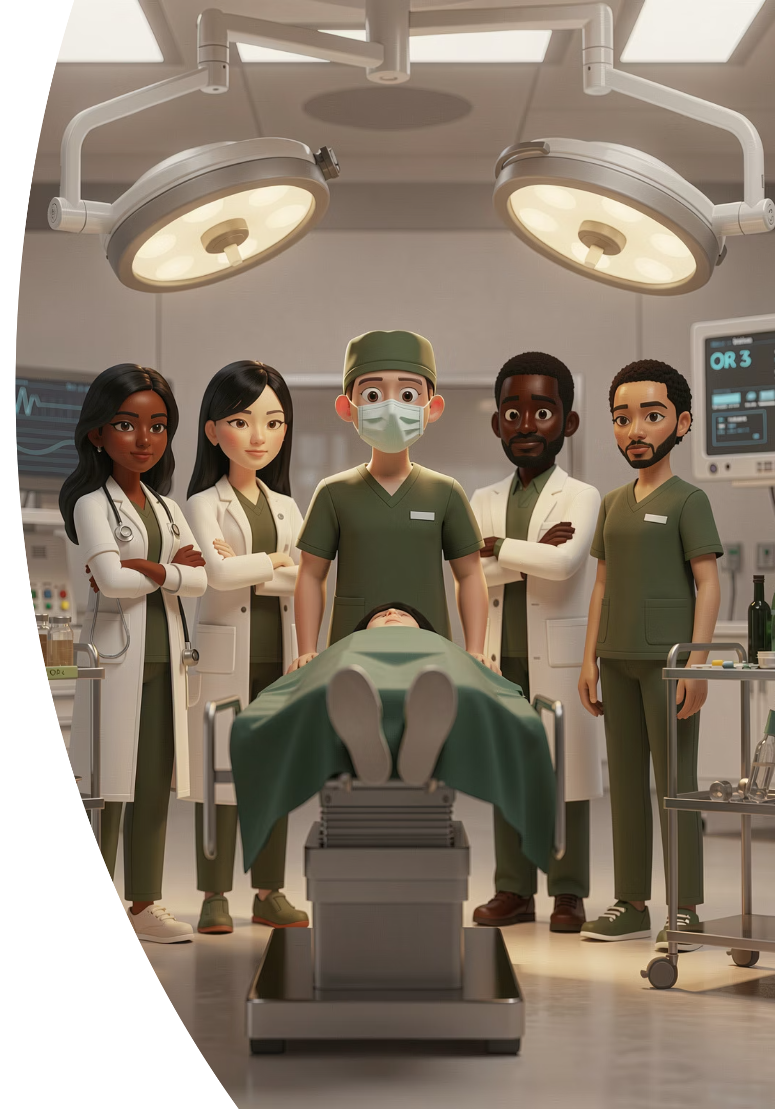
Assessing Professionalism?
THE HUMAN SIDE OF MEDICINE
Lessons from General Practice
Dr Ramesh Mehay GP Educator (25+ years)
Former Training Programme Director (17 years)
Editor "The Essential Handbook of GP Training & Education"www.bradfordvts.co.uk

Slide 2




UNDERSTANDING
ASESSEMENT METHODS
THE ASSESSOR
SPECIALIST EXAMS
THE TRAINER
THE MENTOR
THE COACH

Slide 3
1. UNDERSTANDING

Slide 4


Professionalism is not the "soft" side of medicine.
Professionalism is a core patient safety mechanism .
Actually, it protects us ALL.

Slide 5

Professionalism Is Not Just "Being Nice"
Professionalism Is
Professionalism Protects
Patients
Colleagues
Organisations
Reputations
Public trust
Safe communication
Emotional regulation
Accountability
Team respect
Patient-centred behaviour
Professionalism is functional, not cosmetic.

Slide 6


Professionalism: not as soft as you think…
Professionalism is not simply "being nice."
It is about safe behaviour under pressure — fundamentally about protecting patients and maintaining trust.
"Awareness of when performance, conduct or health might place patients or colleagues at risk."
—RCGP Descriptor
HIT
I'LL CARE
H — Honesty
I — Insight
I — Integrity
L — Limits recognised
T — Trust
L — Listening to/Learning from feedback
C — Concerns acted upon
A — Accountability
R — Respect for colleagues
E — Engagement/openness

Slide 7

Lessons from Malaysian Airelines
Crash & near misses high
Hierarchical cockpit cultures
Pilots authoritarian (“power distance”)
Airline staff to scared to speak up
Crew Resource Management (CRM) PROFESSIONALISM training
Rates significantly lower
Improved human-human relations
Safety being everybody's responsibility
Pilot happier, crew happier, passengers safe.

Slide 8
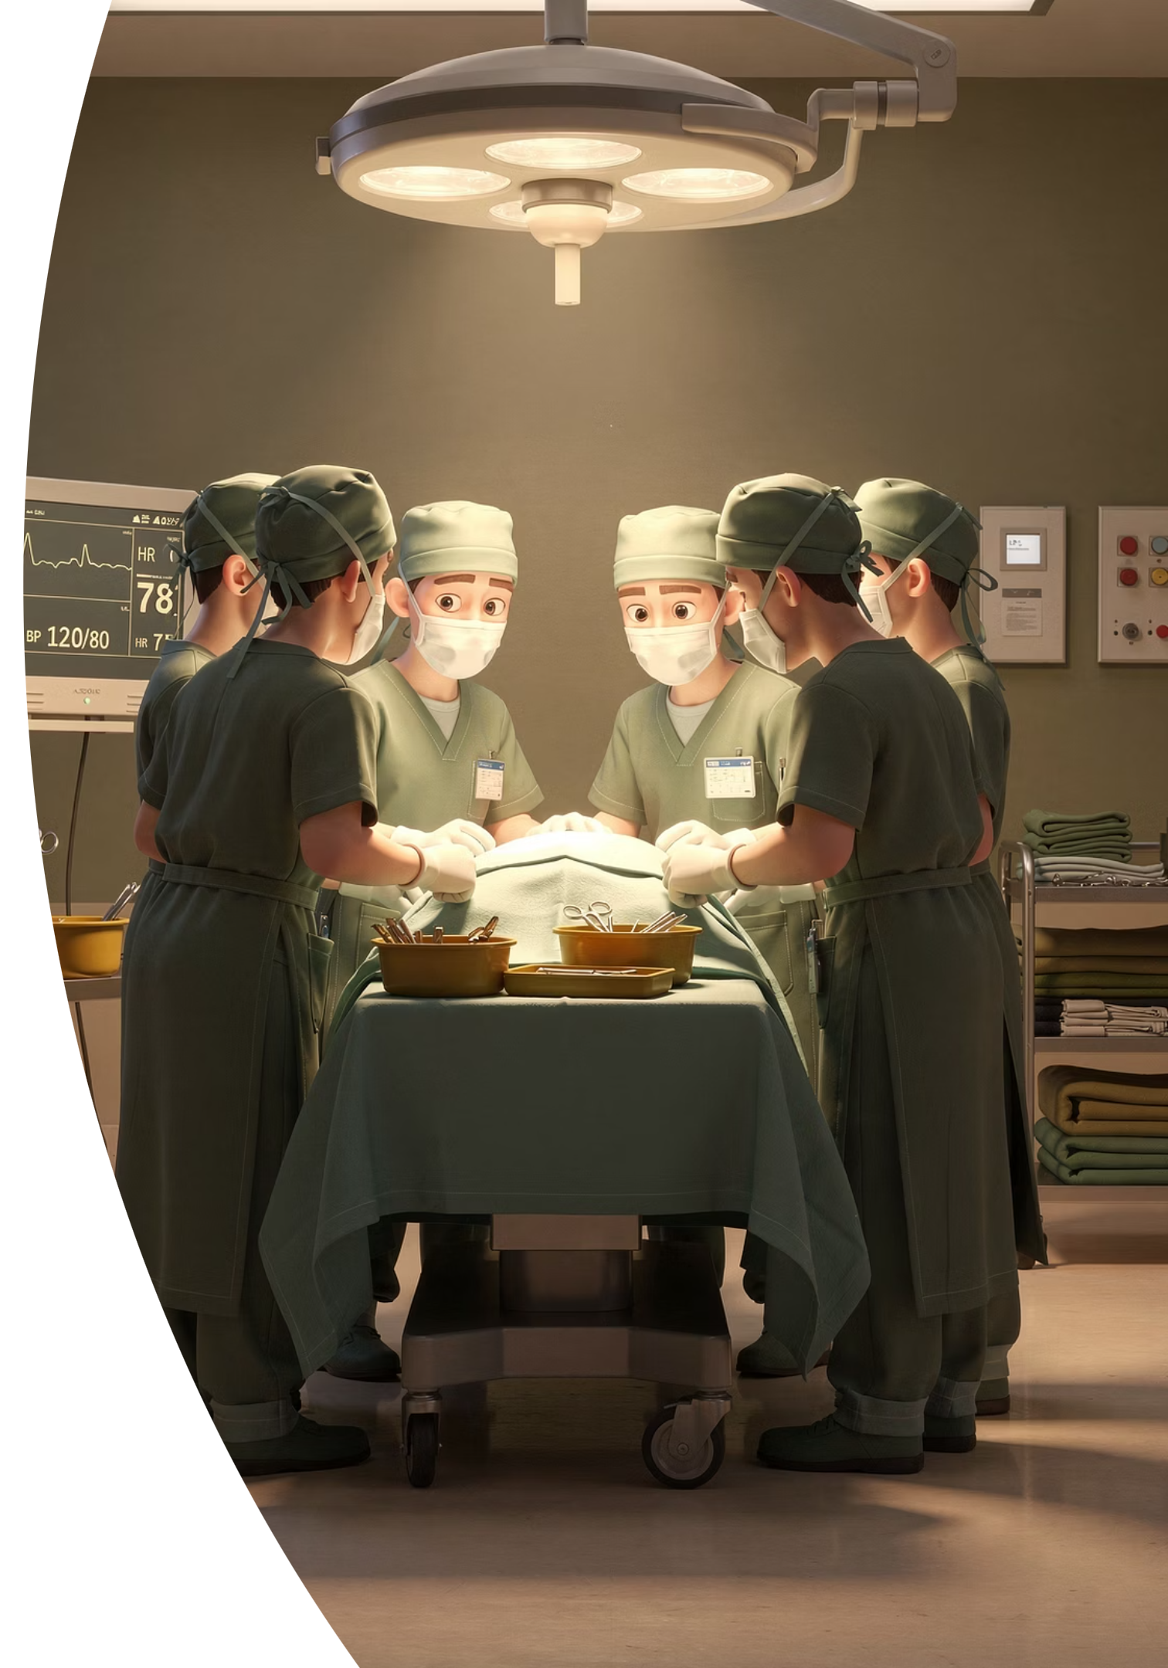

Are they similar?
THE AIRLINE INDUSTRY
UNSAFE THEATRE CULTURE
high stakes,
time pressure,
technical expertise,
hierarchy,
and catastrophic consequences if juniors stay silent.
Silence & delayed escalation
Avoidable error
Burnout and fear-based practice
Professionalism in surgery is a patient safety issue.

Slide 9
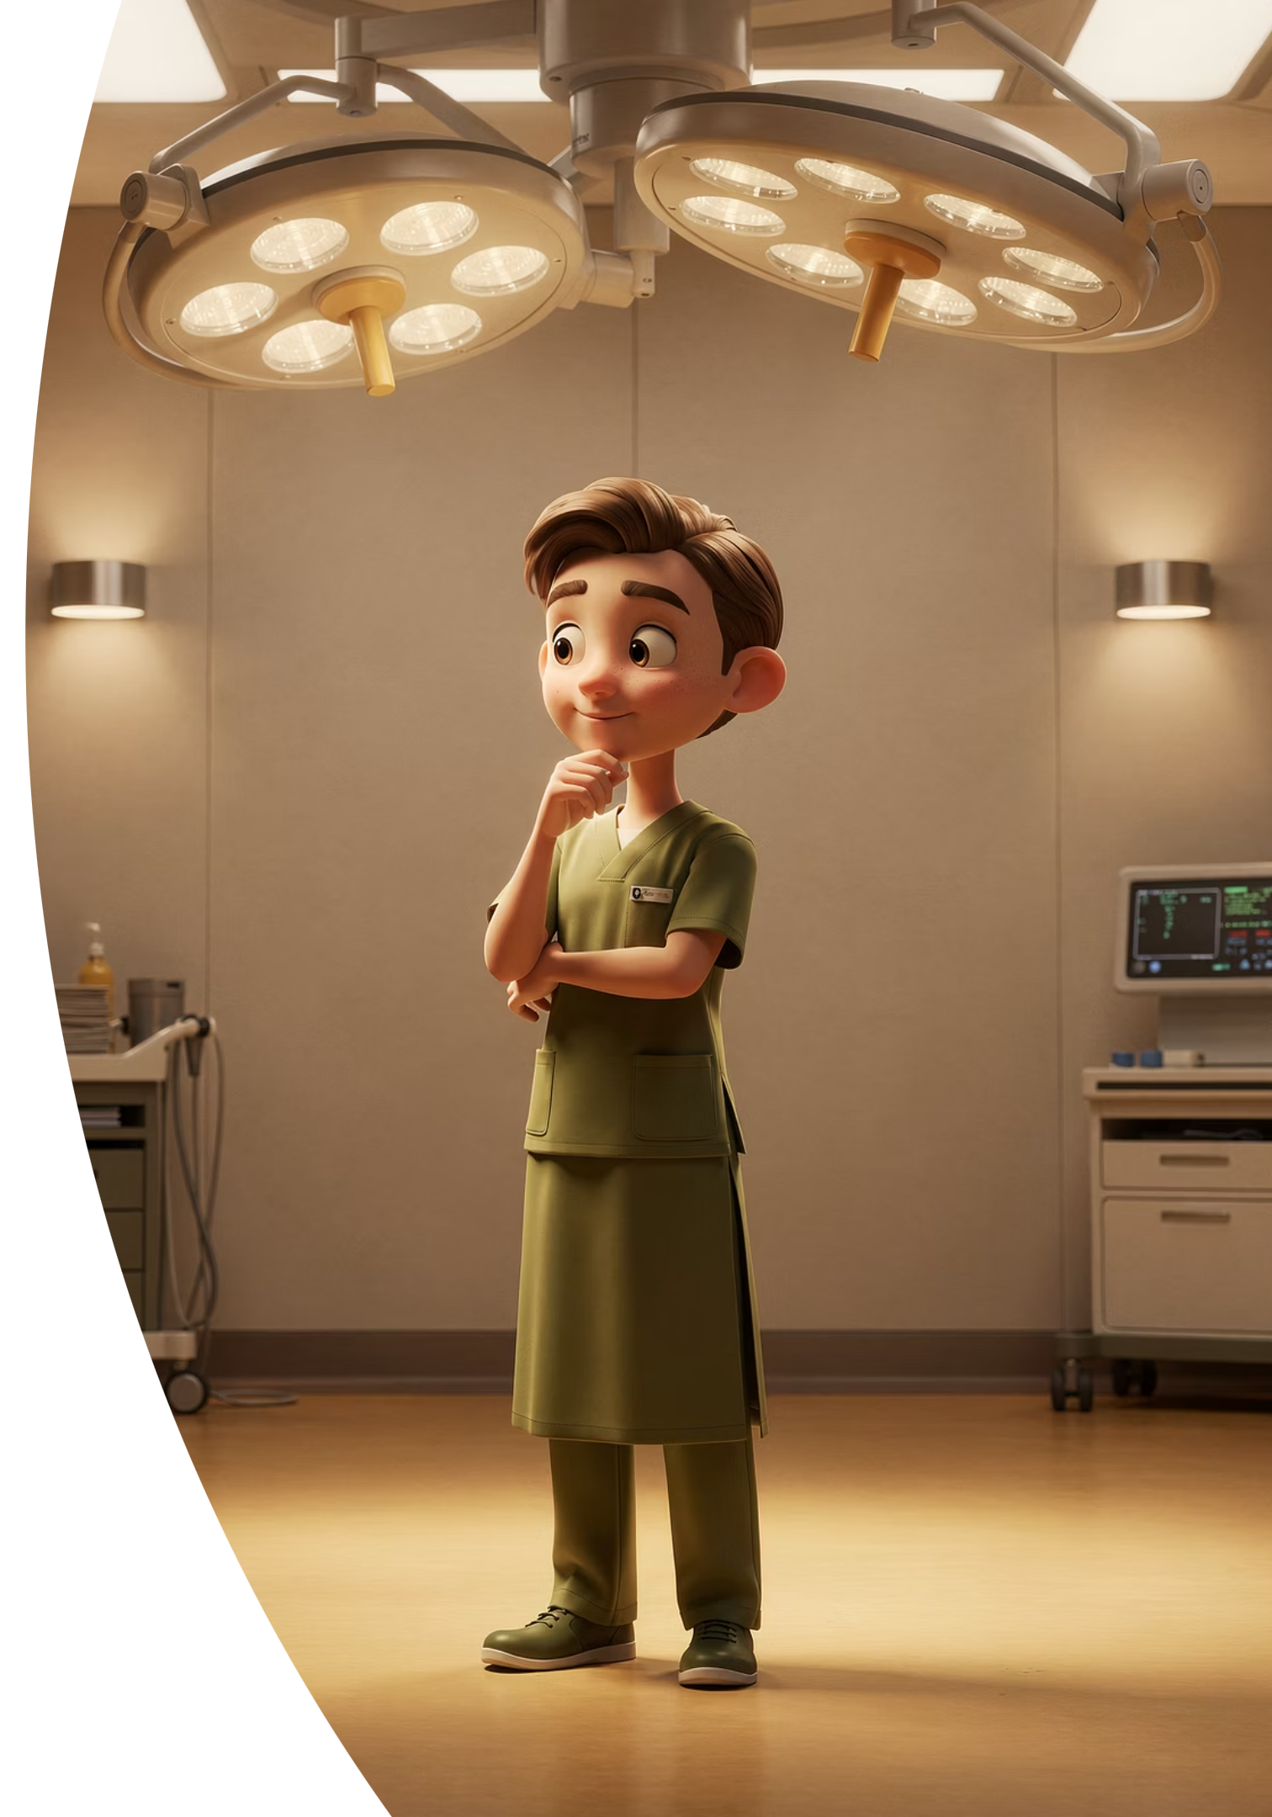
Does Professionalism Matters as Much as Technical Skill?
A technically brilliant surgeon who humiliates staff, dismisses concerns, avoids reflection, communicates poorly, or intimidates juniors…
…may still be dangerous.
Would you let a technically brilliant pilot fly if the entire crew were terrified to speak up?
Technical excellence without professionalism can still produce unsafe care.

Slide 10
2. ASSESSMENT METHODS

Slide 11


Why Assess? Because ASSESSMENT DRIVES LEARNING
Trainees learn what gets rewarded, noticed, and gets them through training. If professionalism is poorly assessed, it becomes optional, performative, and superficial.
The Driving Test Analogy
People drive more carefully when they know they are being assessed rigorously.
If behaviour is not meaningfully assessed, behaviour will not meaningfully change.

Slide 12

ASSESSMENT DRIVES LEARNING
To assess it, it must be assessed:
1. Meaningfully,
2. Repeatedly &
3. Behaviourally.
MR B

Slide 13
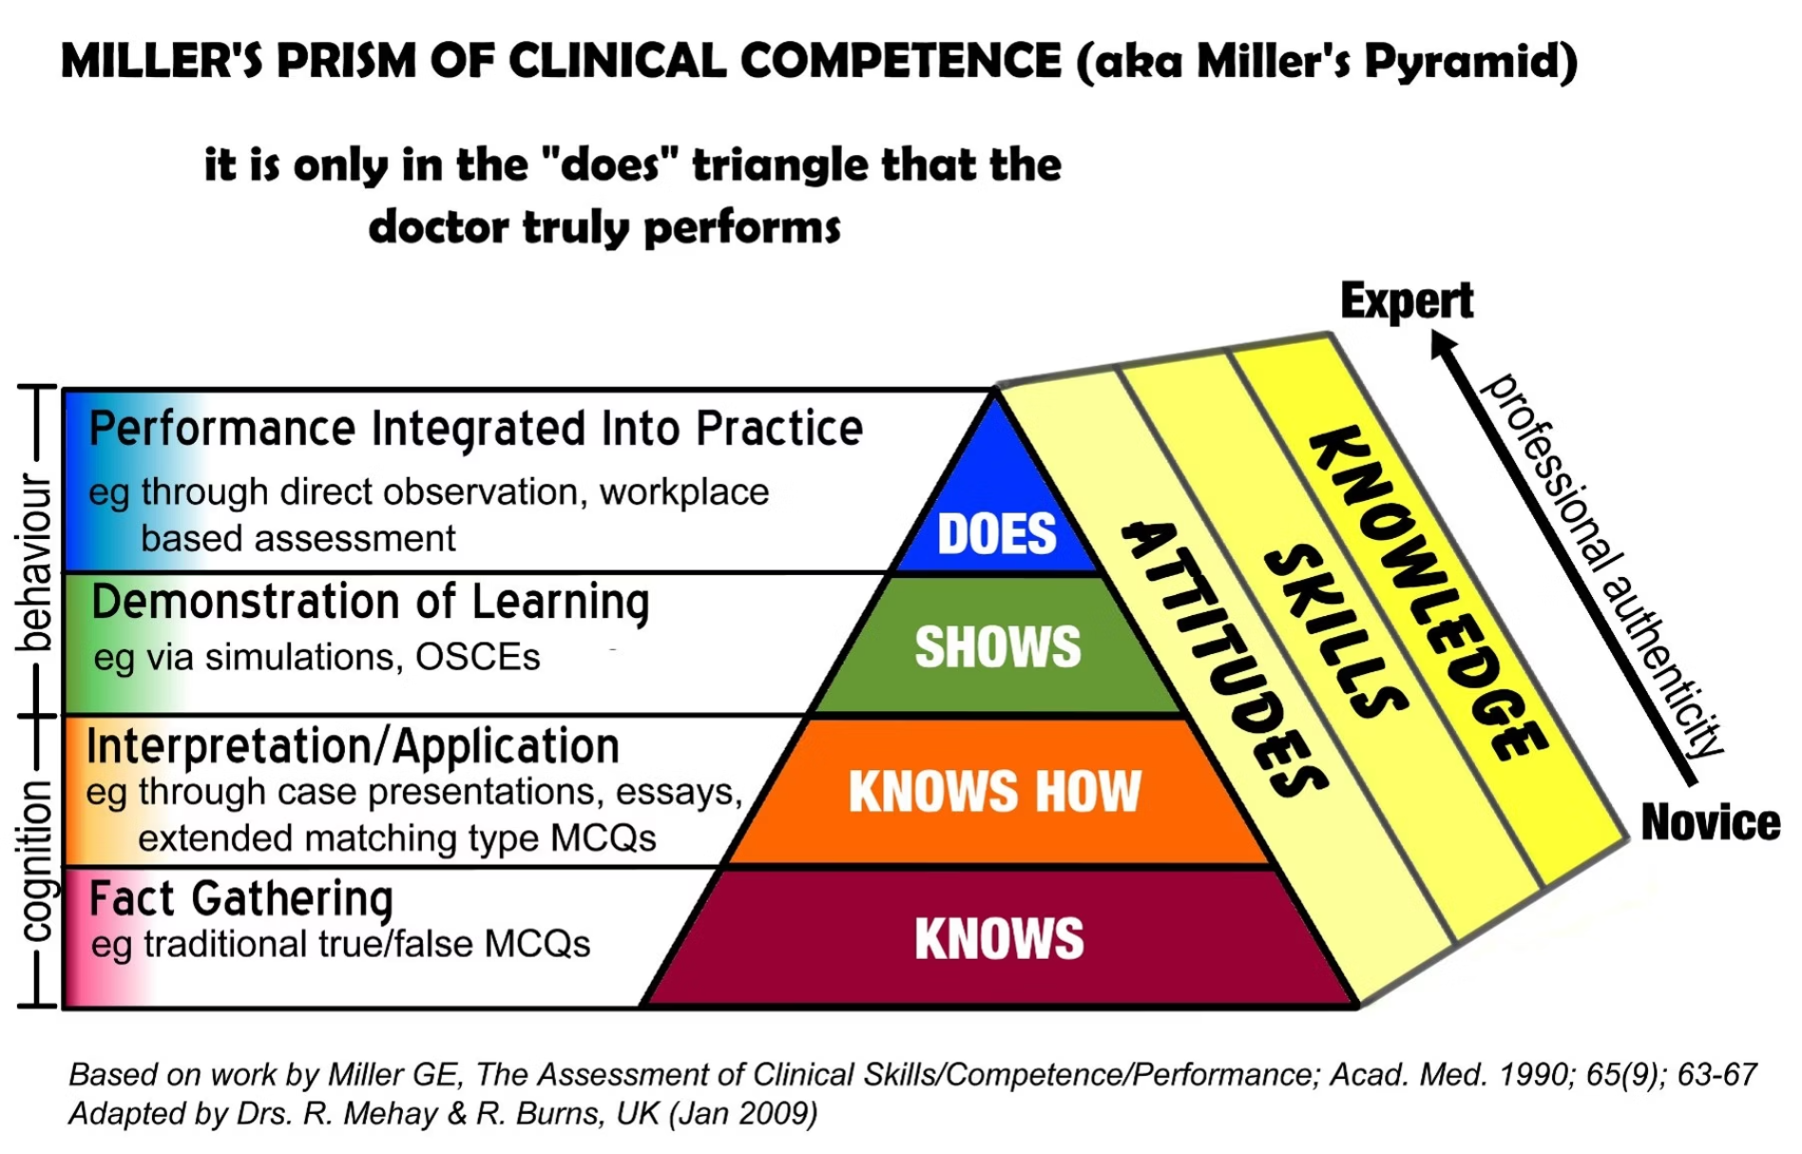
Miller's Pyramid - what level are we assessing at?
DRIVING ANALOGY
Knows - knowledge of ethics theory & frameworks (viva, small essay). FRCS?
Shows - demonstrates (simulated stations, observing behaviours)
Does - longitudinal (WPBA, repeated observation & feedback, MSF, PSQ). This is what we have been doing in GP since 2007.
Professionalism is behavioural — it must be assessed behaviourally.

Slide 14
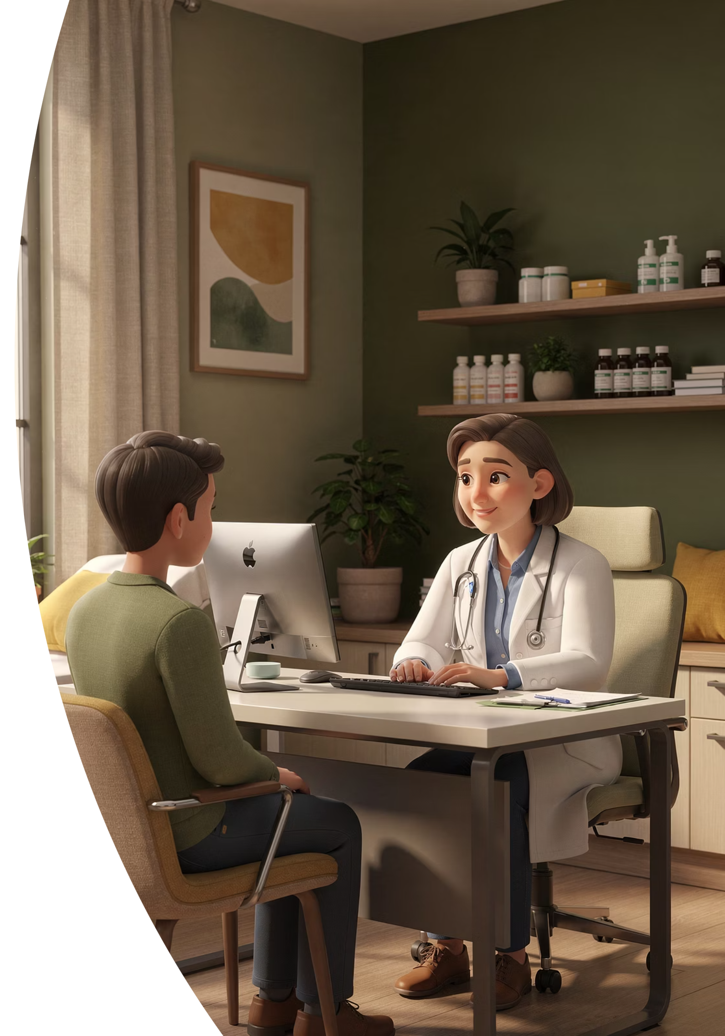
Lessons from GP (since 2007)
Consultation Assessment
CBDs, (lower Miller) COTs (higher Miller)
Multi-Source Feedback
MSF and Patient Satisfaction Questionnaires (PSQ)
Reflective Practice
Learning Logs, SEAs and Complaints reflection
Examinations
AKT (Knowledge: GMC's Fitness to Practice = lower Miller), SCA (higher Miller)
Longitudinal Review
ESR, CSR, and ARCP processes
Professionalism in GP is not assessed once. It is assessed meaningfully, repeatedly (longitudinally), & behaviourally. And there is Triangulation of assessment.

Slide 15
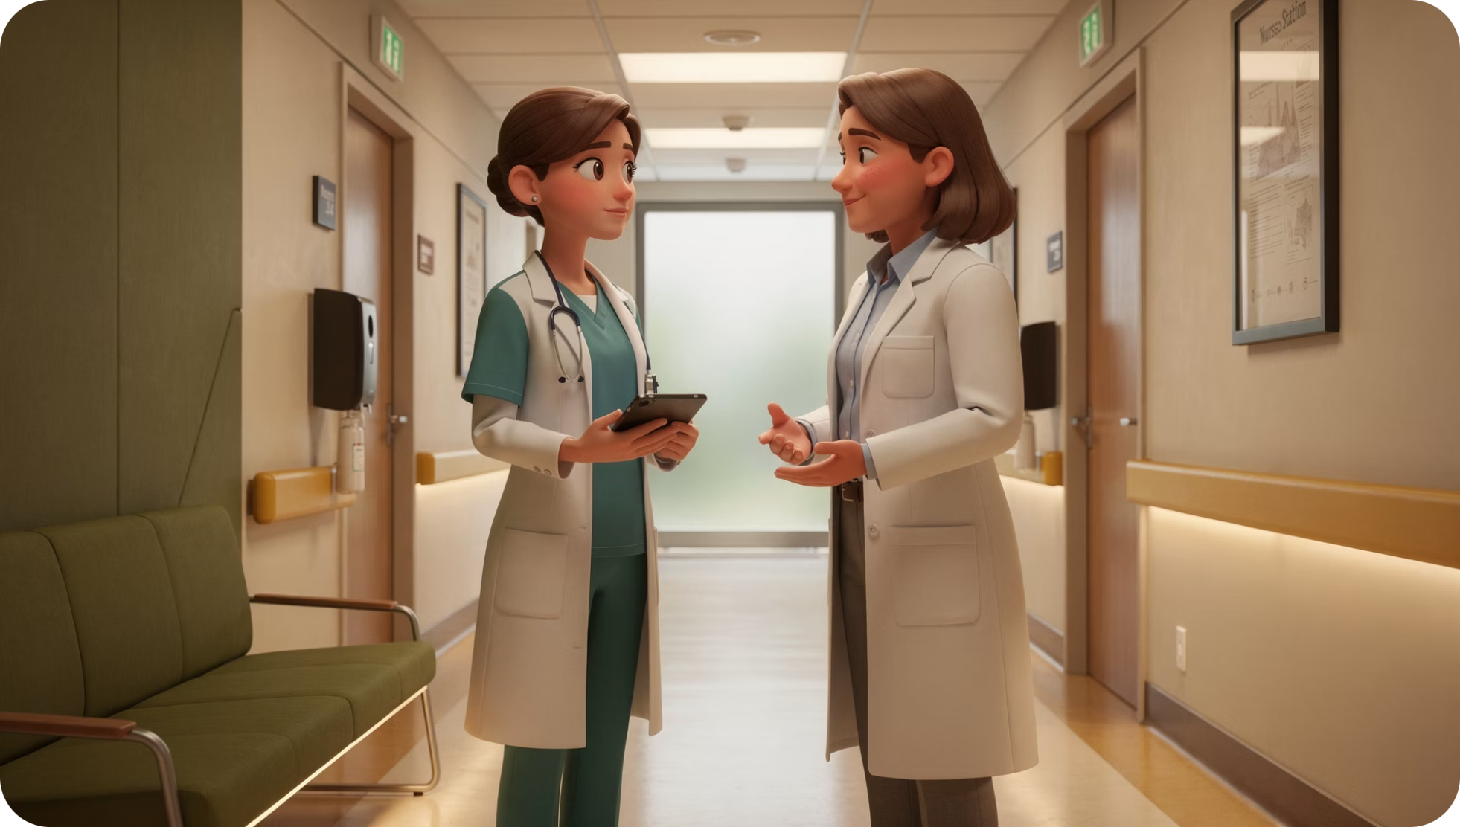

Research on Workplace-Based Assessment
Miller & Archer (2010)
WPBAs increase awareness, but evidence for sustained behaviour change is limited.
What Improves Behaviour Change
Credible feedback · Structured reflection · Repeated reinforcement · Coaching and mentoring
Assessment alone is insufficient. Reflection and coaching/mentoring are essential companions.

Slide 16
Reflection & Coaching Research
Bennett et al. (2007)
Lillevang et al. (2020)
Reflective practice combined with coaching improved clinical competence.
Structured reflection improved reflective ability in GP specialist training.
The key distinction: superficial reflection produces little change. Deep, insight-oriented reflection on real experiences drives genuine behaviour change.

Slide 17
Coaching vs Mentoring
Coaching
Mentoring
Develops insight
Asks reflective questions
Supports self-generated solutions
Directs and advises
Draws on experience
Identifies goals
Both approaches matter in professionalism development — they are complementary, not competing.

Slide 18

Complaints & SEAs Are Powerful Professionalism Data
Complaints & SEAs may reveal communication failures, poor insight, avoidance, disrespect, and lack of openness.
Proposed Approach
Significant complaints should be declared, reflected upon, discussed with supervisors, and inform ARCP processes.
Key Message
Complaints & SEAs are educational opportunities, not merely administrative irritations.
Think about regular SEA team meetings.

Slide 19
3. ASSESSOR/TRAINER/MENTOR/COACH

Slide 20


It starts with you. Role-modelling Changes Behaviour
Would a junior challenge me if they thought I was about to make a mistake?
Does my presence calm or silence a room?
Do colleagues feel psychologically safe around me?
How would nurses describe my behaviour?
Professionalism begins with honest self-awareness.
Professionalism creates psychological safety.
Psychological safety prevents harm.

Slide 21

Passionate Mentors Change Behaviour
People drive differently when assessment is rigorous.
If professionalism assessment is rigorous:
Behaviours improve
Standards rise
Unsafe attitudes become harder to ignore
Assessment standards shape professional culture.

Slide 22


Assessor Training Matters
Poor Assessor Behaviours
Inflated scores and inconsistency
Avoidance of difficult feedback
"Failure to fail"
Pell et al. (2008) · Hodwitz et al. (2019) · Roberts et al. (2020)
If assessors trivialise professionalism, trainees will too. Calibration and shared standards are essential.

Slide 23
4. SPECIALIST EXAMS

Slide 24
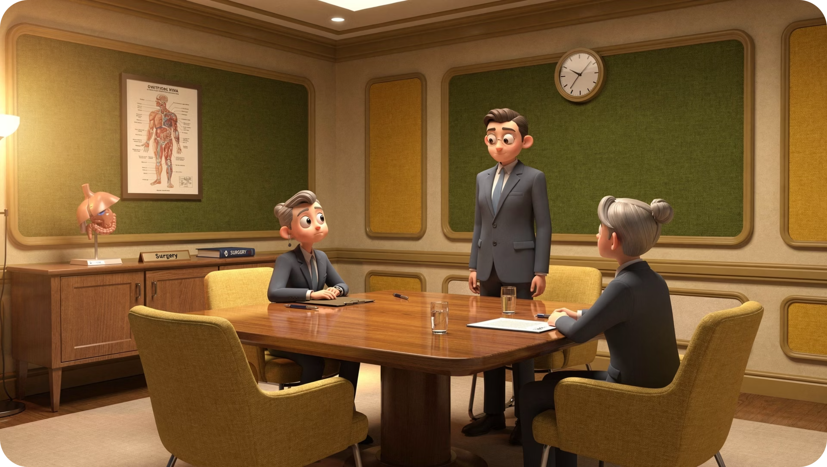

What do your Specialist Assessments Do?
Low Miller:
Viva discussion
Ethics reasoning
Written questions
Professionalism should move beyond theoretical discussion — this is evolution, not criticism.

Slide 25

Proposal — Surgical Professionalism OSCEs
Potential OSCE Stations
Assessment Domains
Handling complaints
Consent failure discussions
Colleague confrontation
Apology after complication
Speaking-up and theatre conflict scenarios
Empathy
Insight
Accountability
Leadership
Professionalism can be assessed behaviourally. This is one of the strongest practical proposals.

Slide 26
Example Theatre Scenario
"You shouted at me in theatre in front of everyone."
— ODP to Surgeon
1
2
Defensiveness
Ownership
Does the surgeon deny or deflect?
Is there genuine acknowledgement?
3
4
Empathy
Accountability
Is the impact on the colleague recognised?
Is there a commitment to change?
Professionalism is revealed under challenge and emotional activation.

Slide 27
Final Take-Home Messages
01
02
03
Assessment drives learning
Professionalism must be assessed behaviourally — 'Knows How' is insufficient
Specialist training & exams needs more 'Shows How' assessment
04
05
Complaints & SEAs are professionalism data; no blame culture
Assessor quality matters
What behaviours are we currently tolerating because we are not truly assessing them?

Slide 28
References
Miller GE. The assessment of clinical skills/competence/performance. Acad Med. 1990.
Miller A, Archer J. Impact of workplace based assessment on doctors' education and performance. BMJ. 2010.
Bennett GA et al. Reflective practice and coaching study. 2007.
Lillevang G et al. GAR reflective assessment tool. 2020.
Pell G et al. Assessor training in criterion-based assessment. 2008.
Hodwitz K et al. Assessor subjectivity in workplace assessment. 2019.
RCGP Workplace Based Assessment Capability Descriptors.
ISCP Surgical Curriculum Documentation.

